Slide 1
SOS - WORKSHOP
Simulating Hard X-ray beamline optics by ray-tracing using ShadowOui
Manuel Sánchez del Río
AAM, ISDD, ESRF

Slide 2
Oasys+ShadowOui
Install Oasys+ShadowOui:
  https://github.com/srio/oasys-installation-scripts/wiki
Download Tutorial Examples:
  https://github.com/srio/ShadowOui-Tutorial

Slide 3
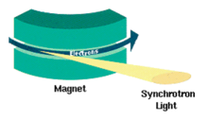
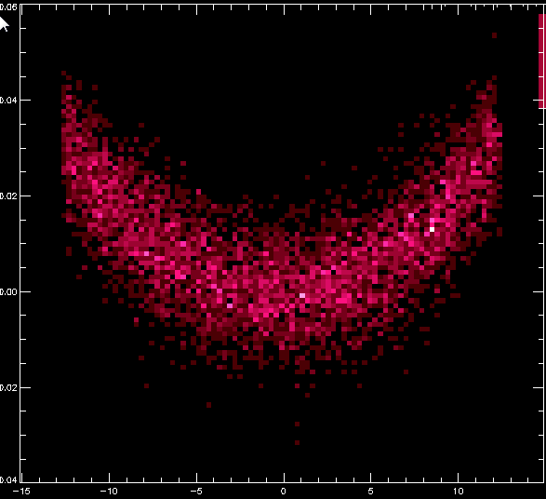
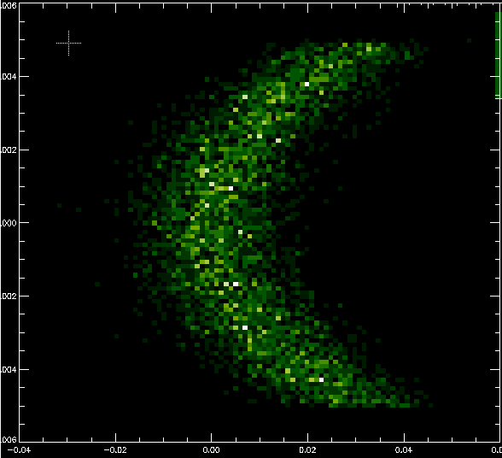
BM – Emission by N incoherent e⁻
ex12_bendingmagnet.ows
z
Real Space (top)
Phase Space (H)
x
x’
y
x
y
x
Monte Carlo (SHADOW)
  Energy (and polarisation) sampled from spectrum
  Angular Distribution (1e⁻, σ’_{x}, σ’_{z})
  Geometry (along the arc, σ_{x}, σ_{z})
  Limitation: Computer time and memory
    Typically: 10³ - 10⁹ rays
    Desirable: one ray per photon, i.e., 10¹⁴ -10²⁰

Slide 4
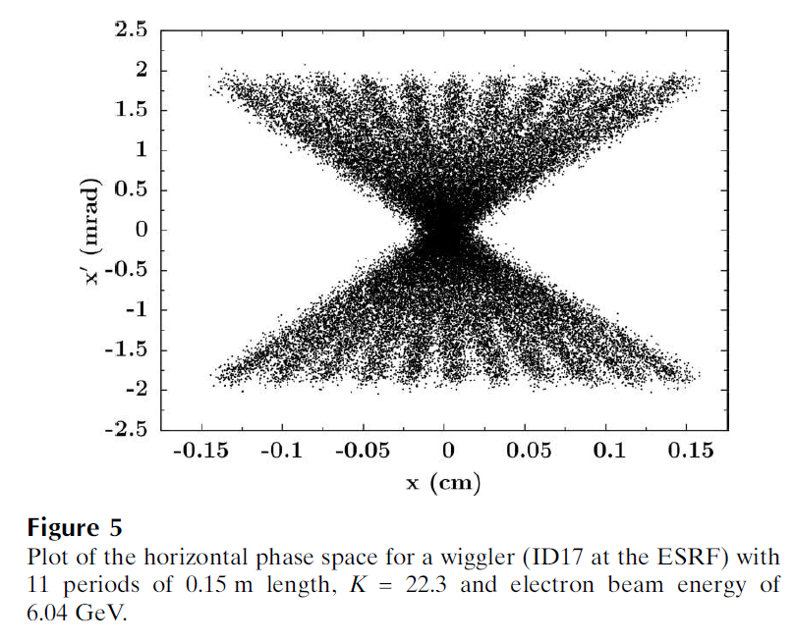
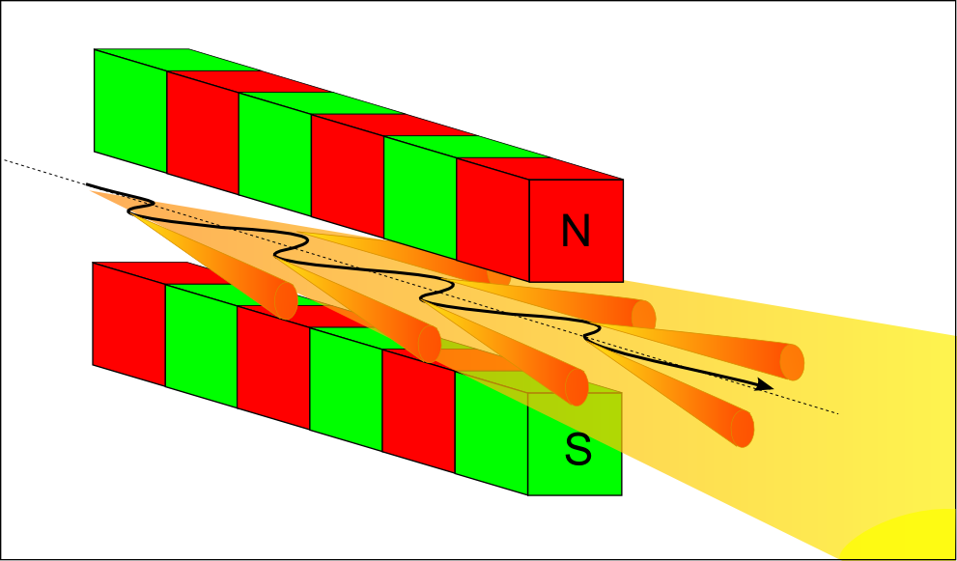
Wiggler: Like BM, but a bit more complex
ex13_insertiondevices.ows

Slide 5
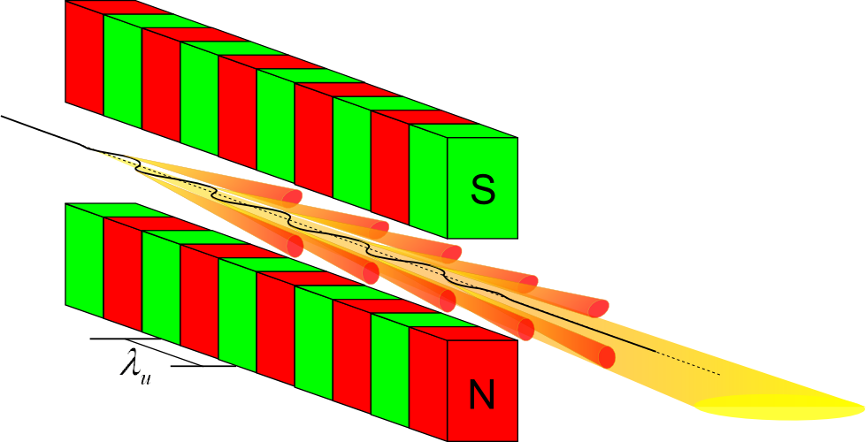
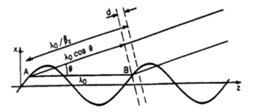

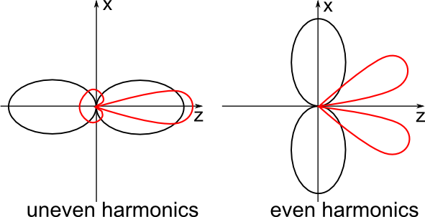
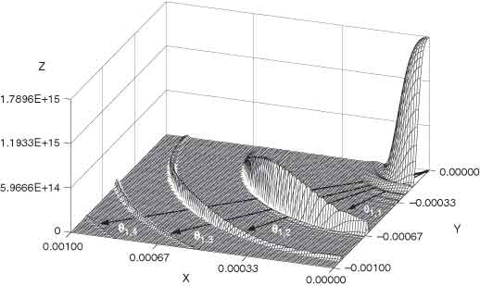
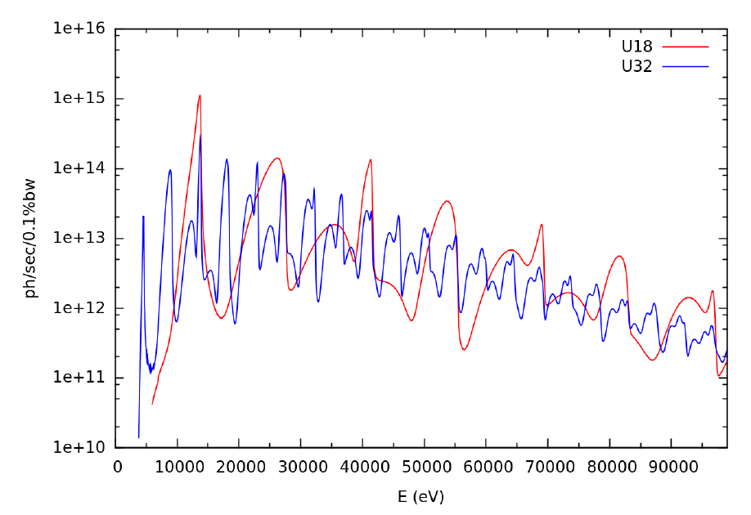
Undulator: Much more complex:
1e⁻ emission interferes with itself
ex13_insertiondevices.ows
For a single energy
(odd harmonic)

Slide 6
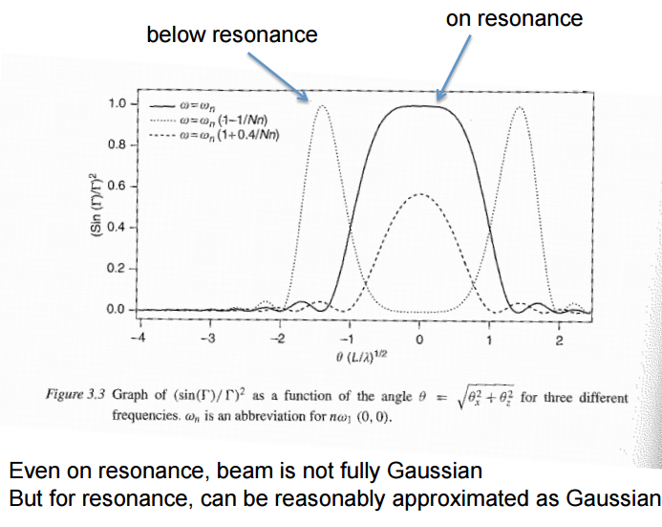
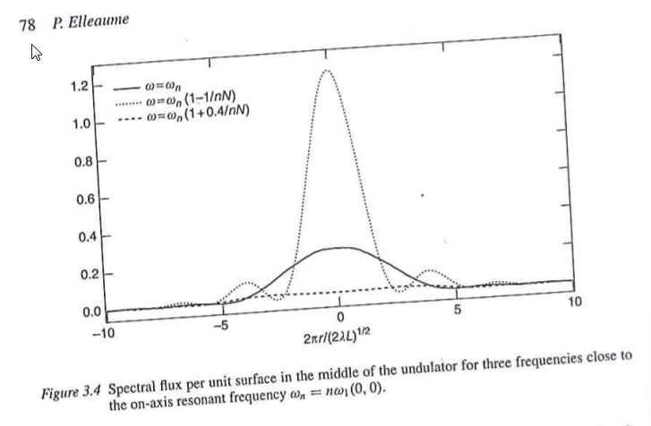
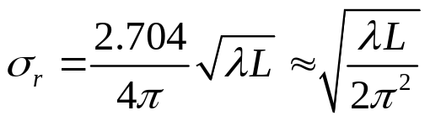
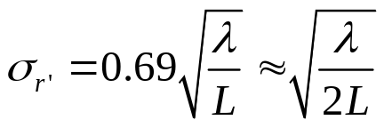
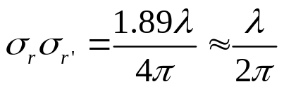
Onuki & Elleaume Undulators, Wigglers and their applications, CRC press, 2002
ex13_insertiondevices.ows
Undulator beams have not Gaussian profiles (even at resonances)
BY NOW, WE APPROXIMATE UNDULATORS BY GEOMETRIC SOURCES WITH GAUSSIAN SIZES AND DIVERGENCES

Slide 7
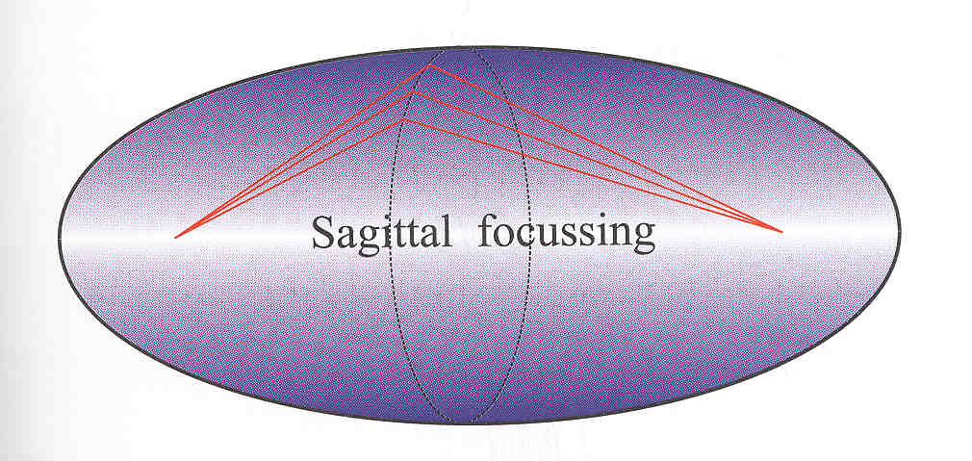
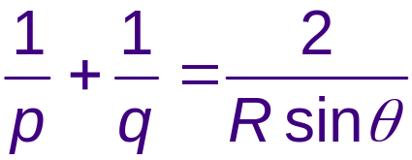
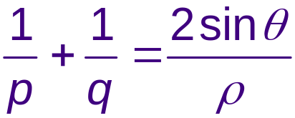
Non-imaging system:
BL as a concentrator: which shape (in reflection)?
ex15_aberration.ows
Point to point focusing (ellipsoid)
Collimating (paraboloid)
Focalization in two planes
  Tangential or Meridional (ellipse or parabola)
  Sagittal (circle)
Demagnification: M=p/q
Easier manufactiring:
  2D: Ellipsoid => Toroid
  Only one plane: cylinder Ellipsoid (ellipse)=> cylinder (circle)
  Sagittal radius: non-linear (ellipsoid) => constant (cylinder) or linear (cone),
Aberrations
p
q
ρ
ρ

Slide 8
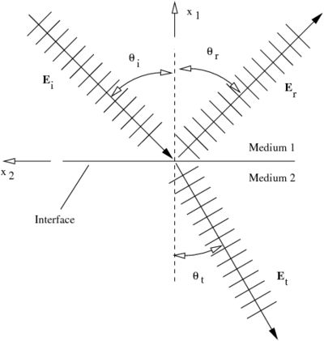
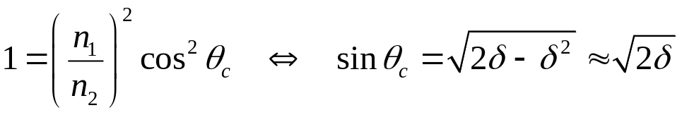
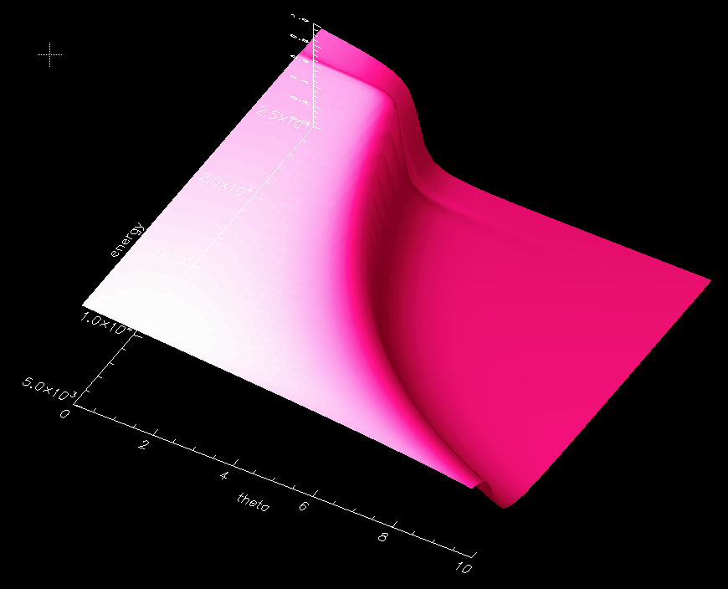

Mirrors
Geometrical model Physical model
ex15_aberration.ows
Fresnel equations give the reflectivity as a function of angle and photon energy. As a consequence, one gets the critical angle:

Slide 9
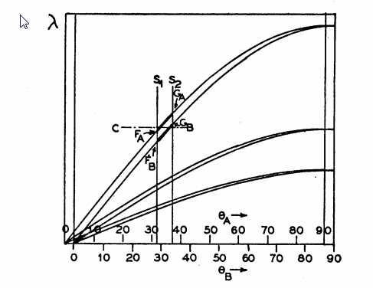
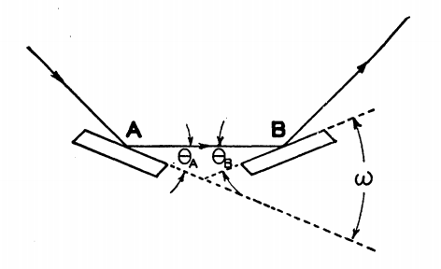
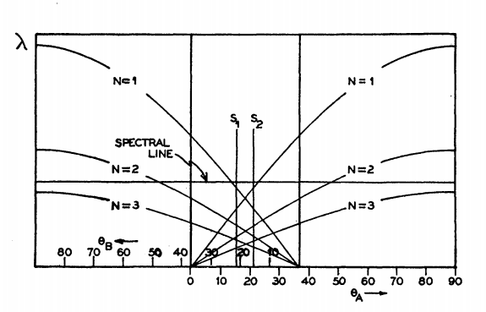
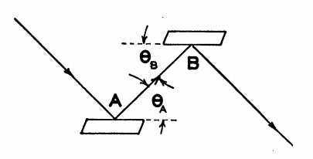
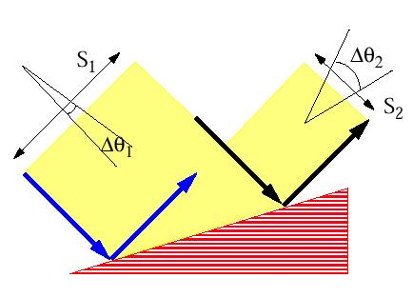
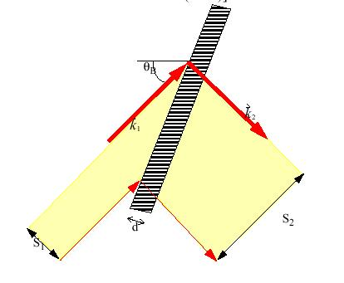
Crystals
Theory of the Use of More Than Two Successive X-Ray Crystal Reflections to Obtain Increased Resolving Power
J W. M. DuMond Phys. Rev. 52, 872 – (1937)
http://dx.doi.org/10.1103/PhysRev.52.872
ex17_crystalmono.ows
BRAGG or reflection
ex18_sagittalfocusing.ows
OTHER_EXAMPLES/crystal_analyzer_diced.ows
OTHER_EXAMPLES/crystal_asymmetric_backscattering.ows
LAUE or transmission
(ex23_crystal_laue.ows)

Slide 10

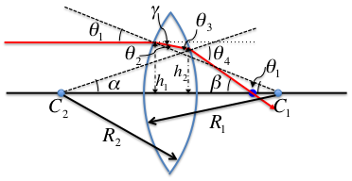
LENSE = TWO INTERFACES
Geometrical model Physical model
absorption in media
  I/I₀ = exp(-μ t)
(OTHER_EXAMPLES/lens_elliptical.ows)
OTHER_EXAMPLES/CRL_Snigirev_1996.ows
ex24_transfocator.ows
CRL = n identical Lenses
TRANSFOCATOR = m different CRLs

Slide 11
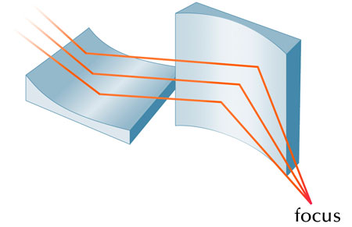
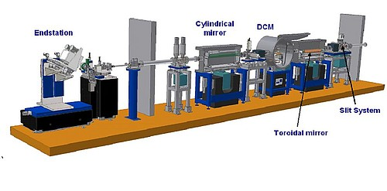
Other
ex16_kb.ows
ex19_beamline.ows

