Slide 1
OASYS-SRW
A GUI for SRW in OASYS
Luca Rebuffi (ANL)

Slide 2
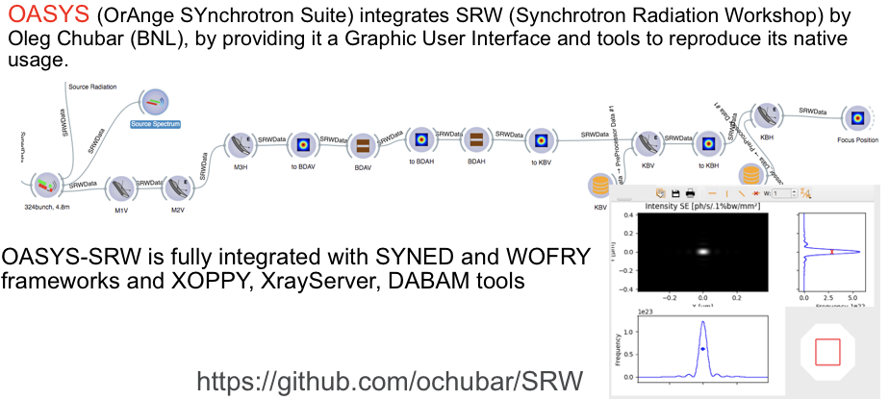
Introduction to OASYS-SRW

Slide 3
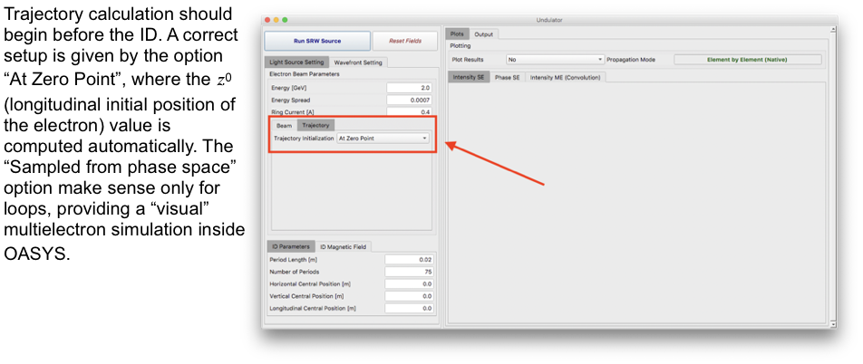
OASYS-SRW automations: Sources

Slide 4
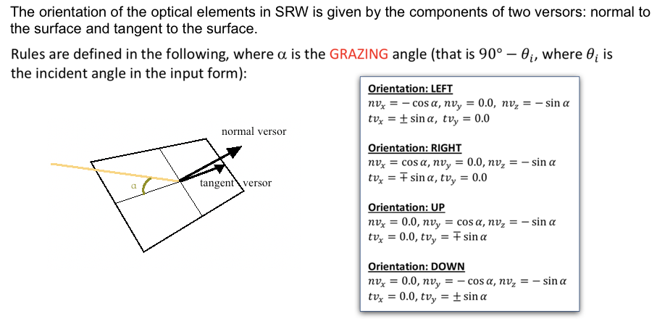
OASYS-SRW automations: Optical Elements

Slide 5
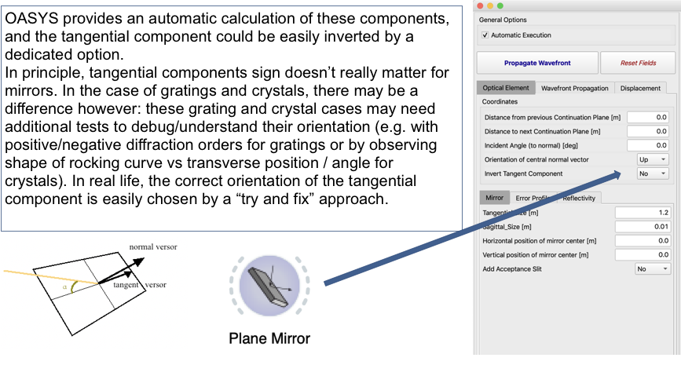
OASYS-SRW automations: Optical Elements

Slide 6
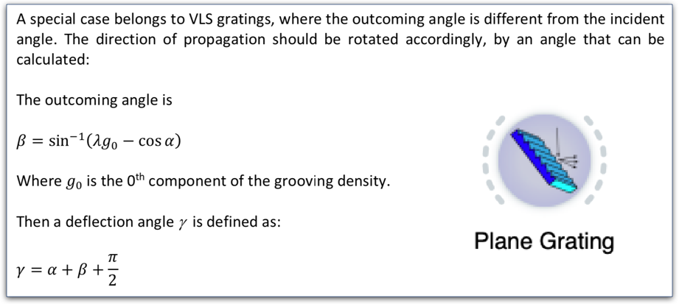
OASYS-SRW Automations: Gratings

Slide 7
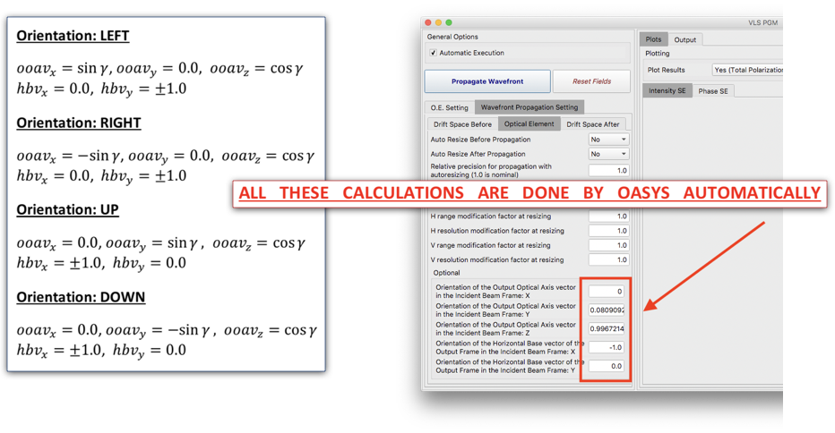
OASYS-SRW Automations: Gratings

Slide 8
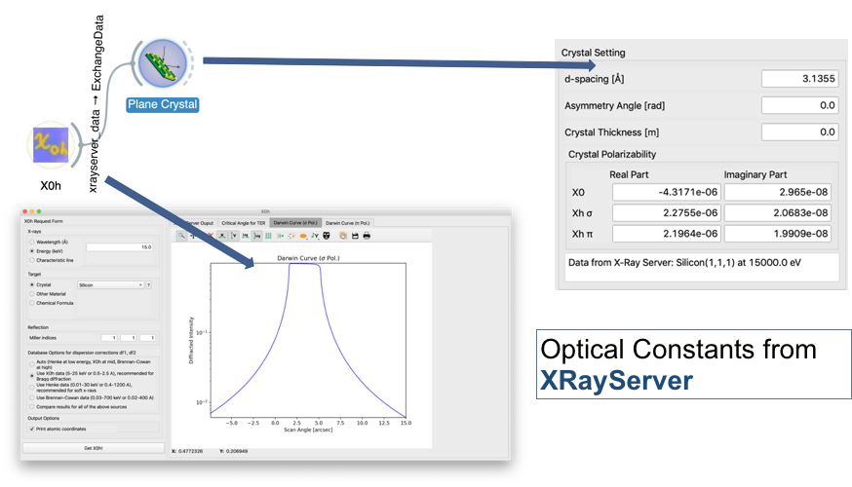
OASYS-SRW Automations: Crystals

Slide 9
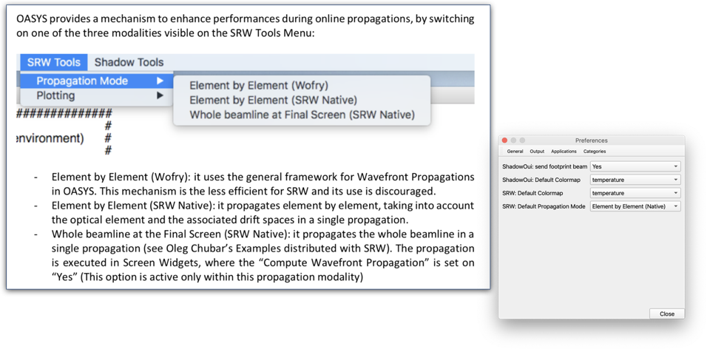
OASYS-SRW: Propagation modes

Slide 10
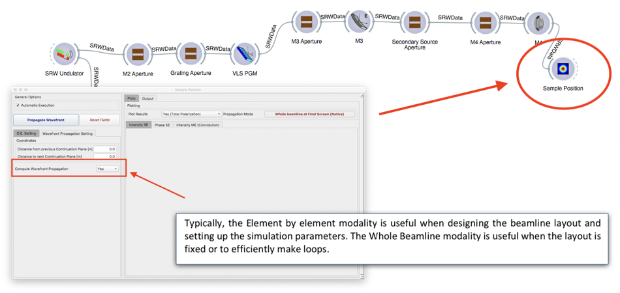
OASYS-SRW: Propagation modes

Slide 11
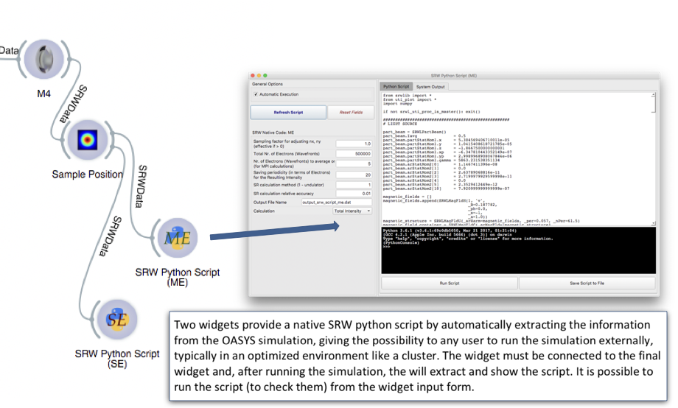
OASYS-SRW: Native SRW Tools

Slide 12
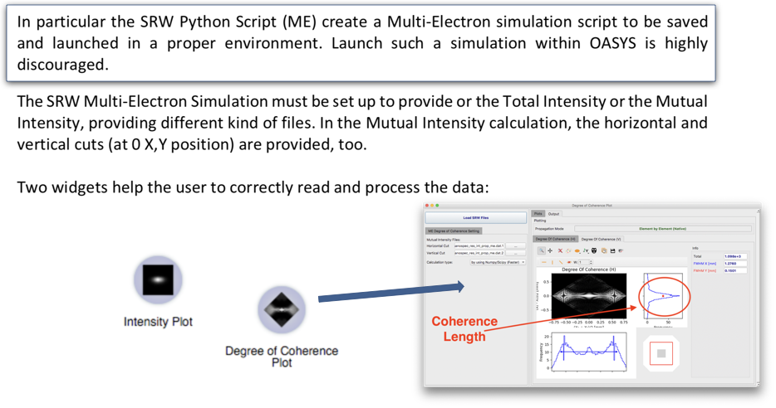
OASYS-SRW: Native SRW Tools

Slide 13
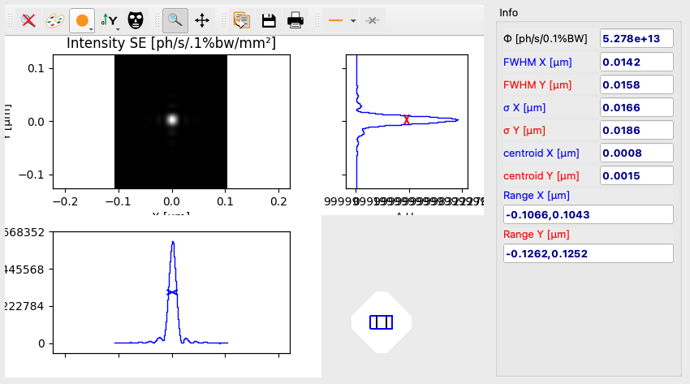
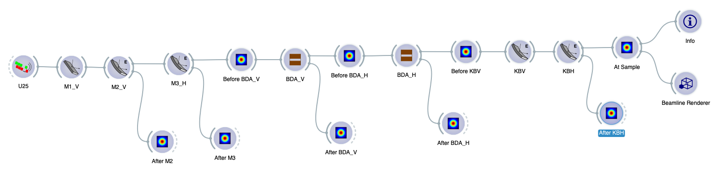
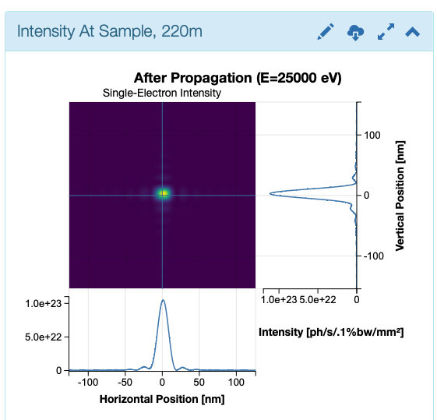
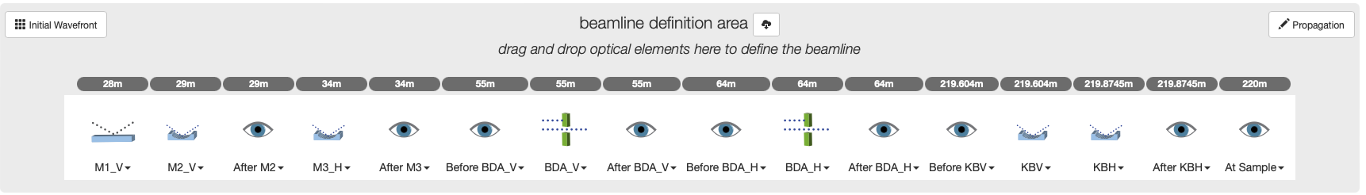

OASYS-SRW: ISN Beamline

