Slide 1
Basis of coherence
Xianbo Shi
Optics Group, Advanced Photon Source

Slide 2
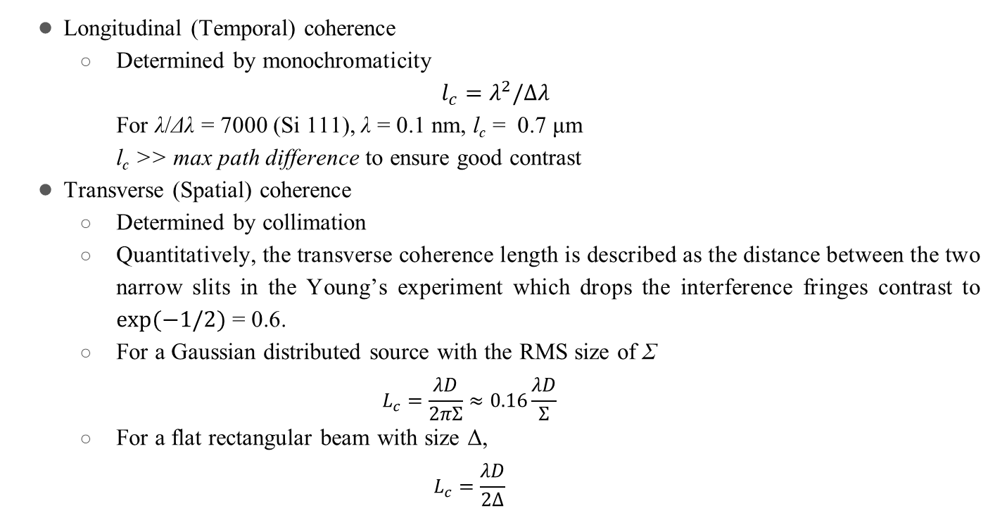
Coherence length
Longitudinal (Temporal) coherence
Determined by monochromaticity
$$l_{c}=λ^{2}/Δλ$$
For λ/Δλ = 7000 (Si 111), λ = 0.1 nm, l_{c} = 0.7 μm
l_{c} >> max path difference to ensure good contrast
Transverse (Spatial) coherence
Determined by collimation
Quantitatively, the transverse coherence length is described as the distance between the two narrow slits in the Young’s experiment which drops the interference fringes contrast to $exp⁡(−1/2)$ = 0.6.
For a Gaussian distributed source with the RMS size of Σ
$$L_{c}=\frac{λD}{2πΣ}≈0.16\frac{λD}{Σ}$$
For a flat rectangular beam with size Δ,
$$L_{c}=\frac{λD}{2Δ}$$
H. Onuki and P. Elleaume, Undulators, Wigglers and Their Applications (Taylor and Francis, London, 2003).

Slide 3
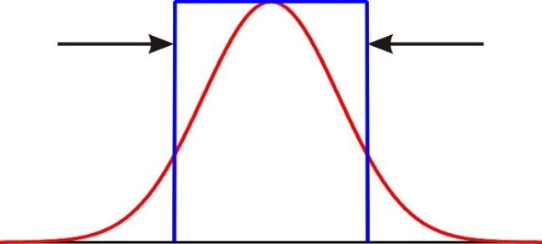
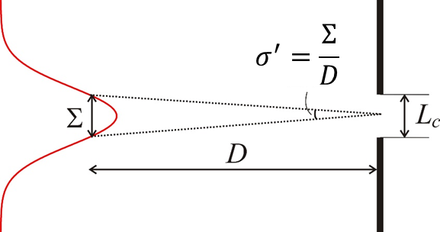
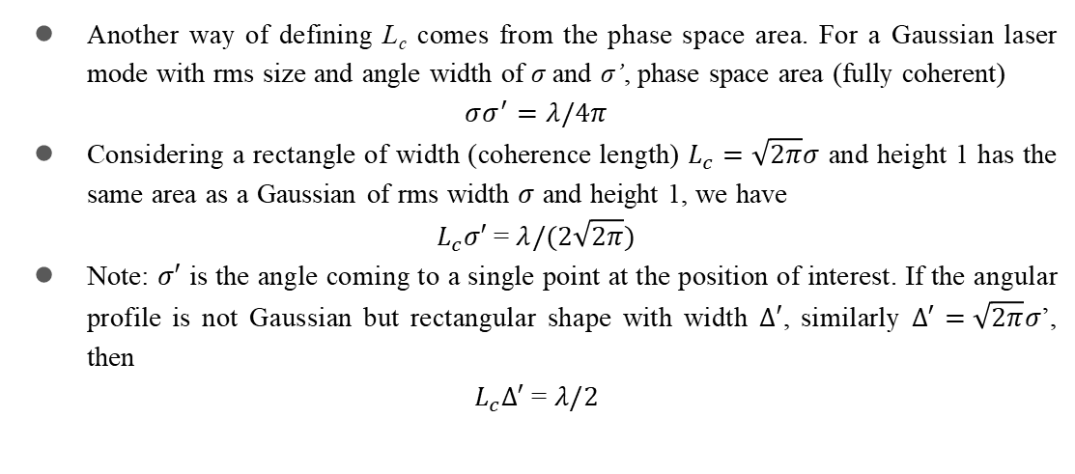
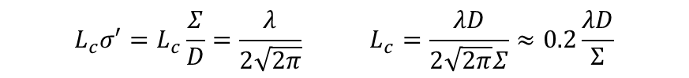

Transverse coherence length
Another way of defining L_{c} comes from the phase space area. For a Gaussian laser mode with rms size and angle width of σ and σ’, phase space area (fully coherent)
$$σσ^{′}=λ/4π$$
Considering a rectangle of width (coherence length) $L_{c}=\sqrt{2π}σ$ and height 1 has the same area as a Gaussian of rms width $σ$ and height 1, we have
$$L_{c}σ′ \text{=} λ/(2\sqrt{2π})$$
Note: $σ′$ is the angle coming to a single point at the position of interest. If the angular profile is not Gaussian but rectangular shape with width $Δ′$, similarly $Δ^{′}=\sqrt{2π}σ$’, then
$$L_{c}Δ^{′} \text{=} λ/2$$
$\sqrt{2π}σ$
Coherence by propagation (van Cittert-Zernike theorem) of an incoherence source with Gaussian distribution profile of rms size 𝛴.
$$L_{c}σ′=L_{c}\frac{Σ}{D}=\frac{λ}{2\sqrt{2π}} L_{c}=\frac{λD}{2\sqrt{2π}Σ}≈0.2\frac{λD}{Σ}$$

Slide 4
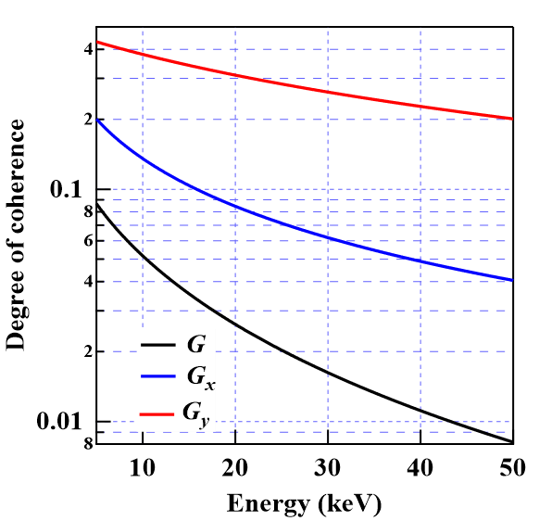
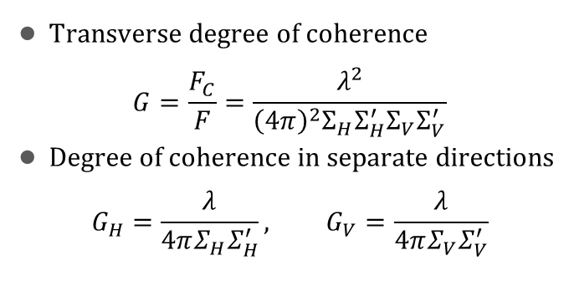
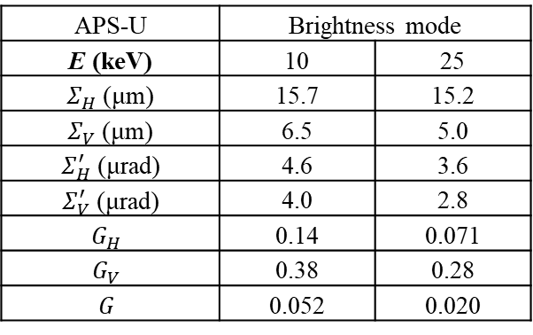
Coherence fraction
Transverse degree of coherence
$$G=\frac{F_{C}}{F}=\frac{λ^{2}}{{\left(4π\right)}^{2}Σ_{H}Σ_{H}^{′}Σ_{V}Σ_{V}^{′}}$$
Degree of coherence in separate directions
$$G_{H}=\frac{λ}{4πΣ_{H}Σ_{H}^{′}}, G_{V}=\frac{λ}{4πΣ_{V}Σ_{V}^{′}}$$
APS-U | Brightness mode
E (keV) | 10 | 25
$Σ_{H}$ (μm) | 15.7 | 15.2
$Σ_{V}$ (μm) | 6.5 | 5.0
$Σ_{H}^{′}$ (μrad) | 4.6 | 3.6
$Σ_{V}^{′}$ (μrad) | 4.0 | 2.8
$$G_{H}$$ | 0.14 | 0.071
$$G_{V}$$ | 0.38 | 0.28
$$G$$ | 0.052 | 0.020

Slide 5
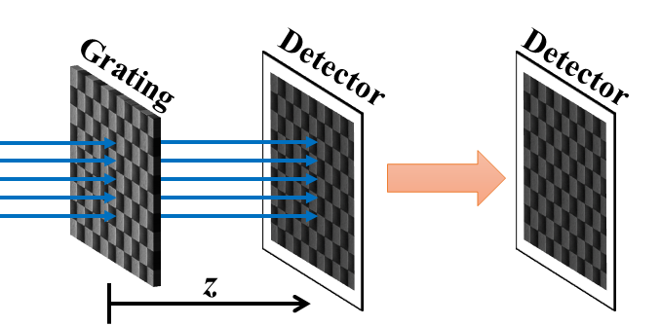
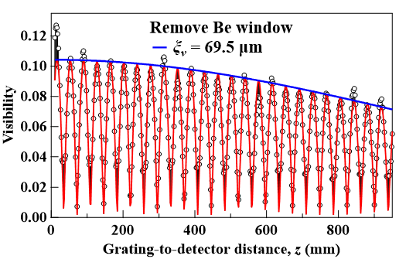
APS 33-ID-D Coherence Measurement
2016 water-cooled diamond mono
2018 changed to cryo-cooled Si mono
Vertical coherence length | Vertical coherence length | 1 s
Acquisition time | 10 ms | 1 s
Water-cooled diamond (2016) | 15.0 μm | 13.0 μm
Cryo-cooled Si (2018) | 45.8 μm | 39.8 μm
Better Si crystals (2019) | 67.9 μm | 56.1 μm
Remove Be window (2020) | 69.5 μm | 41.8 μm
2020 remove Be window
2019 new Si crystal
Xianbo Shi, et al., J. Phys. Conf. Ser. 2380(1), 012064 (2022).

