Slide 1
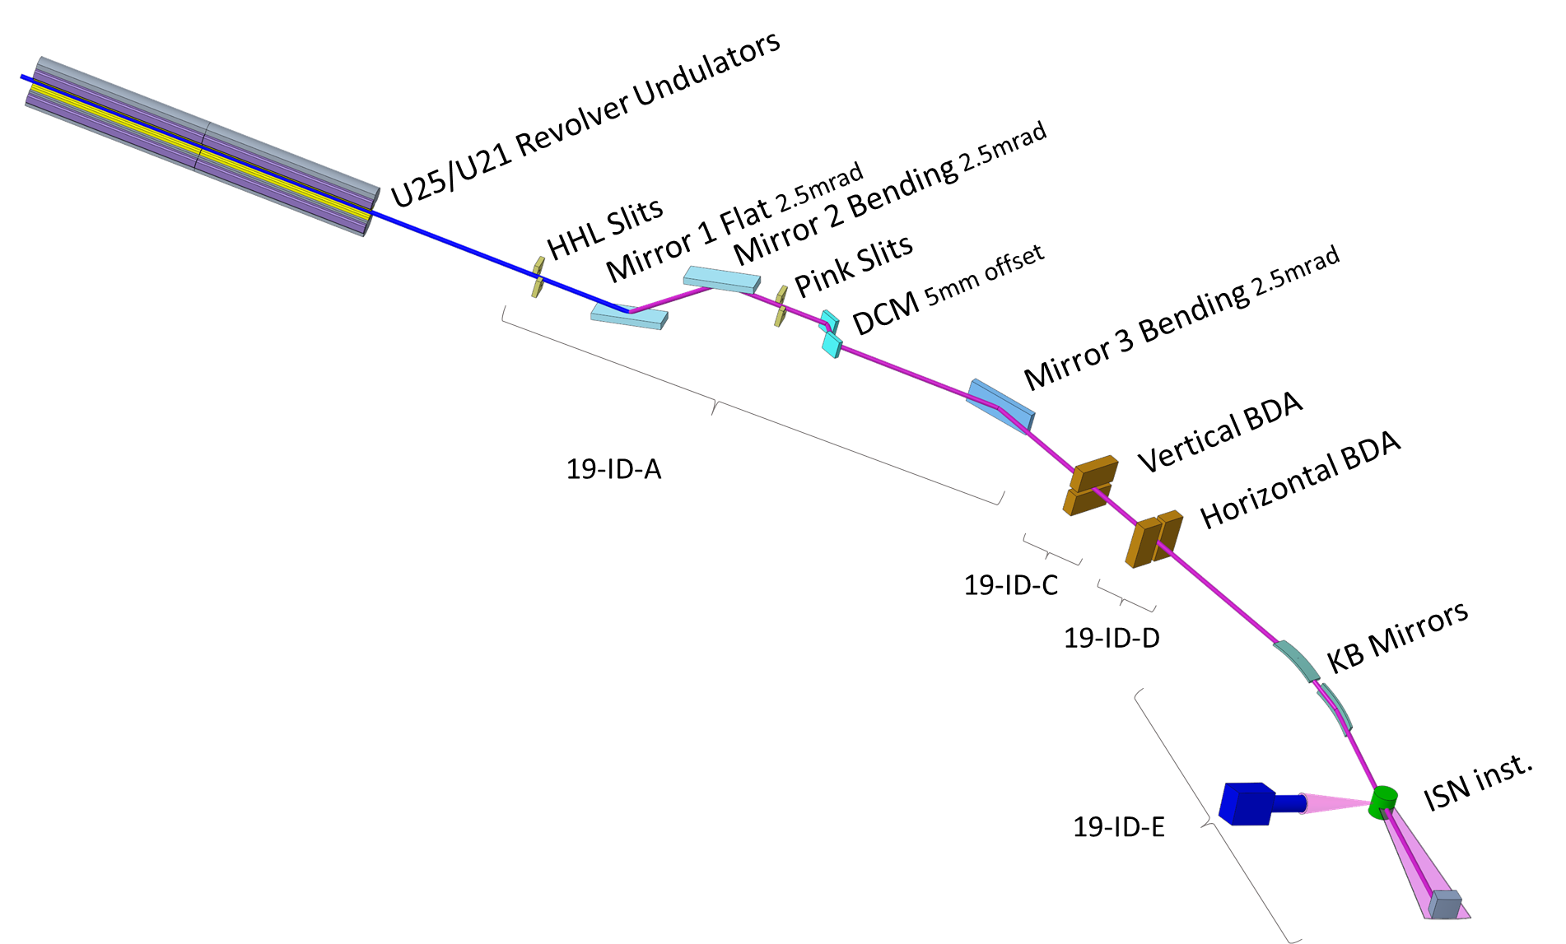
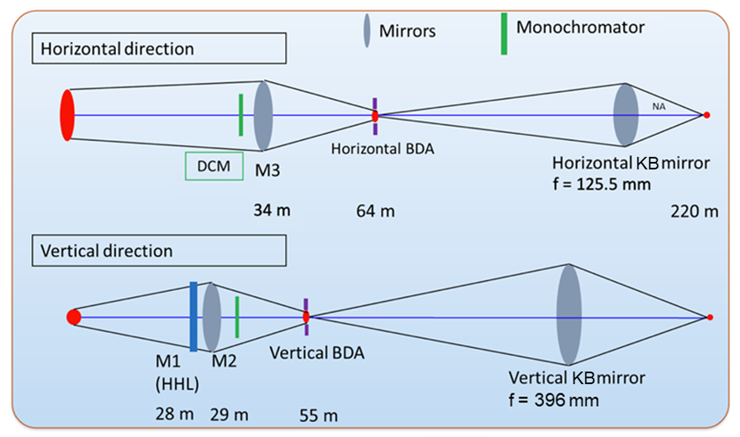
ISN layout

Slide 2
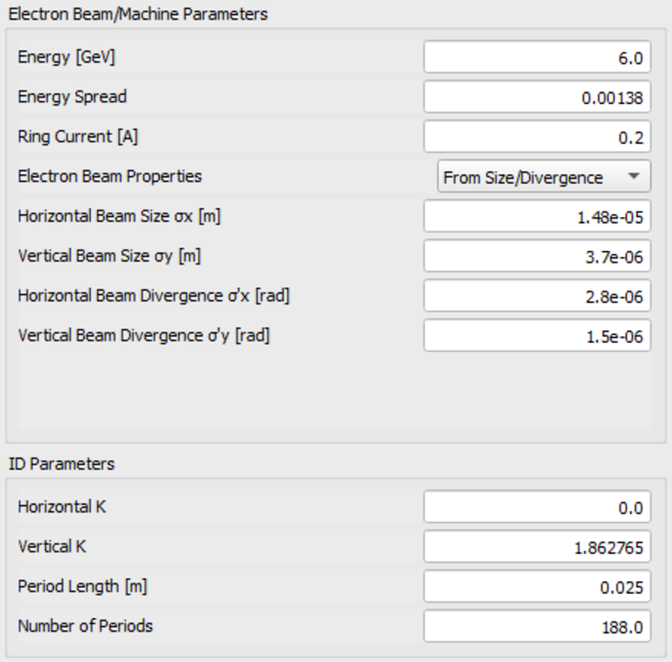
Source parameters
APS-U brightness mode
U25 at 25 keV (fifth harmonic)

Slide 3
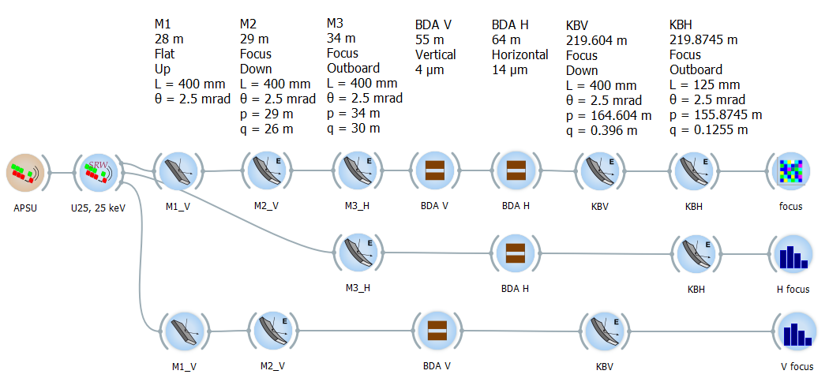
OASYS SHADOWOUI – layout only
2D
H only
V only
All mirrors are Pt coated, optical width large enough to cover full beam
Assume elliptical cylinder shape for all focusing mirrors.

Slide 4
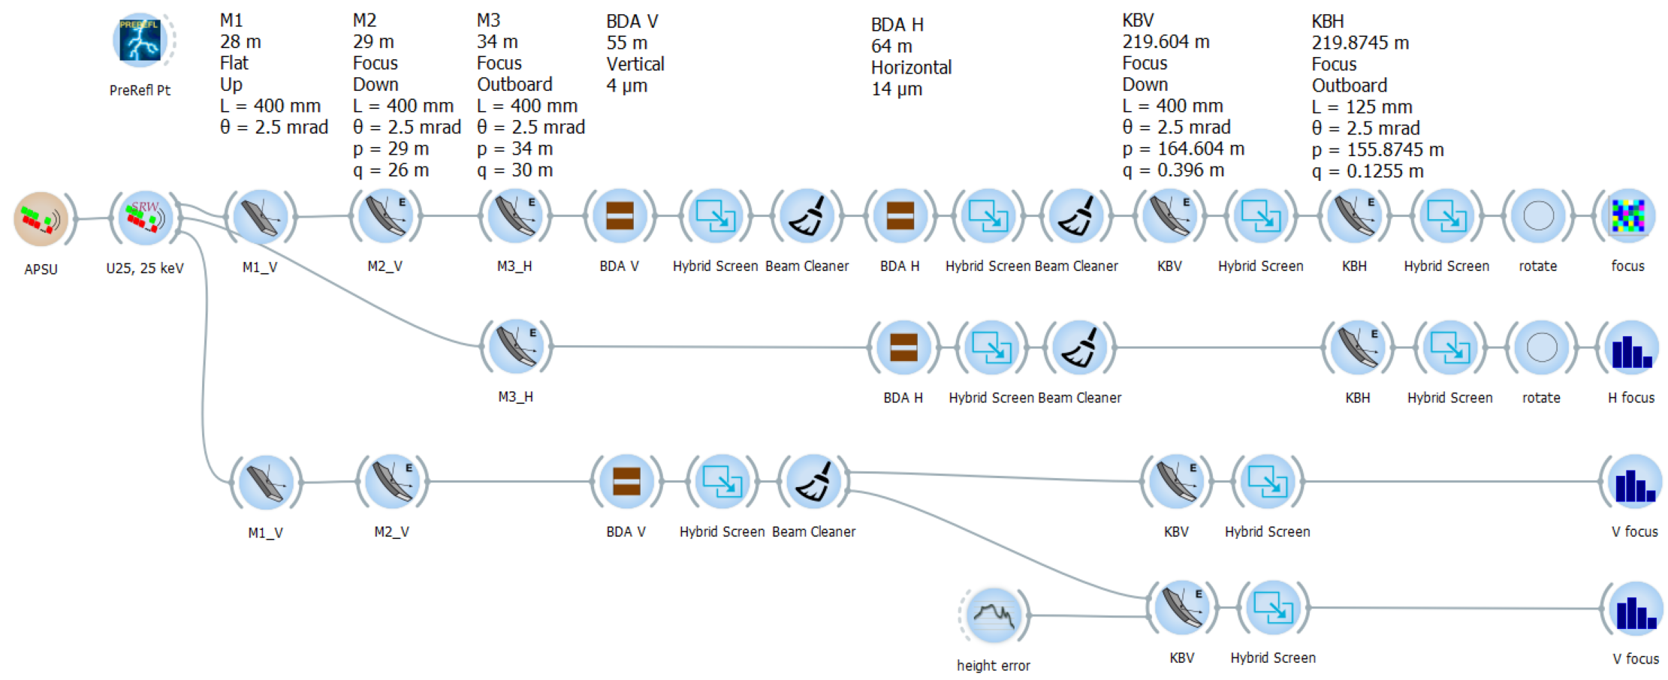
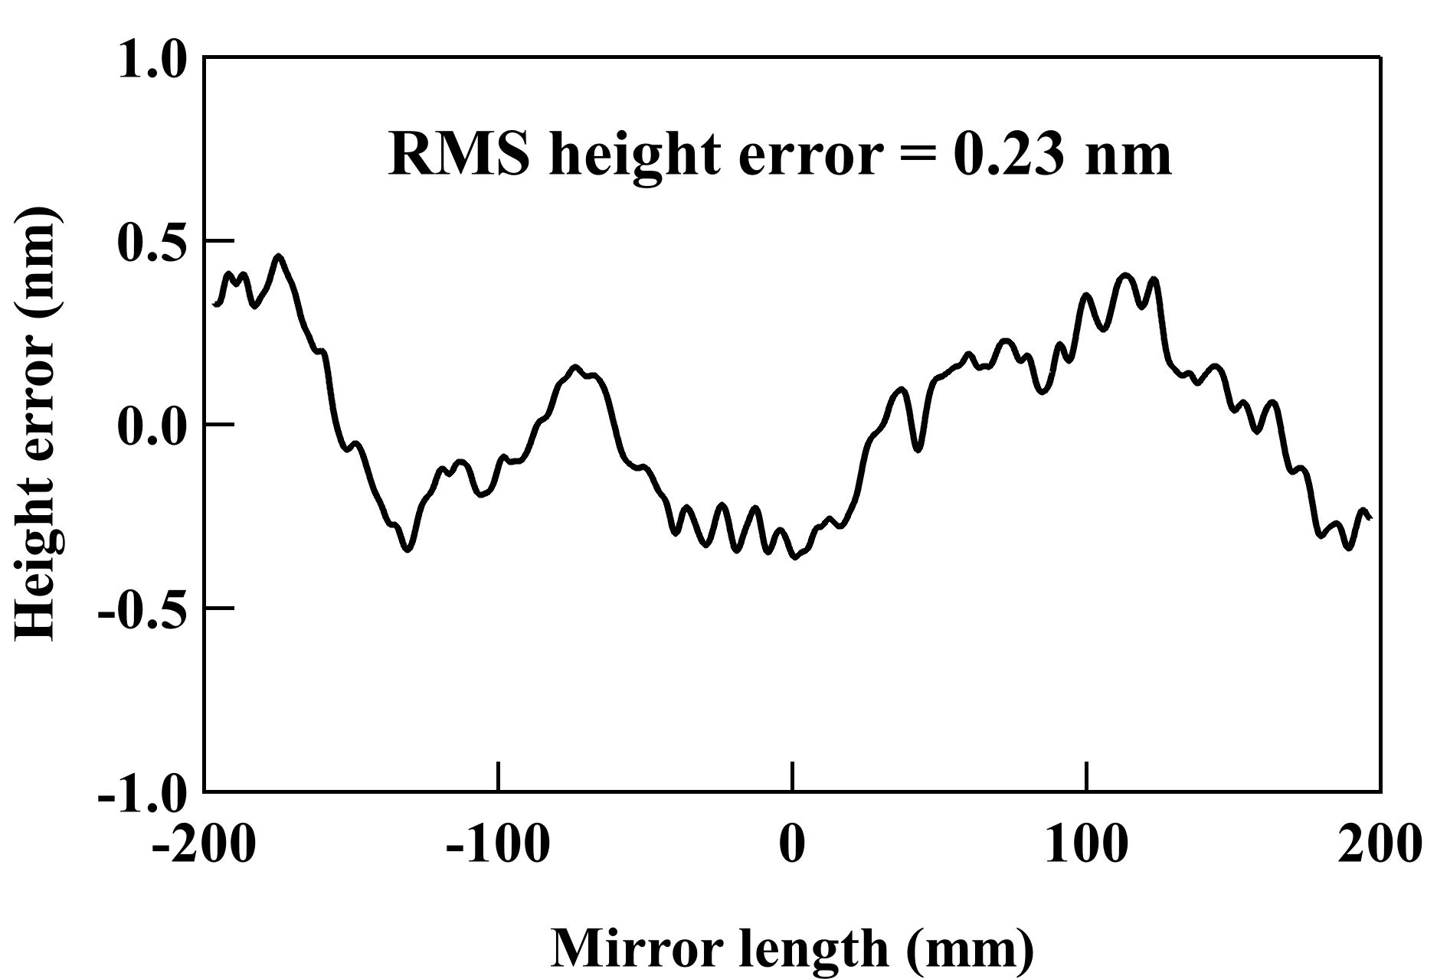
OASYS SHADOWOUI – full workspace

