Slide 1




Introduction to COMSYL
Manuel Sanchez del Rio
srio@lbl.gov

Slide 2
COMSYL
Coherent Modes of Synchrotron Light
(calculates the coherent modes for undulators in storage rings)

Slide 3




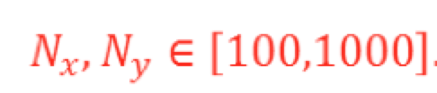
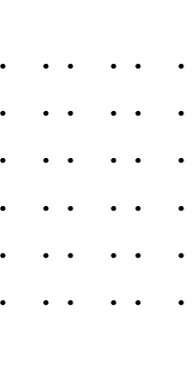
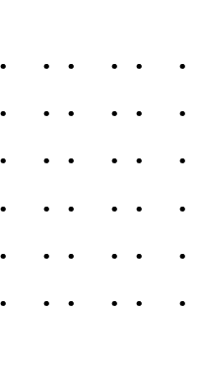
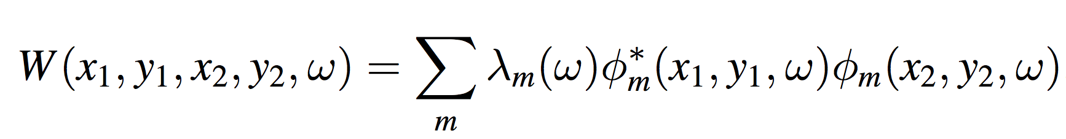
W ~ 10⁸ – 10¹² (Gb-Tb)
Propagate: 4D integrals
4D function
2D functions
Store m x N x N Propagate: 2D integrals

Slide 4
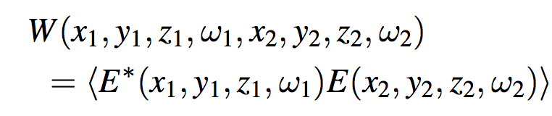
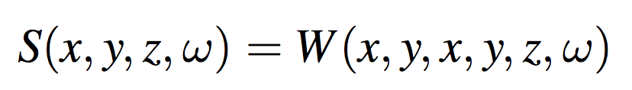
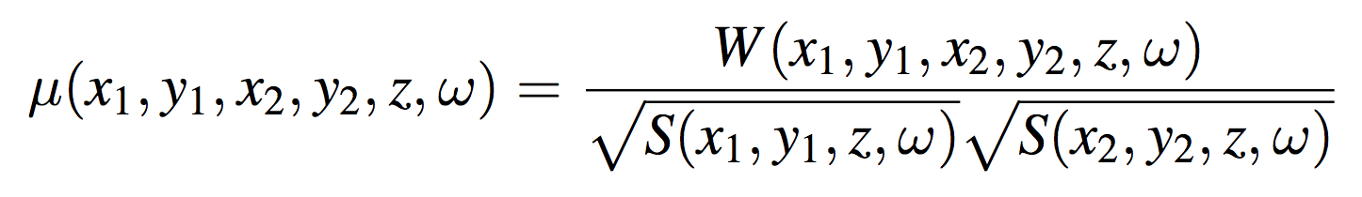
CROSS SPECTRAL DENSITY
Mutual Coherent Function (t-dependency) or Cross Spectral Density (ω-dependency)
8D function that propagates using a doble wave equation
Wide sense stationary: W≠0 if ω₁=ω₂=ω Long bunch length, high ω , not to small Δω Geloni et al. NIM A 588 463 (2008)
Decoupling z: 4D function (for given z and ω)
Spectral Density “intensity”
Spectral Degree of Coherence
W ~ 10⁸ – 10¹² (Gb-Tb)
Propagate: 4D integrals
4D function
2D functions

Slide 5
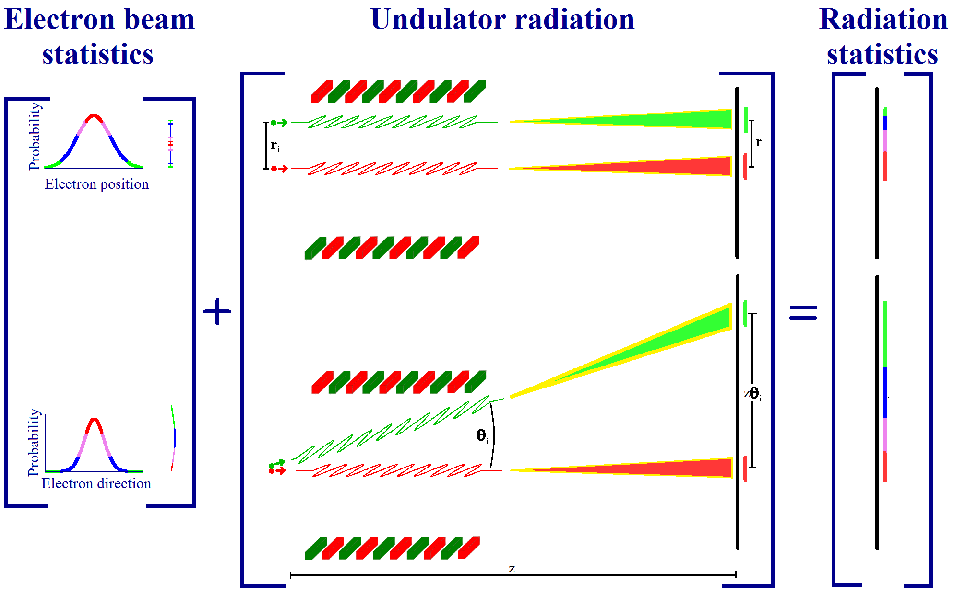
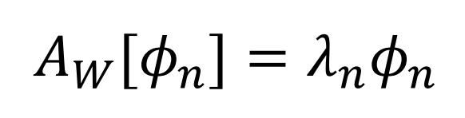
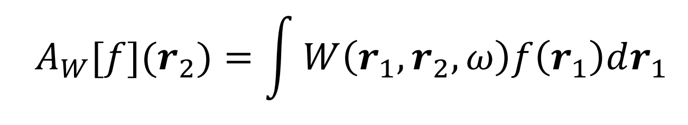
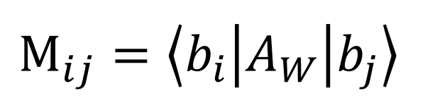
COMSYL (Coherent Modes for Synchrotron Light)
COMSYL https://github.com/mark-glass/comsyl
Glass & Sanchez del Rio (2017) EPL 119 p 34004
Undulator
radiation
Calculate CSD
Coherent mode decomposition
SRW
K.-J. Kim Proc. SPIE 0582 (1986)
OASYS
Friedholm equation:
Propagate CSD along the beamline
Diagonalize M with iterative solver slepc
Large memory.
Parallel computers using MPI.
Large clusters (ESRF). Cloud computing (AWS, etc.)
Rediagonalize CSD

Slide 6
Info COMSYL
Repository: https://github.com/mark-glass/comsyl
Installation: https://github.com/mark-glass/comsyl/wiki

Slide 7
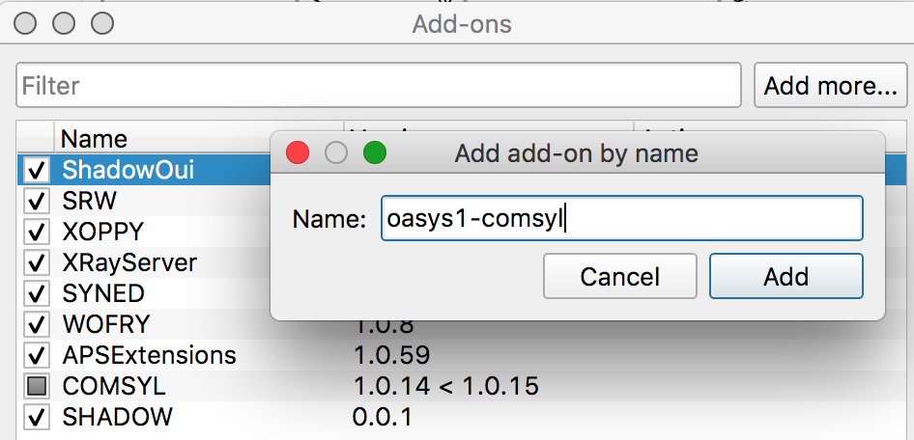
Install Comsyl-Oasys (not for COMSYL calculations, only for displaying and propagating results)
Add-on
Download files (BIG!!) from: http://ftp.esrf.eu/pub/scisoft/comsyl/

Slide 8

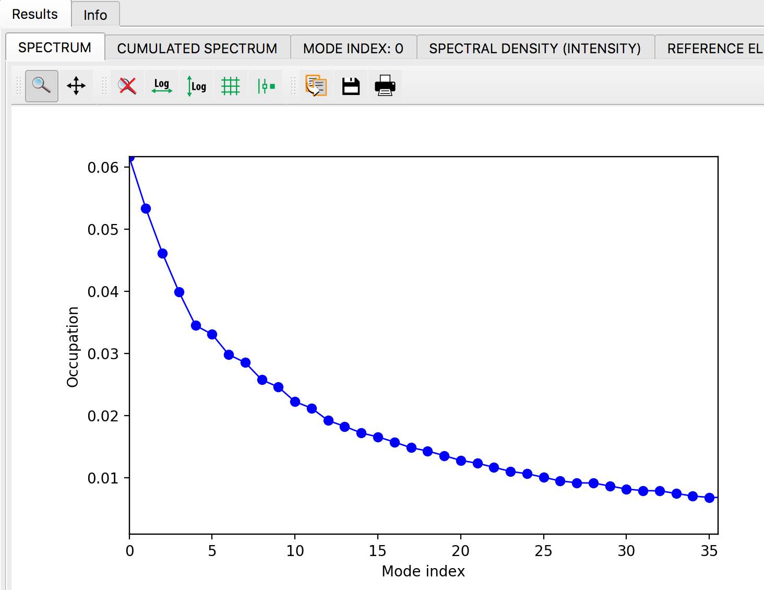
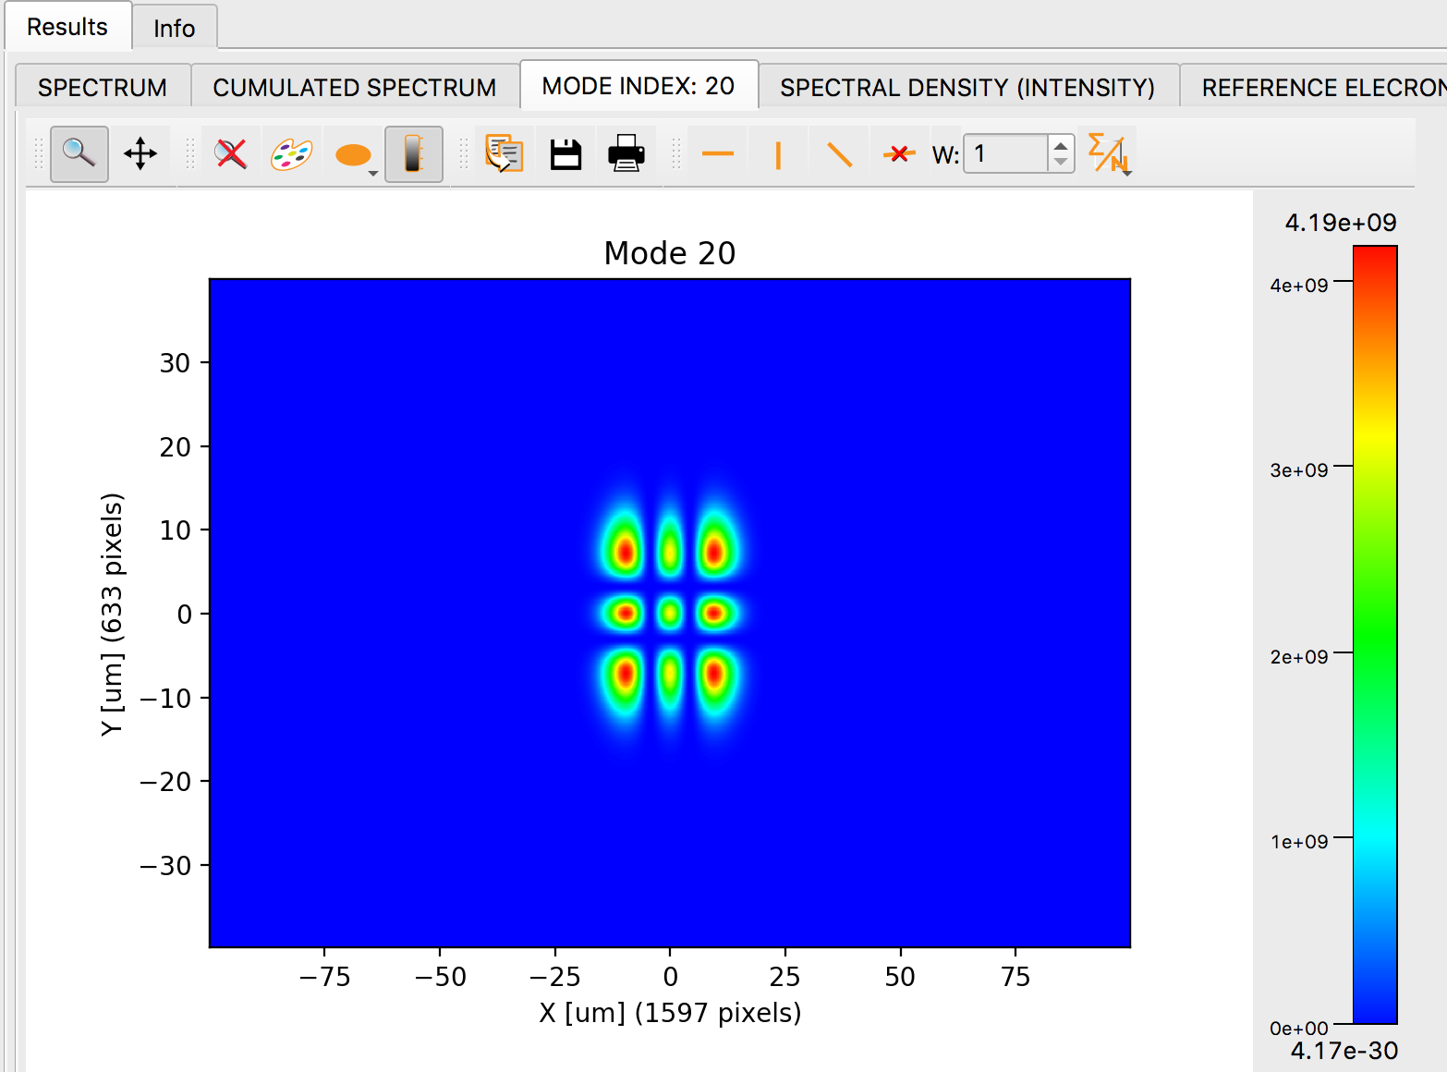
OASYS-COMSYL
Read and visualize COMSYL calculations
﻿Undulator ISN 25KeV: ﻿u_25keV_s10.0.npy

Slide 9
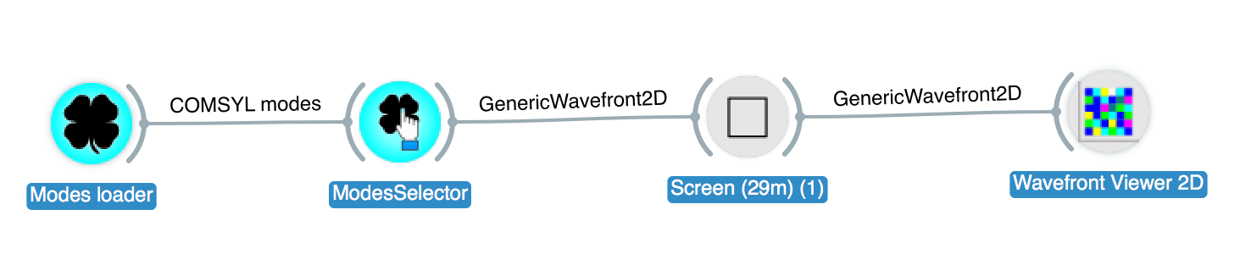
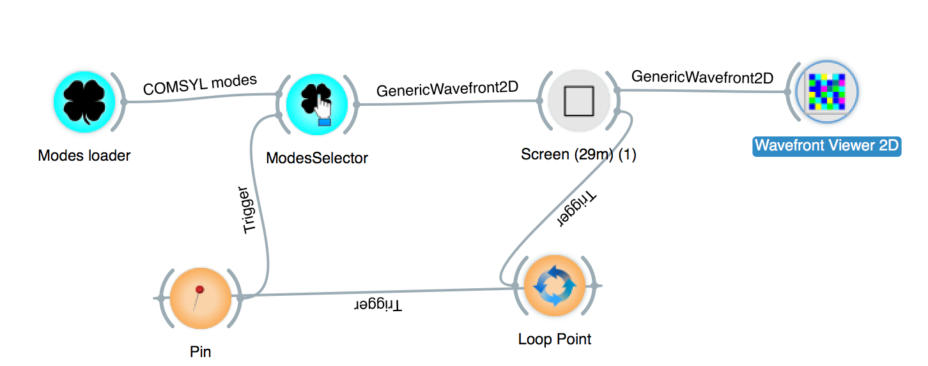
OASYS-COMSYL
WOFRY
Extract wavefronts to propagate with WOFRY or SRW
Loop over number of modes:

Slide 10
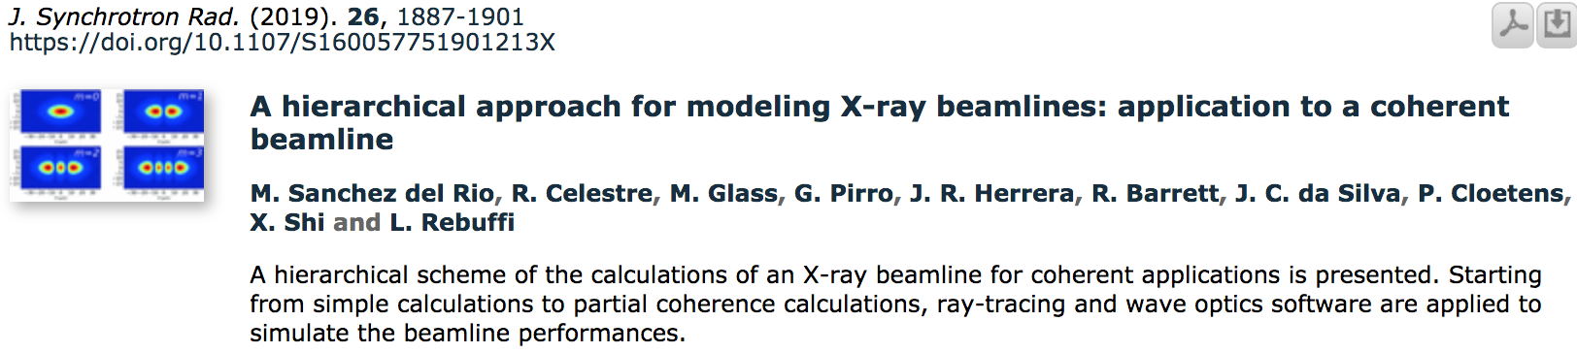
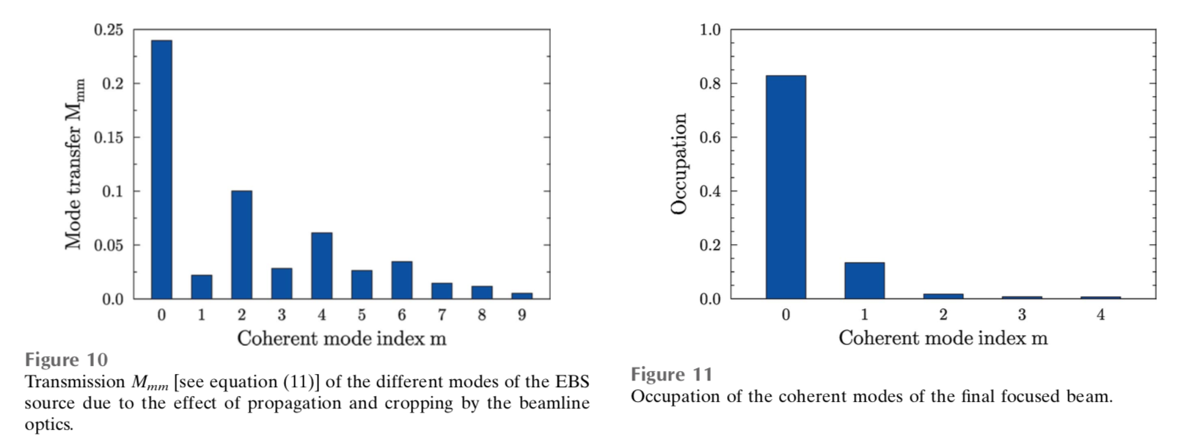
COMSYL: ESRF ID16A
After recalculate modes (rediagonalization)
Just propagation

Slide 11
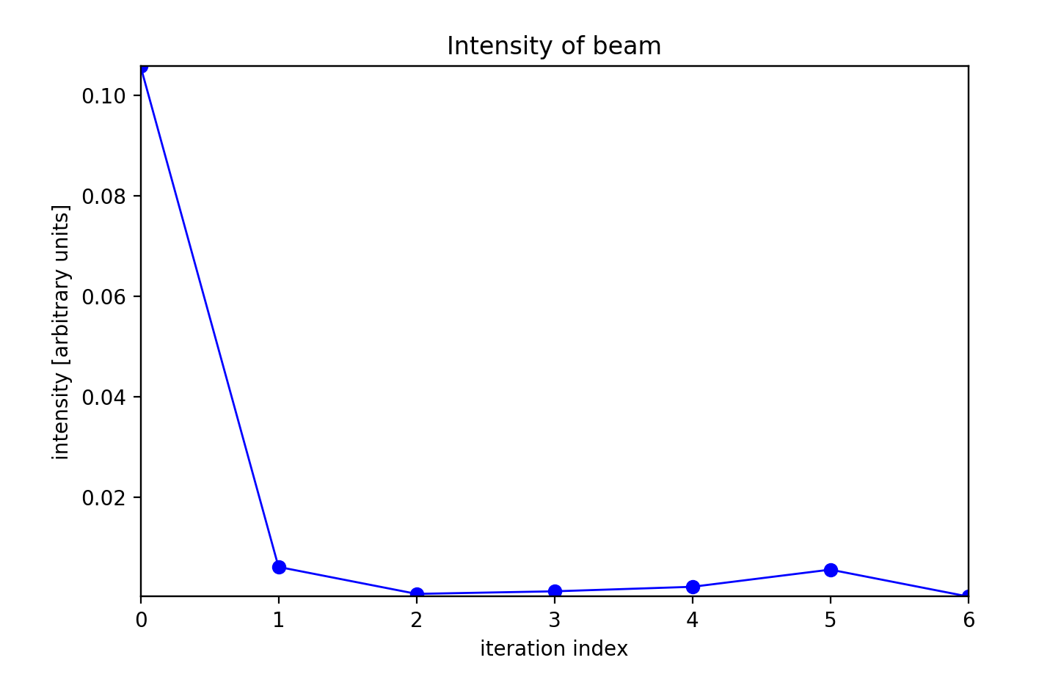
Mode transmission for ISN

Slide 12
Run Comsyl

Slide 13
OASYS and Comsyl

Slide 14
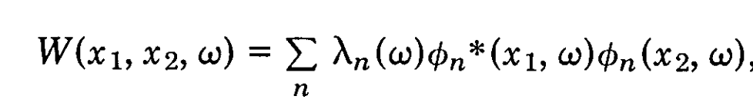
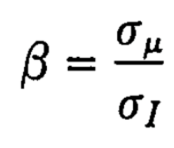
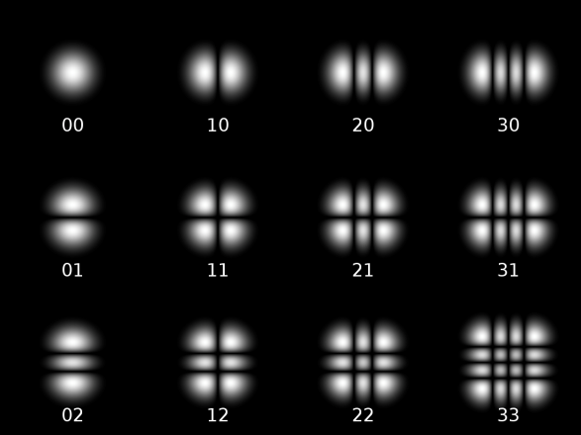
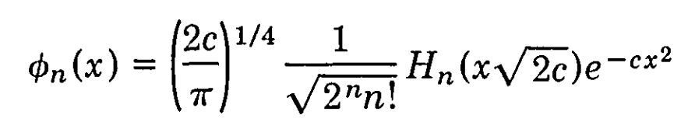
SIMPLE CASE: 1D Gaussian SHELL-MODEL
Both intensity (Spectral Density) and correlation (Spectral Degree of Coherence) are Gaussians
σ_{I}>>σ_{μ} the source is mostly incoherent (quasi homogeneous)
σ_{I}<<σ_{μ} is mostly coherent
I
I
Eigenvalues
Eigenfunctions
(Hermite-Gaussian modes)
Magic property: Propagation invariance
In the first mode (Gaussian) :
In 2D (H x V)
2D Hermite-Gaussian or
TEM_{nm} modes

Slide 15
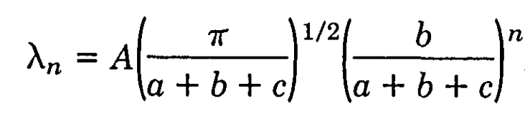
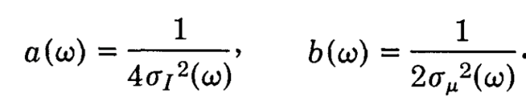

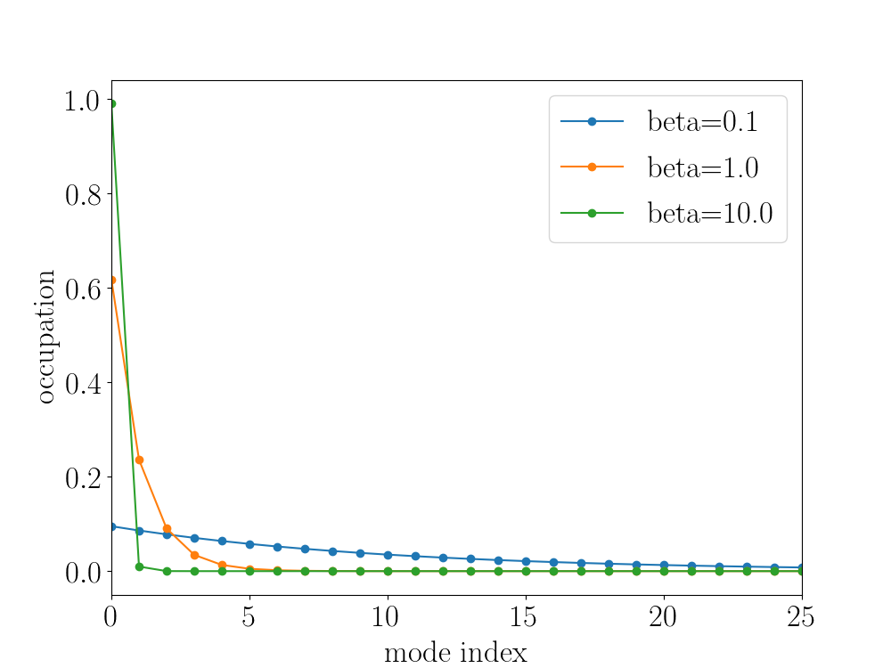


The spectrum of coherent modes
Eigenvalues
Mode occupation:
Coherent: β>>
Coherent fraction:
incoherent
β<<
In general we cannot apply Gaussian Shell-model to synchrotron

