Slide 1
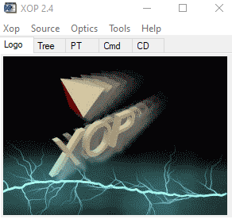
XOP – STATUS
erhtjhtyhy
Roger Dejus
Control Account Manager for Insertion Devices for APS Upgrade
December 11, 2019
Argonne, IL

Slide 2
Outline
History and Scope
Current distribution (v2.4)
Overview
Examples
References
Summary

Slide 3
History and Scope
Developed during the early 1990s to suit local needs at the ESRF and the APS (efforts officially merged 1995; now 25 years in the making … end of life)
XOP v2.0: 1,000 CD-ROMs distributed (400 registered users)
Front-end graphical user interface for computer codes of different origins and different languages for the synchrotron radiation community (written in the licensed Interactive Data Language IDL)
Modelling of x-ray sources
Characterization of optical elements (mirrors, filters, crystals, multilayers, etc.) and their effect on sources (“pipes” via files)
Multipurpose visualizations and data analyses
Optional plug-in of external software packages “extensions” expands the functionality of XOP

Slide 4
Current XOP Distribution v2.4 (2015)
Used worldwide by synchrotron radiation facilities (and many others) and has been crucial for beamline designers and users for over a decade. The current version runs on Unix, Linux, Mac OS X, and Windows.
The graphical user interface and many modules of the code are written in IDL, which is subject to U.S. Export Control and is categorized under Export Control Classification Number (ECCN) 5D002 (as of IDL v8.0). As such, it can only be distributed to users who have completed and submitted an application that is approved by the Argonne’s Export Control process.
Licensed since April 2015 with 2,029 application requests to date (10% denied)
Licensed with IDL v8.3 embedded and good thru September 20, 2021 (no additional IDL embedding requests planned)
Replaced by the OASYS software, which contains similar functionalities (codes) but also with enhancements and new codes for different applications

Slide 5
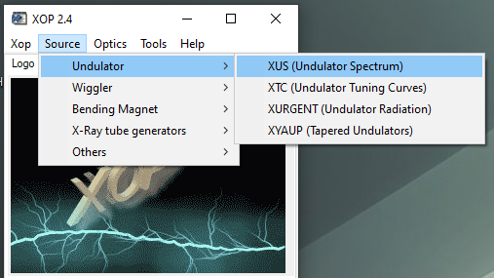
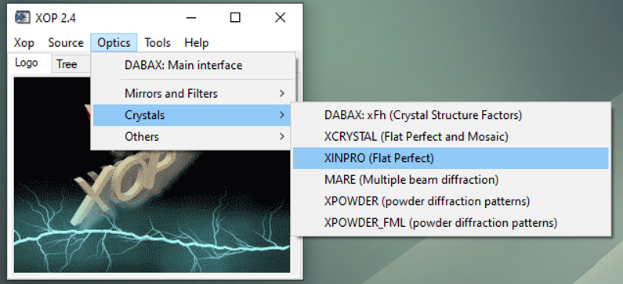
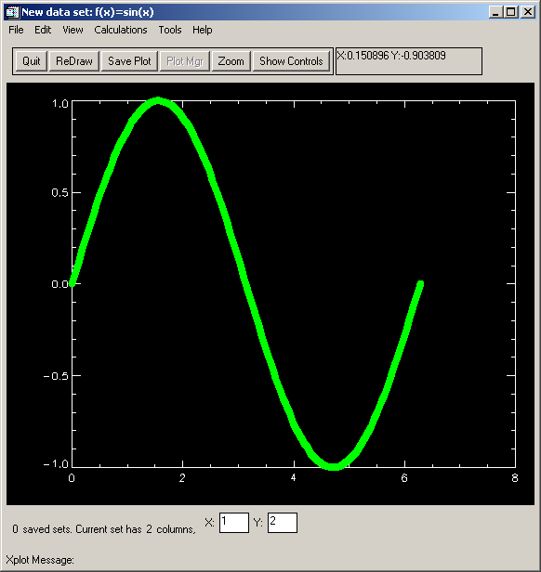
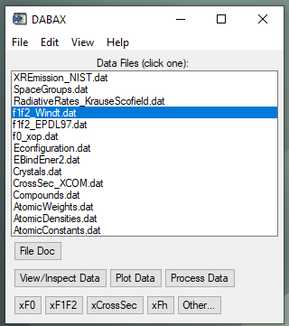
Overview
XOP Extensions
X-Ray Sources
X-Ray Optics and Photon -Atom Interactions
SHADOWVUI
Interface to the SHADOW ray-tracing code (Cerrina et al.)
IMD
Multilayer software (Windt)
TOPO
Surface topography (Windt)
General Purpose Tools and Documentation
XPLOT

Slide 6
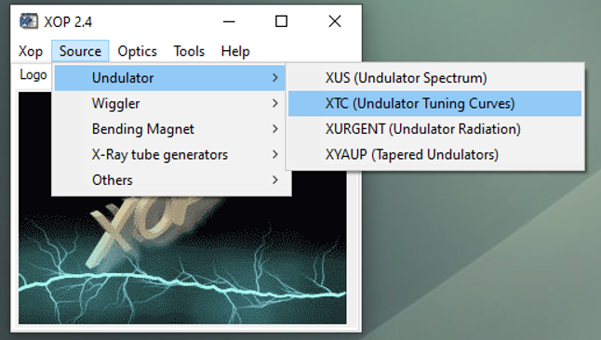
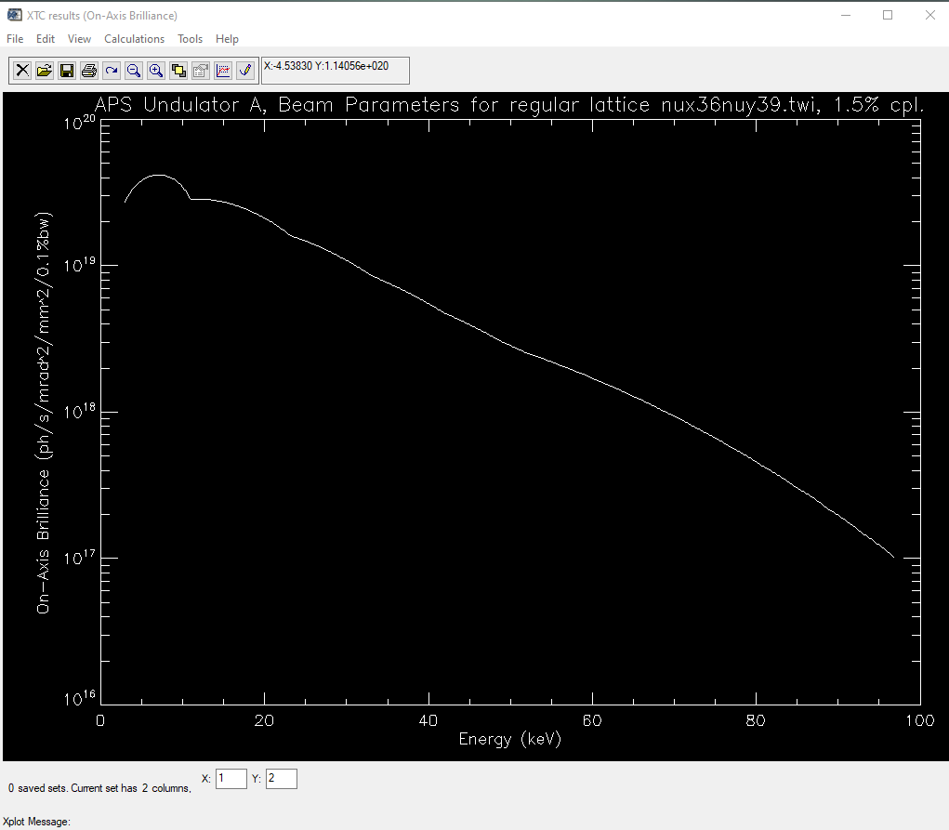
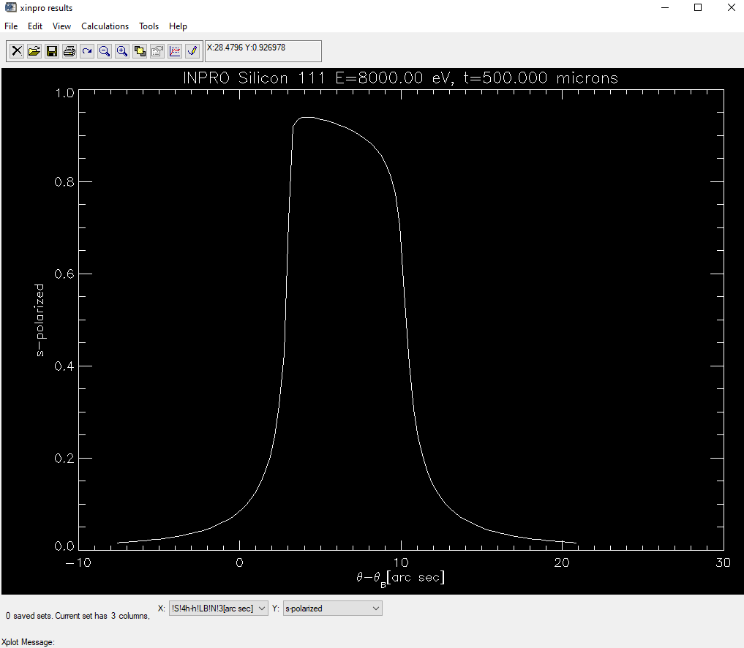
XOP Examples – XTC and XINPRO
On-Axis Brilliance Tuning Curves (XTC)
Si X-Ray Crystal Diffraction Profile (XINPRO)

Slide 7
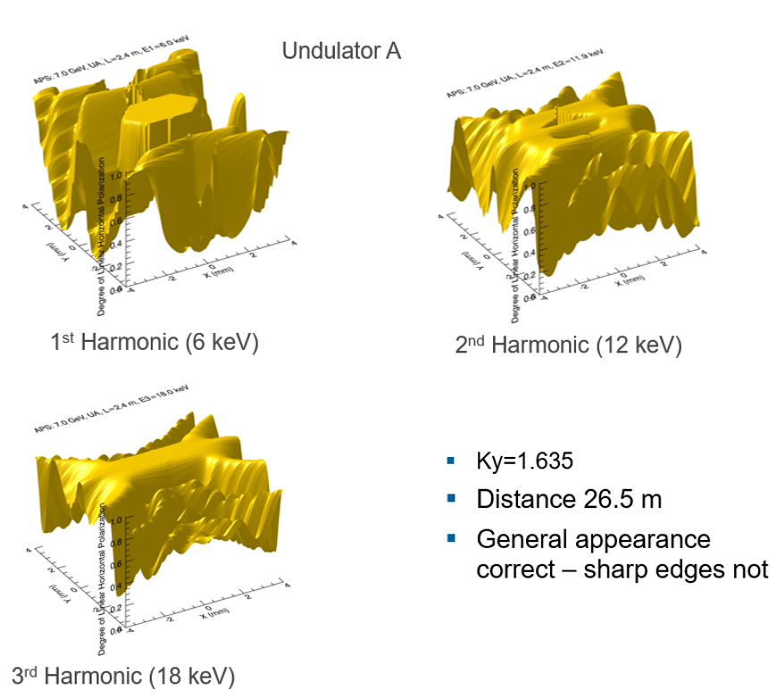
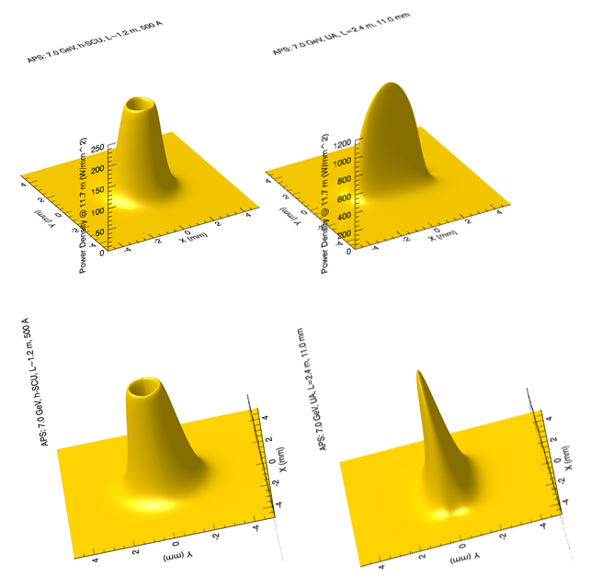
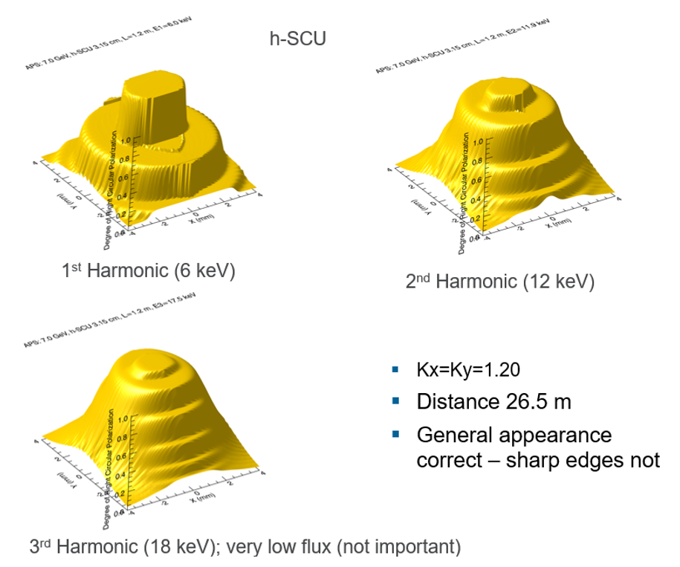
XOP Examples – XUS: Helical SCU vs. APS Undulator A
UA Horizontal Linear Polarization
Power Density h-SCU left, UA right
h-SCU Circular Polarization

Slide 8
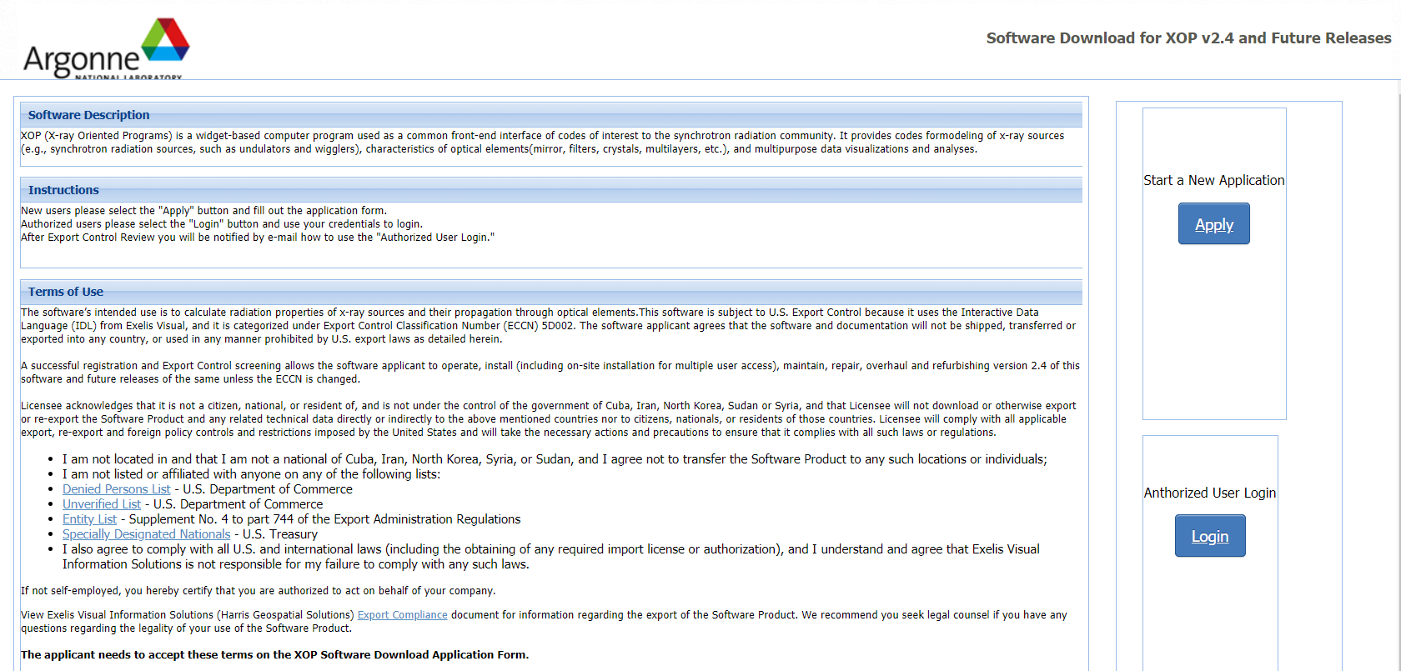
XOP Request for Downloads
https://beam.aps.anl.gov/apps/xop/

Slide 9
References
Manuel Sánchez del Río and Roger J. Dejus "XOP v2.4: recent developments of the x-ray optics software toolkit", Proc. SPIE 8141, Advances in Computational Methods for X-Ray Optics II, 814115 (23 September 2011); https://doi.org/10.1117/12.893911
https://www.aps.anl.gov/Science/Scientific-Software
https://beam.aps.anl.gov/apps/xop/
srio@esrf.fr or srio@lbl.gov
dejus@anl.gov

Slide 10
XOP Successful and appreciated 25 years
Download requests continues
Replaced by the new oasys software

Slide 11
Thank you!
Questions?

