Slide 1
Synchrotron Sources

Slide 2
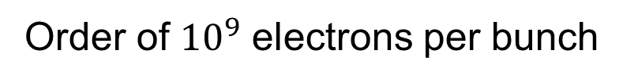
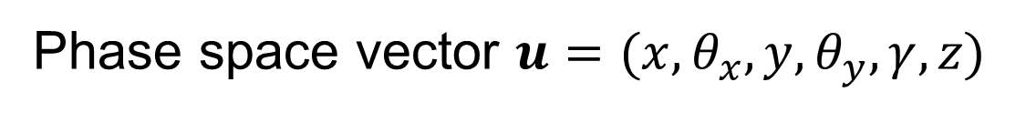
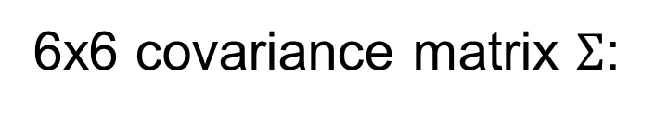
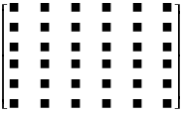
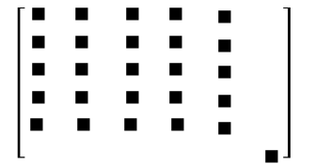
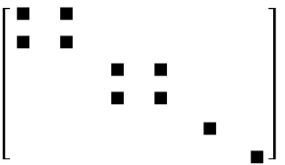
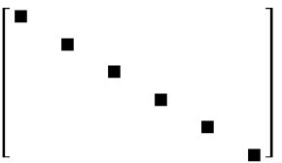
ELECTRON BEAM DESCRIPTION
In storage rings, the electrons are statistically distributed inside bunches
P₁
P₂
P₃
General
No z-coupling
Finite alpha
Symmetry point

Slide 3
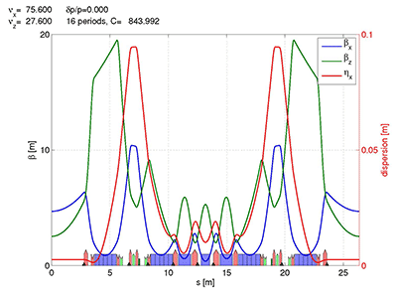

Stotage ring: electron beam sizes
Horizontal emittance = 147 pm
With ε the emittance (constant), and Twiss parameters:
At s (any point of the trajectory):
EBS (S28D):
β_{x} = 6.90 m
β_{y} = 2.64 m
σ_{x} = 30.2 μm
σ_{y} = 3.64 μm
σ_{x’}= 4.37 μrad
σ_{z’}=1.37 μrad
At waist (zero correlation, ρ=α=0, β is minimum):

Slide 4
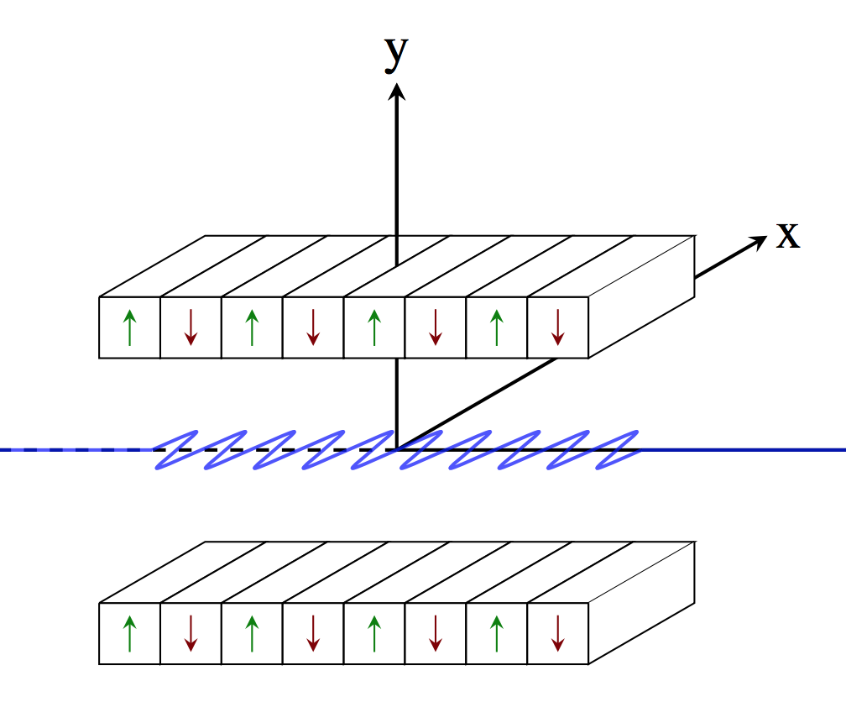
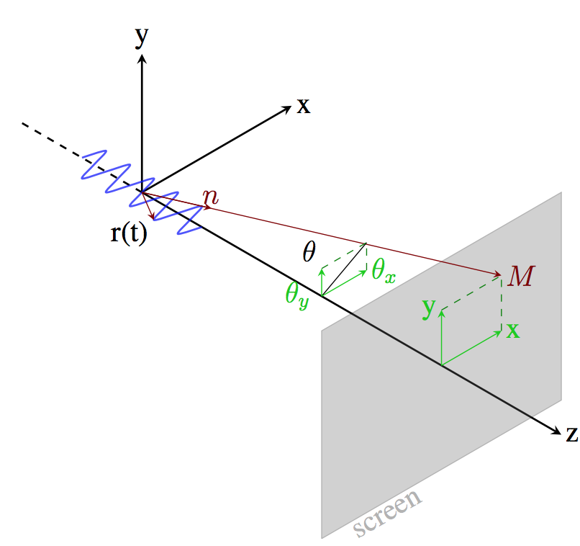
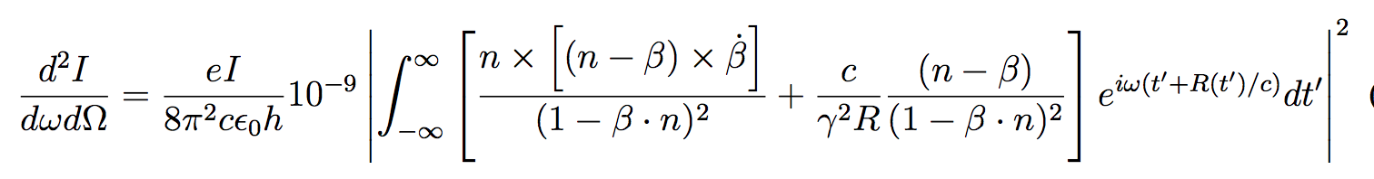
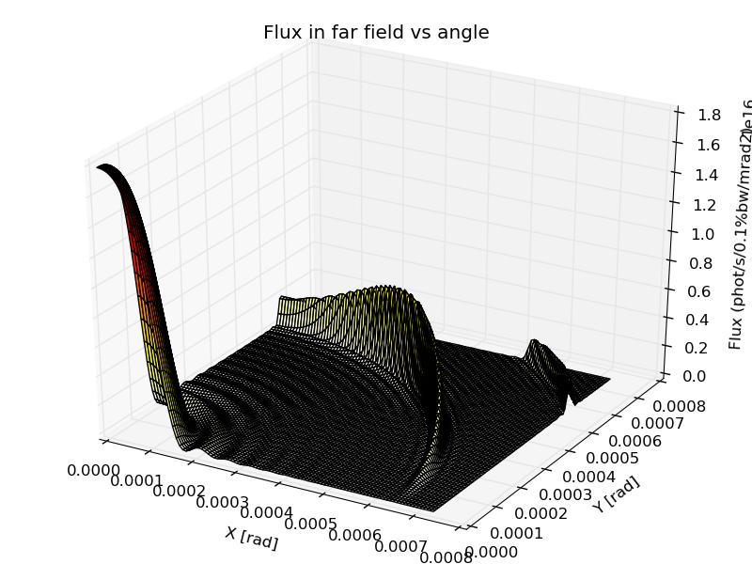
SINGLE ELECTRON PHOTON EMISSION (Zero emittance)
Undulator emission, after classical electrodynamics (e.g., Jackson, etc)

Slide 5
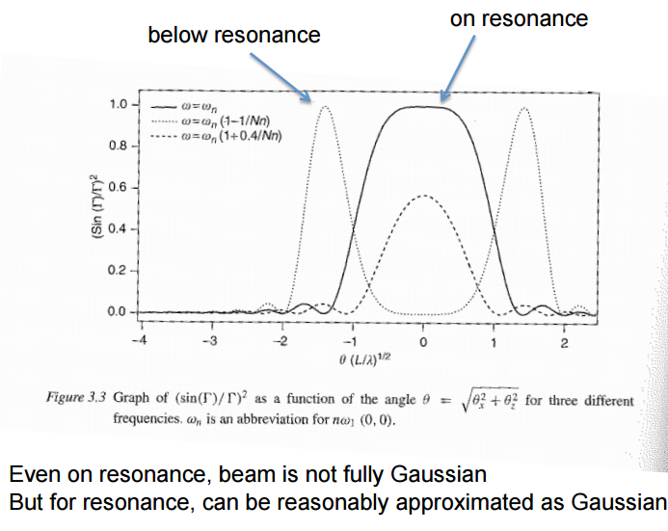
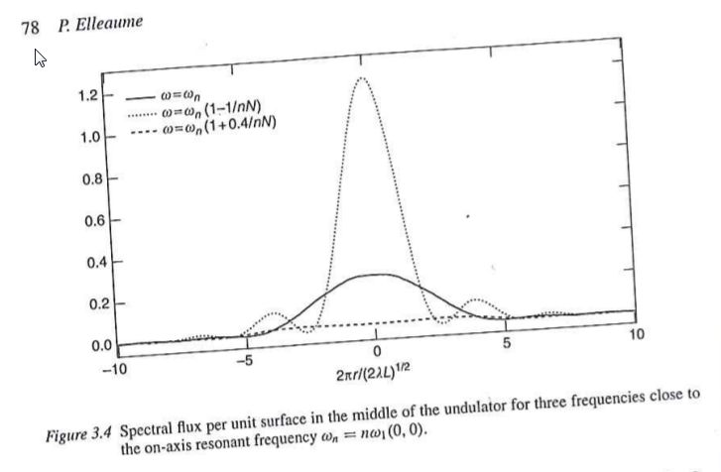
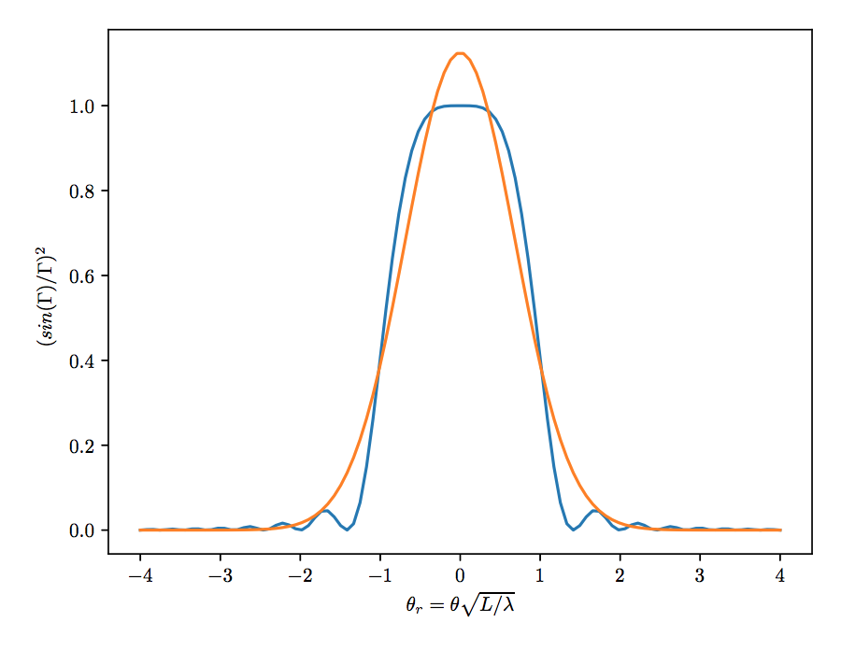
Undulator emission (single electron or filament beam or zero emmittance) (after Onuki & Elleaume, Undulators, Wigglers and their applications, CRC press, 2002)
Undulator beams have not Gaussian profiles (even at resonances)
These formulas are APPROXIMATED!

Slide 6
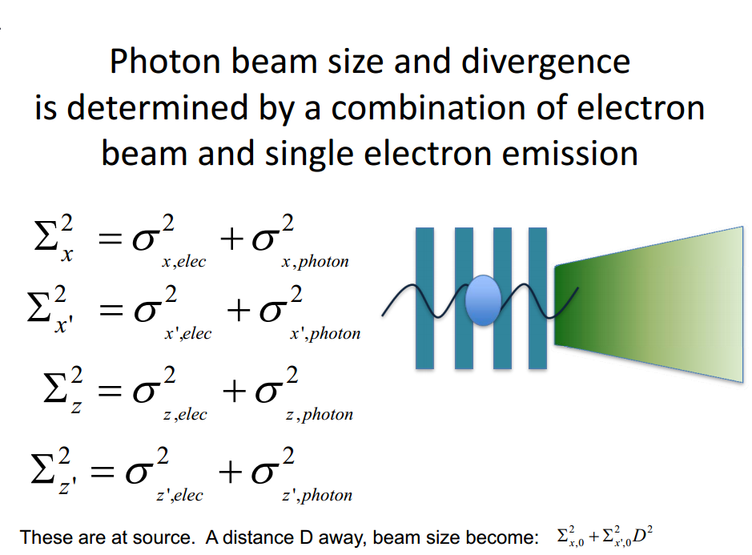
Courtesy: Boaz Nash
(FOR UNDULATORS, THESE FORMULAS ARE VALID AT THE WAIST, AT THE UNDULATOR RESONANCE, AND SUPOSSING GAUSSIAN EMISSION OF PHOTONS)
ShadowOui performs “numeric convolution” by Monte Carlo sampling of the electron beam [Gaussian] and photon emission [non Gaussian]

Slide 7
Mirrors

Slide 8
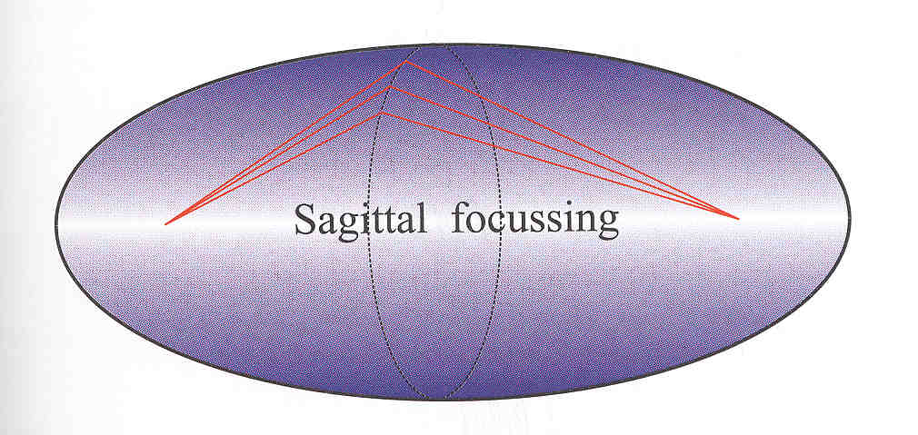
Mirror shape
Ellipsoid: Point to point focusing
Paraboloid: Collimating
Focalization in two planes
Tangential or Meridional (ellipse or parabola)
Sagittal (circle)
Demagnification: M=p/q
Easier manufacturing:
2D: Ellipsoid => Toroid
Only one plane: cylinder Ellipsoid (ellipse)=> cylinder (circle)
Sagittal radius: non-linear (ellipsoid) => constant (cylinder) or linear (cone),
All mirrors produce aberrations
R
p
q
ρ

Slide 9
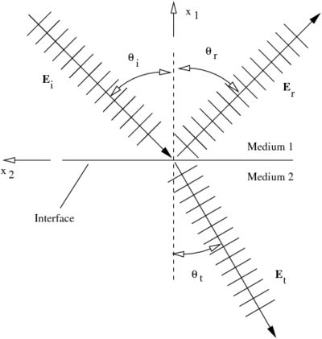
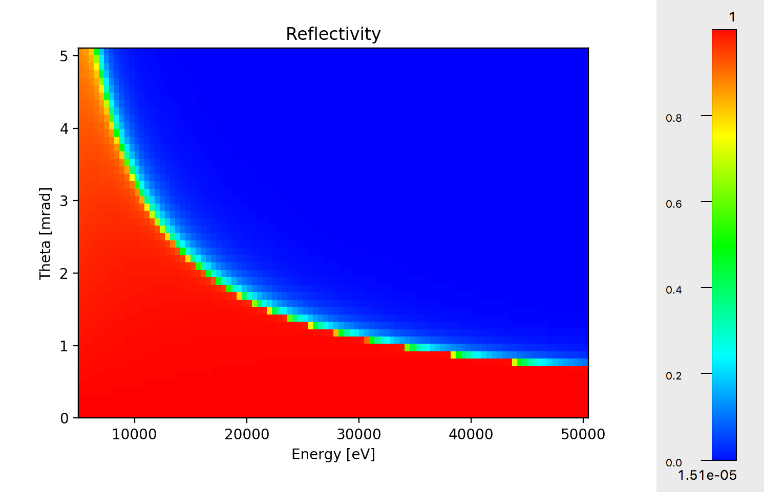

Mirrors Geometrical model Physical model Specular reflection Fresnel formulas
Fresnel equations give the reflectivity as a function of angle and photon energy. As a consequence, one gets the critical angle:
Si

Slide 10

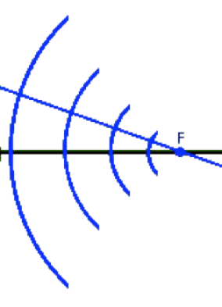


LENS
p
q

Slide 11
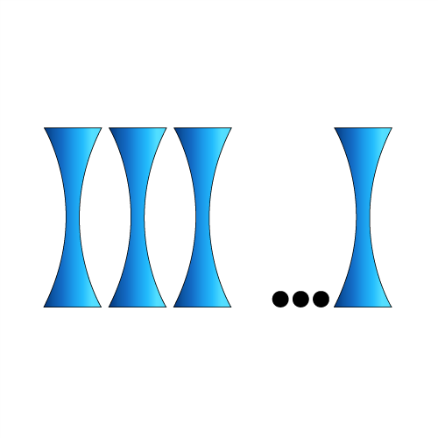
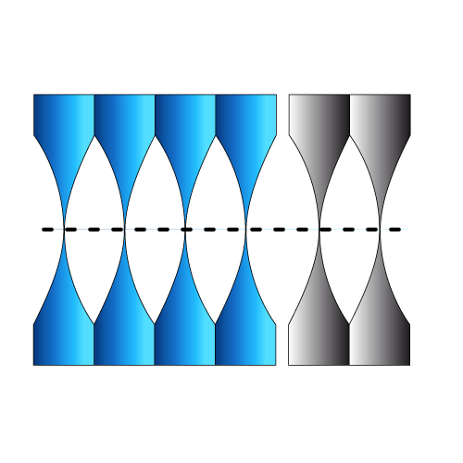
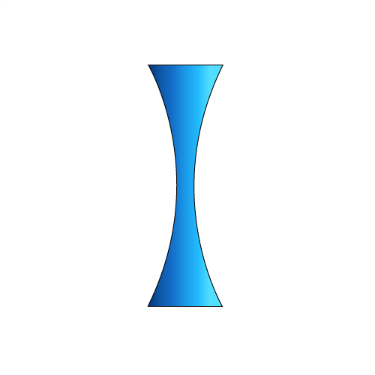




CRL (COMPOUND REFRACTIVE LENSES) = replicate N lenses
Compound Refractive Lens (CRL)
Single interface
Lens
Transfocator
1996 Experimental demonstration of CRL
A. Snigirev et al Nature 384 (1996) 49
2011 Transfocator

Slide 12

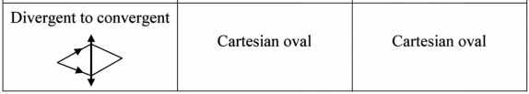
HIGH DEMAGNIFICATION with SINGLE LENSES
material->air air->material
K. Evans-Lutterodt et al
Single Element elliptical hard X-ray micro-optics
Opt. Expr. 11, 8, 919-926 (2003).
M. Sánchez del Rio & L. Alianelli,
J. Synchr. Rad. 19 (2012) 366
When illuminating with coherent light, reducing acceptance decreases N.A. therefore increases coherent diffraction ~0.61 λ/ (h/q)
The rays become very grazing to there is total reflection. Not a limitation for kinoform lenses (K. Evans-Lutterodt et al Phys. Rev. Lett. 99 (2007)). For standard lenses one can reverse the lens.
There is a lot of absorption => remove material and convert it to a Fresnel lens (W. Jark et al J. Synchr. Rad. 13 (2006))
Use the lens shape adapted for your needs

Slide 14
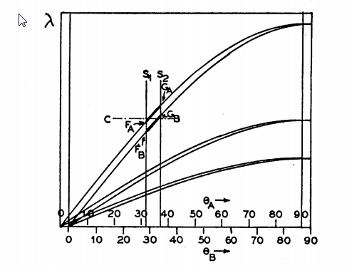
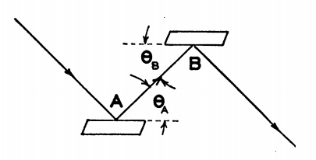
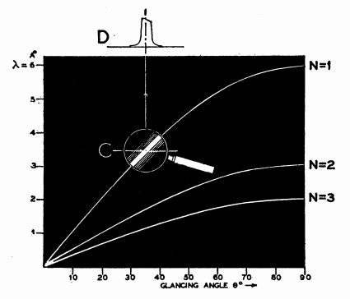
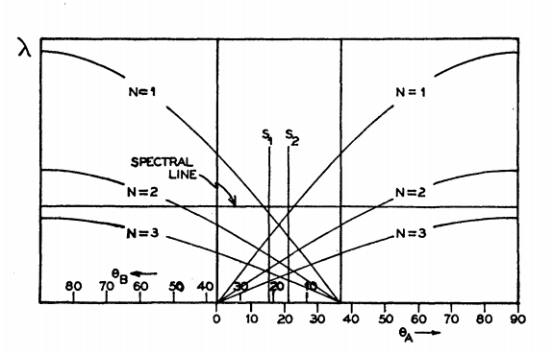
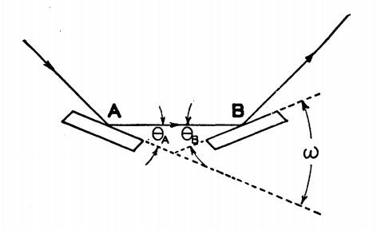
Theory of the Use of More Than Two Successive X-Ray Crystal Reflections to Obtain Increased Resolving Power J W. M. DuMond Phys. Rev. 52, 872 – (1937) http://dx.doi.org/10.1103/PhysRev.52.872
ex17_crystalmono.ows

Slide 15
Trace (the beamline)
z
Energy, Intensity
y
x
z
z
p
q
x
y
x

Slide 16
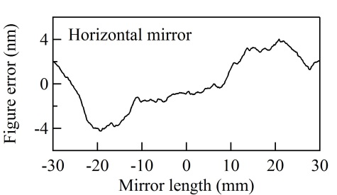
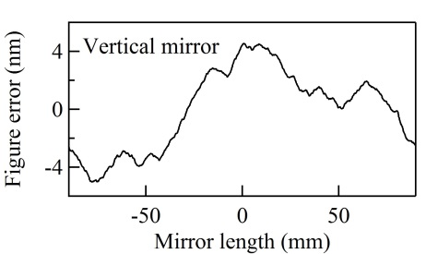
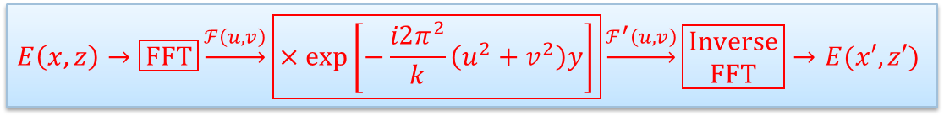
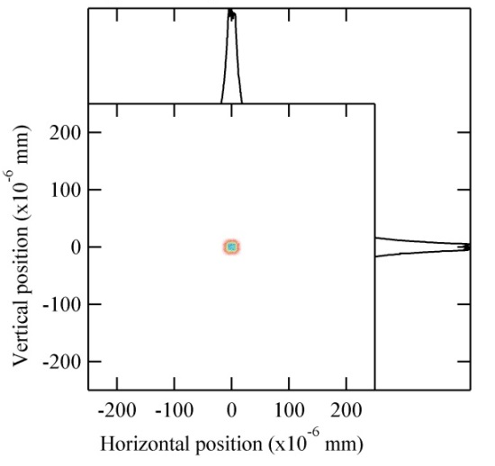
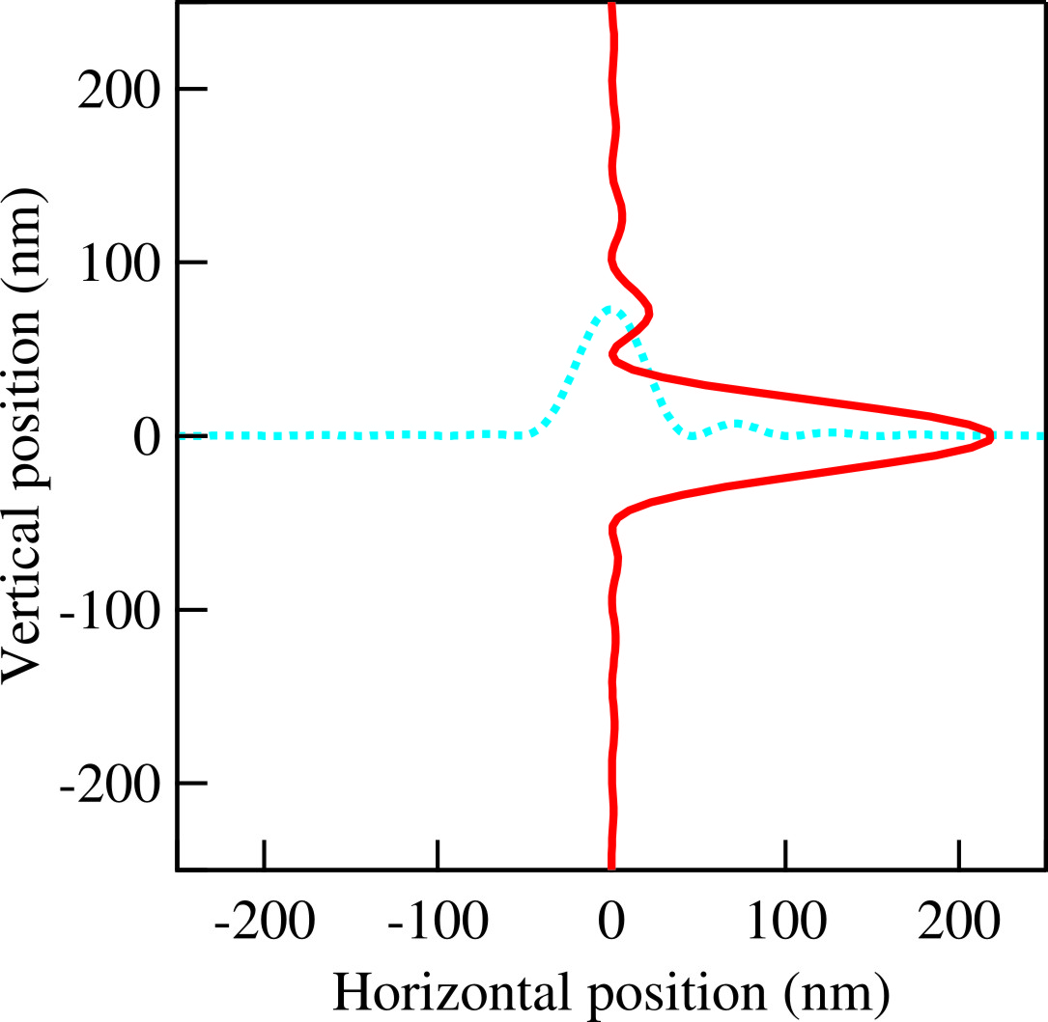
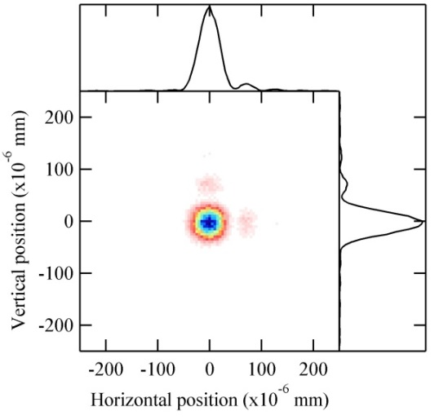


HYBRID METHOD IN SHADOW (X. Shi et al.) Combining ray tracing and wavefront propagation
Ideal lens with focal lengths of f_{x} and f_{z}
Ray tracing of the beamline

