Slide 1
HERCULES 2019 Simulating beamline optics by ray-tracing using ShadowOui
Manuel Sánchez del Río
AAM, ISDD, ESRF

Slide 2



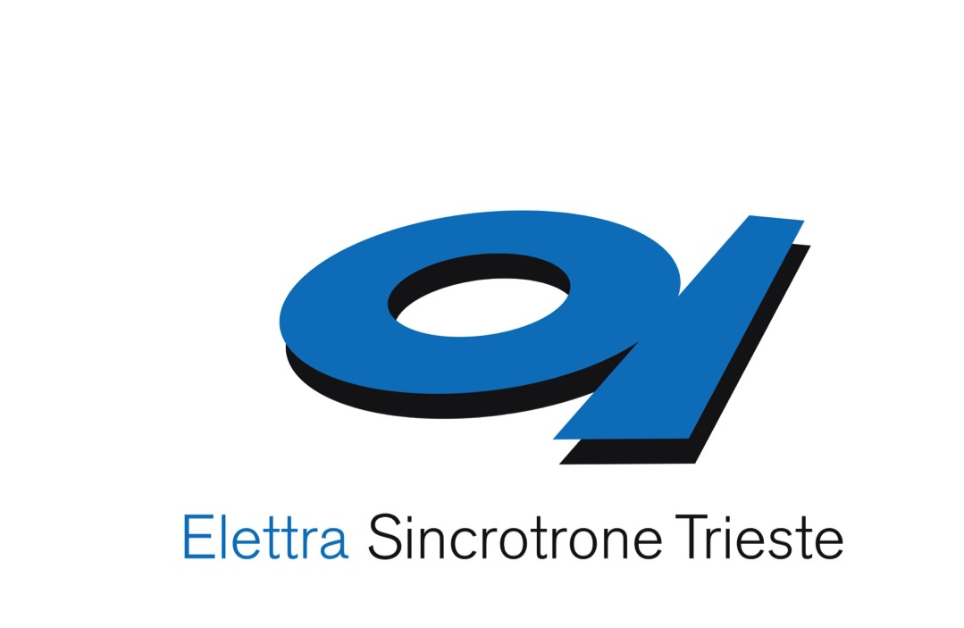
The OASYS Project
Manuel Sanchez del Rio
Luca Rebuffi
OASYS = OrAnge SYnchrotron Suite
A common platform to build synchrotron-oriented User Interfaces that communicate
The upper layer of the application presented to the user
Open Source & Python technology
Luca Rebuffi, Manuel Sanchez del Rio (2017)
OASYS (OrAnge SYnchrotron Suite) : an open-source graphical environment for x-ray virtual experiments
Proc.SPIE 10388: 10388-10388. http://dx.doi.org/10.1117/12.2274263
https://www.elettra.eu/oasys.html
Notes:
Slide 3 – (..) : Content of the presentation
Insert a new slide: Home > “New Slide” and choose a slide Layout:
For Title & Subtitle
For text with bullet points
For Text
For Picture, graphs, visuals
Two columns
Blank
If you want Copy & paste an element from the Clip Board to the particular slide: 1. Click on a box to mark it.
2. Position the mouse pointer on the box frame: Copy! 3. Click on the particular slide: Paste!
How you intend to use the elements is your choice. You can combine the text block style with the background colour in different manner.

Slide 3
Synchrotron Virtual Experiments
Beamline Experiment Chain
Storage Ring
(e⁻ optics)
Radiation devices
(e⁻ -> γ)
Beamline
(γ optics)
Sample
(γ −matter interactions)
Shadow
XOP
crystal
X-ray server
WISE
WOFRY
COMSYL

Slide 4
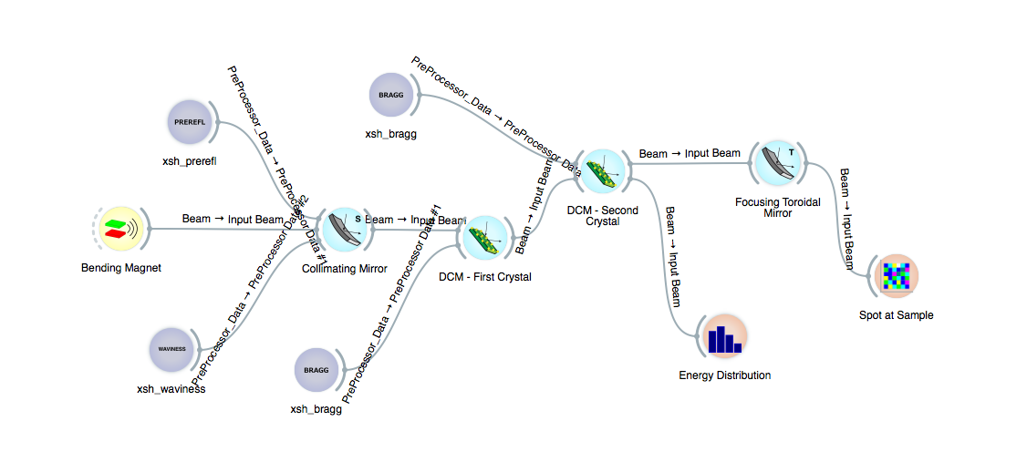
OASYS powered by ORANGE
ORANGE infrastructure, engine and concept quite naturally adapts to describe a synchrotron radiation experiment, and in particular a radiation transport simulation!
Notes:
Slide 3 – (..) : Content of the presentation
Insert a new slide: Home > “New Slide” and choose a slide Layout:
For Title & Subtitle
For text with bullet points
For Text
For Picture, graphs, visuals
Two columns
Blank
If you want Copy & paste an element from the Clip Board to the particular slide: 1. Click on a box to mark it.
2. Position the mouse pointer on the box frame: Copy! 3. Click on the particular slide: Paste!
How you intend to use the elements is your choice. You can combine the text block style with the background colour in different manner.

Slide 5
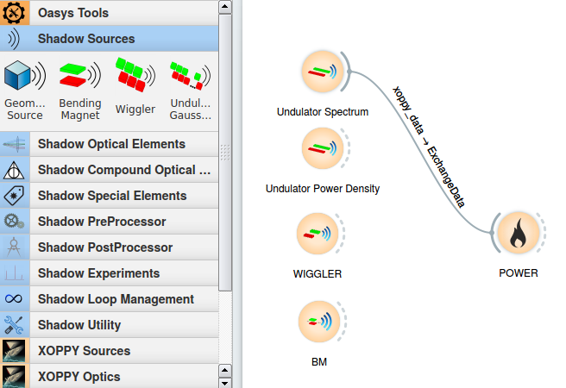
Source emission (XOPPY)
Undulator spectrum – power
Undulator power density
Wiggler spectrum
BM

Slide 6
Computer simulation of light sources and optical components is a mandatory step in the design and optimization of synchrotron and FEL radiation beamlines
different codes for numerical simulations are available, implementing different physical approaches
RAY-TRACING
WAVEFRONT
PROPAGATION
Shadow
RAY
SRW
PHASE
XRT
McXtrace
WISE
Notes:
Slide 3 – (..) : Content of the presentation
Insert a new slide: Home > “New Slide” and choose a slide Layout:
For Title & Subtitle
For text with bullet points
For Text
For Picture, graphs, visuals
Two columns
Blank
If you want Copy & paste an element from the Clip Board to the particular slide: 1. Click on a box to mark it.
2. Position the mouse pointer on the box frame: Copy! 3. Click on the particular slide: Paste!
How you intend to use the elements is your choice. You can combine the text block style with the background colour in different manner.

Slide 7
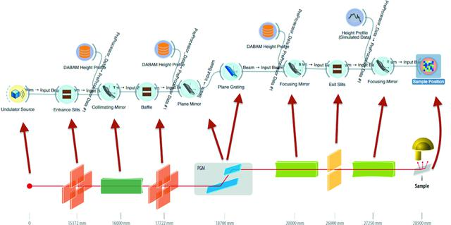
Beamline Optics – Ray tracing ShadowOUI
Luca Rebuffi, Manuel Sánchez del Río (2016) ShadowOui : a new visual environment for X-ray optics and synchrotron beamline simulations Journal of Synchrotron Radiation 23: 6. 1357-1367 Nov. http://dx.doi.org/10.1107/S1600577516013837
Xianbo Shi, Ruben Reininger, Manuel Sanchez del Rio, Lahsen Assoufid (2014) A hybrid method for X-ray optics simulation : combining geometric ray-tracing and wavefront propagation Journal of Synchrotron Radiation 21: 4. 669-678 http://dx.doi.org/10.1117/12.2061950

Slide 8
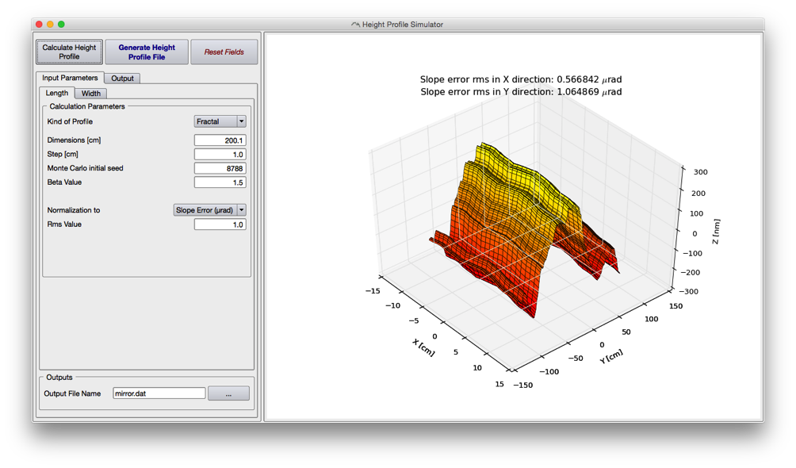
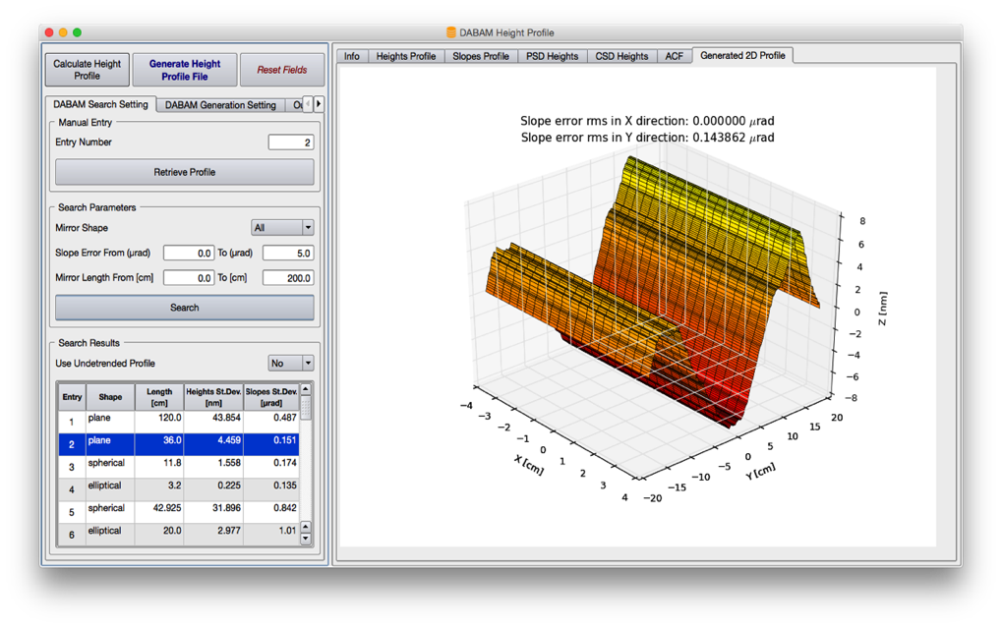
Advanced Simulation Tools: Height Profile Generators
ShadowOui contains more evolved tools for simulating the surface error profile to be added to the optical element surface:
Height Profile Simulator
DABAM Height Profile
M. Sanchez del Rio, D. Bianchi, D. Cocco, M. Glass, M. Idir, J. Metz, L. Raimondi, L. Rebuffi, R. Reininger, X. Shi, F. Siewert, S. Spielmann-Jaeggi, P. Takacs, M. Tomasset, T. Tonnessen, A. Vivo and V. Yashchuk, J. Synchrotron Rad. (2016) 23, 665-678,
doi:10.1107/S1600577516005014
Notes:
Slide 3 – (..) : Content of the presentation
Insert a new slide: Home > “New Slide” and choose a slide Layout:
For Title & Subtitle
For text with bullet points
For Text
For Picture, graphs, visuals
Two columns
Blank
If you want Copy & paste an element from the Clip Board to the particular slide: 1. Click on a box to mark it.
2. Position the mouse pointer on the box frame: Copy! 3. Click on the particular slide: Paste!
How you intend to use the elements is your choice. You can combine the text block style with the background colour in different manner.

Slide 9
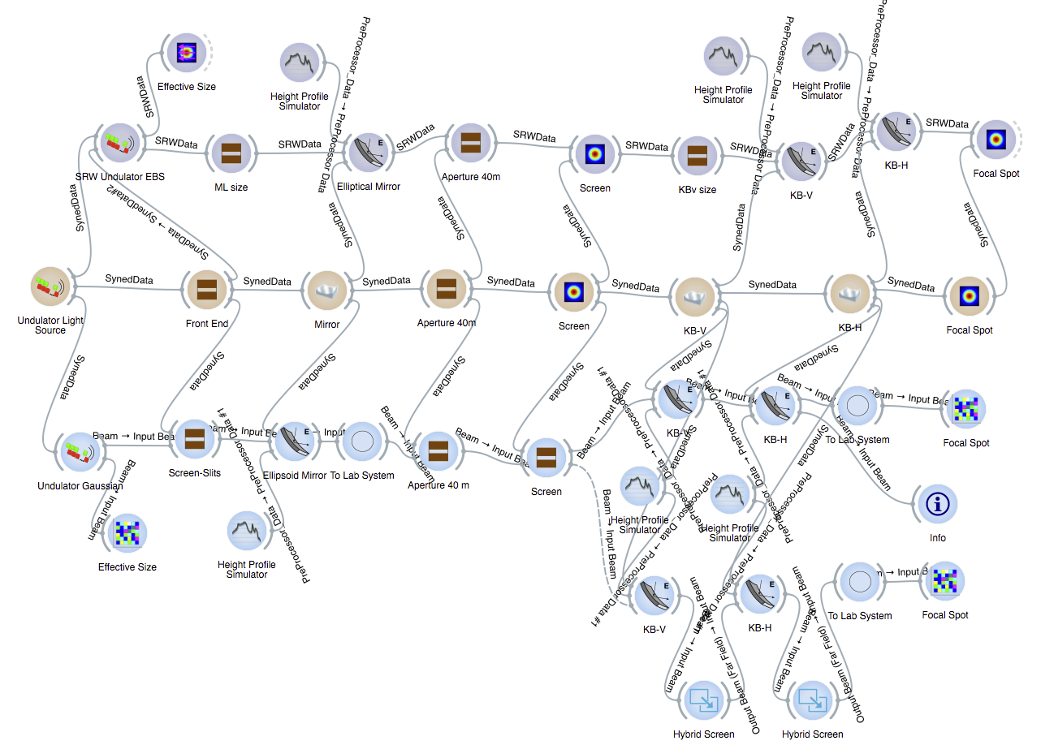
Hard X-ray Nano-focusing Beamline @ Low Emittance Storage Ring
INTEROPERABILITY!!!!
Luca Rebuffi, Manuel Sanchez del Rio (2017)
Interoperability and complementarity of simulation tools for beamline design in the OASYS environment
Proc.SPIE 10388: 10388-10388 http://dx.doi.org/10.1117/12.2274232

Slide 10
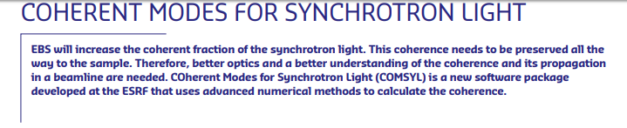
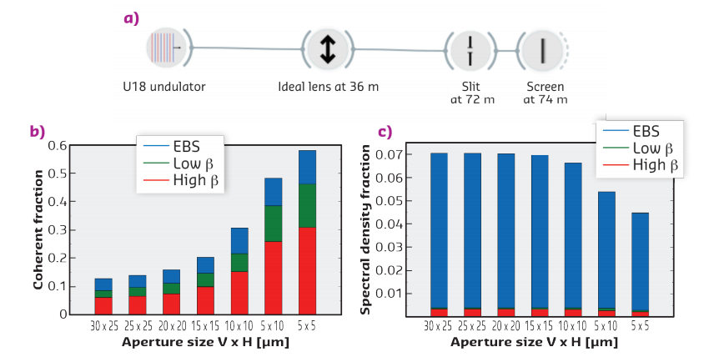
COMSYL
ESRF Highlights (in press)
Mark Glass, Manuel Sanchez del Rio (2017)
Coherent modes of X-ray beams emitted by undulators in new storage rings EPL (Europhysics Letters) 119: 3.
http://stacks.iop.org/0295-5075/119/i=3/a=34004

Slide 11
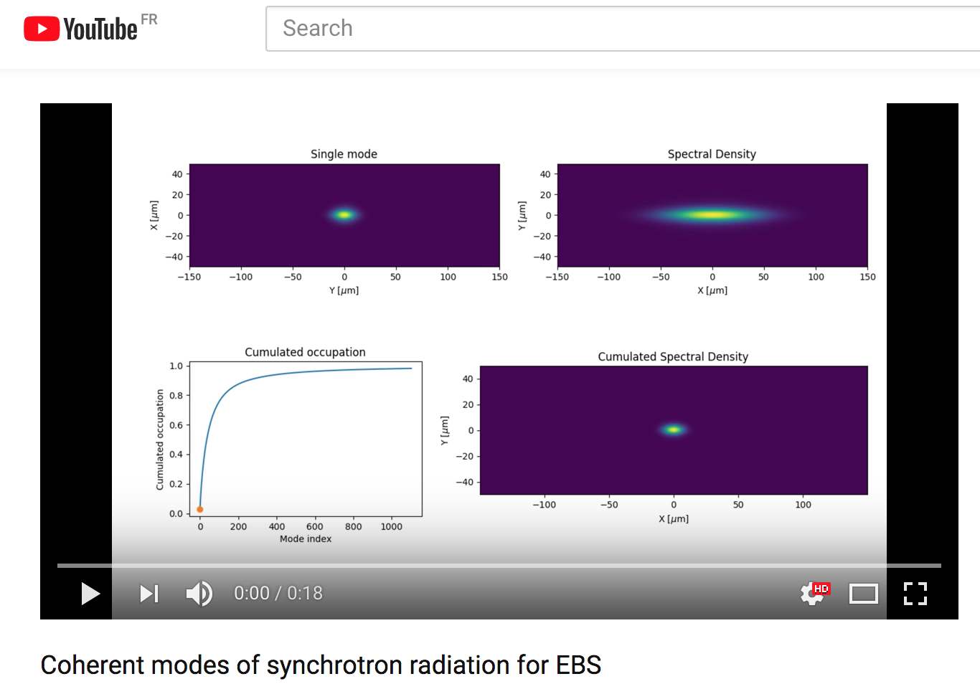
COMSYL EBS SOURCE U18 17 keV (CF 0.028)
https://youtu.be/h24RrJZaQ80

Slide 12
Outline
Software
Sources (BM, wigglers and undulators)
Optics
Reflective (aberrations, slope errors)
Diffractive (dispersion)
Refractive (chromatic aberrations)
Coherence

Slide 13
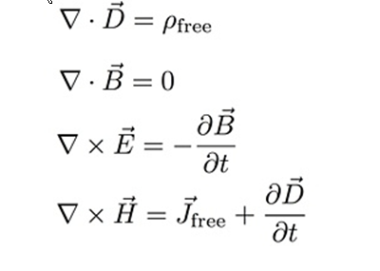
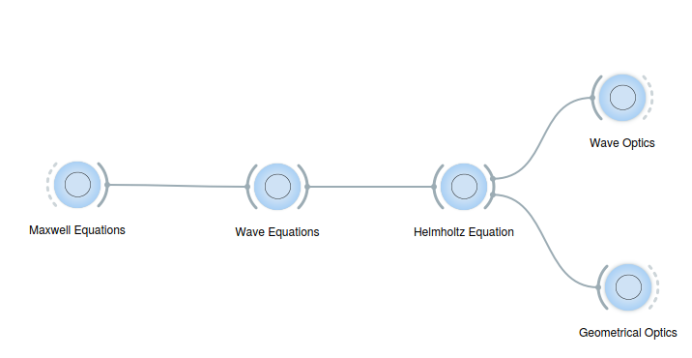
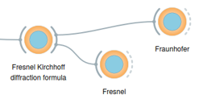


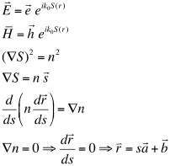
Each wavefront is a solution of the Helmholz equation, and it is fully coherent.
Partial coherence require working with many wavefronts. Each individual wavefront is coherent, but incoherent with respect to others
SRW
Each ray is a solution of the Helmholz equation.
Many rays represent an incoherent beam. Each individual ray is coherent, but incoherent with respect to others
SHADOW

Slide 14
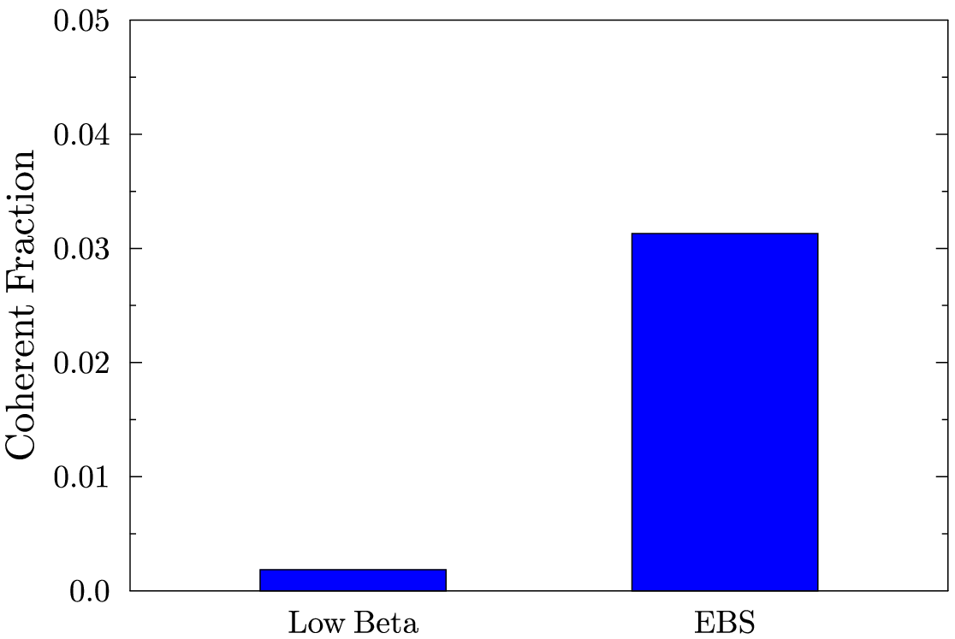
At HIGH ENERGIES, WE ARE FAR FROM DIFFRACTION-LIMIT (=FULLY COHERENCE) U17 2m @ 17 keV (K=0.4842) L=2m Coherent Fraction THEREFORE, ANY BEAMLINE SIMULATION MUST START WITH RAY TRACING (INCOHERENT BEAMS)
3.13 %
0.18 %

Slide 15
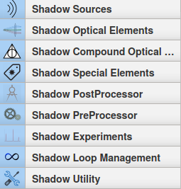

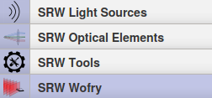
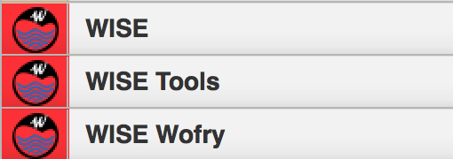
CONTEXT: OASYS TOOLBOX TO SIMULATE VIRTUAL EXPERIMETS
Beamline Experiment Chain
Storage Ring
(e⁻ optics)
Radiation devices
(e⁻ -> γ)
Beamline
(γ optics)
Sample
(γ −matter interactions)
NEW OASYS-BASED TOOLBOX
ShadowOui
XOPPY
SRW
WOFRY
X-rayserver
wise
http://www.elettra.eu/oasys.html

Slide 16
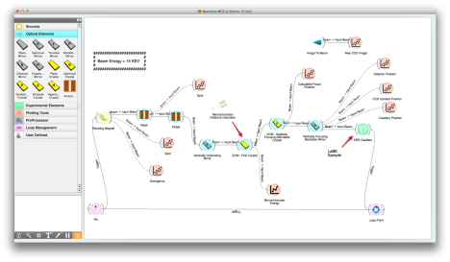
OASYS: A NEW PLATFORM FOR BEAMLINE SIMULATIONS
Oasys is a new software platform for simulating virtual experiments in the synchrotron radiation world
Oasys is the result of a collaboration among ESRF, Elettra and University of Ljubljana.
It integrates different state-of-the-art simulation packages for beamline simulation and X-ray optics.

Slide 17
Oasys+ShadowOui
Install Oasys+ShadowOui:
https://github.com/oasys-kit/oasys-installation-scripts/wiki
Today: Use rnice.
Download Tutorials:
export all_proxy=http://proxy.esrf.fr:3128/
git clone https://github.com/srio/ShadowOui-Tutorial
Start OASYS:
oarsub –I –l nodes=1/cpu=1/core=8,walltime=10:00:00
/scisoft/XRayOptics/OASYS1_RNICE8/start_oasys.sh

Slide 18
Trace (the beamline)
z
Energy, Intensity
y
x
z
z
p
q
x
y
x

Slide 19
X-ray sources
X-ray tubes
Radioactive sources / Excitation by radioactive decay
Synchrotron Bending Magnets
Synchrotron insertion devices (wigglers and undulators)
X-ray lasers
Others: Inverse Compton, Channeling
Pulsars/Quasars/Black holes etc.
ShadowOui has tools to simulate synchrotron sources. In addition a “Geometrical Source” can be used to approximate any source.

Slide 20

Compute e⁻ beam sizes
With ε the emittance (constant), and Twiss parameters:
At s (any point of the trajectory):
At waist (zero correlation, ρ=α=0, β is minimum):
ShadowOui asks for σ and ε at waist (plus distance from waist to center of device)

Slide 21
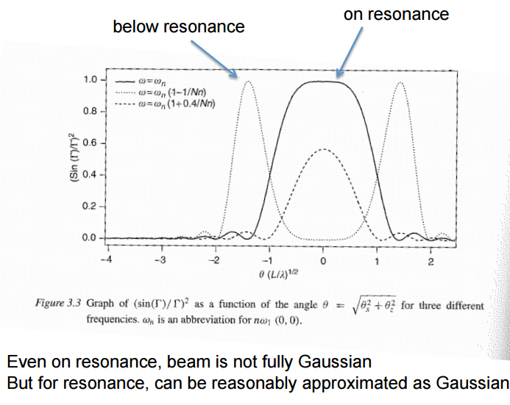
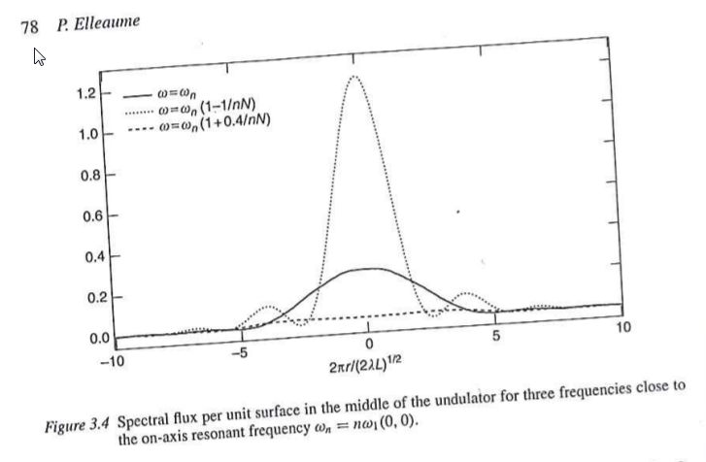
Onuki & Elleaume Undulators, Wigglers and their applications, CRC press, 2002
ex13_insertiondevices.ows
Undulator beams have not Gaussian profiles (even at resonances)
BY NOW, WE APPROXIMATE UNDULATORS BY GEOMETRIC SOURCES WITH GAUSSIAN SIZES AND DIVERGENCES

Slide 22
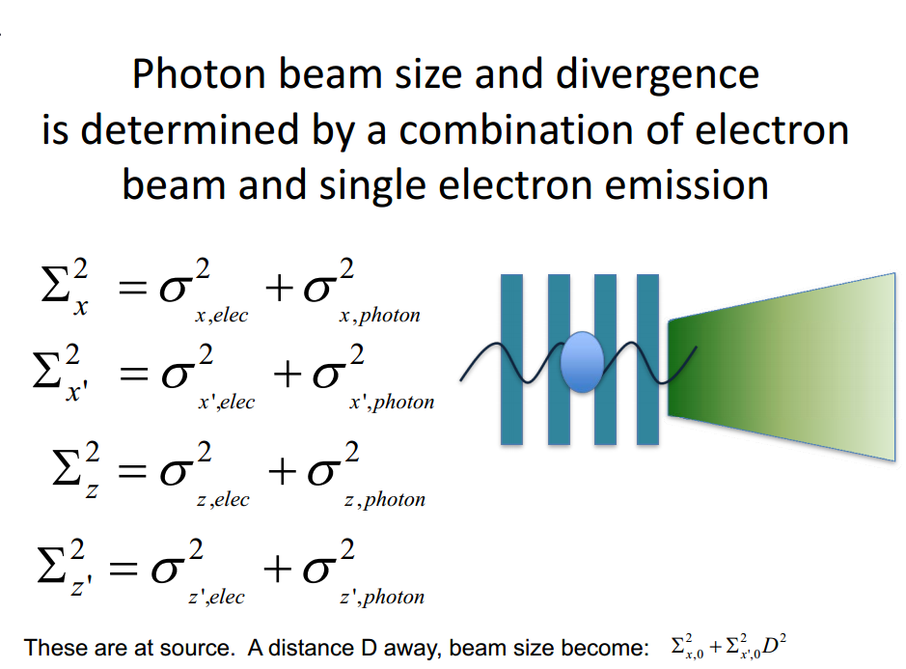
Courtesy: Boaz Nash
(FOR UNDULATORS, THESE FORMULAS ARE VALID AT THE WAIST, AT THE UNDULATOR RESONANCE, AND SUPOSSING GAUSSIAN EMISSION OF PHOTONS)
ShadowOui performs “numeric convolution” by Monte Carlo sampling of the electron beam [Gaussian] and photon emission [non Gaussian]

Slide 23
Source characteristics (XOPPY)
Undulator spectrum – power
Undulator power density
Wiggler spectrum
BM

Slide 24
Optical elements
For each optics element SHADOW includes:
Geometrical model: how the direction of the rays are changed (reflected, refracted or diffracted)
Physical model: how the ray intensity (in fact electric fields) decreases because of the interaction
Structures along the surface =>playing with the direction
Structures in depth => playing with the reflectivity

Slide 25
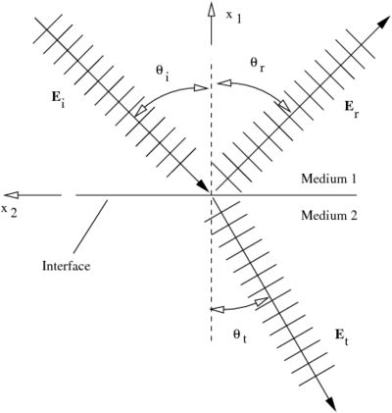
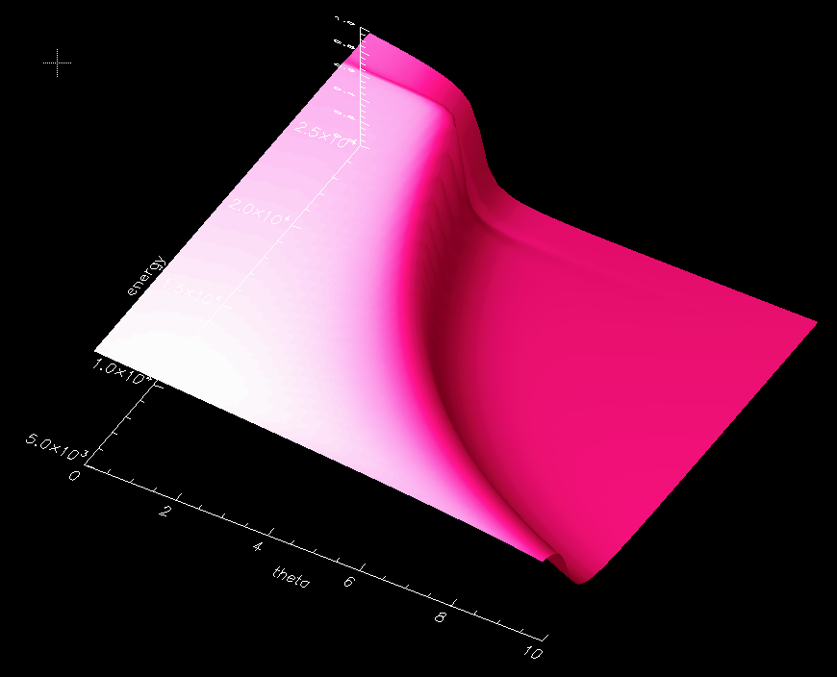

Mirrors Geometrical model Physical model
ex15_aberration.ows
Fresnel equations give the reflectivity as a function of angle and photon energy. As a consequence, one gets the critical angle:

Slide 26
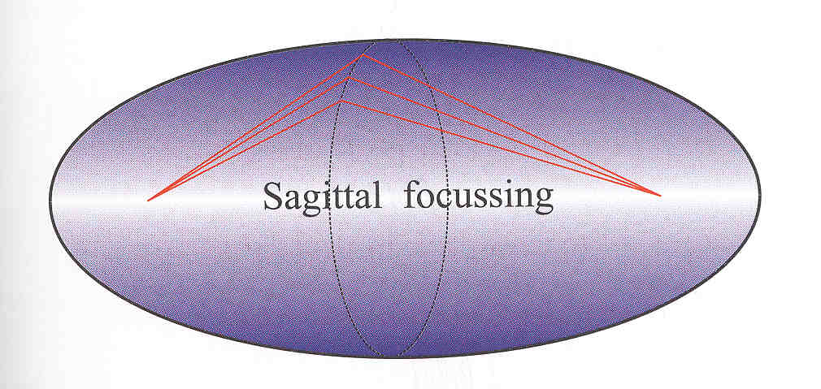
Mirror shape
ex15_aberration.ows
Point to point focusing (ellipsoid)
Collimating (paraboloid)
Focalization in two planes
Tangential or Meridional (ellipse or parabola)
Sagittal (circle)
Demagnification: M=p/q
Easier manufactiring:
2D: Ellipsoid => Toroid
Only one plane: cylinder Ellipsoid (ellipse)=> cylinder (circle)
Sagittal radius: non-linear (ellipsoid) => constant (cylinder) or linear (cone),
Aberrations
p
q
ρ
ρ

Slide 27
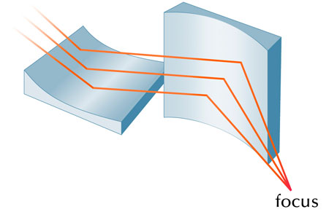
Kirkpatrick-Baez
ex16_kb.ows

Slide 28
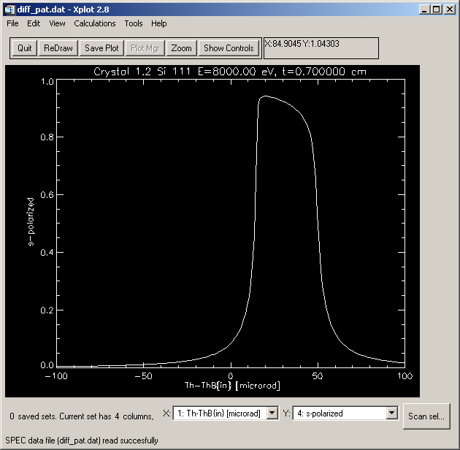
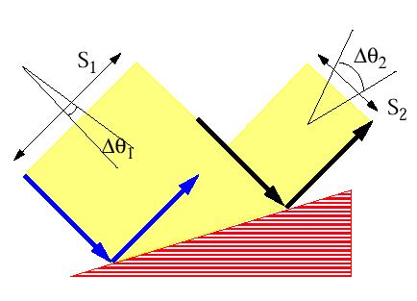
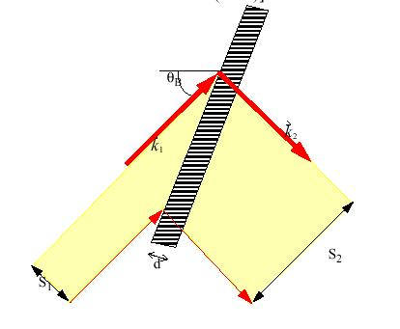
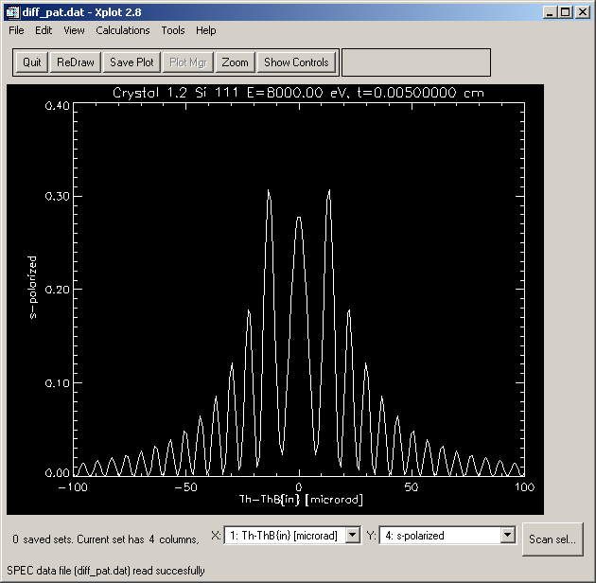
Crystals
Geometrical model
like a grating originated by the truncation of the Bragg planes with the crystal surface. Crystals are dispersive elements, except for the most used case of Bragg-Symmetric reflection.
Physical model
(crystal reflectivity) is given by the Dynamical Theory of Diffraction and gives the “Darwin width”
BRAGG or reflection
ex17_sagittalfocusing.ows
OTHER_EXAMPLES/crystal_analyzer_diced.ows
OTHER_EXAMPLES/crystal_asymmetric_backscattering.ows
LAUE or transmission
(ex23_crystal_laue.ows)

Slide 29
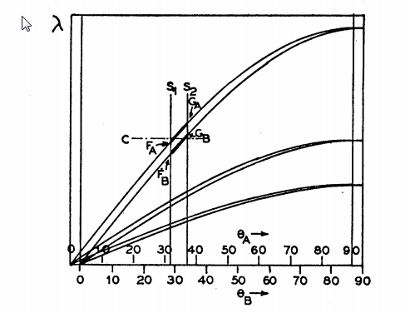
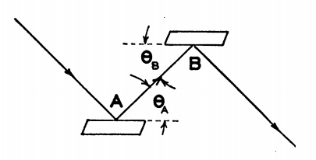
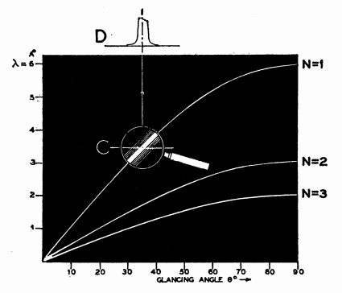
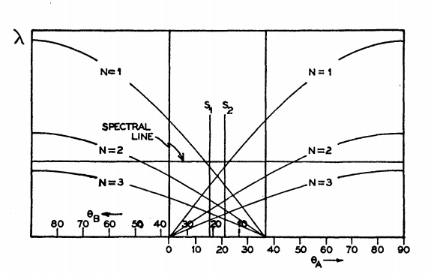
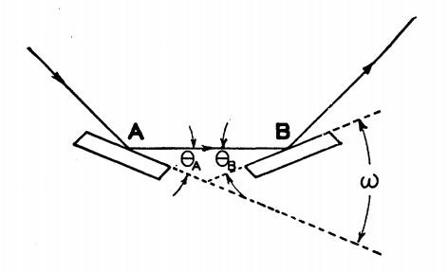
Theory of the Use of More Than Two Successive X-Ray Crystal Reflections to Obtain Increased Resolving Power J W. M. DuMond Phys. Rev. 52, 872 – (1937) http://dx.doi.org/10.1103/PhysRev.52.872
ex17_crystalmono.ows

Slide 30
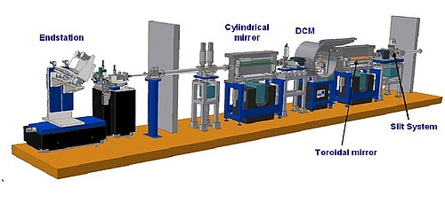
Other
ex19_beamline.ows

Slide 31

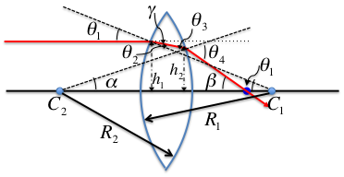
LENSE = TWO INTERFACES Geometrical model Physical model
absorption in media
I/I₀ = exp(-μ t)
(OTHER_EXAMPLES/lens_elliptical.ows)
OTHER_EXAMPLES/CRL_Snigirev_1996.ows
ex24_transfocator.ows
CRL = n identical Lenses
TRANSFOCATOR = m different CRLs

Slide 32
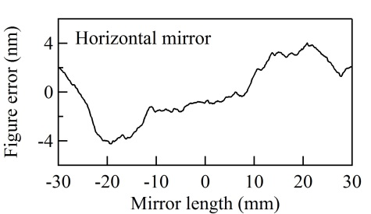
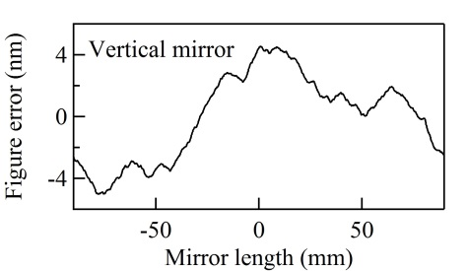
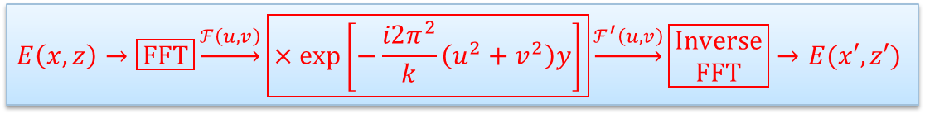
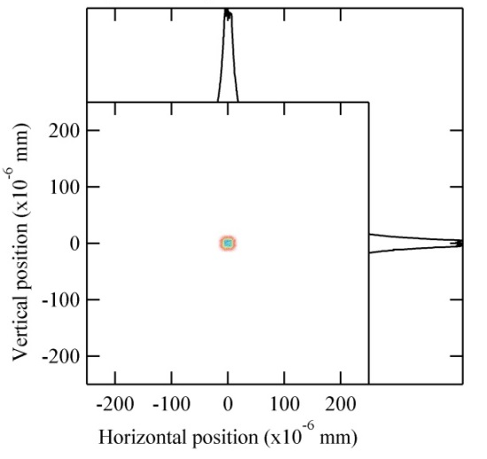
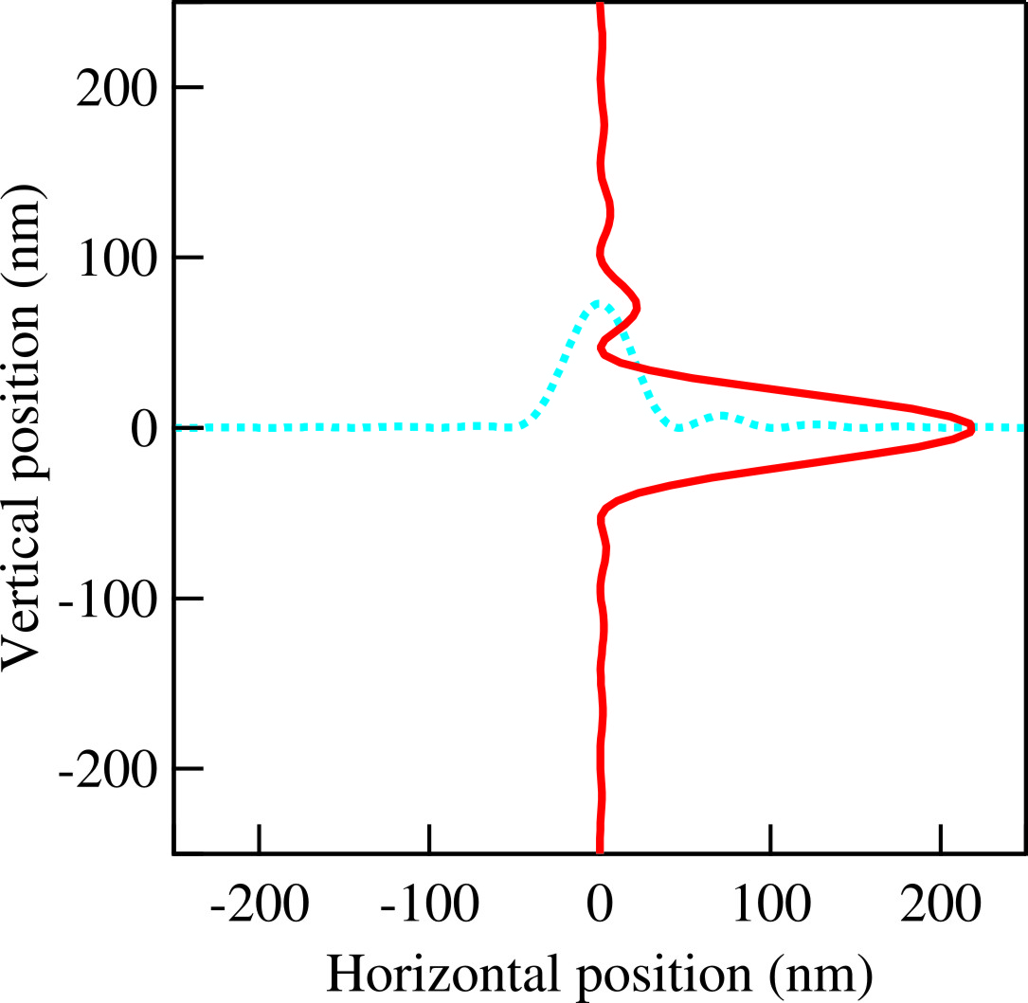
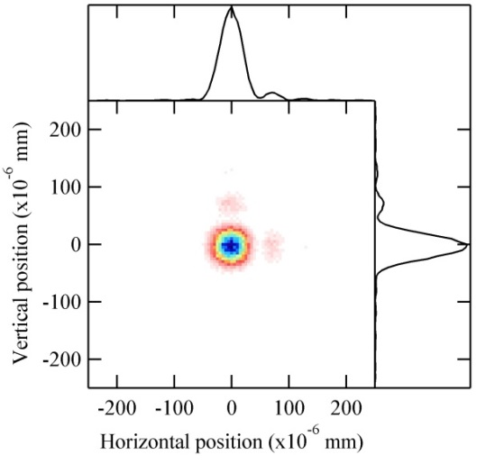


HYBRID METHOD IN SHADOW (X. Shi et al.) Combining ray tracing and wavefront propagation
Ideal lens with focal lengths of f_{x} and f_{z}
Ray tracing of the beamline

Slide 33
