Slide 1
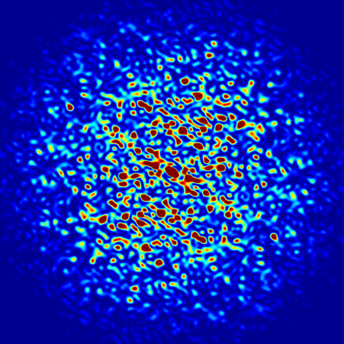
Introduction to SRW
Luca Rebuffi (ANL)
Second OASYS School
APS-ANL, Lemont, IL
December 11-13, 2019
Notes:
Univ of Chicago Review, Aug. 30, 2010
1
Good morning, my name is Luca Rebuffi and I am staff member of the X-Ray Optics Group at the APS of the Argonne National Laboratory

Slide 2
Outline
Introduction
Wavefront Propagators
Partial Coherence
Notes:
My presentation, after a brief introduction on WPPM method, will show you how this method has been ported into the graphical environment of the suite Orange, and then will show you a few example of the WONDER software in action

Slide 3
Introduction

Slide 4
Introduction
Notes:
Powder diffraction provides several information about a crystalline material: structural information like...

Slide 5
Propagation of a Wavefront in free space
Notes:
Powder diffraction provides several information about a crystalline material: structural information like...

Slide 6
WAVEFRONT PROPAGATORS

Slide 7
Standard Propagator
Notes:
Powder diffraction provides several information about a crystalline material: structural information like...

Slide 8
Quadratic Term/Quadratic Term Special Propagators
Notes:
Powder diffraction provides several information about a crystalline material: structural information like...

Slide 9
From Waist/To Waist Propagators
Notes:
Powder diffraction provides several information about a crystalline material: structural information like...

Slide 10
PARTIAL COHERENCE

Slide 11
SRW – Multi Electron
Notes:
Powder diffraction provides several information about a crystalline material: structural information like...

Slide 12
SRW – M.E.: Total Intensity
Notes:
Powder diffraction provides several information about a crystalline material: structural information like...

Slide 13
SRW – M.E.: Mutual Intensity
Notes:
Powder diffraction provides several information about a crystalline material: structural information like...

Slide 14
References
Official Repository
https://github.com/ochubar/SRW
Chubar, O. and Ellaume, P.: Accurate and efficient computation of synchrotron radiation in the near field region. Proceedings of the 6th European Particle Accelerator Conference - EPAC-98, pages 1177-1179
Chubar, O.: Wavefront calculations. Proc. SPIE, 4143:48-59 (2001)
Chubar, O., Berman, L., Chu, Y. S., Fluerasu, A., Hubert, S., Idir, M., Kaznatcheev, K., Shapiro, D. Shen, Q. and Baltser, J.: Development of partially-coherent wavefront propagation simulation methods for 3rd and 4th generation synchrotron radiation sources. Proc. SPIE, 8141:814107 (2011)
SRW Publications
Chubar, O.: Recent updates in the "Synchrotron Radiation Workshop" code, on-going developments, simulation activities, and plans for the future. Proc. SPIE, 9209:920907 (2014)
Chubar, O., Rakitin, M., Chen-Wiegart, Y.K., Chu, Y.S., Fluerasu, A., Hidas, D. and Wiegart, L.: Main functions, recent updates, and applications of Synchrotron Radiation Workshop code. Proc. SPIE, 10388:1038805 (2017)
Books
Paganin, D.: Coherent X-Ray Optics. Oxford Series on Synchrotron Radiation, 6. Oxford Science Publications (2006)
Notes:
Powder diffraction provides several information about a crystalline material: structural information like...

Slide 15
Thank you!

