Slide 1
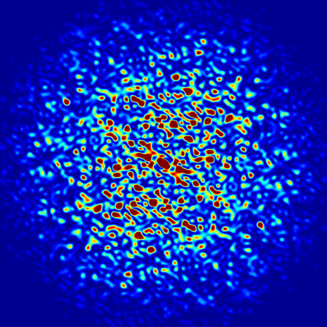
Introduction to OASYS
Luca Rebuffi (ANL)
Second OASYS School
APS-ANL, Lemont, IL
December 11-13, 2019
Notes:
Univ of Chicago Review, Aug. 30, 2010
1
Good morning, my name is Luca Rebuffi and I am staff member of the X-Ray Optics Group at the APS of the Argonne National Laboratory

Slide 2
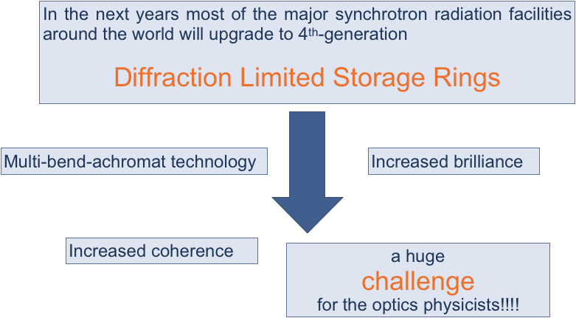
Introduction to OASYS
Notes:
My presentation, after a brief introduction on WPPM method, will show you how this method has been ported into the graphical environment of the suite Orange, and then will show you a few example of the WONDER software in action

Slide 3
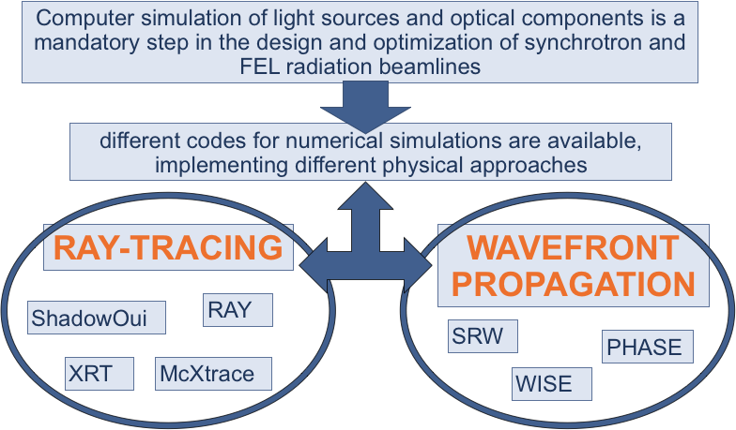
Introduction to OASYS
Notes:
My presentation, after a brief introduction on WPPM method, will show you how this method has been ported into the graphical environment of the suite Orange, and then will show you a few example of the WONDER software in action

Slide 4
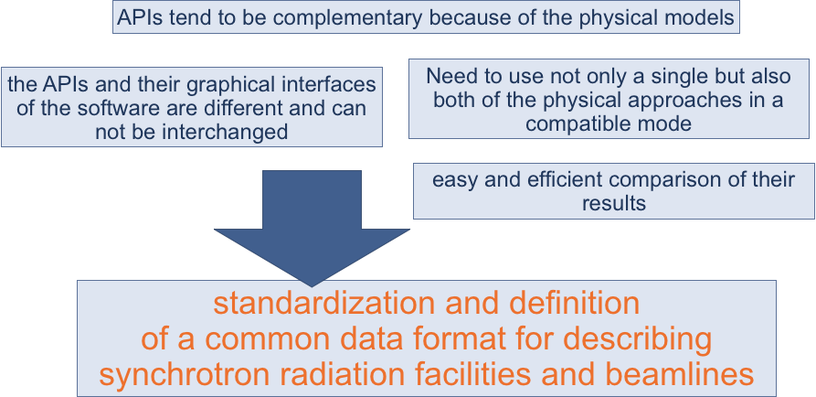
Introduction to OASYS
Notes:
My presentation, after a brief introduction on WPPM method, will show you how this method has been ported into the graphical environment of the suite Orange, and then will show you a few example of the WONDER software in action

Slide 5
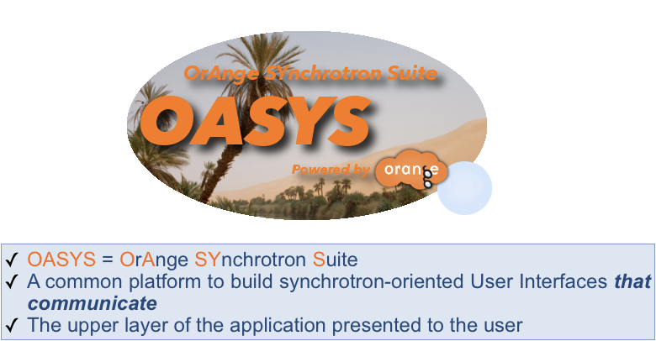
Introduction to OASYS
Notes:
My presentation, after a brief introduction on WPPM method, will show you how this method has been ported into the graphical environment of the suite Orange, and then will show you a few example of the WONDER software in action

Slide 6
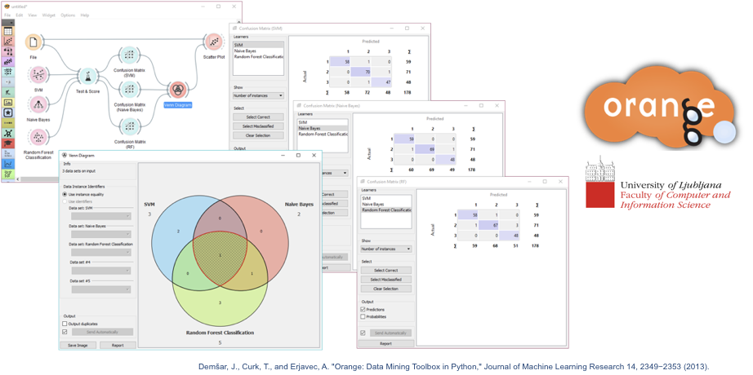
Introduction to OASYS
Notes:
My presentation, after a brief introduction on WPPM method, will show you how this method has been ported into the graphical environment of the suite Orange, and then will show you a few example of the WONDER software in action

Slide 7
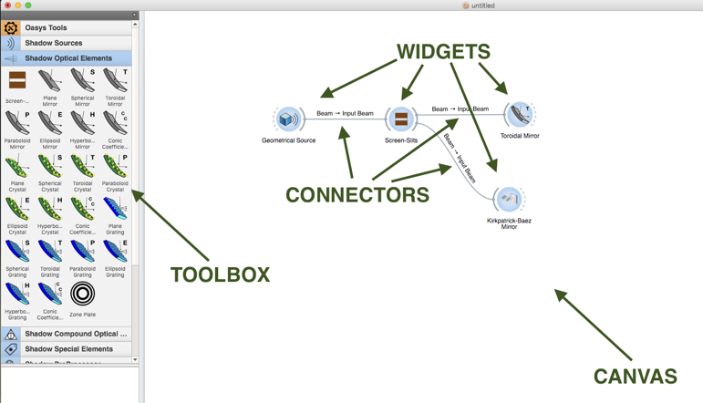
Introduction to OASYS
Notes:
My presentation, after a brief introduction on WPPM method, will show you how this method has been ported into the graphical environment of the suite Orange, and then will show you a few example of the WONDER software in action

Slide 8
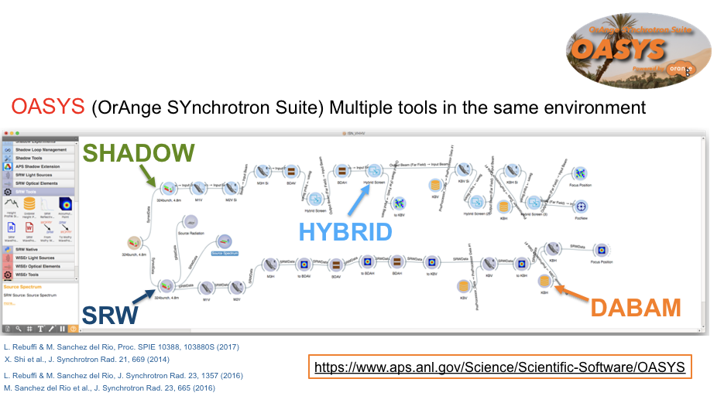
Introduction to OASYS
Notes:
My presentation, after a brief introduction on WPPM method, will show you how this method has been ported into the graphical environment of the suite Orange, and then will show you a few example of the WONDER software in action

Slide 9
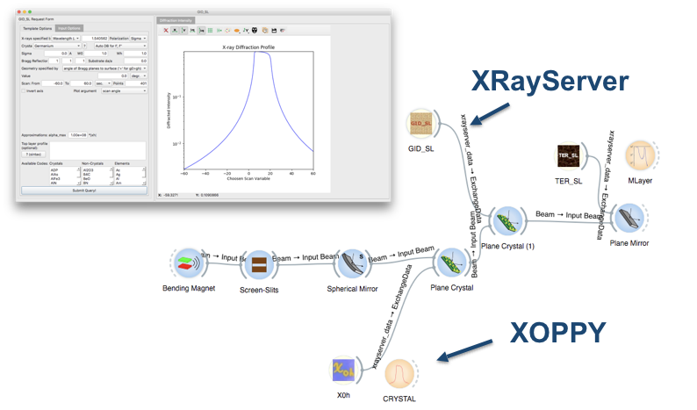
Introduction to OASYS
Notes:
My presentation, after a brief introduction on WPPM method, will show you how this method has been ported into the graphical environment of the suite Orange, and then will show you a few example of the WONDER software in action

Slide 10
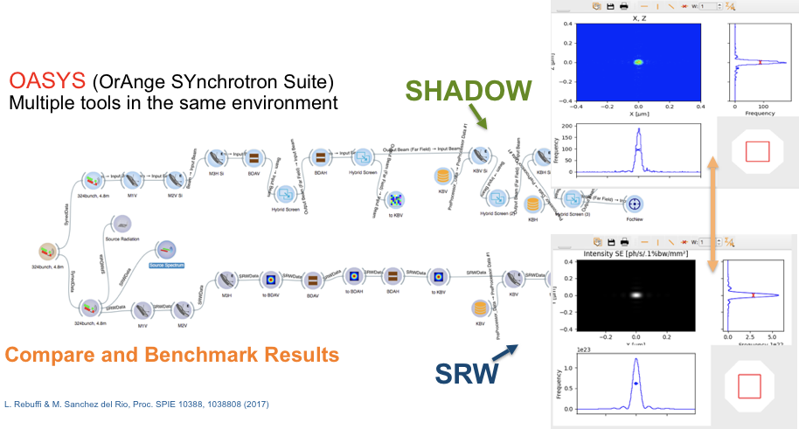
Introduction to OASYS
Notes:
My presentation, after a brief introduction on WPPM method, will show you how this method has been ported into the graphical environment of the suite Orange, and then will show you a few example of the WONDER software in action

Slide 11
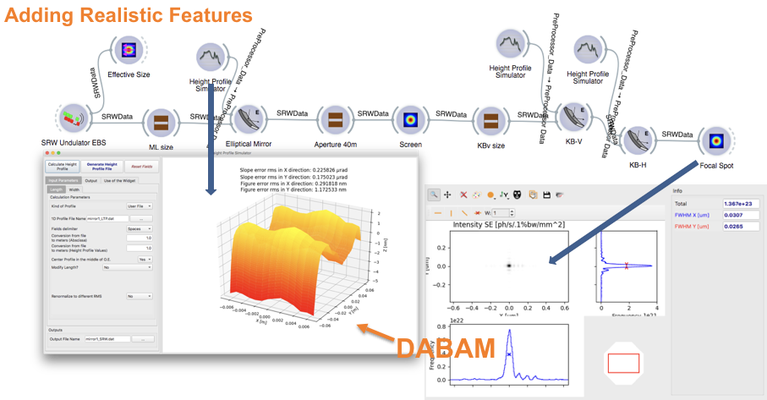
Introduction to OASYS
Notes:
My presentation, after a brief introduction on WPPM method, will show you how this method has been ported into the graphical environment of the suite Orange, and then will show you a few example of the WONDER software in action

Slide 12
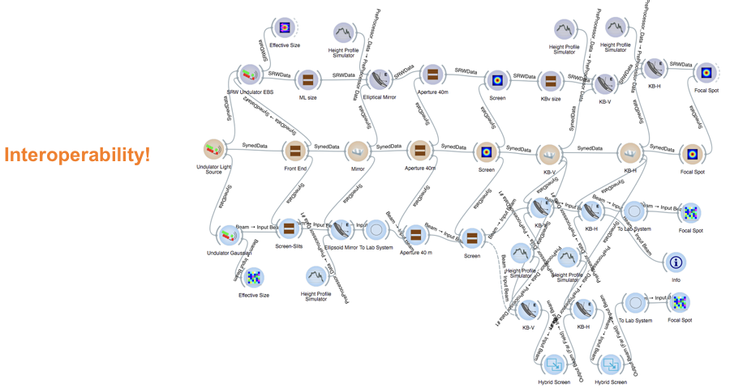
Introduction to OASYS
Notes:
My presentation, after a brief introduction on WPPM method, will show you how this method has been ported into the graphical environment of the suite Orange, and then will show you a few example of the WONDER software in action

Slide 13
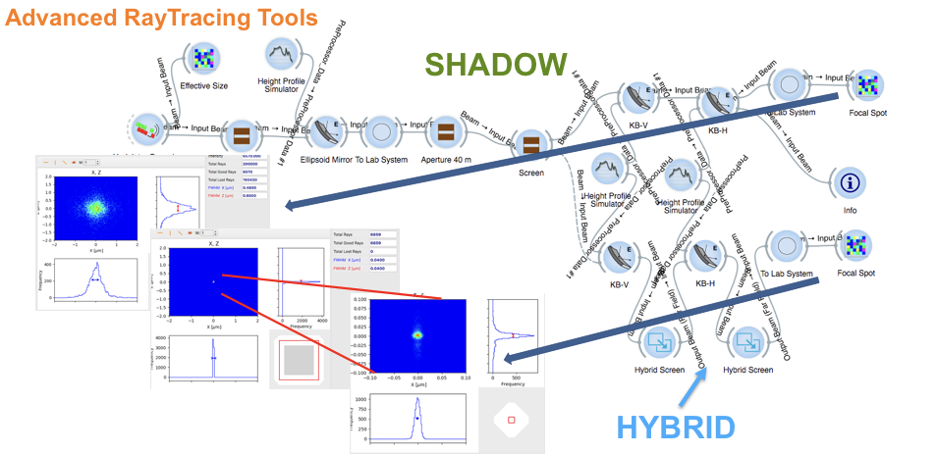
Introduction to OASYS
Notes:
My presentation, after a brief introduction on WPPM method, will show you how this method has been ported into the graphical environment of the suite Orange, and then will show you a few example of the WONDER software in action

Slide 14
References
Official Web Page
https://www.aps.anl.gov/Science/Scientific-Software/OASYS
M. Sanchez del Rio, L. Rebuffi, J. Demšar, N.Canestrari and O. Chubar, A proposal for an open source graphical environment for simulating X-ray optics, Proc. SPIE 9209, 92090X (2014)​
X. Shi, R. Reininger, M. Sanchez del Rio, L. Assoufid, A hybrid method for X-ray optics simulation: combining geometric ray-tracing and wavefront propagation, J. Synchrotron Rad. 21, 669 (2014)
X. Shi, R. Reininger, M. Sanchez del Rio, J. Qian, L. Assoufid, X-ray optics simulation and beamline design using a hybrid method: diffraction-limited focusing mirrors, Proc. SPIE, 9209, 920909 (2014)
OASYS Publications
M. Sanchez del Rio, D. Bianchi, D. Cocco, M. Glass, M. Idir, J. Metz, L. Raimondi, L. Rebuffi, R. Reininger, X. Shi, F. Siewert, S. Spielmann-Jaeggi, P. Takacs, M. Tomasset, T. Tonnessen, A. Vivo and V. Yashchuk, DABAM: an open-source database of X-ray mirrors metrology, J. Synchrotron Rad. 23 (2016).
L. Rebuffi, M. Sanchez del Rio, ShadowOui: A new visual environment for X-ray optics and synchrotron beamline simulations, J. Synchrotron Rad. 23 (2016)
L. Rebuffi, M. Sanchez del Rio, Interoperability and complementarity of simulation tools for beamline design in the OASYS environment, Proc. SPIE 10388, 1038808 (2017)​.​​​​​​
L. Rebuffi, M. Sanchez del Rio, OASYS (OrAnge SYnchrotron Suite): an open-source graphical environment for x-ray virtual xperiments, Proc. SPIE 10388, 103880S (2017)​​​​​.
Notes:
Powder diffraction provides several information about a crystalline material: structural information like...

Slide 15
Thank you!

