Slide 1
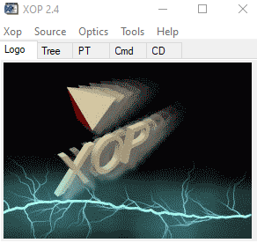
XOP – Overview
erhtjhtyhy
Roger Dejus
Control Account Manager for Insertion Devices for APS Upgrade
December 11, 2019
Argonne, IL

Slide 2
Outline
History and Scope
Overview
Examples
Current distribution (v2.4)
Summary

Slide 3
History and Scope
Developed during the early 1990s to suit local needs at the ESRF and the APS (efforts officially merged 1995; now 25 years in the making)
XOP v2.0: 1,000 CD-ROMs distributed (400 registered users)
Front-end graphical user interface (written in the Interactive Data Language IDL) for computer codes (of different origins and different languages) for the synchrotron radiation community
Modelling of x-ray sources
Characterization of optical elements (mirrors, filters, crystals, multilayers, etc.)
Multipurpose visualizations and data analyses
Optional plug-in of external software packages “extensions” expanding the functionality of XOP

Slide 4
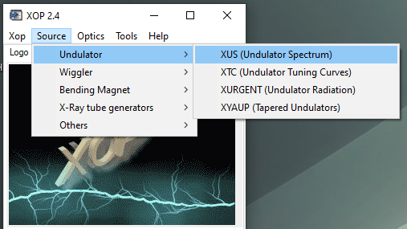
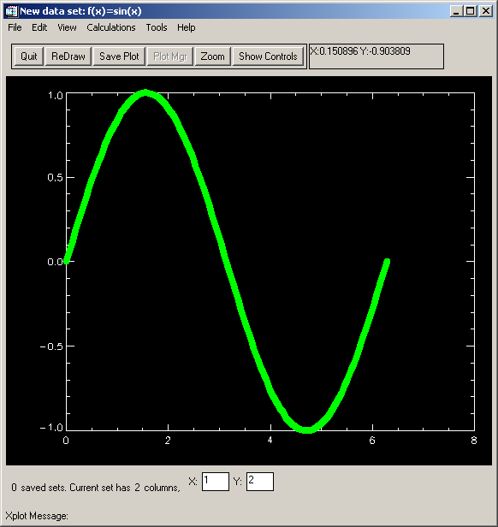
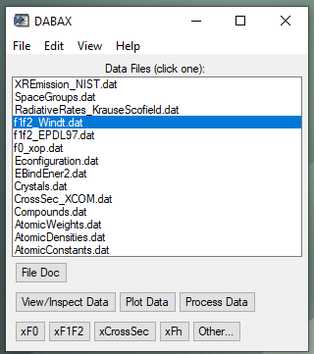
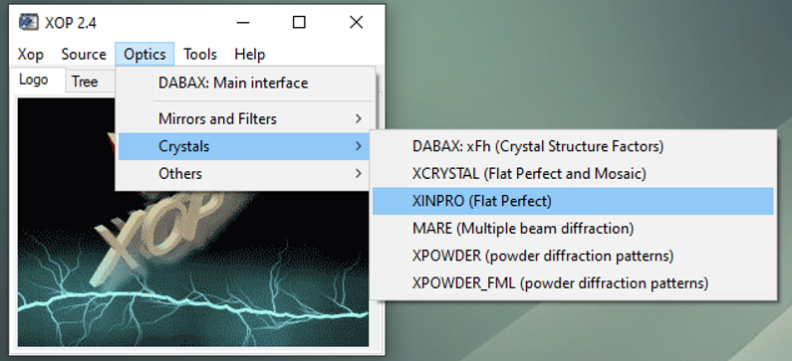
Overview
X-Ray Optics and Photon Atom Interactions
X-Ray Sources
XOP Extensions
General Purpose Tools and Documentation
SHADOWVUI
Interface to the SHADOW ray-tracing code
IMD
Multilayer software (Windt)
TOPO
Surface topography (Windt)
XPLOT

Slide 5
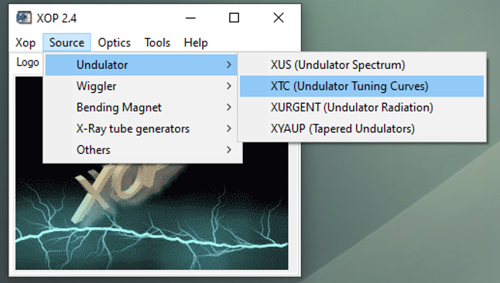
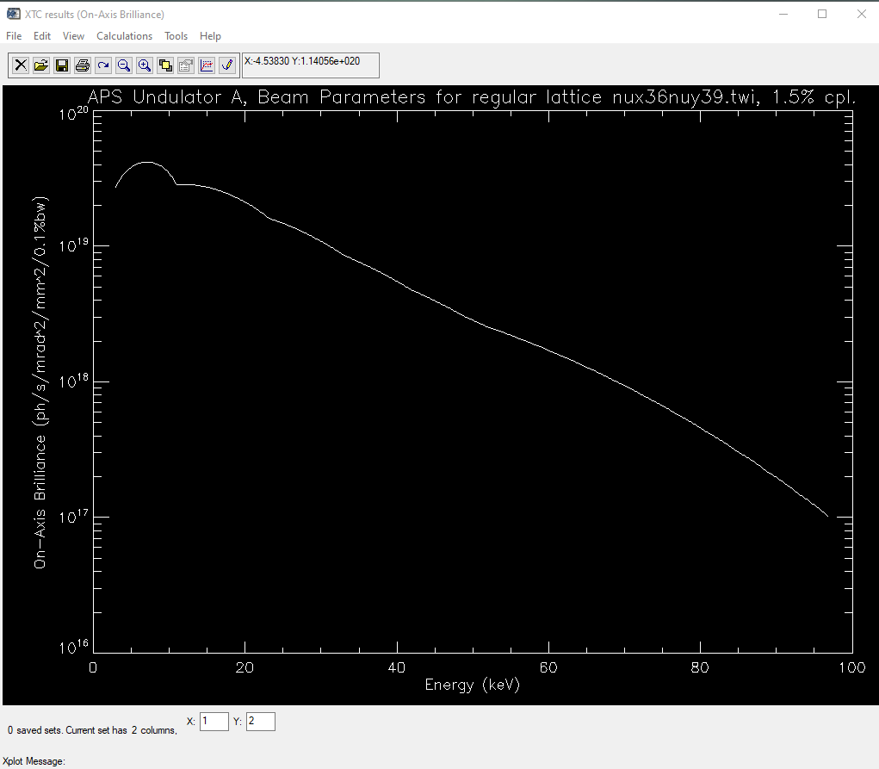
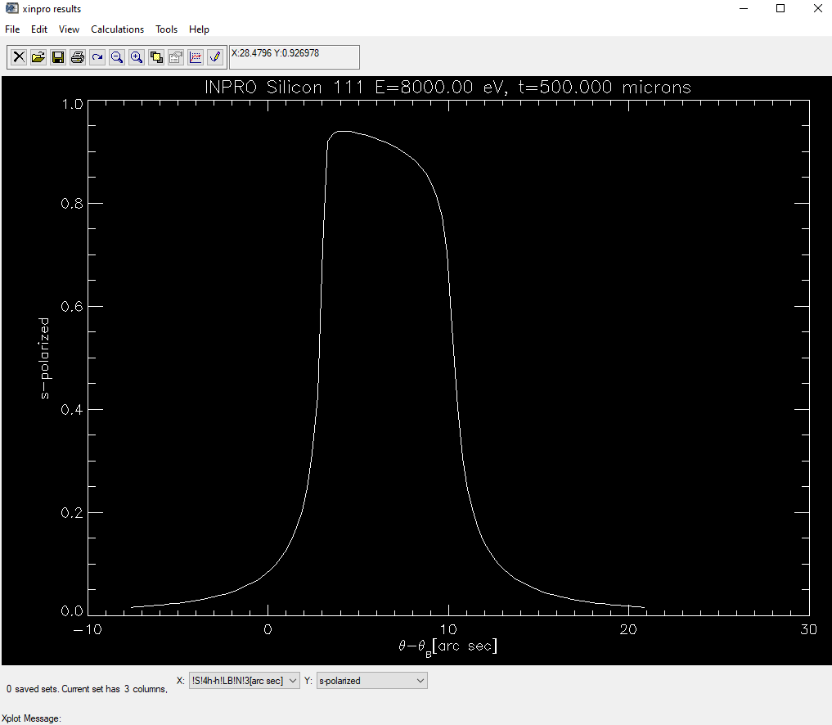
XOP Examples – XTC and XINPRO

Slide 6
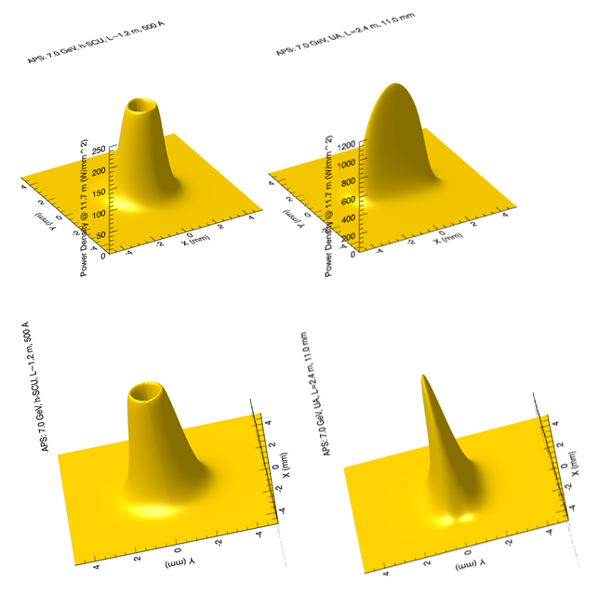
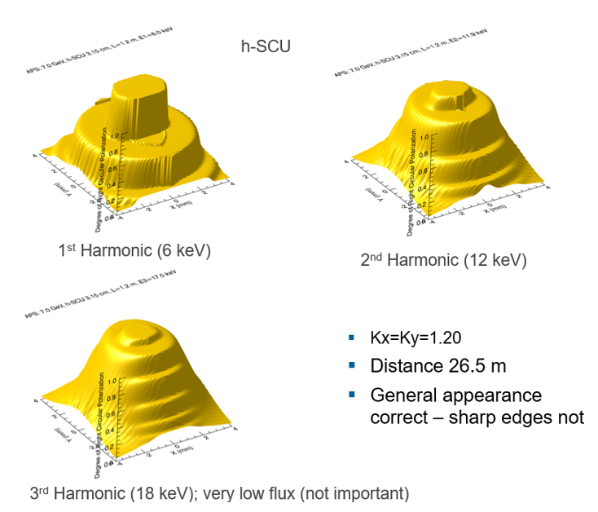
XOP Examples – XUS

Slide 7
Current XOP Distribution v2.4 (2014)
Used worldwide by synchrotron radiation facilities (and many others) and has been crucial for beamline designers and users for over a decade. The current version runs on Unix, Linux, Mac OS X, and Windows.
The graphical user interface and many modules of the code are written in IDL, which is subject to U.S. Export Control and is categorized under Export Control Classification Number (ECCN) 5D002 (as of IDL v8.0). As such, it can only be distributed to users who have completed and submitted an application that is approved by the Argonne’s Export Control process.
Licensed since April 2015 with 2,029 application requests to date (10% denied)
Embedded IDL license with IDL v8.3 good thru September 20, 2021 (no additional embedding requests planned)
Replaced by the OASYS software, which contains some of the functionalities (codes) in XOP but with enhancements and new codes for different applications

Slide 8
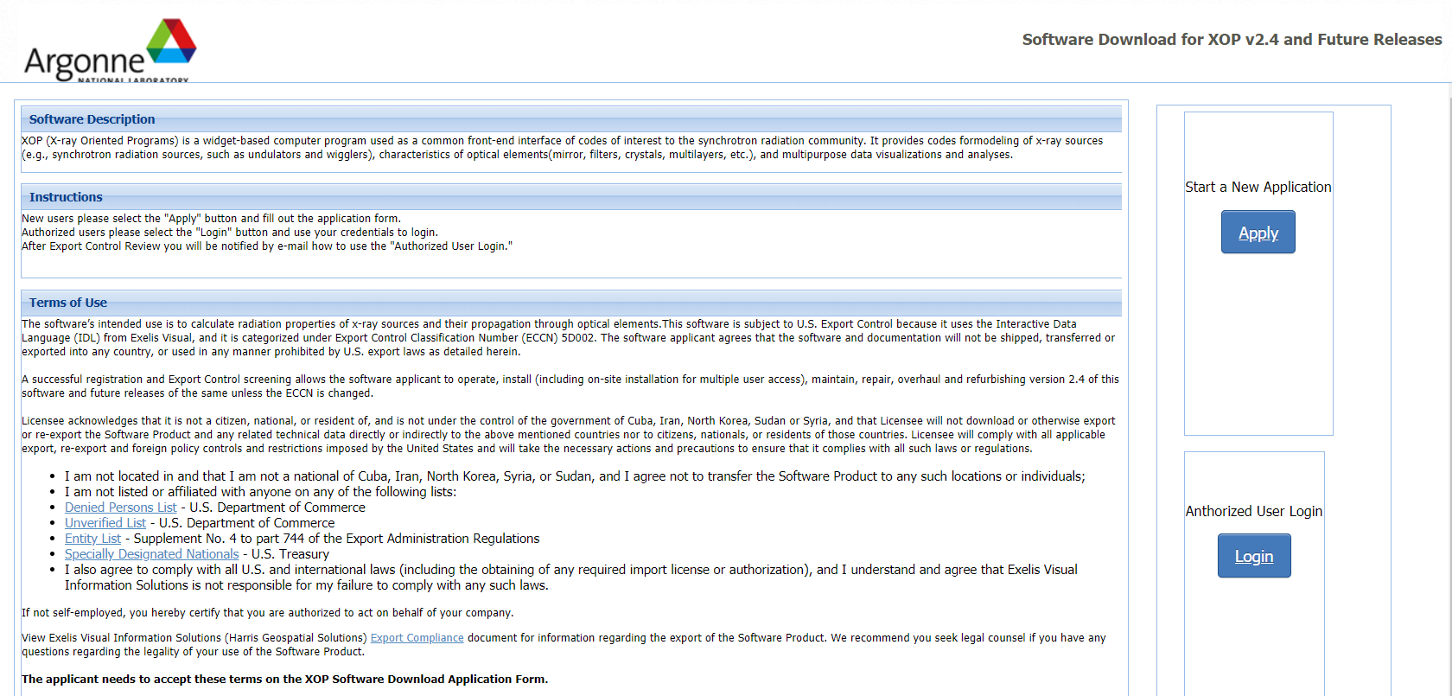
XOP Request for Downloads
https://beam.aps.anl.gov/apps/xop/

Slide 9
References
Manuel Sánchez del Río and Roger J. Dejus "XOP v2.4: recent developments of the x-ray optics software toolkit", Proc. SPIE 8141, Advances in Computational Methods for X-Ray Optics II, 814115 (23 September 2011); https://doi.org/10.1117/12.893911
https://www.aps.anl.gov/Science/Scientific-Software
https://beam.aps.anl.gov/apps/xop/
srio@esrf.fr or srio@lbl.gov
dejus@anl.gov

Slide 10
XOP Successful and appreciated 25 years
Download requests continues
Replaced by the new oasys software

Slide 11
Thank you!
Questions?

