Slide 1
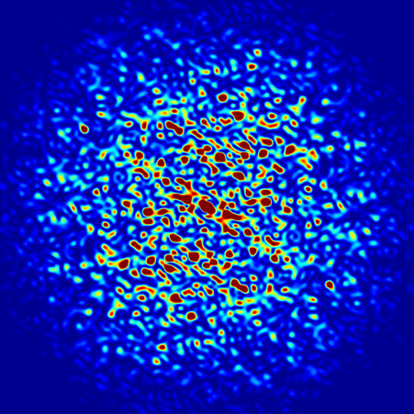
Introduction to SRW
Luca Rebuffi (ANL)
Second OASYS School
APS-ANL, Lemont, IL
December 11-13, 2019
Notes:
Univ of Chicago Review, Aug. 30, 2010
1
Good morning, my name is Luca Rebuffi and I am staff member of the X-Ray Optics Group at the APS of the Argonne National Laboratory

Slide 2
Outline
Introduction to Wavefront Propagation
SRW Propagators
Notes:
My presentation, after a brief introduction on WPPM method, will show you how this method has been ported into the graphical environment of the suite Orange, and then will show you a few example of the WONDER software in action

Slide 3
Introduction to wavefront propagation

Slide 4
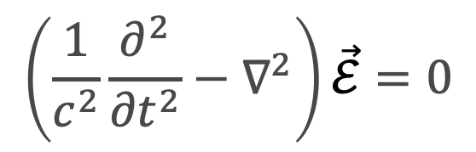
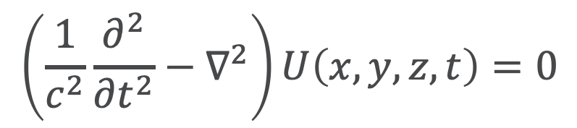
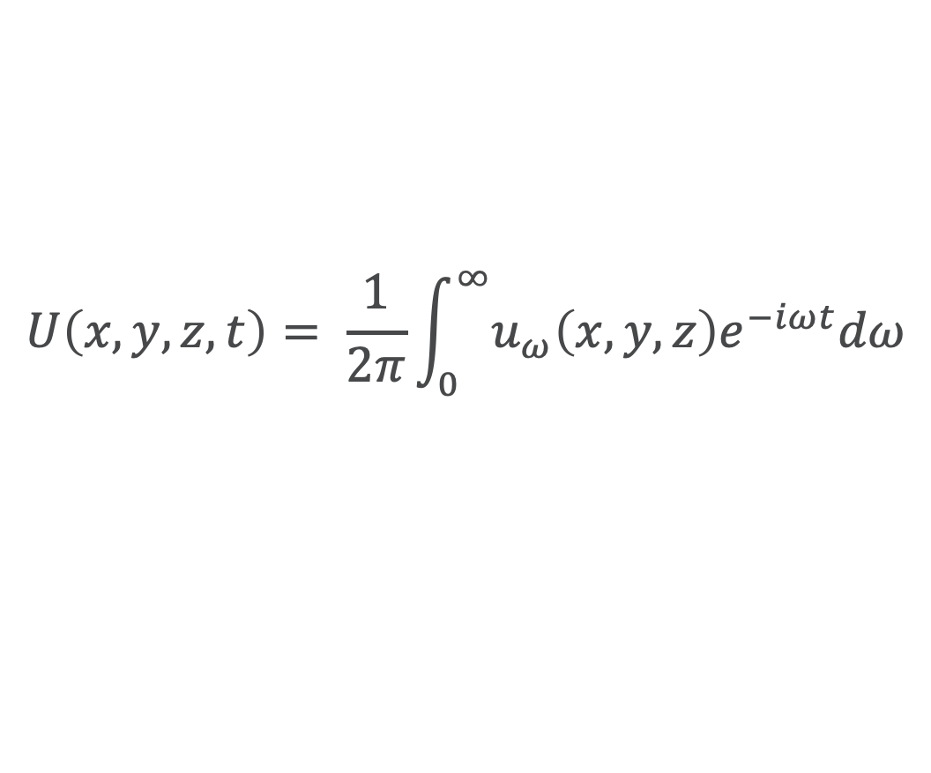
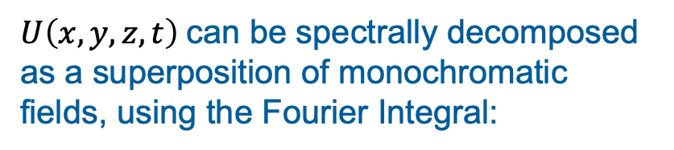
Electromagnetic field propagation in free space
From Maxwell equations: wave equation describing spatial and temporal evolution of the electromagnetic fields in free space (D’Alembert equation)
$$\left(\frac{1}{c^{2}}\frac{∂^{2}}{{∂t}^{2}}−∇^{2}\right)\vec{ℰ}=0$$
$$\left(\frac{1}{c^{2}}\frac{∂^{2}}{{∂t}^{2}}−∇^{2}\right)U\left(x, y, z, t\right)=0$$
Scalar theory: describe each component of the fields separately
$U\left(x, y, z, t\right)$stands for any of the three component of the vector fields $\vec{ℰ}$ or magnetic field $\vec{ℬ}$ or, for light propagating along the z direction, any of the two electric field components $ℰ_{σ}$ and $ℰ_{π}$.
$U\left(x, y, z, t\right)$can be spectrally decomposed as a superposition of monochromatic fields, using the Fourier Integral:
$$U\left(x, y, z, t\right)= \frac{1}{2π}\int_{0}^{∞}{u_{ω}\left(x, y, z\right)e^{−iωt}dω}$$
Notes:
Powder diffraction provides several information about a crystalline material: structural information like...

Slide 5
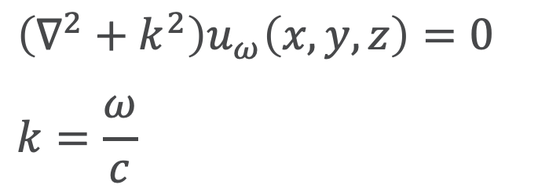
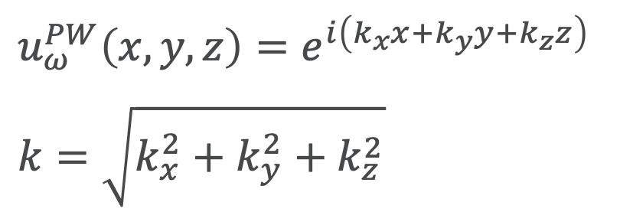
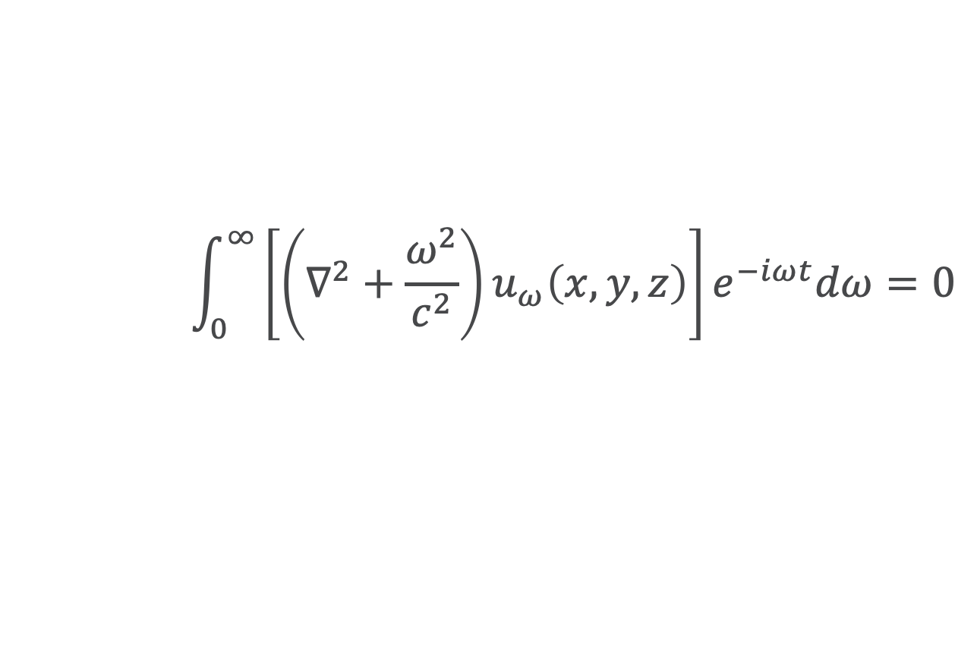
Electromagnetic field propagation in free space
$$\int_{0}^{∞}{\left[\left(∇^{2}+\frac{ω^{2}}{c^{2}}\right)u_{ω}\left(x, y, z\right)\right]e^{−iωt}dω=0}$$
This expression can be used in the D’Alembert equation:
The terms in square bracket has to go to 0, so we obtain the separation of the temporal component and a new equation (Helmholtz equation)
$$\left(∇^{2}+k^{2}\right)u_{ω}\left(x, y, z\right)=0$$
$$k=\frac{ω}{c}$$
⇒ Non-monochromatic light can be solved by calculating separately every monochromatic component
$$u_{ω}^{PW}\left(x, y, z\right)=e^{i\left(k_{x}x+k_{y}y+k_{z}z\right)}$$
$$k=\sqrt{k_{x}^{2}+k_{y}^{2}+k_{z}^{2}}$$
Trivial solutions of the Helmholtz equation are plane waves:
Notes:
Powder diffraction provides several information about a crystalline material: structural information like...

Slide 6
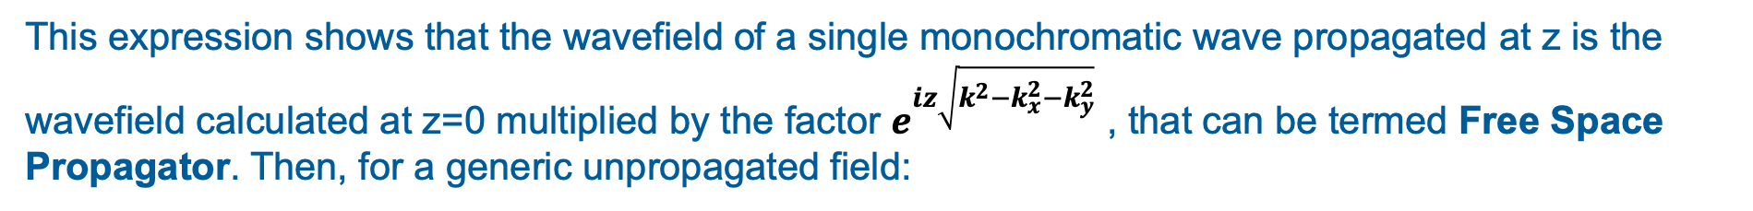
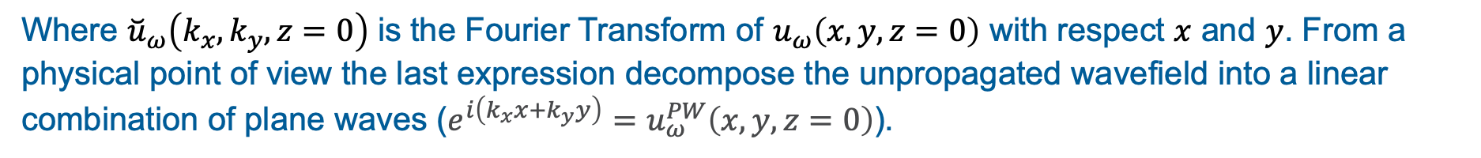
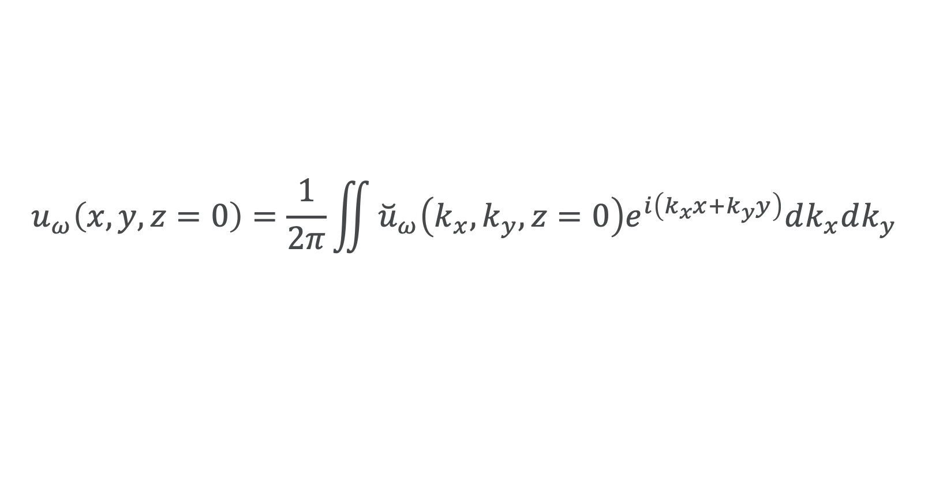
Electromagnetic field propagation in free space
$$u_{ω}^{PW}\left(x, y, z\right)=e^{i\left(k_{x}x+k_{y}y\right)}e^{iz\sqrt{{k^{2}−k}_{x}^{2}−k_{y}^{2}}}=u_{ω}^{PW}\left(x, y, z=0\right)e^{iz\sqrt{{k^{2}−k}_{x}^{2}−k_{y}^{2}}}$$
This expression shows that the wavefield of a single monochromatic wave propagated at z is the wavefield calculated at z=0 multiplied by the factor $e^{iz\sqrt{{k^{2}−k}_{x}^{2}−k_{y}^{2}}}$ , that can be termed Free Space Propagator. Then, for a generic unpropagated field:
$$u_{ω}\left(x, y, z=0\right)=\frac{1}{2π}\iint{{\breve{u}}_{ω}\left(k_{x},k_{y},z=0\right)e^{i\left(k_{x}x+k_{y}y\right)}dk_{x}dk_{y}}$$
Where ${\breve{u}}_{ω}\left(k_{x},k_{y},z=0\right)$ is the Fourier Transform of $u_{ω}\left(x, y, z=0\right)$ with respect $x$ and $y$. From a physical point of view the last expression decompose the unpropagated wavefield into a linear combination of plane waves ($e^{i\left(k_{x}x+k_{y}y\right)}=u_{ω}^{PW}\left(x, y, z=0\right)$).
Notes:
Powder diffraction provides several information about a crystalline material: structural information like...

Slide 7
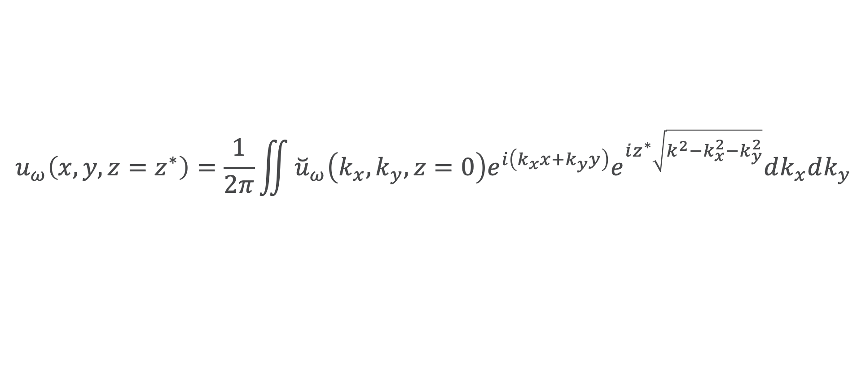
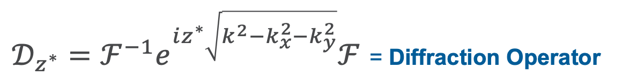
Electromagnetic field propagation in free space
By multiplying each of this plane waves for the free space propagator we obtain the propagated wavefield at $z=z^{∗}>0:$
$$u_{ω}\left(x, y, z=z^{∗}\right)=\frac{1}{2π}\iint{{\breve{u}}_{ω}\left(k_{x},k_{y},z=0\right)e^{i\left(k_{x}x+k_{y}y\right)}e^{iz^{∗}\sqrt{{k^{2}−k}_{x}^{2}−k_{y}^{2}}}dk_{x}dk_{y}}$$
Rewriting the whole procedure in terms of operators:
$$u_{ω}\left(x, y, z=z^{∗}\right)=𝒟_{z^{∗}}u_{ω}\left(x, y, z=0\right)$$
$𝒟_{z^{∗}}=ℱ^{−1}e^{iz^{∗}\sqrt{{k^{2}−k}_{x}^{2}−k_{y}^{2}}}ℱ$ = Diffraction Operator
Notes:
Powder diffraction provides several information about a crystalline material: structural information like...

Slide 8
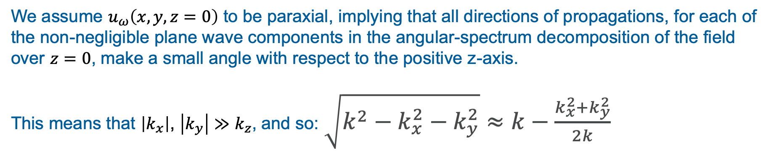
Fresnel Approximation
We assume $u_{ω}\left(x, y, z=0\right)$ to be paraxial, implying that all directions of propagations, for each of the non-negligible plane wave components in the angular-spectrum decomposition of the field over $z=0$, make a small angle with respect to the positive z-axis.
This means that $\left|k_{x}\right|$, $\left|k_{y}\right|≫k_{z}$, and so: $\sqrt{{k^{2}−k}_{x}^{2}−k_{y}^{2}}≈k−\frac{k_{x}^{2}+k_{y}^{2}}{2k}$
The Diffraction Operator becomes: $𝒟_{z^{∗}}≈𝒟_{z^{∗}}^{F}={e^{i{kz}^{∗}}ℱ}^{−1}e^{−\frac{iz^{∗}\left(k_{x}^{2}+k_{y}^{2}\right)}{2k}}ℱ$

Slide 9
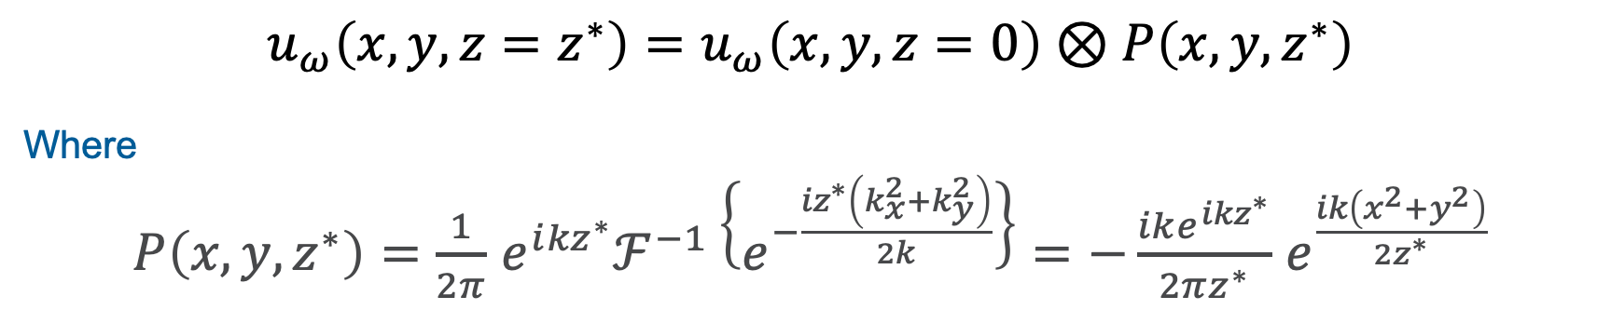
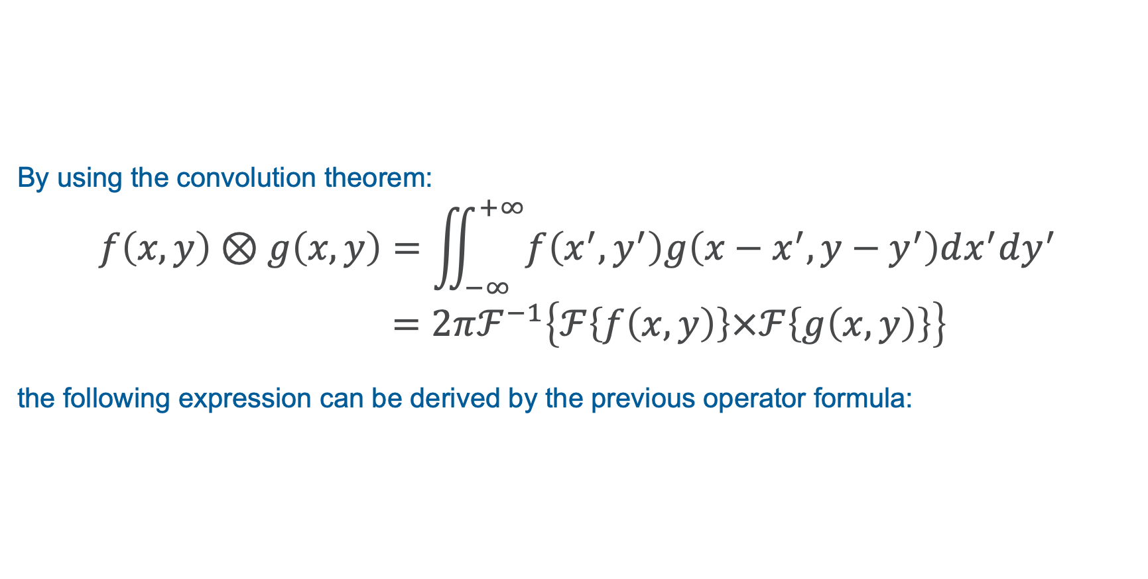
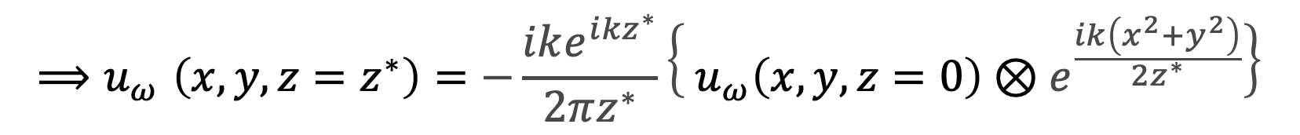
Fresnel Approximation
By using the convolution theorem:
$$f\left(x,y\right)⊗g\left(x,y\right)=\iint_{−∞}^{+∞}{f\left(x^{′},y^{′}\right)g\left(x−x^{′}, y−y^{′}\right)dx^{′}dy^{′}}$$
$=2πℱ^{−1}\left\{ℱ\left\{f\left(x,y\right)\right\}×ℱ\left\{g\left(x,y\right)\right\}\right\}$
the following expression can be derived by the previous operator formula:
$$u_{ω}\left(x, y, z=z^{∗}\right)=u_{ω}\left(x, y, z=0\right)⊗P\left(x, y,z^{∗}\right)$$
Where
$P\left(x, y,z^{∗}\right)=$ $\frac{1}{2π}$ ${e^{i{kz}^{∗}}ℱ}^{−1}\left\{e^{−\frac{{iz}^{∗}\left(k_{x}^{2}+k_{y}^{2}\right)}{2k}}\right\}=−\frac{ike^{i{kz}^{∗}}}{2πz^{∗}}$ $e^{\frac{ik\left(x^{2}+y^{2}\right)}{2z^{∗}}}$
$${⟹u}_{ω}\left(x, y, z=z^{∗}\right)=−\frac{ike^{i{kz}^{∗}}}{2πz^{∗}}\left\{{ u}_{ω}\left(x, y, z=0\right)⊗e^{\frac{ik\left(x^{2}+y^{2}\right)}{2z^{∗}}}\right\}$$

Slide 10
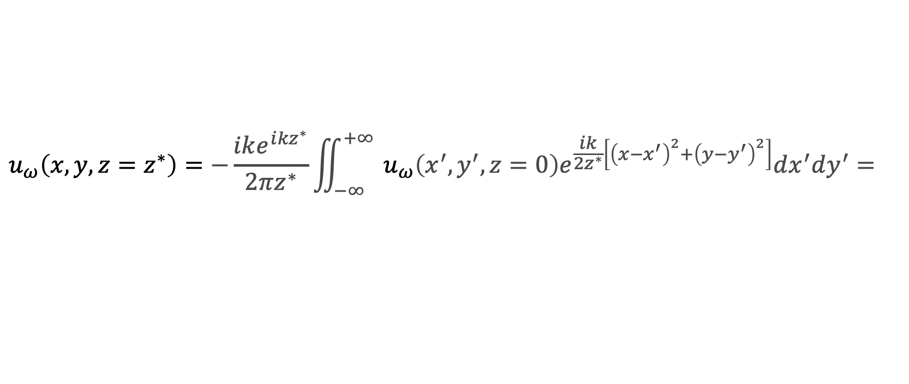
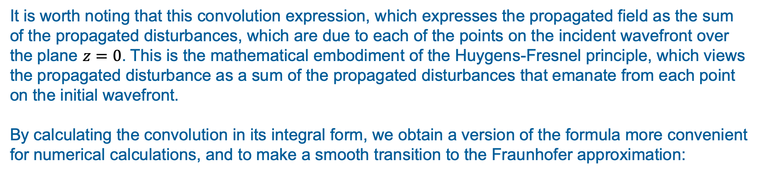
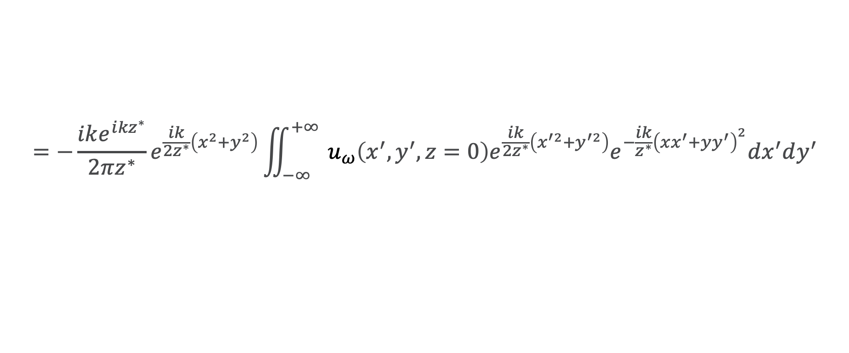
Fresnel Approximation
It is worth noting that this convolution expression, which expresses the propagated field as the sum of the propagated disturbances, which are due to each of the points on the incident wavefront over the plane $z=0$. This is the mathematical embodiment of the Huygens-Fresnel principle, which views the propagated disturbance as a sum of the propagated disturbances that emanate from each point on the initial wavefront.
By calculating the convolution in its integral form, we obtain a version of the formula more convenient for numerical calculations, and to make a smooth transition to the Fraunhofer approximation:
$$u_{ω}\left(x, y, z=z^{∗}\right)=−\frac{ike^{i{kz}^{∗}}}{2πz^{∗}}\iint_{−∞}^{+∞}{{ u}_{ω}\left(x^{′},y^{′}, z=0\right)e^{\frac{ik}{2z^{∗}}\left[{\left(x−x^{′}\right)}^{2}+{\left(y−y^{′}\right)}^{2}\right]}dx^{′}dy^{′}}=$$
$$=−\frac{ike^{i{kz}^{∗}}}{2πz^{∗}}e^{\frac{ik}{2z^{∗}}\left(x^{2}+y^{2}\right)}\iint_{−∞}^{+∞}{{ u}_{ω}\left(x^{′},y^{′}, z=0\right){e^{\frac{ik}{{2z}^{∗}}\left(x^{′2}+y^{′2}\right)}e}^{−\frac{ik}{z^{∗}}{\left(xx^{′}+yy^{′}\right)}^{2}}dx^{′}dy^{′}}$$

Slide 11
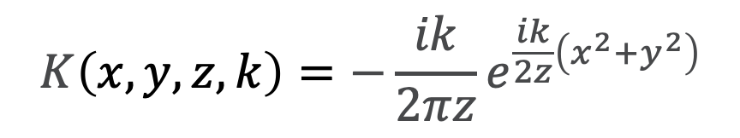
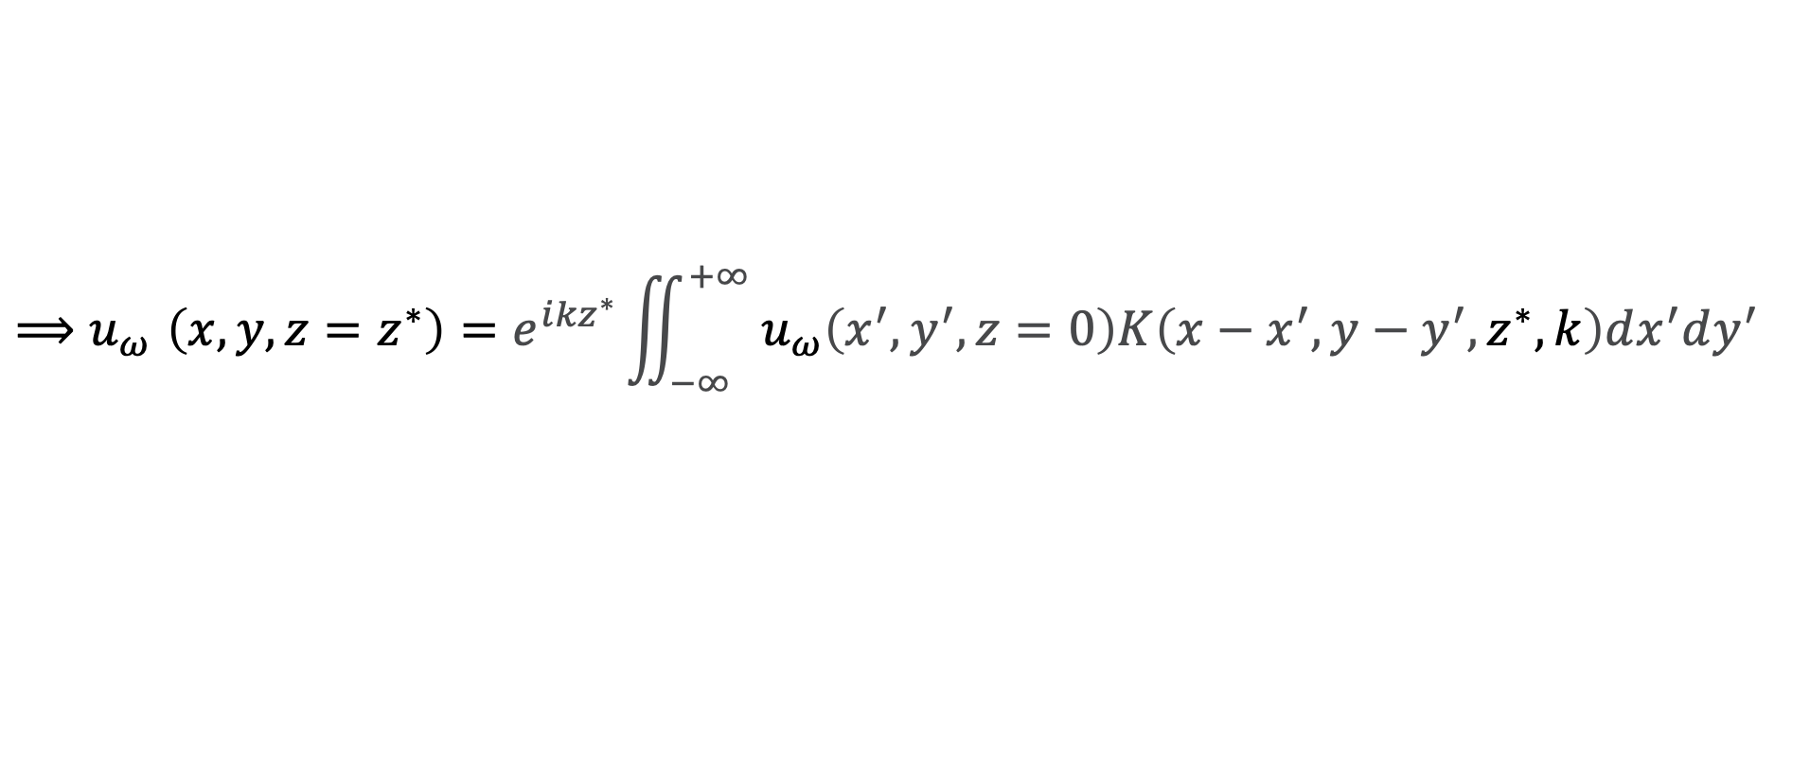
Fresnel Approximation
This expression is also rewritten in terms of a kernel function K(x, y):
$$K\left(x, y, z, k\right)=−\frac{ik}{2πz}e^{\frac{ik}{2z}\left(x^{2}+y^{2}\right)}$$
$${⟹u}_{ω}\left(x, y, z=z^{∗}\right)=e^{i{kz}^{∗}}\iint_{−∞}^{+∞}{{ u}_{ω}\left(x^{′},y^{′}, z=0\right)K\left(x−x^{′},y−y^{′},z^{∗}, k\right)dx^{′}dy^{′}}$$

Slide 12
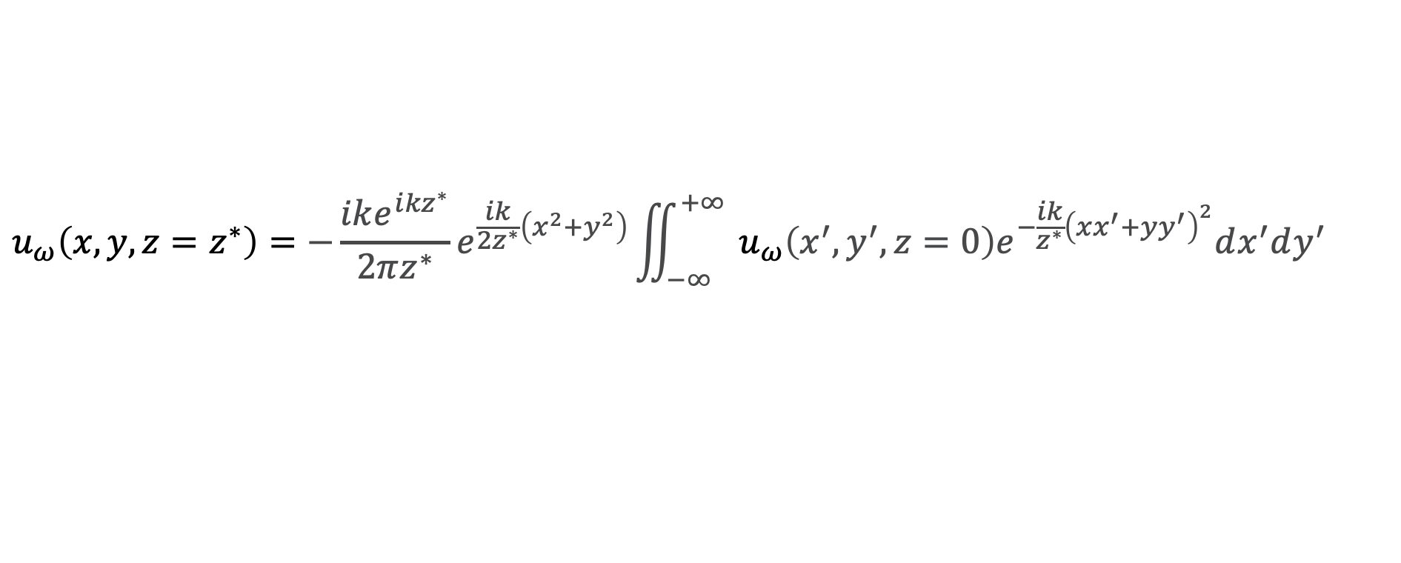
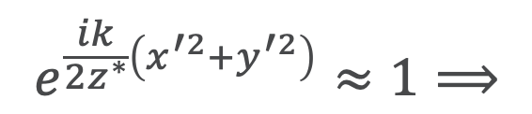
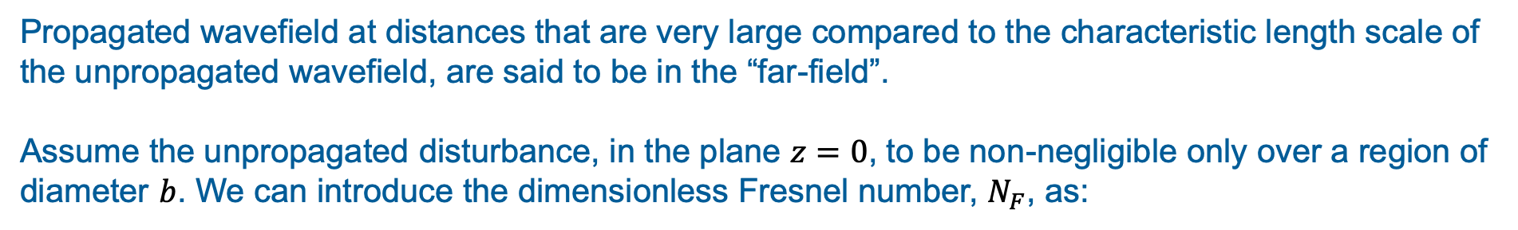

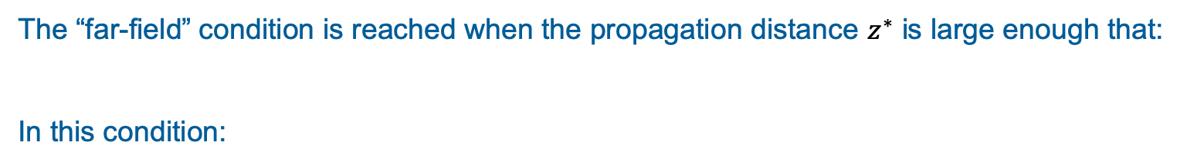
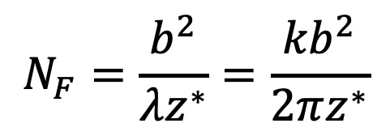
Fraunhofer Approximation
Propagated wavefield at distances that are very large compared to the characteristic length scale of the unpropagated wavefield, are said to be in the “far-field”.
Assume the unpropagated disturbance, in the plane $z=0$, to be non-negligible only over a region of diameter $b$. We can introduce the dimensionless Fresnel number, $N_{F}$, as:
$$N_{F}=\frac{b^{2}}{λz^{∗}}=\frac{{kb}^{2}}{2πz^{∗}}$$
The “far-field” condition is reached when the propagation distance $z^{∗}$ is large enough that:
In this condition:
$$N_{F}≪1$$
$$e^{\frac{ik}{{2z}^{∗}}\left(x^{′2}+y^{′2}\right)}≈1⟹$$
$$u_{ω}\left(x, y, z=z^{∗}\right)=−\frac{ike^{i{kz}^{∗}}}{2πz^{∗}}e^{\frac{ik}{2z^{∗}}\left(x^{2}+y^{2}\right)}\iint_{−∞}^{+∞}{{ u}_{ω}\left(x^{′},y^{′}, z=0\right)e^{−\frac{ik}{z^{∗}}{\left(xx^{′}+yy^{′}\right)}^{2}}dx^{′}dy^{′}}$$

Slide 13
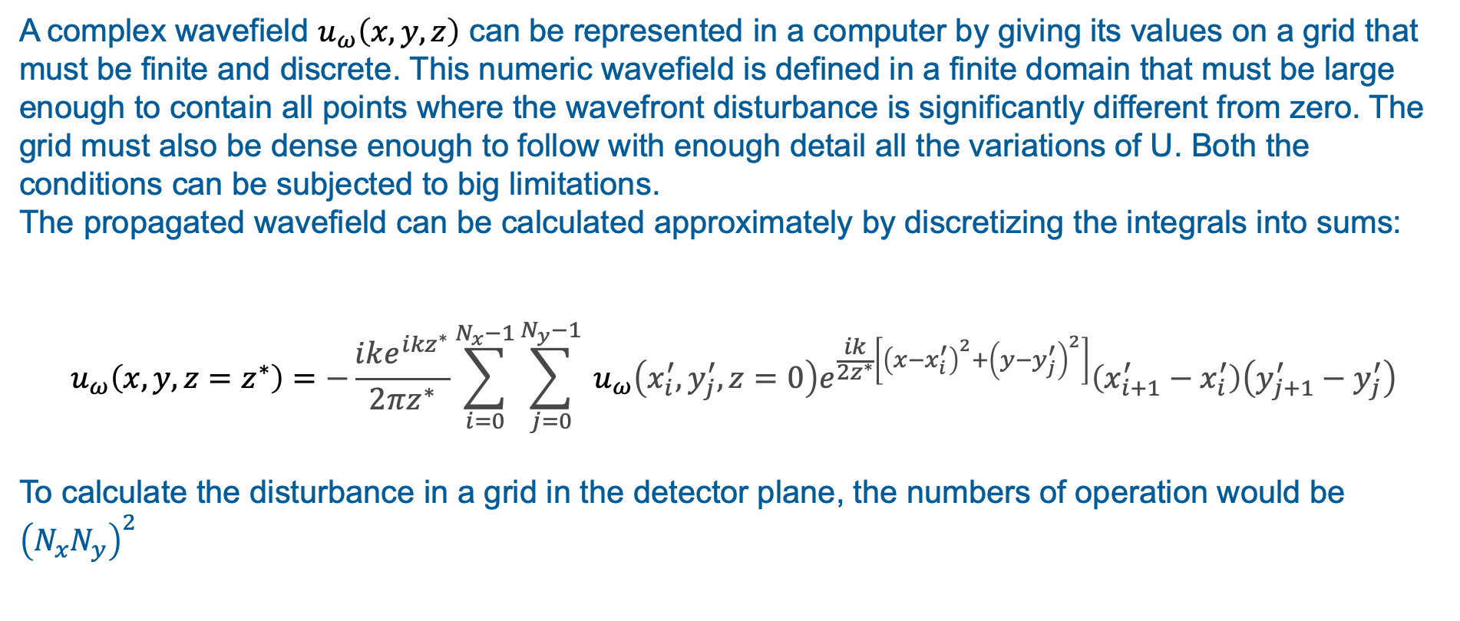
Wavefront and Propagator discretization
A complex wavefield $u_{ω}\left(x, y, z\right)$ can be represented in a computer by giving its values on a grid that must be finite and discrete. This numeric wavefield is defined in a finite domain that must be large enough to contain all points where the wavefront disturbance is significantly different from zero. The grid must also be dense enough to follow with enough detail all the variations of U. Both the conditions can be subjected to big limitations.
The propagated wavefield can be calculated approximately by discretizing the integrals into sums:
$$u_{ω}\left(x, y, z=z^{∗}\right)=−\frac{ike^{i{kz}^{∗}}}{2πz^{∗}}\sum_{i=0}^{N_{x}−1}{\sum_{j=0}^{N_{y}−1}{{ u}_{ω}\left(x_{i}^{′},y_{j}^{′}, z=0\right)e^{\frac{ik}{2z^{∗}}\left[{\left(x−x_{i}^{′}\right)}^{2}+{\left(y−y_{j}^{′}\right)}^{2}\right]}\left({x_{i+1}^{′}−x}_{i}^{′}\right)\left({y_{j+1}^{′}−y}_{j}^{′}\right)}}$$
To calculate the disturbance in a grid in the detector plane, the numbers of operation would be ${\left(N_{x}N_{y}\right)}^{2}$

Slide 14
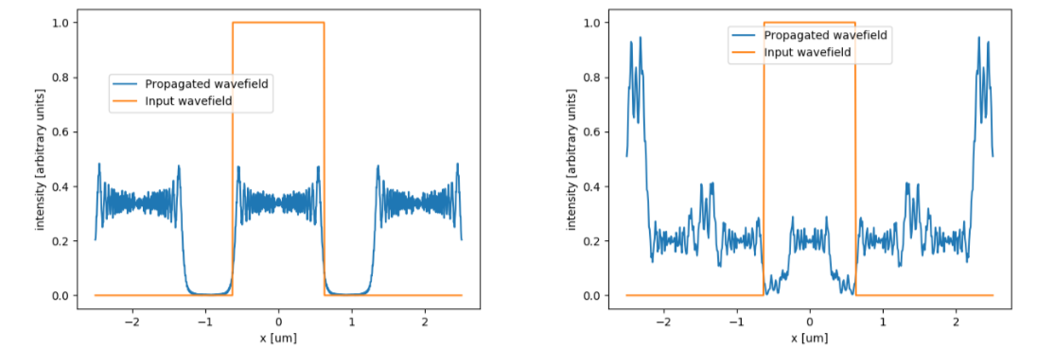
Wavefront and Propagator discretization
Effect of the discretization: Replicas
Replicas can be avoided by increasing the sampling or by isolating the main feature at the image plane, if the replica are well separated.
Effect of under-sampling: Aliasing
Under-sampling produces an overlapping of the replicas, thus completely distorting the expected result. This effect is called aliasing.

Slide 15
SRW PROPAGATORS

Slide 16
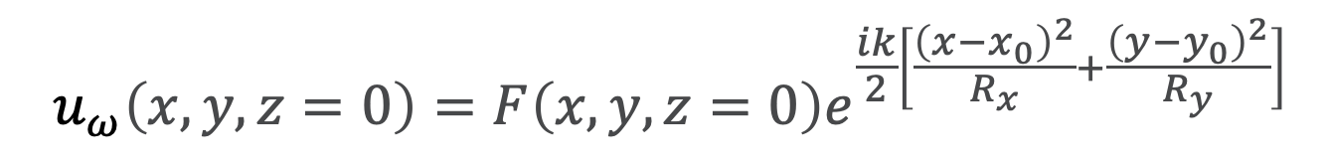
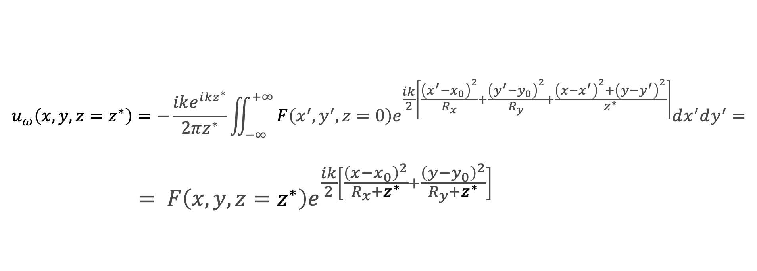
Analytical treatment of the quadratic radiation phase terms
Assume that the electric field before the propagation has quadratic terms in its phase, defined by the radii of the wavefront curvature in the horizontal and vertical planes $R_{x}$, $R_{y}$ and the transverse ordinates of the center point ($x_{0} ,y_{0}$)
$${ u}_{ω}\left(x,y, z=0\right)=F\left(x,y,z=0\right)e^{\frac{ik}{2}\left[\frac{{\left(x−x_{0}\right)}^{2}}{R_{x}}+\frac{{\left(y−y_{0}\right)}^{2}}{R_{y}}\right]}$$
The propagated wavefield becomes:
$$u_{ω}\left(x, y, z=z^{∗}\right)=−\frac{ike^{i{kz}^{∗}}}{2πz^{∗}}\iint_{−∞}^{+∞}{F\left(x^{′},y^{′}, z=0\right)e^{\frac{ik}{2}\left[\frac{{\left(x^{′}−x_{0}\right)}^{2}}{R_{x}}+\frac{{\left(y^{′}−y_{0}\right)}^{2}}{R_{y}}+\frac{{\left(x−x^{′}\right)}^{2}+{\left(y−y^{′}\right)}^{2}}{z^{∗}}\right]}dx^{′}dy^{′}}=$$
$$= F\left(x,y,z=z^{∗}\right)e^{\frac{ik}{2}\left[\frac{{\left(x−x_{0}\right)}^{2}}{R_{x}+z^{∗}}+\frac{{\left(y−y_{0}\right)}^{2}}{R_{y}+z^{∗}}\right]}$$
Chubar, O. and Celestre, R., Opt. Express 27, 28750-28759 (2019)

Slide 17
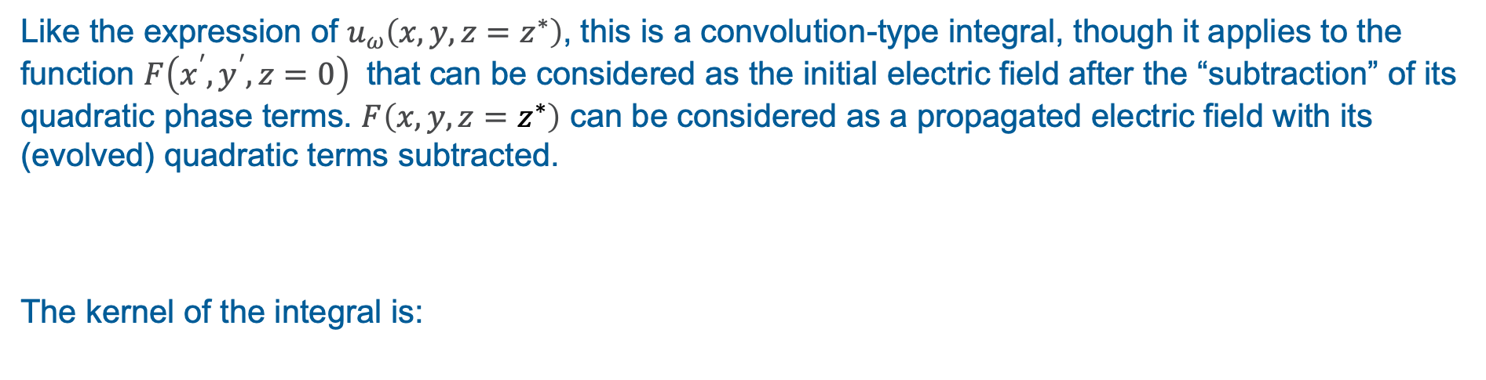
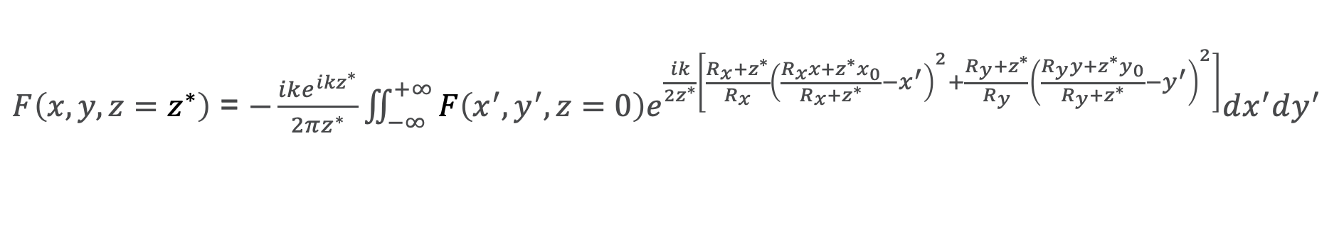
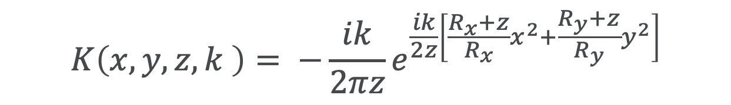
Analytical treatment of the quadratic radiation phase terms
Where:
$F\left(x,y,z=z^{∗}\right)$ = $−\frac{ike^{i{kz}^{∗}}}{2πz^{∗}}\iint_{−∞}^{+∞}{F\left(x^{′},y^{′}, z=0\right)e^{\frac{ik}{2z^{∗}}\left[\frac{R_{x}+z^{∗}}{R_{x}}{\left(\frac{R_{x}x+z^{∗}x_{0}}{R_{x}+z^{∗}}−x^{′}\right)}^{2}+\frac{R_{y}+z^{∗}}{R_{y}}{\left(\frac{R_{y}y+z^{∗}y_{0}}{R_{y}+z^{∗}}−y^{′}\right)}^{2}\right]}dx^{′}dy^{′}}$
Like the expression of $u_{ω}\left(x, y, z=z^{∗}\right)$, this is a convolution-type integral, though it applies to the function $F\left(x^{′},y^{′}, z=0\right)$ that can be considered as the initial electric field after the “subtraction” of its quadratic phase terms. $F\left(x,y,z=z^{∗}\right)$ can be considered as a propagated electric field with its (evolved) quadratic terms subtracted.
The kernel of the integral is:
$$K\left(x,y,z, k \right)= −\frac{ik}{2πz}e^{\frac{ik}{2z}\left[\frac{R_{x}+z}{R_{x}}x^{2}+\frac{R_{y}+z}{R_{y}}y^{2}\right]}$$
Chubar, O. and Celestre, R., Opt. Express 27, 28750-28759 (2019)

Slide 18
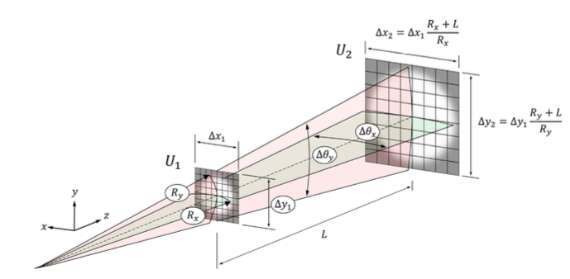
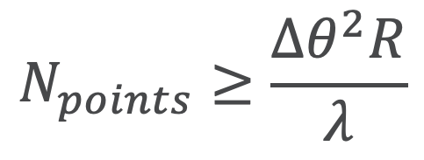
Number of Points in the Propagation Plane
$$N_{points}≥\frac{{Δθ}^{2}R}{λ}$$
For each transversal direction:
Chubar, O. and Celestre, R. Opt. Express 27, 28750-28759 (2019)
Notes:
Powder diffraction provides several information about a crystalline material: structural information like...

Slide 19
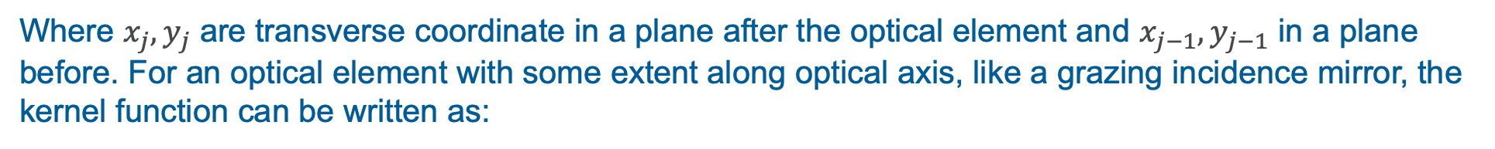
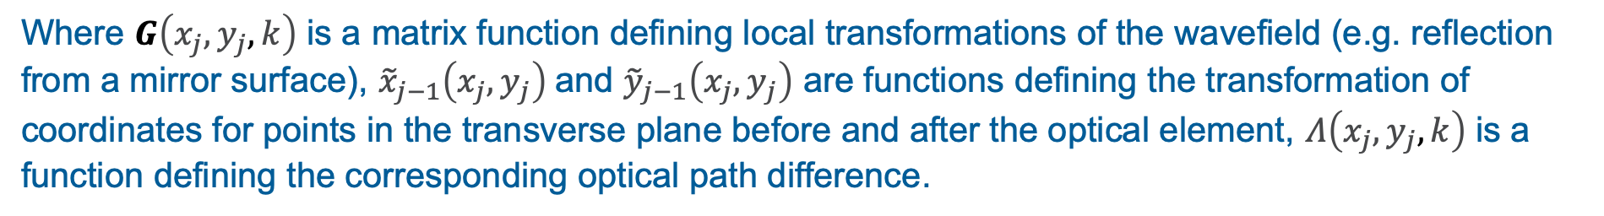
Effects of Optics Elements
SRW uses a matrix expression of the propagator acting on all the transverse components of the Electric Field. For a "thin" optical element we can write the kernel function by using a complex transmission matrix function:
$$K\left(x_{j},y_{j},x_{j−1},y_{j−1}, k\right)≈T\left(x_{j},y_{j}, k\right)δ\left(x_{j−1}−x_{j}\right)δ\left(y_{j−1}−y_{j}\right)$$
Where $x_{j},y_{j}$ are transverse coordinate in a plane after the optical element and $x_{j−1},y_{j−1}$ in a plane before. For an optical element with some extent along optical axis, like a grazing incidence mirror, the kernel function can be written as:
$$K\left(x_{j},y_{j},x_{j−1},y_{j−1}, k\right)≈G\left(x_{j},y_{j},k\right)e^{ikΛ\left(x_{j},y_{j},k\right)}δ\left(x_{j−1}−{\tilde{x}}_{j−1}\left(x_{j},y_{j}\right)\right)δ\left(y_{j−1}−{\tilde{y}}_{j−1}\left(x_{j},y_{j}\right)\right)$$
Where $G\left(x_{j},y_{j},k\right)$ is a matrix function defining local transformations of the wavefield (e.g. reflection from a mirror surface), ${\tilde{x}}_{j−1}\left(x_{j},y_{j}\right)$and ${\tilde{y}}_{j−1}\left(x_{j},y_{j}\right)$ are functions defining the transformation of coordinates for points in the transverse plane before and after the optical element, $Λ\left(x_{j},y_{j},k\right)$ is a function defining the corresponding optical path difference.
Chubar, O., Berman, L., Chu, Y. S., Fluerasu, A., Hubert, S., Idir, M., Kaznatcheev, K., Shapiro, D. Shen, Q. and Baltser, J., Proc. SPIE, 8141:814107 (2011)

Slide 20

SRW Standard Propagator
Is the Fresnel Propagator:
$$u_{ω}\left(x, y, z=z^{∗}\right)=−\frac{ike^{i{kz}^{∗}}}{2πz^{∗}}\iint_{−∞}^{+∞}{{ u}_{ω}\left(x^{′},y^{′}, z=0\right)e^{\frac{ik}{2z^{∗}}\left[{\left(x−x^{′}\right)}^{2}+{\left(y−y^{′}\right)}^{2}\right]}dx^{′}dy^{′}}=$$
propagation over a drift space with gentle (de)magnification
before slits, ideal lenses and smooth phase elements
preserves number of pixel and ranges
given proper sampling, can be used for focusing
works for strongly astigmatic systems
Notes:
Powder diffraction provides several information about a crystalline material: structural information like...

Slide 21
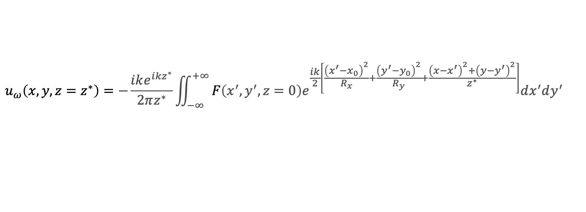
Quadratic Term/Quadratic Term Special Propagator
Is the Fresnel propagator with analytical treatment of the quadratic phase terms
$$u_{ω}\left(x, y, z=z^{∗}\right)=−\frac{ike^{i{kz}^{∗}}}{2πz^{∗}}\iint_{−∞}^{+∞}{F\left(x^{′},y^{′}, z=0\right)e^{\frac{ik}{2}\left[\frac{{\left(x^{′}−x_{0}\right)}^{2}}{R_{x}}+\frac{{\left(y^{′}−y_{0}\right)}^{2}}{R_{y}}+\frac{{\left(x−x^{′}\right)}^{2}+{\left(y−y^{′}\right)}^{2}}{z^{∗}}\right]}dx^{′}dy^{′}}$$
Quadratic Term | Quadratic Term Special
propagation over a drift space in general before complex optical elements (e.g. curved mirrors). preserves number of pixel, ranges are recalculated to accommodate the wavefront can be used for or from focusing works for strongly astigmatic systems. | different calculation of 𝑅𝑥 and 𝑅𝑦 and processing near the waist propagation over a drift-spaces in general especially adequate when (strongly astigmatic) wavefront is being focused or emerging from very small slits strong diffracting elements (gratings) preserves number of pixel, ranges are recalculated to accommodate the wavefront can be used for or from focusing works for strongly astigmatic systems.
Notes:
Powder diffraction provides several information about a crystalline material: structural information like...

Slide 22

From Waist/To Waist Propagator
Is the Fraunhofer Propagator:
$$u_{ω}\left(x, y, z=z^{∗}\right)=−\frac{ike^{i{kz}^{∗}}}{2πz^{∗}}e^{\frac{ik}{2z^{∗}}\left(x^{2}+y^{2}\right)}\iint_{−∞}^{+∞}{{ u}_{ω}\left(x^{′},y^{′}, z=0\right)e^{−\frac{ik}{z^{∗}}{\left(xx^{′}+yy^{′}\right)}^{2}}dx^{′}dy^{′}}$$
From Waist | To Waist
propagation of a wavefront emerging from a focal position in both vertical and horizontal directions output plane (several times) larger than the input plane preserves number of pixel, ranges are recalculated to accommodate the wavefront fails for strongly astigmatic systems. | propagation of a wavefront being focused on both directions output plane (several times) smaller than the input plane preserves number of pixel, ranges are recalculated to accommodate the wavefront fails for strongly astigmatic systems.
Notes:
Powder diffraction provides several information about a crystalline material: structural information like...

Slide 23
References
Official Repository
Official SRW User Interface
https://github.com/ochubar/SRW
https://www.sirepo.com/srw
Chubar, O. and Ellaume, P.: Accurate and efficient computation of synchrotron radiation in the near field region. Proceedings of the 6th European Particle Accelerator Conference - EPAC-98, pages 1177-1179
Chubar, O.: Wavefront calculations. Proc. SPIE, 4143:48-59 (2001)
Chubar, O., Berman, L., Chu, Y. S., Fluerasu, A., Hubert, S., Idir, M., Kaznatcheev, K., Shapiro, D. Shen, Q. and Baltser, J.: Development of partially-coherent wavefront propagation simulation methods for 3rd and 4th generation synchrotron radiation sources. Proc. SPIE, 8141:814107 (2011)
SRW Publications
Chubar, O.: Recent updates in the "Synchrotron Radiation Workshop" code, on-going developments, simulation activities, and plans for the future. Proc. SPIE, 9209:920907 (2014)
Chubar, O., Rakitin, M., Chen-Wiegart, Y.K., Chu, Y.S., Fluerasu, A., Hidas, D. and Wiegart, L.: Main functions, recent updates, and applications of Synchrotron Radiation Workshop code. Proc. SPIE, 10388:1038805 (2017)
Chubar, O. and Celestre, R.: Memory and CPU efficient computation of the Fresnel free-space propagator in Fourier optics simulation. Opt. Express 27, 28750-28759 (2019)
Books
Paganin, D.: Coherent X-Ray Optics. Oxford Series on Synchrotron Radiation, 6. Oxford Science Publications (2006)
Notes:
Powder diffraction provides several information about a crystalline material: structural information like...

Slide 24
Thank you!

