Slide 1
Synchrotron Sources

Slide 2
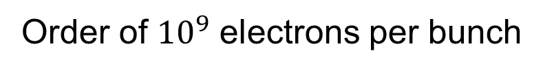
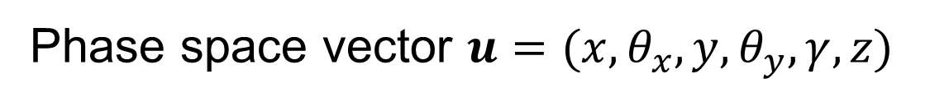
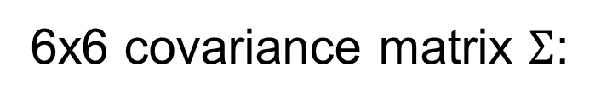
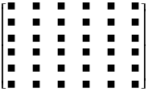
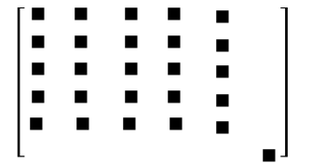
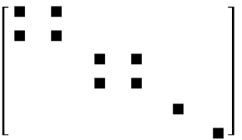
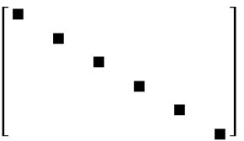
ELECTRON BEAM DESCRIPTION
In storage rings, the electrons are statistically distributed inside bunches
P₁
P₂
P₃
General
No z-coupling
Finite alpha
Symmetry point

Slide 3
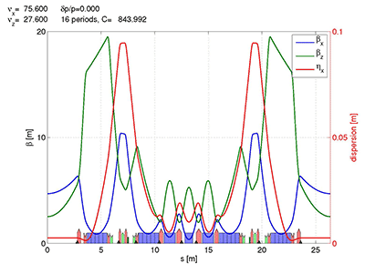

Stotage ring: electron beam sizes
Horizontal emittance = 147 pm
With ε the emittance (constant), and Twiss parameters:
At s (any point of the trajectory):
EBS (S28D):
β_{x} = 6.90 m
β_{y} = 2.64 m
σ_{x} = 30.2 μm
σ_{y} = 3.64 μm
σ_{x’}= 4.37 μrad
σ_{z’}=1.37 μrad
At waist (zero correlation, ρ=α=0, β is minimum):

Slide 4
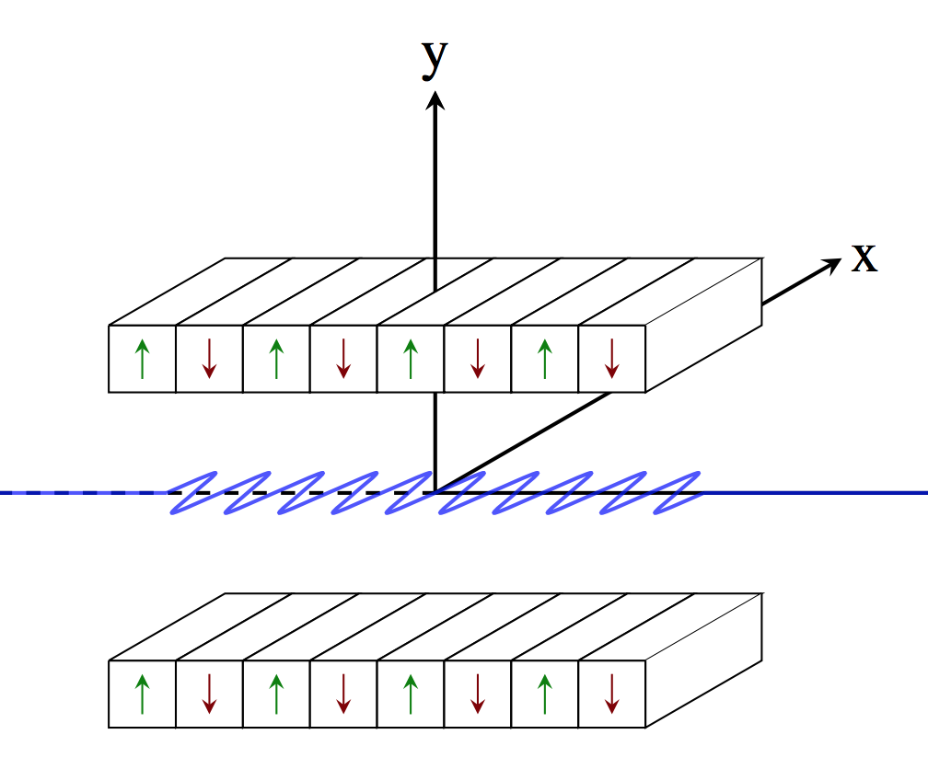
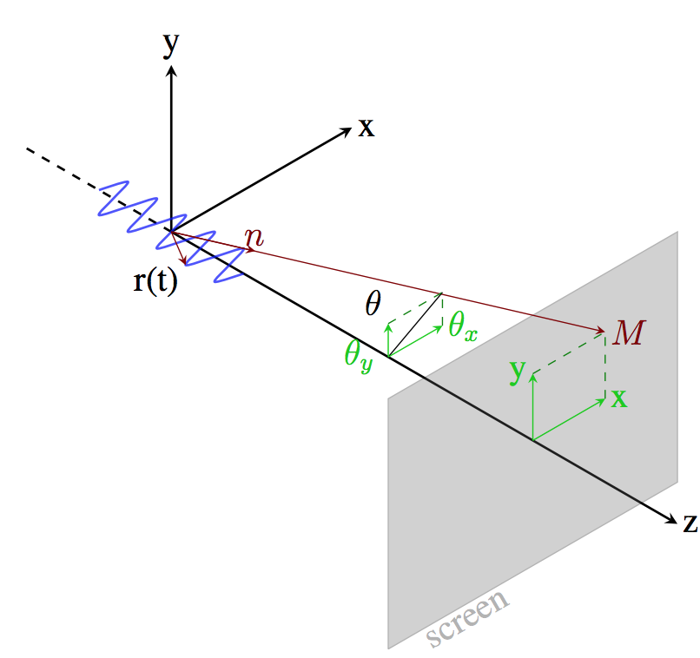
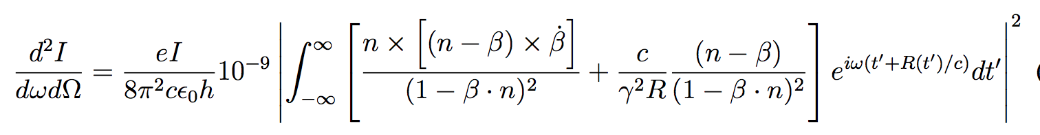
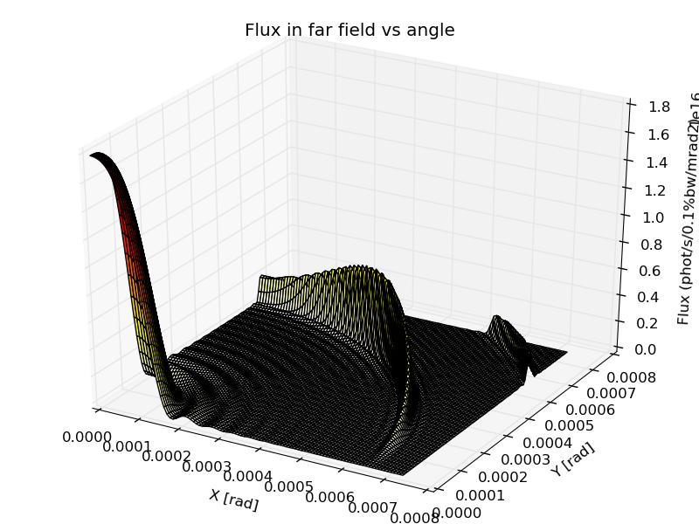
SINGLE ELECTRON PHOTON EMISSION (Zero emittance)
Undulator emission, after classical electrodynamics (e.g., Jackson, etc)

Slide 5
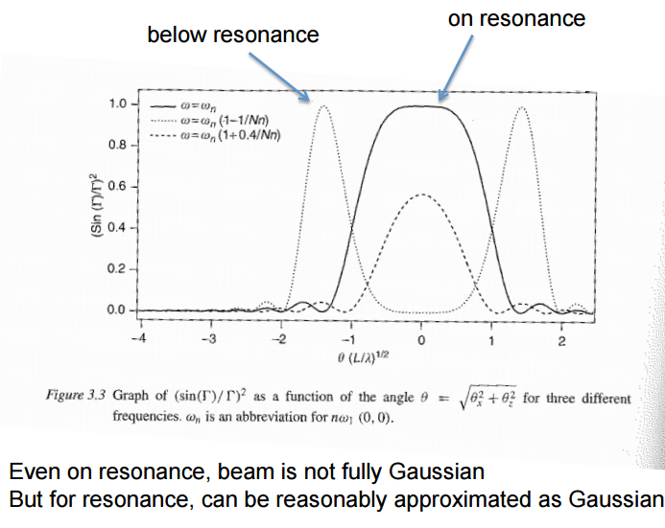
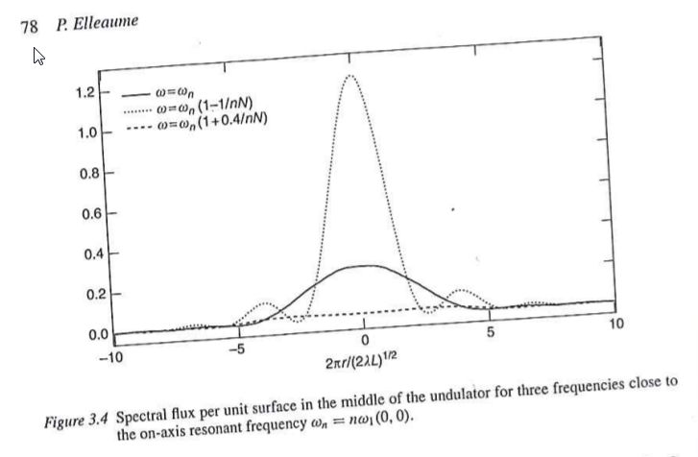
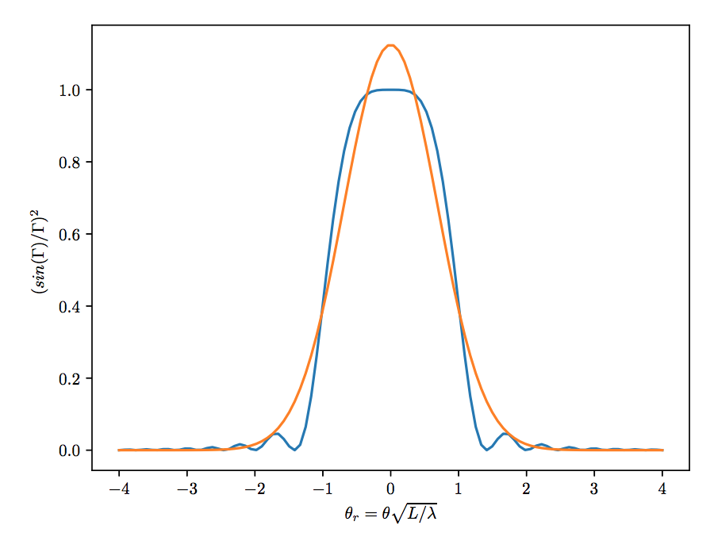
Undulator emission (single electron or filament beam or zero emmittance) (after Onuki & Elleaume, Undulators, Wigglers and their applications, CRC press, 2002)
Undulator beams have not Gaussian profiles (even at resonances)
These formulas are APPROXIMATED!

Slide 6
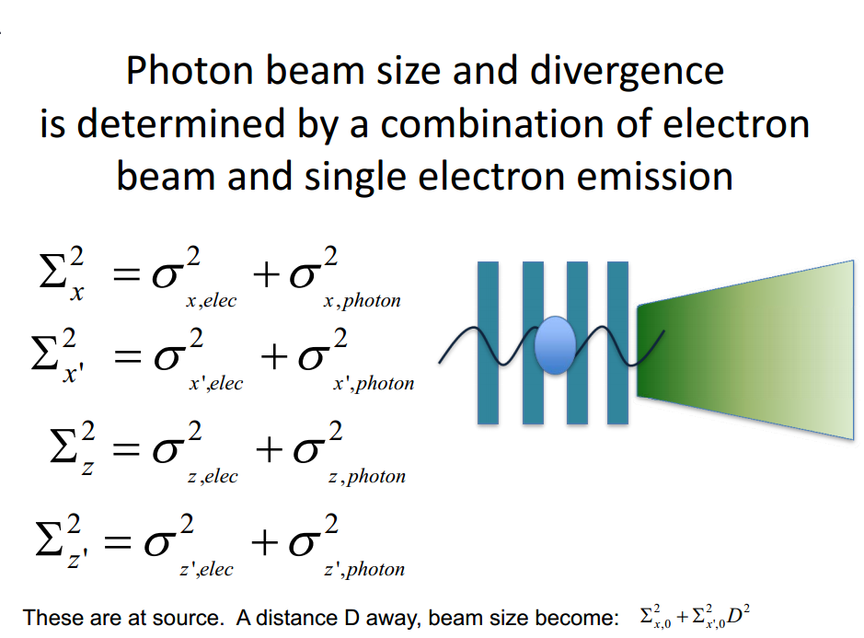
Courtesy: Boaz Nash
(FOR UNDULATORS, THESE FORMULAS ARE VALID AT THE WAIST, AT THE UNDULATOR RESONANCE, AND SUPOSSING GAUSSIAN EMISSION OF PHOTONS)
ShadowOui performs “numeric convolution” by Monte Carlo sampling of the electron beam [Gaussian] and photon emission [non Gaussian]

Slide 7
Mirrors

Slide 8
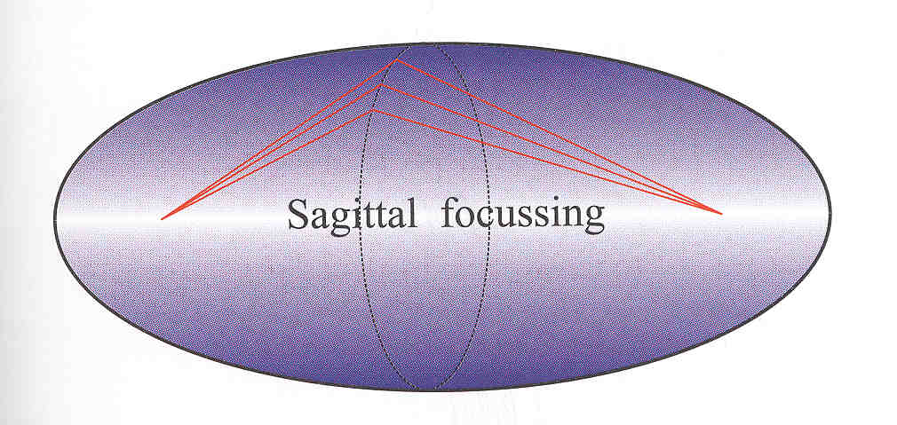
Mirror shape
Ellipsoid: Point to point focusing
Paraboloid: Collimating
Focalization in two planes
Tangential or Meridional (ellipse or parabola)
Sagittal (circle)
Demagnification: M=p/q
Easier manufacturing:
2D: Ellipsoid => Toroid
Only one plane: cylinder Ellipsoid (ellipse)=> cylinder (circle)
Sagittal radius: non-linear (ellipsoid) => constant (cylinder) or linear (cone),
All mirrors produce aberrations
R
p
q
ρ

Slide 9
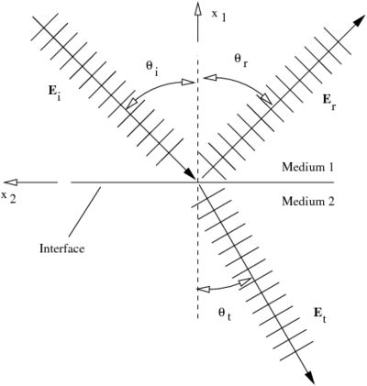
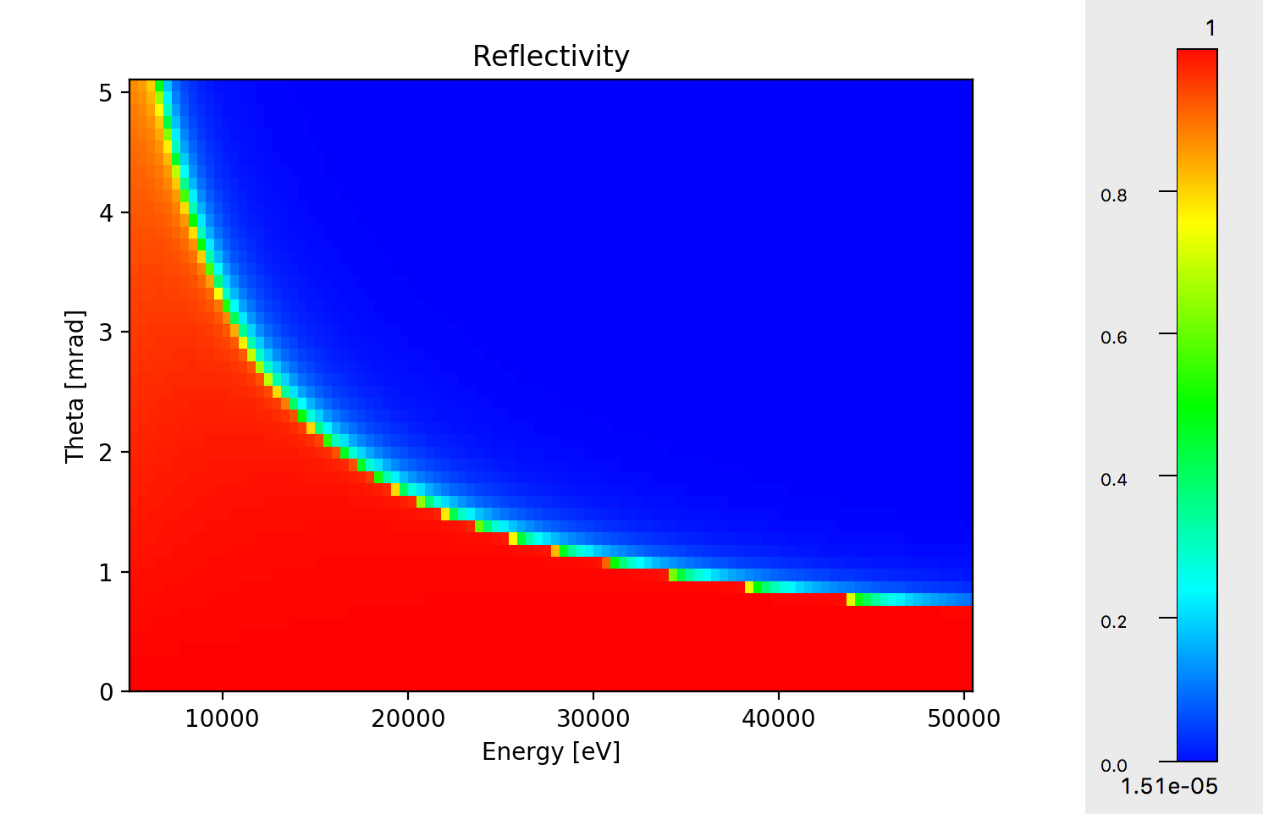

Mirrors Geometrical model Physical model Specular reflection Fresnel formulas
Fresnel equations give the reflectivity as a function of angle and photon energy. As a consequence, one gets the critical angle:
Si

Slide 10
Lenses

Slide 11

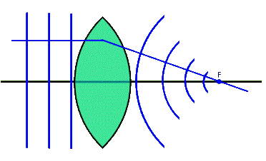

LENS
p
q

Slide 12
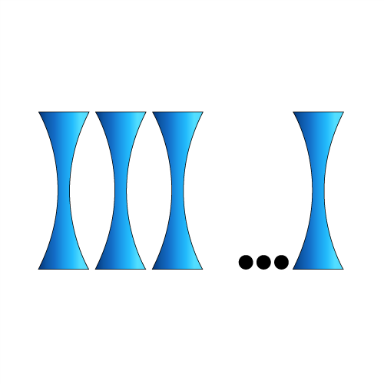
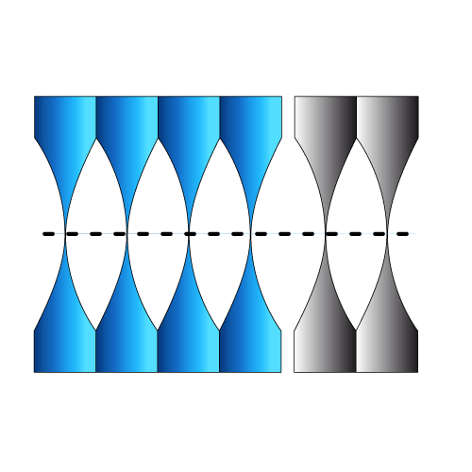
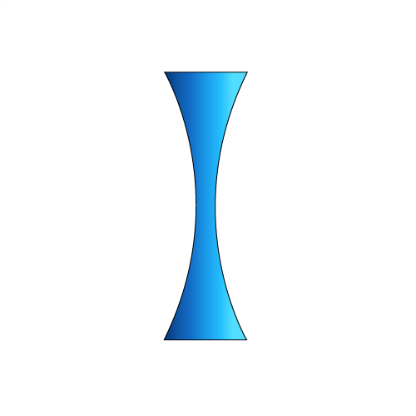




CRL (COMPOUND REFRACTIVE LENSES) = replicate N lenses
Compound Refractive Lens (CRL)
Single interface
Lens
Transfocator
1996 Experimental demonstration of CRL
A. Snigirev et al Nature 384 (1996) 49
2011 Transfocator

Slide 13

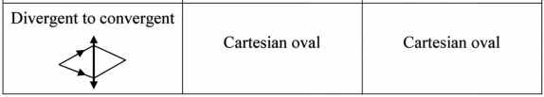
HIGH DEMAGNIFICATION with SINGLE LENSES
material->air air->material
K. Evans-Lutterodt et al
Single Element elliptical hard X-ray micro-optics
Opt. Expr. 11, 8, 919-926 (2003).
M. Sánchez del Rio & L. Alianelli,
J. Synchr. Rad. 19 (2012) 366
When illuminating with coherent light, reducing acceptance decreases N.A. therefore increases coherent diffraction ~0.61 λ/ (h/q)
The rays become very grazing to there is total reflection. Not a limitation for kinoform lenses (K. Evans-Lutterodt et al Phys. Rev. Lett. 99 (2007)). For standard lenses one can reverse the lens.
There is a lot of absorption => remove material and convert it to a Fresnel lens (W. Jark et al J. Synchr. Rad. 13 (2006))
Use the lens shape adapted for your needs

Slide 14
Crystals

Slide 15
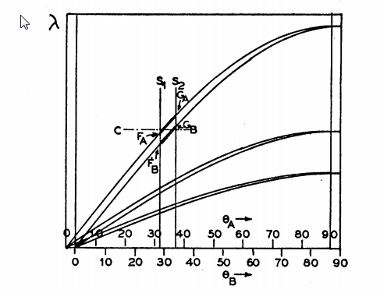
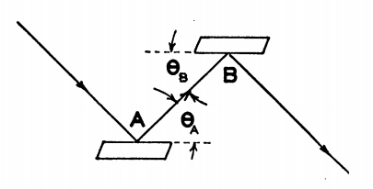
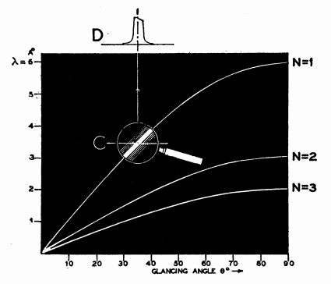
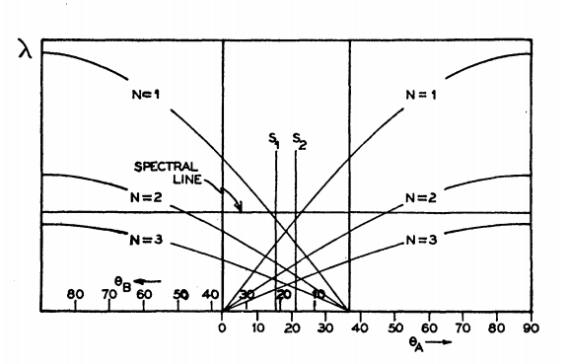
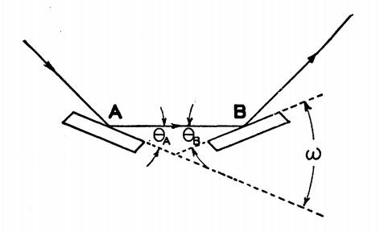
Theory of the Use of More Than Two Successive X-Ray Crystal Reflections to Obtain Increased Resolving Power J W. M. DuMond Phys. Rev. 52, 872 – (1937) http://dx.doi.org/10.1103/PhysRev.52.872
ex17_crystalmono.ows

Slide 16
Trace (the beamline)
z
Energy, Intensity
y
x
z
z
p
q
x
y
x

Slide 17
Coherence

Slide 18
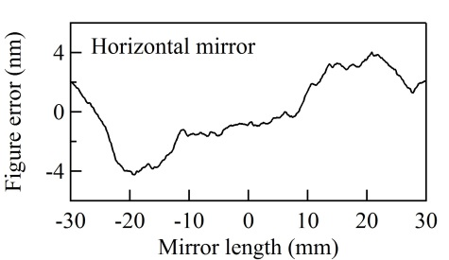
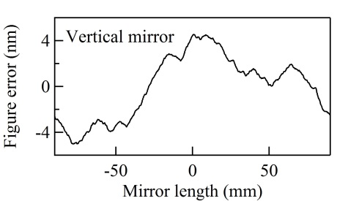
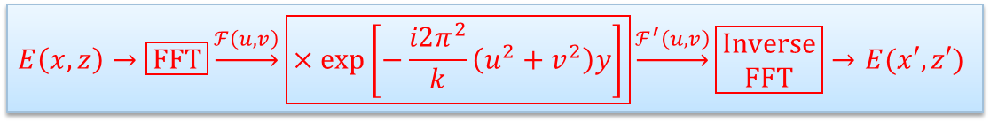
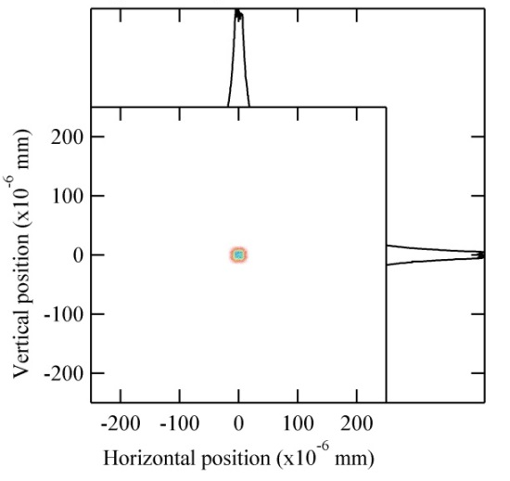
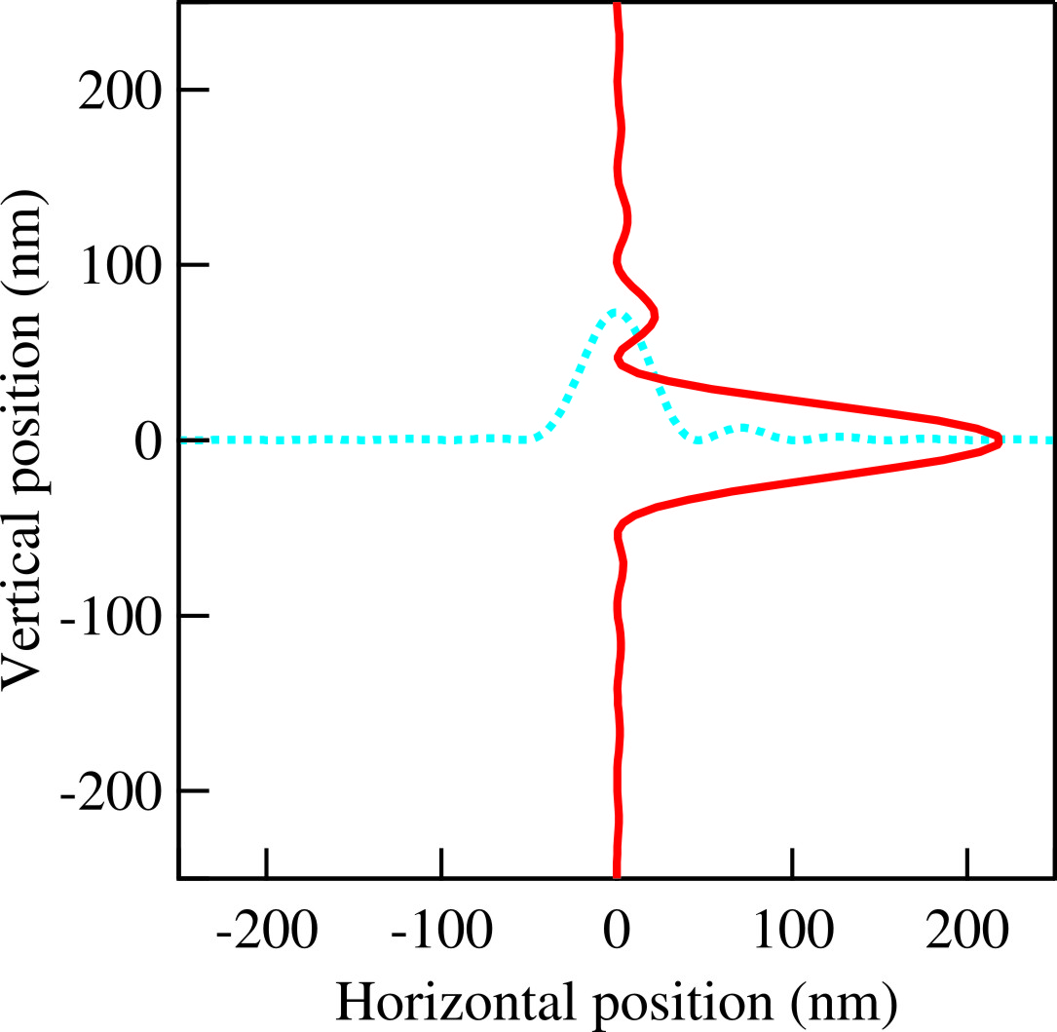
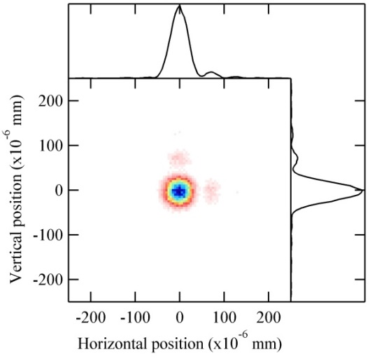


HYBRID METHOD IN SHADOW (X. Shi et al.) Combining ray tracing and wavefront propagation
Ideal lens with focal lengths of f_{x} and f_{z}
Ray tracing of the beamline

Slide 19
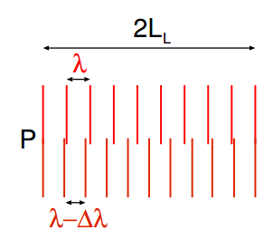
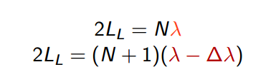
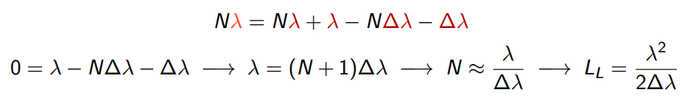
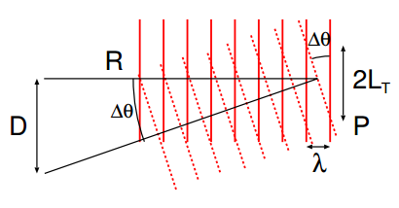
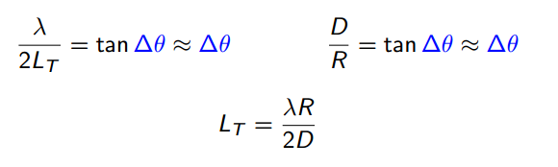
COHERENT LENGTHS - TWO WAVES http://www.csrri.iit.edu/~segre/phys570/10F/lecture_04.pdf
Starting with TWO well defined (thus coherent) waves with THE SAME intensity:
LONGITUDINAL (TEMPORAL) COHERENCE LENGTH L_{L}
Distance over which two waves from the same source point with slightly different wavelengths will completely dephase.
TRANSVERSE COHERENCE LENGTH L_{T}
The lateral distance along a wavefront over which there is a complete dephasing between two waves of the same wavelength, which originate from two separate points in space

Slide 20
correlation lengths for a typical synchrotron
the synchrotron beam is not formed by two single monochromatic plane waves
But we give some approximated values…
LONGITUDINAL COHERENCE
Imagine that a typical monochromator:
Produces a typical of ∆λ/λ = 10⁻⁴ (Si 111) peak distribution (Gaussian)
For main wavelength of λ = 1Å we select two lines thus separated its width ∆λ = 10⁻⁴ Å
The wavefronts of these two monochromatic waves are plane and identical
STATIONARY: This correlation time is much smaller than “bunch time” ~ 15 10⁻³ / c ~10⁻¹² s~ ps

Slide 21
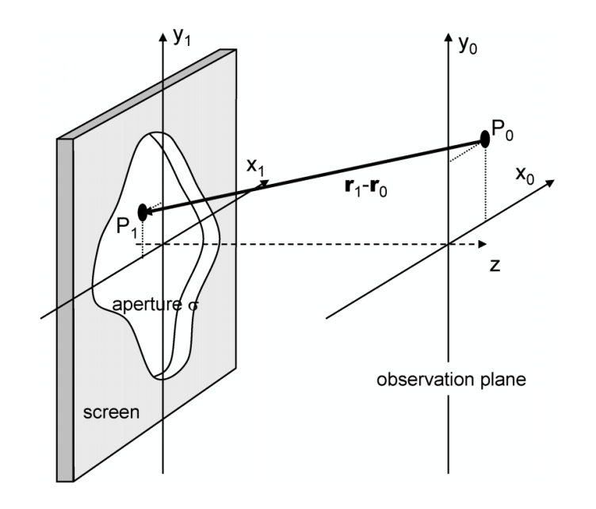
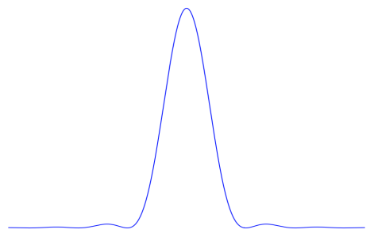
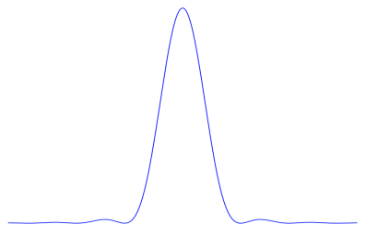
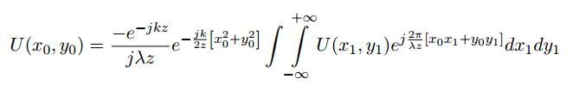
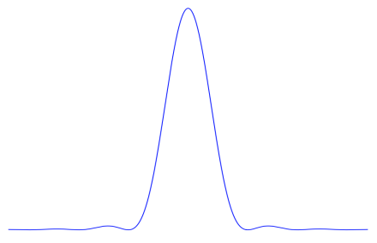
FRAUNHOFER DIFFRACTION
z1 z2
Fourier transform with conjugated variables:
x ; f_{x}=x/(λ z) ~ sinθ/λ (same for y)
The same shape for different distances
f_{x}=x/(λ z) ~ sinθ/λ ~ θ/λ
F1 = np.fft.fft2(image) # Take the fourier transform of the image

Slide 22
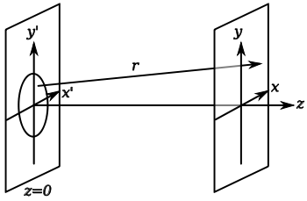

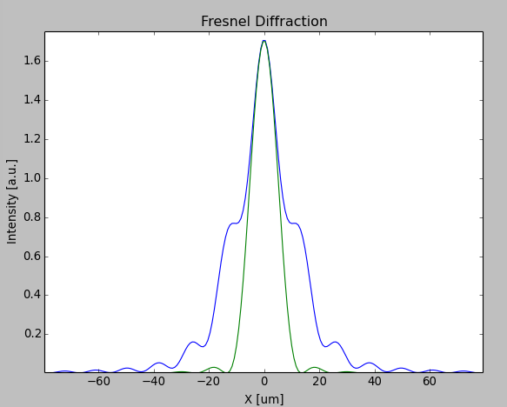


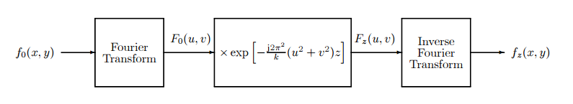
FRESNEL DIFFRACTION
Numeric calculation: convolution with a Gaussian kernel
CONVOLUTION

Slide 23
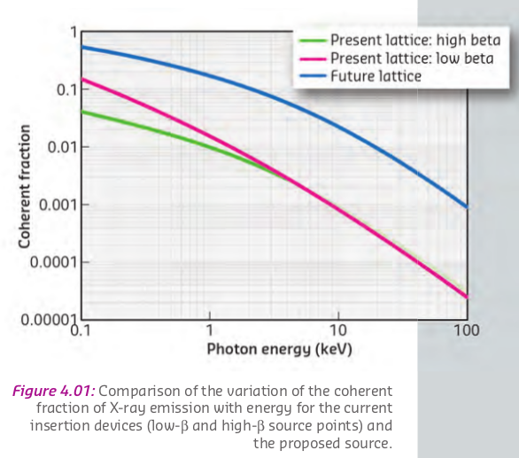
Quantifying efficiency of the source to emit coherent radiation:
coherent fraction for SR lattices (Undulator emission)

