Slide 1




Introduction to WOFRY
Manuel Sanchez del Rio
srio@lbl.gov

Slide 2
WOFRY
https://github.com/oasys-kit/wofry
Wave Optics FRamwork in pYthon
WOFRY is the OASYS framework for waveoptics calculations. It contains a threefold functionality:
it provides a generalization (or abstraction) of a software tool for wave optics, combining the component definitions from SYNED with the abstract declaration of wavefronts and propagators https://doi.org/10.1117/12.2274232
it defines a mechanism for interfacing a wave optics code (e.g., SRW, WISE etc.) in it, a first step for becoming interfaced in OASYS
it provides native implementations of simple wavefronts (e.g., plane waves, spherical waves, Gaussian sources) and propagators for prototyping optical systems.

Slide 3
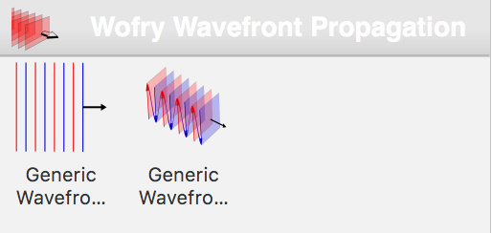
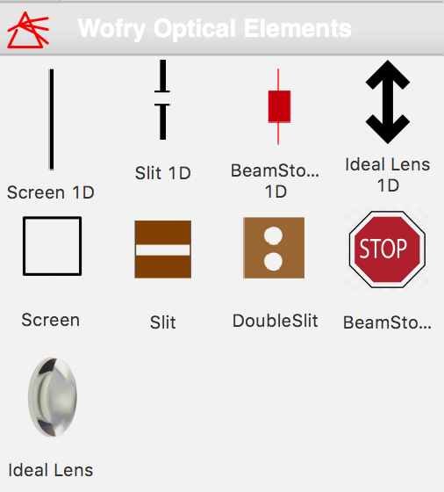
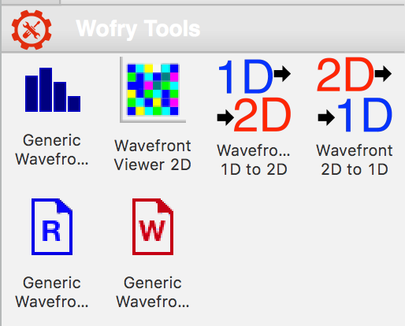
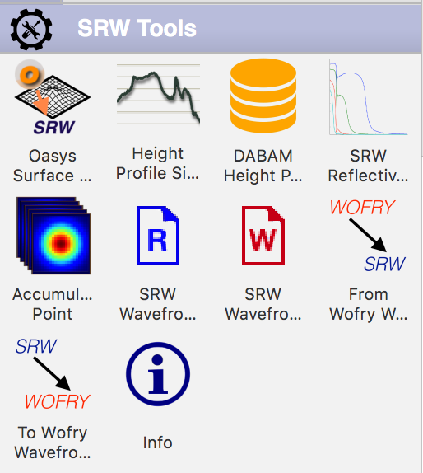
WOFRY Sources Optical elements Tools

Slide 4
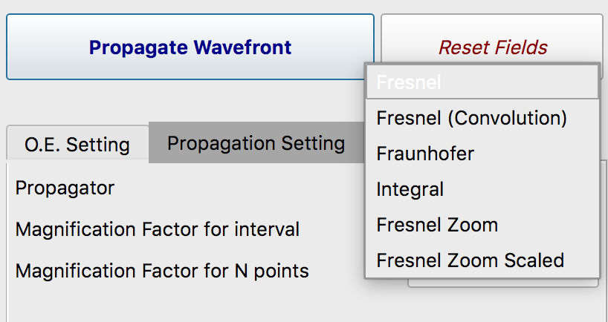
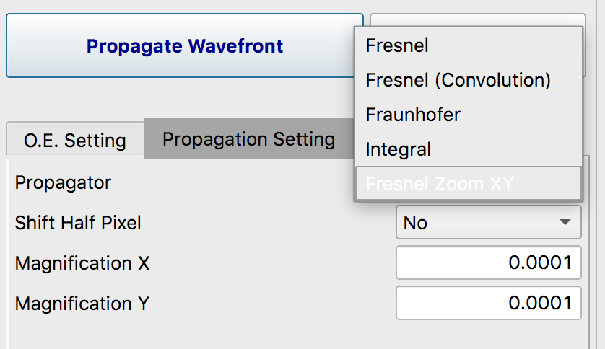
Propagators
Fresnel
Fresnel (convolution)
Integral
Fresnel Zoom
Fresnel Zoom Scaled
1D
2D

Slide 5
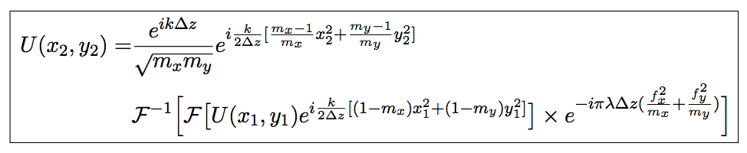
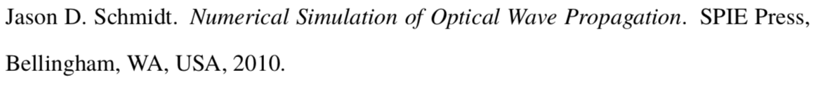
Zoom Propagator
G. Pirro, Master Thesis (2017)
https://github.com/oasys-kit/documents/blob/master/zoom_propagator_pirro_thesis.pdf

Slide 6
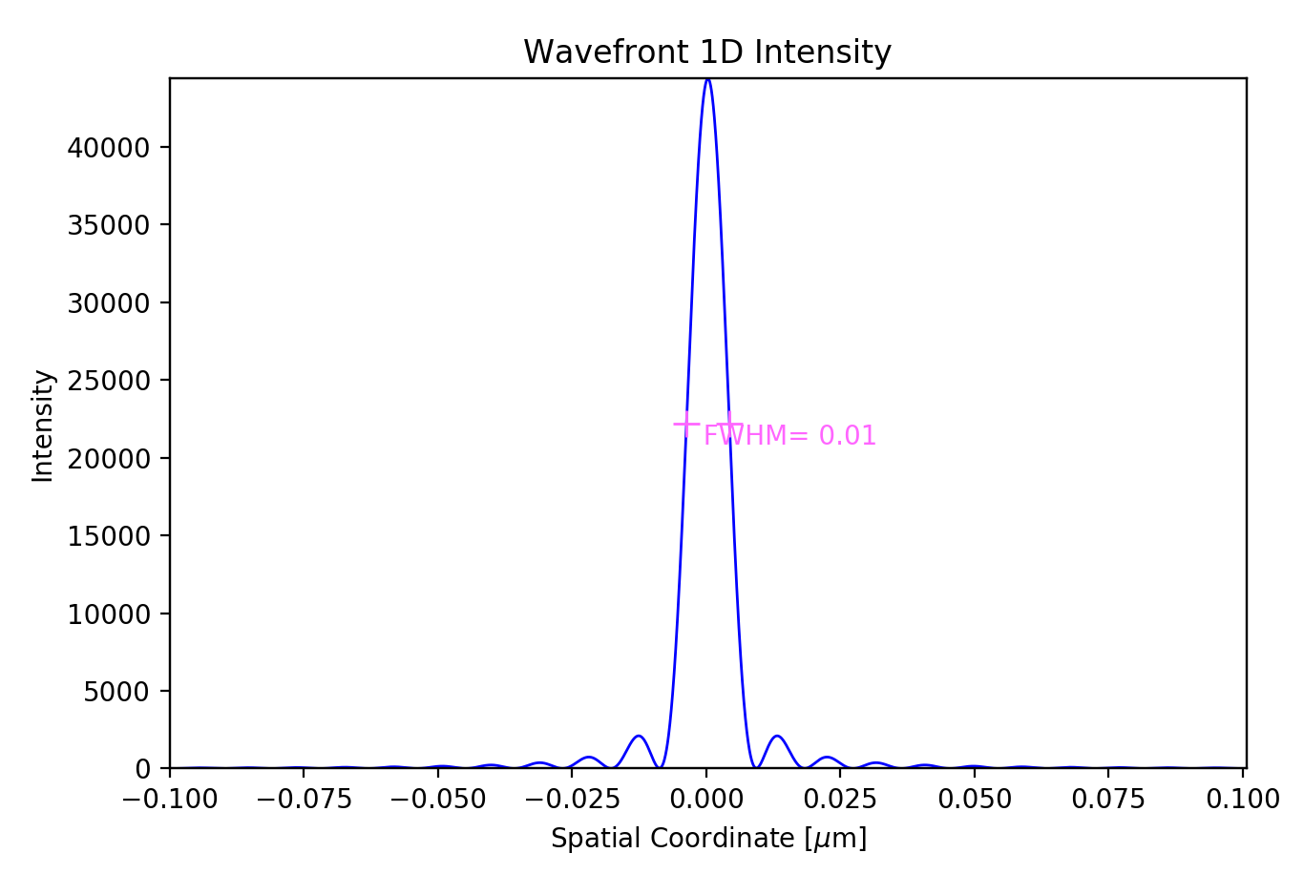
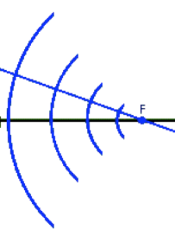
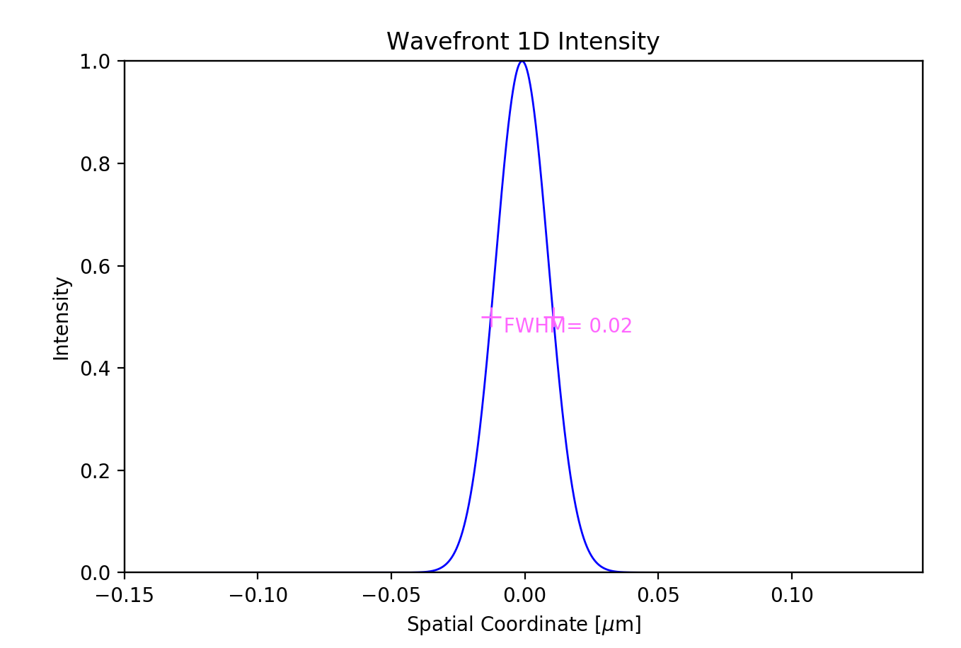

wofry_examples.ows simple propagation cases
Aperture=0.4 mm, Ε=17225 eV, D=5cm
Converging spherical +
Propagation (D)
Plane + Lens (F=D)+ Propagation (D)
F=D
Spherical divergent+ Lens (F=D/2)+ Propagation (D)
F=D/2
Gaussian+ Propagation(D)+ Lens (F=D/2)+ Propagation (D)
F=D/2
6

Slide 7
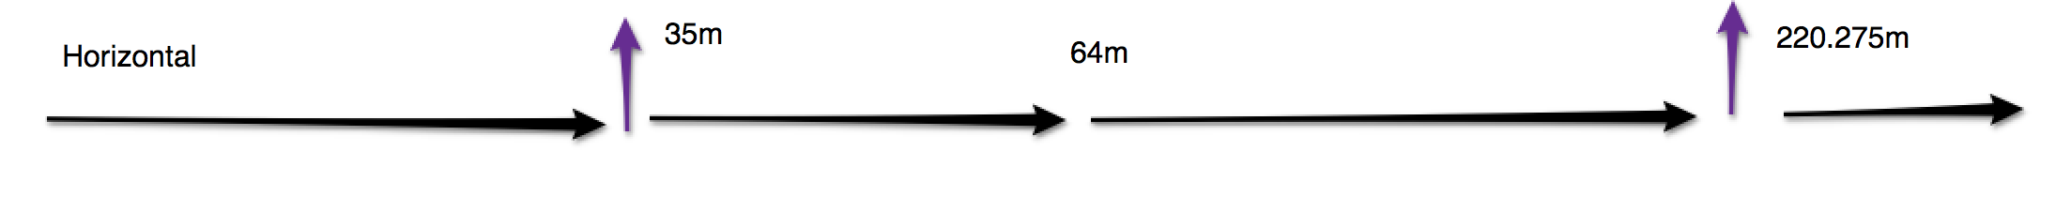
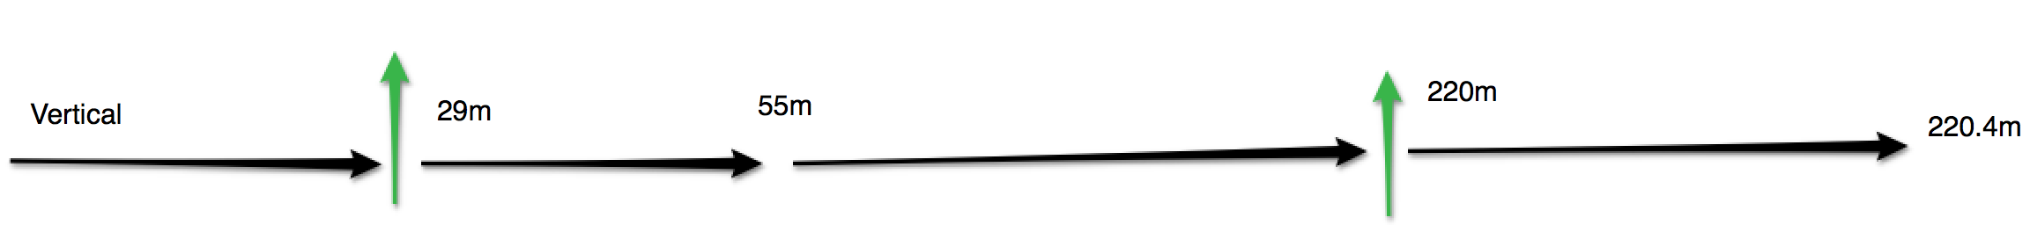
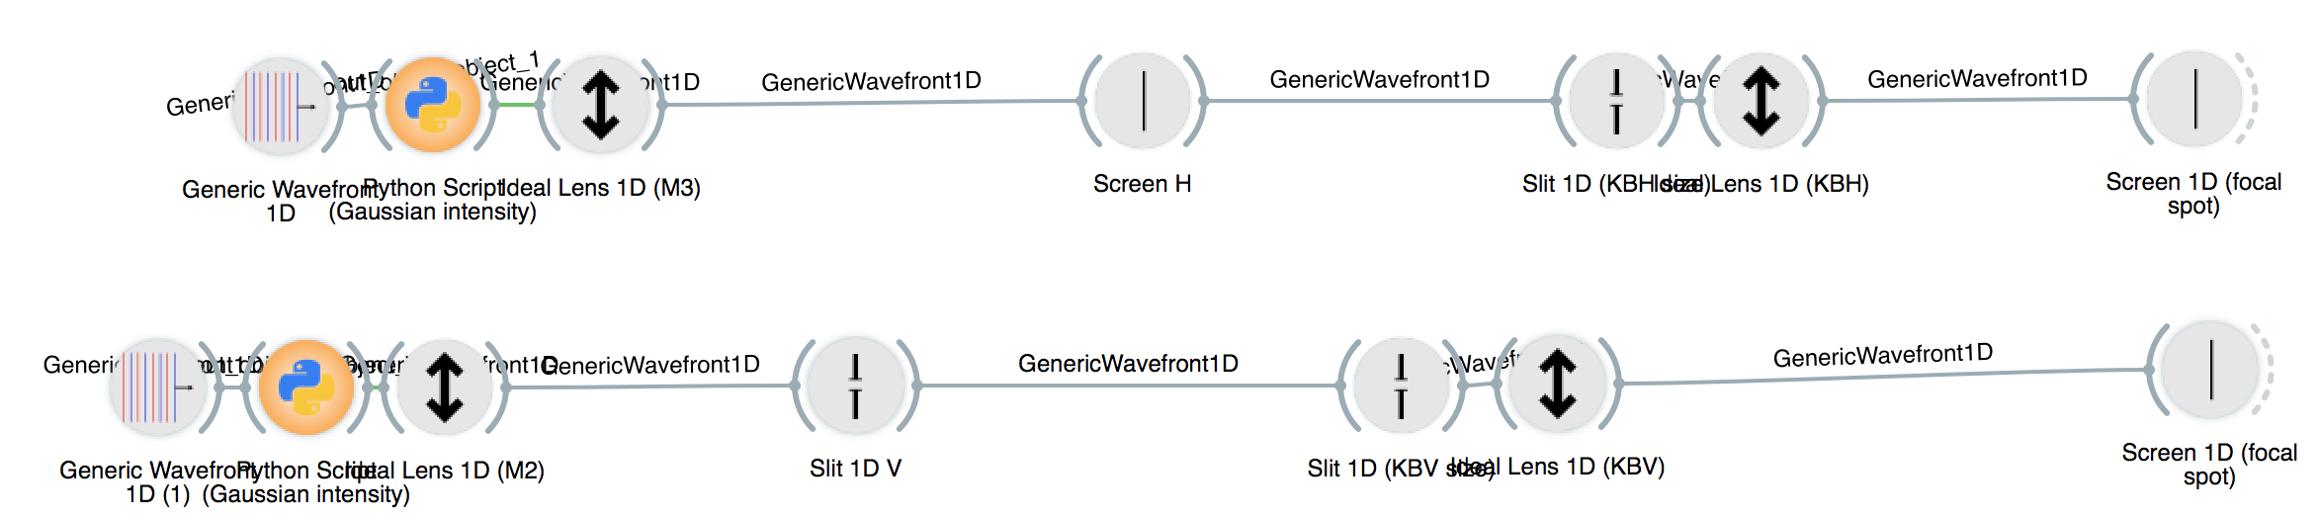
1D simplified model of ISN Beamline

Slide 8
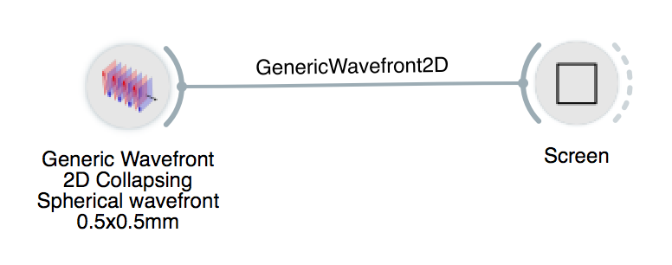
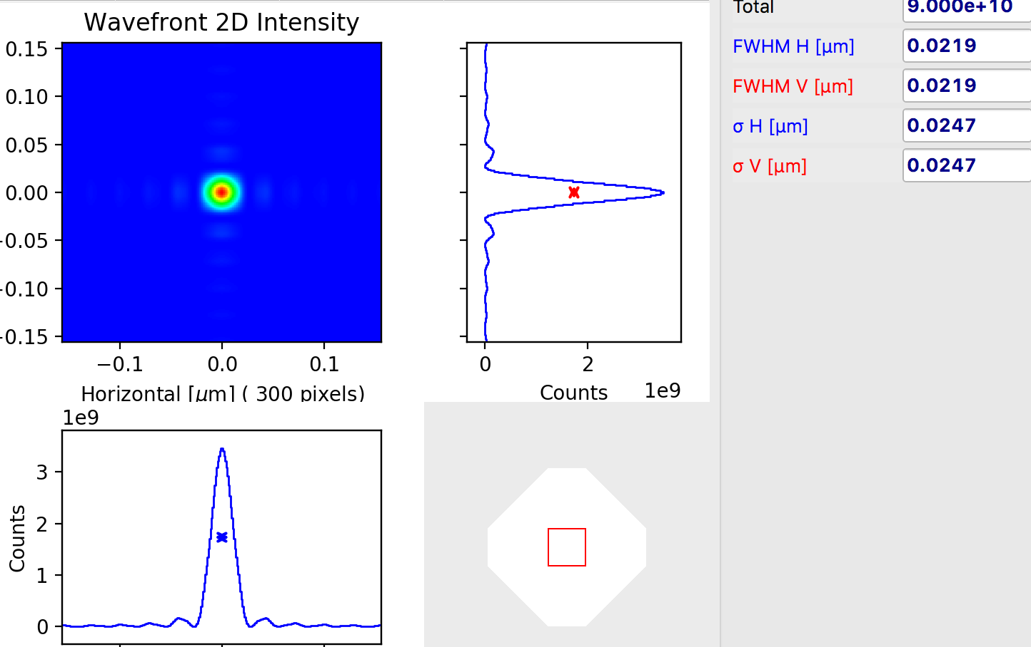
2D Oversimplified Beamline
Theoretical consideration
The diffraction by a DxD square aperture of a collapsing spherical wavefront has an intensity distribution proportional to sinc²(kDx/2f ) sinc²(kDy/2f), where k=2π/λ, x(y) is the horizontal (vertical) coordinate, and f is the distance aperture-focus (D/f is the divergence). Considering that the FWHM of sinc²(x) is approximately 2.78, one obtains a FWHM=0.885 * wavelength / divergence=18nm

Slide 9
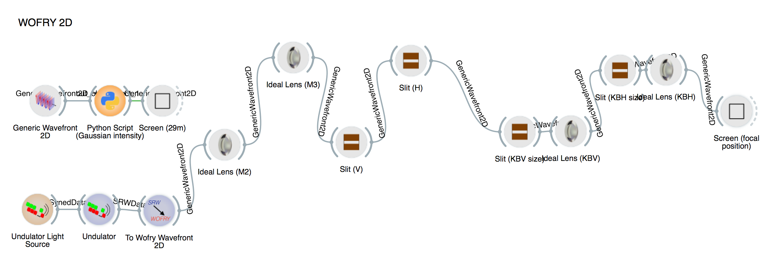
2D simplified model of ISN Beamline

Slide 10
Shortcuts to second OASYS school web:
http://tinyurl.com/r5fq6pe
http://tinyurl.com/v98cllg/﻿ISN_undulator_25KeV.json

