Slide 1

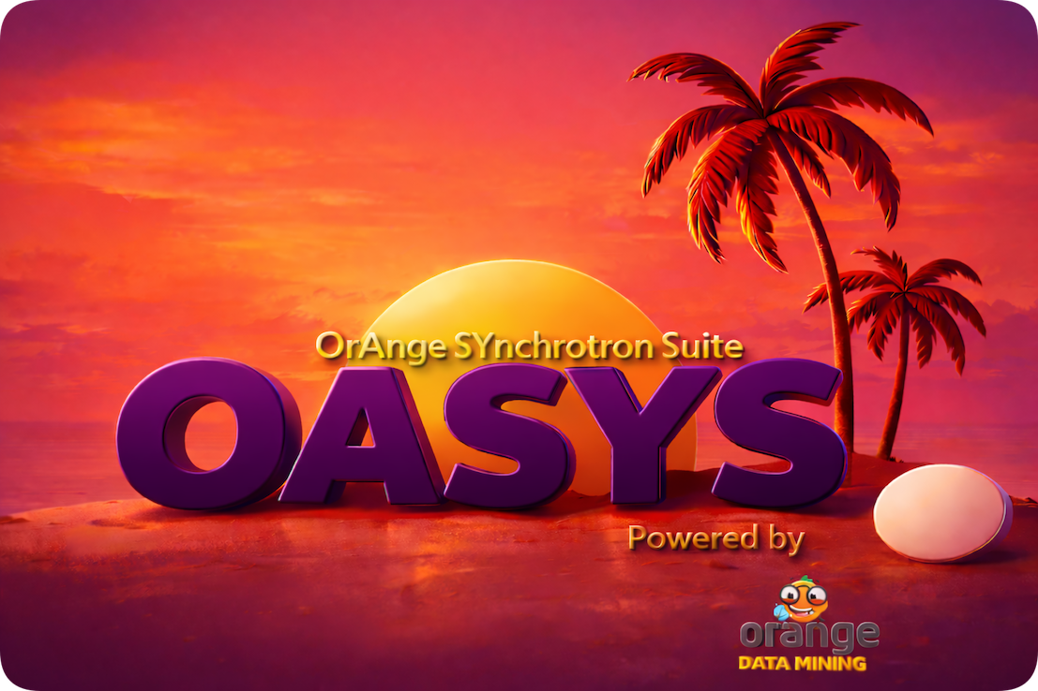
Scripting, programming, Oasys add-on’s
Manuel Sanchez del Rio
srio@esrf.eu
ESRF Grenoble, France

Slide 2
Scripting, programming, OASYS add-on’s
Outline:
Scripting in OASYS
Programming new sources or elements in shadow4
Creating your own OASYS widgets
Collaborating efforts
Conclusions

Slide 3
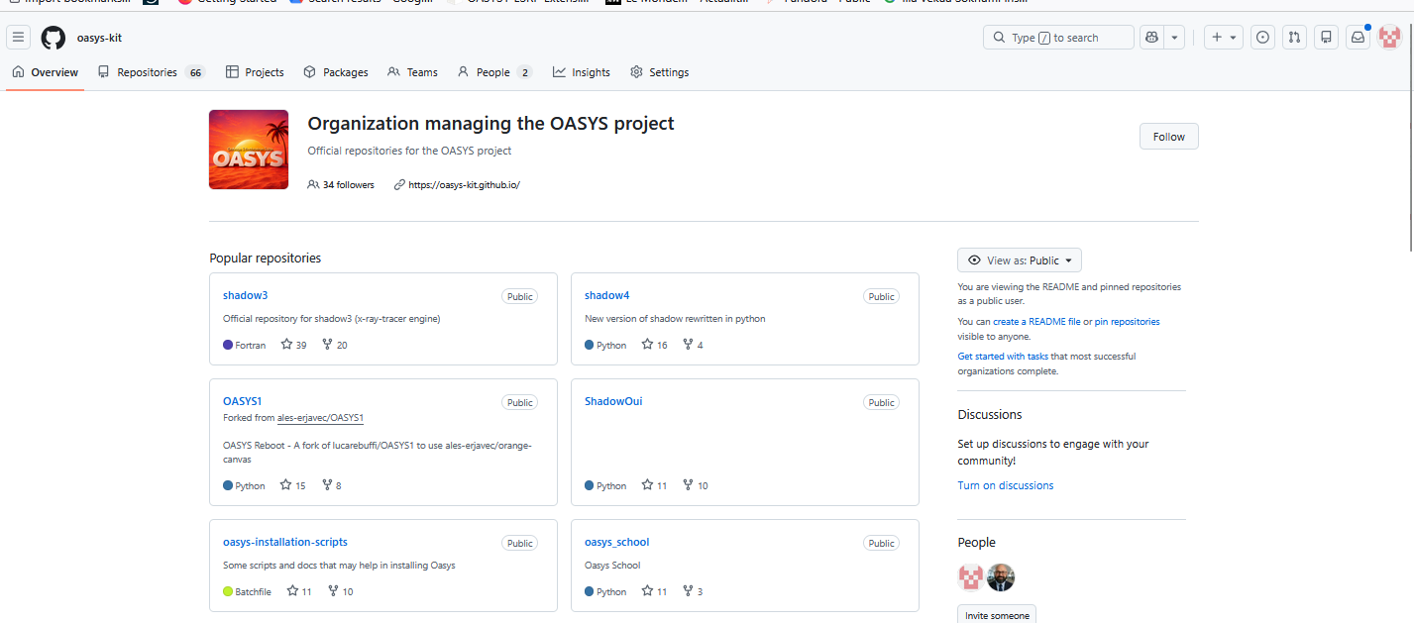
https://github.com/oasys-kit The GitHub organization oasys-kit is the Pandora's box of OASYS — open it, and you'll find the entire open source universe of synchrotron optics simulation waiting inside.

Slide 4
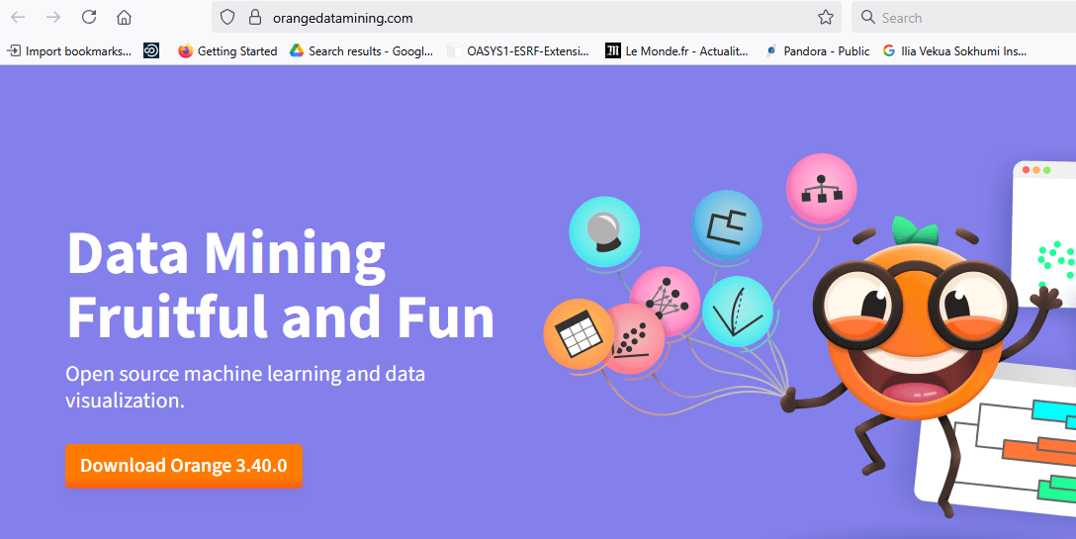
Orange3

Slide 5
Orange3-> Oasys2 -> Add-on’s
Interface: Oasys-Orange widgets Libraries
Your stuff in addon
ESRF add-on
OASYS2-ESRF-Extensions
https://github.com/oasys-kit
SRW
OASYS2-SRW + wofrysrw
Non-official official
WOFRY
OASYS2-WOFRY + wofryimpl + wofry
SHADOW4
OASYS2-SHADOW4 + shadow4
OASYS2-SHADOW4-Advanced + shadow4-advanced
XOPPY
OASYS2-XOPPY + xoppylib
SYNED
OASYS2-SYNED + syned

Slide 6
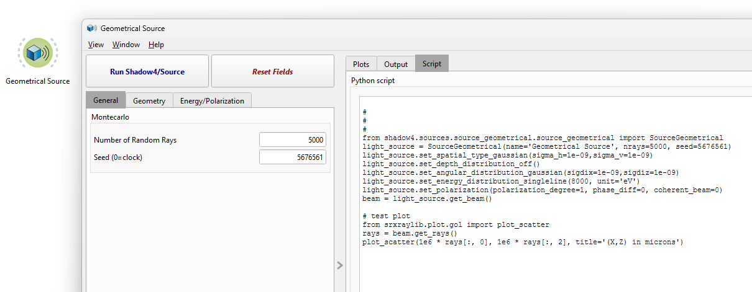
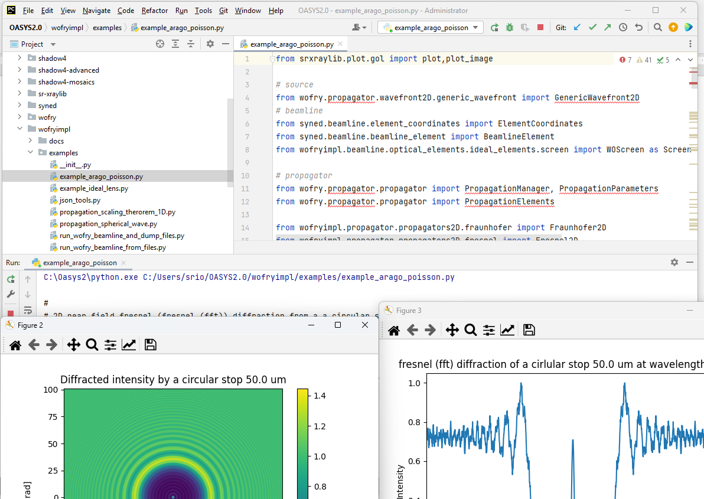
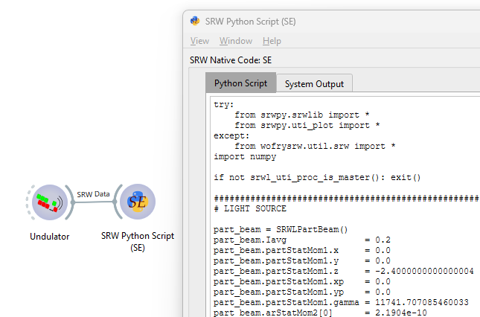
Automatic scripts (use base libs)
SHADOW4, XOPPY, WOFRY
SRW
Create your py env (or use OASYS2) pip install shadow4 (etc)…
Run locally

Slide 7
Scripts (programmer) doc
Download and use the source code
git clone https://github.com/oasys-kit/shadow4
https://shadow4.readthedocs.io/ (srxraylib, syned, crystalpy, wofryimpl, wofry, dabax, shadow4)
Automitize calculations, perform optimization, adapt in/out, make nice plots, etc.
See examples by Juan
Reporting problems/bugs
Write an issue
https://github.com/oasys-kit/shadow4/issues
Contact us (email)
etc

Slide 8
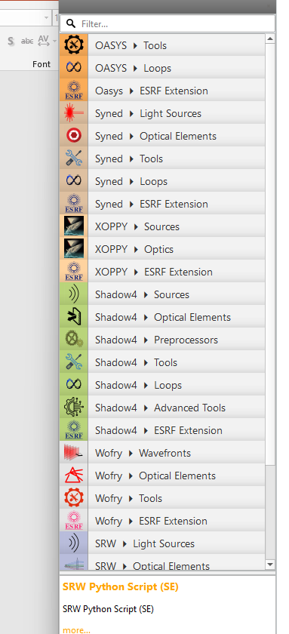
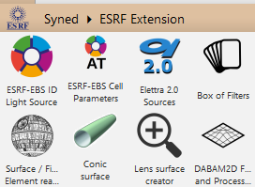

Add-on’s: Modify / write widgets
Create your own add-on: - personal add-on (new application, e.g. wiser) - facility “extension” add-on [call us for a get starting session]
Use existing widgets for starting (copy and modify)
User contributions promoted to general use: - provide widget + calculation code - suggest calculation code + widget by us
We are available for help, e.g. zoom sessions for getting started

Slide 9
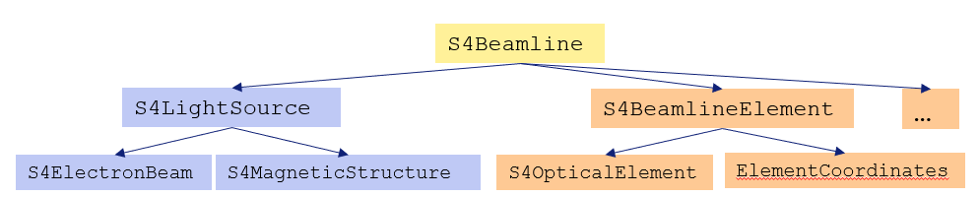
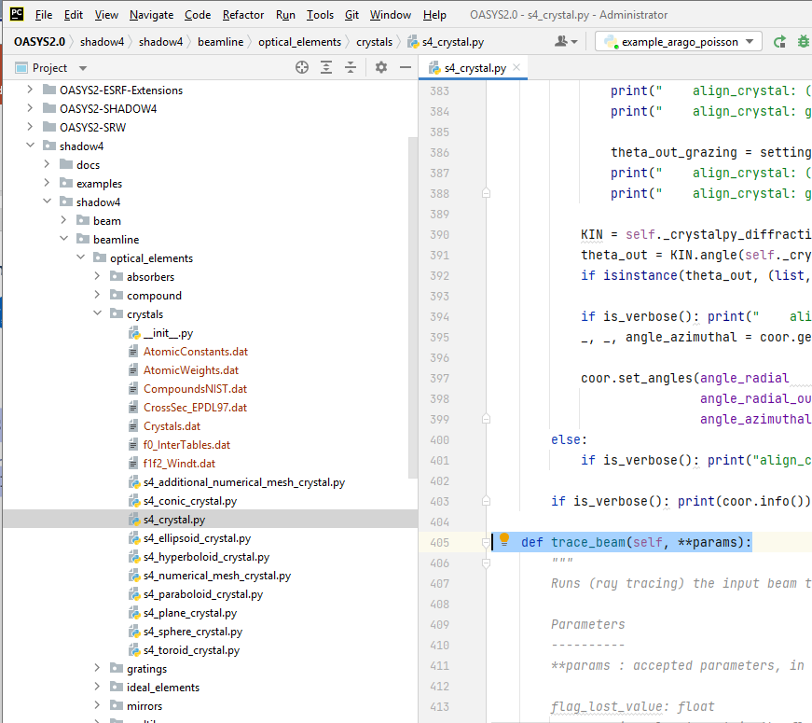
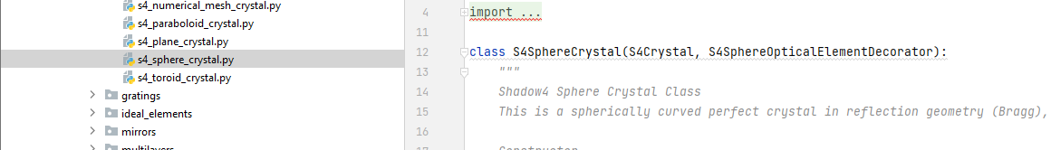
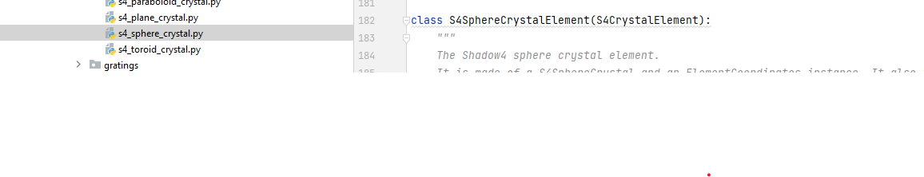
Shadow4: python package (kernel) + Interface (OASYS add-on) https://github.com/oasys-kit/shadow4
User API
Container: inheritates from SYNED
Performs calculation
Inheritates from s4_crystal

Slide 10
Thank you!

