Slide 1

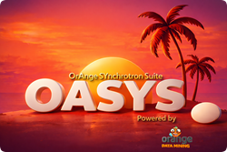
Hands-on scripting
Juan Reyes Herrera
juan.reyesherrera@elettra.eu
Optics group, Elettra Sincrotrone Trieste, Italy
Friday 20, 2026
ESRF Visitor Center
EPN Campus, Grenoble, France

Slide 2
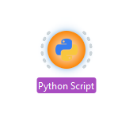
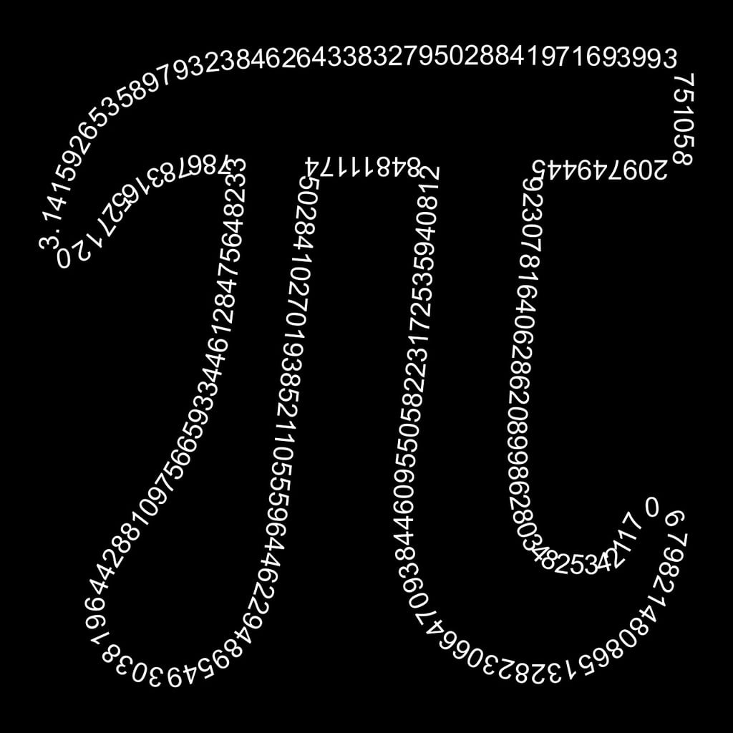
Hands-on scripting
A few examples:
Python scripts on OASYS GUI - SHADOW4
Estimating PI using SHADOW4
Full scripting: Mirror angular misalignments

Slide 3

Python scripts on OASYS GUI - SHADOW4
Please open the OASYS workflow:
eos26_hands-on_SHADOW4_scripting_part1.ows
GitHub repository:

Slide 4
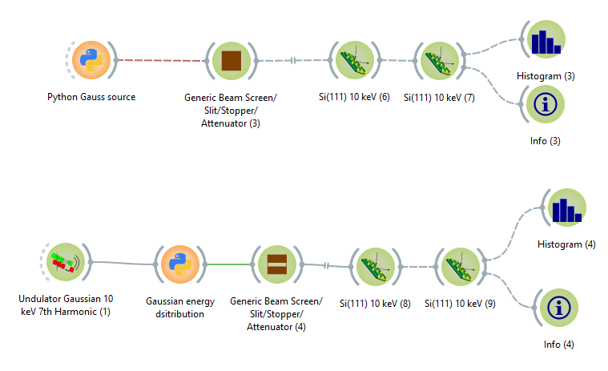
Python scripts on OASYS GUI - SHADOW4
In OASYS is possible to use Python scripts directly integrated into your visual workflows, example:
Using a script as source
Using a script to modify a beam
https://shadow4.readthedocs.io/en/latest/shadow4.beam.html#shadow4.beam.s4_beam.S4Beam.apply_attenuation

Slide 5



Estimating PI using SHADOW4
As an example of SHADOW4 scripting we can use its Monte Carlo random sampling to estimate PI.
$$\frac{\text{area} \text{of} \text{circle}}{\text{area} \text{of} \text{square}}=\frac{πr^{2}}{4r^{2}}=\frac{π}{4}$$
$$r$$
$$π=4\frac{\text{number} \text{of} \text{points} \text{inside} \text{the} \text{circle}}{\text{number} \text{of} \text{point} \text{inside} \text{the} \text{square} }$$

Slide 6
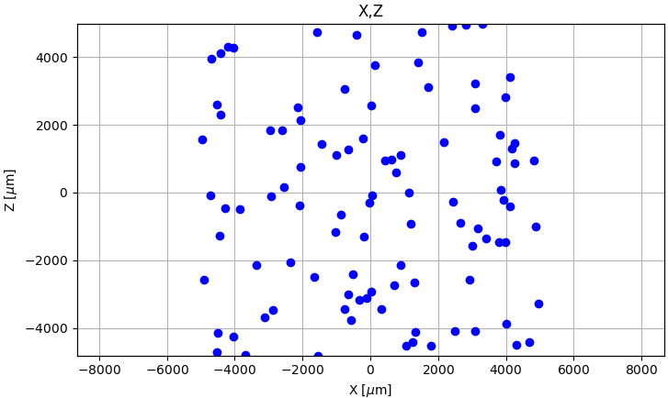
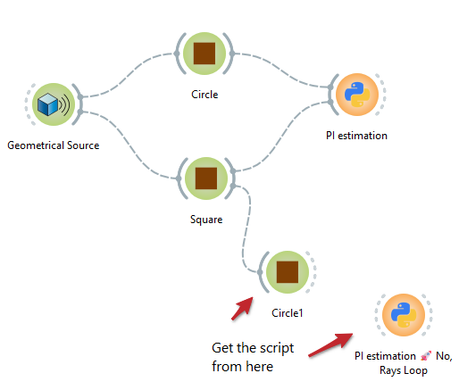
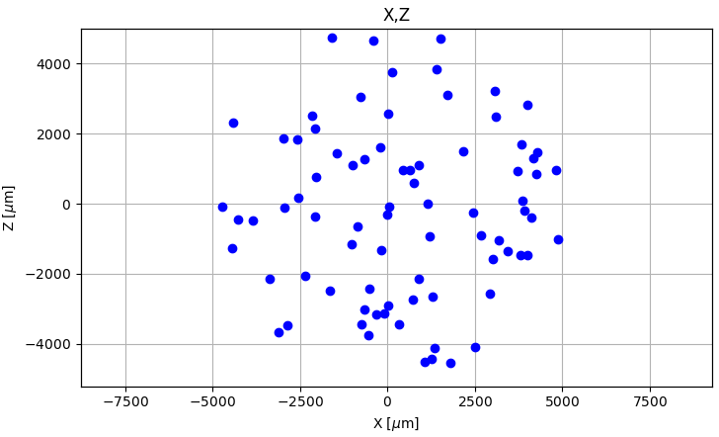
Estimating PI using SHADOW4
Square slit
S4 workflow
Circle slit

Slide 7
Python scripts on OASYS GUI - SHADOW4
Please open the OASYS workflow:
eos26_hands-on_SHADOW4_scripting_part2_misalignment.ows
GitHub repository:

Slide 8
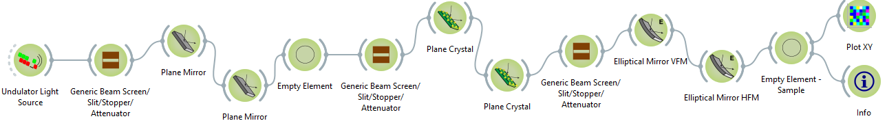
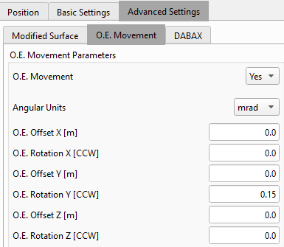

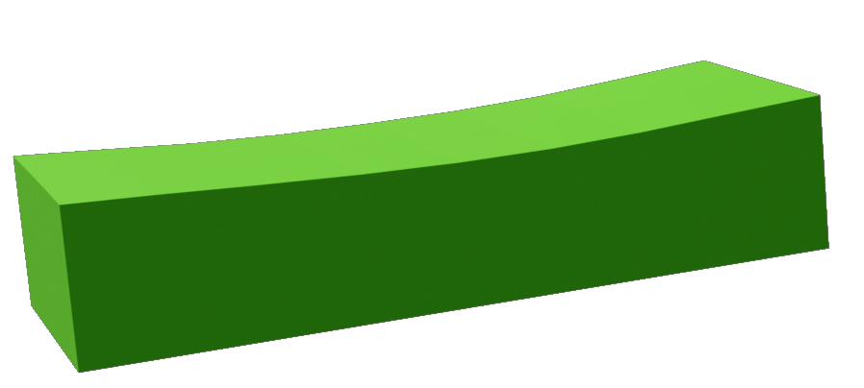
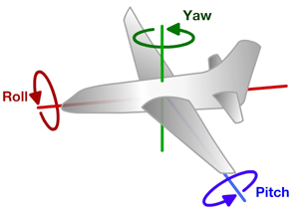
Full scripting: Mirror angular misalignments
Example on SHADOW4 scripting to get a KB mirror misalignment effect on the beam.
S4 workflow
Mirror angular misalignment
Z
Yaw = Rotation Z
Roll = Rotation Y
Y
X
Pitch = Rotation X

Slide 9
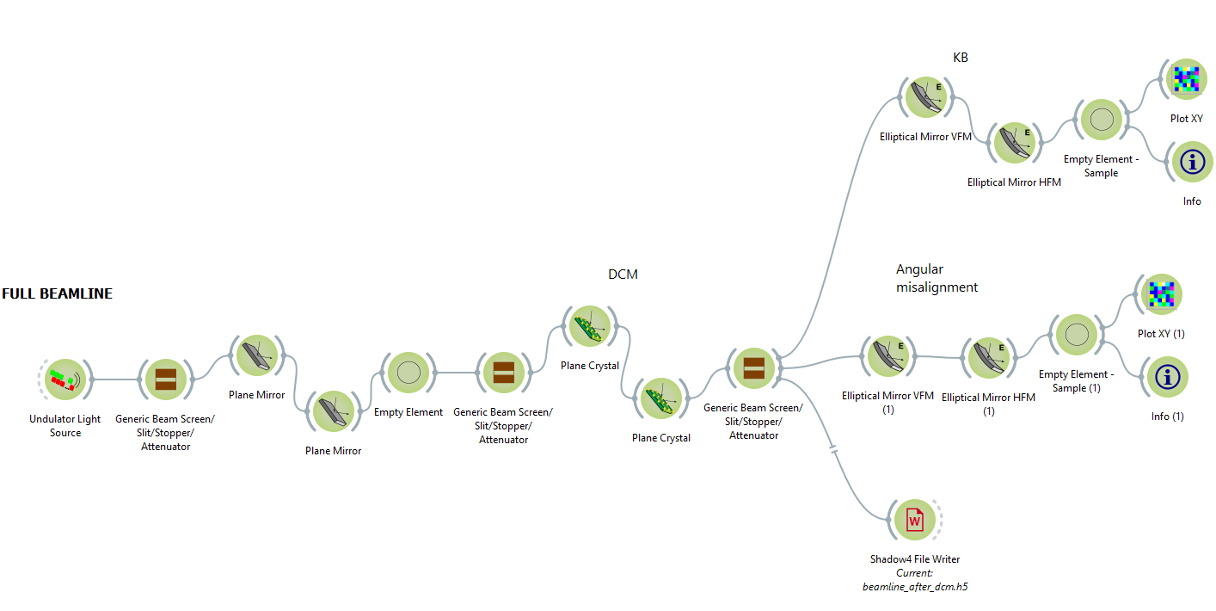
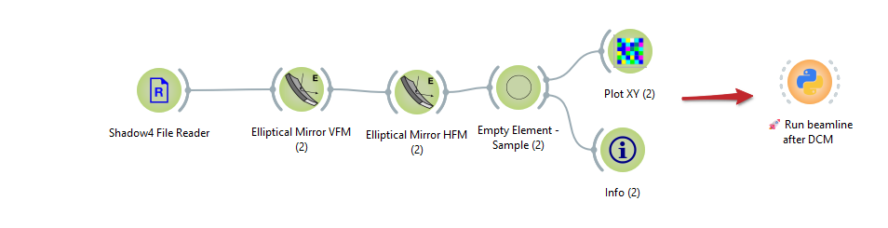
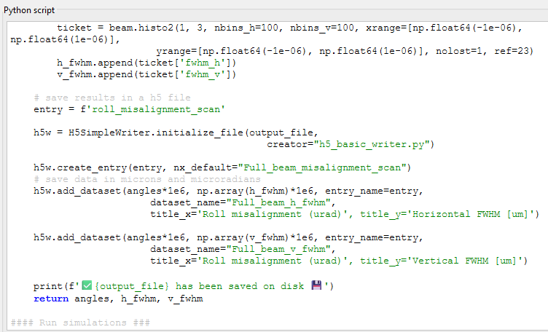
Full scripting: Mirror angular misalignments
Using a shadow4 beam file
Full beamline script

Slide 10
Thank you!

