Slide 1


Call For Contributions
TAO 2.5

Slide 2

Introduction
How to Contribute ?
What is the process ?
How much effort ? What type of competencies are required ?
How to make sure my contribution will be correctly integrated ?
Tools ?
Where do I start ?
What are the typical contributions ?

Slide 3
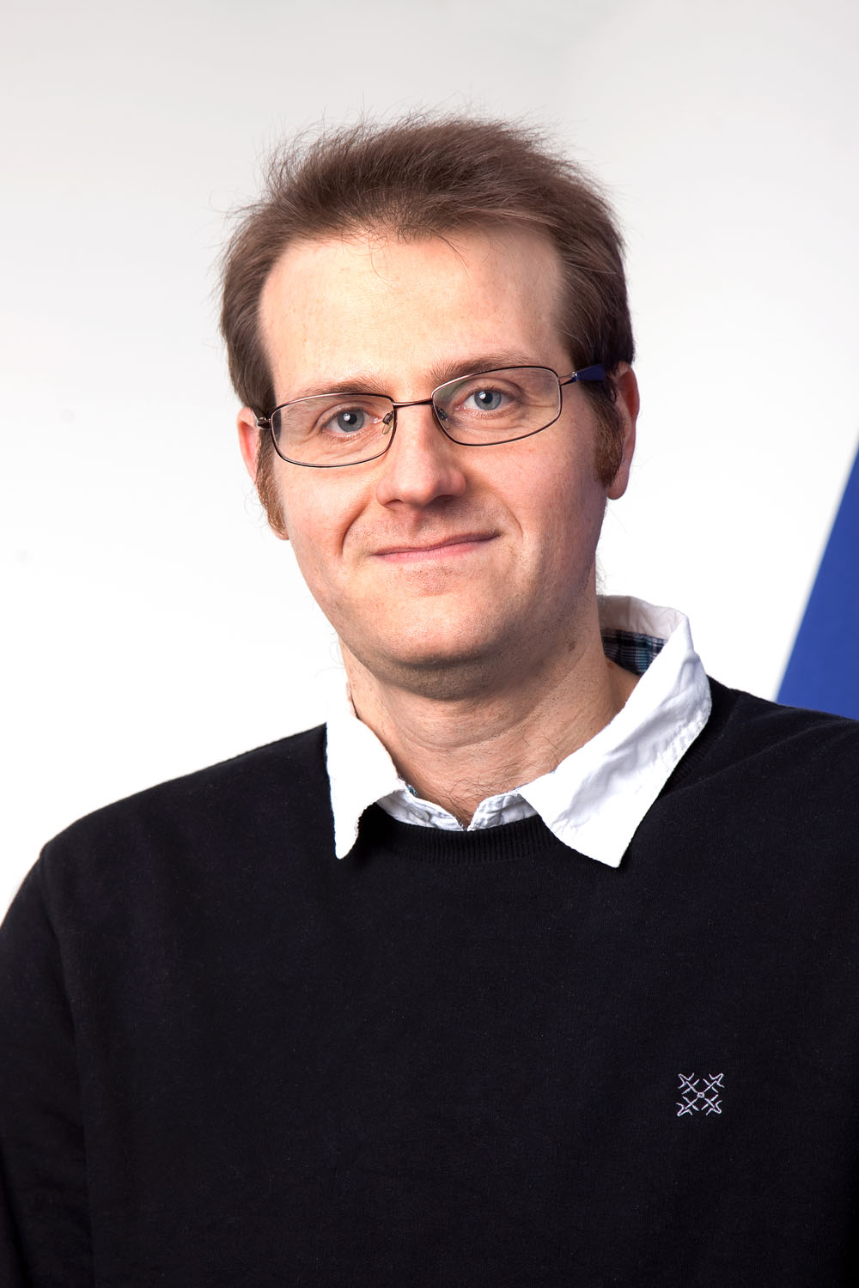

Your New Friend !
First Name: Lionel
Email: lionel@taotesting.com
“The strength of the team is each individual
member. The strength of each member
is the team”
Do you have something in mind for
a potential contribution ?
Press the button !
Q/A responsible

Slide 4
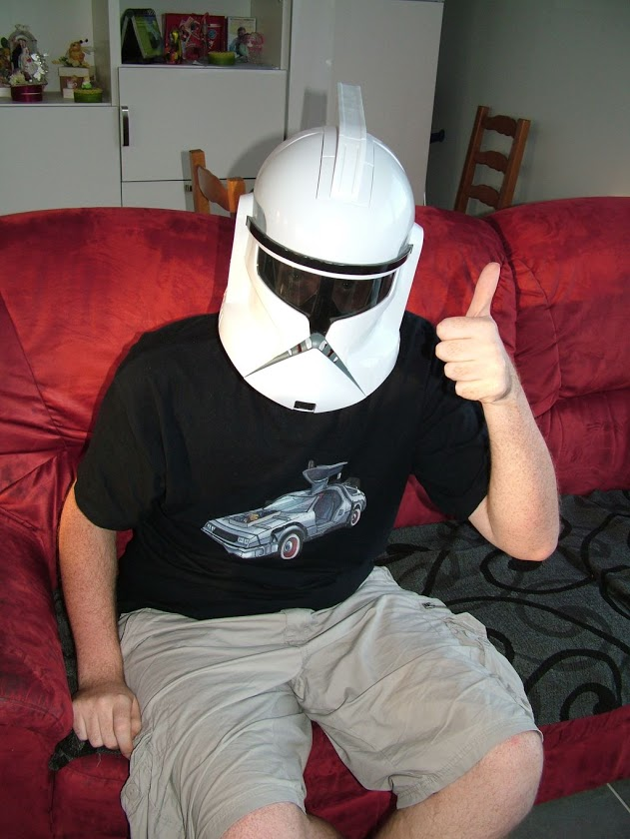
Your New Friend !
First Name: Lionel
Email: lionel@taotesting.com
Do you have something in mind for
a potential contribution ?
Q/A responsible

Slide 5
Typical contributions
* Testing
* Reporting
* Feedbacks/Features requests
* Translate TAO
* Build items/tests and share them
* Share tutorials or documentations on any component
* Participate to our focus groups
* Develop new extensions
Our tools :
http://forge.taotesting.com
http://translate.taotesting.com/
Typical contributions

Slide 6

Call For Contributions
1 – Focus Group on TAO Usability
Participate to our monthly online focus group on usability. Proposals for new interfaces will be presented to you. Share your opinion to improve our GUI !
Another New Friend !
First Name: Sophie
Email: sophie@taotesting.com
Q/A responsible

Slide 7
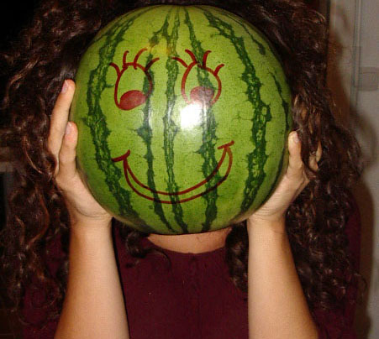
Call For Contributions
1 – Focus Group on TAO Usability
Give a new face to TAO
Objective: have our first online meeting : Oct, 23th
The only thing you need to do is to raise your hands.
Q/A responsible

Slide 8
Call For Contributions
2 – External Results Storage
TAO Results storage interface allows to customize how the data gets stored
Send along data through REST into JasperReports ?
=> Separation of concerns
Another New Friend !
First Name: patrick
Email: patrick@taotesting.com
Dir. Soft. Dev.

Slide 9
Call For Contributions
3 – Adaptive Testing
TAO Test driver interface allows for custom external drivers implementation
Another New Friend !
First Name: Joel
Email: joel@taotesting.com
The Architect

Slide 10
Call For Contributions
4 - Mobile Continuous Testing
Subscribe to our mobile tester focus group. You will receive notification by email for testing TAO tests on your mobile smart-phone/tablets.
5 - Rest Connectors From Java/Python/ ???
Implement independent Library helping programmers to handle TAO data remotely from another technology
Other contributions

Slide 11
Summary
1 – We need developers but also translators, testers, content providers, usability experts, technical Writers, education representatives, etc.
2 – There are supportive tools on our
Forge.tao.lu
==> forums
==> wiki
==> Bug tracker
==> New features requests
But in case you have doubt just drop an email to :
lionel@taotesting.com
Or
info@taotesting.com
The Architect

