Slide 1
Kairos VR
Jonathan Oates
Kaitlin Dell

Slide 2
General Description
Strategic space-combat game in which you control your ship via a holographic display in front of you. The primary focus is on out-maneuvering and outwitting your opponents.
Holographic table in front of you (effectively top-down)
Spacey controls (conservation of momentum, etc.)
Can freeze time in order to plan attacks and maneuvers

Slide 3
Basic Mechanics
Flight Controls
Ship flies towards reticle (controlled by Vive wand)
Weapon Controls
Ship fires active weapon towards reticle (where applicable)
Range, accuracy, rate of fire, and effects vary
Time Pause
Temporarily freeze time in order to plan attacks and maneuveurs

Slide 4
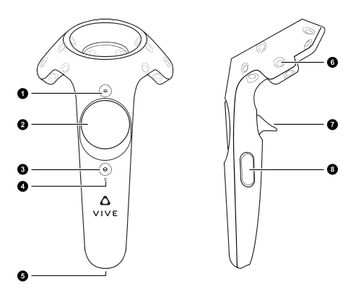
Controls
options menu
R: weapons radial
L: ship radial
fire/use
Steam Overlay
pause time

Slide 5
Timeline
November 22nd
Continued sound discovery
Sound implementation
Continued texturing
Initial playtesting
November 29th
Playtesting continued
Changes based on playtesting results planned (implementation started)
December 6th
Trailer draft
Playtest changes implemented
December 13th
All the things done (posters, documents, etc.)
Final version built and ready for demo

Slide 6
Play-Testing Plans
Primary Group: Friends and Family
Wide range in gaming experience
Wide age range (children to adults)
General Strategy
How much fun was had (focus and duration of play)
Usage of mechanics (weapon-switching and time-slow)
How easy game was to explain (intuitiveness)
Game Mode: Asteroids!
Already a known game for most players
Very basic ruleset for actual game (don’t die)
Primary focus becomes the use of our game’s specific mechanics

