Slide 1
Kairos VR
Jonathan Oates
Kaitlin Dell

Slide 2
General Description
Strategic space-combat game in which you control your ship via a holographic display in front of you. The primary focus is on out-maneuvering and outwitting your opponents.
Holographic table in front of you (effectively top-down)
Spacey controls (conservation of momentum, etc.)
Can freeze time in order to plan attacks and maneuvers

Slide 3
Basic Mechanics
Flight Controls
Ship flies towards reticle (controlled by Vive wand)
Weapon Controls
Ship fires active weapon towards reticle (where applicable)
Range, accuracy, rate of fire, and effects vary
Time Pause
Temporarily freeze time in order to plan attacks and maneuveurs

Slide 4
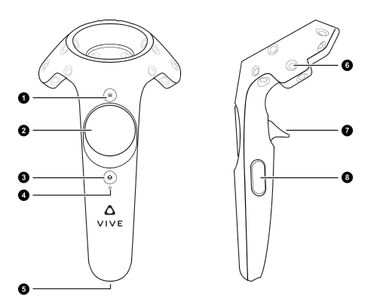
Controls
options menu
L: weapons radial
R: ship radial
fire/use
Steam Overlay
pause time

Slide 5
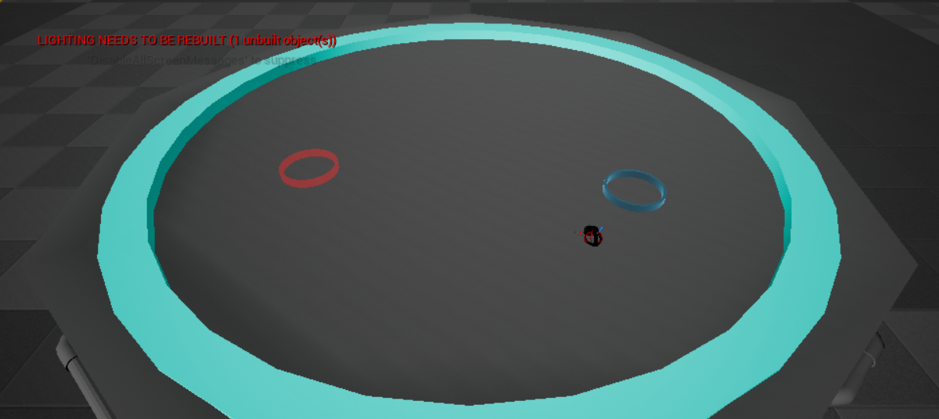
In Game (WIP)
weapon control
ship control
bullet trace
player ship

Slide 6
Not Shown in Screenshot
Additional monitors
Monitors will be arrayed above the table
Give information regarding enemy ships, weapon cooldowns, etc.
Additional ships
Enemy ships will vary in style according to faction of ship
Cabin interior
Detailed interior of your ship’s cabin that reacts to game events
Ex: Lights go red and dark when ship is heavily damaged

Slide 7
Timeline
November 8st
Continued programming (dynamic environment, AI refinement, additional weapons)
Sound discovery
Trailer produced and edited
November 15th
Continued programming (for remainder of project)
Mission implementation (simple goals to start)
Trailer refinement
November 22nd
Sound implementation
Texturing done
November 29th
Playtesting conducted
Changes based on playtesting results planned (implementation started)
December 6th
Trailer fully refined (sounds, updated gameplay footage, titles, etc.)
Playtest changes implemented
December 13th
All the things done (posters, documents, etc.)
Final version built and ready for demo (also project saved to USB drive)

Slide 8
Engines, APIs, etc.
Unreal Engine 4.17.2 (4.18 if easily portable)
Autodesk Maya 2018
Substance Painter
HTC Vive (full setup)

