Slide 1

Slide 1
Medical Insurance Fraud Detection
Data Incubator Capstone Project
Tao Lang

Slide 2

Slide 5
Background: Medicare Fraud
17%
The United States spends 16.9% of its GDP on healthcare, almost double the amount of the average OECD country¹ .
Medicare fraud is the claiming of Medicare health care reimbursement to which the claimant is not entitled.
The project is for senior directors and auditors from the Center for Medicare & Medicaid services who administer/audit the Medicare programs to monitor fraud, defend their decision to audit, and reduce costs.
9.4%
9.4%² of sampled Medicare claims are detected as fraud.
5%
Fewer than 5% of Medicare claims are being audited.
https://www.commonwealthfund.org/publications/issue-briefs/2020/jan/us-health-care-global-perspective-2019
This is extracted from data with time horizon between Dec 2008 and Dec 2009 .
1

Slide 3

Slide 9
Data Introduction
Beneficiaries are the individuals
who are enrolled in Medicare
Inpatient services where the patient is
admitted into the facility (e.g. hospital)
Data Cleansing and Data Wrangling
Beneficiary ID
Demographic data
Inpatient/Outpatient annual
reimbursement amount in $
Inpatient/Outpatient annual
deductible amount in $
Chronic condition
Beneficiary ID
Claim ID and Claim date
Amount of reimbursement
Days in hospital
Insurance deductible paid in $
Procedure Code
ID of physician
Created variables
Average Amount per Procedure/Physician/Operation
Deductible Ratio
Cost per day in hospital
etc.
R
Beneficiary
11 MB
Provider
85 KB
Inpatient
8 MB
Outpatient
73 MB
Additional
Data/Variable
XG Boost
Logistic Regression
provider is the organization
who provides the care
Outpatient services consists of visits to a
physician but not admitted to the hospital
Provider ID
Fraud Flag
Beneficiary ID
Claim ID and Claim date
Amount of reimbursement
Insurance deductible paid in $
Procedure Code
ID of physician
2

Slide 4

Slide 2
Data Summary
Gender% in Acct
Race% in Acct
Age Group % in Acct
State (%) in Fraud Acct
3
Notes:
123

Slide 5
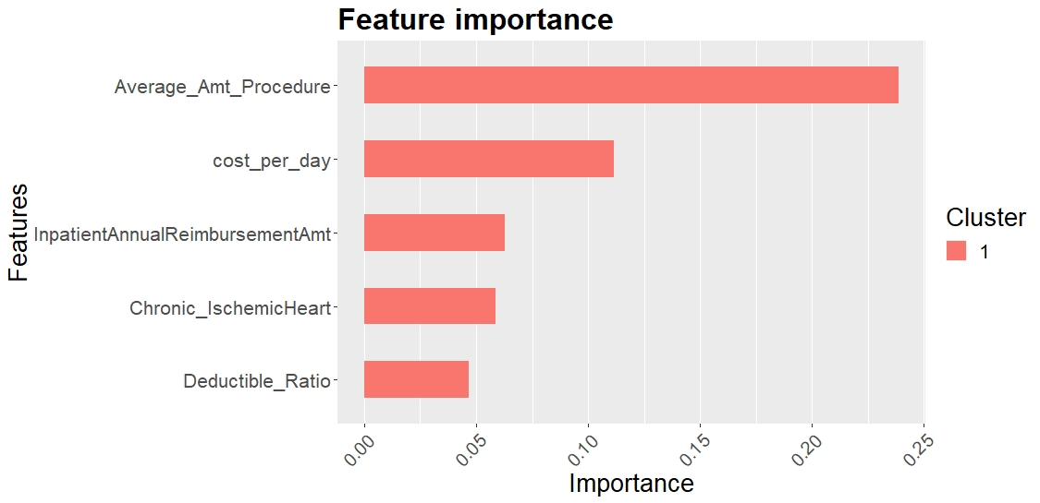
Slide 3
Important Features
Model Performance
90%
Accuracy
87%
Prediction Power
4

Slide 6
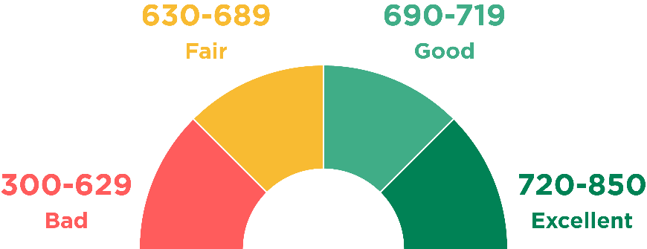

Slide 8
Scorecard and Traffic Light
Fraud Risk
High
Medium
Low
5
8

Slide 7
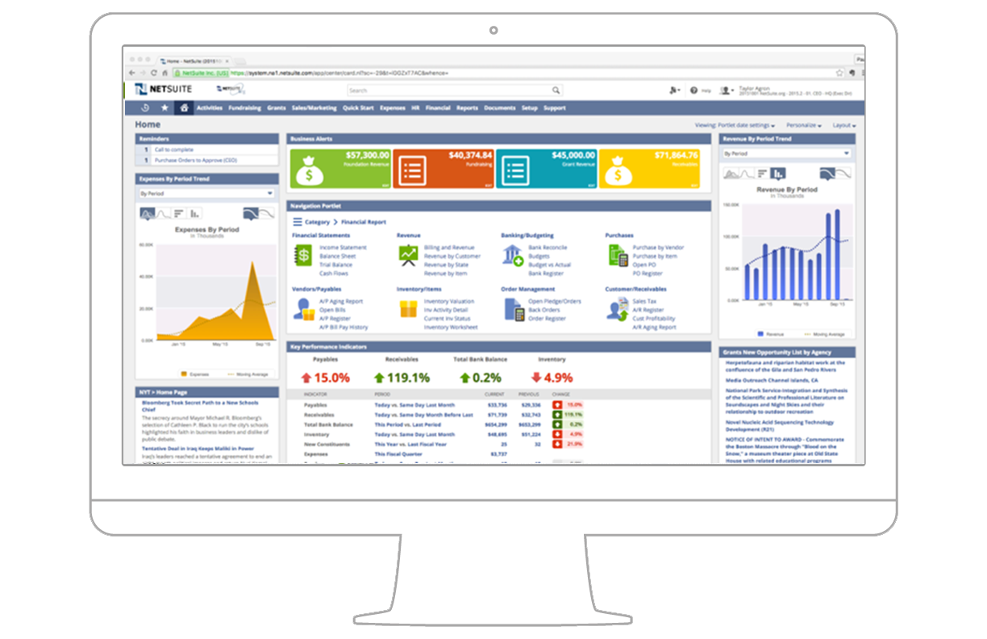
Slide 8
User Interface – Dashboard (Example)
Enter Claim information/Provider information, then the system can computer a score and probability of fraud.
Assorted accounts by color
The probability of fraud for certain provider y/y
Overall correct fraud detection y/y
6
8

Slide 8
Slide 10
Key Takeaway
Cost Saving
High Accuracy
The model can help reduce costs in 2 ways. First, save $Billions fraud spending; second, save labor costs to review files.
With accuracy of 90% to detect fraud, the model can be calibrated frequently to absorb new information.
The hybrid model system tells us not only what factors are the most important, but also why and how we could use the factors to detect fraud. This can help auditors to defend themselves. Additionally, the model embedded Dashboard is accurate, cost saving, user friendly and time saving.
User Friendly
Time Saving
Dashboard provides user friendly, easy interpretation, and straightforward information for auditor to defend themselves.
From data to final results, there is non-stop.
7

Slide 9
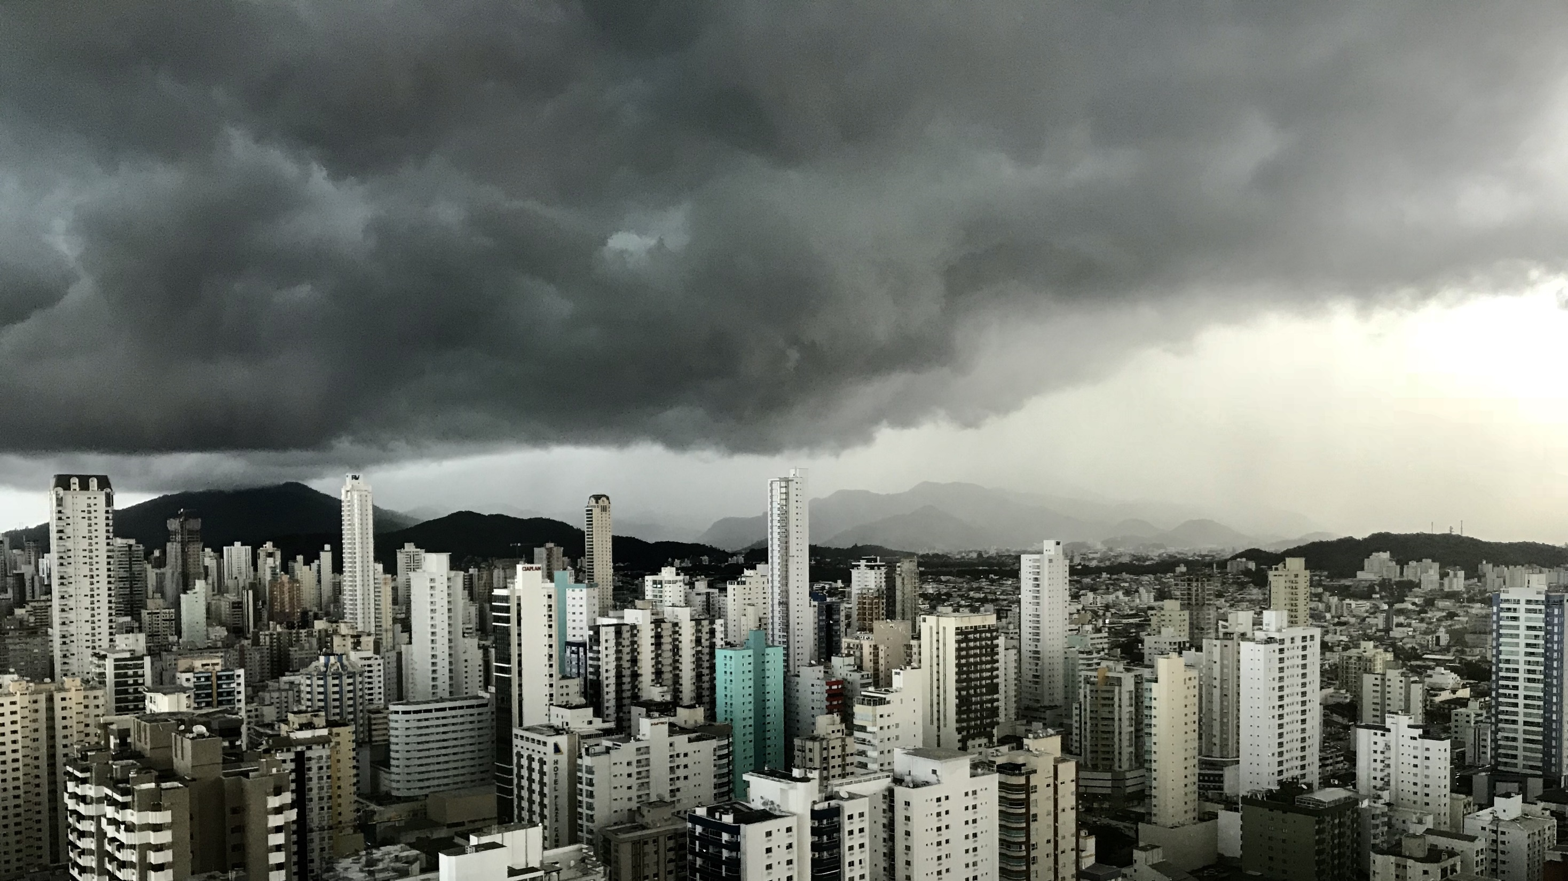
Slide 11
Thank You

