Slide 1
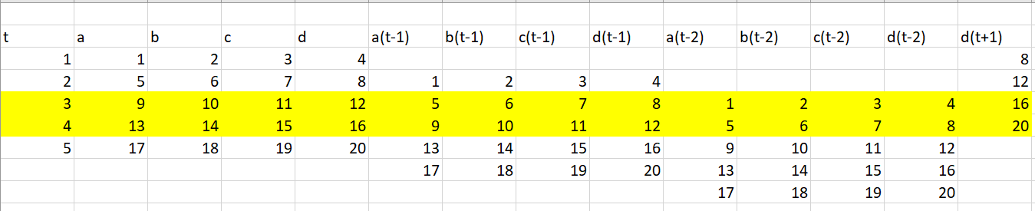
Implementation to include more time step lag
Main ideas:
Treat different time step lag data as separate feature/input
Reconsolidate results when constructing Boolean network
Implementations:
Preprocess data to expand input X while maintain label Y
Adjust CGP & MLP parameters accordingly
Combine regulatory genes together when calculating structure accuracy

Slide 2
True positive comparison
Time step lag = 1
TP | Max | Min | Mean | Var
STD | 6 | 0 | 3.2666 | 2.6850
FIT | 6 | 1 | 3.6333 | 1.6195
MLP | 7 | 2 | 4.2333 | 1.6333
Time step lag <= 3
TP | Max | Min | Mean | Var
STD | 7 | 3 | 4.2333 | 2.0471
FIT | 8 | 3 | 4.7 | 1.8034
MLP | 8 | 3 | 5.0666 | 1.5126

Slide 3
False positive comparison
Time step lag = 1
FP | Max | Min | Mean | Var
STD | 18 | 4 | 11.6333 | 16.1022
FIT | 17 | 8 | 12.5 | 7.5
MLP | 21 | 10 | 14.8 | 7.5448
Time step lag <= 3
FP | Max | Min | Mean | Var
STD | 21 | 7 | 14.6 | 11.6275
FIT | 19 | 11 | 15.3333 | 3.8850
MLP | 23 | 13 | 16.7 | 4.8379

Slide 4

Time step lag = 1
Structural | Max | Min | Mean | Var
STD | 0.8024 | 0.5925 | 0.6868 | 0.0027906
FIT | 0.7654 | 0.6172 | 0.6806 | 0.0013531
MLP | 0.7407 | 0.5802 | 0.6596 | 0.0013946
Time step lag <= 3
Structural | Max | Min | Mean | Var
STD | 0.7530 | 0.5555 | 0.6621 | 0.0022335
FIT | 0.7407 | 0.6049 | 0.6588 | 0.0010877
MLP | 0.7160 | 0.5555 | 0.6465 | 0.0012033

Slide 5
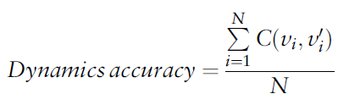
Time step lag = 1
Dynamic | Max | Min | Mean | Var
STD | 0.7198 | 0.4879 | 0.5895 | 0.003953712
FIT | 0.9227 | 0.8743 | 0.8964 | 0.000158830
MLP | 0.9178 | 0.8599 | 0.8863 | 0.000199148
Time step lag <= 3
Dynamic | Max | Min | Mean | Var
STD | 0.7195 | 0.4550 | 0.5800 | 0.003991631
FIT | 0.9735 | 0.9259 | 0.9490 | 0.000172762
MLP | 0.9682 | 0.9100 | 0.9403 | 0.000191007

Slide 6
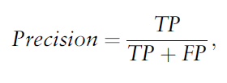
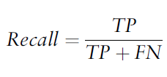
Precision | Max | Min | Mean | Var
STD | 0.5555 | 0.0 | 0.2274 | 0.014392109
FIT | 0.4285 | 0.0625 | 0.2270 | 0.006120946
MLP | 0.3750 | 0.1176 | 0.2234 | 0.004200752
Recall | Max | Min | Mean | Var
STD | 0.3529 | 0.0 | 0.1921 | 0.009290856
FIT | 0.3529 | 0.0588 | 0.2137 | 0.005603945
MLP | 0.4117 | 0.1176 | 0.2490 | 0.005651672
Notes:
Precision is the ratio of correctly inferred connections over the total number of positive Predictions
Recall is the ratio of true predicted connections over the total number of actual connections

Slide 7
Structural | Max | Min | Mean | Var
STD | 0.8024 | 0.5925 | 0.6868 | 0.0027906
FIT | 0.7654 | 0.6172 | 0.6806 | 0.0013531
MLP | 0.7407 | 0.5802 | 0.6596 | 0.0013946
Dynamic | Max | Min | Mean | Var
STD | 0.7198 | 0.4879 | 0.5895 | 0.003953712
FIT | 0.9227 | 0.8743 | 0.8964 | 0.000158830
MLP | 0.9178 | 0.8599 | 0.8863 | 0.000199148
Notes:
Structural accuracy is the ratio of correct predictions out of all predictions
average of gene-wise dynamics consistency over all genes

Slide 8
Structural Accuracy
Methods | CDC-15 | CDC-28 | In Silico-1 | In Silico-2 | S.cerevisiae
my | 0.7654 | 0.7654 | 0.7600 | 0.8500 | 0.7603
NNBNI | 0.7820 | 0.7654 | 0.7653 | 0.8144 | 0.7661
GABNI | 0.7160 | 0.7073 | 0.7373 | 0.7777 | 0.7120
ARACNE | 0.6585 | 0.5476 | 0.6633 | 0.6000 | 0.6796
GENIE3 | 0.6125 | 0.5421 | 0.5533 | 0.6237 | 0.6720
dynGENIE3 | 0.6097 | 0.5609 | 0.6435 | 0.6336 | 0.6666
BTNET | 0.5802 | 0.5662 | 0.6800 | 0.7600 | 0.6929

Slide 9
Dynamic accuracy
Methods | CDC-15 | CDC-28 | In Silico-1 | In Silico-2 | S.cerevisiae
my | 0.9420 | 0.9166 | 0.8850 | 0.9500 | 0.8983
NNBNI | 1.0000 | 1.0000 | 1.0000 | 1.0000 | 0.9900
GABNI | 0.9900 | 1.0000 | 1.0000 | 0.9900 | 0.9900
ARACNE | 0.9600 | 0.9600 | 0.9200 | 0.9700 | 0.9700
GENIE3 | 0.9800 | 0.9900 | 0.9700 | 0.9400 | 0.9600
dynGENIE3 | 0.9700 | 0.9900 | 0.9900 | 0.9600 | 0.9800
BTNET | 0.9900 | 0.9900 | 0.9800 | 0.9500 | 0.9800

Slide 10
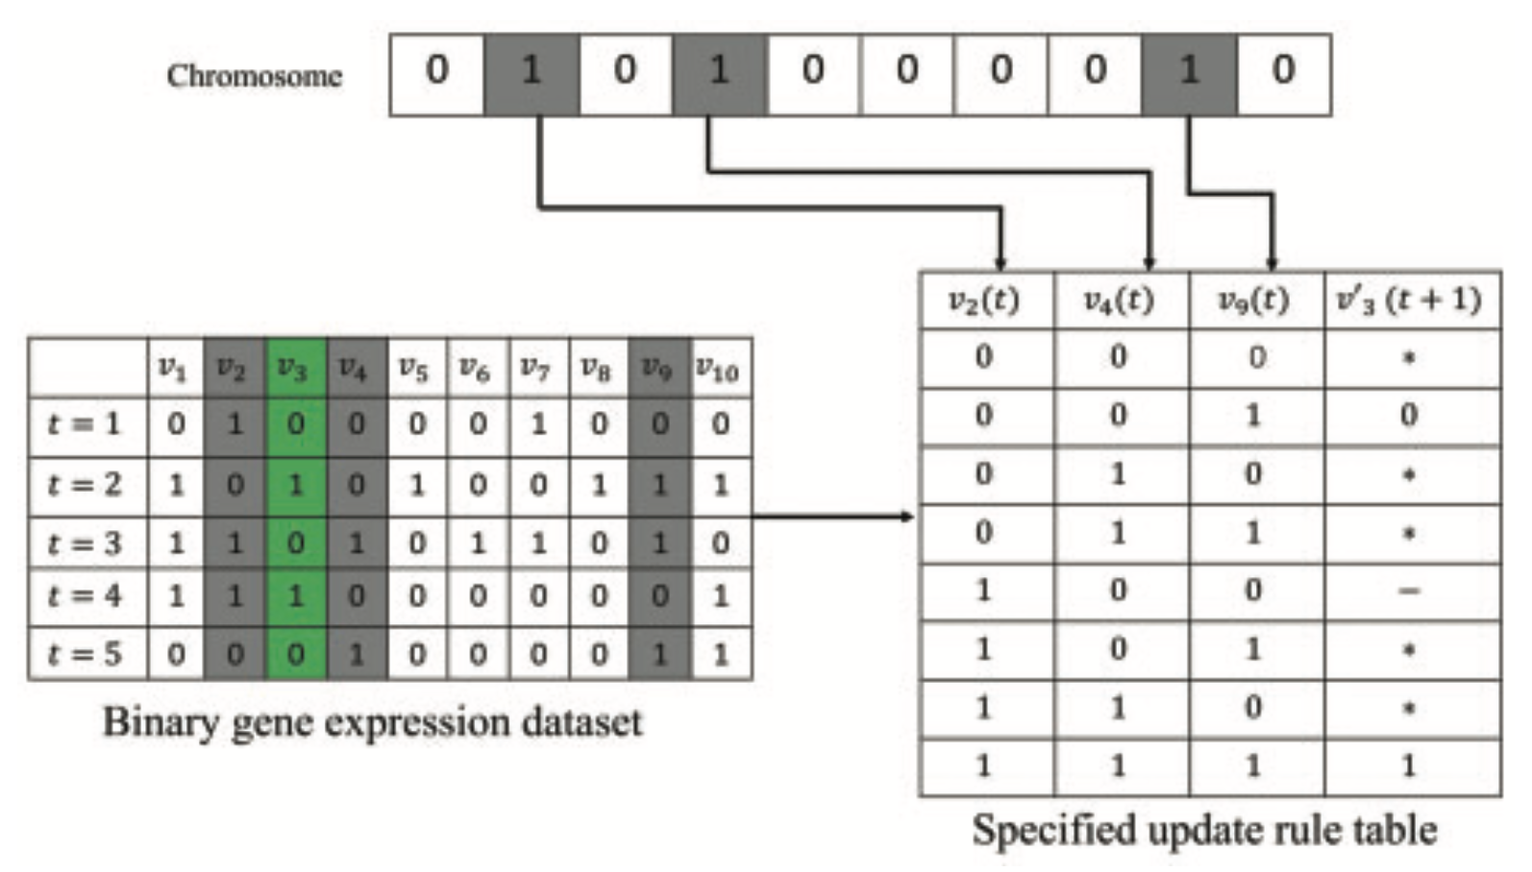

Slide 11
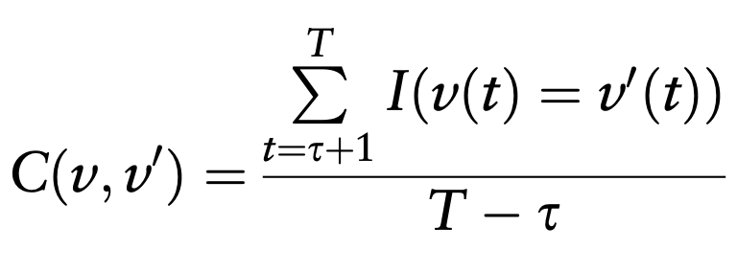
Step1: 0/1 count map: (key -> bit string, value -> count)
Count Map 0
Count Map 1
Bit string – count
001 – 1
100 – 1
010 - 2
Bit string – count
111 – 1
100 – 1
010 - 3
Step2: false count for same bit string
for key in keys(count_map_0)
false_count += min(count_map_0[key], count_map_1[key])
end
gene_wise_consistency = 1 – false_count/(T – t)

Slide 12
Revisited dynamic accuracy
Methods | CDC-15 | CDC-28 | In Silico-1 | In Silico-2
my | 0.7577 | 0.8125 | 0.8050 | 0.8750
NNBNI | 0.7874 | 0.8194 | 0.7900 | 0.8600
Structural accuracy
Methods | CDC-15 | CDC-28 | In Silico-1 | In Silico-2
my | 0.7654 | 0.7654 | 0.7600 | 0.8500
NNBNI | 0.7820 | 0.7654 | 0.7653 | 0.8144

Slide 13
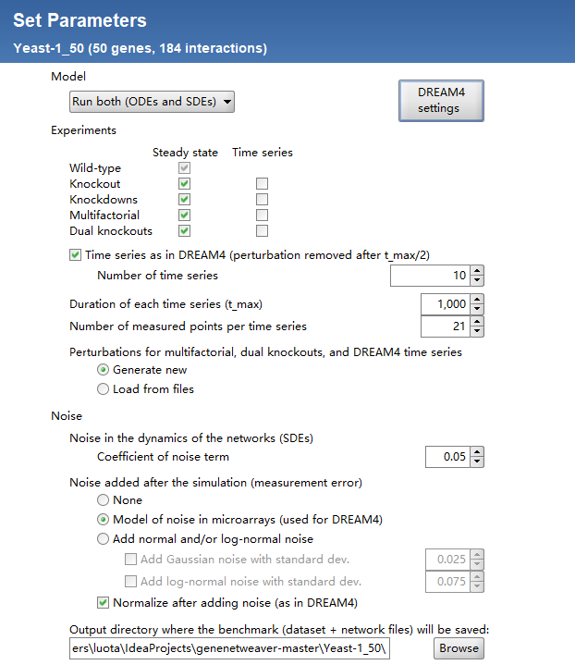

Slide 14
Noise level | Inference methods | TP | FP | FN | Structural accuracy | Dynamic accuracy
5% Noise | my | 14 | 64 | 170 | 0.9064 | 0.8536
 | GENIE3 | 23 | 112 | 161 | 0.8908 | 0.8354
 | ARCANE | 26 | 212 | 158 | 0.852 | 0.8529

