Slide 1
Introduction to Deep Learning Frameworks
Omar Orqueda
September 30, 2019

Slide 2
Outline
DL frameworks
Motivational example
DL using AWS
Model Zoo
Advanced topics
Links

Slide 3








Slide 4
Key Requirements for DL Frameworks
Automatic differentiability
Portability
Scalability
GPU support
Simple APIs

Slide 5
Key Requirements for DL Frameworks
Asynchronous execution
Imperative and symbolic model support
Training algorithm/strategy support
Model save & load

Slide 6
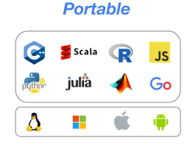



Apache MXNet

Slide 7
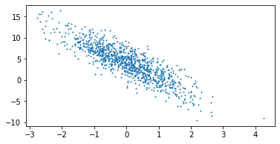
Why do we need a Framework?

Slide 8
Algorithm
Define Model
Define Loss Function
Initialize Model
Training Loop
Read Input in Batches
Compute Gradient with Respect to Loss Function
Update Parameters
Compute Loss
Evaluate Trained Model

Slide 9
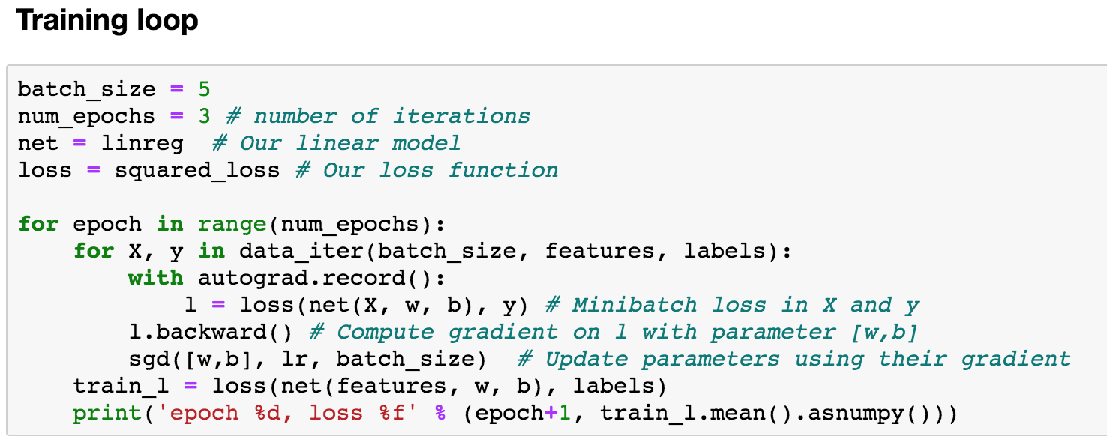
Linear Model Using Jupyter Notebooks

Slide 10
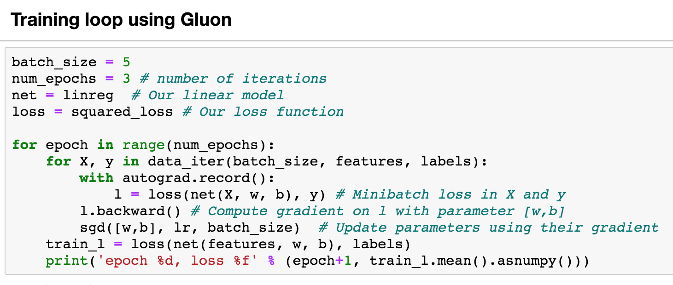
Linear Model Using Jupyter Notebooks

Slide 11

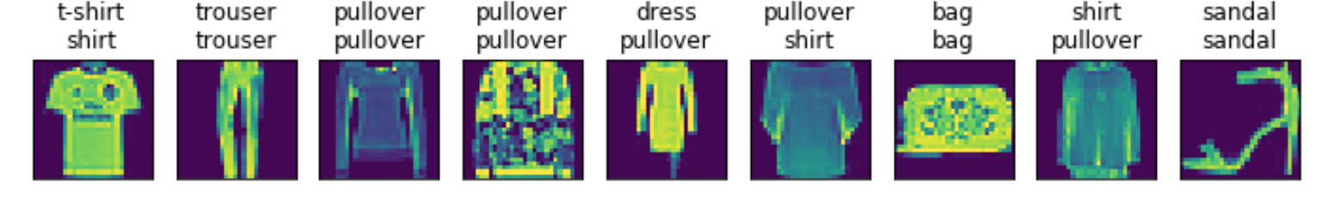
Classification Model – Fashion MNIST
Prediction

Slide 12
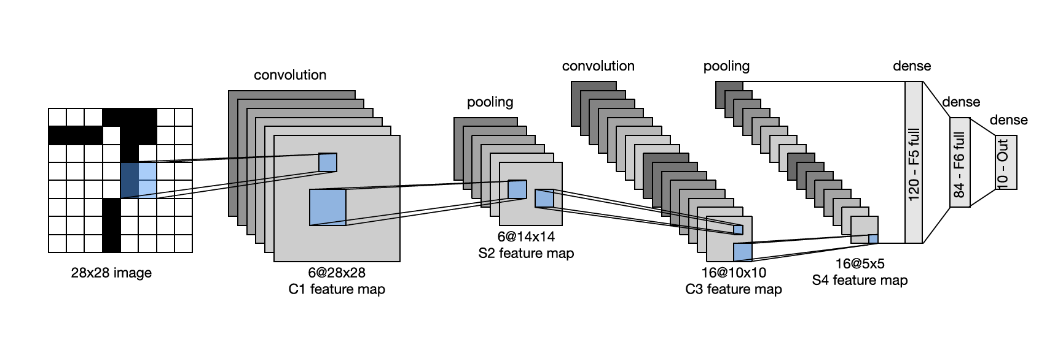
LeNet5: A 5-layer CNN
LeNet5 consists of two parts:
a block of convolutional layers to capture spatial patterns; and
a block of fully-connected layers.
Notes:
Convolutional layer – spatial pattern
Avg pooling – dimensionality reduction. ¼ of the prepooling size

Slide 13
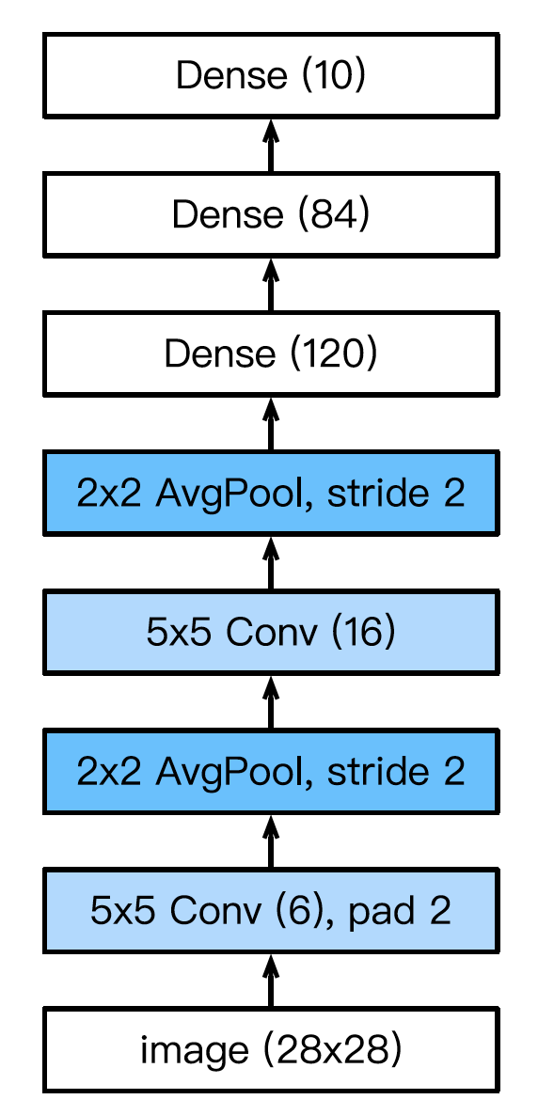
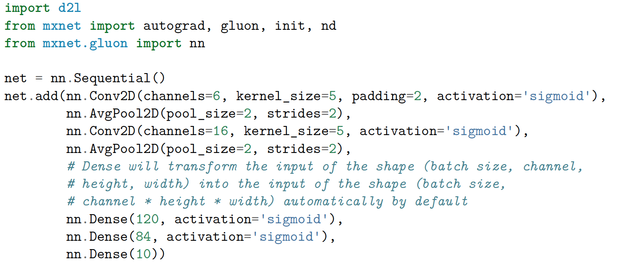
LeNet5: A 5-layer CNN

Slide 14
Modern CNNs – Learning Feature Engineering
AlexNet
VGG
GoogLeNet
ResNet (Residual Networks)
DenseNet (Densely-connected Networks)

Slide 15
Model Zoo
Provide predefined models (trained or not)
Include pre- and post-processing transforms
Example:
from mxnet.gluon.model_zoo import vision
squeezenet = vision.squeezenet1_0()
resnet18 = vision.resnet18_v1(pretrained=True)

Slide 16
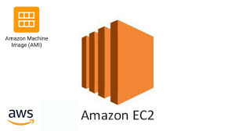

Deep Learning in AWS
DLAMI: Software configuration for your instance
SageMaker: Fully managed environment

Slide 17
Creating DLAMIs
Sign-in at https://aws.amazon.com
Choose the right region (US West (Oregon))
Select “EC2” service
Select ”Launch Instance”
Pick “Deep Learning Base AMI (Ubuntu)”
Select “GPU instances”
Check cost at https://aws.amazon.com/ec2/pricing/on-demand/
p3s have latest NVIDIA Volta GPU. Recommended, use p2. xlarge
Create/use an SSH key

Slide 18
Using DLAMIs
Go to “EC2”
Copy “Public IP”
Login into your EC2 instance: ssh -i ~/.ssh/YOUR_KEY ubuntu@YOUR_IP
Run Jupyter notebook on the EC2 instance: jupyter notebook --no-browser --port=8889
Start port forwarding on your laptop: ssh -i ~/.ssh/YOUR_KEY -N -f -L localhost:8890:localhost:8889 ubuntu@ YOUR_IP
Copy token remote machine
Login with local browser: https://localhost:8890/?token=YOUR_TOKEN
Notes:
ssh -i ~/.ssh/id_rsa_fastai ubuntu@35.160.235.231
jupyter notebook --no-browser --port=8889
ssh -i ~/.ssh/id_rsa_fastai -N -f -L localhost:8890:localhost:8889 ubuntu@35.160.235.231
https://localhost:8890/?token=decf71e541e58f56e93fe977cebfd4e943b126455e559e82&token=decf71e541e58f56e93fe977cebfd4e943b126455e559e82

Slide 19
Advanced Topics
JIT/Optimization
Distributed Learning
Parameter server
All-reduce
Model Server
Hyperparameter tuning
AutoML

Slide 20
Links
https://mxnet.incubator.apache.org/
https://www.d2l.ai/
https://www.tensorflow.org/
https://pytorch.org/
https://chainer.org/
https://keras.io/
https://developer.nvidia.com/deep-learning
https://libraries.io/github/intel/mkl-dnn

