Slide 1
Creative Platform Using Public AI Models Through Postman
Oscar Zarate
Northwestern EECS 496-7
Advanced Deep Learning

Slide 2
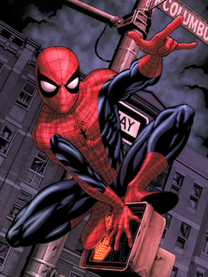
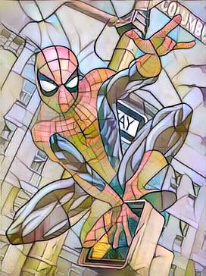
Creative AI Applications
Design
Style Transfer
Pose Capture and Transfer
Image Completion
Video Completion
Information
Image/Video/Asset Tagging
Style classification
Visual
Font
Action

Slide 3
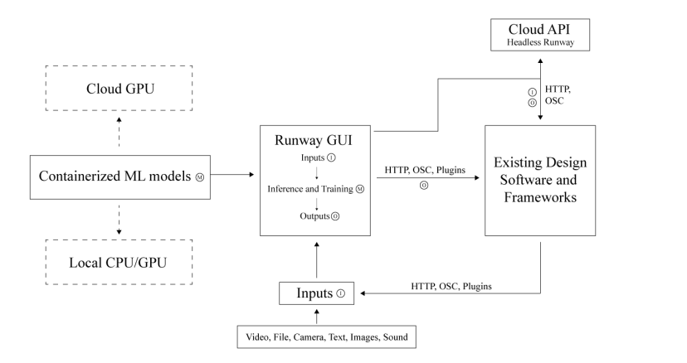

Runway – Flexible Use of Pre-Trained Models
Valenzuela, Cristóbal, Alejandro Matamala, and Anastasis Germanidis. "Runway: Adding artificial intelligence capabilities to design and creative platforms."

Slide 4
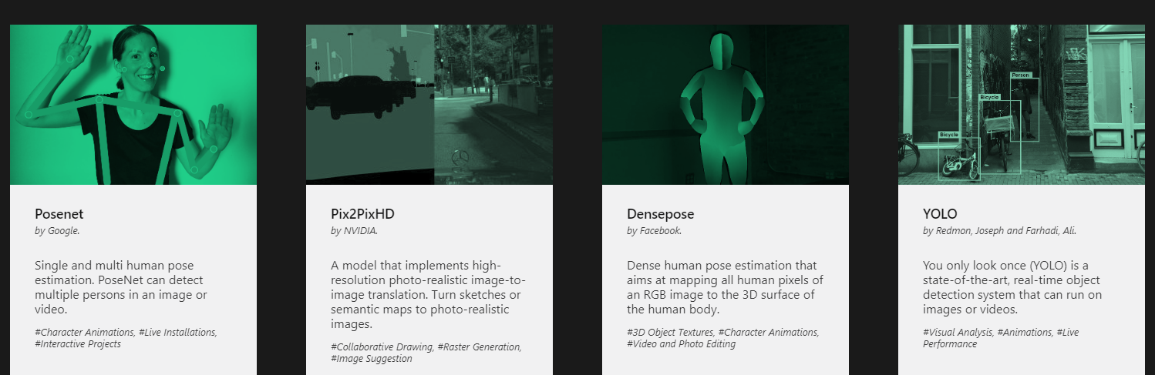
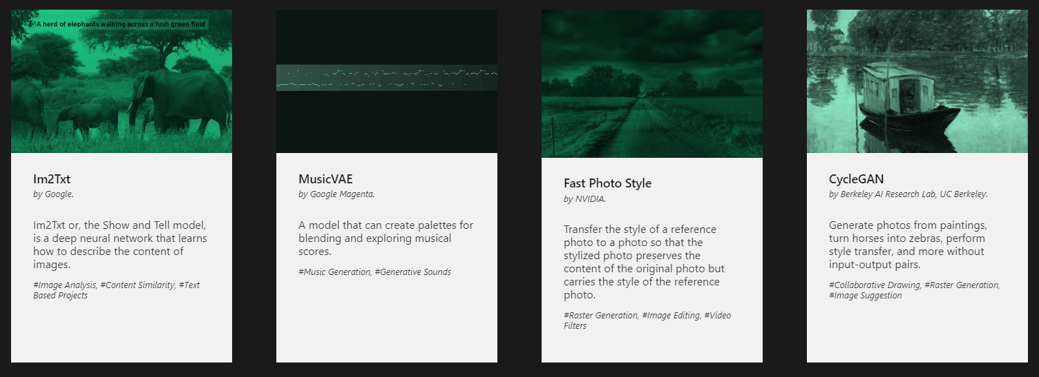
Runway – Flexible Use of Pre-Trained Models

Slide 5
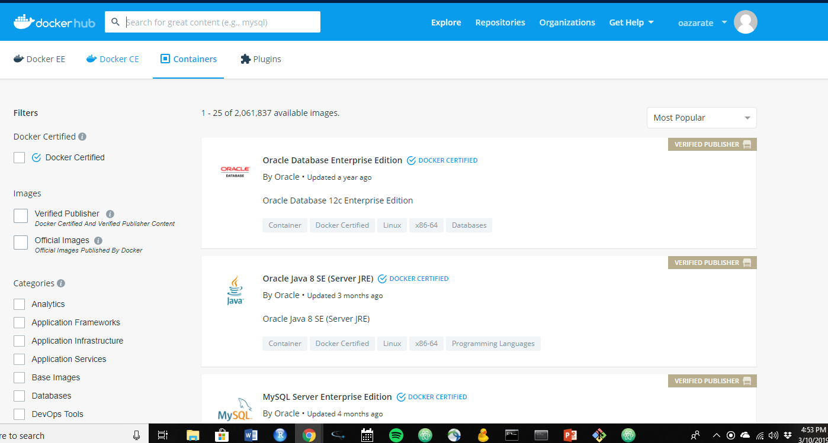
Docker Hub

Slide 6
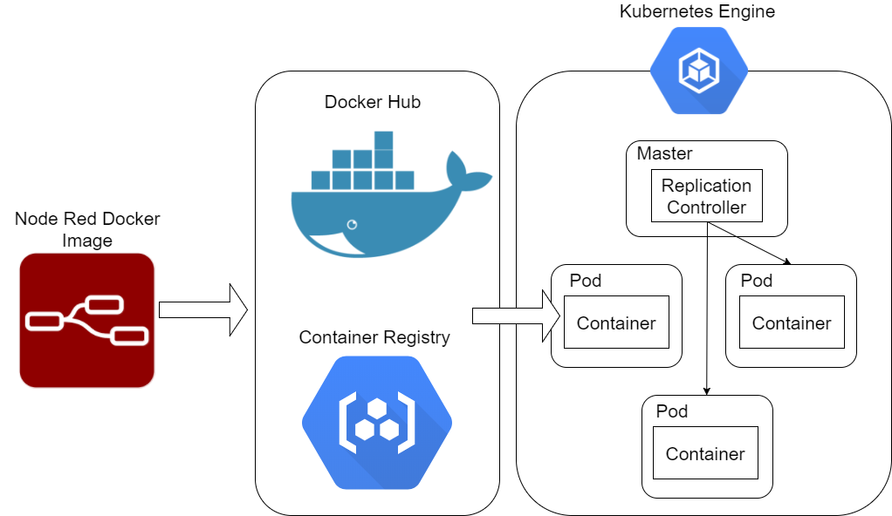
Docker Hub and Kubernetes
https://medium.com/google-cloud/deploy-your-node-red-environment-onto-kubernetes-clusters-using-google-cloud-platform-2e4775c2e79f

Slide 7
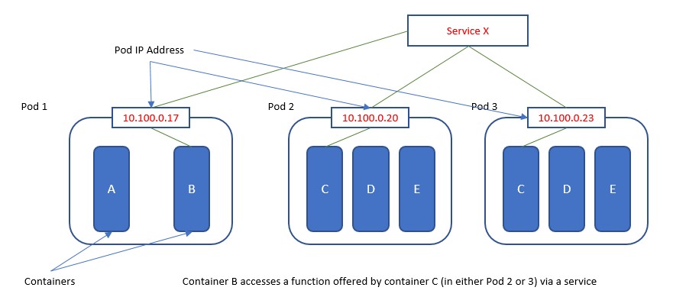
An API-Centric Approach
What is a hassle-free way to implement a similar technology?
Microservices approach takes advantage of the independence of each container
Furthermore, there are ready frameworks to convert ML models into REST APIs, etc.
Furthermore…
https://en.wikipedia.org/wiki/Kubernetes#/media/File:Pod-networking.png

Slide 8

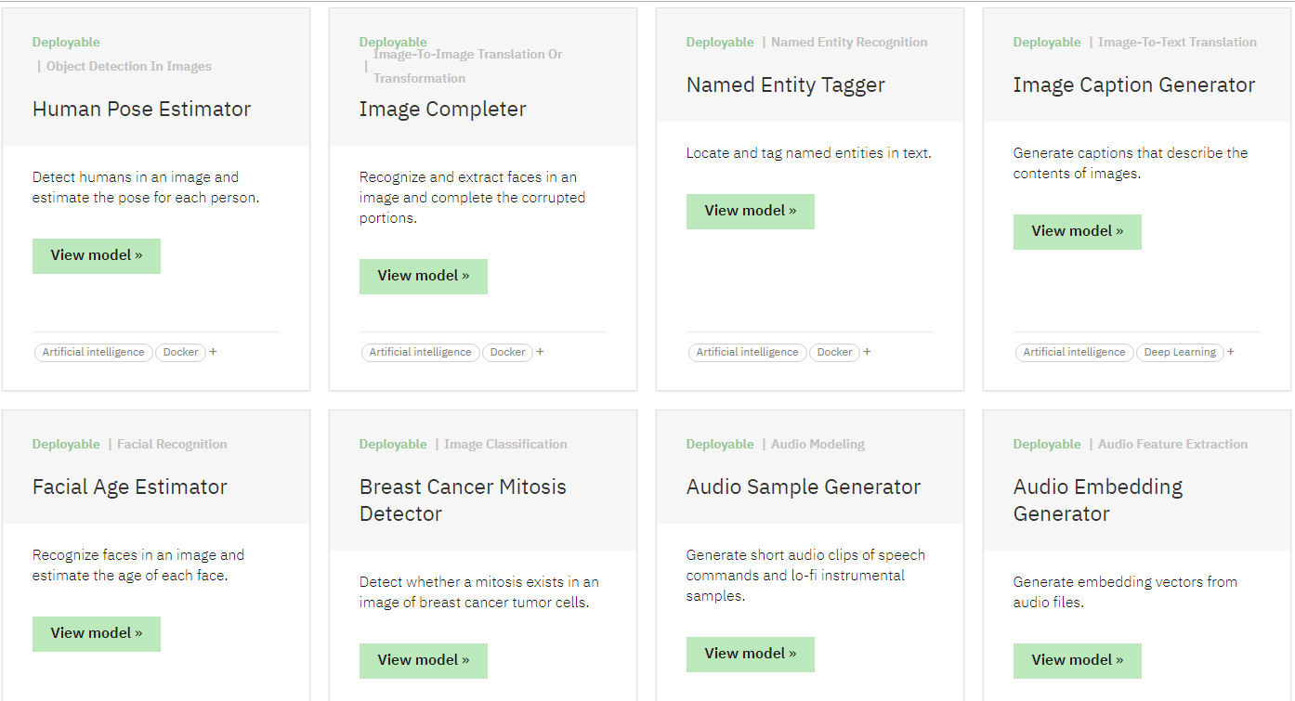

Slide 10

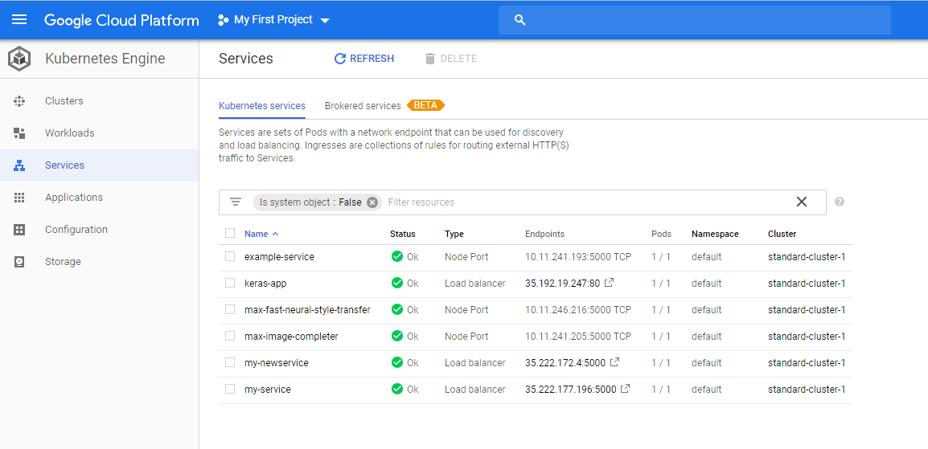



Kubernetes

Slide 11

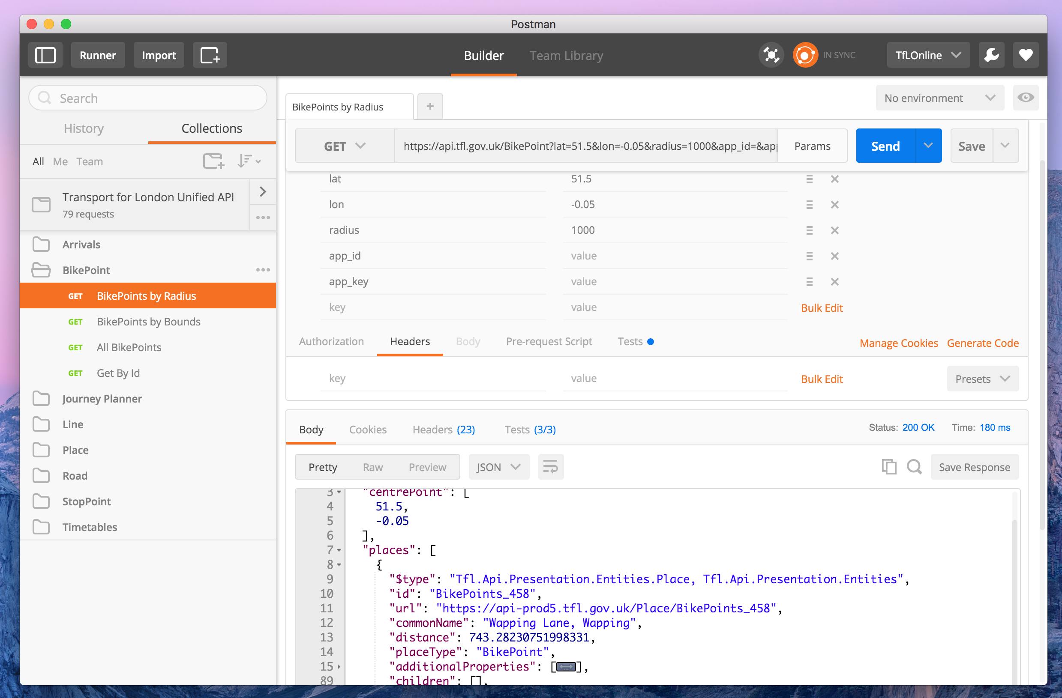
Postman
API Testing software
Save collections of specific API calls
User-friendly(ish)
https://blog.tfl.gov.uk/2016/03/10/run-our-api-examples-with-postman/

Slide 12
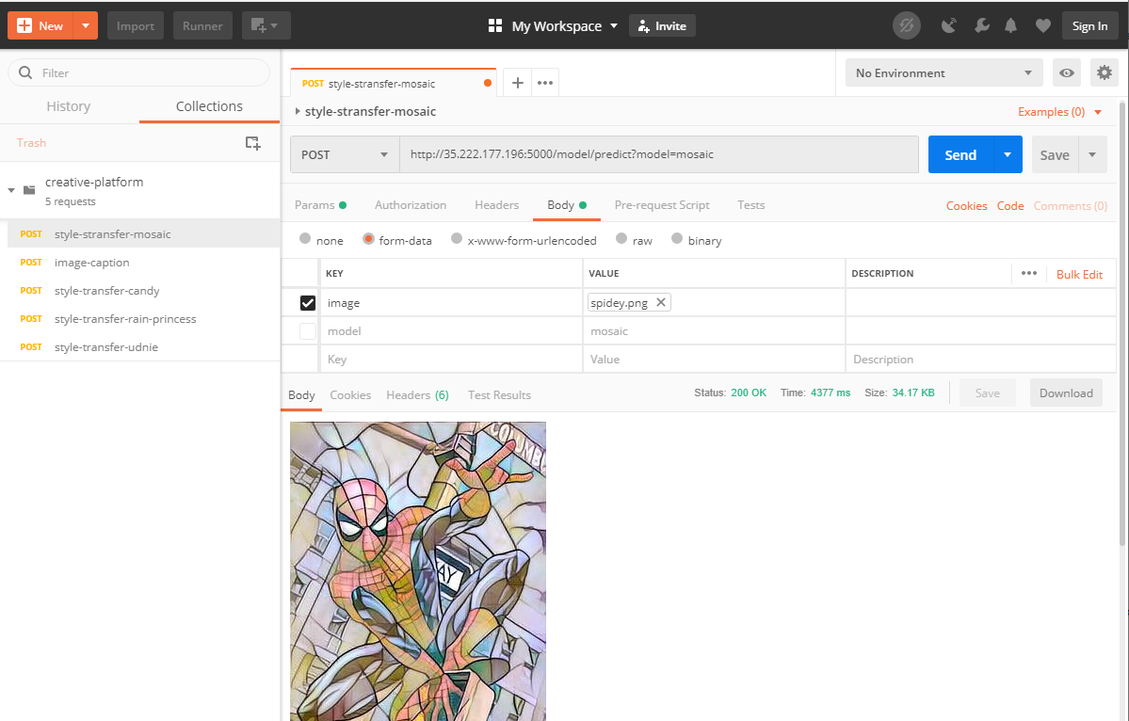

Slide 13
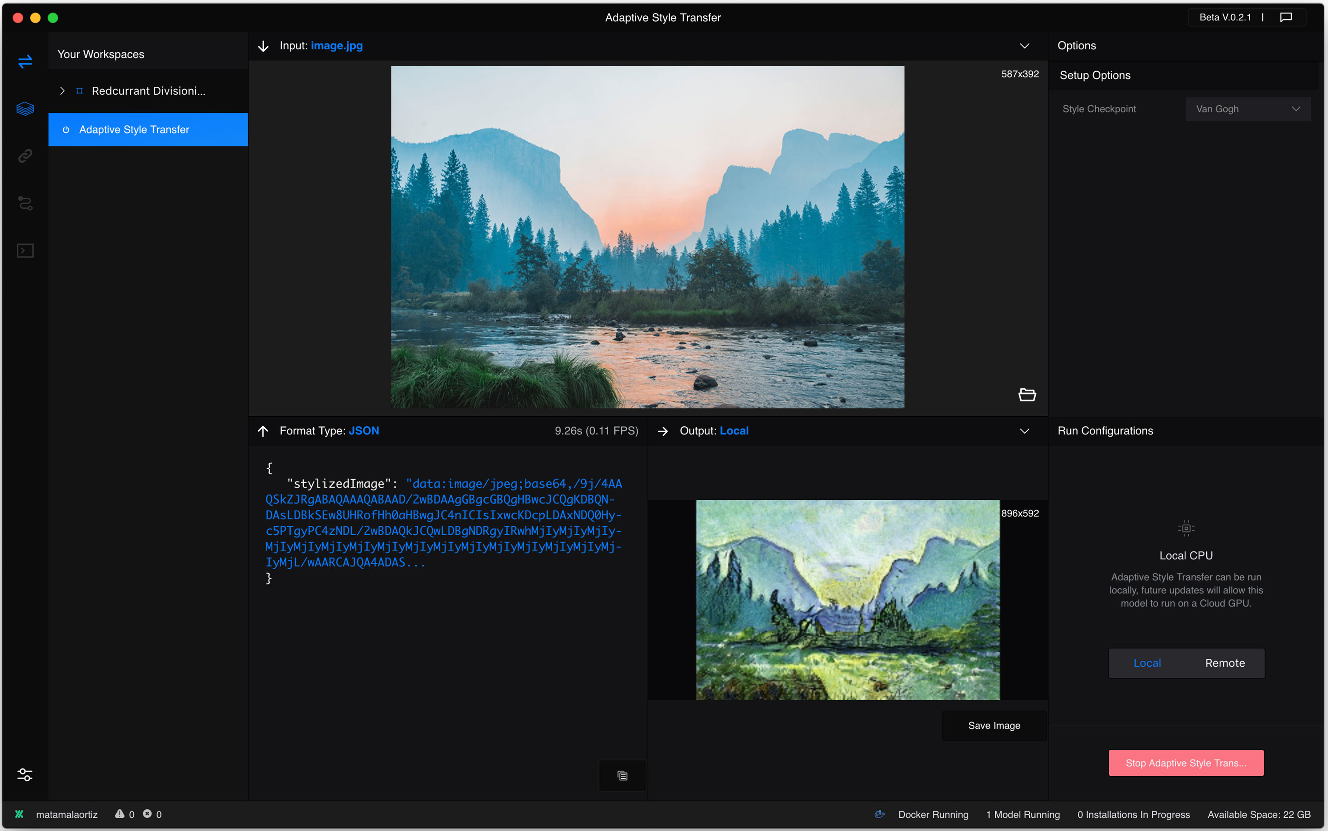
Comparison to Runway

Slide 14
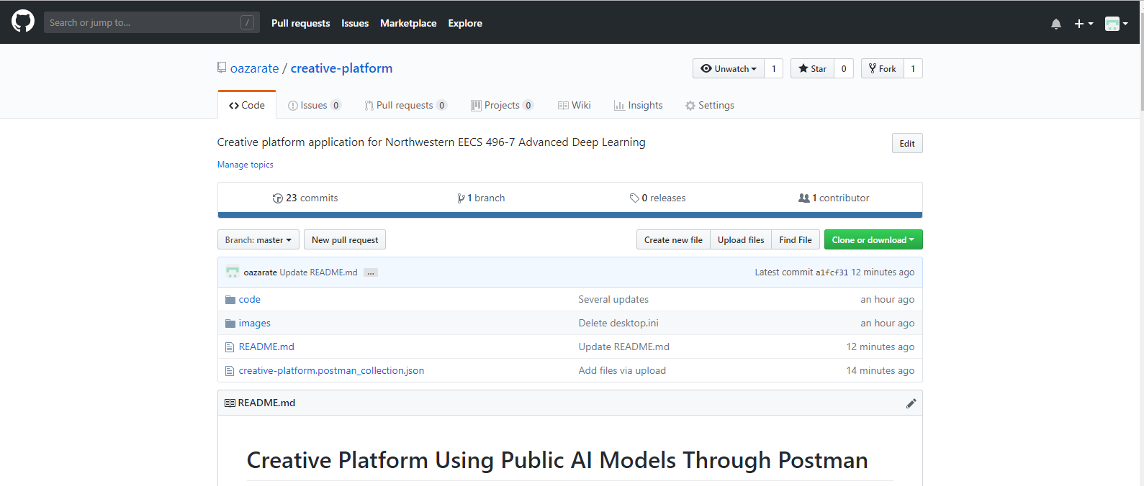

Slide 15
github.com/oazarate/creative-platform

Slide 16
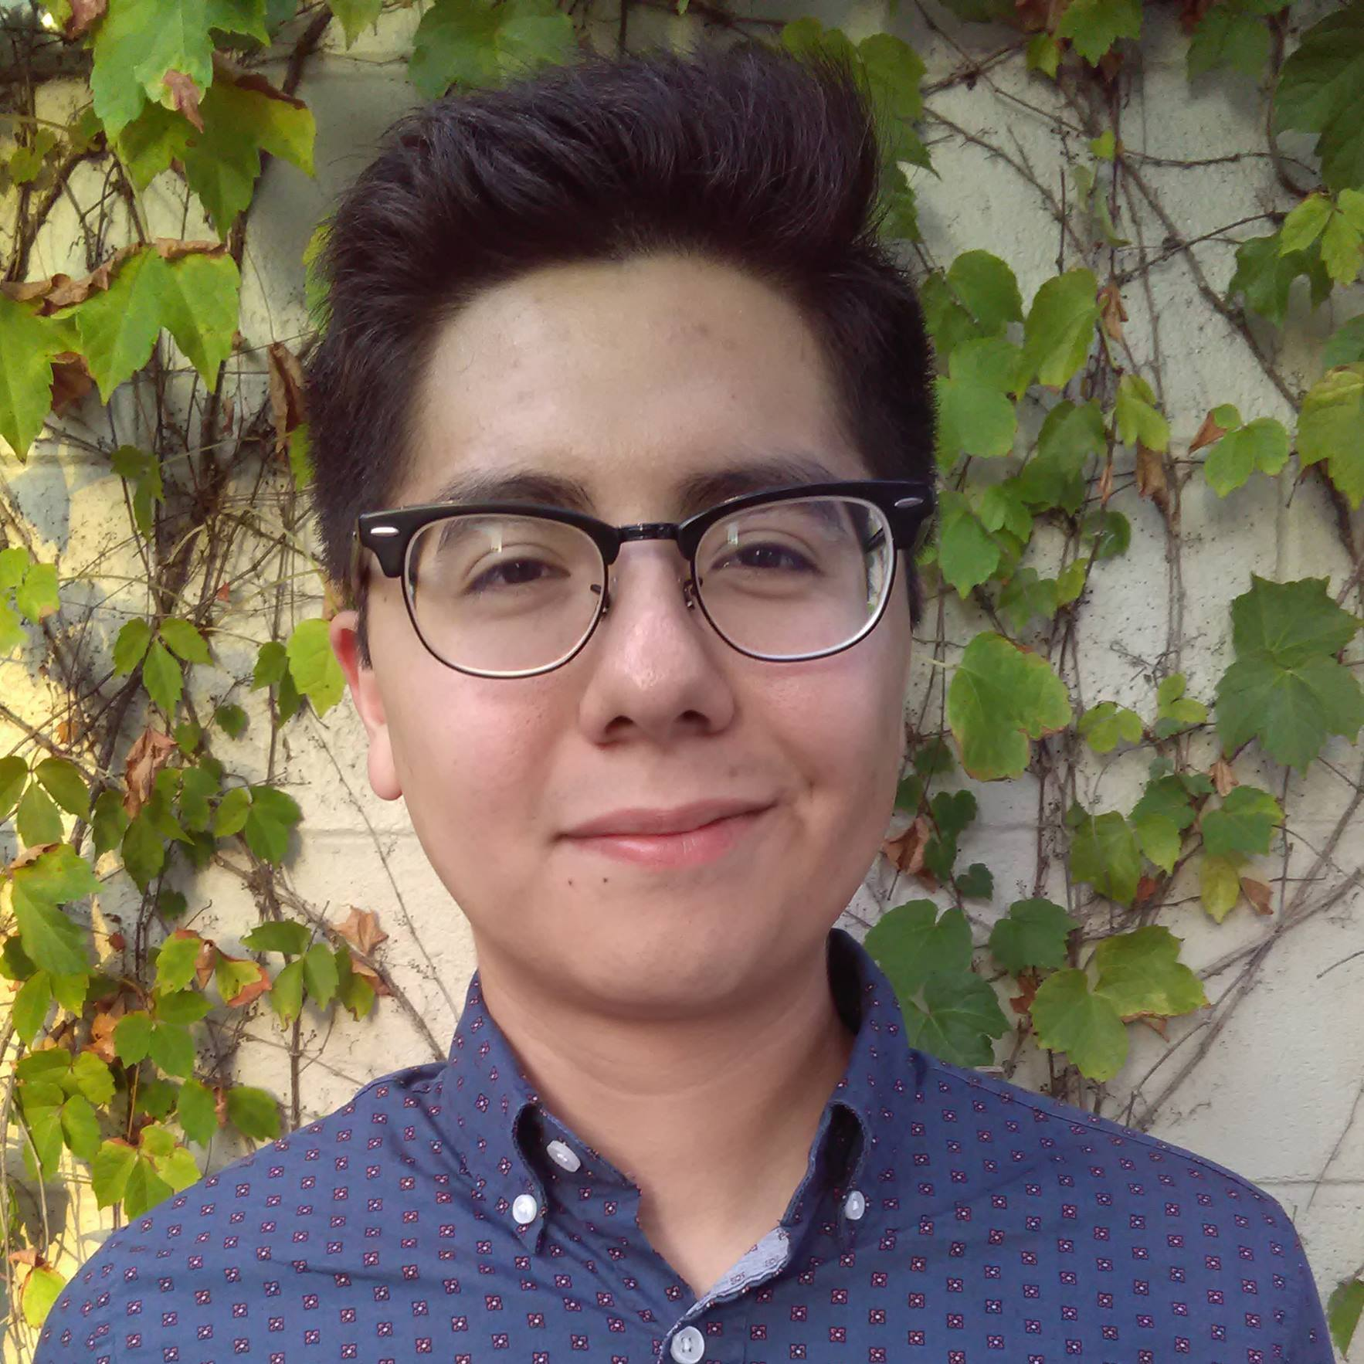

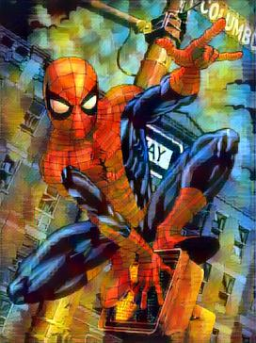
Features Implemented
ImageNet Classifier
Style transfer (IBM)
Mosaic
Candy
Rain Princess
Udnie
Image Complete
(Face Complete)

Slide 17
Thank you!
Any Questions?

