Slide 1

GROUP 2
PROJECT PRESENTATION

Slide 2


Net-migration Across Regions of the World
60%
70%
75%
35%
45%
65%
Countries of the World

Slide 3
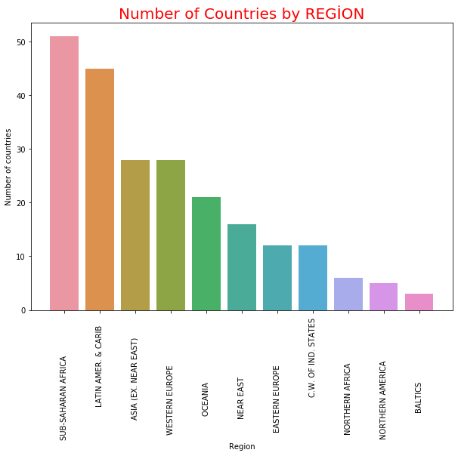
This bar chart shows:
The number of countries in each region across the world.
Sub-Saharan Africa has the highest number of countries;
Baltics has the least number of countries.

Slide 4
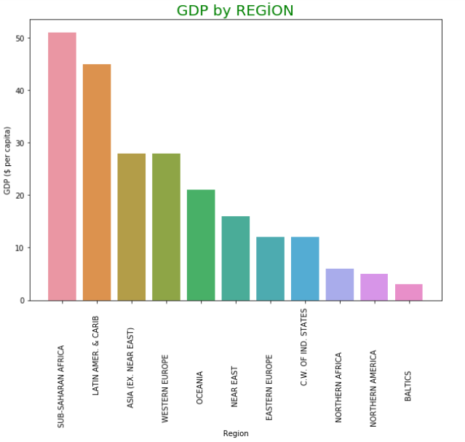
This bar chart shows:
The GDP per Capital of each region across the world.
Sub-Saharan Africa has the highest GDP index;
Baltics has the least GDP index.

Slide 5
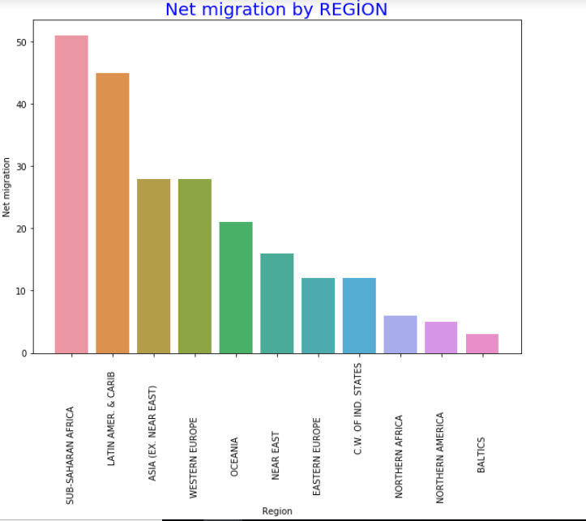
This bar chart shows:
The Net-migration per region.
Sub-Saharan Africa has the highest Net-migration;
Baltics has the least Net-migration.

Slide 6
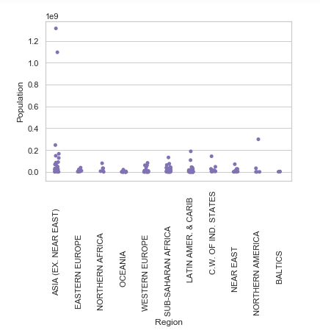
POPULATION ACROSS REGIONS
This scatter plot shows:
The population across each region.
Asia is the most populous region;
Baltics is the least populous.

Slide 7
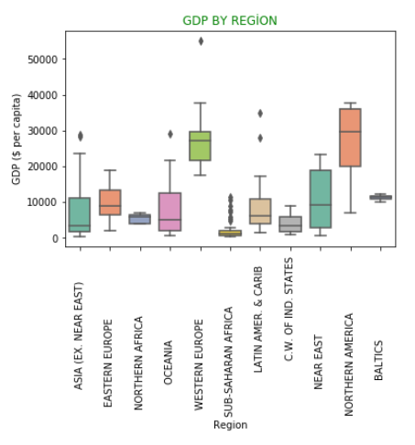
Gross Domestic Product per region
This Box plot shows:
The GDP per Capital of each region across the world.
Sub-Saharan Africa has the highest GDP index;
Baltics has the least GDP index.

Slide 8
DATA SOURCE
The GDP per Capital of each region across the world.
Sub-Saharan Africa has the highest GDP index;
Baltics has the least GDP index.

Slide 9
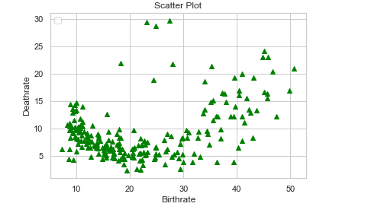
Birthrate/Deathrate Distribution
This scatter plot shows:
Dense distribution depicts the reason for positive Net-migration ;
Sparse distribution indicates a negative Net-migration value..

Slide 10
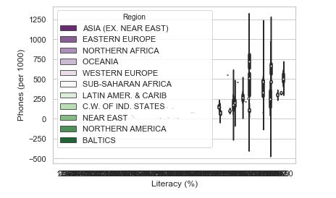
Literacy/Technology(Phones) Distribution
The GDP per Capital of each region across the world.
Western Europe has more Immigrants due to high literacy level and technological advancement;
Sub-Saharan Africa has less immigrants.

Slide 11
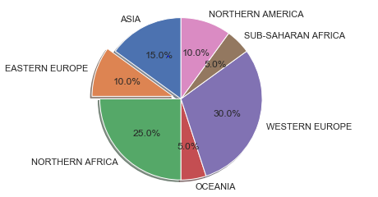
Net-migration Across Regions of the World
Notes:
Photo by 贝莉儿 NG on Unsplash

Slide 12
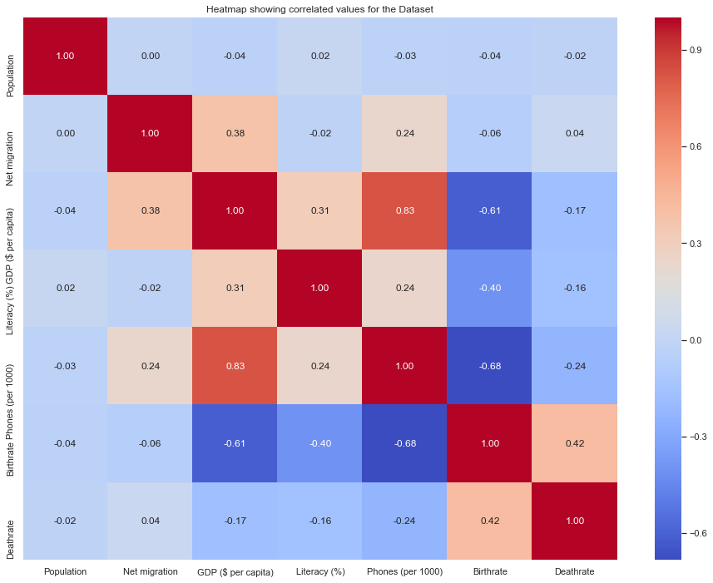
CORRELATION BETWEEN NET-MIGRATION AND THE OTHER VARIABLES
We can say that following factors are positively correlated with Net migration:- r>0 for:-
GDP_Per_Capita = (0.38) - highest postive correlation with Net migration
Phones - (0.24)
Deathrate = (0.04)
Following values are inversely correlated with GDP per capita:- r<0 for:-
Literacy (%) = (-0.02)
Birthrate = (-0.06) - Highly negatively correlated
Population = (0.00)
Note that net migration has 0.00 corellation with population
Notes:
Photo by 贝莉儿 NG on Unsplash

Slide 13
Regions of the world
ASIA (EX. NEAR EAST)
OCEANIA
NORTHERN AMERICA
BALTICS
SUB-SAHARAN AFRICA
NORTHERN AFRICA
C.W. OF IND. STATES
NEAR EAST
EASTERN EUROPE
WESTERN EUROPE
LATIN AMER. & CARIB

Slide 14
THANK YOU

