Slide 1


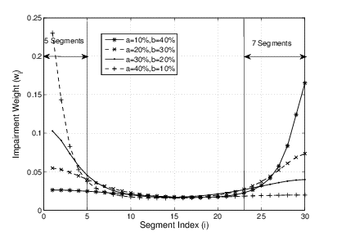
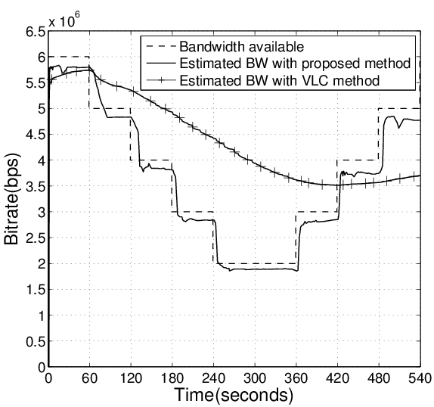
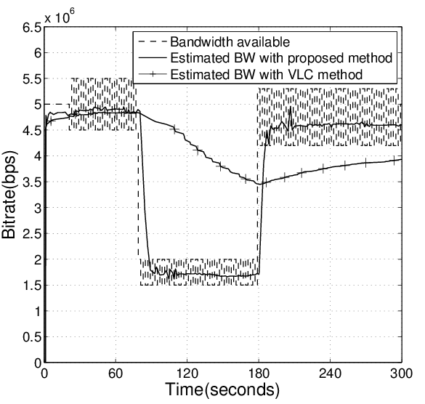
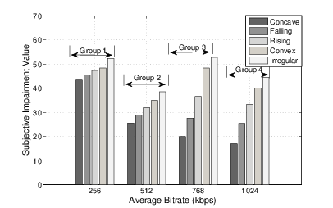


BUPT-QUALCOMM Joint Research Program
User Experience Study on DASH
Liu Yitong, Liu Hao, Shen Yun, Lin Qi, Shen Hui, Li Yuchen
Beijing university of Posts and Telecommunications, China
Email: liuyitong@bupt.edu.cn
Summary
QoE Model of Level Variation
Study on QoE of DASH
Validate DASH service QoE model
Research 3 impairment factors on DASH service: Initial Delay, Stall, and Level Variation
Test 107 video samples and 64 participants
Propose QoE model in 2 ways: non-linear regression and machine learning
Compare BUPT model with UCSD model provided by Qualcomm
Propose a QoE model of level variation
Identify QoE influence factors via two-way ANOVA analysis
Propose a QoE evaluation model based on Primacy and Recency Effects
Predict stall of DASH service
Research on bitrate adaptation algorithms of DASH
Propose a QoE-based bitrate adaptation algorithm
Propose a bandwidth estimating method for 2 typical scenarios
Research on the performance of bitrate adaptation for multi-user scenario
Extended research: study on HEVC coding
Reduce complexity for real-time coding
Primacy and Recency Effects
QoE evaluation functions:
Bandwidth Estimation
Test Impairment Factors on DASH Service
Estimate bandwidth for two typical scenario
Long-term variation within wide range
Short-term fluctuation within narrow band
Polynomial Model
Performance of BUPT Model
Performance Validation of UCSD Model
1.Bandwidth change pattern detect:
$$CV\left(i\right)= \frac{S(i)}{\overline{T(i)}}$$
$S(i)$ and $\overline{T(i)}$:standard variation and average of last n segments’ throughput
PCC : 0.8719, MSE : 0.0961
Performance is improved, even better in low motion scenario.
Result of UCSD Model
(Provided by UCSD)
PCC : 0.91
MSE : 0.082
Our Validation Result of UCSD Model
PCC : 0.7811
MSE : 0.1821
Figure 2. Bandwidth estimation for scenario 1
2.Bandwidth estimate:
$${BW}_{e}\left(i\right)= \sum_{j=i−n−1}^{i−1}{ω\left(j\right)T(j)}$$
$$ω\left(k\right)=\left\{\begin{aligned}\frac{e^{k}}{\sum_{i=1}^{n}{e^{i}}} if CV\left(i\right)>0.1 \\ \frac{1}{n} others\end{aligned}\right.$$
$$k=j−\left(i−n−1\right)+1$$
Machine Learning Model
≤12.5
>12.5
Machine Learning Model
Train M5P and Regression Tree.
Regression Tree Model:
≤16.5
>16.5
≤25.5
>25.5
≤16.5
>25.5
Figure 3. Bandwidth estimation for scenario 2
Subjective Impairment Tests
Subjective impairment tests under simulated environment
Influence factors:
Average bitrate
Bitrate fluctuation patterns:
Concave, Falling, Convex
Irregular: bitrate switches frequently with huge amplitude
Bitrate switching frequency

