Slide 1


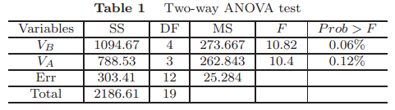
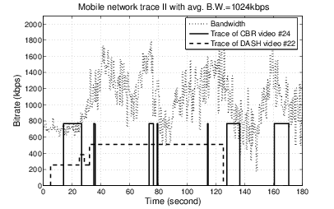
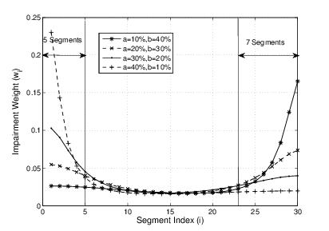
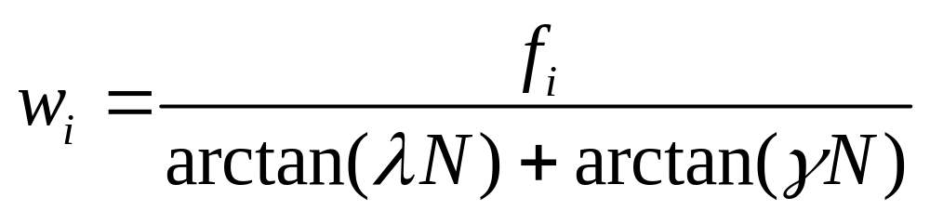
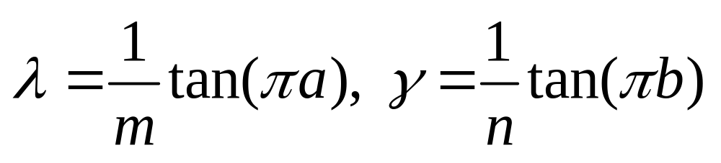
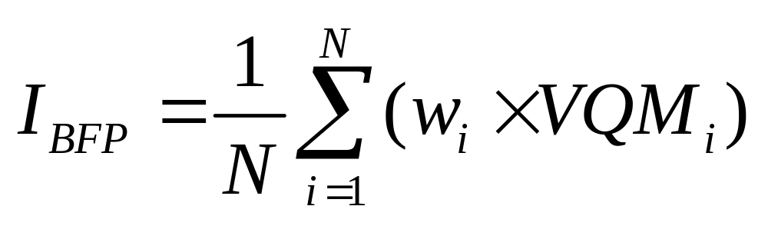
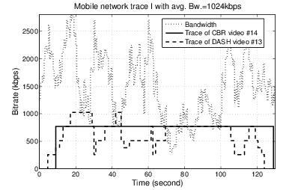
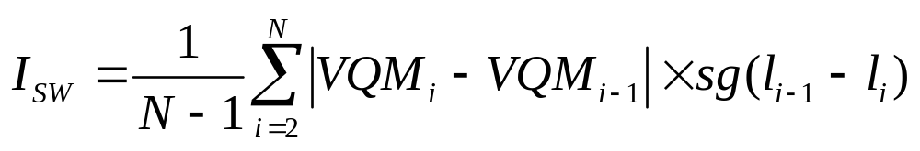
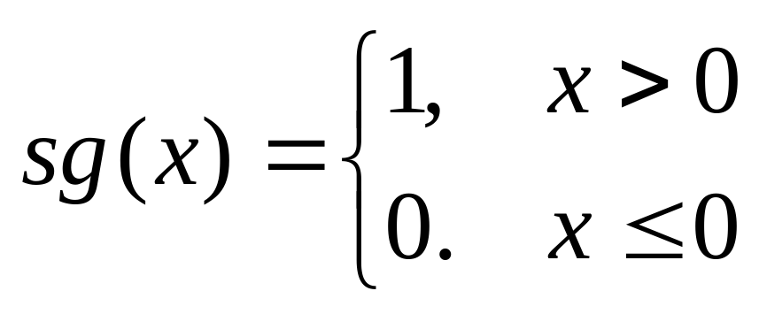
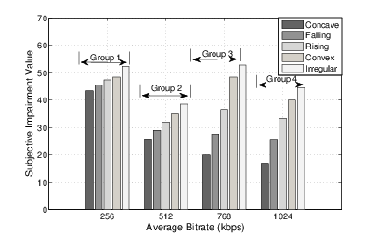
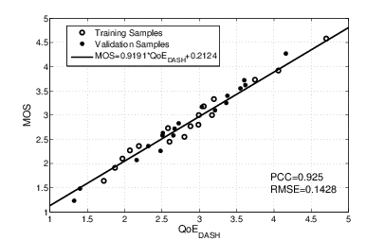
BUPT-QUALCOMM Wireless Research Center
Quality of Experience Study on DASH
Shen Yun, Liu Yitong
Beijing university of Posts and Telecommunications, China
Email: shen0069@gmail.cn
Outline
Validation on Influence Factors
Research QoE enhancement of DASH, compared with constant bitrate streaming
  More fluent playback
Identify QoE influence factors via two-way ANOVA analysis
  Segment bitrate, bitrate fluctuation pattern, bitrate Switching
Propose QoE evaluation model based on Primacy and Recency Effects
Analyze the performance with subjective tests
Two-way analysis of variance (ANOVA) test
Input factors: bitrate fluctuation pattern, average bitrate
ANOVA results:
Both two factors are of significant influence on QoE of DASH
QoE promotion of DASH
When bandwidth is changeable and insufficient
When bandwidth is stable and sufficient enough
Fluency influences users’ experience greater than image quality
DASH promotes QoE greatly under the congested practical network with changeable throughput
Impairment on bitrate fluctuation pattern
    CBR video #24:
    Stall duration = 110s
    Stall number = 6 times
    Sub. Impair. Value = 60
    DASH video #22:
    Stall duration = 0.35ms
    Stall number = 1
    Sub. Impair. Value = 43
Primacy and Recency Effects
    CBR video #14:
    Stall duration = 0.3ms
    Stall number = 1
    Sub. Impair. Value = 27
    DASH video #22:
    Stall duration = 0.3ms
    Stall number = 1
    Sub. Impair. Value = 45
Impairment on bitrate switching
Frequency bitrate decreased switching causes serious subjective impairment
QoE evaluation model for DASH
QoE evaluation functions:
Performance analysis
Subjective impairment tests
Subjective impairment tests under simulated environment
    35 test videos from both simulated environment and real network traces
    Two-fold cross validation
    Pearson Correlation Coefficient = 0.92
    RMSE = 0.14
    Our QoE model can reflect user’s experience on DASH accurately
    Influence factors:
    Average bitrate
    Bitrate fluctuation patterns:
    Concave, Falling, Convex
    Irregular: bitrate switches frequently with huge amplitude
    Bitrate switching frequency
Fifth Workshop of Qualcomm-sponsored University Research in Greater China

