Slide 1


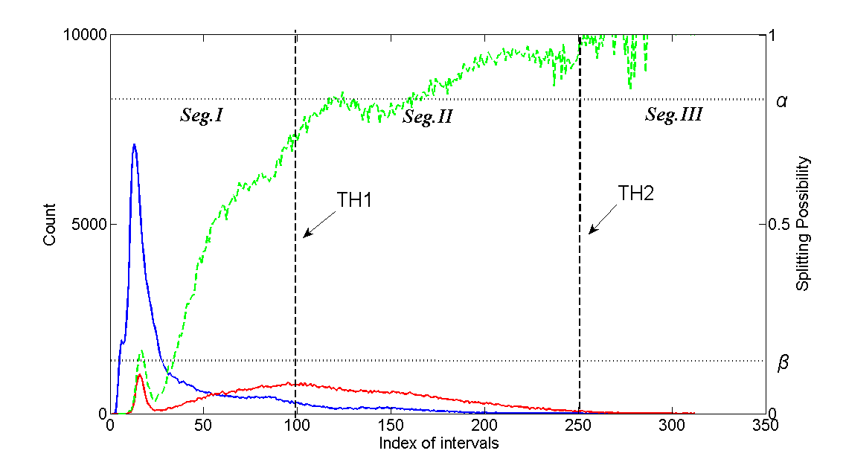
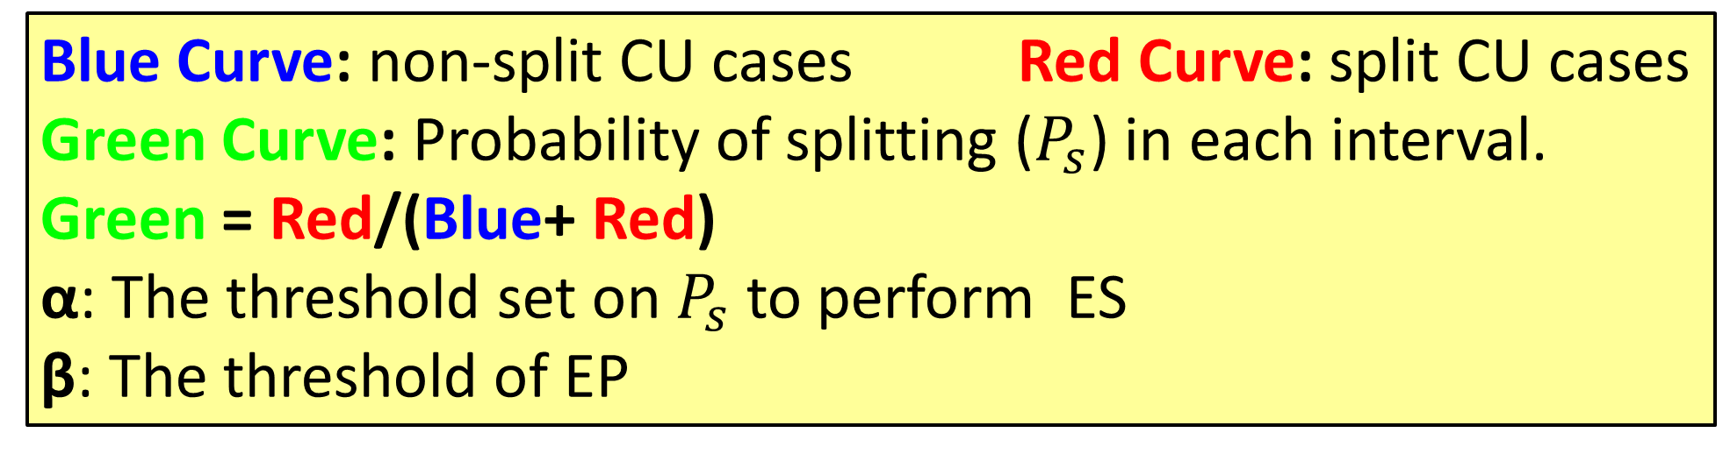
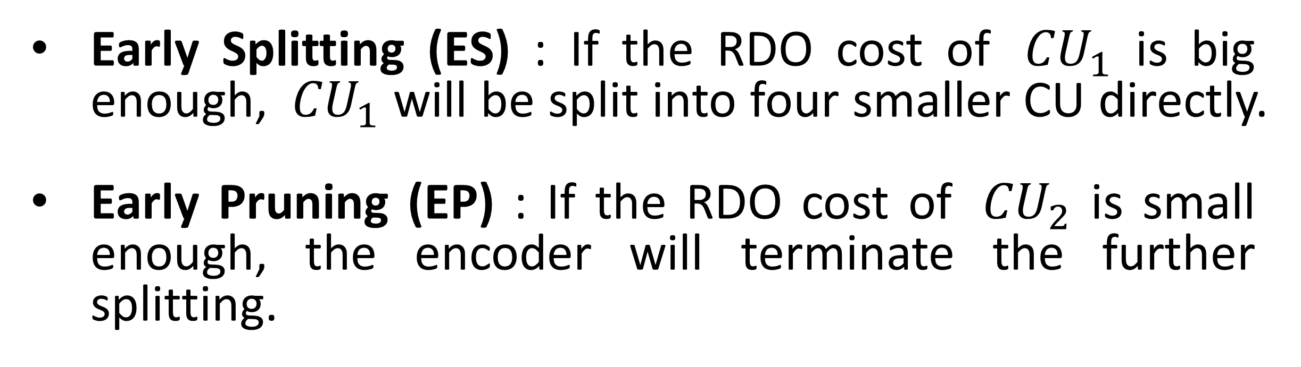
BUPT-QUALCOMM Wireless Research Center
Fast CU Splitting and Pruning Method Based on Online Learning for Intra Coding In HEVC
Yuchen Li, Yitong Liu, Dacheng Yang
Beijing university of Posts and Telecommunications, China
Abstract
Task: Reducing Complexity of HEVC
Method: Histogram Statistics based on Online Learning
Result: Reduce complexity by 38.8% at the cost of
1.05% BD-rate increasing on average.
Method abstract
Fig. 3 Splitting Probability Statistics with unequal length of intervals
Interval: In order to perform statistics, the RDO cost data were separated into specific interval length. In fig.2 the length of intervals is 50. In Fig. 3 the length is set differently. The value of parameters in Fig. 3 is listed in Table 1.
Table 1. The summary result of the proposed method for sequence in Class A to Class E.
Class & Sequences |  | ∆Time | Ave. | BD-rate loss | Ave.
A | NebutaFestival | 54% | 46% | 0.21% | 0.82%
 | PeopleOnStreet | 29% |  | 0.66%
 | Traffic | 39% |  | 1.01%
 | SteamLocomotiveTrain | 63% |  | 1.41%
B | BasketballDrive | 43% | 41% | 0.81% | 1.35%
 | Cactus | 30% |  | 0.91%
 | BQTerrace | 30% |  | 0.77%
 | Kimono | 70% |  | 3.68%
 | ParkScene | 30% |  | 0.58%
C | BasketballDrill | 30% | 30% | 0.97% | 0.79%
 | BQMall | 31% |  | 1.19%
 | PartyScene | 29% |  | 0.50%
 | RaceHorsesC | 31% |  | 0.53%
D | BasketballPass | 35% | 28% | 1.22% | 0.75%
 | BlowingBubbles | 29% |  | 0.34%
 | BQSquare | 25% |  | 0.75%
 | RaceHorses | 23% |  | 0.69%
E | FourPeople | 41% | 49% | 1.37% | 1.52%
 | Johnny | 54% |  | 1.70%
 | KristenAndSara | 51% |  | 1.48%
 | Total |  | 38.8% |  | 1.05%
Fig. 1. Partition of CU HEVC with quadtree structure.
Early Splitting (ES) : If the RDO cost of ${ CU}_{1}$ is big enough, ${ CU}_{1}$ will be split into four smaller CU directly.
Early Pruning (EP) : If the RDO cost of ${ CU}_{2}$ is small enough, the encoder will terminate the further splitting.
Histogram Statistics
Fig. 2 Splitting Probability Statistics with isometric intervals
Future work
Blue Curve: non-split CU cases Red Curve: split CU cases
Green Curve: Probability of splitting ($P_{s}$) in each interval.
Green = Red/(Blue+ Red)
α: The threshold set on $P_{s}$ to perform ES
β: The threshold of EP
The future work will focus on applying this method on inter coding. Duo to different QP setting and different compressing types, some revising of our method have to be made, and this would become the next step of our work.

