Slide 1





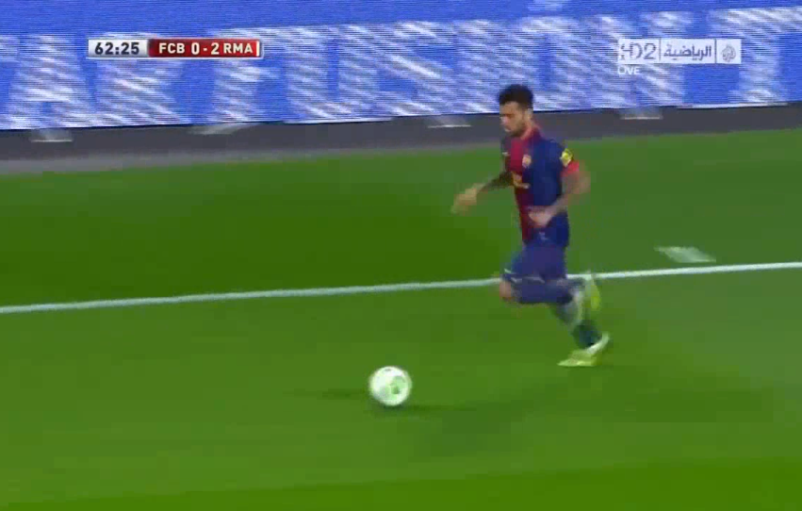
BUPT-QUALCOMM Joint Research Program
BUPT Subjective Test on DASH QoE Model
Liu Hao, Liu Yitong, Ran Yu, Wang Zhe
Beijing university of Posts and Telecommunications, China
Email: liuyitong@bupt.edu.cn
Summary
Test Model
Proposed DASH QoE subjective test methodologies to validate the UCSD Model
Conducted DASH QoE Tests
Tested 107 video samples with impairments from Initial Delay, Stall, and Level Variation
Recruited 64 users to participate in the test and received more than 2800 votes
Conducted model validation and comparison with the results of BUPT and UCSD
Propose QoE model in 2 ways: non-linear regression and machine learning
R = f(I_{ID}, I_{ST}, I_{LV})
64 participants from BUPT are divided into 3 groups.
Each tester watches about 45 test video clips in one hour.
Impairment due to Initial Delay
Impairment due to Stall
Impairment due to Level Variation
Subjective Test Videos
QoE Model Validation
All(96) Video Clips’ Result
Figure 1. Medium Motion Videos (BunnyCartoon and Movie)
Our Validation Result of UCSD Model
PCC : 0.7811
MSE : 0.1821
Result of UCSD Model
(Provided by UCSD)
PCC : 0.91
MSE : 0.082
Comparison of Model Validation Result between BUPT and UCSD
Type Factor | BUPT | UCSD | Subjective Results between BUPT & UCSD
PCC | 0.7811 | 0.8785 | 0.8141
MSE | 0.4267 | 0.2873 | 0.4077
Figure 2. High Motion Videos (Sports)
Video | Amount | Motion | Test Factors
BunnyCartoon_Stall_1-11 | 11 | Medium | Stall
Movie_Case01-48 | 48 | Medium | All factors*
Sport_Case01-48 | 48 | High | All factors
 | Results provided by UCSD | Recalculation Results by BUPT
PCC | 0.91 | 0.8785
MSE | 0.082 | 0.2873
All factors*: stall, initial delay, and level variation
User Experience Model Study of BUPT
Polynomial Model
Machine Learning Model
Machine Learning Model
Train M5P and Regression Tree.
Regression Tree Model:
≤12.5
>12.5
Result of BUPT PCC : 0.8719 MSE : 0.0961
≤16.5
>16.5
≤25.5
>25.5
 | Movie (48) Medium Motion | All (96)
PCC(R) | 0.9441 | 0.8782
RMSE(R) | 4.6662 | 6.367
≤16.5
>25.5
PCC of Polynomial Model is the highest.
Impairments of Stall and Level Variation is more serious than Initial Delay.
Initial Delay seems independent with Stall and Level Variation.
Model performs better in low motion scenarios.
ML Algorithm | PCC (Centesimal System Score)
M5P Tree | 0.84
Regression Tree | 0.85
PCC result is remarkable in ML.
Performance of two algorithms is close.
Complexity of Regression Tree is higher.
Characters of these video samples are not enough for M5P Model Tree.

