Slide 1


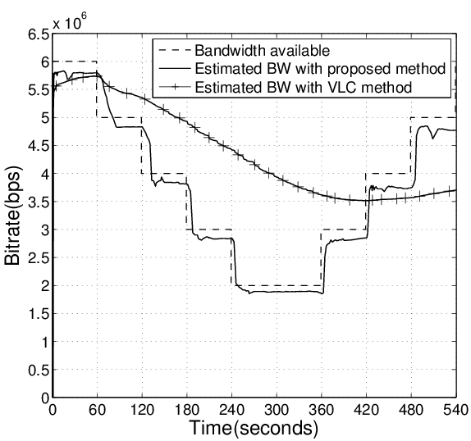
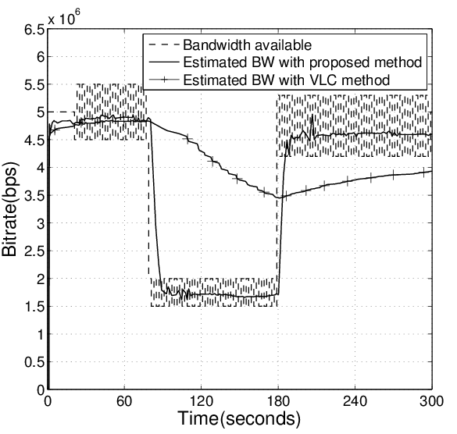
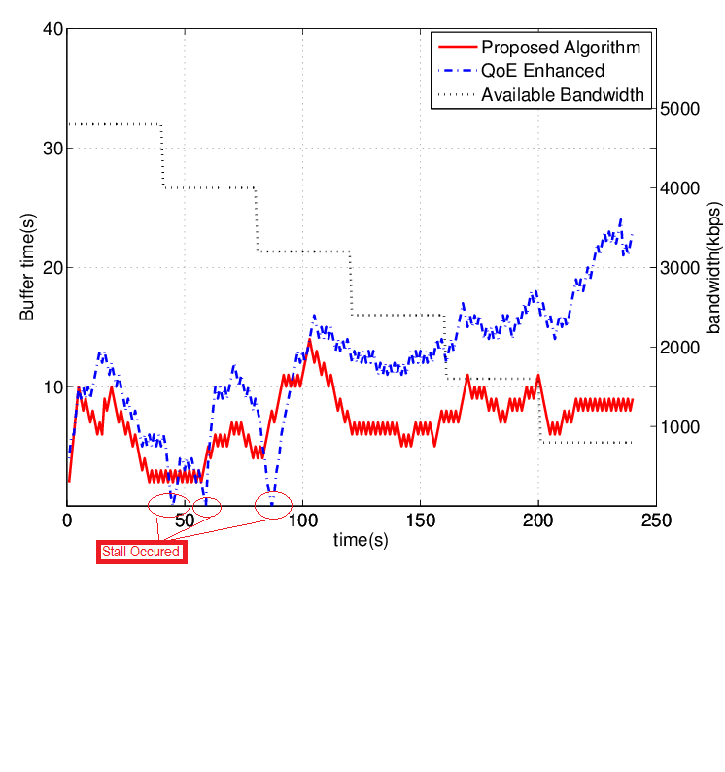
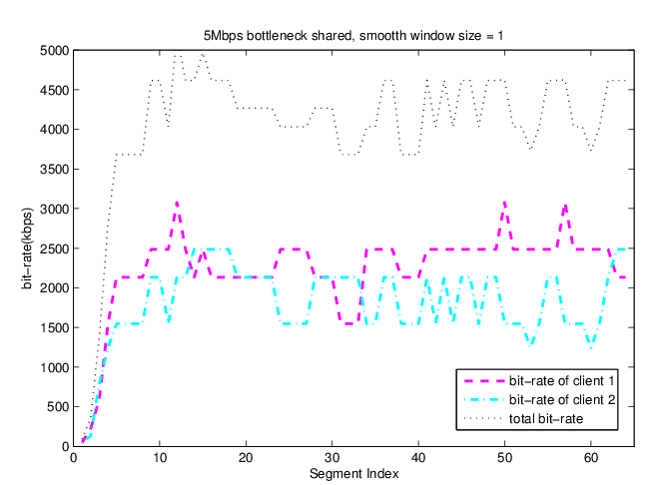
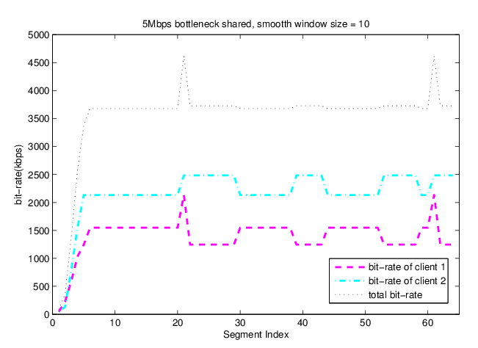



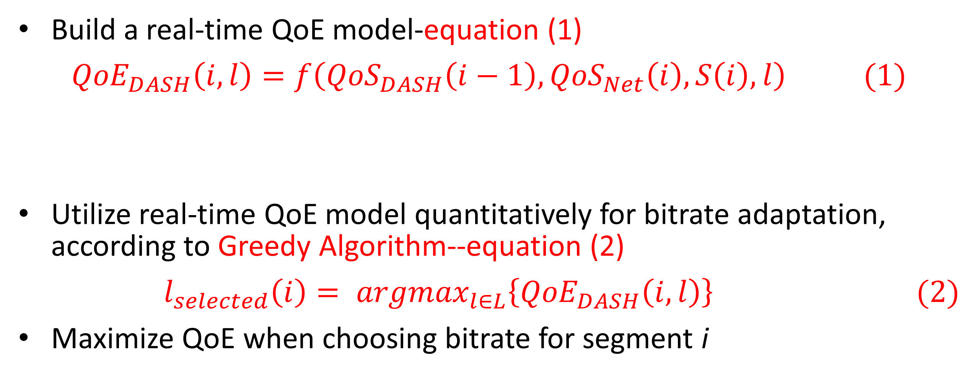

BUPT-QUALCOMM Joint Research Program
Rate Adaptation Algorithms for Dynamic Adaptive Streaming over HTTP
Lin Qi, Shen Hui, and Liu Yitong
Beijing University of Posts and Telecommunications, China
Email: shenhui0509@bupt.edu.cn
Summary
Predict stall
1.Stall probability:
Segment size(bytes) obeys Gaussian Distribution:
$S_{l}(i)\sim N\left(μ,σ\right),μ=b_{l}∗τ;σ=0.2μ$
Stall occurs when
$$B−\frac{S_{l}(i)}{{BW}_{est}}+τ≤0$$
Thus
$P=1−Φ(\frac{S_{d}−μ}{σ})$ with $S_{d}={BW}_{est}\left(B+τ\right)$
2.Stall duration
$$L_{st}= \int_{S_{d}}^{∞}{f\left(x\right)\left(\frac{{TH}_{PB}}{2}+\frac{x}{{BW}_{est}}−B − τ\right)dx}$$
$$f\left(x\right)= \frac{1}{σ\sqrt{2π}}e^{− \frac{{(x−μ)}^{2}}{2σ^{2}}}$$
Propose a QoE based bitrate adaptation algorithm
Propose a bandwidth estimation algorithm for 2 typical scenarios
Research on the bitrate adaptation performance for multi-user scenario
${BW}_{est}$: estimated bandwidth
$B$: Buffer of client in second
$τ$: duration of one segment
$b_{l}$:bitrate of level l
${TH}_{PB}$:Playback threshold
QoE based bit-rate adaptation
Build a real-time QoE model-equation (1)
$${QoE}_{DASH}\left(i,l\right)=f\left({QoS}_{DASH}\left(i−1\right),{QoS}_{Net}\left(i\right),S\left(i\right),l\right) (1)$$
Utilize real-time QoE model quantitatively for bitrate adaptation, according to Greedy Algorithm--equation (2)
$$l_{selected}\left(i\right)= {argmax}_{l∈L}\left\{{QoE}_{DASH}\left(i,l\right)\right\} (2)$$
Maximize QoE when choosing bitrate for segment i
${QoS}_{DASH}$: includes stall , initial delay and level variation. Details in another poster.
$S\left(i\right)$:State of client before sending request of segment i, mainly buffer length
Bandwidth estimation
Analyze performance
1.Propose a stall prediction method
2.Adopt UCSD DASH QoE model for simulation
3.Compare with algorithm utilizing QoE model qualitatively^{[1]}
4.Compare with overall optimization results deduced from provided bandwidth variation
Estimate bandwidth for 2 typical scenario
Long-term variation within wide range—response quickly
Short-term fluctuation within narrow band—keep stable
Table 1. QoE Comparison
Bandwidth Variation Scenario | QoE Scores
 | Proposed Algorithm | Compared Algorithm^{[1]} | Overall Optimization
Fluctuation | 3.7419 | 3.5773 | 3.7705
Gradually drop | 3.8380 | 3.3778 | 3.8405
Dramatically drop | 3.9492 | 3.7343 | 3.9506
Figure 2. Bandwidth estimation for scenario 1
Figure 3. Bandwidth estimation for scenario 2
1.Bandwidth change pattern detect:
$$CV\left(i\right)= \frac{S(i)}{\overline{T(i)}}$$
$S(i)$ and $\overline{T(i)}$:standard variation and average of last n segments’ throughput
2.Bandwidth estimate:
$${BW}_{e}\left(i\right)= \sum_{j=i−n−1}^{i−1}{ω\left(j\right)T(j)}$$
$$ω\left(k\right)=\left\{\begin{aligned}\frac{e^{k}}{\sum_{i=1}^{n}{e^{i}}} if CV\left(i\right)>0.1 \\ \frac{1}{n} others\end{aligned}\right.$$
$$k=j−\left(i−n−1\right)+1$$
[1] Dongeun Suh et al, "QoE-enhanced Adaptation Algorithm over DASH for Multimedia Streaming" 2014
Future work
Network-assisted DASH
Involve network device into adaptation
Resource allocation for multi-user
Figure 1. Buffer under gradually drop scenario
Research on multi-user scenario
Simulate two-users condition
Compare several bitrate adaptation algorithms
When bitrate adaptation is smoother , fairness and efficiency are less
Note :Smooth window size: The number of segments involved in bandwidth estimation
Figure 4. User = 2, smooth window size = 1
Unfairness = 545.9; Utilization = 0.819
Figure 5. User = 2, smooth window size = 15
Unfairness = 784.3; Utilization = 0.712

