Slide 1
Employee Salary Calculator System
Presented by: obada

Slide 2
Introduction
The Employee Salary Calculator System is a web-based payroll management application.
It automates salary calculation, payslip generation, employee management, and reporting.
This presentation covers the problem, proposed solution, design diagrams, mockups, tools, and development methodology.

Slide 3
Problem Statement
Current payroll workflows rely on manual calculations and spreadsheets.
This leads to errors, inefficiency, and inconsistency.
Generating payslips and payroll reports is time-consuming.
Difficult to track salary history, deductions, and employee changes.
No centralized system for employees, HR, Finance, and Admin.

Slide 4
Proposed Solution
Build a centralized system to automate payroll and salary management.
Automatically calculate salaries, deductions, allowances, and net pay.
Generate detailed payslips for each employee.
Provide dashboards for HR, Finance, Admin, and Employees.
Support advance salary requests and approval workflows.
Improve accuracy, speed, and accessibility of payroll operations.

Slide 5
Project Idea
Develop a full payroll management system using React, Node.js, MySQL, and Codex.
Provide role-based access to different departments.
Streamline employee management, salary setup, payroll processing, and reporting.
Enhance transparency and reduce HR/Finance workload.
Deliver a scalable, modern, and user-friendly solution.

Slide 6
Stakeholders
Employees: View payslips, request advances.
HR Staff: Manage employees, run payroll, approve requests.
Finance Staff: Review reports, verify payouts.
Administrators: Manage system users and roles.
Executives/Management: Monitor accuracy and compliance.
IT Department: Maintain system security and performance.

Slide 7
System Actors
Employee: Views payslips, submits advance requests.
HR Staff: Manages employee data and performs payroll calculations.
Finance Staff: Retrieves payslips and checks financial reports.
Administrator: Manages user accounts, roles, and system access.

Slide 8
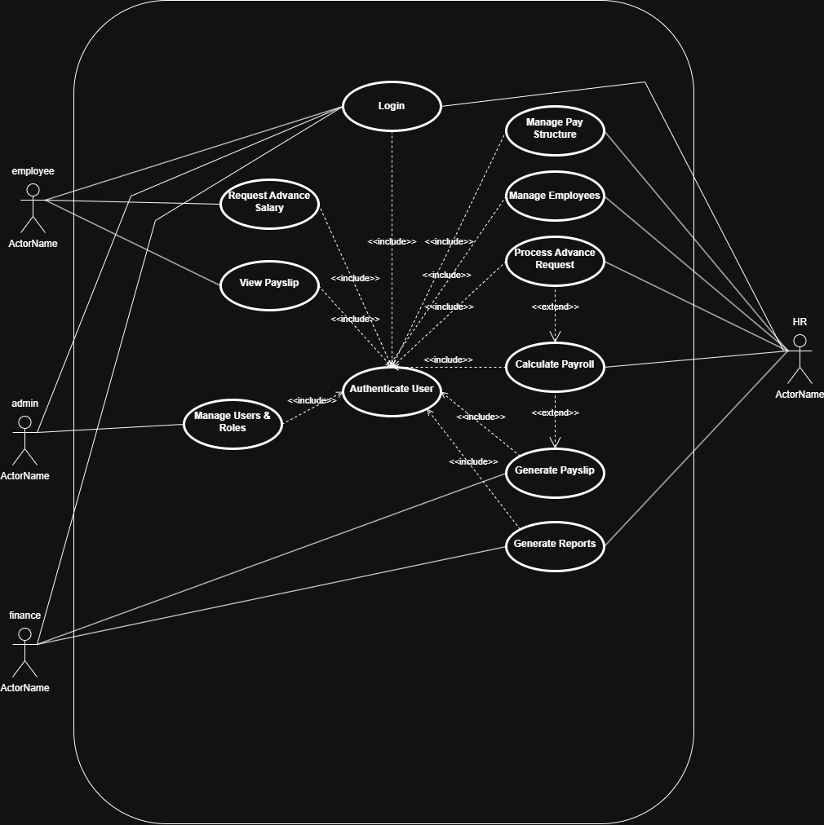
Use Case Diagram
The diagram shows how each actor interacts with the system.
Key use cases: Login, View Payslip, Request Advance, Manage Employees, Run Payroll, Generate Reports, Manage Users.

Slide 9
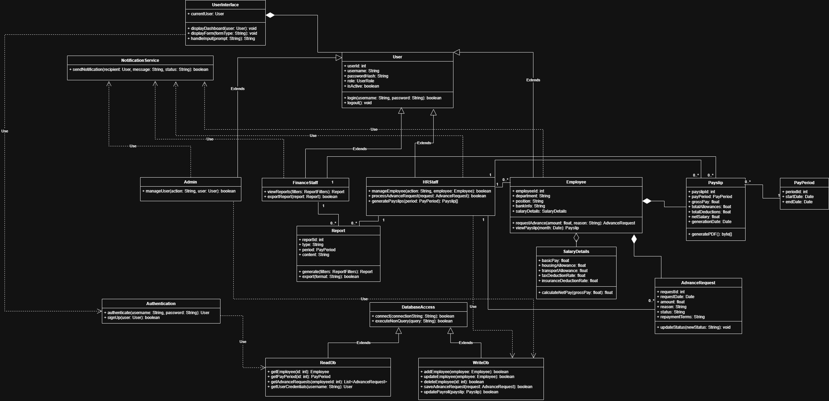
Class Diagram
Main classes: User, SalaryDetails, PayPeriod, Payslip, AdvanceRequest, Report.
Shows relationships and data structures used throughout the system.

Slide 11
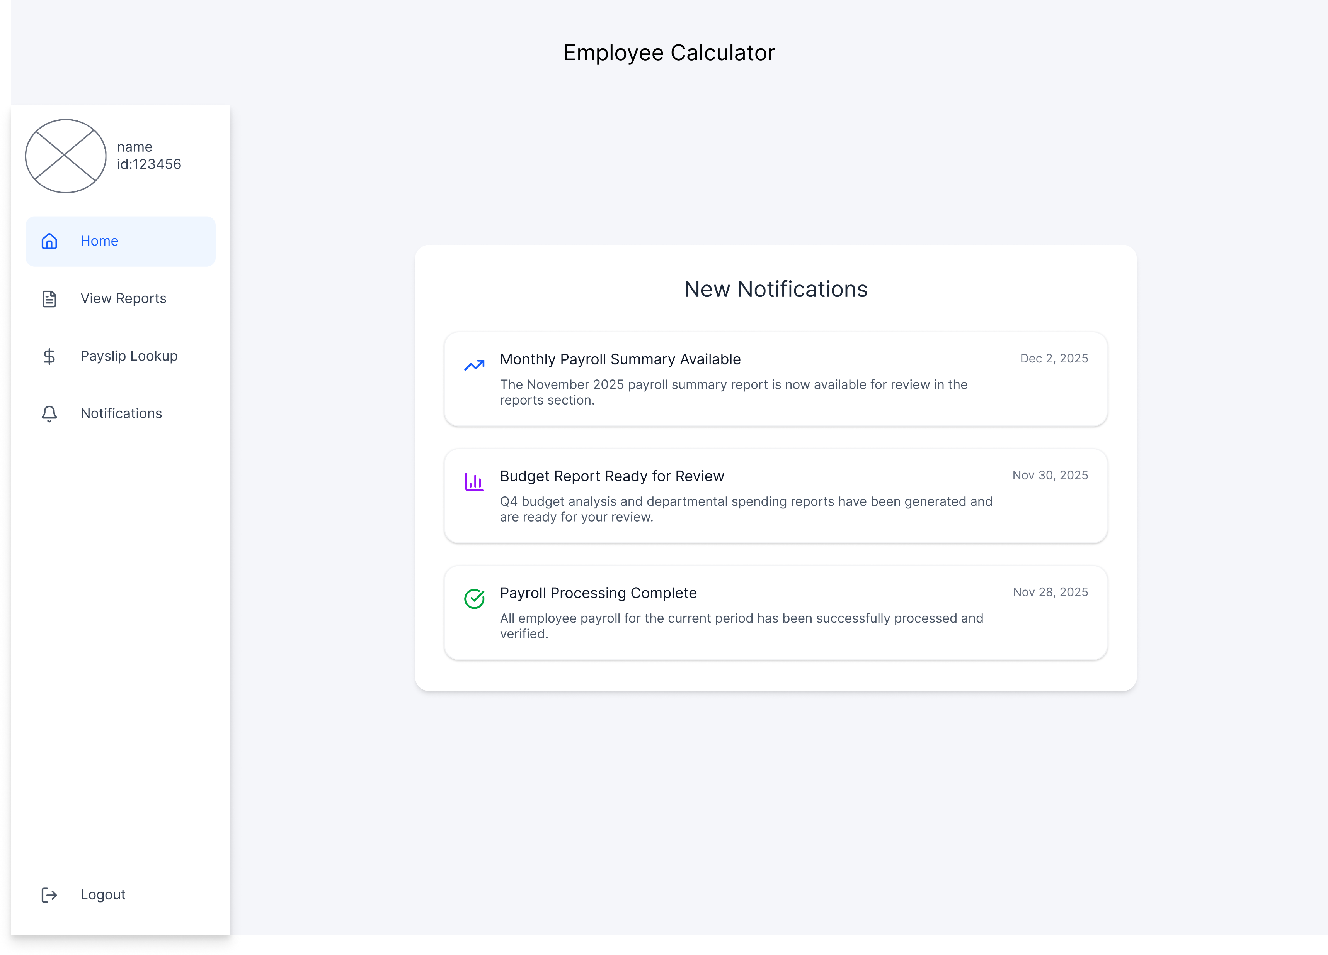
Employee Mockups

Slide 12
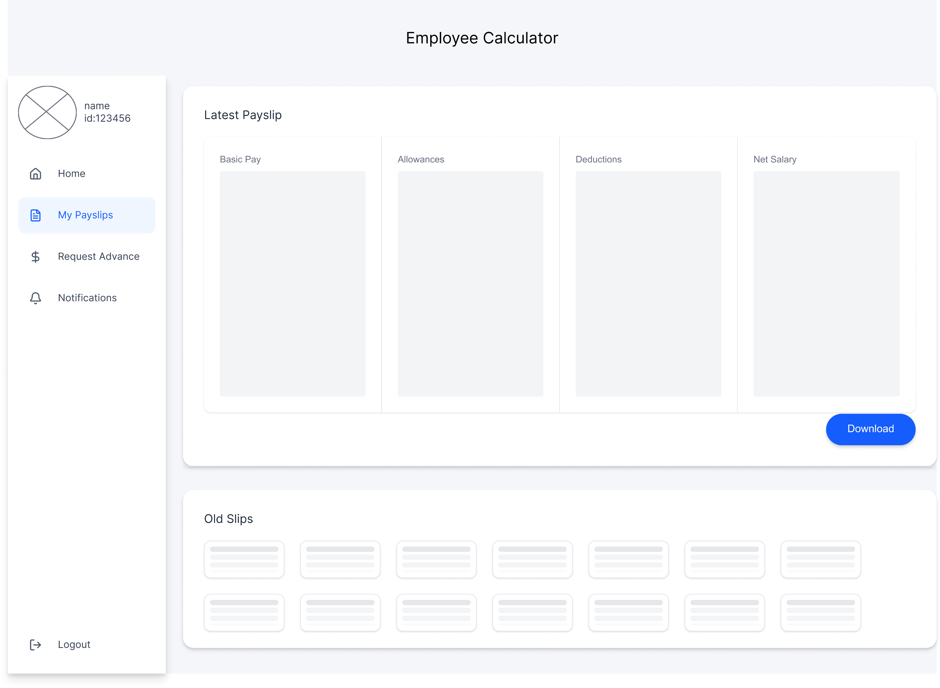

Slide 13
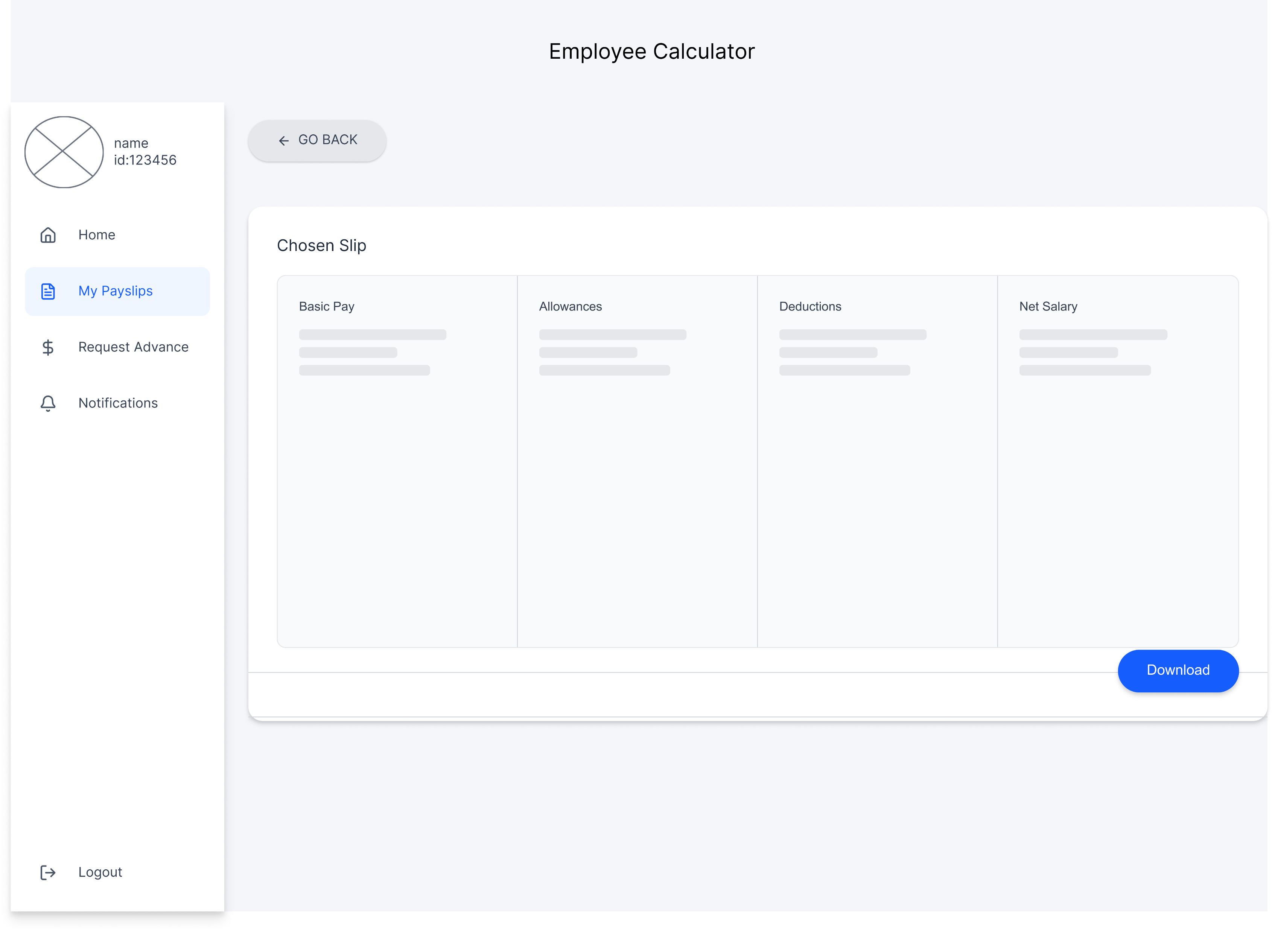

Slide 14
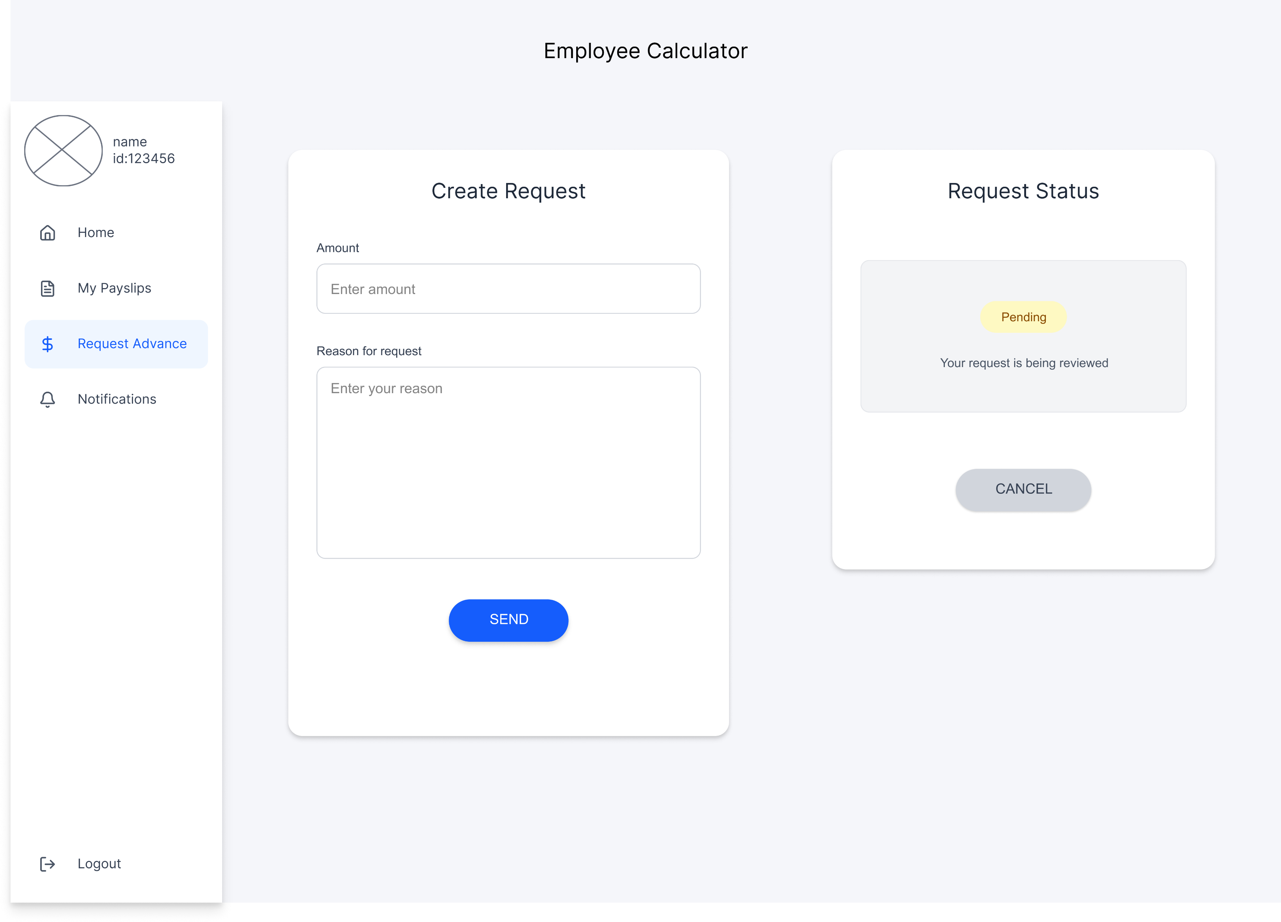

Slide 15
Finance

Slide 16
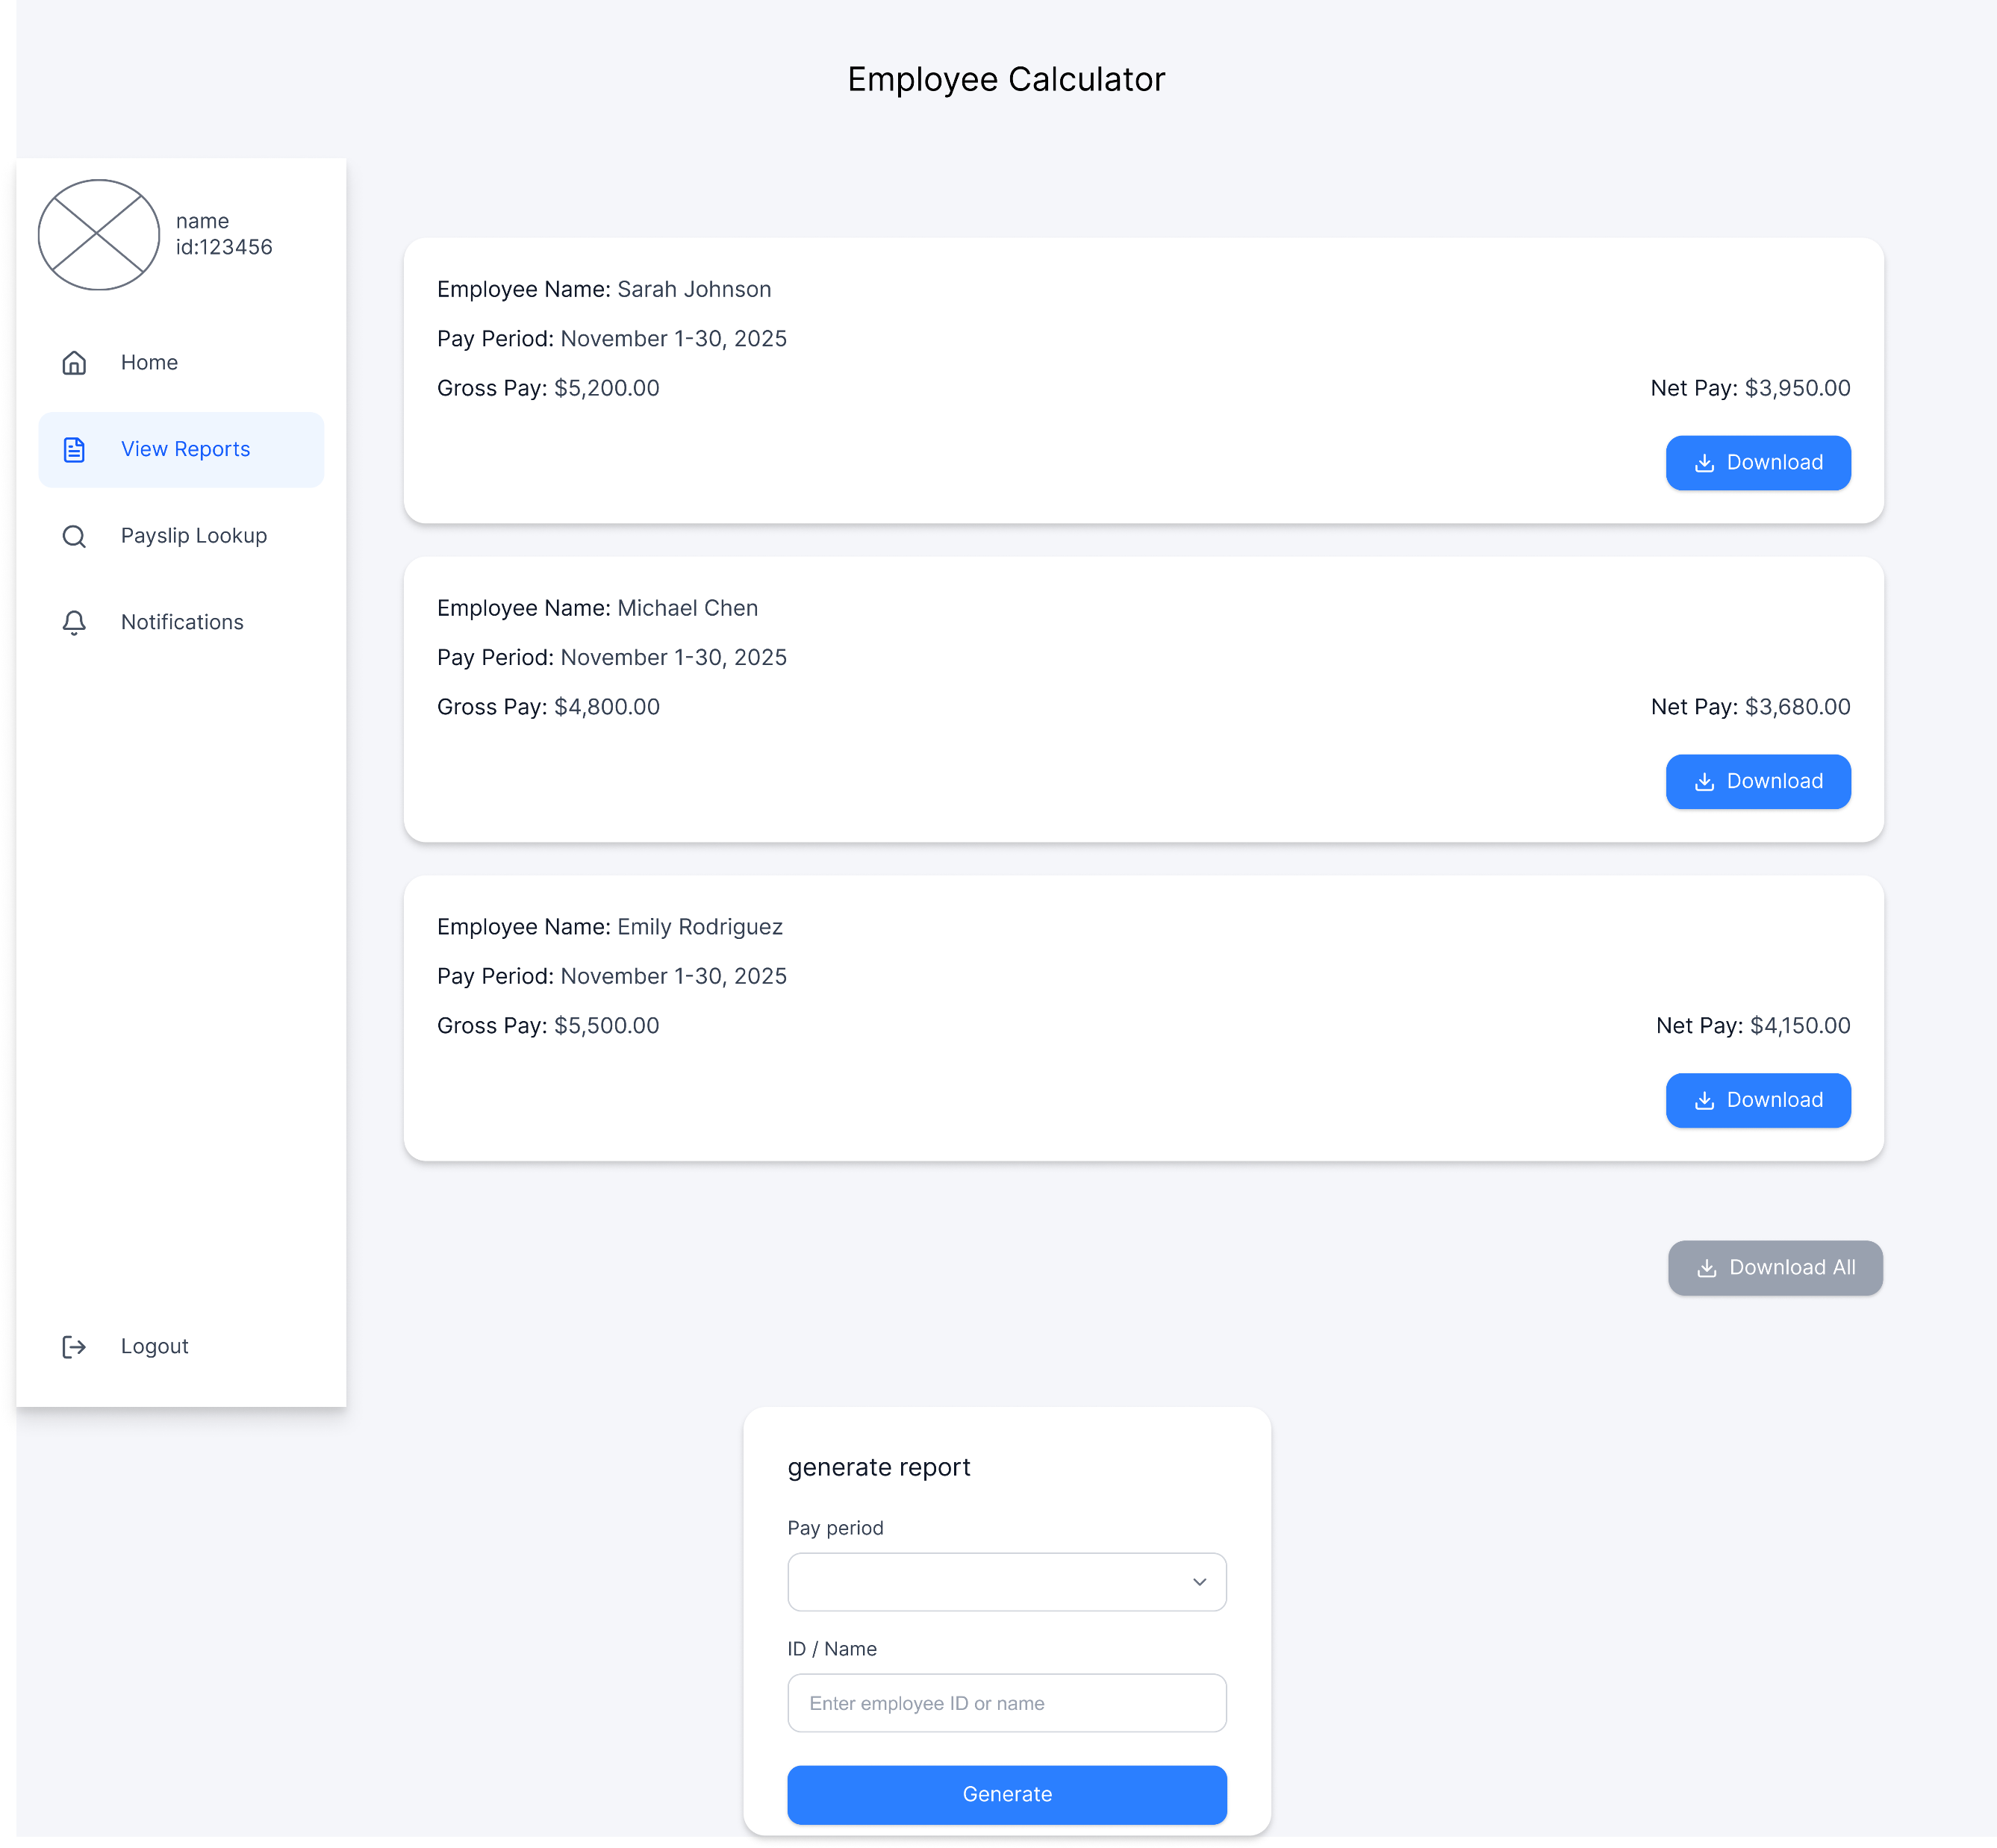

Slide 17
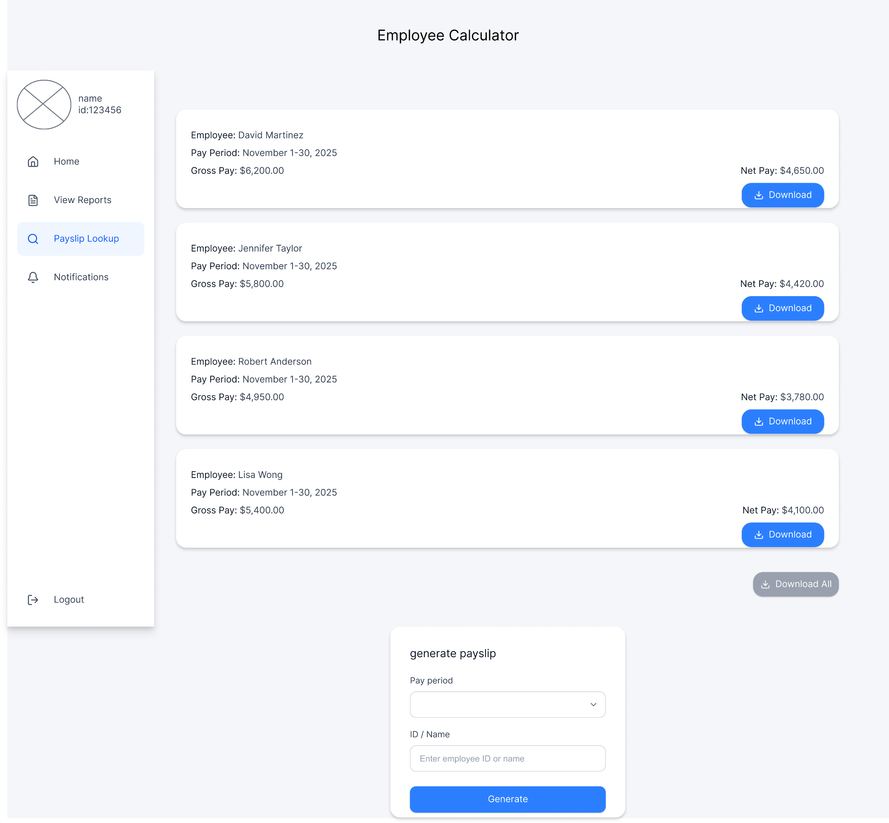

Slide 18
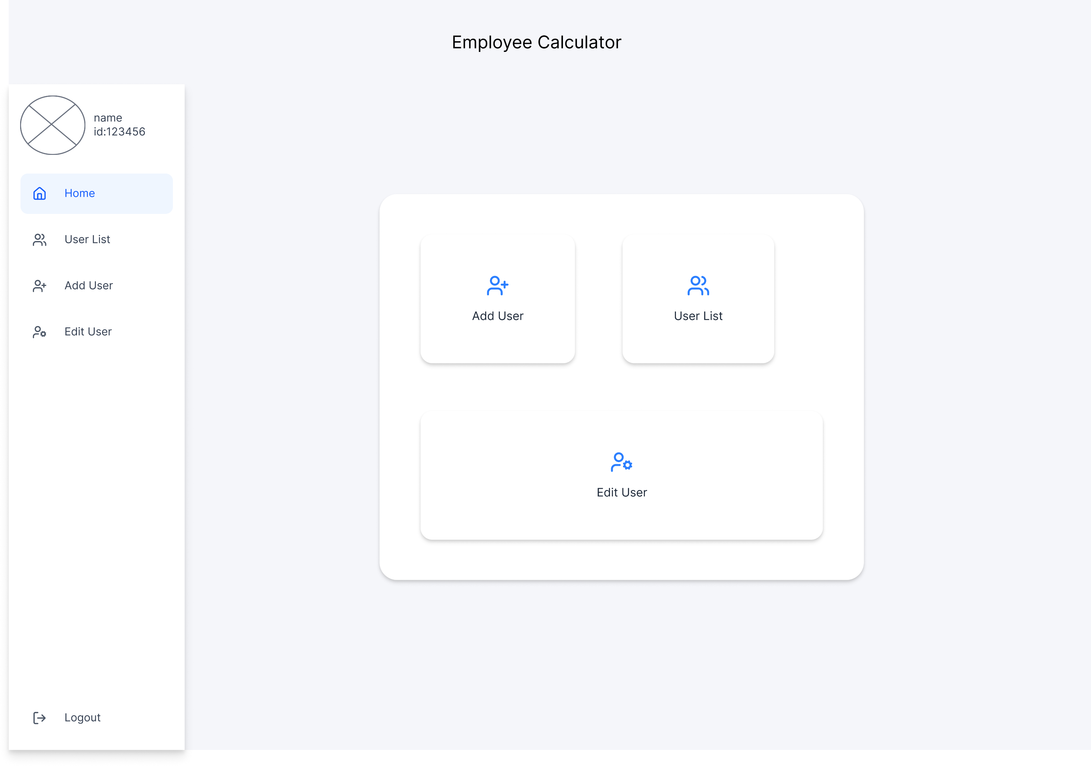
Admin

Slide 19
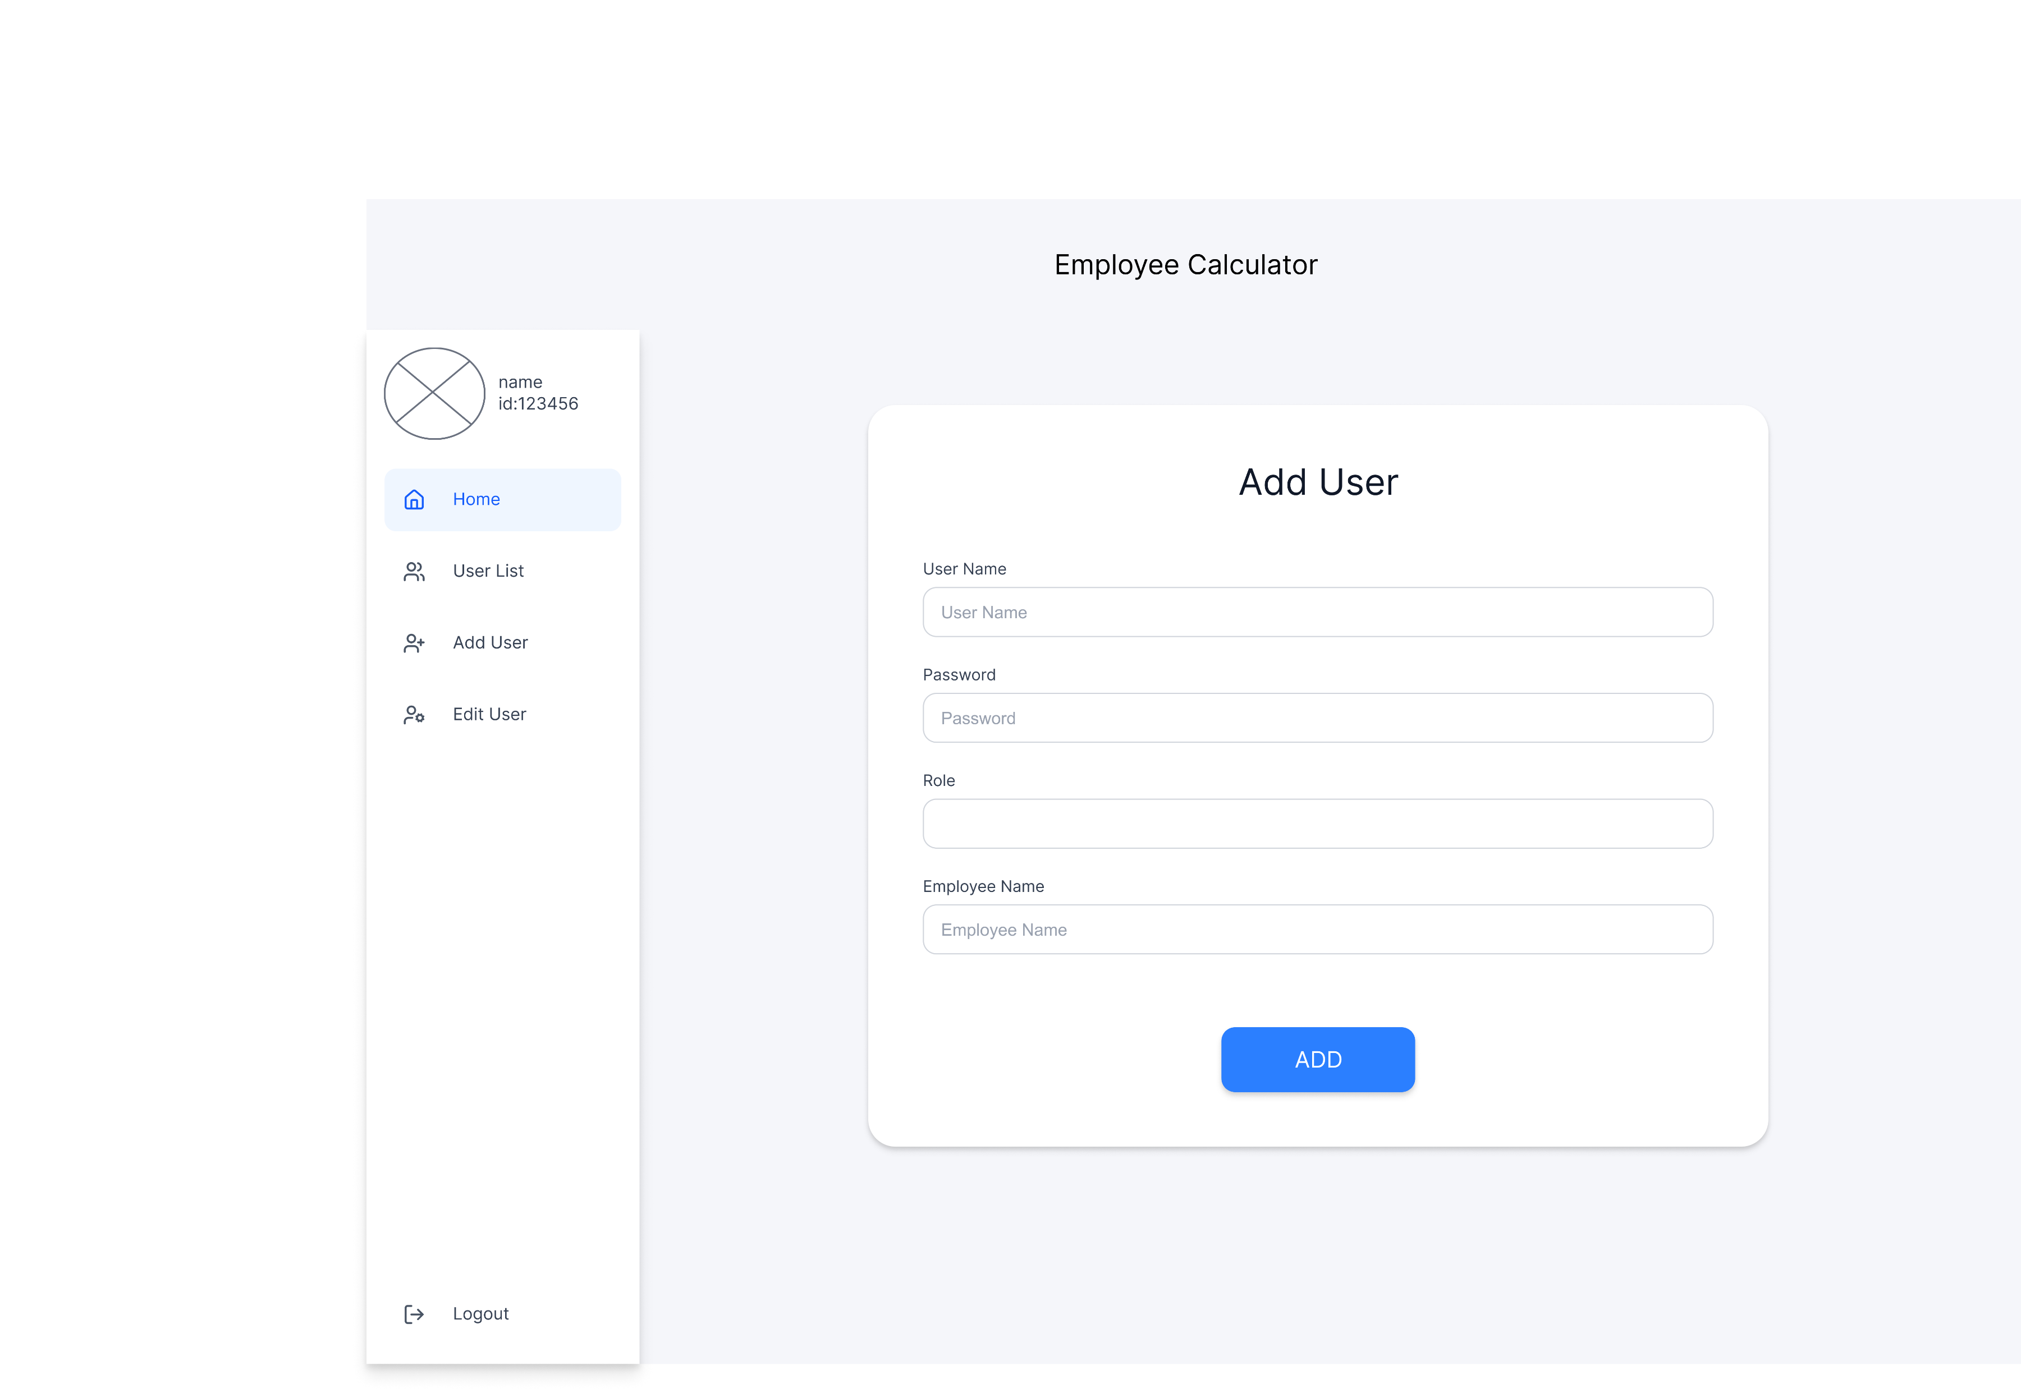

Slide 20
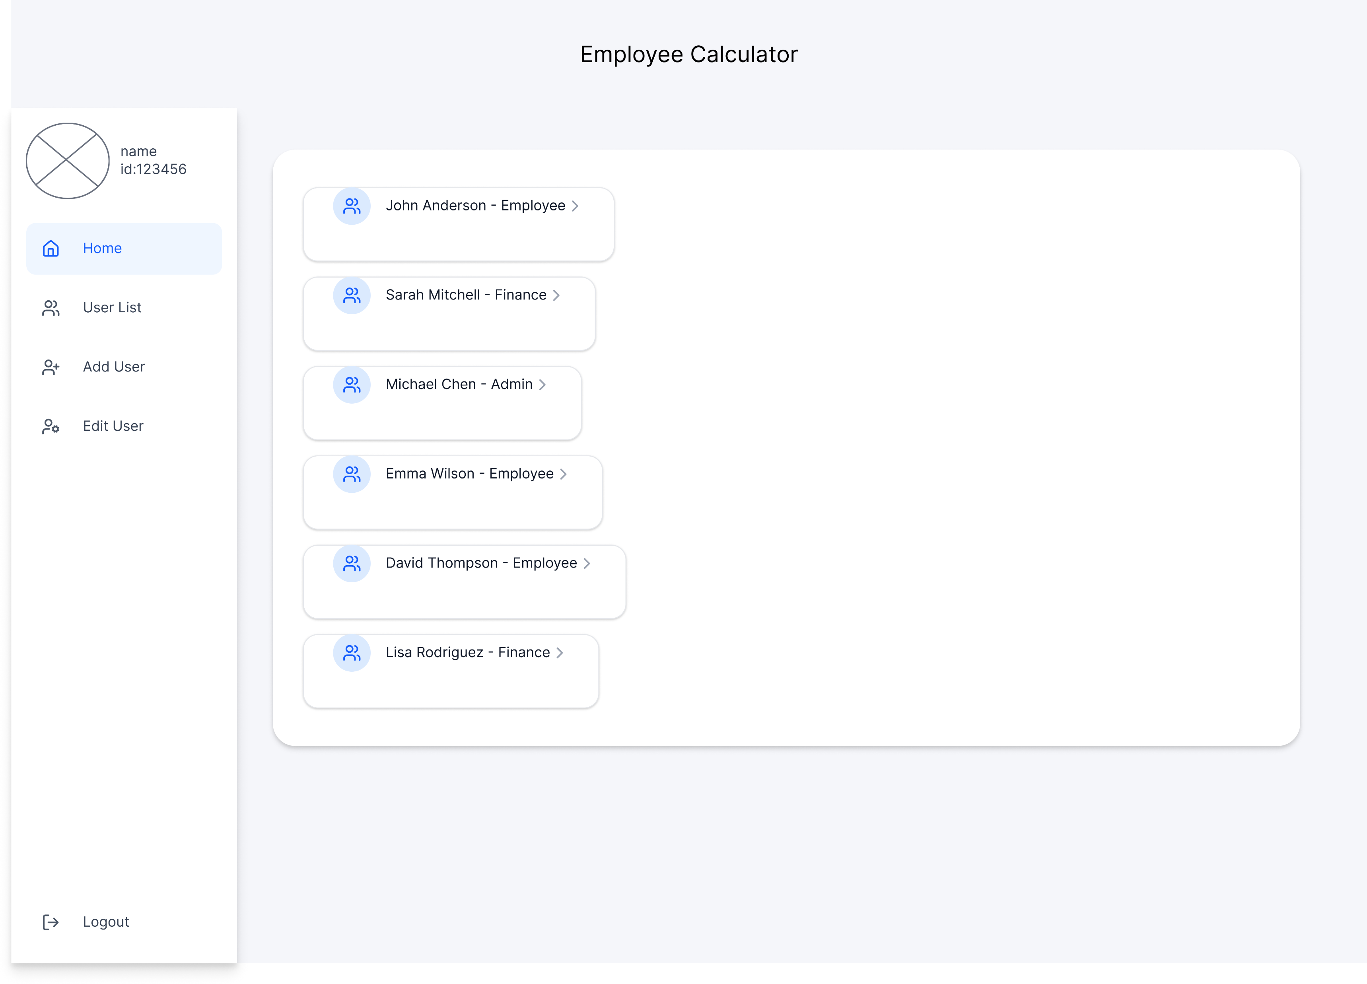

Slide 21
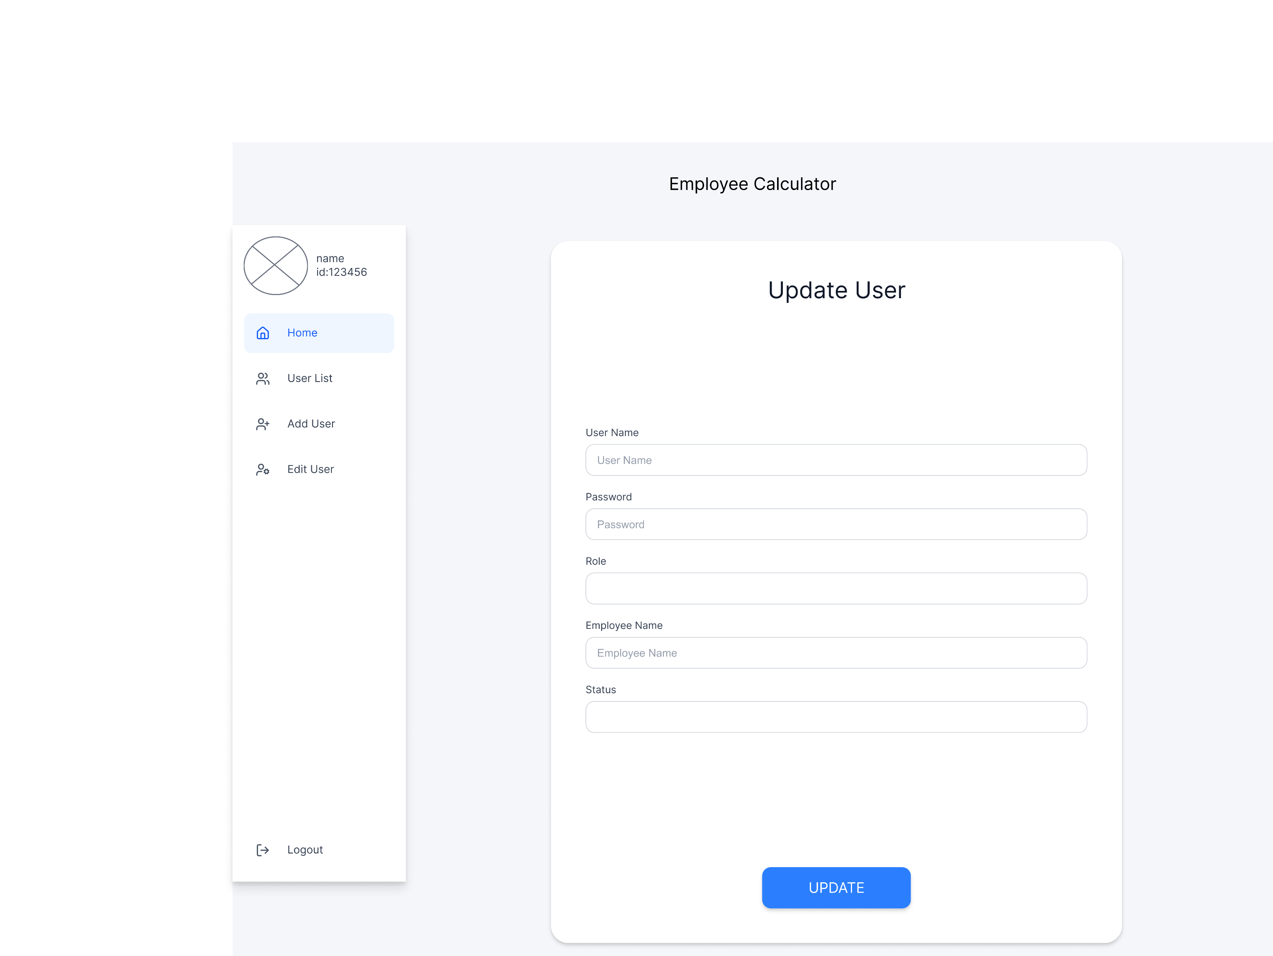

Slide 23
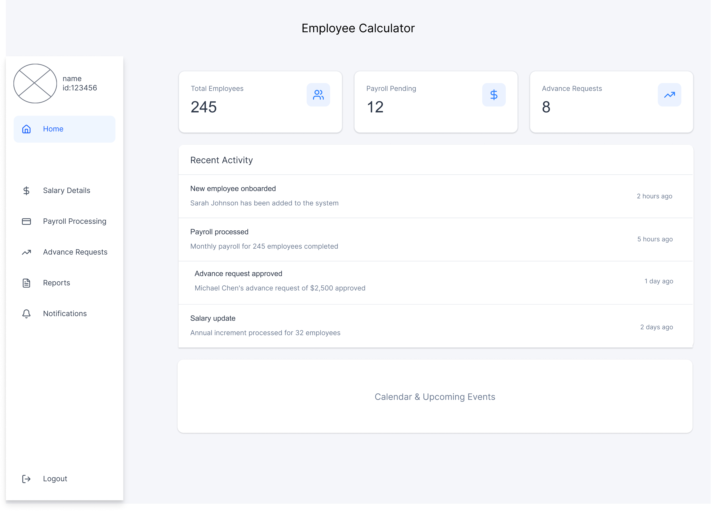
HR

Slide 24
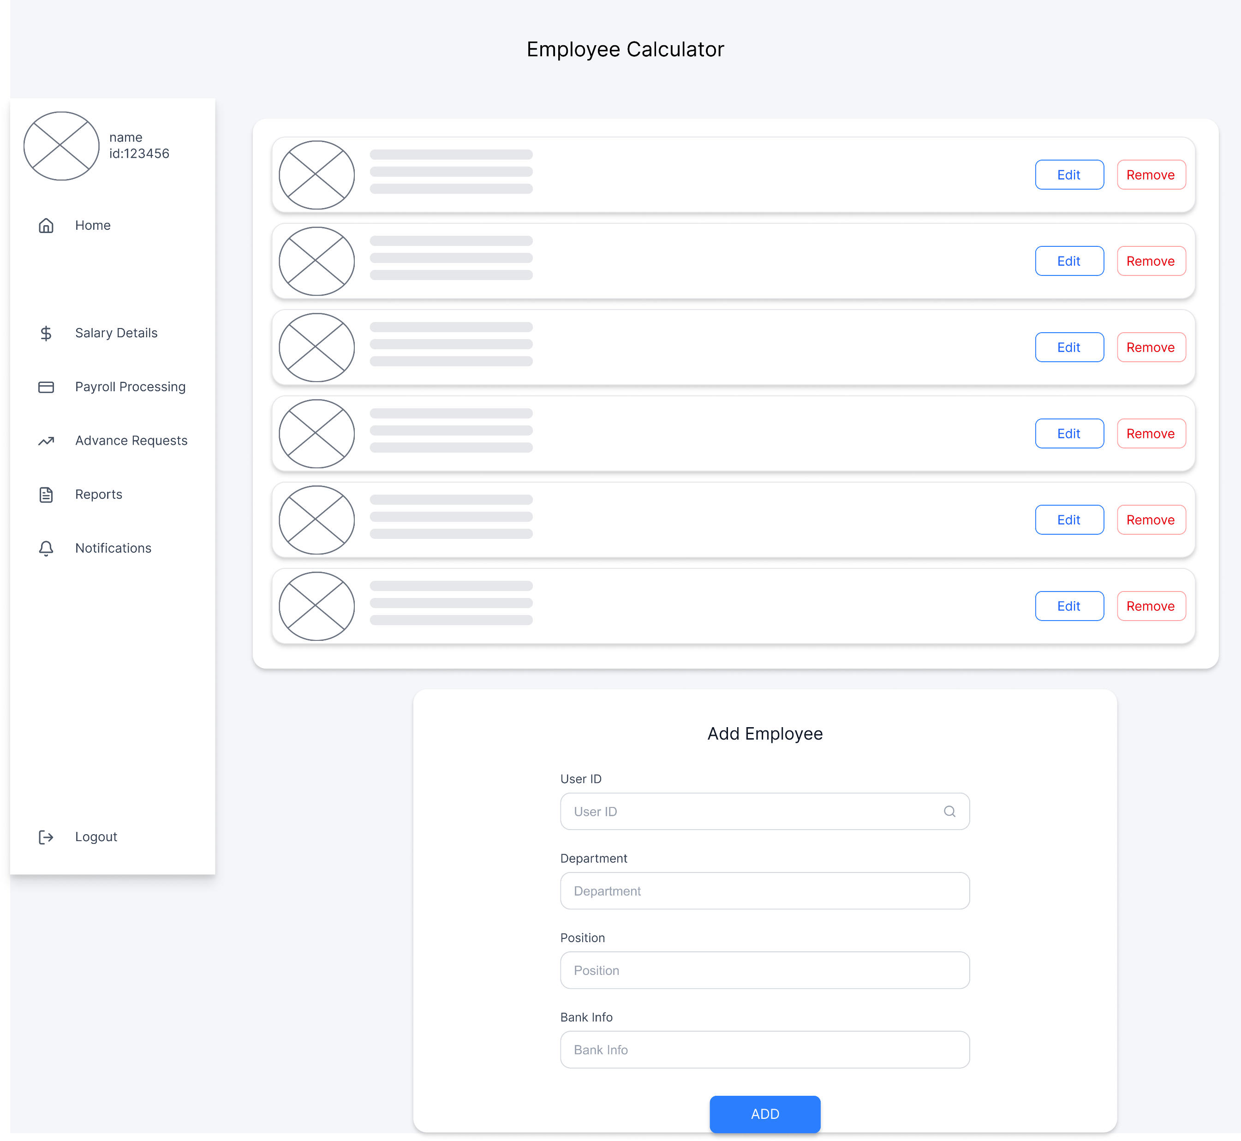

Slide 25
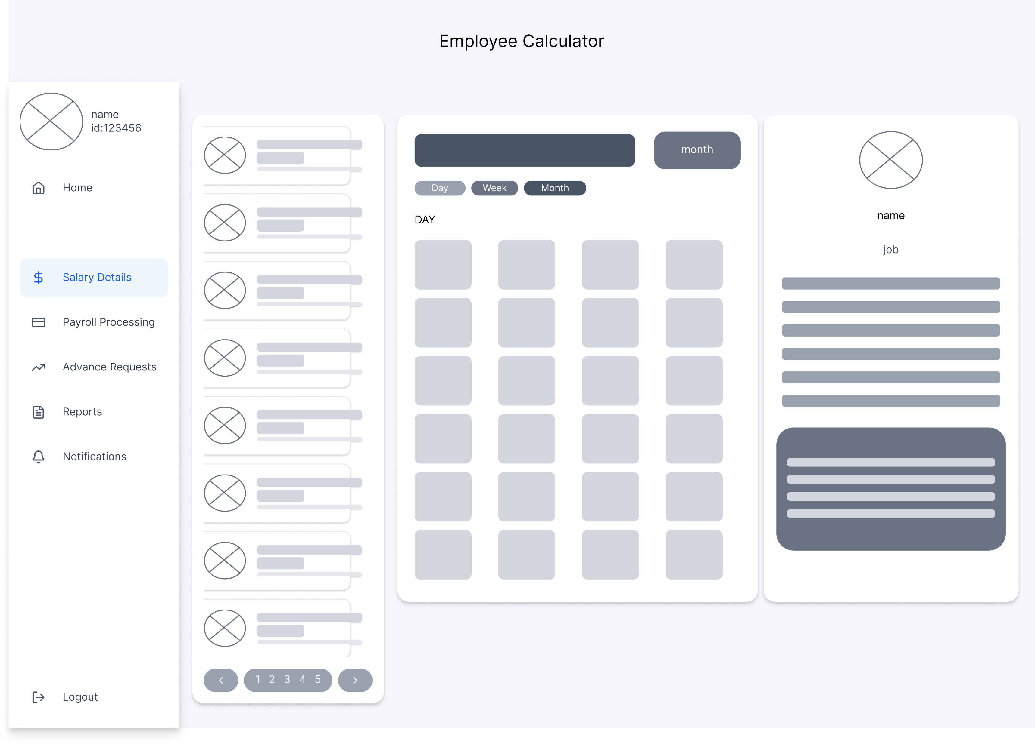

Slide 26
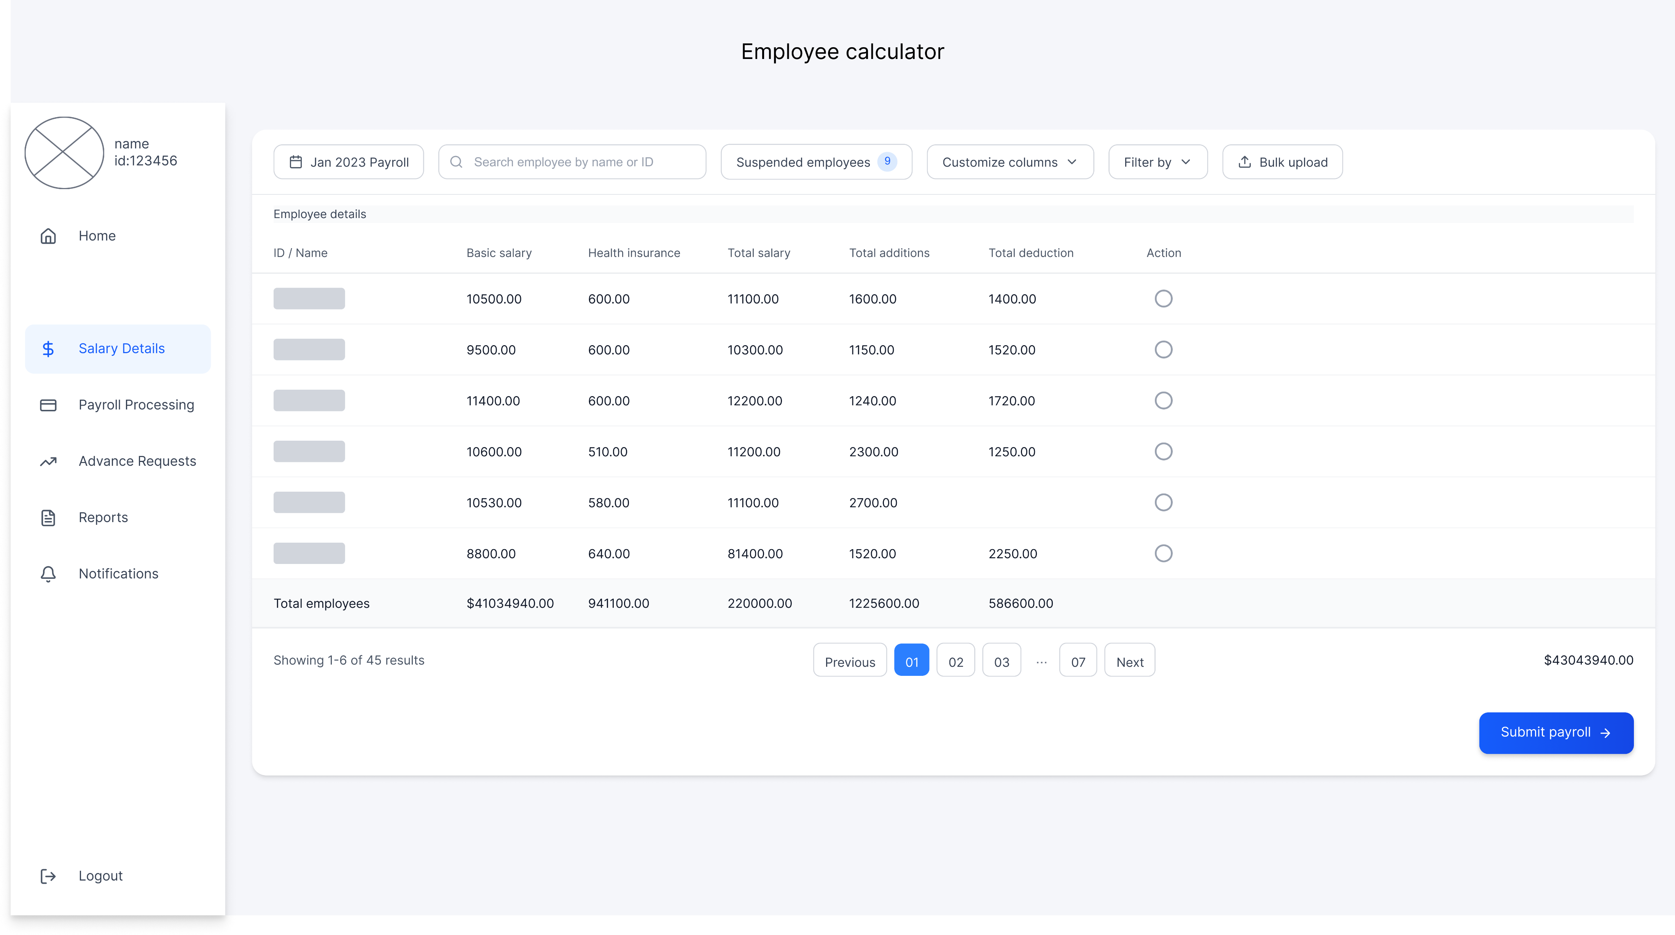

Slide 27
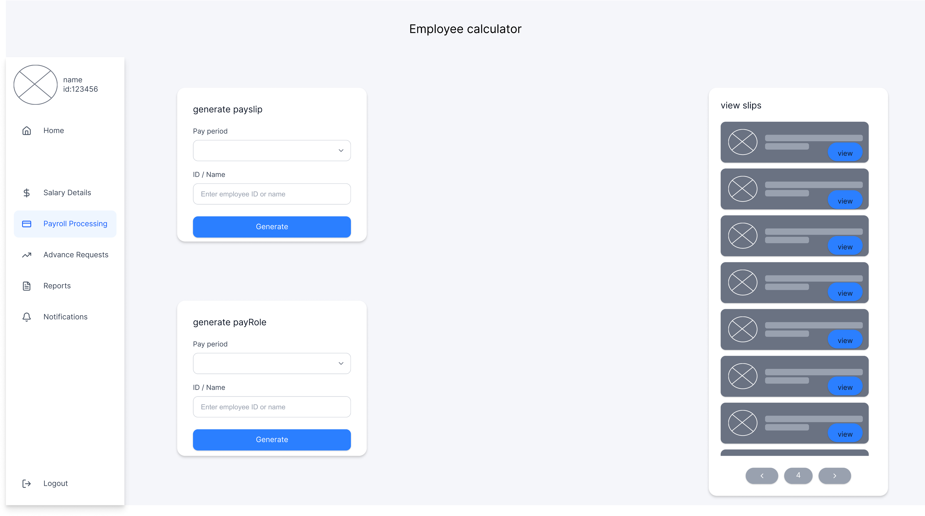

Slide 28
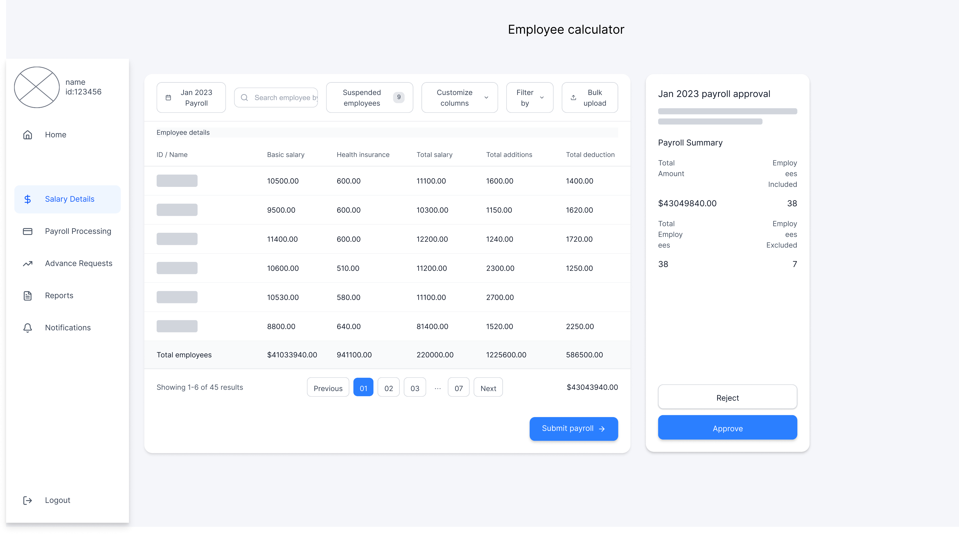

Slide 29
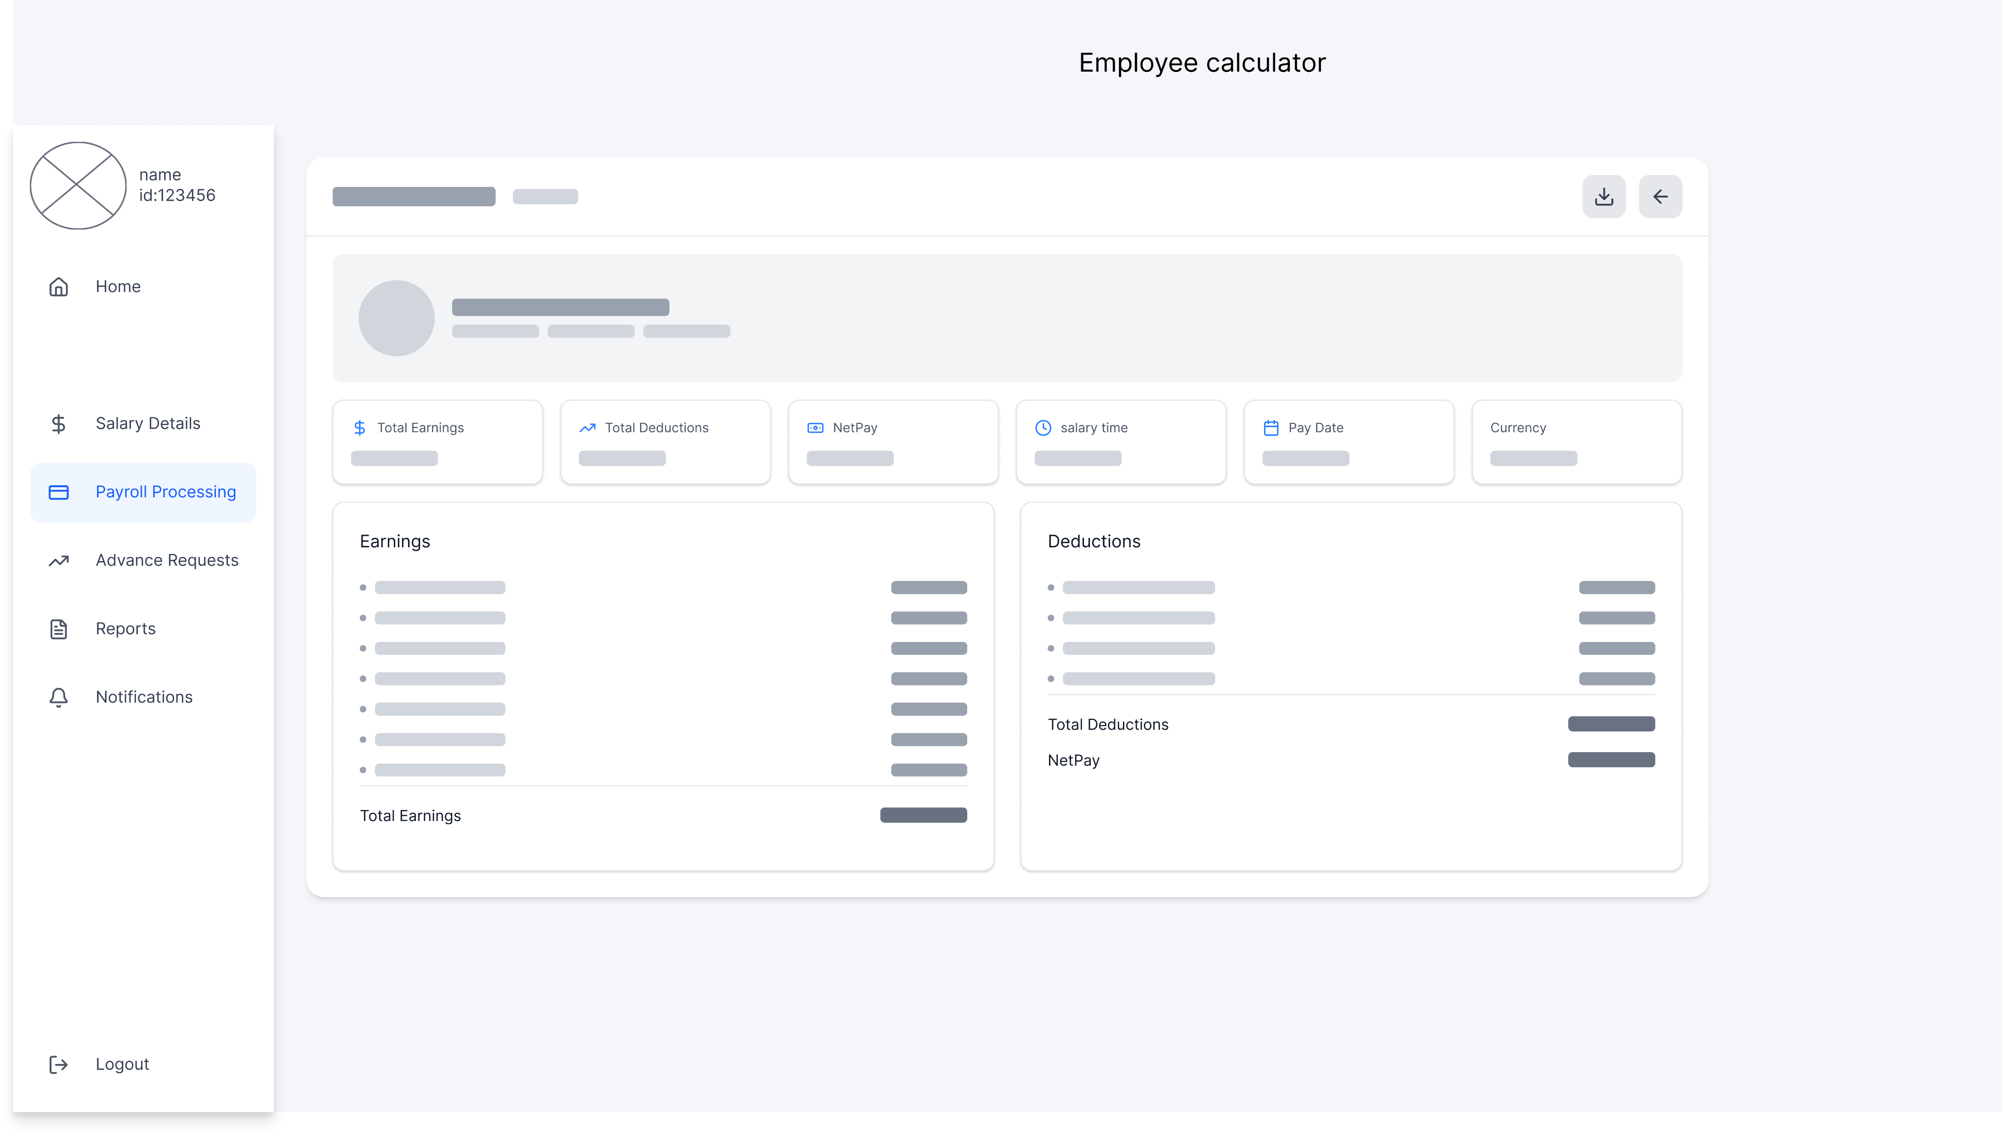

Slide 30
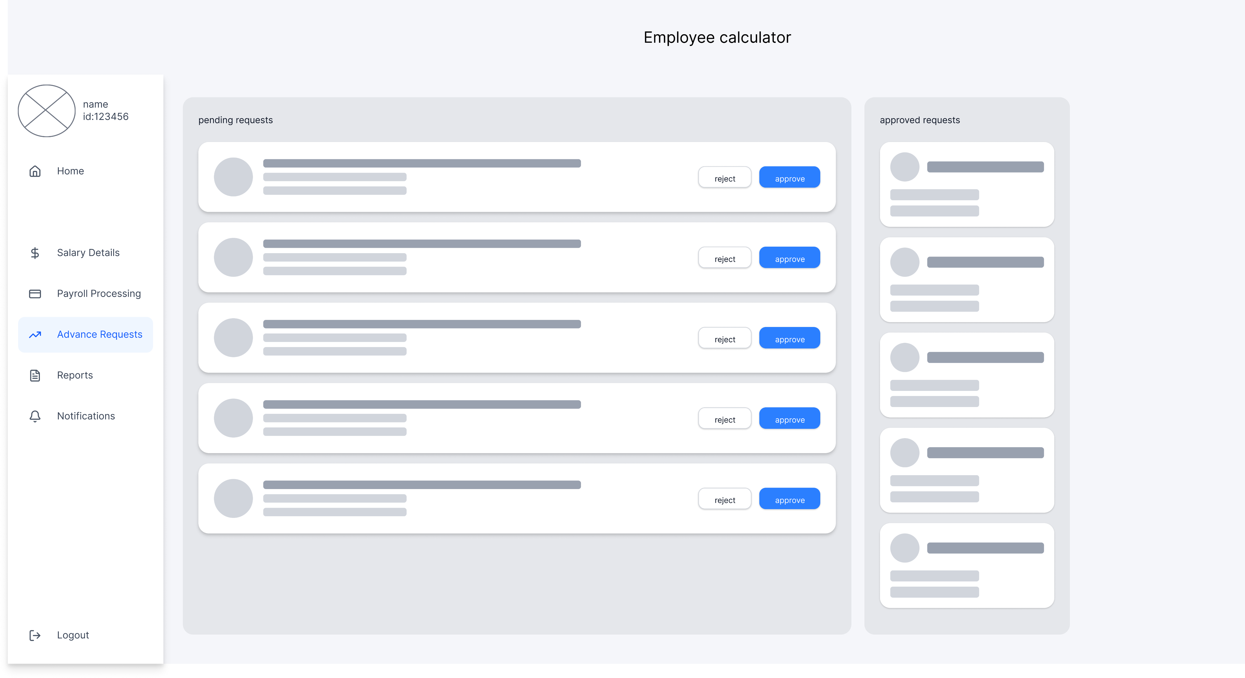

Slide 31
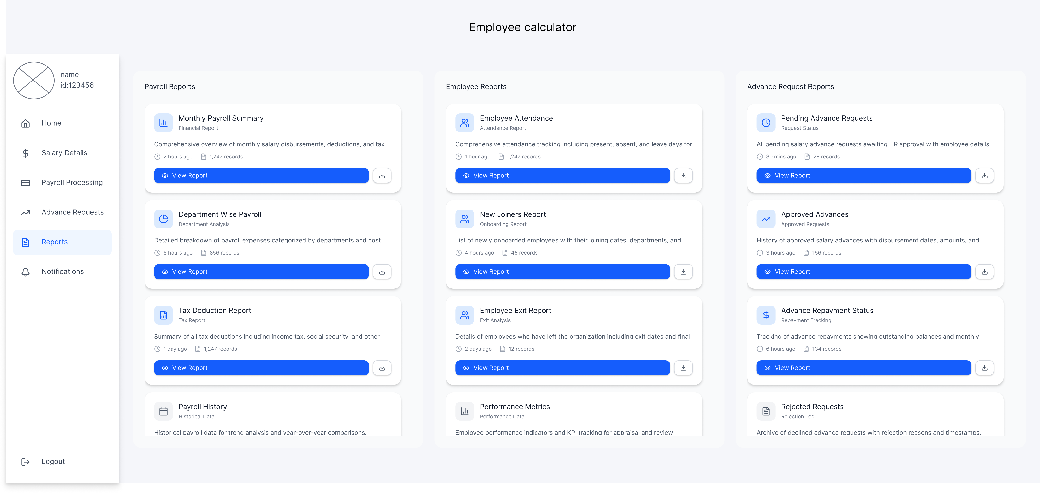

Slide 32
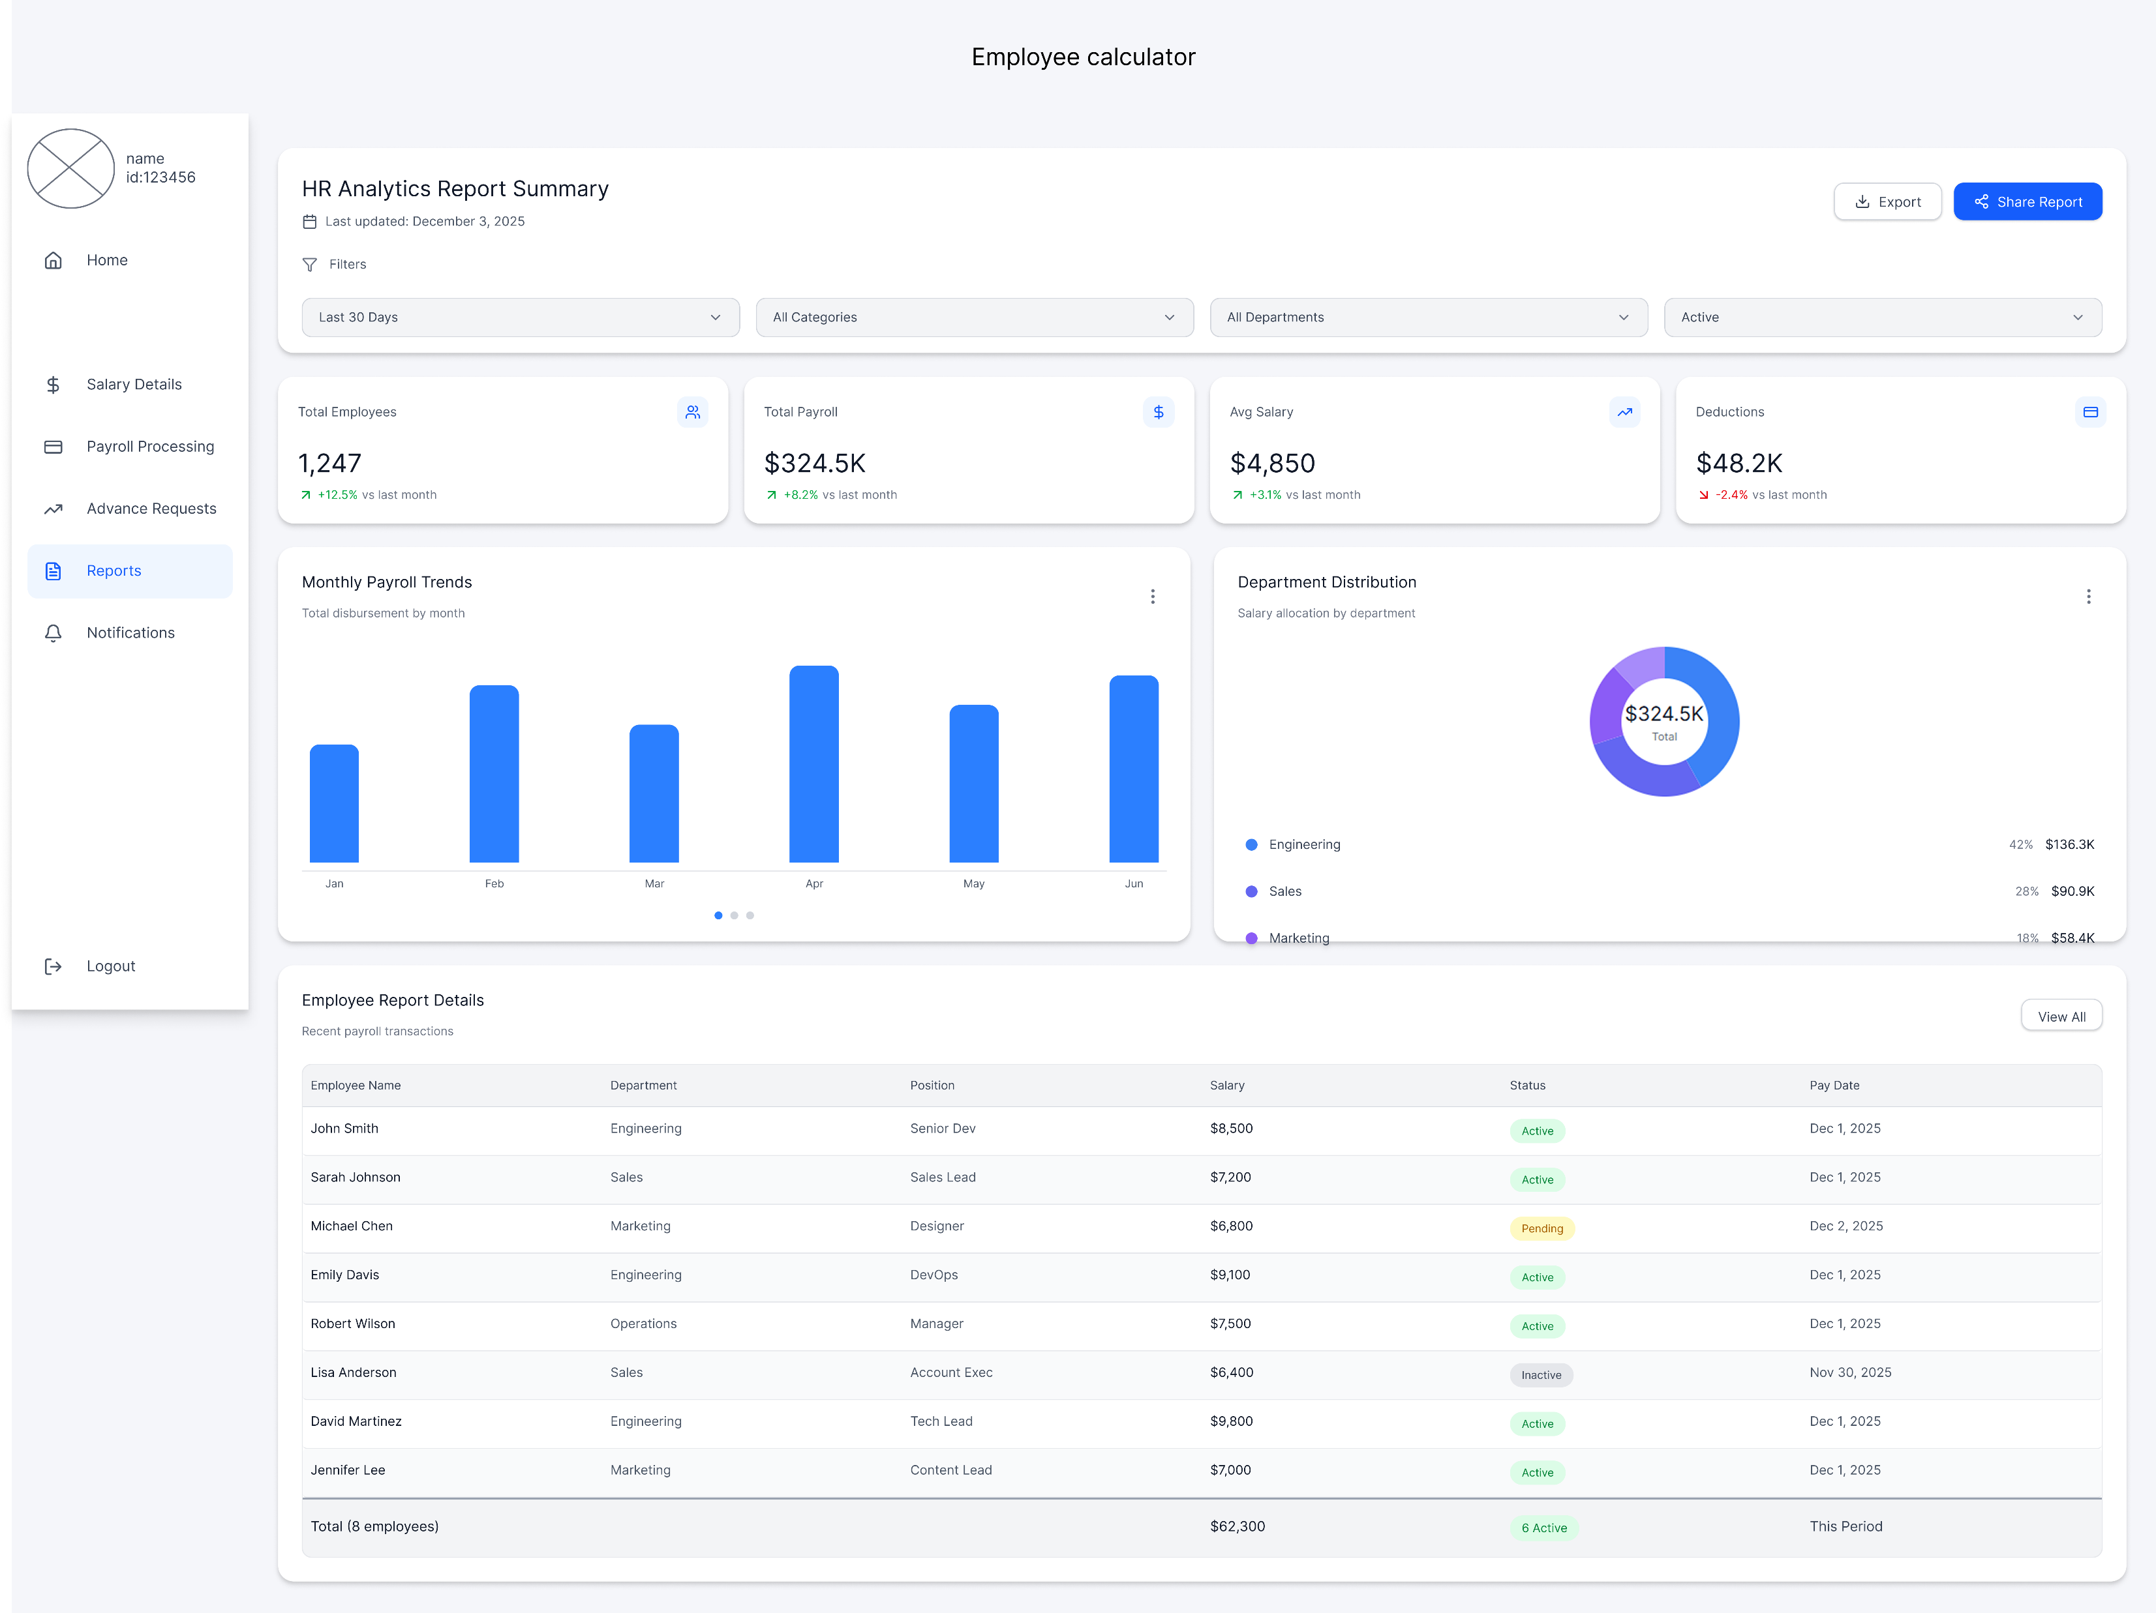

Slide 33
Design Technique
Figma/Wireframing tools: Used for page designs and prototypes.
Diagramming tools: Used for use case, class diagrams, and ERDs.
VS Code: Main development environment with Codex assistance.Figma/Wireframing tools: Used for page designs and prototypes.
Diagramming tools: Used for use case, class diagrams, and ERDs.
VS Code: Main development environment with Codex assistance.

Slide 34
Development Techniques
Iterative Prototyping (build → review → improve).
Component-Based Development for modular UI creation.
API-Driven Development using REST APIs.
AI-Assisted Code Generation (Codex) to speed up boilerplate work.
Manual coding for complex salary logic.

Slide 35
Development Tools
React.js: Frontend interface components.
Node.js + Express: Backend logic and API structure.
MySQL: Relational database storing employees, salaries, payslips.
Vite: Fast build tool and dev environment.
VS Code: Coding environment with extensions and Codex.

Slide 36
Software Development Methodology – RAD
Chosen methodology: Rapid Application Development (RAD)
Reasons:
Many UI screens require quick, iterative prototyping.
Frequent feedback from HR/Finance/Admin needed.
Codex accelerates development cycles.
Changes can be made quickly without restarting the project.
Benefits: Faster delivery, better user involvement, fewer errors.

Slide 37
Conclusion
The system automates payroll and reduces manual errors.
Provides role-based dashboards for employees, HR, Finance, and admin.
Integrates payslips, salary calculations, reporting, and request workflows.
Built using modern technologies: React, Node.js, MySQL, Codex.
RAD methodology ensures quick development and continuous improvement.

