Slide 1
AI-Powered Medical Imaging System
Obada Al-halaybeh
23110107

Slide 2

Introduction
Current hospital challenges:
  Slow reporting times
  Radiologist overload
  Accuracy risks
AI can support doctors with faster, reliable imaging

Slide 3

Project Aim & Objectives
Aim: Improve diagnostic speed and accuracy using AI.
Objectives:
  Integrate with PACS/EHR
  Provide secure and reliable reporting
  Train hospital staff
  Improve patient outcomes

Slide 4
Requirements
Functional | Non-Functional
Automated image analysis | High accuracy
Integration with PACS/EHR | Data security (HIPAA/GDPR)
Real-time alerts and reporting | Compliance with medical standards

Slide 5
Project Scope
In scope | Out of scope
AI development | Physical equipment maintenance
PACS/EHR integration | unrelated hospital IT systems
training
deployment

Slide 6
Project Timeline
6-month duration
Key Milestones:
  1 Sept – Project Kickoff
  15 Sept – Design Approval
  21 Nov – Module Testing
  15 Dec – System Integration
  30 Jan – Pilot Testing
  16 Feb – Full Deployment

Slide 7
Budget Overview
Total Cost: $114,800
Distribution:
Project Management – 30%
Software – 17%
Hardware – 13%
Environmental Project – 13%
Training – 9%
Reserves – 17%

Slide 8
Risks & Mitigation
⚠ risk | ✅ solution
Data Breach | encryption + audits
Staff Resistance | training + support
Integration Failure | early testing
AI Accuracy Issues | pilot + feedback

Slide 9
Change Management Plan
Awareness
emails
Posters
Readiness
training
pilot system
Resilience
help desk
feedback forms
workshops
user guides
ongoing support

Slide 10
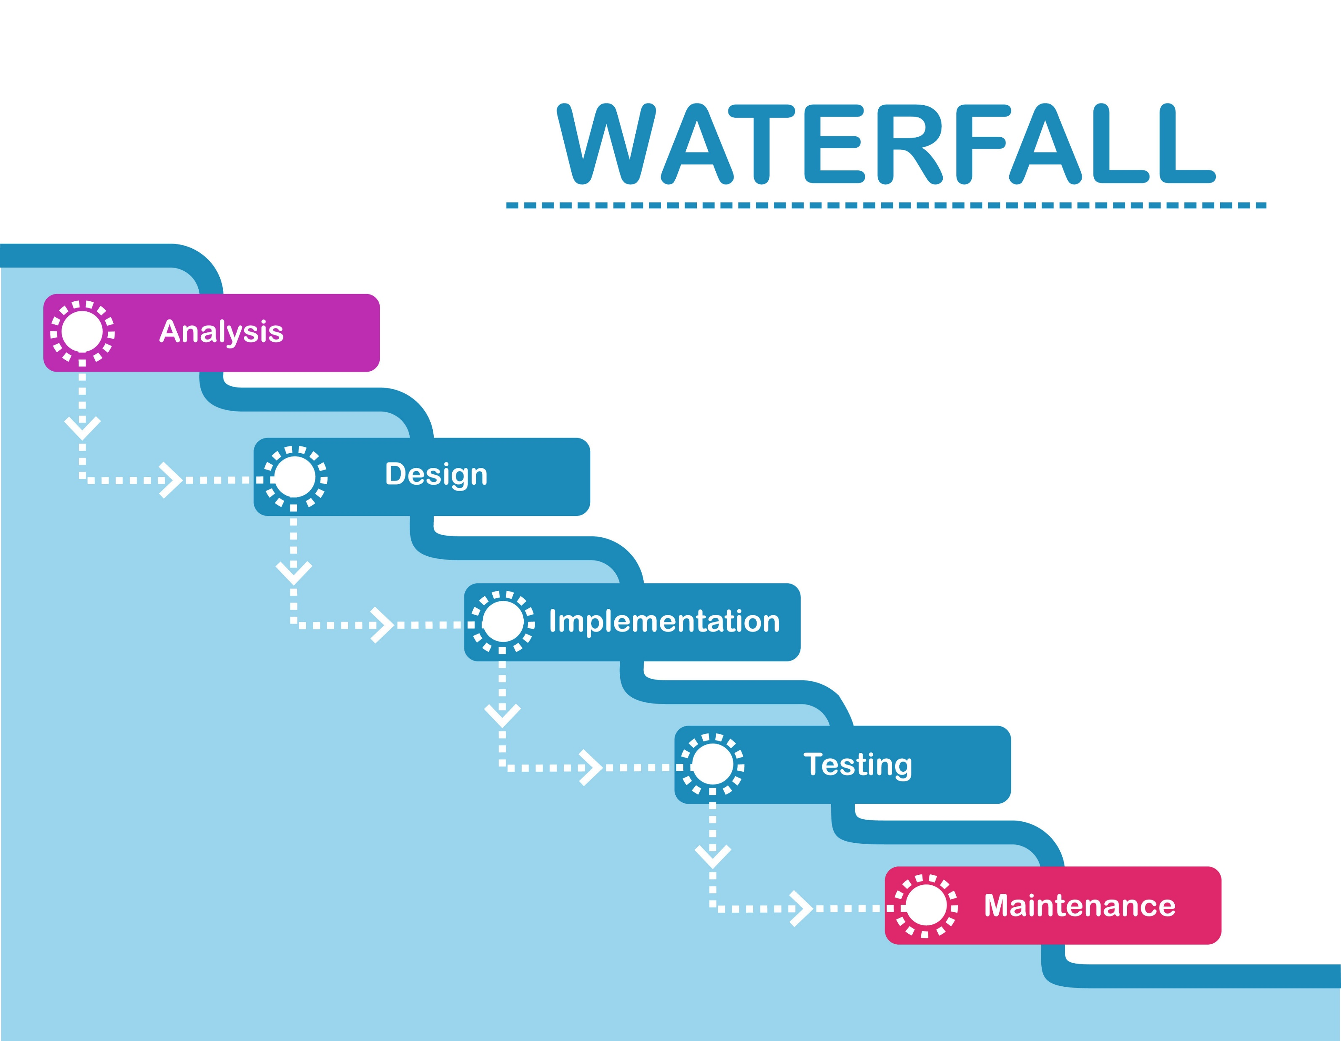
Software Development Methodology
Using Waterfall model
Step-by-step:
  Requirements → Design → Development → Testing → Deployment → Maintenance
Fits hospital project: structured, documented, regulatory-friendly

Slide 11
Project Benefits
Faster image reporting
Reduced workload for radiologists
More accurate diagnosis support
Improved patient care
Secure handling of medical data

Slide 12

Conclusion
AI system meets hospital’s needs
Budget and timeline are realistic
Risks are managed
Change plan ensures smooth adoption
Next step: hospital approval and full deployment

