Slide 1

Business process support
Obada al-halaybeh_23110107

Slide 2

Products
In this project I selected three products from company called razer to be more specific the products were from their keyboard collection.
Razer Ornata V3 Gaming Keyboard
Razer BlackWidow V4 X Mechanical Gaming Keyboard
Razer Huntsman Mini 60% Gaming Keyboard-white
These products were chosen as they represents the same category (keyboards) from the same company razer, each keyboard has its own unique feature, making them a good products to do a comparative analysis on.

Slide 3
Data generation
The data collection was done using helium 10, helium 10 is a chrome browser extension that provides a real time analyses on products listed on amazon.
Helium 10 is mostly used in e-commerce analytics as it allow product tracking and pricing trends.
the data you get from that will be listed as: time, sales rank, list price and new price.
Time: the time when the product was ordered ,year/month/day/hour( for the products in the project I took a 1year span)
Sales rank: the position it has in its category(indicates popularity).
List price: manufacturer suggested price.
New price: the vendor offered price.

Slide 4
Why This Data is Relevant
Time data: help us find and analyze the spike of sales for a product.
Seals rank: help us find how popular this product to the others(from the same category as keyboards).
List price: give us the intended pricing strategy from the company also can be analyzed to see how consistent is the price a long the time line.
New price: show us the real price the customer paid for the product, we can study customer behavior from it as if there is a discount or an offer for the product.
All of these data are important to help stakeholders in marketing and pricing decisions, as finding the best period for discounts and tracking the product comptitvnest in the market.
Since I am gathering information about the same type of product from the same company but on a different levels(features), this data will be meaningful, and will give insight about customer beahvior, price sensitivity, and seasonal trends. all of that is important in decision making in the e-commerce world.

Slide 5
data science tools and technologies used in the project
Helium 10
Excel
Power BI
Orange

Slide 6
Helium 10 – data collection
It is a specialized Amazon analytics tool.
It extract real world data such as time of the purchase, sales rank, list price and new price.
it also provide up to date and reliable sales information gathered directly from the Amazon marketplace.

Slide 7
Microsoft Excel – data preparation and enhancement
excel take the raw csv file and clean the data and give a clean format.
Functions include formatting, removing errors and structuring datasets in tables (pivot tables).
Make sure that the dataset is clean and consistent before any analysis.

Slide 8
Power BI – data analysis and visualization
It is a business intelligence tool that transform data into interactive dashboards.
It also use DAX(data analysis expressions)to do custom measures like total sales average price and comparisons.
It enable real time dynamic data exploration.

Slide 9
Orange – data mining and predictive analysis
Orange is a machine learning and data mining platform.
It's used to apply clustering, classification or predictive modeling on sales datasets.
Helps move beyond descriptive analytics into predictive insights.

Slide 10
Helium 10 – decision making
Helium 10 was my starting point because it gave me real sales data straight from Amazon for the three Razer keyboards. It provided details like sales rank, time, list price, and new price, so I could see exactly how each product performed over the year. This made the data reliable and realistic, helping me understand which products were most popular and how different pricing strategies influenced customer demand.

Slide 11
Excel – decision making
Once I had the raw data, I used Excel to clean and organize it. With pivot tables, filters, and formulas, I could shape the data into a format that made sense and was easy to analyze. This step was important because it removed errors and inconsistencies, so I knew I was working with accurate information. In other words, Excel made sure my analysis later on in Power BI and Orange was based on clean, trustworthy data.

Slide 12
Power BI – decision making
Power BI came next, and this is where the data really started to tell a story. Using DAX functions like SUM, AVERAGE, and FILTER, I was able to create measures that showed things like total revenue, average selling price, and product comparisons. The dashboards in Power BI made it easy to see sales trends over time and spot differences between products. This way, decision-makers can quickly understand what’s going on and make smarter choices in real time.

Slide 13
Orange – decision making
Finally, I used Orange to go beyond just describing the past. Orange applies data mining and machine learning to find hidden patterns and even predict future trends. For example, it can highlight unusual sales behavior or forecast which product might do better in the coming months. This turns the data from something that only explains what has already happened into a tool that helps plan for what’s next, making decisions much more proactive.

Slide 14
Business Process Supported
Business Process Supported: Marketing and Sales Optimization (through sales monitoring and data-driven decision-making)It tracks product performance over time using sales rank, list price, and new price.
Tracks product performance using time, sales rank, list price, and new price
Focuses on sales monitoring and marketing decision-making
Ensures decisions are based on data, not assumptions

Slide 15
Value for the Marketing Department
Marketing Department Benefits: Smarter Campaigns and Pricing Strategies.
Sales Visibility: Gives marketers a clear view of demand and product performance over time.
Promotion Timing: Identifies peak sales periods, helping plan campaigns when customers are most active.
Pricing Insights: Shows how price changes and discounts affect overall sales performance.
Product Focus: Compares premium vs budget products, guiding where to invest marketing efforts.

Slide 16
Value for the Company as a Whole
Company-Wide Benefits: Stronger Strategic, Tactical, and Operational Decisions.
Executives: insights for long-term strategic planning.
Sales managers: better daily decisions on stock and discounts.
Brand managers: evaluate market positioning and brand health.
Improves decision-making at all levels (strategic, tactical, operational) and Leads to reduced risks, optimized resources, and stronger growth.

Slide 17
Stakeholder Value Assessment
Brand Managers
  Trend Visibility: Brand managers can clearly see how each Razer keyboard performs across the year, identifying periods of growth and decline in sales rank.
  Product Comparison: They can compare performance between Ornata V3, Huntsman Mini, and BlackWidow V4 to determine which model needs stronger marketing support.
  Discount Sensitivity: Data on list price vs. new price helps them understand how customers react to discounts, guiding future pricing strategies without damaging brand perception.

Slide 18
Stakeholder Value Assessment
Sales Managers
  Promotion Planning: Sales managers can analyze which months respond best to price cuts or promotions, making campaigns more effective and less wasteful.
  Target Setting: With clear historical trends, they can set realistic sales targets for each product, improving team motivation and performance tracking.
  Performance Review: Data allows them to evaluate past campaigns, learning which strategies worked and which products failed to meet expectations, improving future planning.

Slide 19
Stakeholder Value Assessment
Company Executives
  High-Level Insights: Executives gain a big-picture view of overall product health, seeing which Razer keyboards are profitable, stable, or underperforming.
  Investment Planning: They can decide where to allocate budgets, such as investing more in high-performing premium products or boosting weaker ones with promotions.
  KPI Monitoring: Dashboards give executives measurable KPIs (sales rank, revenue impact, price trends), enabling more confident and data-driven strategic decisions.

Slide 20
Evaluation of Stakeholder Impact – over all evaluation
Brand Managers: Benefit significantly from sales rank and pricing insights, as this helps them adjust product positioning, evaluate market competitiveness, and align brand perception with customer expectations.
Sales Managers: Gain the most practical and immediate value, since they use sales data to plan promotions, set realistic targets, and review performance to improve daily and monthly operations.
Company Executives: Receive high-level strategic insights, enabling them to decide where to invest, how to balance the product portfolio, and how to guide long-term company growth.

Slide 21
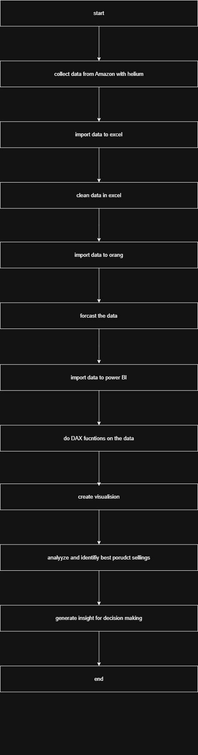
Flow chart and explanation
Look in notes
Notes:
START
This project starts with a clear goal: turn raw sales data from Amazon into useful insights that can actually guide marketing and sales decisions. Instead of relying on guesses, we want to build a process that makes every step data-driven.
Collect Amazon Data using Helium 10
The first step is collecting the data. Using Helium 10, I pulled one year of sales information for the three Razer keyboards. The dataset included the time of each record, the sales rank, the list price, and the new price. This gives us a solid base of real market data to work with.
Save and Clean the Data in Excel
After downloading the CSVs, I moved everything into Excel. Here I organized the files, cleaned the data, and created new fields like discount amount and discount percentage. This step was about making sure the dataset was accurate, consistent, and ready for analysis.
Forecasting and Data Mining in Orange
To take things further, I used Orange for forecasting and data mining. By applying time-series models such as ARIMA, I was able to predict how sales rank and pricing might behave in the coming months. This step adds a forward-looking perspective to the analysis.
Import Data into Power BI
Once the data was prepared, I brought it into Power BI. With DAX functions, I calculated important business metrics like total revenue, average selling price, and monthly trends. Power BI also let me start building dashboards so the numbers could be seen in a clear, visual way.
Visualization in Power BI
I then combined the actual data with the forecasts back in Power BI. The dashboards show everything in one place—sales patterns, price changes, discounts, and future projections—making the insights easy to understand at a glance.
Analyze and Identify Best-Selling Products
With these dashboards, it became possible to directly compare the three products. I could see which keyboard sold better during discounts, which one stayed strong without heavy promotions, and which months were the best for marketing campaigns.
Generate Insights for Decision-Making
The final output of the pipeline is clear, actionable insights. Marketing teams can plan campaigns at the right time, sales managers can set realistic targets, and executives can decide where to invest more. Every group gets the information they need to act confidently.
END
In the end, what starts as raw Amazon sales data is transformed into a complete decision-support system. This pipeline doesn’t just explain what happened—it also shows what’s likely to happen next, helping the company build smarter, more data-driven marketing and sales strategies.

Slide 22
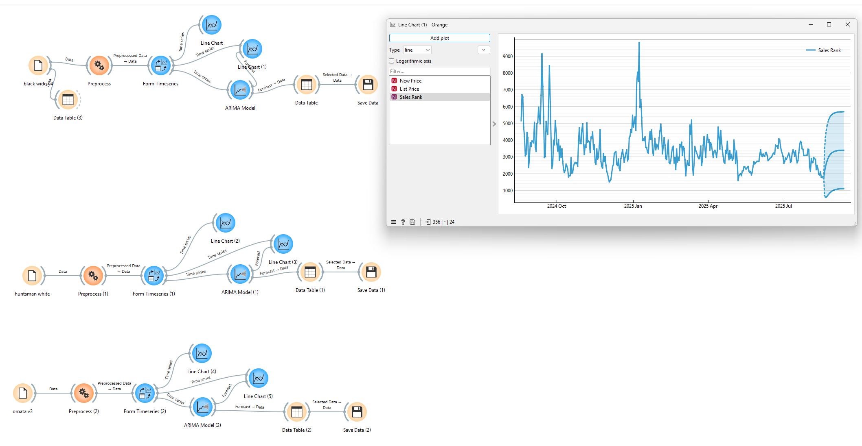
orange

Slide 23
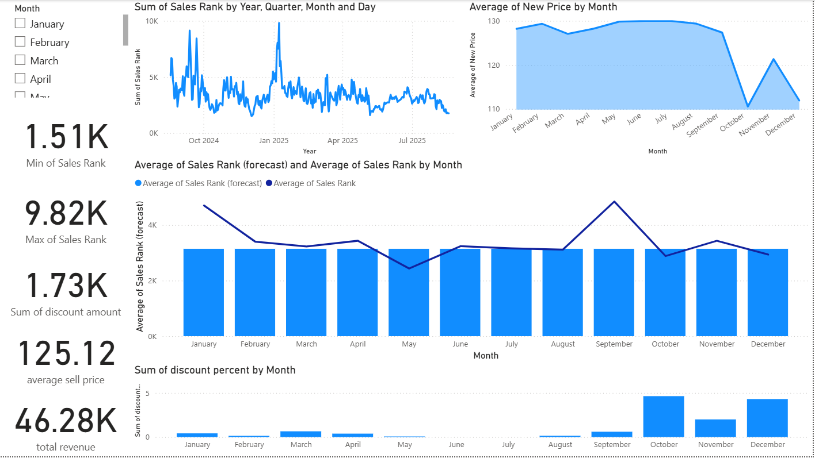
BlackWidow V4 - dashboard

Slide 24
BlackWidow V4-dashboard analysis
Chart / KPI | Analysis
Sales Rank Trend | Rank shows instability, with weaker performance in Q3–Q4.
Average New Price | Price stays high 124 JD, confirming premium positioning.
Discount % | Discounts spike in Oct–Dec, but do not significantly improve rank.
Total Revenue 248K | Strong revenue contribution important for overall portfolio performance.
Forecast (Rank/Price) | Predicts possible decline if no new strategy is applied.

Slide 25
BlackWidow V4 – Recommendations
Insight | Recommendation
High price stability at 124 JD | Keep premium pricing; avoid frequent deep discounts.
Discounts in Oct–Dec don’t improve rank | Use value-added bundles (keyboard + accessories) instead of heavy discounts.
Rank weakens in Q3–Q4 | Run event-based promotions (holidays, gaming launches) to boost demand.
Strong revenue 248K JD | Protect margins by maintaining premium image while sustaining sales volume.
Forecast shows possible decline | Align inventory with forecast to prevent overstock during weaker demand.

Slide 26
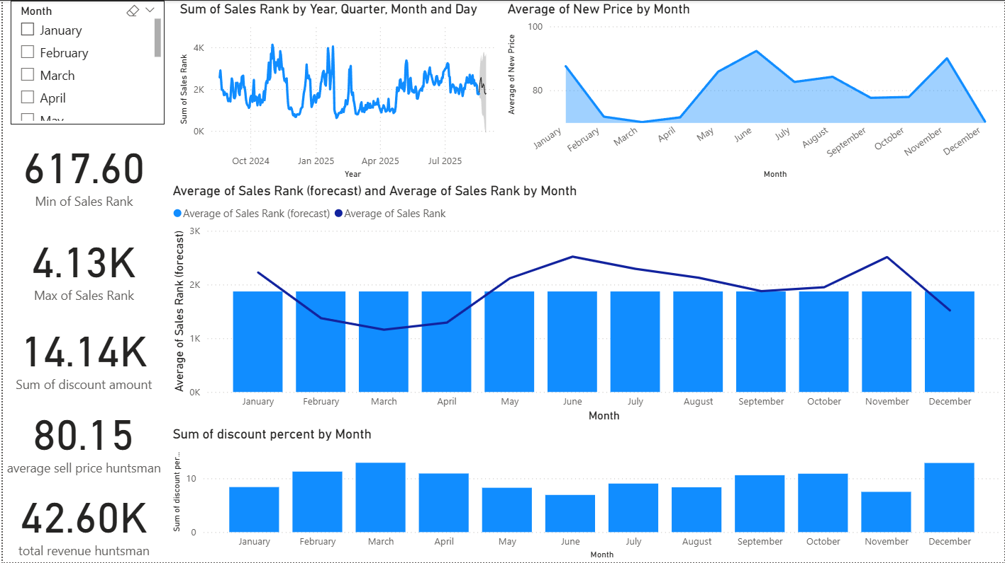
Huntsman Mini - dashboard

Slide 27
Huntsman Mini – dashboard analysis
Chart / KPI | Analysis
Sales Rank Trend | Rank improves significantly during Q1 and Q4, when discounts are applied.
Average New Price | Lower average price 78.9 JD, making it the mid-tier.
Discount % | Consistently higher discounts compared to other products, which drive rank gains.
Total Revenue 260K | Highest total revenue among the three products, mean strong sales volume.
Forecast (Rank/Price) | Forecast suggests stable performance, with steady demand.

Slide 28
Huntsman Mini – Recommendations
Insight | Recommendation
Rank improves during Q1 & Q4 with promos | Continue 10–15% discounts in these periods, scale back in off-peak months.
Lower avg price 78.9 JD | Add bundles/upsells (keycaps, wrist rests) to raise average order value.
Heavy reliance on discounts | Reduce frequency of discounts to protect margin, focus on targeted campaigns.
Highest revenue 260K JD | Maintain Huntsman as the volume growth driver in the product portfolio.
Stable forecast | Use forecast to plan inventory ramp-ups before peak quarters.

Slide 29
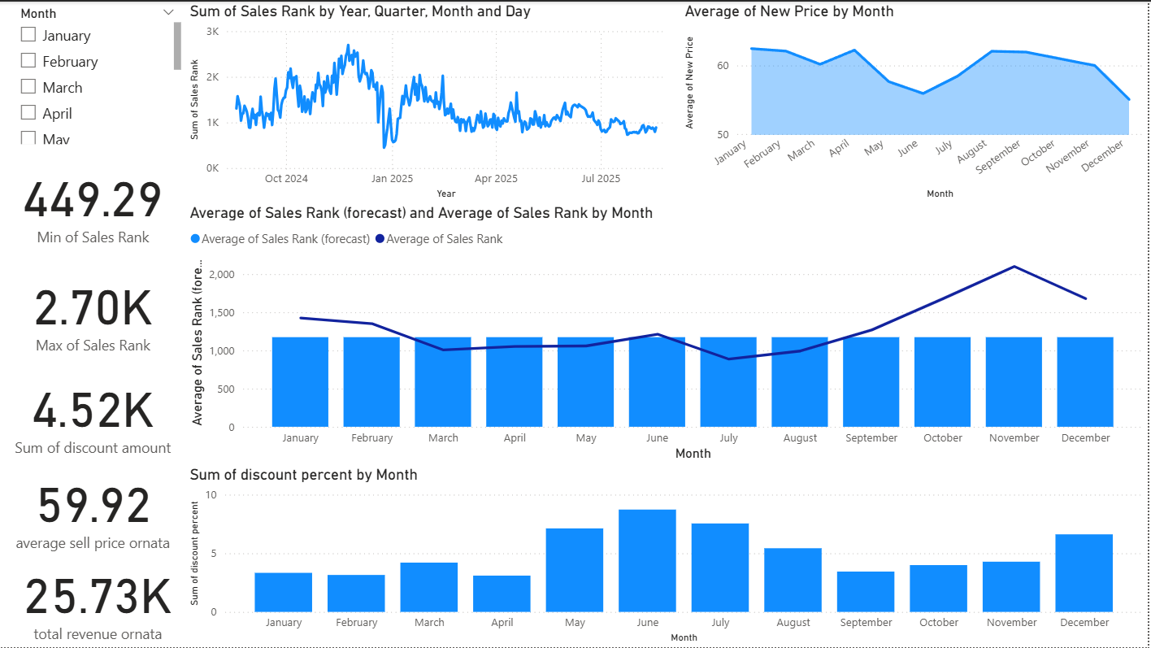
Ornata V3 – dashboard

Slide 30
Ornata V3 – dashboard analysis
Chart / KPI | Analysis
Sales Rank Trend | Rank improves during May–Jun and December, showing strong seasonality.
Average New Price | Lowest average price 59.7 JD, clearly positioned as the budget option.
Discount % | Discounts applied in peak months (May–Jun, Dec) improve rank more effectively.
Total Revenue 166K | Lowest total revenue among the three products; underperforms overall.
Forecast (Rank/Price) | Forecast suggests continued weaker competitiveness compared to others.

Slide 31
Ornata V3 – Recommendations
Insight | Recommendation
Rank improves in May–Jun & Dec | Focus 15–20% targeted promotions during these peak months only.
Lowest average price 59.7 JD | Reinforce value positioning with campaigns highlighting affordability.
Discounts work better than for others | Use seasonal promos + bundles to increase perceived value without deep cuts.
Lowest revenue 166K | Add awareness campaigns to grow visibility among budget-conscious buyers.
Weak forecast | Treat Ornata as an entry-level product keep as portfolio support, not main driver.

Slide 32
Summary for all 3
Product Role | Key Insights | Recommendations
BlackWidow V4 (Premium) | High revenue 248K, high avg price 124 JD, unstable rank in Q3–Q4, forecast dip. | Protect premium pricing, use bundles not discounts, run event-based promos, align inventory before weak quarters.
Huntsman Mini (Volume Driver) | Highest revenue 260K, mid-tier price 79 JD, rank improves in Q1 & Q4 with promos, forecast stable. | Keep 10–15% discounts in Q1 & Q4, reduce in off-peak months, add bundles/upsells, use forecast for stock planning.
Ornata V3 (Value Option) | Lowest revenue 166K, lowest avg price 60 JD, rank improves in May–Jun & Dec, forecast weak. | Position as budget entry-level, run 15–20% targeted promos in peak months, add awareness campaigns, use bundles for value.

Slide 33
Business Requirements – evaluation
Business Requirement | How the Solution Addressed It
Use real marketplace data | Helium 10 provided one year of Amazon sales data (Time, Sales Rank, List, New).
Ensure clean and structured datasets | Excel used for data cleaning, formatting
Provide actionable analysis and KPIs | Power BI dashboards built with DAX (Median Rank, Avg Price, Discount %, MoM).
Forecast future performance | Orange used for time-series forecasting; forecast data merged into Power BI.
Support decision-making across departments | Dashboards and reports tailored for marketing, sales managers, and executives.
Enable comparative analysis across product tiers | Side-by-side dashboards for the keyboards allow easy comparison

Slide 34
User Requirements – evaluation
User Requirement | How the Solution Addressed It
Understand which products are price-sensitive | Power BI visuals show clear price-performance links
Plan seasonal promotions | Forecasts indicate when performance may dip, allowing proactive campaign timing
Optimize budget usage | Discount efficiency and rank trends show when marketing spend has best impact
Communicate results visually to management | Dashboards use cards, line charts, and slicers to simplify communication

Slide 35
Identified Gaps & Limitations
Area | Gap
Dataset | Limited to 1 year and 3 products lacks competitor data, reviews, ads.
Automation | Entire process is manual no scheduled refresh or direct integration.
Modeling | Forecasts are univariate (ARIMA only) external drivers not included.
Decision Metrics | No ROI, promo effectiveness, or discount elasticity measures yet.
Dashboards | Executives lack a fully interactive compare-all products page.

Slide 36
Suggested Improvements
Area | Improvement
Data & Features | Extend dataset to 24+ months add more products to compare.
Automation | Use Helium 10 API or scheduled refresh to update dashboards.
Modeling | Add multivariate forecasting (consider ads, reviews, competitors).(better accuracy)
Dashboards | Add executive comparison view include ROI and discount elasticity KPIs.
Governance | Apply role-based access, version control, and secure dashboard sharing.

Slide 37
Social, Legal, and Ethical Implications
Legal Implications
Data Ownership & Terms of Use
The data I used came from Amazon through Helium 10. Technically, Amazon owns this data, and we’re only allowed to use it under their terms of service. Since my project only works with aggregated sales rank and prices (and not personal customer data), it stays safe and within the rules.
Intellectual Property
Things like product images, logos, and brand content are protected by Razer and Amazon. In my project, I only worked with numbers (rank, price, sales trends), so I didn’t copy or misuse any of their intellectual property.
Data Compliance
Because I didn’t deal with customer names, addresses, or sensitive data, I didn’t have to worry about laws like GDPR. But if future work used reviews or customer feedback, then making sure the data is anonymized would be very important.

Slide 38
Social, Legal, and Ethical Implications
Social Implications
Consumer Impact
Using data can help companies give better prices and plan promotions, which is good for buyers. But if it’s overused, it can also train customers to just wait for discounts instead of buying normally.
Market Fairness
Bigger companies that use advanced tools can get ahead faster, while smaller sellers may struggle to keep up. It’s important to use the insights fairly so the market doesn’t become one-sided.
Accessibility
The dashboards I built aren’t just for top management; they can also help sales and marketing teams make decisions. This way, the benefits of the analysis are shared across the company, not just kept at the top.

Slide 39
Social, Legal, and Ethical Implications
Ethical Implications
Transparency
It’s important that decisions made with the data are clear to everyone. For example, if marketing is told to run a campaign in October, they should know why the data suggested that, instead of blindly trusting the system.
Data Bias
Sales rank data usually favors products that are already popular. If the company only follows this, it might ignore newer or less-known products, which creates bias in decisions.
Responsible Forecasting
Forecasts are predictions, not 100% facts. If managers rely too much on them without understanding their limits, it could lead to bad decisions. That’s why it’s better to show forecasts with confidence ranges and explain the risks.

Slide 40
Data Security Threats and Measures
Data Security Threats
One risk is unauthorized access. Since the data is stored in Excel files and shared dashboards, someone without permission could access the files if they’re not protected.
Another risk is data leakage. For example, if a file is sent through email or stored on an unsecured drive, it could be copied or misused.
There is also the chance of data loss or corruption, especially when everything is refreshed manually. If the raw data files or Power BI reports are deleted or corrupted, rebuilding them would be difficult.
Finally, tampering or manipulation is a risk. If someone edits the Excel sheets or dashboard measures without proper controls, it could lead to wrong insights and bad business decisions.

Slide 41
Data Security Threats and Measures
Security Measures
The first step is role-based access. Only the right people (e.g., marketing, sales managers, executives) should have access to the dashboards or raw data. This prevents misuse.
Files should be encrypted and password-protected, especially if they are stored locally or shared online. Using a secure cloud system like OneDrive or SharePoint can also help.
To prevent loss, regular backups of the raw data, cleaned data, and PBIX files should be stored in a safe location.
For trust and transparency, changes should be version controlled. That way, if something is edited, the team can see who made the change and when.
Finally, secure refresh and API connections (instead of manual CSV downloads) would reduce the risk of tampered or outdated data.

Slide 42
Data Security Threats and Measures
Maintaining Trust
By putting these measures in place, the company makes sure the data is accurate, safe, and reliable. This builds trust not just with managers who use the dashboards but also with executives who rely on the forecasts for strategic decisions.

Slide 43
Razer Data Breach Case Study
Company: razer
year: 2020
breach type: unprotected Razer database
In August 2020, security researcher Bob Diachenko discovered an unprotected Razer database that exposed over 100,000 customer records, including names, email addresses, phone numbers, order history, billing, and shipping details though not payment cards

Slide 44
Business Impact
These incidents had significant implications:
  Personal data exposure risks customer privacy, trust, and brand reputation.
  Leak of internal code and credentials threatened Razer’s intellectual property and system security.
After the 2020 leak, Razer sued its IT vendor Capgemini and won US$6.5 million in damages, due to the misconfiguration that caused the breach

Slide 45
Recovery Actions
Razer immediately secured its systems, reset user sessions, and asked users to reset passwords when the 2023 incident surfaced.
The company launched investigations and pledged to report findings to authorities; for the 2020 incident, it changed its server configurations and raised awareness of the vulnerability.

Slide 46
Lessons learnt
Secure data configurations rigorously small misconfigurations (like in the 2020 leak) can expose massive datasets.
Protect internal systems and code, not just user data source code and credentials can be just as valuable to attackers.
Act swiftly and transparently in response to threats. Razer’s immediate countermeasures (password resets, investigations) helped manage the fallout.
Vendor risk matters Razer’s legal success shows that responsibility extends across service providers and that their security posture matters too.

Slide 47
Reference
CNA. (2020). IT vendor appeals against US$6.5 million in damages awarded to gaming firm Razer over data leak. [online] Available at: https://www.channelnewsasia.com/singapore/razer-data-leak-it-vendor-capgemini-appeal-damages-3618121?utm_source [Accessed 2 Sep. 2025].
‌Toulas, B. (2023). Razer investigates data breach claims, resets user sessions. [online] BleepingComputer. Available at: https://www.bleepingcomputer.com/news/security/razer-investigates-data-breach-claims-resets-user-sessions/?utm_source [Accessed 2 Sep. 2025].

Slide 48
Carroll, M.W. (2015). Sharing Research Data and Intellectual Property Law: A Primer. PLOS Biology, [online] 13(8), p.e1002235. doi:https://doi.org/10.1371/journal.pbio.1002235.
‌Nations, U. (2022). Marine litter, an analytical overview. Unep.org, [online] 2(1). doi:https://doi.org/N/A.
‌Wikipedia Contributors (2025). Algorithmic accountability. Wikipedia.

