Slide 1
PANL-SQL: Palestinian Arabic Natural Language to SQL Translation
Emphasizing Palestinian Dialect and University Database Context
The datasets, model, and fine-tuning codes for PANL-SQL (github.com)

Slide 2
Objective
Our aim was to develop a model capable of translating Arabic Natural Language (NL) queries into SQL, specifically focusing on the Palestinian dialect and a university database context.

Slide 3

Methods
We utilized WikiSQL (translated to Arabic) and a university-specific dataset (created manually).
For the model, we adopted AraT5 transformer and Turjuman model for translation.

Slide 4
Datasets

Slide 5
WikiSQL[1]
80,654 examples of English Natural Language (NL) to SQL query pairs.
Each English NL query translated into three translations. This process multiplied the initial 80,654 pairs into approximately 241,962 Arabic NL-SQL pairs (80,654 distinct SQL queries).
The translation process done using the Turjuman[2] model, that built on the foundation of the AraT5 transformer[3].
V. Zhong, C. Xiong, and R. Socher, “Seq2sql: Generating structured queries from natural language using reinforcement learning,” CoRR, vol. abs/1709.00103, 2017.
E. M. B. Nagoudi, A. Elmadany, and M. Abdul-Mageed, “Turjuman: A public toolkit for neural arabic machine translation,” in Proceedings of the 5th Workshop on Open-Source Arabic Corpora and Processing Tools (OSACT5), (Marseille, France), European Language Resource Association, June 2022.
M. B. Nagoudi, A. Elmadany, and M. Abdul-Mageed, “Arat5: Text to-text transformers for arabic language generation,” arXiv preprint arXiv:2109.12068, 2021.

Slide 6
Specific Dataset
Creation Process:
Created database filled with dummy data.
Identified 70 common queries in Modern Standard Arabic (MSA).
Formulated corresponding SQL statements for each query.
Executed each SQL statement to verify output consistency with its MSA question.
Initiated dialect translation task with university students, generating 2,844 variants.
Students Form: https://obada-jaras.github.io/NL-Variants-Frontend

Slide 7
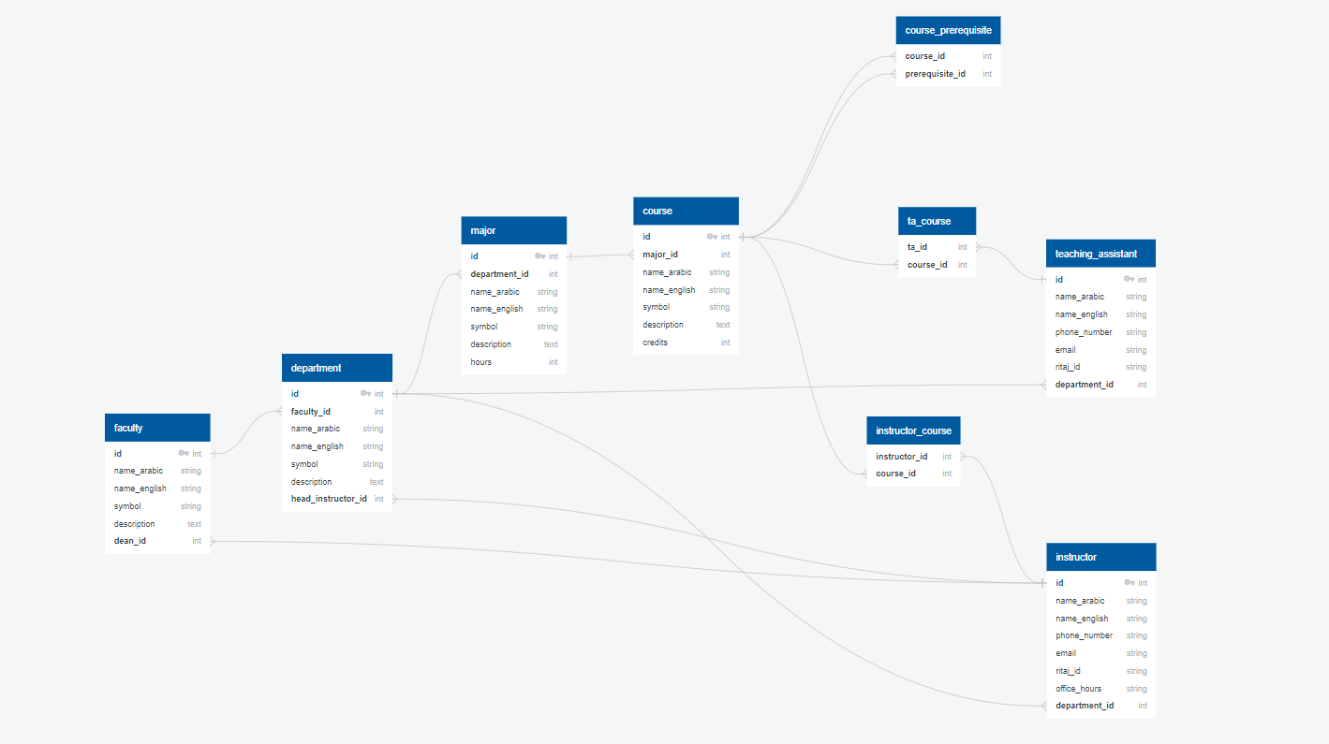
Our Database Structure
Figure 1: University Info Database Structure

Slide 8
Fine-Tuning
We employed a two-step sequential fine-tuning approach, general fine-tuning followed by specific fine-tuning, to train the model.

Slide 9
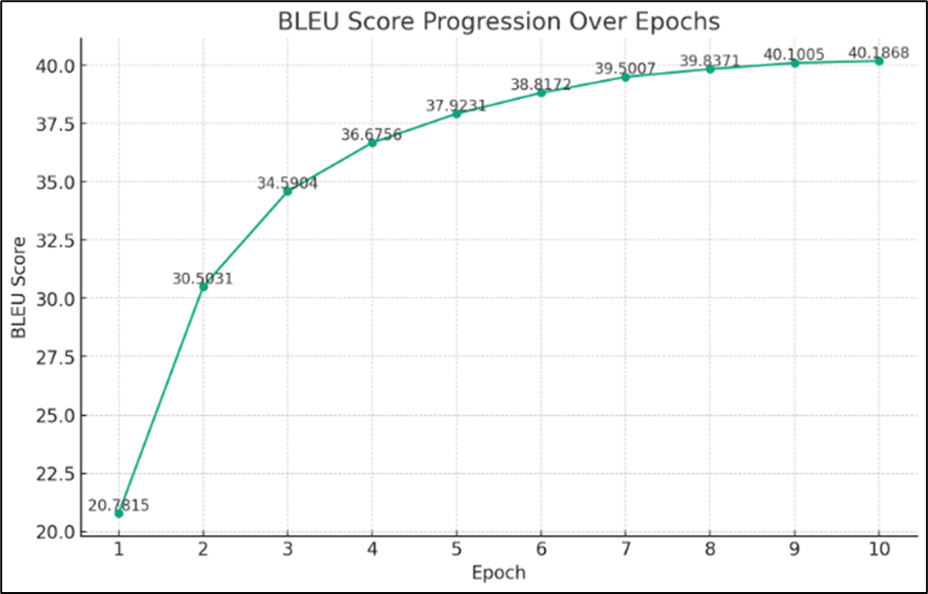
General Fine-Tuning
On the translated WikiSQL dataset.
Figure 2: Progression of BLEU[4] Score Over Ten Epochs During the General Fine-tuning Phase Using the WikiSQL Dataset.
4 K. Papineni, S. Roukos, T. Ward, and W.-J. Zhu, “Bleu: a method for automatic evaluation of machine translation,” in Proceedings of the 40th annual meeting of the Association for Computational Linguistics, pp. 311–318, 2002.

Slide 10
Specific Fine-Tuning
On our specific dataset (Palestinian NL variants - SQL).

Slide 11
Results

Slide 12
Total Evaluated Examples: 427
Execution Success Rate (Valid SQL): 0.94
Accuracy: 0.92
Average SQL Generation Time: 4.69 seconds

Slide 13
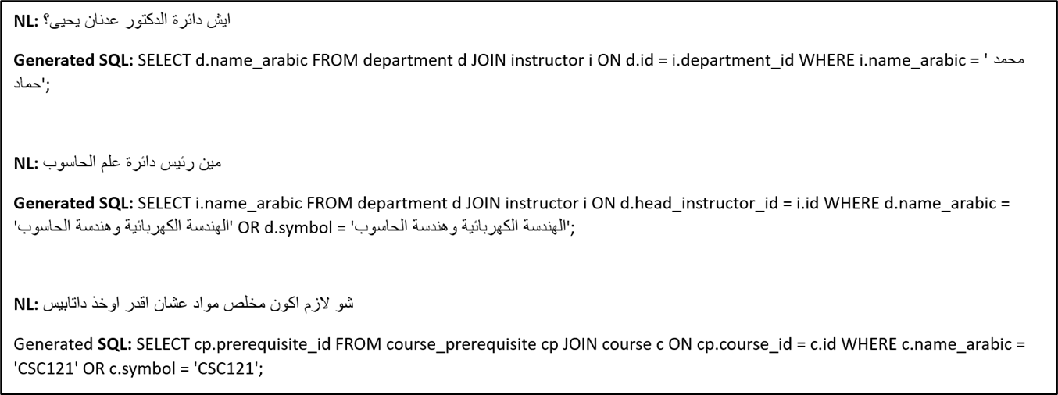
Handling Unknown Values
Figure 2: Examples of the model's struggle with unknown values it was not trained on.

Slide 14
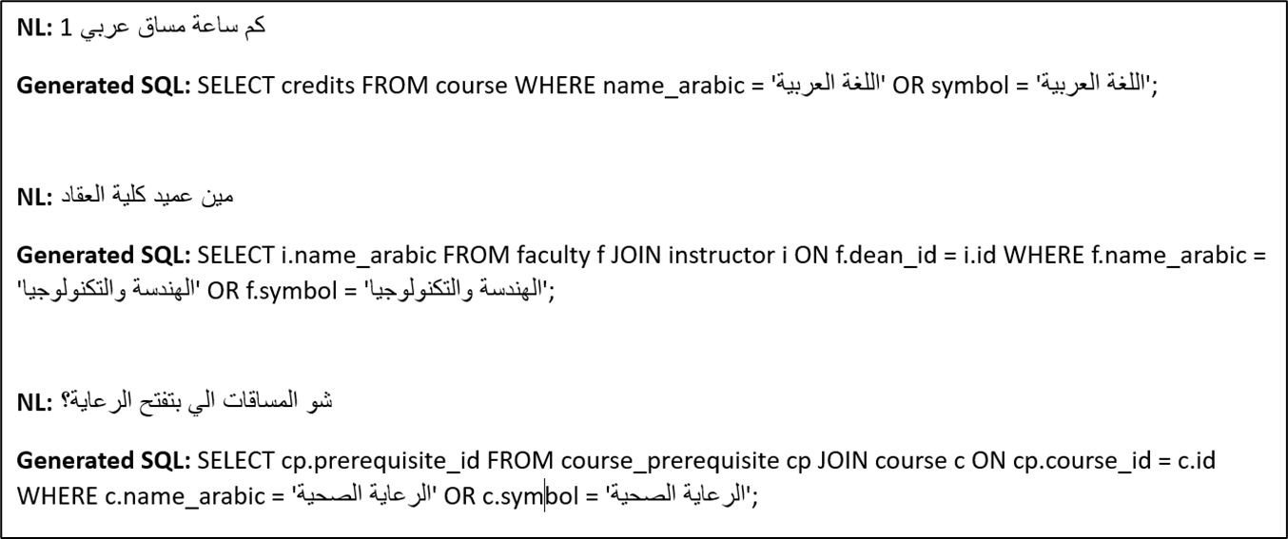
Value Variations
Figure 3: Examples of the model's ability to manage variations in values.

Slide 15
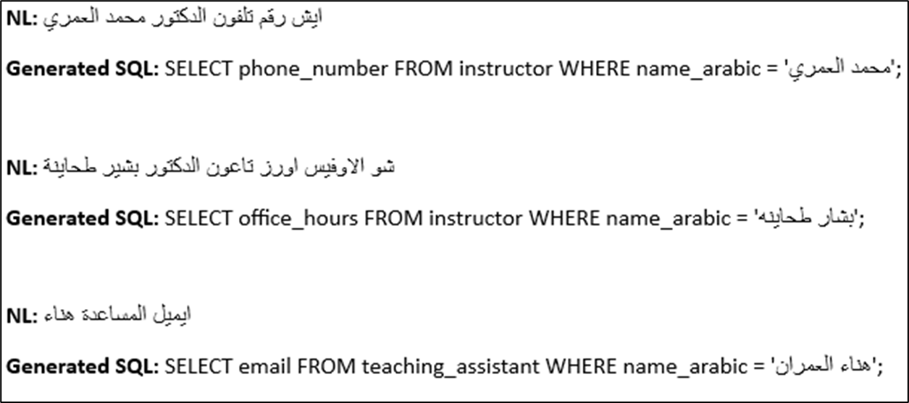
Simple Queries
Figure 4: Examples of the model's excellent performance on very simple queries.

Slide 16
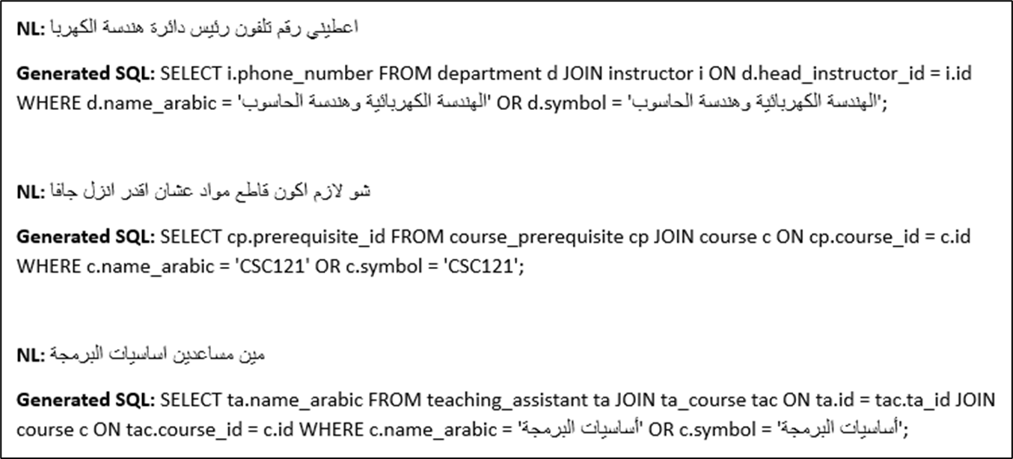
Simple Queries with JOINs
Figure 5: Examples of the model's performance on simple queries involving JOIN operations.

Slide 17
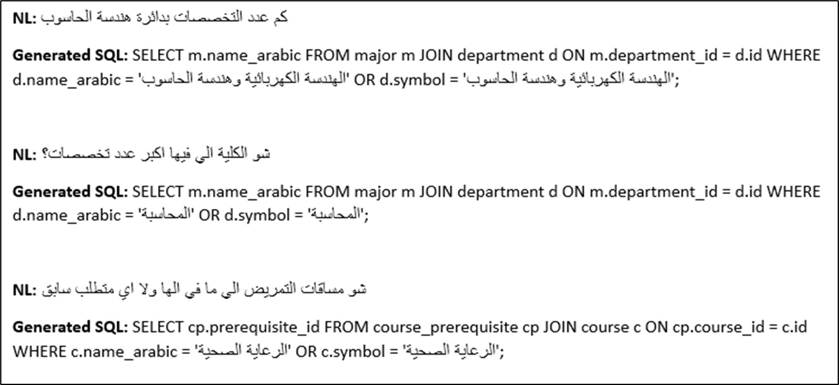
Complex Queries
Figure 6: Examples of the model's struggle with complex queries.

Slide 18
System Integration
Our trained model was incorporated into an interactive web interface, featuring a simple input field and output for database responses.
Webpage: https://obada-jaras.github.io/PANL-SQL

Slide 19
Future Work

Slide 20
Future Work
1. More preprocessing and data cleaning.
2. Try more translation approaches (e.g. Google Translate API).
3. Complex dataset utilization.
4. Models experimentation & Hyperparameter tuning.
Continued in the next slide…

Slide 21
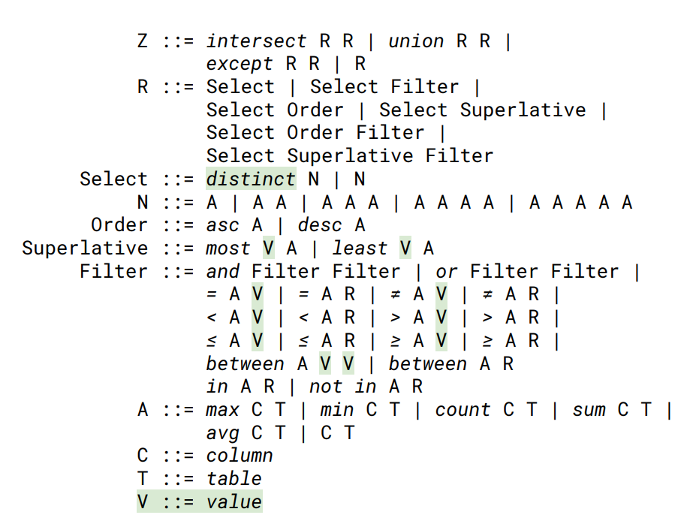
Future Work
5. Intermediate representation.
Figure 7: SemQL 2.0 Grammar[4]
4. U. Brunner and K. Stockinger, “Valuenet: A natural language-to-sql system that learns from database information,” in 2021 IEEE 37th International Conference on Data Engineering (ICDE), pp. 2177–2182, IEEE, 2021.
Continued in the next slide…

Slide 22
Future Work
6. Values management.
من هو عميد كلية [faculty-name]؟
SELECT i.name_arabic FROM faculty f JOIN instructor i ON f.dean_id = i.id WHERE f.name_arabic = '[faculty-name]';
Advantage of:
POS, NER, and WordNet to extract labels.
Embeddings to match with the best value (correct in the database).
Continued in the next slide…

Slide 23
Conclusion
This proof-of-concept study shows potential for Arabic NL to SQL translation, specifically the Palestinian dialect. The model managed simple queries well, with future work aimed at refining handling of specific training values. It's a promising step towards broader NL to SQL systems, especially for underrepresented languages like Arabic

