Slide 1
Sudoku Solver Supervisor: Eng. Joud Khattab
Student:
Obada Saleh
Hamza farhat
Applied Project
20183

Slide 2
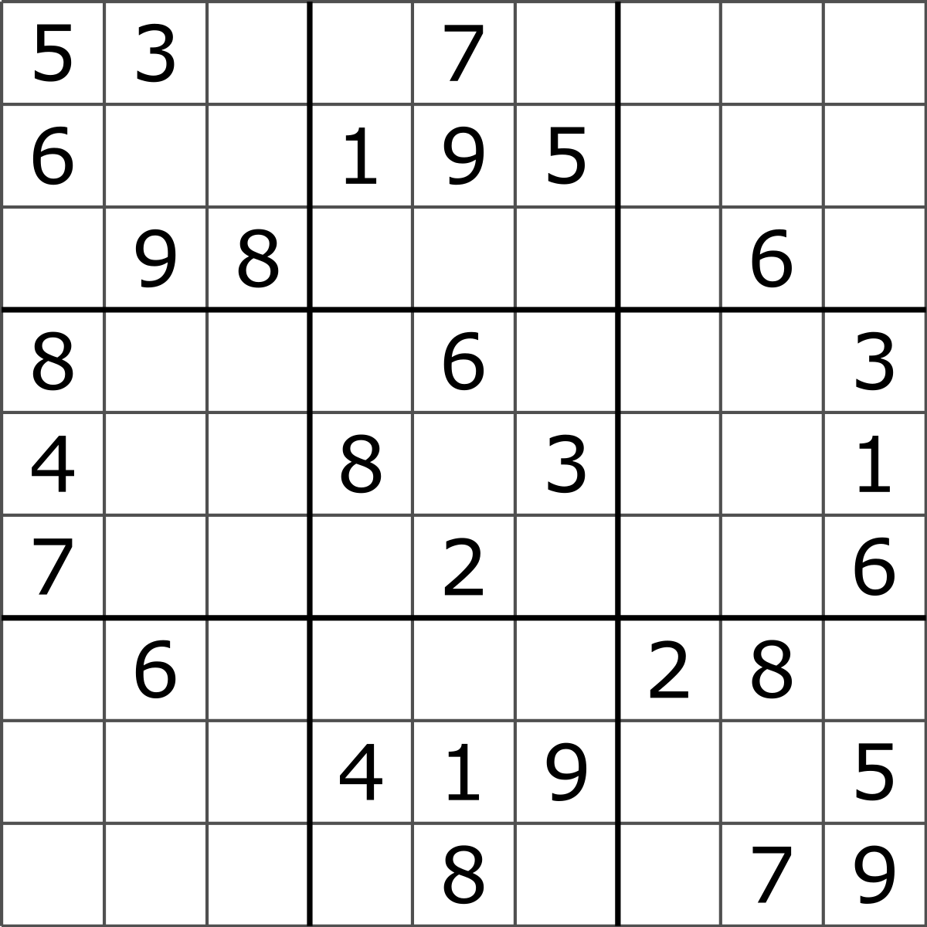
Sudoku Game
Sudoku is one of the most popular puzzle games of all time. The goal of Sudoku is to fill a 9×9 grid with numbers so that each row, column and 3×3 section contain all of the digits between 1 and 9. As a logic puzzle, Sudoku is also an excellent brain game.

Slide 3



Project
OCR Algorithm
AI Algorithm
tesseract:
is an optical character recognition (OCR) tool for python. That is, it will recognize and “read” the text embedded in images.
Sudoku has high complexity $n^{n}$.
Write an algorithm to find the optimal solution.

Slide 4

Python Language
Python is an interpreted high-level programming language for general-purpose programming.
Python features a dynamic type system and automatic memory management. It supports multiple programming paradigms, including object-oriented, imperative, functional and procedural, and has a large and comprehensive standard library.

Slide 5
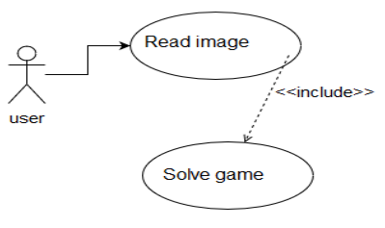
UseCase Diagram

Slide 6
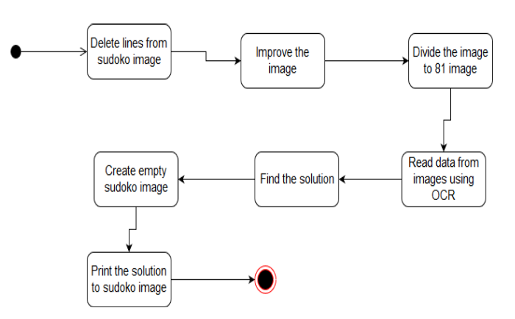
Activity Diagram

Slide 7
The proposed algorithm

Slide 8
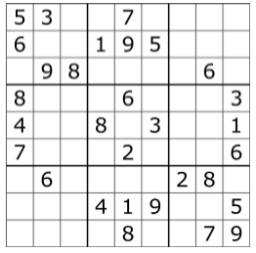
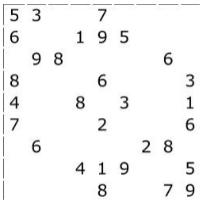
First

Slide 9
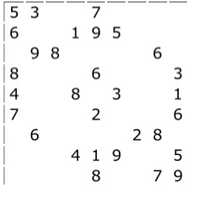

Second

Slide 10
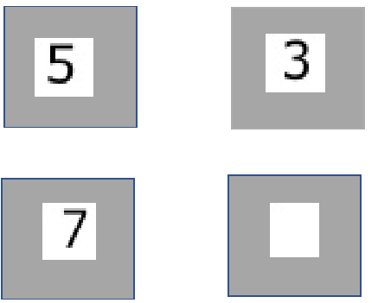
Finally

Slide 11
Solution Algorithm

Slide 12
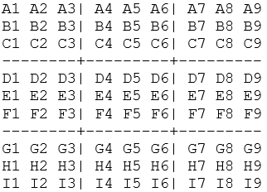
Unit, row, and column

Slide 13
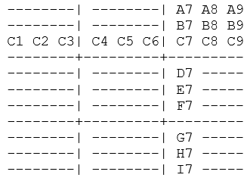
Peers

Slide 14
Solution Rules
1- If a square has only one possible value, then eliminate that value from the square's peers.
2- If a unit has only one possible place for a value, then put the value there.

Slide 15
References:
1. openCV tutorial. Available from: https://opencv-pythontutroals.readthedocs.io/en/latest/py_tutorials/py_tutorials. html 2. Python tutorial. Available from:
https://www.w3schools.com/python/default.asp
3. https://www.geeksforgeeks.org/ 4. https://stackoverflow.com/

Slide 16
Thank You

