Slide 1
Supervisors : Dr.Gassan Chadoud Dr.Wassim Juneidi
Design and Implementation of a Secure File Sharing Platform.
Prepared By : Obadah Saleh - Hamza Farhat - Ahmad Ammouneh

Slide 2
Project Overview
The idea of the project comes from the increasing use of file sharing platforms on the Internet and the need to provide a good level of security in these platforms.
The user is interested in accessing to his files via these services that the user will be access on his files in secure.

Slide 3
Project Objective
Build system.
CIA.
File Sharing .
Upload files.
Download files.

Slide 4
Functional requirements
Manage services provided to participants by the platform manager securely.
Securely upload files by users.
Ensure the integrity and confidentiality of files uploaded by users. Securely download shared files.
Allow users to share files.

Slide 5
Non-functional requirement
Ensure the security, confidentiality and integrity to be used.
Graphical user interface.

Slide 6
Time Plan
Executive Business | Gregorian month
 | 3 | 3 | 4 | 5 | 6
Preliminary study | X
A reference study on similar platforms |  | X
A reference study on the basics of information security |  | X
Analytical Study |  | X
Design Study |  |  | X
Implementation of the platform |  |  | X | X
of the platform tests |  |  | X | X | X
Document the project and the report | X | X | X | X | X

Slide 7
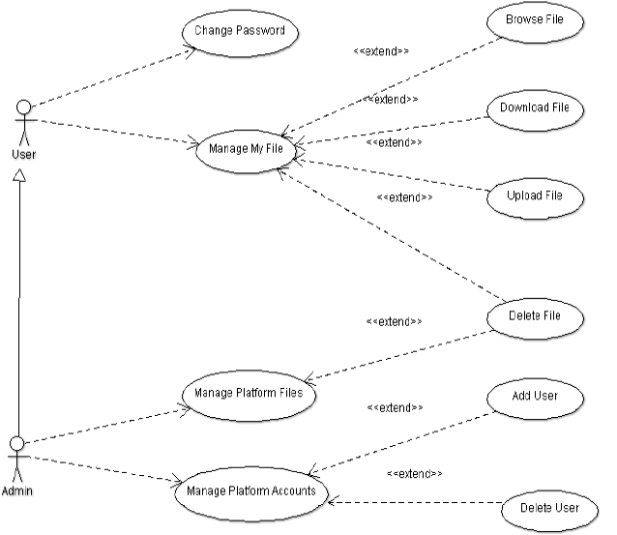

Slide 8
Platform’s Services
Visitor:
Register
Admin :
Add User.
Delete User.
Delete Files.
User:
Change Password.
Browse Files.
Download File.
Upload File.
Delete File.

Slide 9

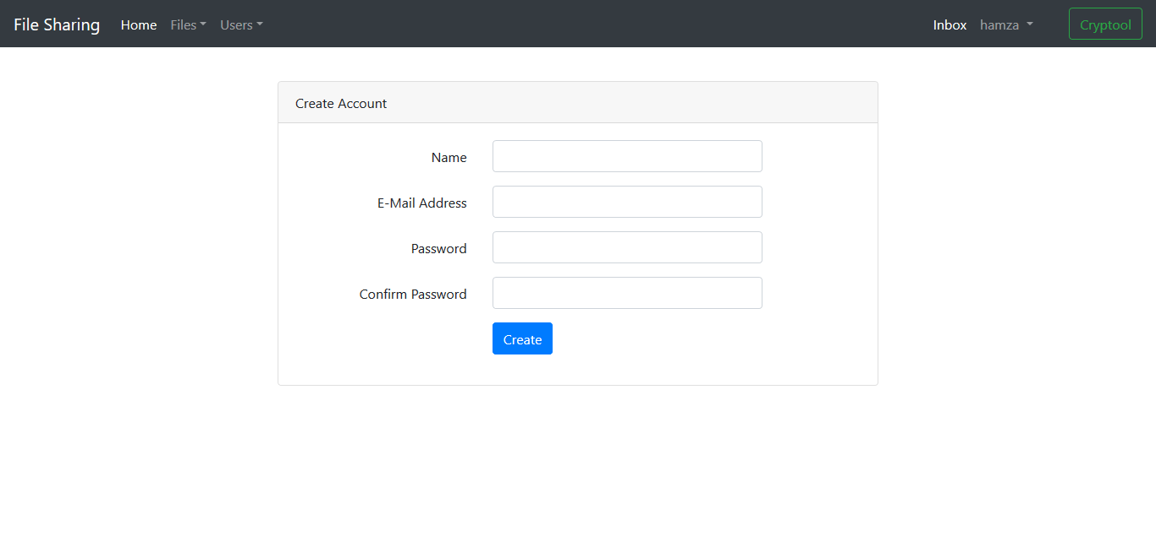

Registration
Request
Response
ADMIN

Slide 10



Website login
verification
response
E-mail
password
Web server
MySql DB server
Logged in
Browser

Slide 11
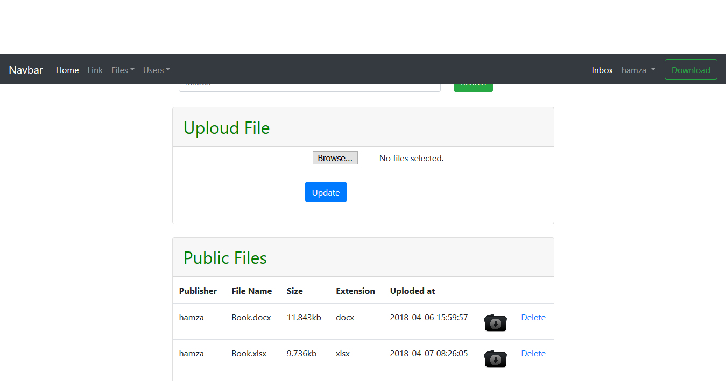
Upload File
User chose a file for upload.
The file save in website Data Base.

Slide 12
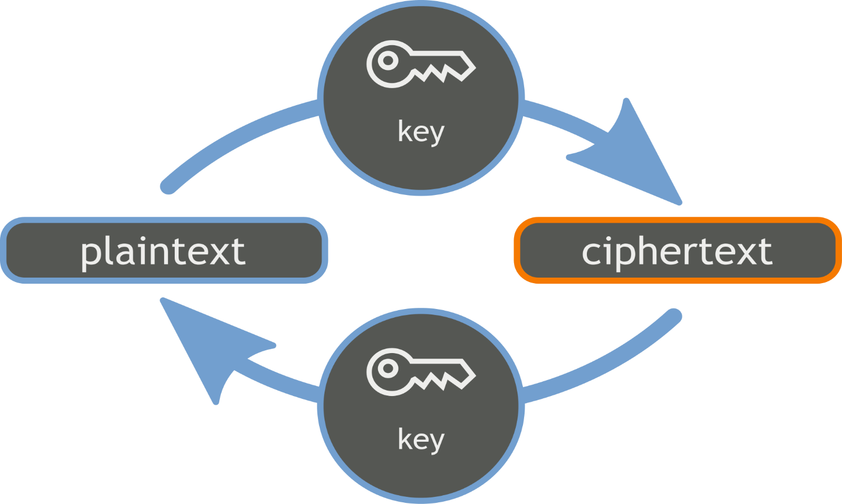
Encryption
Symmetric encryption:
Stream cipher:
Vernam , CR4 , Hill
Advantages:
Fast.
No error propagation.
Drawbacks:
Requirement for synchronization.
Block cipher:
DES , 3DES , AES
Provides:
CIA .

Slide 13
Symmetric Encryption & Decryption
CipherText
CipherText
CipherText
Network
Symmetric Algorithm , Key
Symmetric Algorithm , Key
PlainText
PlainText

Slide 14
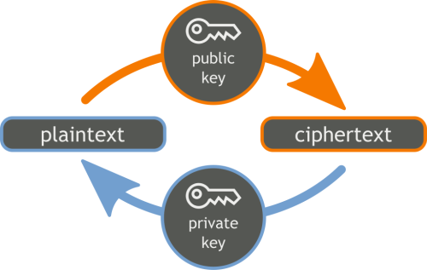
Encryption
Asymmetric encryption:
Block cipher:
RSA , El-Gamal
Provides:
CIA
Non-Repudiation

Slide 15
Asymmetric Encryption & Decryption
CipherText
CipherText
CipherText
Network
Asymmetric Algorithm ,Public Key
Asymmetric Algorithm ,Private Key
PlainText
PlainText

Slide 16
Authentication
Entity or User Authentication:
Allows to identity verification.
Befor message exchange during signing.
Message Authentication:
During message exchange for each message.

Slide 17
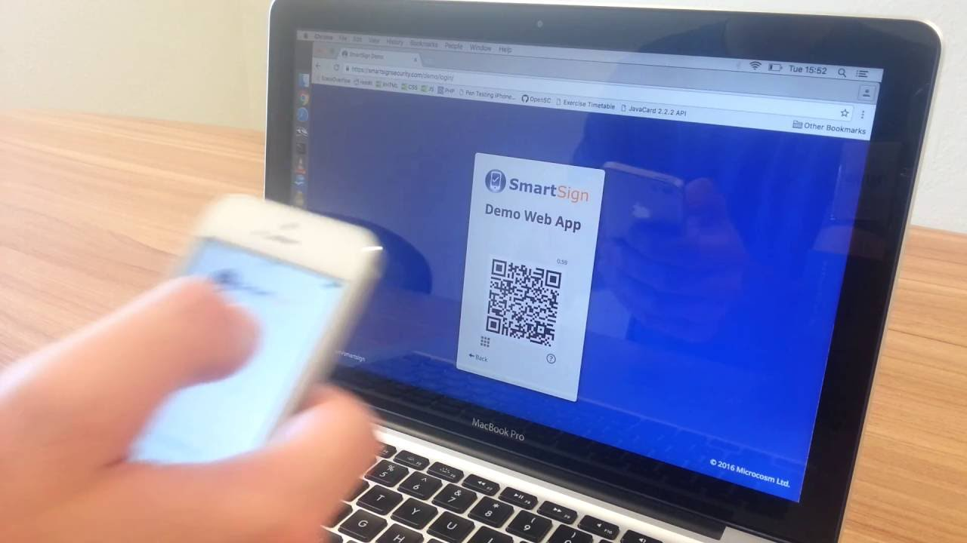
Google 2 factor authentication

Slide 18
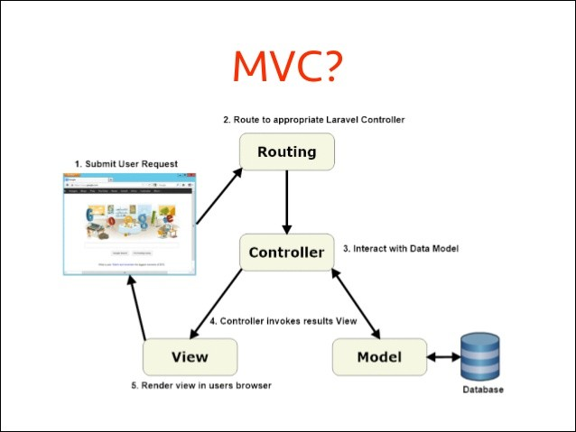

Slide 19
Future Prospects
Used encryption and decryption in website .
This platform is enable to update or addition to comes cloud computing Application .

Slide 20
Test

Slide 21
References
Books:
Cryptography-and-Network-Security-PrinciplesandPractice_6thEd.
WebSites:
https://www.Laravel.com
https://www.packagist.org

Slide 22


