Slide 1

Notes:
============================================================ SLIDE 1 - TITLE ============================================================

Slide 2
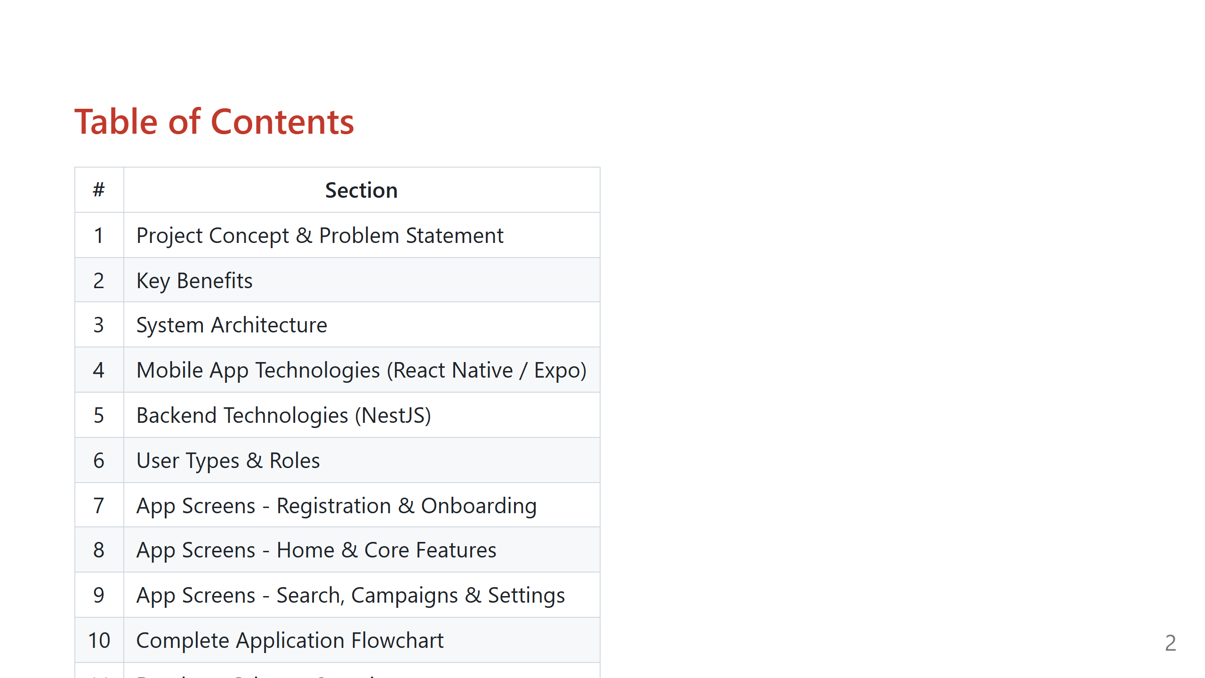
Notes:
============================================================ SLIDE 2 - TABLE OF CONTENTS ============================================================

Slide 3
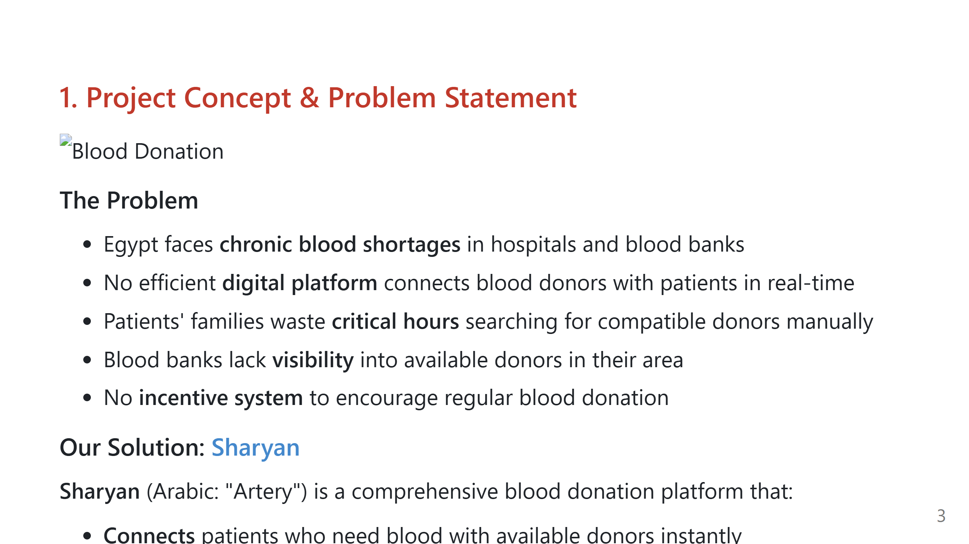
Notes:
============================================================ SLIDE 3 - PROJECT CONCEPT ============================================================

Slide 4
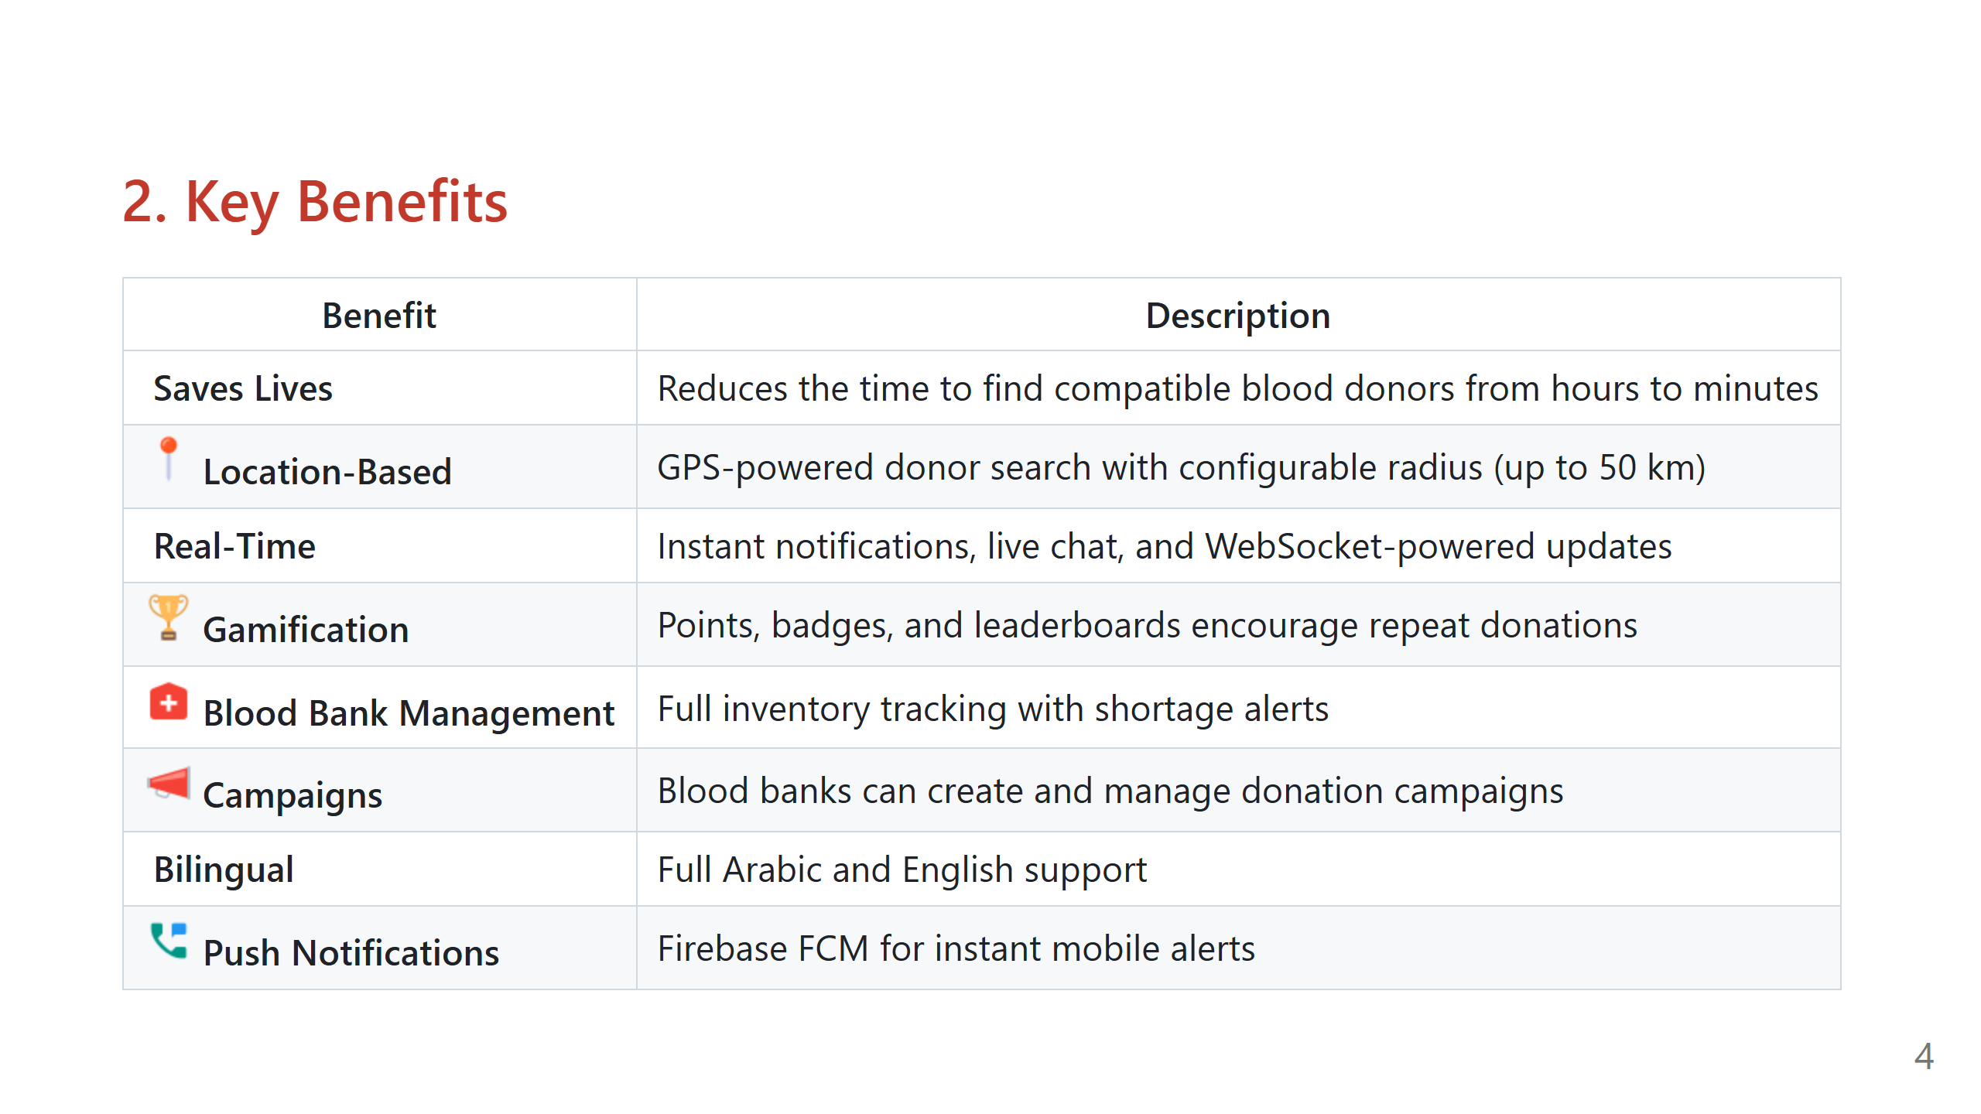
Notes:
============================================================ SLIDE 4 - BENEFITS ============================================================

Slide 5
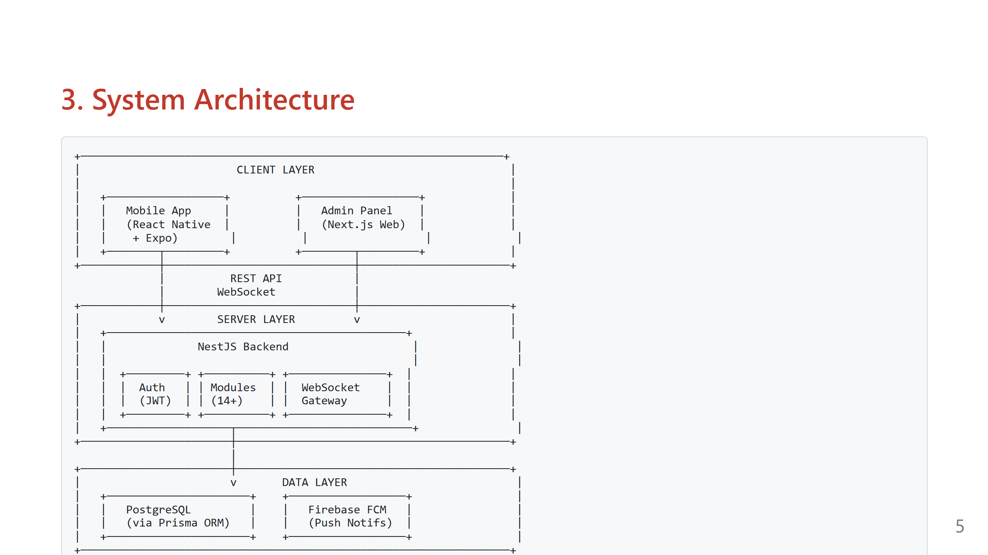
Notes:
============================================================ SLIDE 5 - SYSTEM ARCHITECTURE ============================================================

Slide 6
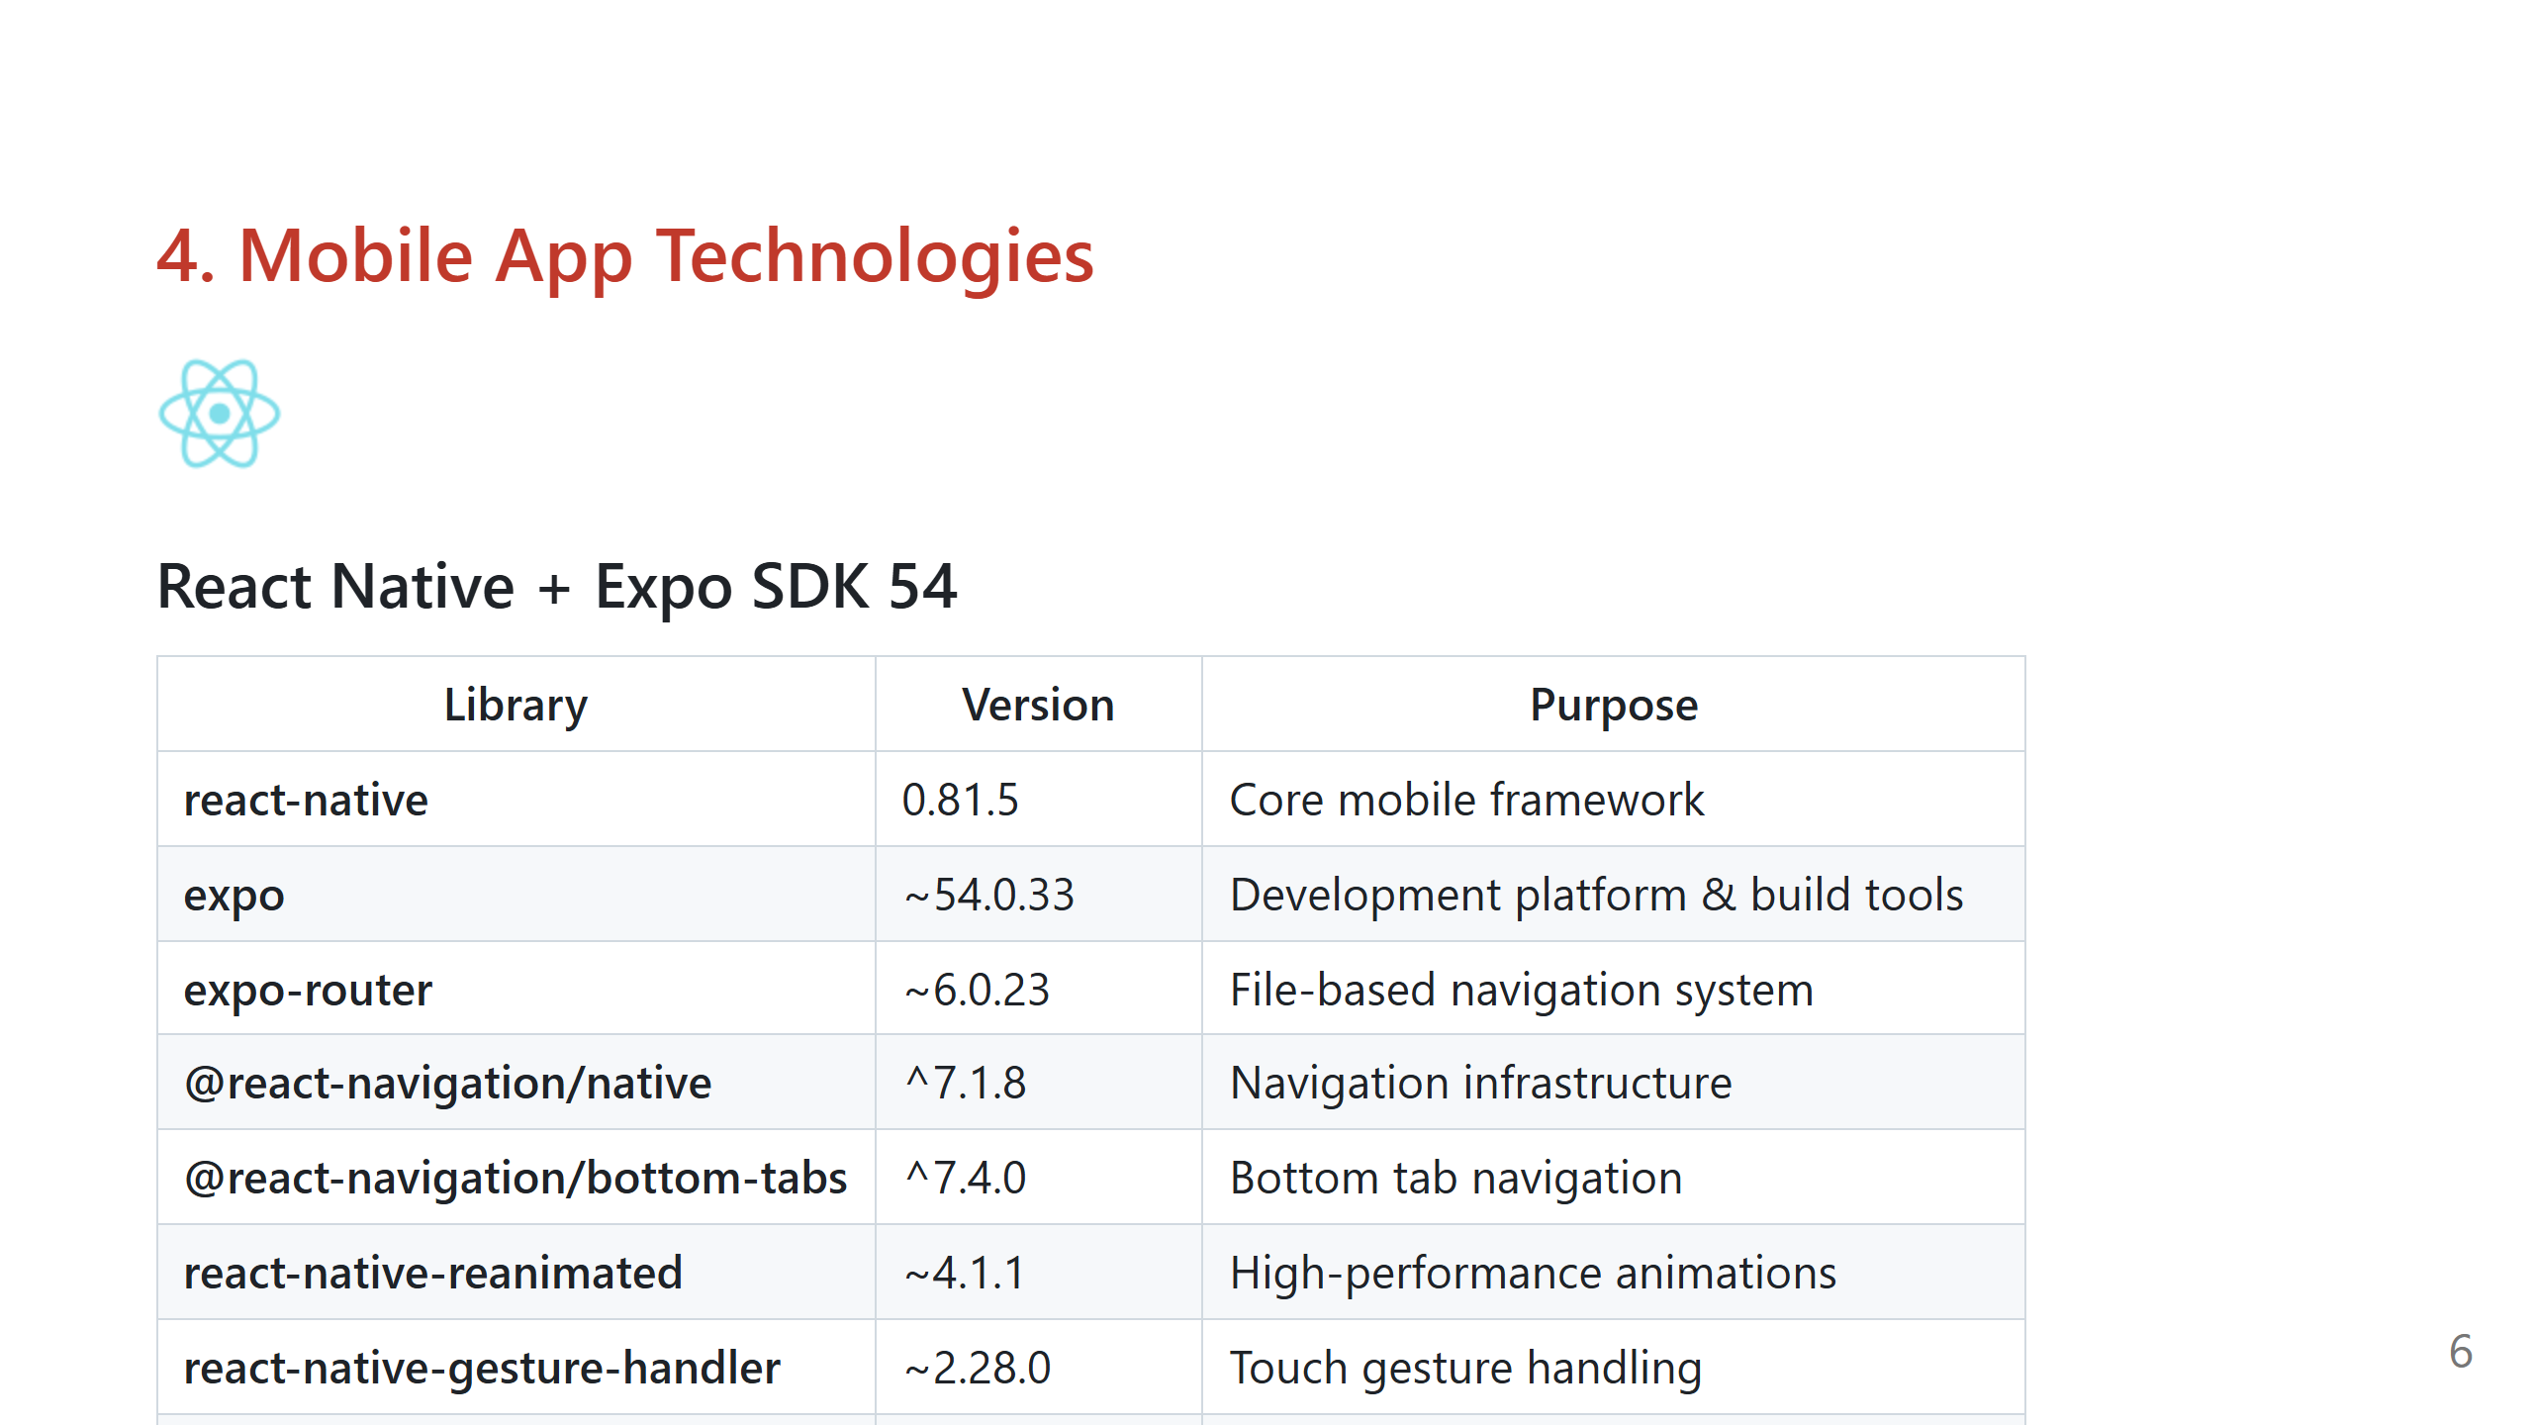
Notes:
============================================================ SLIDE 6 - MOBILE TECHNOLOGIES ============================================================

Slide 7
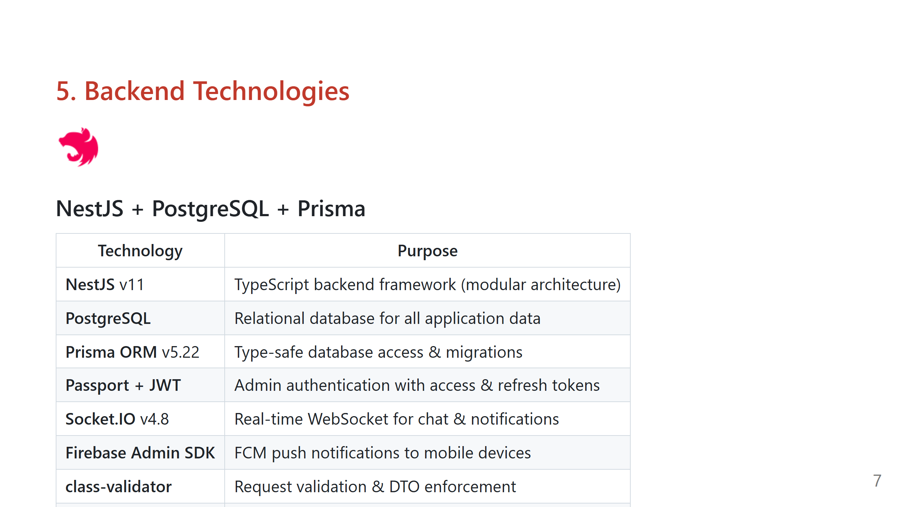
Notes:
============================================================ SLIDE 7 - BACKEND TECHNOLOGIES ============================================================

Slide 8
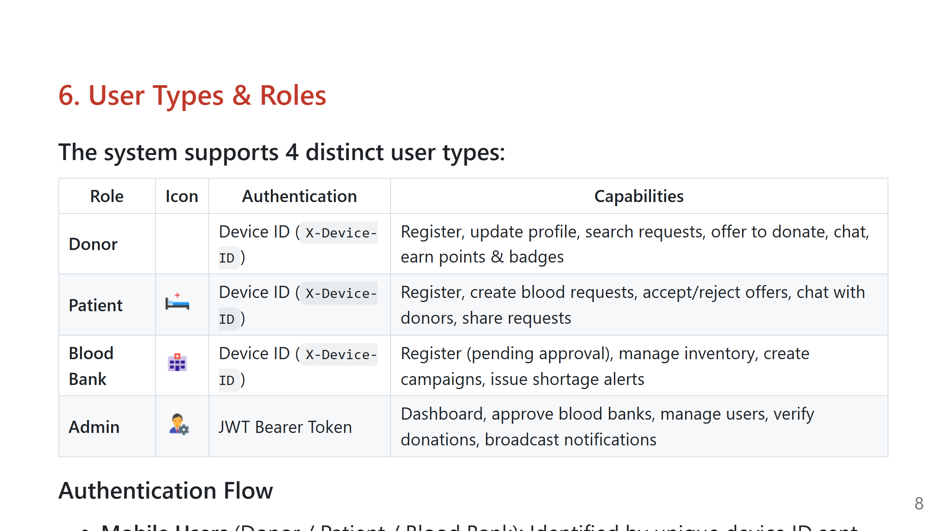
Notes:
============================================================ SLIDE 8 - USER TYPES ============================================================

Slide 9
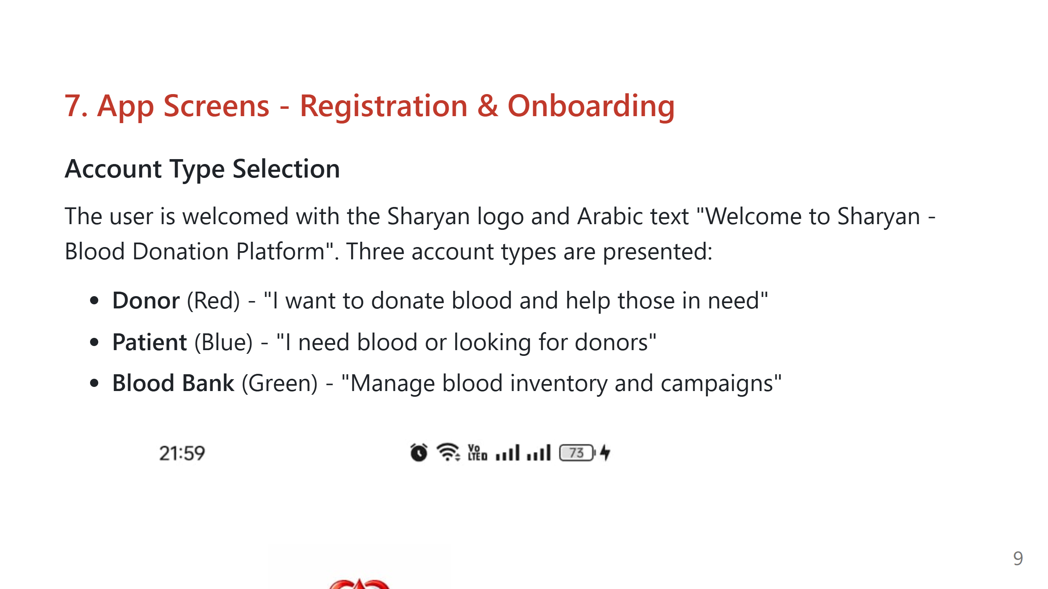
Notes:
============================================================ SLIDE 9 - APP SCREENS: REGISTRATION ============================================================

Slide 10
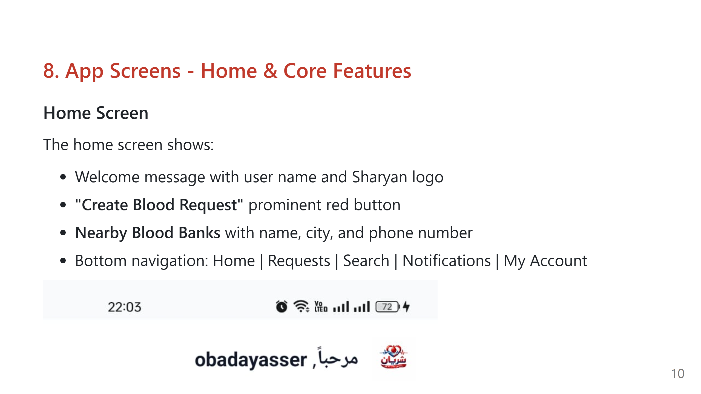
Notes:
============================================================ SLIDE 10 - APP SCREENS: HOME & CORE ============================================================

Slide 11
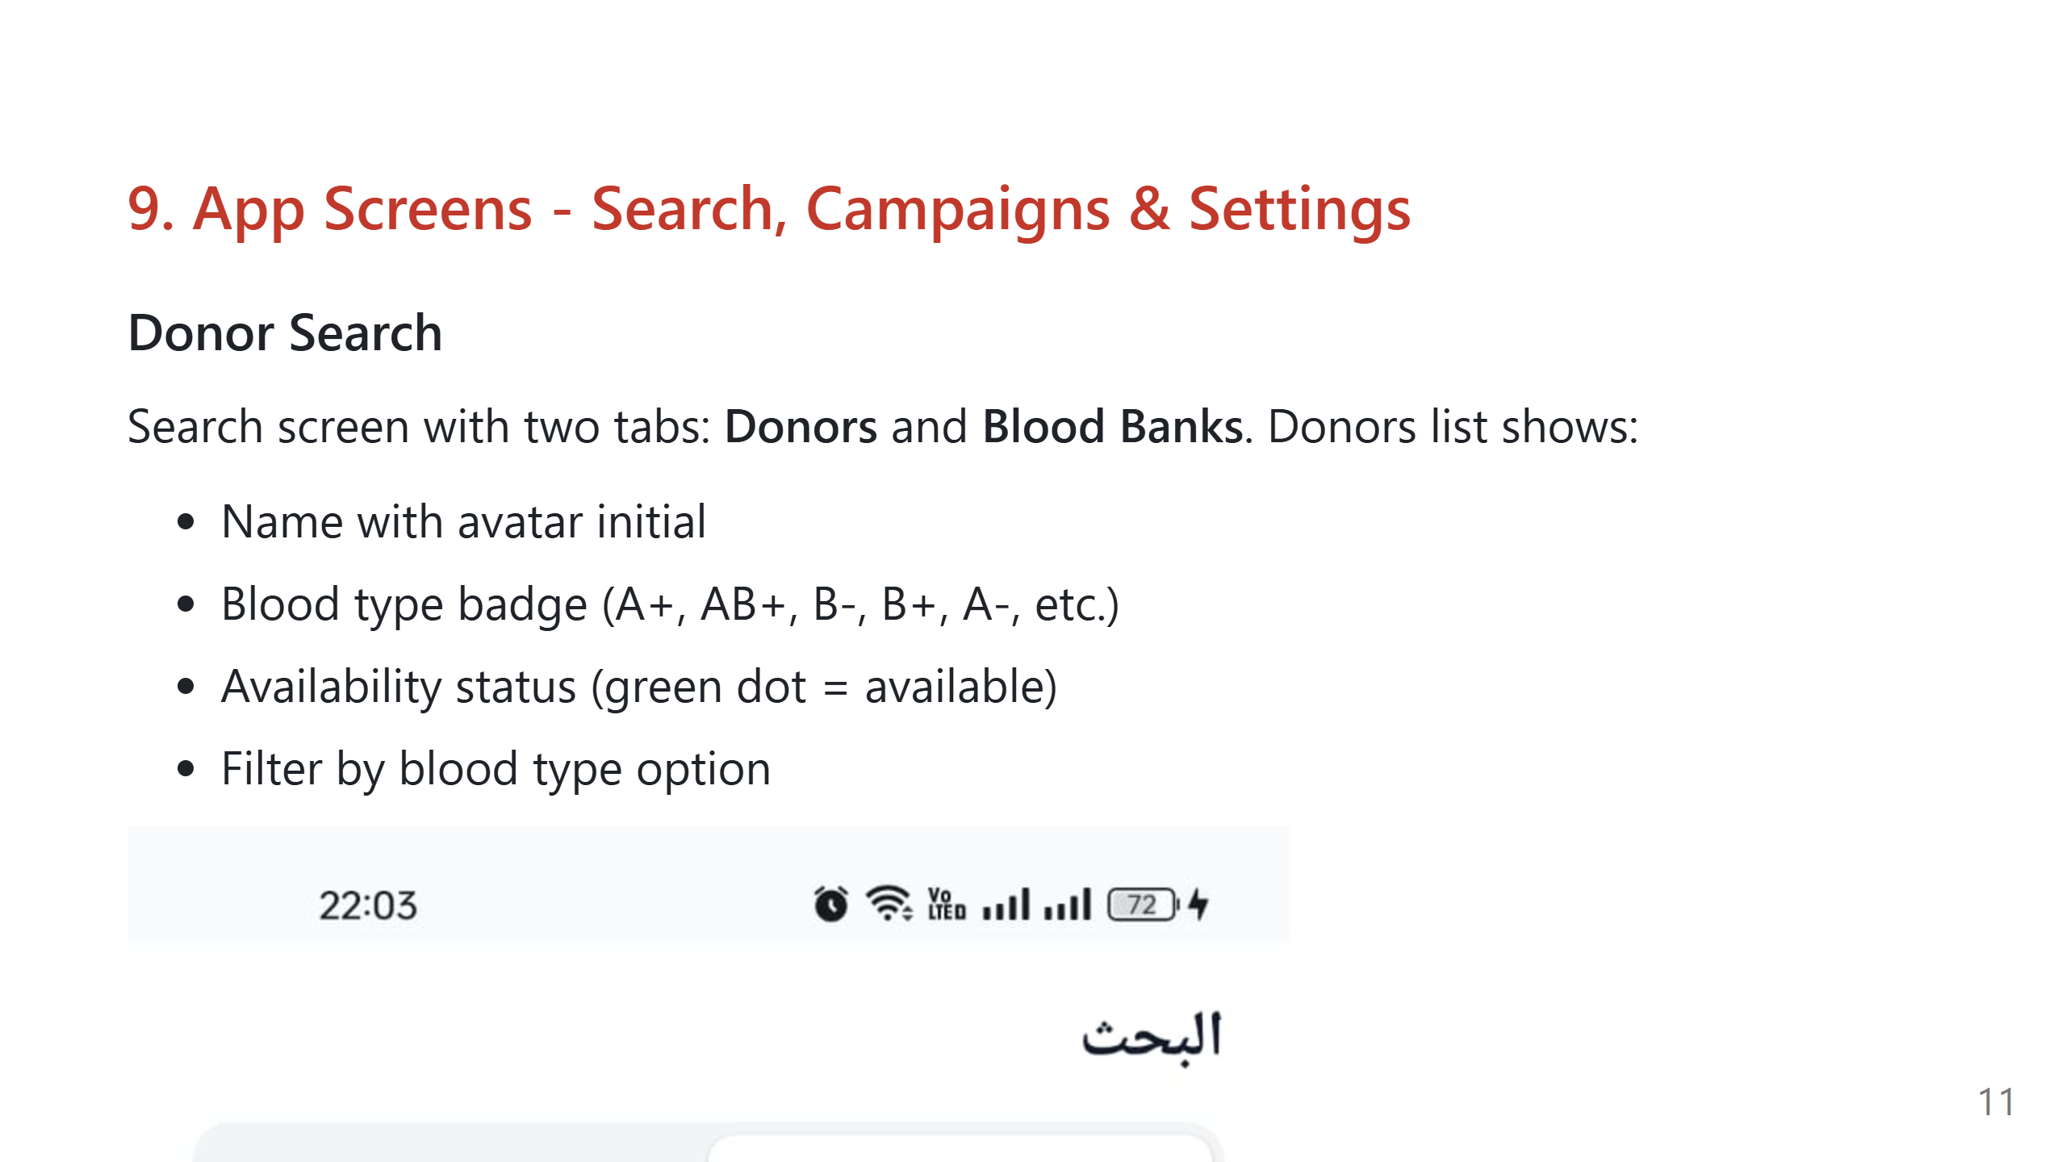
Notes:
============================================================ SLIDE 11 - APP SCREENS: SEARCH, CAMPAIGNS, SETTINGS ============================================================

Slide 12
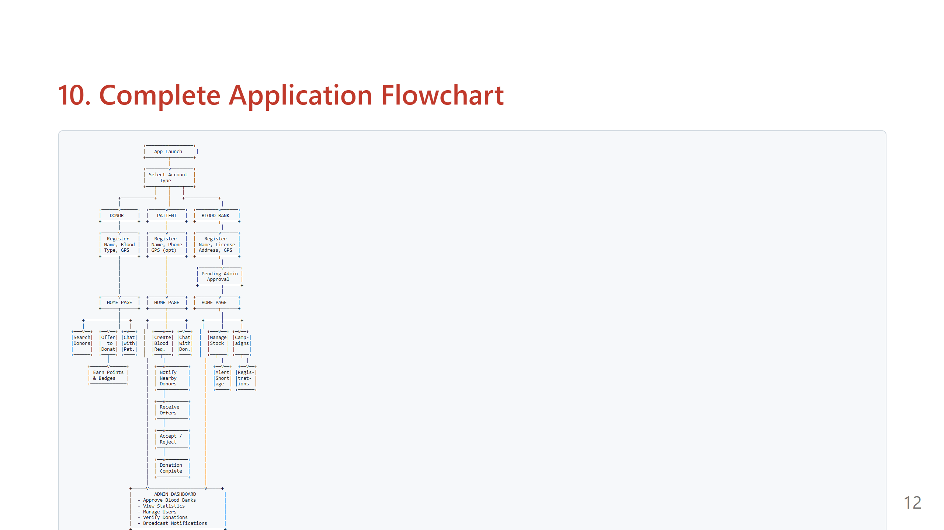
Notes:
============================================================ SLIDE 12 - FLOWCHART ============================================================

Slide 13
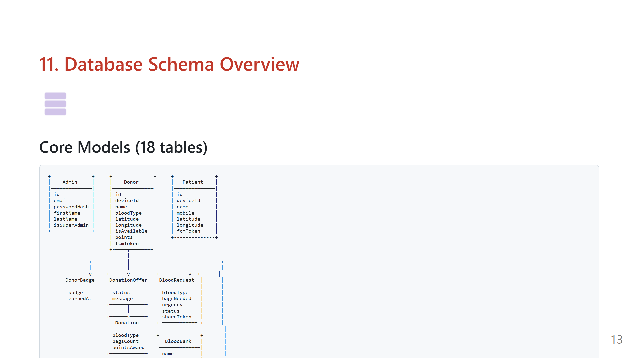
Notes:
============================================================ SLIDE 13 - DATABASE SCHEMA ============================================================

Slide 14
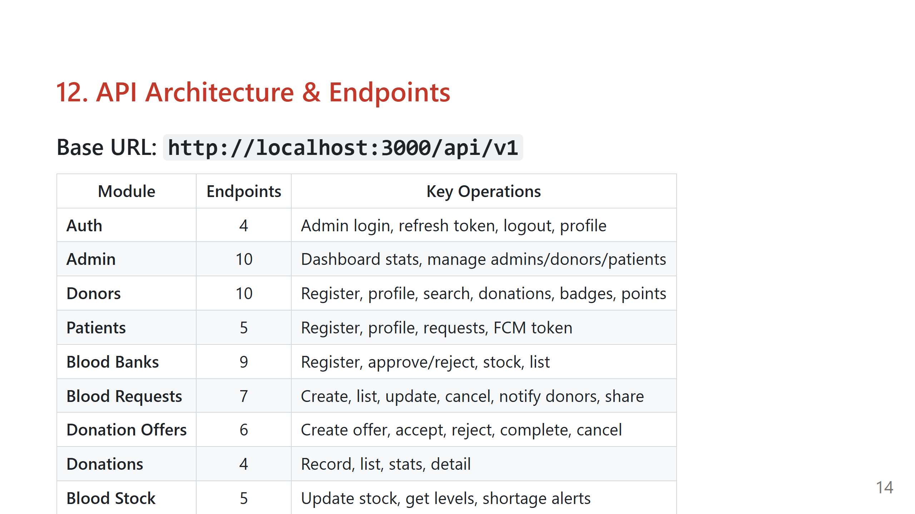
Notes:
============================================================ SLIDE 14 - API ARCHITECTURE ============================================================

Slide 15
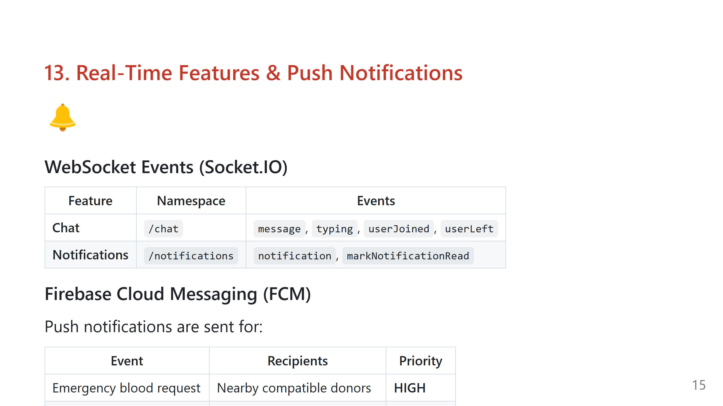
Notes:
============================================================ SLIDE 15 - REAL-TIME & NOTIFICATIONS ============================================================

Slide 16
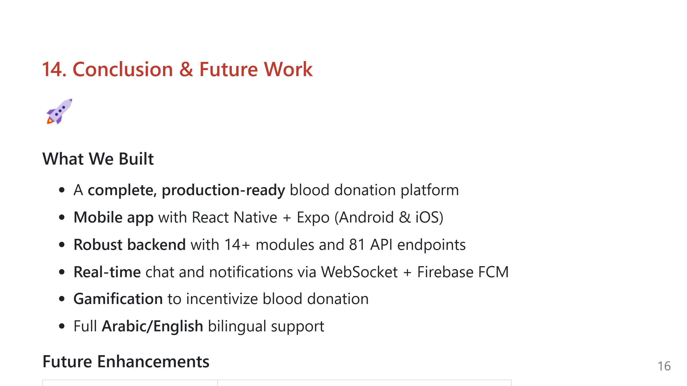
Notes:
============================================================ SLIDE 16 - CONCLUSION ============================================================

Slide 17


