Slide 1
Care Process Monitoring Business Intelligence Application
Shirley Baffoe
Aladdin Baarah
Liam Peyton
Omar Badreddin
Saeed A.Behnam
Alain Mouttham
University of Ottawa

Slide 2
Objective
Real-time dashboard for event monitoring and analytics
Current state of patients and beds and their event history
Hourly and historical trends of key metrics
Alerts for out-of-bound metrics and states
Architecture for integrating complex event processing and real-time analytics

Slide 3
Case Study
Acute Coronary Syndrome (ACS) clinical pathway developed and validated with clinical staff at large community hospital
Behavior Driven Development – detailed step by step scenario of a typical patient
Proof of Concept Prototype and Walk Thru
Validated by 80 Clinicians, Executives and IT staff

Slide 4
Approach
Model Clinical Pathway
not as a completely elaborated process
Rather as a series of checkpoints or states
With pre-conditions and expected results
Performance Dashboard of current state
Individual patients
Aggregate throughput
With expected results

Slide 5
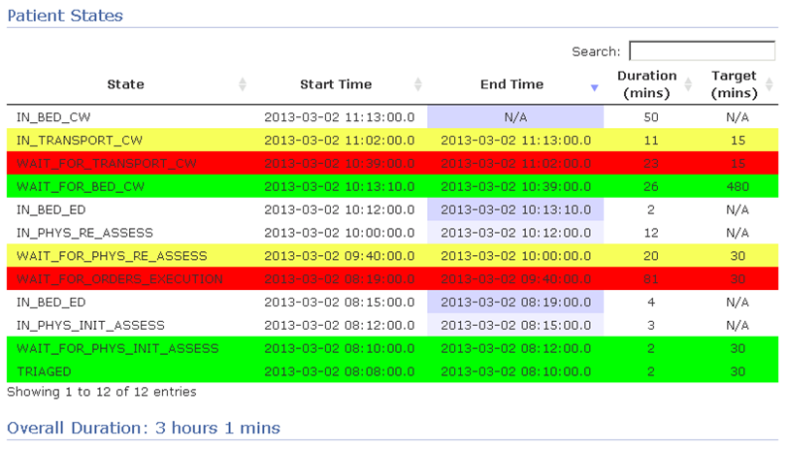
BI Dashboard
Notes:
Uses CEP + ORM database

Slide 6
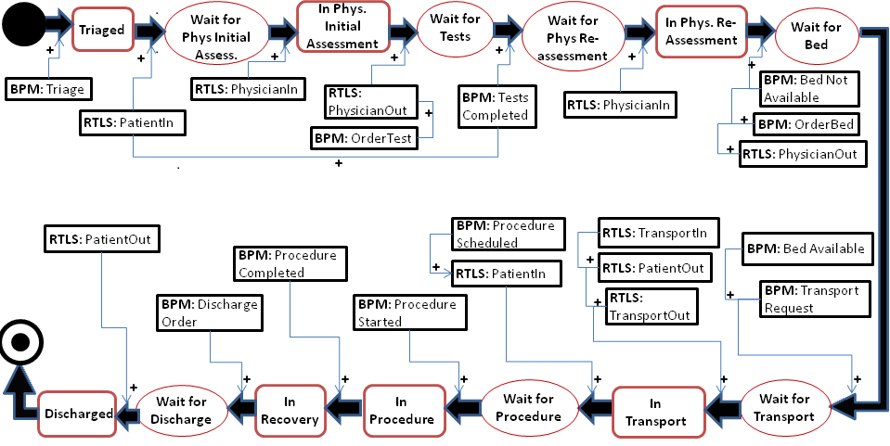
State-based Data Integration Model

Slide 7
IF CURRENT_STATE is Wait for Bed
AND EVENT Bed Available received
AND EVENT TransportRequest received
Then CURRENT_STATE is Wait for Transport

Slide 8
Rules which Transition Patient State |  |  | Inferred Patient State
Current Patient State | Source Event(s) | Event Source
Start | TriageScore | BPM | Triaged
Triaged | PatientIn | RTLS | Wait for Initial Assess.
Wait for Initial Assess | PhysicianIn | RTLS | In Initial Assessment
In Initial Assessment | PhysicianOut | RTLS | In Bed ED
In Bed ED | OrderTests | BPM | Wait for Tests
Wait for Tests | Tests Completed | BPM | Wait for Re-assessment
Wait for Re-assessment | PhysicianIn | RTLS | In Phys. Re-Assessment
In Phys. Re-Assessment | PhysicianOut OrderBed Bed Not Available | RTLS BPM BPM | Wait for Bed CW
Wait for Bed CW | Bed Available Transport Request | BPM BPM | Wait for Transport CW
Wait for Transport CW | TransportIn TransportOut PatientOut | RTLS RTLS RTLS | In Transport CW
In Transport CW | TransportIn TransportOut PatientIn | RTLS RTLS RTLS | In Bed CW

Slide 9
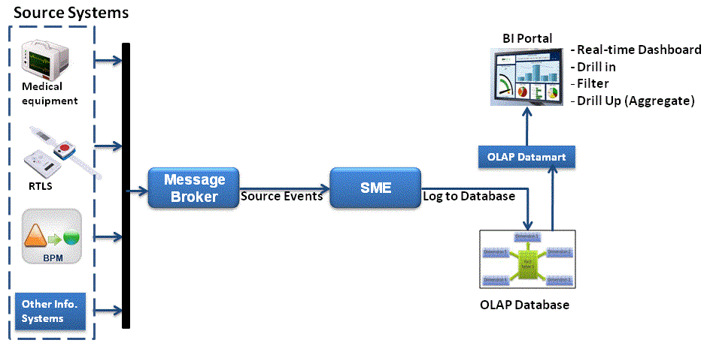
BI Application Architecture
Event Console
Event Test Scripts

Slide 10
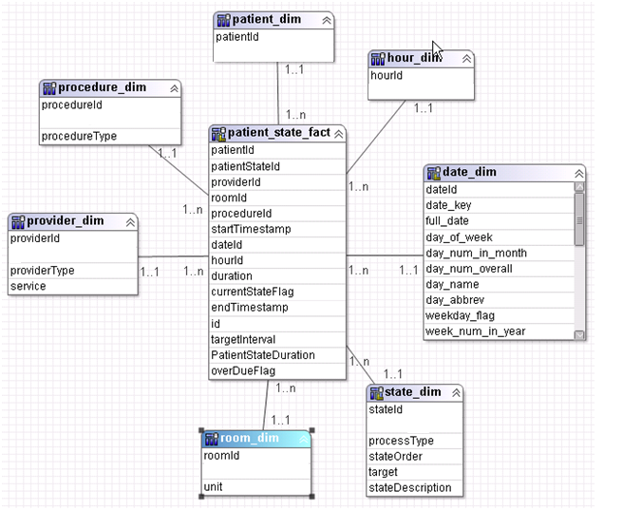
Patient states Star Schema Data Model
Notes:
Used star schema data model. Below are the

Slide 11
Patient events Star Schema Data Model
Patient_event_fact
Notes:
Used star schema data model. Below are the

Slide 12
Questions
What are the right goals?
-what metrics best communicate performance?
-what reports best visualize performance
-what alerts? How often to who?
Where, how and from who or what do we get the events we need for metrics? And how should we process them?
-instrumentation, ease of use, right people at the right time
-surveys, paid observers, inspectors
What are the right checkpoints (states)?
-what pre-conditions, expected results
- patients, doctors, nurses and other actors are in multiple checkpoints simultaneously

Slide 13
Care Process Meta-Model
Performance Management
Process State
Data Integration

Slide 14

Questions

