Slide 1
Model Evaluation
Dr. Nassim Sohaee

Slide 2
Performance Measure
Evaluating a machine learning model
Classification is trickier than Regression

Slide 3
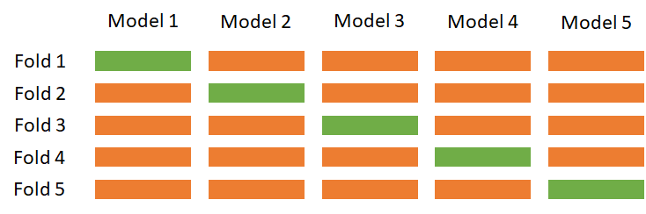
Cross-Validation
Cross-validation is a statistical method of evaluating generalization performance that is more stable and thorough than using a split into a training and a test set.

Slide 4
Cross-Validation
cross_val_score: returns accuracy values
cv parameter: by default 3, but you can set it to any other value.
Average accuracy

Slide 5
Benefits of Cross-Validation
Average accuracy is more accurate than single split accuracy.
Use data for effectively
Control the structure of the folds

Slide 6
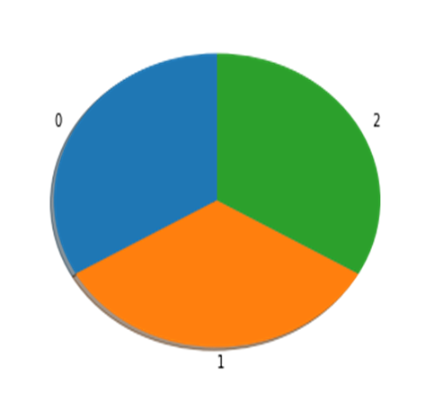
Stratified Cross-Validation
Iris dataset – 3 fold cross validation

Slide 7
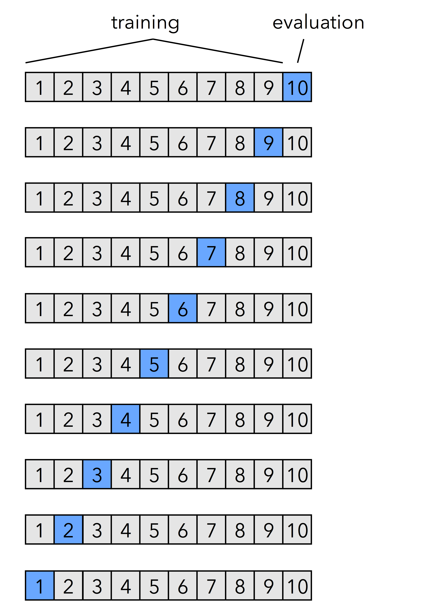
Leave-One-Out Cross-Validation

Slide 8
Grid Search
Evaluate how well a model generalize:
Cross validation
Improve the model’s generalization performance by tuning its parameters.
Grid Search

Slide 9
Simple Grid Search
For loop
Example: SVC - γ and C
γ∈{0.001, 0.01, 0.1, 1, 10, 100}
C∈{0.001, 0.01, 0.1, 1, 10, 100}

Slide 10
The Danger of Overfitting the Parameters and the Validation Set
Try different parameters and selected the one with best accuracy on the test set.
Because we used the test data to adjust the parameters, we can no longer use it to assess how good the model is.

Slide 11
Note
The best_score_ stores the mean cross-validation accuracy, with cross-validation performed on the training set.
This is different from the score for evaluating the generalization of the model.

Slide 12
Evaluation Metrics

Slide 13
Goal
Before picking a machine learning metric, you should think about the high-level goal of the application, often called the business metric.
The consequences of choosing a particular algorithm for a machine learning application are called the business impact.

Slide 14
Binary Classification

Slide 15
Errors
False Positive
Type I error
False Negative
Type II error

Slide 16
Imbalanced Dataset
Fraud Prediction

Slide 17
Dummy classifiers completely ignore the input data!
Dummy classifiers serve as a sanity check on your classifier's performance.
They provide a null metric(e.g. null accuracy) baseline.
Dummy classifiers should not be used for real problems.

Slide 18
Dummy classifiers completely ignore the input data!
Some commonly-used settings for the strategy parameter for DummyClassifierin scikit-learn:
most_frequent: predicts the most frequent label in the training set.
stratified: random predictions based on training set class distribution.
uniform: generates predictions uniformly at random.
constant: always predicts a constant label provided by the user.
A major motivation of this method is F1-scoring, when the positive class is in the minority.

Slide 19
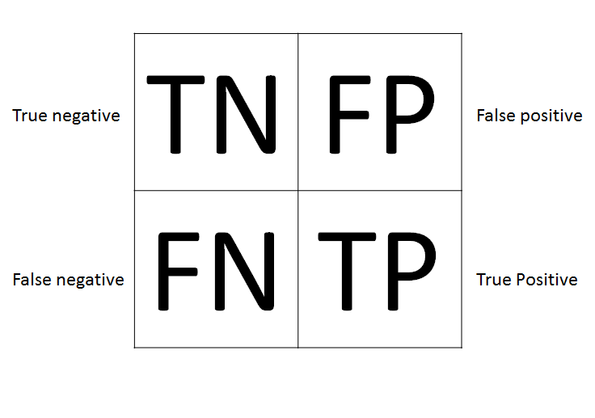
Confusion Matrix

Slide 20
Confusion Matrix
Negative
Positive

Slide 21
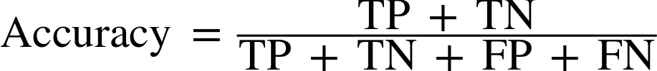
5 | 1
2 | 6
Accuracy = (5 + 6) / (5 + 1 + 2 + 6) = 0.7857

Slide 22
5 | 1
2 | 6
Accuracy = (5 + 6) / (5 + 1 + 2 + 6) = 0.7857

Slide 23

5 | 1
2 | 6
Precision= 6 / 7 = 0.8571

Slide 24

5 | 1
2 | 6
Recall= 6 / (6 + 2) = 0.75

Slide 25
Accuracy | 0.7857
Precision | 0.8571
Recall | 0.75
Accuracy | 0.8571
Precision | 1
Recall | 0.75
Accuracy | 0.9286
Precision | 0.8889
Recall | 1
Negative
Positive

Slide 26
Precision-Recall trade off
Recall-oriented machine learning tasks:
Search and information extraction in legal discovery
Tumor detection
Often paired with a human expert to filter out false positives
Precision-oriented machine learning tasks:
Search engine ranking, query suggestion
Document classification
Many customer-facing tasks (users remember failures!)

Slide 27
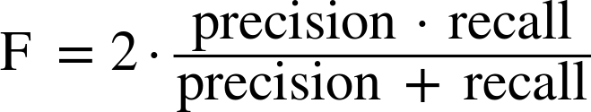
F1-Score

Slide 28
Taking Uncertainty into Account
decision_function
predict_proba

Slide 29
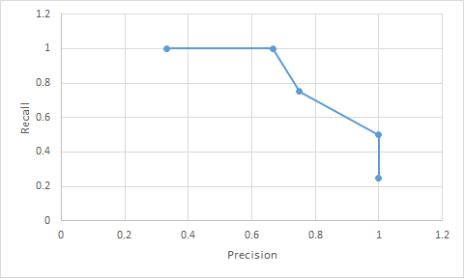
Precision-Recall Curves
True Label | Classifier score
0 | -27.6457
0 | -25.8386
0 | -25.1011
0 | -24.1511
0 | -23.1765
0 | -22.575
0 | -21.8271
0 | -21.7226
0 | -19.7361
0 | -19.5768
0 | -19.3071
0 | -18.9077
0 | -13.5411
0 | -12.8594
1 | -3.9198
0 | -1.9798
1 | 1.824
0 | 4.74931
1 | 15.234624
1 | 21.20597
classifier score threshold | Precision | Recall
-20 | 0.33333333 | 1
-10 | 0.66666667 | 1
0 | 0.75 | 0.75
10 | 1 | 0.5
20 | 1 | 0.25

Slide 30
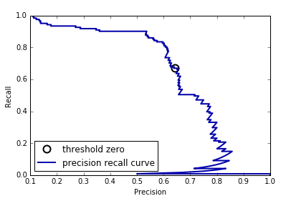
Precision-Recall Curve
The precision_recall_curve function returns a list of precision and recall values for all possible thresholds

Slide 31

Receiver Operating Characteristics (ROC)
ROC is a tool that is commonly used to analyze the behavior of the classifier at different threshold.

Slide 32
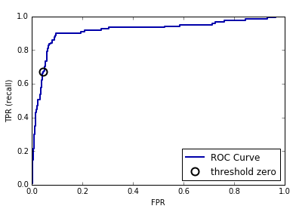
ROC

Slide 33
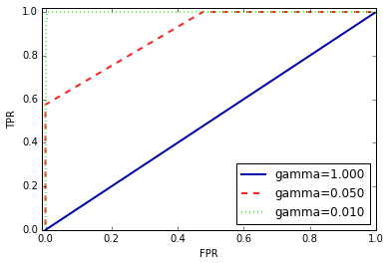
Area Under the Curve (AUC)
We can compute the area under the ROC curve using the roc_auc_score function.

Slide 34
AUC
Use AUC when evaluating models on imbalanced data.
Adjusting the decision threshold might be necessary to obtain useful classification results from a model with a high AUC.

Slide 35
Metrics for Multiclass Classification
Macro-Average
Micro-Average

Slide 36
Macro Average
Each class has equal weight.
Compute metric within each class
Average resulting metrics across classes

Slide 37
Example
Class | Predicted Class | Correct
Orange | Lemon | 0
Orange | Lemon | 0
Orange | Apple | 0
Orange | Orange | 1
Orange | Apple | 0
Lemon | Lemon | 1
Lemon | Apple | 0
Apple | Apple | 1
Apple | Apple | 1
Class​ | Predicted Class​ | Correct​
Orange​ | Not Orange | 0​
Orange​ | Not Orange | 0​
Orange​ | Not Orange | 0​
Orange​ | Orange​ | 1​
Orange​ | Not Orange | 0​
Not Orange | Not Orange | 1​
Not Orange | Not Orange | 0​
Not Orange | Not Orange | 1​
Not Orange | Not Orange | 1​
Class​ | Predicted Class​ | Correct​
1 | 0 | 0​
1​ | 0 | 0​
1 | 0 | 0​
1​ | 1 | 1​
1​ | 0 | 0​
0 | 0 | 1​
0 | 0 | 0​
0 | 0 | 1​
0 | 0 | 1​
TP: 1
FP: 0
Precision = 1

Slide 38

Example
Class | Precision
Orange | 1
Lemon | 0.33
Apple | 0.4
Macro Average Precision =

Slide 39
Micro Average
Each instance has equal weight.
Largest classes have most influence
Aggregate outcomes across all classes
Compute metric with aggregate outcomes

Slide 40

Example
Class | Predicted Class | Correct
Orange | Lemon | 0
Orange | Lemon | 0
Orange | Apple | 0
Orange | Orange | 1
Orange | Apple | 0
Lemon | Lemon | 1
Lemon | Apple | 0
Apple | Apple | 1
Apple | Apple | 1
Micro-average Precision
= (1 + 1 + 2) / (1 + 1 + 2 + 0 + 2 + 3) = 0.44

Slide 41
Regression Metrics
Analyzing overpredicting the target versus underpredicting the target.

Slide 42
Using Evaluation Metrics in Model Selection
scoring argument

