Slide 1
Professional Practices
“Anatomy of a Software House”

Slide 2
Contents
Anatomy
Software house
Anatomy of a typical software house
Example

Slide 3
Anatomy
Anatomy is study of
Structure
Organization
Internal working
Hierarchy chart
Notes:
A study of structure and internal working of something.

Slide 4
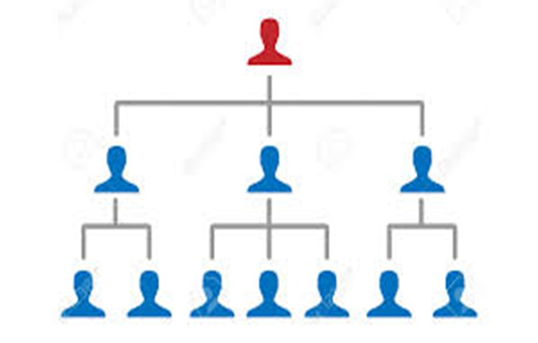
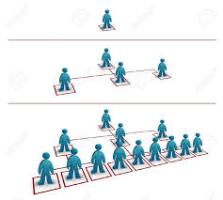
Anatomy may look like

Slide 5

Or like this… There are teams out there!

Slide 6
Software House
“A software house is a company that primarily provides software products. These companies may specialize in business or consumer software or software-as-a-service (SaaS) products. The common definition is that the company is mainly interested in developing and distributing software products”

Slide 7
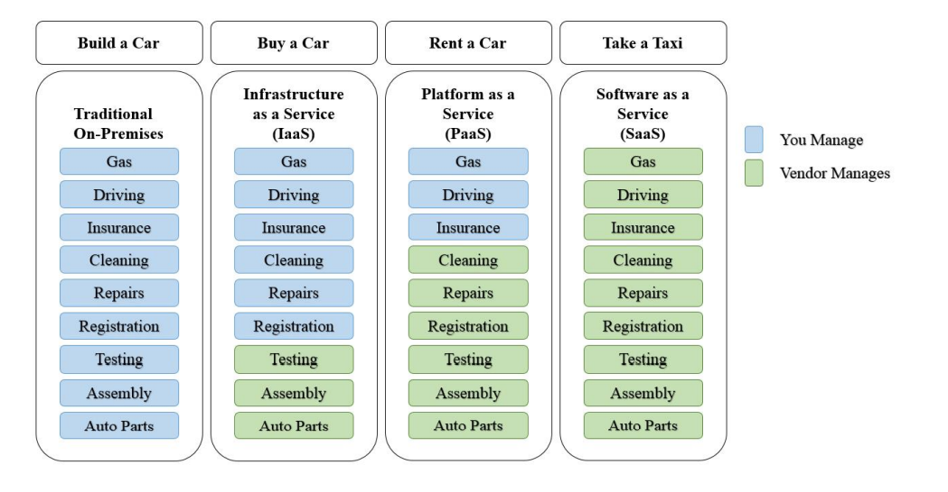
How do organizations use the cloud? Example

Slide 8
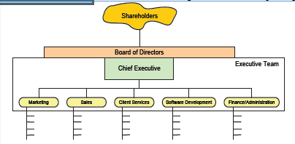
Anatomy of a software House

Slide 9
Shareholders
Owners of the company
Elect the board of directors
Vote on issues
Same for private and public companies

Slide 10
Board of Directors
Represent shareholders interests
governing the organization by establishing broad policies and setting out strategic objectives
selecting, appointing, supporting and reviewing the performance of the chief executive Officer
terminating the chief executive Officer

Slide 11
Board of Directors
Ensure the availability of adequate financial resources
Approve annual budgets
Accountable to the stakeholders for the organization's performance
Set the salaries, compensation and benefits of senior management

Slide 12
Chief Executive Officer
Appointed by the board of directors
Communicate, on behalf of the company, with shareholders, government entities, and the public
Lead the development of the company’s short- and long-term strategy
Create and implement the company or organization’s vision and mission
Evaluate the work of other executive leaders within the company.

Slide 13
Executive Team
Vp & c- level officers
Managed by CEO
In charge of day to day functional areas
Meet regulararly to coordinate strategy, budget etc
Manage the Group's business as a whole
Have extensive authorities within their individual areas of responsibility and have the duty to develop the company's operations in line with the targets set by the Board of Directors and the CEO.

Slide 14
Marketing
Create awareness of and develop the brand you're marketing
Communicate with target audiences and build and develop customer relationships
Help with marketing plans, advertising, direct marketing and campaigns

Slide 15
Marketing
Support the marketing manager in delivering agreed activities
Organize and attend events such as conferences, seminars, receptions and exhibitions
Source and secure sponsorship
Conduct market research, for example using customer questionnaires and focus groups

Slide 16
Sales
Conduct market research to identify selling possibilities and evaluate customer needs
Actively seek out new sales opportunities through cold calling, networking and social media
Set up meetings with potential clients and listen to their wishes and concerns
Notes:
Cold calling is the solicitation of business from potential customers who have had no prior contact with the salesperson conducting the call. Cold calling is an attempt to convince potential customers to purchase either the salesperson's product or service.

Slide 17
Sales
Prepare and deliver appropriate presentations on products/ services
Create frequent reviews and reports with sales and financial data
Ensure the availability of stock for sales
Negotiate/close deals and handle complaints or objections

Slide 18
Client Services
Develop and maintain existing client relationships.
Interact and correspond with prospective clients.
Identify, develop and maintain relations with potential clients to drive allocated revenue for attaining set revenue targets.
Develop and execute yearly formal business plan for assigned territory.

Slide 19
Client Services
Identify decision makers
Identify services and products to meet client issues.
Direct development of client customized solutions.
Negotiate with client for efficient services delivery at profitable fees.
Ensure services are priced correctly for client expansion opportunities

Slide 20
Software Development
Develop, manage and prepare best software development team.
Guide, coach and mentor software development engineers.
Provide project management and technical leadership for every aspect of software.
Prepare lifecycle for different projects inclusive of research, design, development, evaluation, testing along with delivery.

Slide 21
Software Development
Supervise architecture plus lead efforts to develop technical roadmap of all projects.
Establish and stimulate software development standards and processes along with best practices for delivery of scalable and high quality software.
Perform closely with Engineers, Developers and Product Management throughout organization to influence product development assisting or improving products.

Slide 22
Finance and Admin
Overall responsibility for all aspects of financial management and control.
Effective financial reporting in a timely, accurate, relevant and informative manner.
General administration duties.

Slide 23
MindMill Software Ltd.(Established 1993) An Indian Software House
BANKING AND ERP PRODUCTS
INVOICE MATCHING SERVICES
LIBRARY AND DOCUMENT MANAGEMENT SOLUTIONS
INSTITUTE MANAGEMNT SYSTEMS
CONSULTING SERVICES
MANAGED CLINET SERVICES
BESPOKE APPLICATION DEVELOPMENT

Slide 24
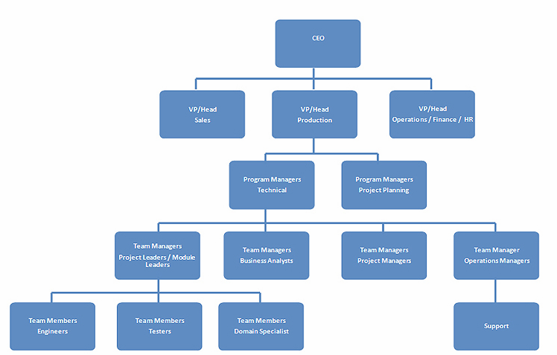
Let’s focus anatomy of bespoke application development section

