Slide 1
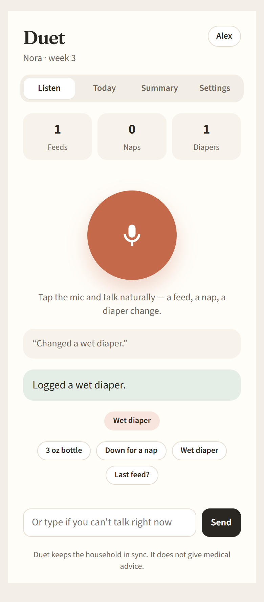

Duet
A voice-first baby log for the whole household
Talk. Log. Stay in sync.
AI Integration Class · Project presentation
Notes:
Introduce Duet: a baby log you talk to. Built for the first 12 weeks, when several people share the care and everyone is exhausted. This deck covers what it does, how it is built, and how it was tested — 115 automated checks, all passing.

Slide 2
The first 12 weeks are a blur
THE PROBLEM
Hands are full
Feeding, rocking, burping — there is rarely a free hand to tap through a form at 3 AM.
Care is shared
Parents, grandparents and night nurses each hold part of the picture. "Did she eat yet?" lives in group texts.
Trackers are form-heavy
Popular apps are built around charts and dashboards. Logging one bottle takes several taps.
Goal Logging should take one sentence, and everyone should see it instantly.
Notes:
Three pain points. Hands are full, so tapping through forms is hard. Care is shared, so information is scattered across texts. Existing trackers are built around dashboards and charts, not quick capture.

Slide 3
Talk. Log. Stay in sync.
THE SOLUTION
Speak naturally "Just gave her a 3 ounce bottle" becomes a logged feed.
Example
You say: "Just gave her a 3 ounce bottle."
Everyone sees it live Every caregiver's screen updates within a second.
Ask the log "When did she last eat?" is answered from today's entries.
Duet: "Logged bottle, 3 oz."
Never gives medical advice Symptom or medicine questions are redirected to the pediatrician.
Partner's phone updates instantly: "Bottle, 3 oz — Alex · just now"
Free No paywall, no credit card. Invite as many caregivers as you need.
Notes:
Walk through the example: you say a normal sentence, Duet logs it and replies in one line. Everyone in the household sees it live. It answers questions from the shared log, and refuses medical questions — it is a log, not a doctor. And it is free.

Slide 4
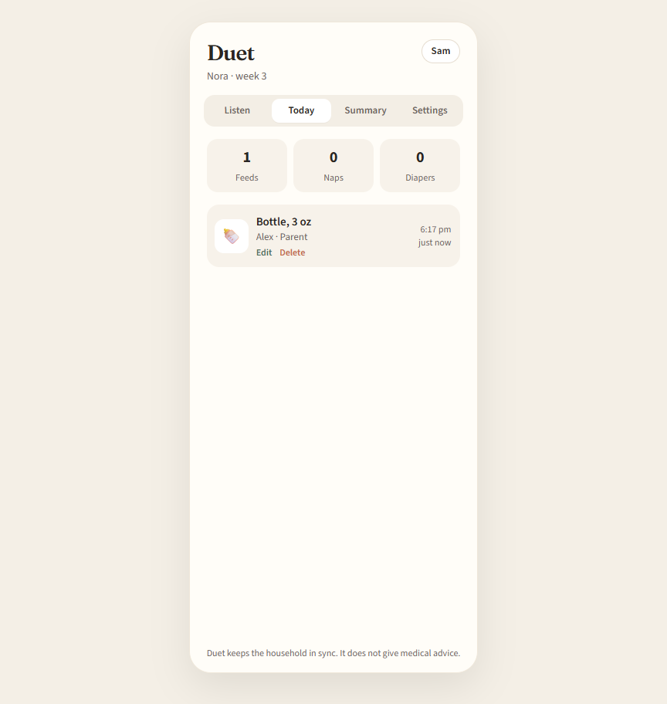
One household, two screens, live
WHAT IT LOOKS LIKE
Alex on a phone logs by voice
Sam on a laptop sees the shared timeline
Notes:
Left is Alex on a phone, logging by voice. Right is Sam on a laptop — the entry shows up on the Today timeline without refreshing. Both screenshots come straight from the automated browser test.

Slide 5
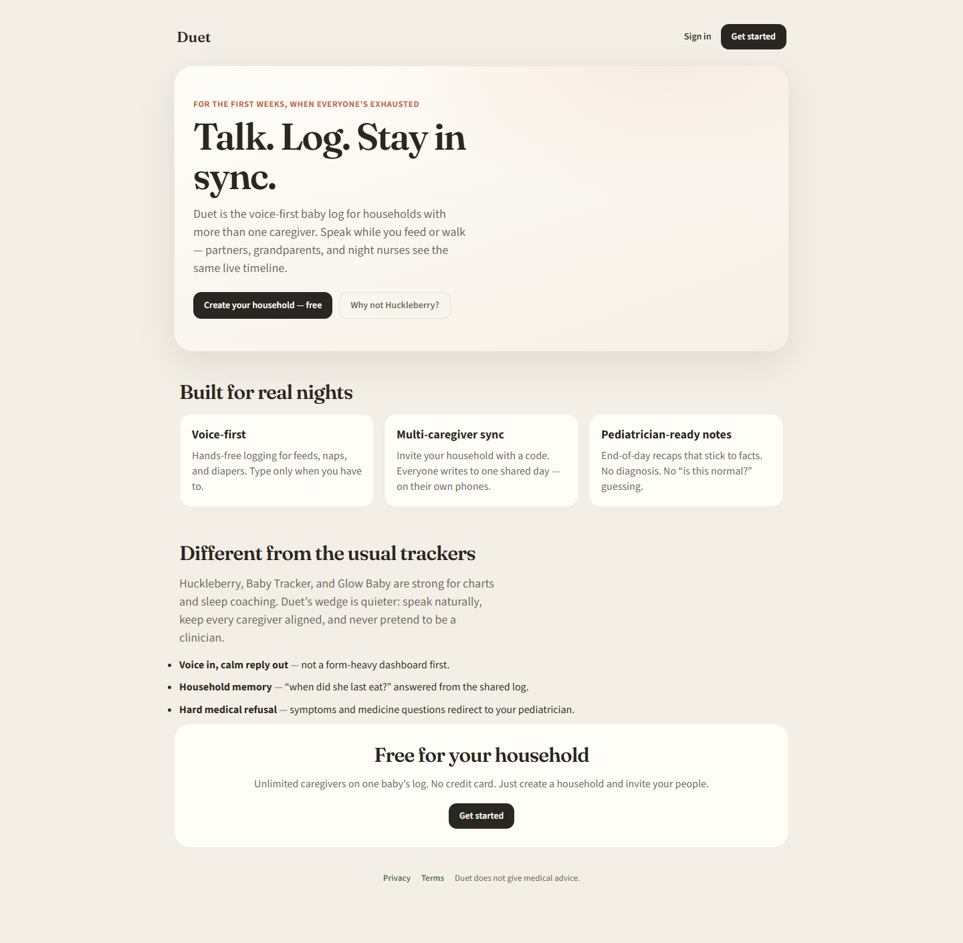
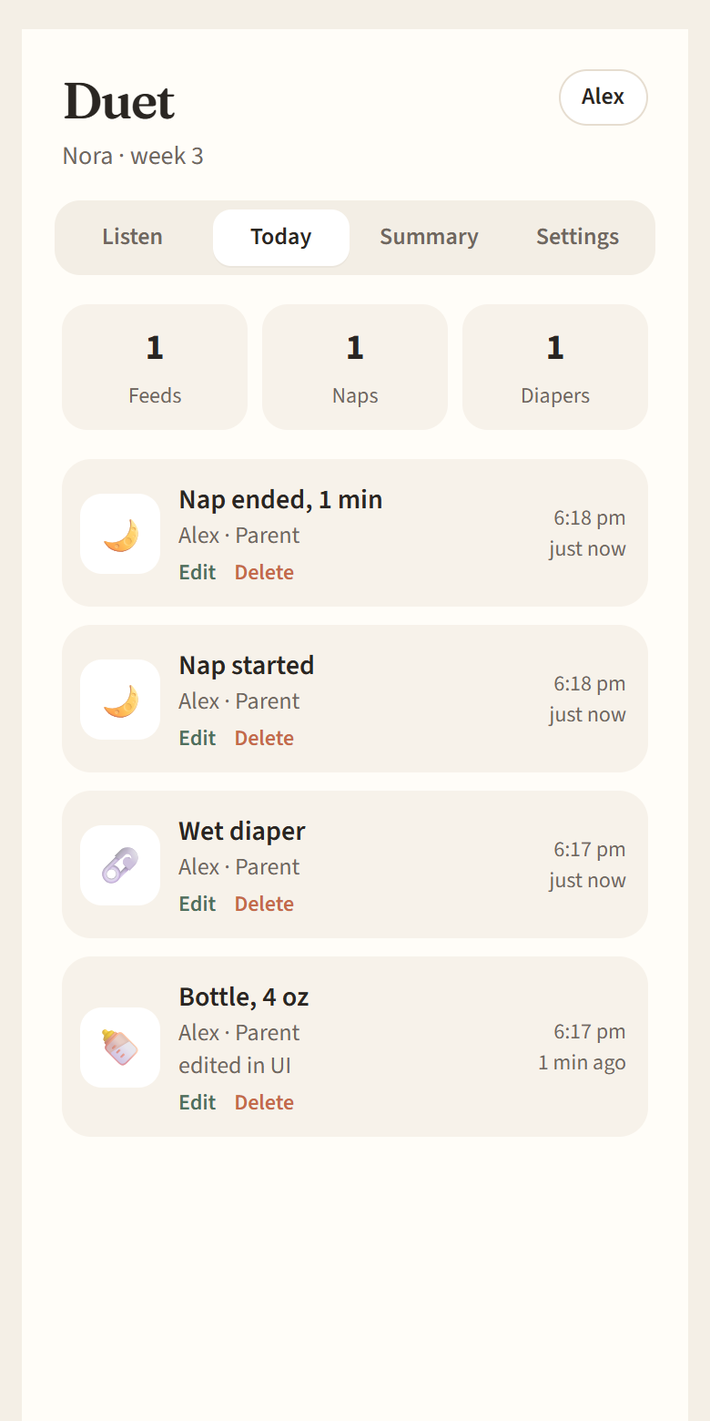
Works on a phone and on a full desktop screen
RESPONSIVE
Desktop: full-width landing page
Phone: Today timeline
Notes:
It is a normal website too. The landing page uses the full desktop width; the app itself stays in a comfortable phone-width column on a laptop. Tests confirm nothing scrolls sideways at phone, tablet or desktop sizes.

Slide 6
Architecture
HOW IT IS BUILT
Live sync
Server-Sent Events
Browser
phone or desktop
pushes updates to every caregiver
React app
one codebase (Vite)
Express API
Node.js server
SQLite
database
Installed web app
Add to Home Screen
Android app
Capacitor wrapper
Sentence parser
local rules · optional Claude AI
Notes:
One React web app runs everywhere. It talks to a small Express server with a SQLite database. Each sentence goes to the parser — a built-in rule-based parser, with an optional Claude AI model if an API key is set. When anything changes, the server pushes a live update to every caregiver using Server-Sent Events.

Slide 7
Three ways to run the same app
ONE CODEBASE
Website
Opens in any browser.
Phone layout on small screens, full-width landing page on desktop.
Same accounts and live sync everywhere.
Installable web app
Web app manifest with name, colors and "standalone" display.
Icons from 48 to 512 px, plus a maskable icon.
Service worker stores the app for offline use.
Separate iPhone tags and home-screen icon.
Android app
Capacitor wraps the same build.
App ID com.duet.household, Duet icon and splash.
Emulator reaches the laptop at 10.0.2.2:5000.
Microphone permission for voice.
No forked code: one command (npm run cap:sync) copies the latest web build into the Android project.
Notes:
No forked code. The same build runs as a website, as an installable app, and inside the Android app. For Android the key detail is networking: the emulator cannot reach "localhost" on the laptop, so the app uses the special address 10.0.2.2.

Slide 8
Voice works in the browser and in the Android app
VOICE
In the browser
Web Speech API
Transcript
"um, she had 4 ounces"
Parser
feed · 120 ml
Logged
+ live sync
In the Android app
native speech plugin
Why a native plugin on Android?
The browser speech API is unreliable inside the Android app's built-in web view. On Android: tap the mic to start, tap again when finished.
Or just type
Notes:
In Chrome, voice uses the built-in Web Speech API. Inside the Android app's web view that API is unreliable, so on Android Duet switches to a native speech-recognition plugin. Both paths produce the same text, which goes through the same parser — so a spoken entry behaves exactly like a typed one.

Slide 9
Three layers of automated tests
TESTING
31
Browser tests
Does the real app work on phone and desktop, live, even offline?
115
automated checks
73
End-to-end tests
Does every feature work for two caregivers, and keep outsiders out?
11
Unit tests
Does Duet understand the sentence?
Notes:
Testing goes from small to big. Unit tests check the sentence parser alone. End-to-end tests act as two caregivers plus an outsider and use every server feature. Browser tests click through the real app in Edge on a phone-sized and a desktop-sized window at the same time.

Slide 10
What the browser test actually does
TESTING
1
Alex · phone
2
Alex · phone
3
Sam · desktop
4
Alex · phone
Alex signs up
Creates household, gets invite code
Sam joins with the code
Alex logs by voice
5
Sam · desktop
6
Sam · desktop
7
Alex · phone
8
Alex · phone
Sam sees it live
Sam edits and deletes
Alex sees changes live
Alex goes offline, logs, reconnects
Every step is checked automatically, including that the other person's screen updates without a refresh.
Notes:
This is the scenario the browser test plays out, with two separate browser sessions. Alex is on a phone-sized screen, Sam on a desktop. Every step is checked automatically, including that changes show up on the other screen without refreshing.

Slide 11
115 of 115 checks passed
RESULTS
Unit + end-to-end | Checks | Result
Sentence understanding (unit) | 11 | Pass
Accounts and sign-in | 10 | Pass
Households and invites | 9 | Pass
Logging by voice and text | 13 | Pass
Edit and delete | 6 | Pass
Summary, settings, export | 12 | Pass
Android app reaching the server | 3 | Pass
Installable web app files | 11 | Pass
Android project setup | 8 | Pass
Server health | 1 | Pass
Real browser (Edge) | Checks | Result
Layout and installability | 6 | Pass
Signup and joining | 5 | Pass
Voice and text with live sync | 7 | Pass
Edit and delete with live sync | 3 | Pass
Summary and settings screens | 4 | Pass
Offline behavior | 4 | Pass
Session and no JavaScript errors | 2 | Pass
115 passed · 0 failed
11 unit · 73 end-to-end · 31 browser
Notes:
Every area passed in the final run on October 1. The left column is the server-side and parser tests, the right column is what was clicked through in the real browser.

Slide 12
Testing found 4 real bugs, all fixed
WHY TEST?
Removing a caregiver crashed the server
Failed for anyone who had logged an entry.
Found by: End-to-end test
Fix: Removal now revokes access but keeps their history; they can rejoin.
"She had 4 ounces" wasn't logged
The parser knew "ounce" but not "ounces" or "drank".
Found by: End-to-end test
Fix: Added the missing words and 2 new unit tests.
Opening the app offline signed you out
The failed account check erased the saved login.
Found by: Code review for the offline test
Fix: Stays signed in, shows "You're offline", reloads on reconnect.
Header button had no visible label
Dark text on a dark button: a blank black bar.
Found by: Reviewing test screenshots
Fix: Fixed the color; a test now checks every main button.
Notes:
This is the value of testing. None of these showed up in normal clicking around. Each one is fixed, and each now has a test so it cannot come back unnoticed.

Slide 13

No signal? Duet still opens
OFFLINE
Stored on the device
The service worker keeps the app shell, so it opens with no network.
Clear message, still signed in
"You're offline. Duet will load your household automatically when you reconnect."
Entries are queued
Anything logged offline is saved on the phone.
What you see with no connection
Syncs on reconnect
The app reloads itself and the queued entry reaches every caregiver.
Notes:
The service worker stores the app on the device. Opened with no connection, Duet shows a clear offline message instead of a blank page, keeps you signed in, and saves entries to send later. When the connection returns it reloads by itself and the saved entry reaches the other caregiver. All of this is checked by the browser test.

Slide 14
What has not been tested yet
HONEST LIMITS
Not tested | Why | How to check it
Running in the Android emulator | Android Studio not installed on the test computer | Install Android Studio, run npm run cap:sync then npm run cap:open, press Run
Real spoken voice | Automated tests cannot use a microphone (a stand-in recognizer was used) | Open in Chrome, tap the mic, say "Just gave her a 3 ounce bottle"
iPhone "Add to Home Screen" | No iPhone or Mac available | Safari → Share → Add to Home Screen
Everything else, including the Android project's settings, is covered by the 115 automated checks.
Notes:
Be upfront about these three. The Android project is configured and verified, but it has not been run in an emulator because Android Studio was not installed on the test machine. Real speech cannot be automated. And no iPhone was available.

Slide 15
Run it and test it yourself
TRY IT
# start the app
npm start
# run every test
npm test
npm run test:e2e
npm run test:ui
# Android
npm run cap:sync
npm run cap:open
Open the app
http://localhost:5000 in any browser.
On a phone: install it from the browser menu or Share sheet.
Read the full report
docs/TEST_REPORT.md lists every check, the bugs found, and the raw test output.
Notes:
Everything is free and runs locally. Start the server, then run the three test commands; each should end with 0 failed. The browser test saves fresh screenshots every time.

Slide 16
Thank you
Questions? Happy to do a live demo.
115 automated checks · 4 bugs found and fixed · one codebase for web and Android
Notes:
Offer a live demo: open the app on a phone and a laptop side by side, log by voice on one, and show it appear on the other.

