Slide 1

“Did anyone feed her?”
3:00 AM
Every new family asks this, over and over, every single day.
Notes:
It's three in the morning. The baby is crying, and you're holding her with one arm. Your partner asks: did she eat at midnight, or was that ten? Nobody knows. Every new family lives this moment, over and over, every single day.

Slide 2
Newborn care never stops, and it is shared
THE PROBLEM
8–12
6+
0
feeds a day
diaper changes a day
free hands at 3 AM
Today: the record lives in group texts and memory, and tracker apps make you tap through forms to log one bottle.
Feeding and diaper ranges: typical newborn guidance from the American Academy of Pediatrics.
Notes:
A newborn eats eight to twelve times a day, and needs at least six diaper changes. The care is shared between parents, grandparents, and sometimes a night nurse. So the record ends up scattered across group texts and tired memories. And the tracking apps out there are built around forms and charts. Logging one bottle takes several taps, with hands that are already full.

Slide 3
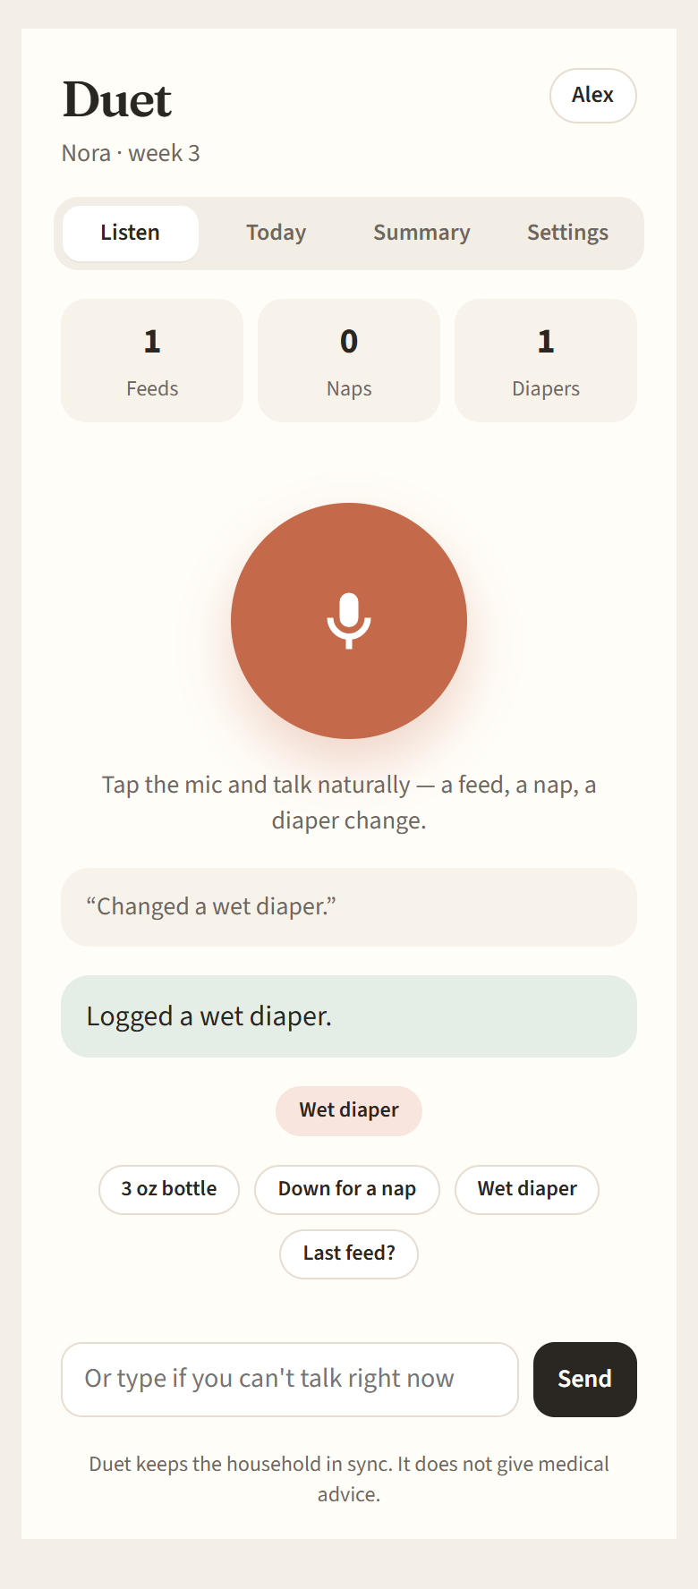

Meet Duet
The baby log you simply talk to.
Talk. Log. Stay in sync.
Notes:
Meet Duet. The baby log you simply talk to. Say, just gave her a three ounce bottle, and it's logged. And everyone in your household sees it, instantly.

Slide 4
One sentence. That’s the whole interface.
HOW IT WORKS
1
2
3
Say it
Duet logs it
Everyone sees it
“Just gave her a 3 ounce bottle.”
Feed · 3 oz (90 ml) · 3:02 AM
Every caregiver’s screen updates in about a second.
No forms. No typing. One sentence.
Notes:
Here's how it works. Tap the mic and speak naturally. Duet understands feeds, naps, and diaper changes, converts the amounts, and confirms in one short line. Within about a second, every caregiver's screen updates. No forms. No typing. Just one sentence.

Slide 5
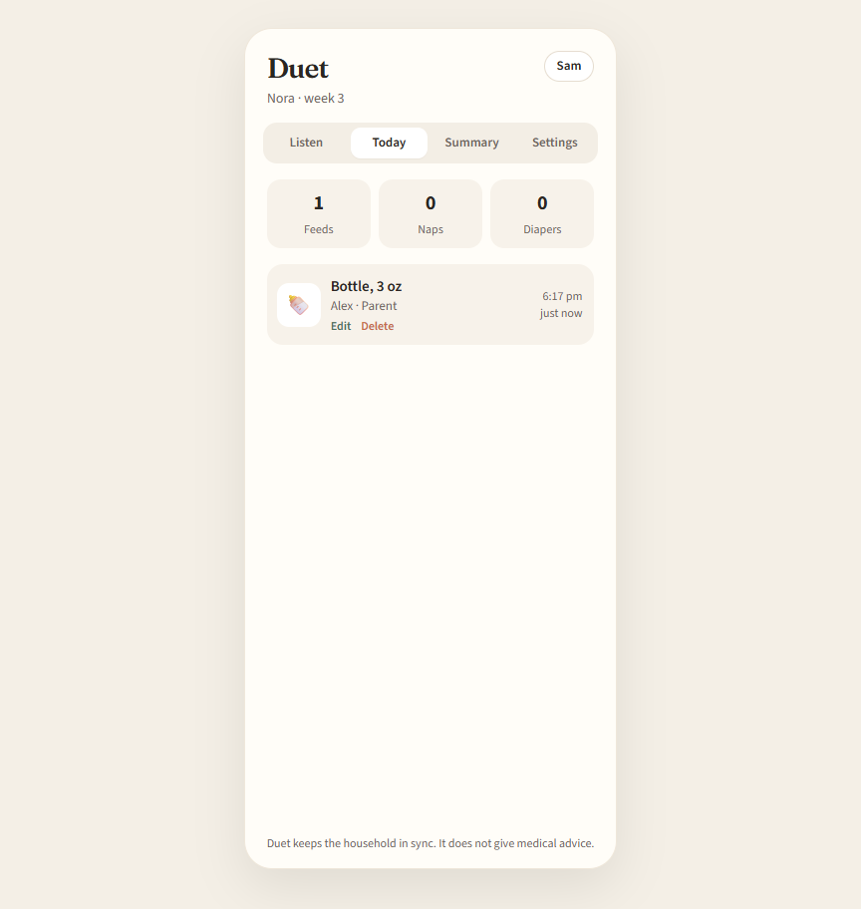
One household, two screens, live
SEE IT IN ACTION
Alex logs by voice on her phone
Sam sees it live on a laptop
Notes:
Here it is in action. Alex just speaks into her phone, and Duet logs it. Sam, on a laptop across town, sees every entry appear on the shared timeline, without refreshing. And if anyone asks, when did she last eat, Duet answers straight from the log.

Slide 6
What makes Duet different
WHY DUET
Voice-first
The whole household
Built for full hands. Speak a sentence instead of filling in a form.
Partners, grandparents and nannies join with a private invite code.
Works everywhere
Safe by design
Any browser, installed on the home screen, or the Android app. Even offline.
A log, not a doctor. Medical questions are sent to the pediatrician.
Notes:
What makes Duet different? It's voice first, built for the moments when your hands are full. It's made for the whole household, with private invite codes for partners, grandparents, and nannies. It works everywhere: in any browser, on your home screen, or as an Android app, even offline. And it's safe by design. Duet is a log, not a doctor. Medical questions always go to the pediatrician.

Slide 7
Every baby comes with a team
WHO IT’S FOR
New parents
3.6M
The first 12 weeks. Where we start.
Grandparents and relatives
Helping out in shifts.
babies born in the US every year
Nannies and night nurses
Hand-offs without a paper notebook.
Next: clinics and birthing classes
Source: CDC, U.S. births 2023
Recommend Duet to every new family.
Notes:
About three point six million babies are born in the United States every year. Behind every one of them is a team of caregivers who need to stay in sync. Duet starts with new parents in those first twelve weeks, then grows to grandparents, nannies, and night nurses, and later to clinics and birthing classes.

Slide 8
Free to start. Built to grow.
BUSINESS MODEL
Free
Duet Plus
Partners
CORE, FOREVER
PLANNED SUBSCRIPTION
PLANNED CHANNEL
Voice logging
Unlimited caregivers
Live sync on every device
Visit-ready reports for the pediatrician
Long-term trends
More than one child
Hospitals
Birthing classes
Families start before they go home
Built-in growth: every family that signs up invites its own partner, grandparents and nannies.
Notes:
Our model is simple. The core of Duet is free, forever: voice logging, unlimited caregivers, and live sync. Next, we plan Duet Plus, a small subscription with visit-ready reports for the pediatrician, long-term trends, and support for more than one child. And we'll partner with hospitals and birthing classes, so families get Duet before they even go home. And growth is built in: every family that signs up brings its own caregivers along.

Slide 9
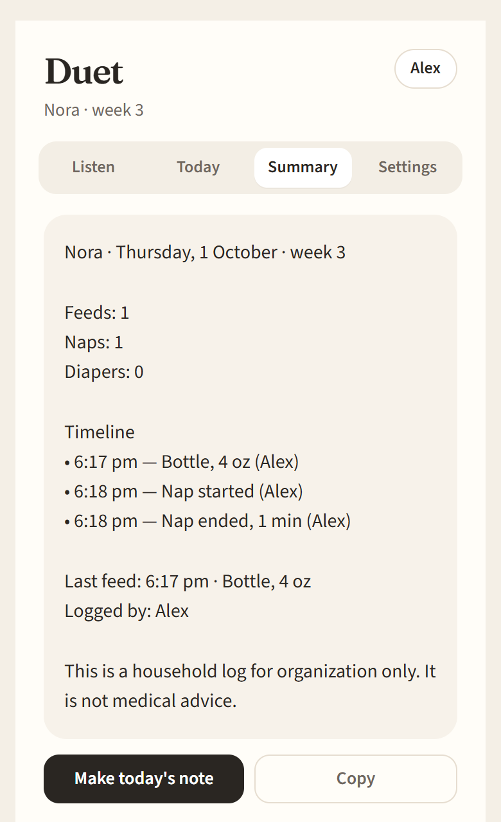
Built, tested, and working today
TRACTION
Website, installable app and Android app
One codebase.
115/115
Live sync tested on two screens
A phone and a laptop, at the same time.
automated checks passed
unit · end-to-end · real browser
Works offline
Entries are saved and sent when you reconnect.
Notes:
And this isn't just an idea. Duet is built and working today, as a website, an installable app, and an Android app. It passed all one hundred and fifteen automated checks, including live sync between two caregivers and offline use.

Slide 10
Try Duet with us.
10 families
2-week pilot
Your feedback
Duet · Talk. Log. Stay in sync.
Notes:
Here's our ask. Help us find ten families for a two week pilot, and tell us what would make Duet a must-have. Because at three in the morning, nobody should have to wonder: did she eat? Duet. Talk, log, stay in sync.

