Slide 1
Chose Effective
Data Warehouse Technologies
Md. Obaidul Haque Sarker
Lead Data Architect

Slide 2
Data Warehouse
Evaluation Criteria
Pricing Model: Pay-as-you-go, reserved instances, or consumption-based pricing.
Scalability: Ability to scale compute and storage independently.
Performance: Query execution speed and optimization.
Data Integration: Support for ETL/ELT tools and real-time data ingestion.
Security & Compliance: Encryption, access controls, and compliance certifications.
Ease of Use: User-friendly interfaces and administration capabilities.
Machine Learning & AI Capabilities: Built-in support for analytics and AI integration.

Slide 3
Evolution of Data Warehouses Technologies
First Generation (1980s - Early 2000s) - Traditional On-Premise Data Warehouses
Second Generation (Mid-2000s - 2010s) - Big Data & Hadoop-Based Warehouses (2000s - 2010s).
Third Generation (2010s - Present) - Cloud Data Warehouses.
Forth Generation (Late 2010s – Present) - Data Lakehouse & Real-Time Warehousing

Slide 4
First Generation (1980s - Early 2000s)
Traditional Data Warehouses
Architecture: Monolithic, Enterprise Data Warehouse (EDW), On-premises.
Use Case: Batch processing, structured data storage, and SQL-based analytics.
Key Technologies: IBM Db2 Warehouse, Teradata, Oracle Exadata, MSSQL (OLAP) etc.
Characteristics :
Built on relational databases (RDBMS) optimized for OLAP (Online Analytical Processing).
ETL-based batch processing to ingest structured data.
Star/Snowflake schema design to optimize queries.
Expensive proprietary hardware and software.
Slow, batch-oriented processing (daily or weekly updates).

Slide 5
First Generation (1980s - Early 2000s)
Traditional Data Warehouses (Cont.)
Pros:
✔ High performance for structured data queries in low volume data.
✔ Mature and well-supported platforms.
✔ Strong ACID compliance and enterprise security.
Cons:
✖ Expensive infrastructure and licensing costs.
✖ Poor scalability for unstructured and semi-structured data.
✖ Limited real-time analytics and distributed computing capabilities.
✖ Fixed Schema. Does not support big data processing.

Slide 6
Second Generation (Mid-2000s - 2010s)
Big Data & Hadoop
Architecture: Distributed computing, batch processing (MapReduce), Data Lakes.
Use Case: Handling large-scale unstructured data, data lakes, and batch processing.
Key Technologies: Apache Hadoop, Apache Hive, Apache HBase, Cloudera Impala, Google Bigtable.
Characteristics:
MPP (Massively Parallel Processing) architecture for high-speed analytics.
Distributed query execution across multiple nodes.
Optimized for structured big data analytics.
Columnar storage introduced for faster reads.
Still hardware-intensive, requiring dedicated appliances.

Slide 7
Second Generation (Mid-2000s - 2010s)
Big Data & Hadoop (Cont.)
Pros:
✅ Scalable and high-performance for large datasets.
✅ Faster query execution due to columnar storage and MPP architecture.
✅ Optimized for analytical workloads.
Cons:
❌ Expensive and vendor-locked solutions.
❌ Complex infrastructure management.
❌ Still batch-oriented, with limited real-time capabilities.

Slide 8
Third Generation (2010s - Present)
Cloud Data Warehouses
Architecture: Serverless, MPP (Massively Parallel Processing), Real-time analytics.
Use Case: Scalable, pay-as-you-go analytics, BI workloads, and ML integration.
Key Technologies: Amazon Redshift, Google BigQuery, Snowflake, Microsoft Azure Synapse Analytics etc.
Characteristics:
Fully managed cloud services (pay-as-you-go pricing).
Separation of compute and storage (Snowflake pioneered this).
Support for real-time data ingestion and analytics.
Serverless query execution (e.g., BigQuery).
Integration with data lakes and AI/ML tools.

Slide 9
Third Generation (2010s - Present)
Cloud Data Warehouses (Cont.)
Pros:
✅ Scalable and cost-efficient with auto-scaling capabilities.
✅ Faster deployment (no hardware provisioning).
✅ Supports semi-structured data (JSON, Avro, Parquet).
✅ Real-time analytics and interactive query execution.
Cons:
❌ Cloud dependency (vendor lock-in risks).
❌ Performance variability due to shared cloud resources.
❌ Data transfer costs between storage and compute layers.
❌ Does not support Un-structured data.

Slide 10
Forth Generation (Late 2010s - Present)
Data Lakehouse & Real-Time Warehousing
Databricks (Delta Lake)
Architecture: Hybrid architecture combining Data Lakes and Data Warehouses.
Use Case: Unifying structured, semi-structured, and unstructured data for AI/ML workloads.
Key Technologies: Databricks (Delta Lake), Apache Iceberg, Apache Hudi, Trino (PrestoSQL), Dremio etc.
Characteristics:
Hybrid approach combining data lake storage with data warehouse querying capabilities.
Decoupled storage and compute (open formats like Parquet, ORC).
ACID transactions for consistency in big data environments.
Optimized for real-time and near-real-time analytics.
Supports unstructured, semi-structured, and structured data.

Slide 11
Forth Generation (Late 2010s - Present)
Data Lakehouse & Real-Time Warehousing (Cont.)
Pros:
✅ Flexibility: Supports both structured and unstructured data.
✅ Cost-efficient: Open-source options available.
✅ Scalable & support Real-time analytics and machine learning workloads.
✅ Interoperability: Works with multiple engines (Spark, Presto, Trino).
Cons:
❌ Complex setup and management (requires expertise in multiple tools).
❌ Requires expertise to configure and optimize performance.
❌ Compatibility issues with legacy BI tools.

Slide 12
Comparison of Data Warehouse Generations
Feature | 1st Gen (Traditional DW) | 2nd Gen (Hadoop & Big Data) | 3rd Gen (Cloud DW) | 4th Gen (Lakehouse)
Data Type | Structured | Structured & Semi-structured | Structured & Semi-structured | All (Structured, Semi-structured, Unstructured)
Processing Model | Batch | Batch (MapReduce) | MPP (Massively Parallel Processing) | MPP + Streaming
Scalability | Limited | High | Elastic (Auto-scaling) | Infinite (Lakehouse)
Cost | High (CapEx) | Lower (Open-source) | Pay-as-you-go | Lower (Cloud & On-prem options)
Performance | High (for structured data) | Medium (batch latency) | High (real-time analytics) | Very High (AI & ML Ready)
ML & AI Support | Minimal | Limited | Moderate | Full (Lakehouse-optimized)

Slide 13
Cloud Based Data Warehouse (DW)
AWS Redshift
Google Cloud BigQuery
Azure Fabric / Synapse
Snowflake
Databrick

Slide 14
Feature Comparison of Cloud Based DW
Feature | AWS Redshift | Google BigQuery | Azure Fabric | Snowflake | Databricks
Architecture | Shared-nothing, Columnar Storage | Serverless, Columnar Storage | Lakehouse architecture | Multi-cluster Shared Data | Lakehouse, Delta Lake Storage
Performance Optimization | Columnar compression, Spectrum | Auto-scaling, BI Engine | Optimized storage & compute | Automatic Clustering, Caching | Photon engine, Caching
Scalability | Manual cluster resizing | Fully managed, Auto-scaling | Auto-scaling compute & storage | Elastic scaling | Auto-scaling
Storage | S3-based, Redshift Spectrum | Columnar storage in Google Cloud | OneLake storage | Cloud-agnostic | Delta Lake storage
Storage Model | Columnar | Columnar | Lakehouse | Columnar | Lakehouse
Compute | Separated from storage | Serverless | Separated compute & storage | Separated compute & storage | Apache Spark-based
Pricing Model | Per node-hour | Pay-per-query | Pay-as-you-go, Reserved | Pay-per-compute & storage | Pay-per-use, Reserved pricing
Security | VPC, IAM, Encryption | IAM, Data Loss Prevention | Azure Active Directory, Encryption | Role-based, End-to-end encryption | Fine-grained access control
BI & Analytics Integration | Amazon QuickSight, Tableau | Looker, Tableau | Power BI, Synapse | Power BI, Tableau, Looker | MLflow, SQL Analytics
Machine Learning Support | SageMaker integration | BigQuery ML | Azure ML | Snowpark, Python, Scala | Databricks ML, AutoML

Slide 15
Feature Comparison of Cloud Based DW (Cont.)
Feature | AWS Redshift | Google BigQuery | Azure Fabric | Snowflake | Databricks
Ease of Use | Moderate | Easy | Easy | Very easy | Moderate
Multi-Cloud Support | AWS only | Multi-cloud | Azure only | Multi-cloud | Multi-cloud
Data Sharing | Redshift Data Sharing | Data Transfer Service | Integrated | Secure Data Sharing | Delta Sharing
ETL & Data Ingestion | AWS Glue, Lambda | Dataflow, Pub/Sub | ADF, Synapse pipelines | Snowpipe for streaming data | Databricks Auto Loader
Performance | Columnar storage, optimized for SQL workloads | Fast query execution using Dremel | High performance for analytical queries | Micro-partitioning for efficiency | Optimized for AI/ML workloads
Best For | Traditional BI | Ad-hoc analytics | Enterprise | General BI & analytics | ML & AI Workloads
Pricing Model | Pay per instance & usage | Pay per query (on-demand) | Consumption-based pricing | Pay-as-you-go & reserved instances | Pay-per-use & reserved instances

Slide 16
ETL/ELT and Streaming Tools
ETL / ELT: Airflow, Airbyte, DBT
Streaming Pipeline: Apache Kafka, Apache Spark, AWS Glue

Slide 17
Pricing Comparison of Cloud Based DW
Data Warehouse | Pricing Model | Storage Cost | Compute Cost | Free Tier Availability
AWS Redshift | Pay-per-node or Serverless | $0.024/GB per month | $0.25 per RPU | Yes (Redshift Spectrum)
Google BigQuery | Pay-per-query (serverless) | $0.02 per GB | $5 per TB | Yes (First 1TB free)
Azure Fabric | Pay-as-you-go, Reserved | $0.023 per GB | Based on DWU | Limited Free Tier
Snowflake | Pay-per-second usage | $23 per TB/month | $2-$6 per credit | Yes (trial credits)
Databricks | Pay-per-use, Reserved Pricing | $0.02 per GB | $0.15 per DBU | Yes (Community Edition)

Slide 18
Summary of Monthly Costs
(1TB Data Processed & Stored)
Service | Storage Cost (1TB) | Compute (Query) Cost (1TB) | Total Estimated Cost
AWS Redshift | $24 | $791 | $815
Google BigQuery | $20 | $6 | $26
Azure Fabric | $23 | $5 | $28
Snowflake | $23 | $20 | $43
Databricks | $23 | $20 | $43

Slide 19
Key Differentiators of Cloud Based DW
AWS Redshift: Best suited for businesses already using AWS services, with strong integration and a balance between performance and cost.
Google BigQuery: Ideal for serverless, pay-per-query workloads with built-in ML capabilities.
Azure Fabric: Optimized for Microsoft ecosystem users, offering OneLake storage and seamless integration with Power BI.
Snowflake: Strong multi-cloud capabilities, automatic scaling, and great for mixed workload analytics.
Databricks: Best for data lakehouse architecture, real-time data processing, and AI/ML workloads.

Slide 20
Recommendation for Cloud Based DW
For cost-sensitive users: Google BigQuery (pay-per-query).
For Microsoft Azure users: Azure Fabric integrates seamlessly with the Azure ecosystem.
For AI/ML-heavy workloads: Databricks provides the best ML and big data capabilities.
For enterprises needing flexibility: Snowflake offers strong multi-cloud compatibility.

Slide 21
On-Prem DW Technologies
Category | Tools | Description
A. Data Lake | Apache Hadoop HDFS | Distributed storage system for big data.
 | MinIO | S3-compatible object storage for on-premises cloud.
B. Data Lakehouse | Apache Iceberg | Table format for large-scale analytics in data lakes.
 | Delta Lake | Lakehouse technology that brings ACID transactions to data lakes.
 | Trino (PrestoSQL) | Query engine for data lakes and warehouses.
 | Apache Hudi | Manages large-scale data updates on data lakes with transactional support.
C. Data Ingestion & ETL | Apache NiFi | Data flow automation for moving large datasets.
C.1 Batch Processing | Airebyte | Data Ingestion Tool
 | Apache Airflow | Workflow automation tool for data pipelines.
C.2 Streaming Processing | Apache Kafka | Message broker for real-time data streaming.
 | Apache Spark | Real-time analytics using Spark.
D. Data Governance | Apache Ranger | Security policy enforcement for Hadoop-based systems.
 | Apache Atlas | Metadata and governance for data lakes.
E. Business Intelligence (BI) | Apache Superset | Advanced BI and data exploration platform.
 | Metabase | Lightweight open-source BI tool for dashboards.

Slide 22
Final Thoughts
If we need a traditional data warehouse, Cloud DWs (BigQuery, Snowflake, Redshift) are the best choice for performance and ease of use.
If we require flexibility, open-source, and real-time analytics, Lakehouse architectures (Databricks, Apache Iceberg, Hudi) are the future.
If on-premises is a strict requirement, Apache Iceberg, Apache Hudi, or Apache Hive are viable solutions.

Slide 23
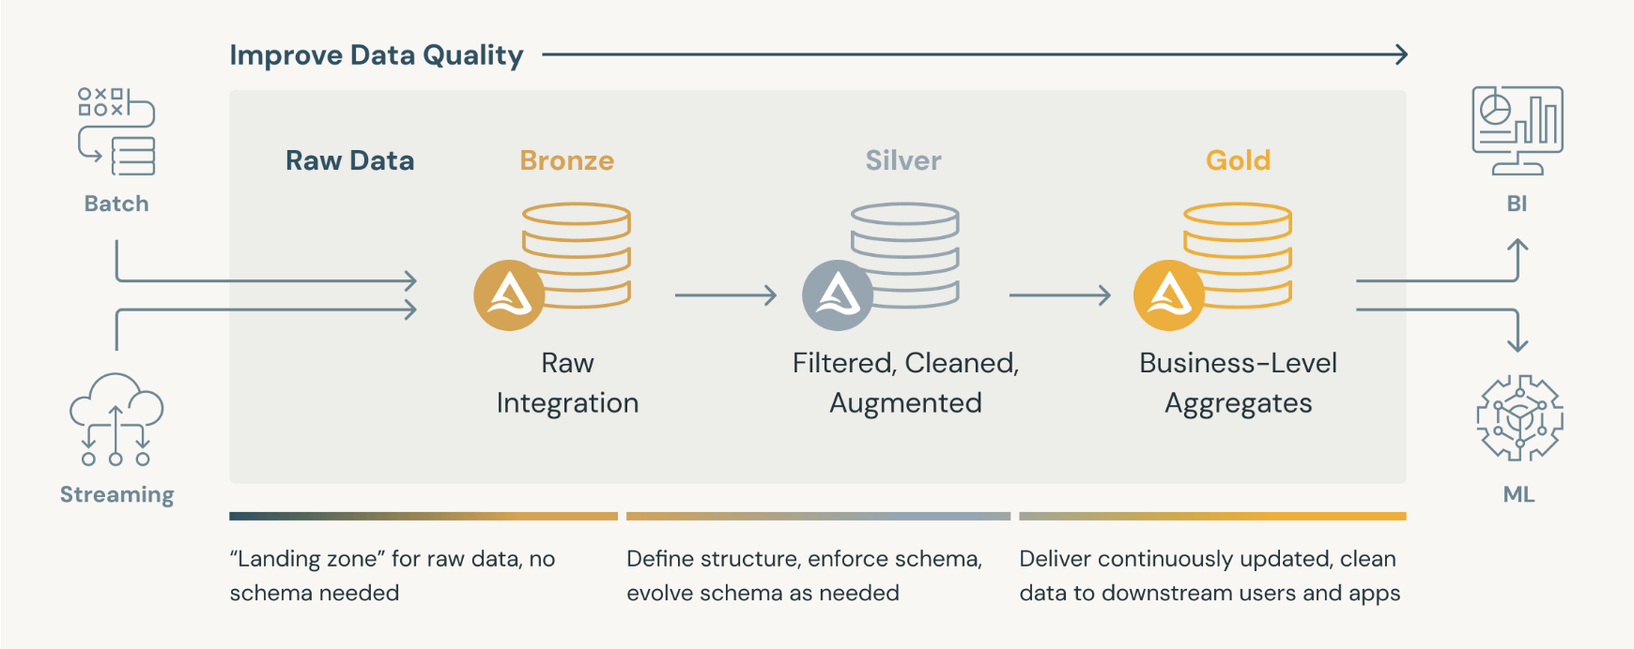
Medallion Architecture

Slide 24
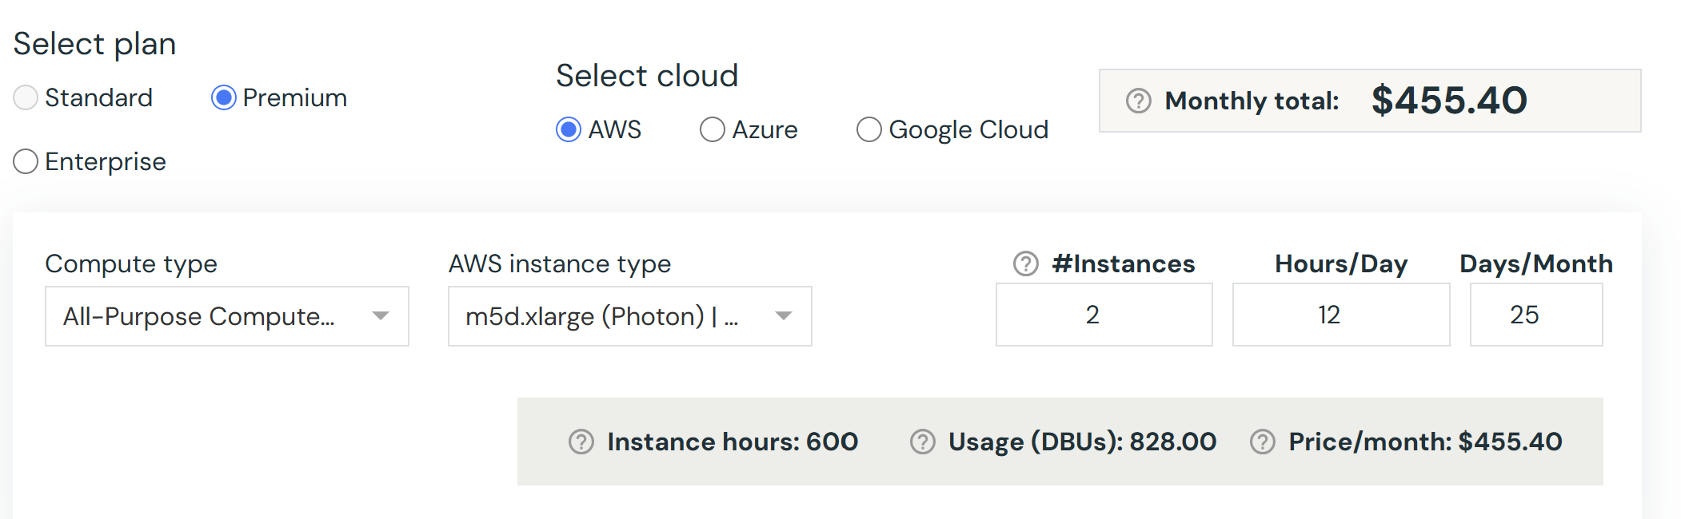
Databrick Pricing
https://www.databricks.com/product/pricing/product-pricing/instance-types

Slide 25
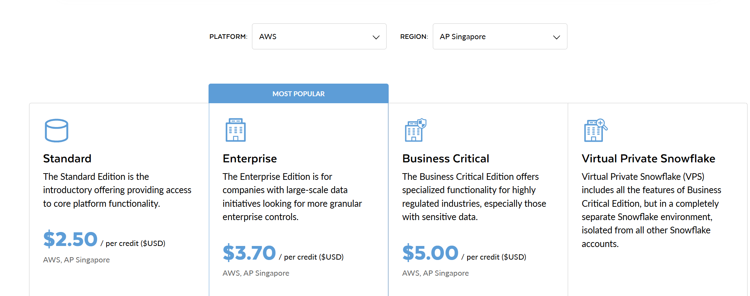
Snowflake Pricing Plan
https://www.snowflake.com/en/pricing-options/

Slide 26
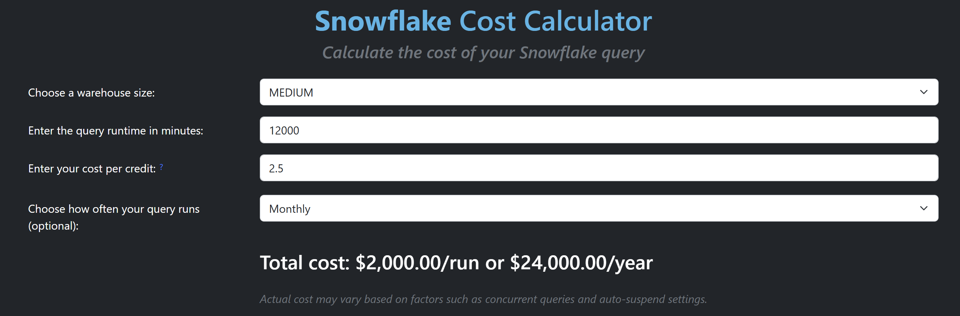
Snowflake Pricing
https://snowflakecostcalculator.com/

Slide 27
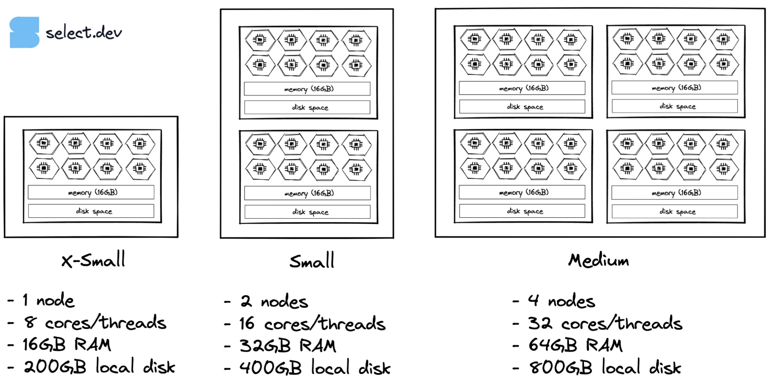
Snowflake Virtual Warehouse Sizing

Slide 28
ETL/ELT/Streaming Tools Pricing
AWS – Singapore Region
Resource | Machine Type | Config | Price/Month (USD) | Purpose
EC2 Machine | t4g.xlarge | 4C, 16G, 100G | 100 | Airflow Server
AWS EMR | C4.4xlarge, 3 Nodes (1 master, 2 data) | 4C, 16G, 100G | 459.9 | Hadoop, Kafka, Spark
AWS EC2 | t4g.xlarge | 4C, 16G, 100G | 100 | Airbyte Server
AWS S3 |  | 1 TB | 25 | Storage
 | Total Price |  | 684.9

Slide 29
Estimated Total Price
Data Warehouse | DW Price/Month | ELT/ETL/Streaming Price/Month | Total Price
Databrick | $455 | $685 | $1140
Snowflake | $2000 | $685 | $2685

Slide 30

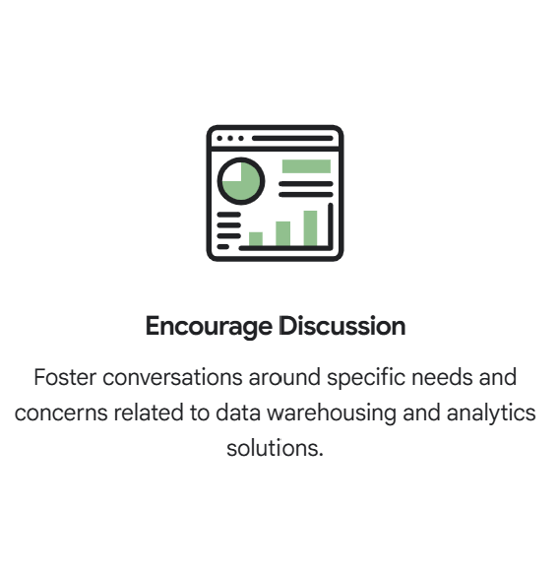
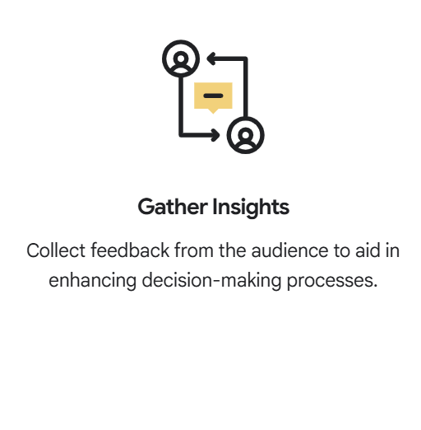
Engage in Questions & Discussion

