Slide 1

European University of Bangladesh Department of Computer science and Engineering Project Report
“Online Tax Management System”
Group Member’s Name ID
Md. Golam Mostafa - 170122072
Md Sirajul Islam - 170122039
Md. Zahangir Hossain - 170122073
Md: Jakir Hosen - 170122038
Md. Usman Goni - 170122060
Supervised by: Shraboni Afroz
Lecturer: Department of CSE,EUB.

Slide 2
European University of Bangladesh Department of Computer science and Engineering
Technologies
HTML
CSS
SQL
PHP
Codeigniter
JavaScript
JQuery
Ajax

Slide 3
European University of Bangladesh Department of Computer science and Engineering Objectives
To create an Online Tax Management System.
To make automatic tax calculation system by using software.
To help the people living in remote areas.
To reduce the time for the Taxpayer to check his tax documents.
To help rural area’s people where tax agency are not available.
To find out the previous tax report in a limited time.
To make annual tax report by individual Taxpayer and easily maintenance. No need any hard copy document.
Skills are no longer required to generate a tax report, anyone can file a tax return.

Slide 4
European University of Bangladesh Department of Computer science and Engineering Tax System
The tax management system is an online web portal that, tax report calculated by yearly and store data in the database for each taxpayer using the TIN number.
After that, tax reports or taxpayer reports searching by the TIN Number. And no need for any hard copy document of the tax report. Just search on by the TIN Number.

Slide 5
European University of Bangladesh Department of Computer science and Engineering Present Problems in Tax
Depend on Agency or Lawyer.
Taxpayer waste time.
Wrong tax possibility.
Tax calculation problem.
Expensive and third party harassment.
Don't find the previous tax history for each taxpayer,
because the tax file is missing.

Slide 6
European University of Bangladesh Department of Computer science and Engineering Our Proposal
EUB Tax System is a Online Tax Reporting System.
We can provided online Tax Report Generate with Store in database.
Our specially provides a new method of the online tax reporting
system for the public that more accuracy and save time for a busy life.
We have many experiences tax and there are more careful
and dedicated.
We provide a good service within limited time.

Slide 7
European University of Bangladesh Department of Computer science and Engineering Features
Anyone can use our services in any where in Bangladesh.
Easy to fill up tax information.
Entry new Taxpayer information (Individual / Company).
View / Update Taxpayer information.
Search Taxpayer by Categories, TIN, National Id and Name.
Submit Tax information step by step (Individual / Company).
View / Update Tax report with Print and PDF generate.
Search Tax by TIN, Invoice and Assessment year.
Entry / Update Head of Tax form.
Time saving and Low Cost.
User friendly UI and Use by (Bangla, English) version.

Slide 8
European University of Bangladesh Department of Computer science and Engineering Limitation
Don’t Integrate online payment method.
Don't mobile-friendly.
Can't use multiple branches.

Slide 9
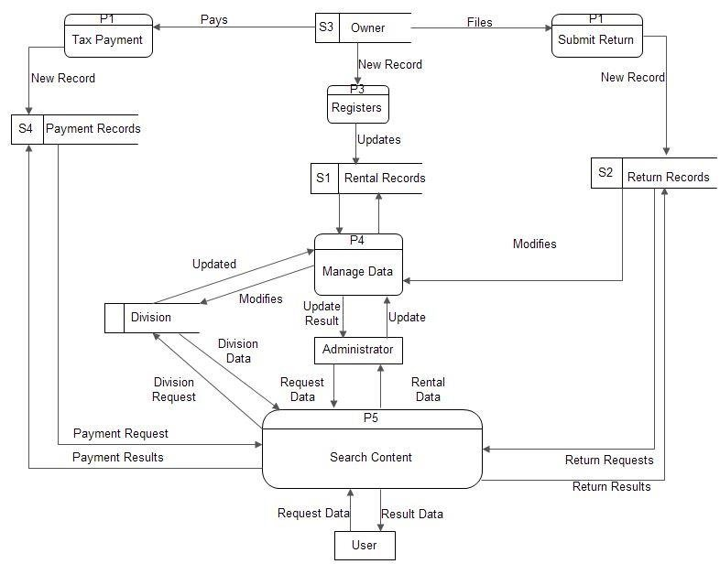
European University of Bangladesh Department of Computer science and Engineering Data-Flow Diagram

Slide 10
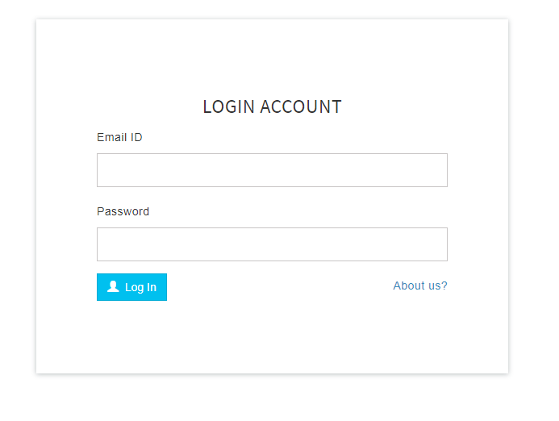
European University of Bangladesh Department of Computer science and Engineering Login Page

Slide 11
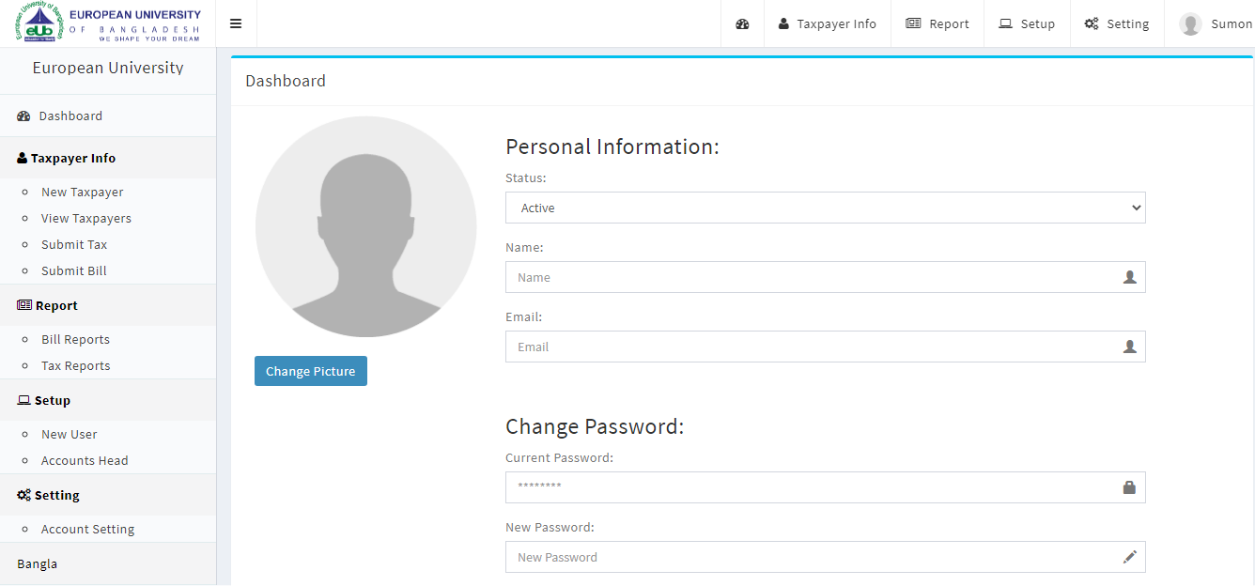
European University of Bangladesh Department of Computer science and Engineering Admin Dashboard

Slide 12
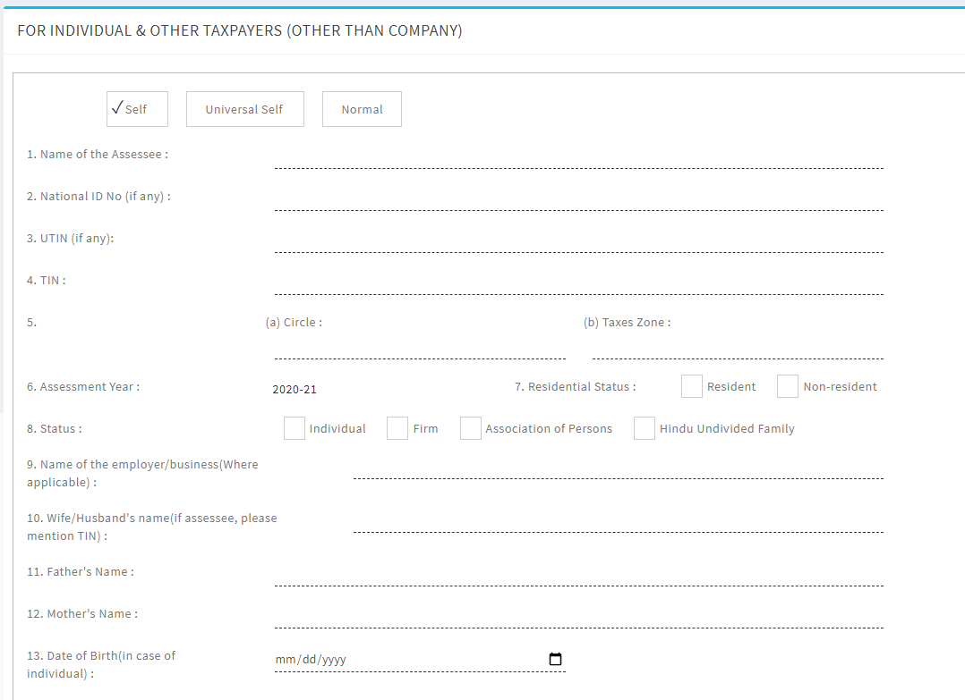
European University of Bangladesh Department of Computer science and Engineering New Taxpayer Entry

Slide 13
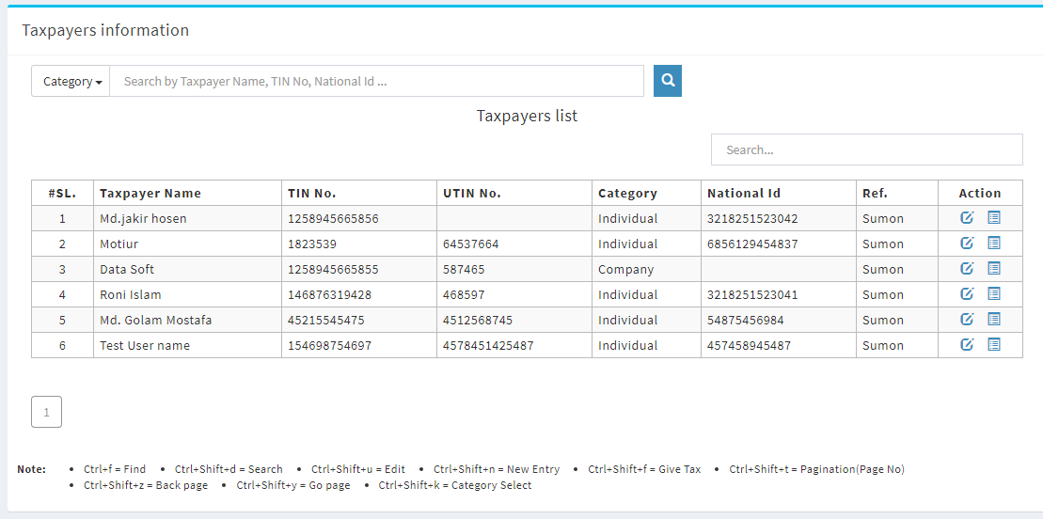
European University of Bangladesh Department of Computer science and Engineering Manage Taxpayer

Slide 14
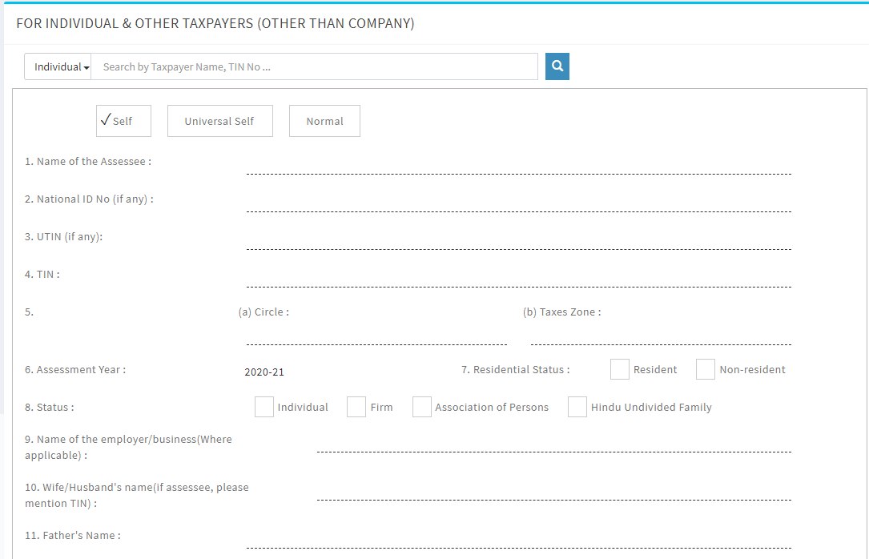
European University of Bangladesh Department of Computer science and Engineering Submit Tax form

Slide 15
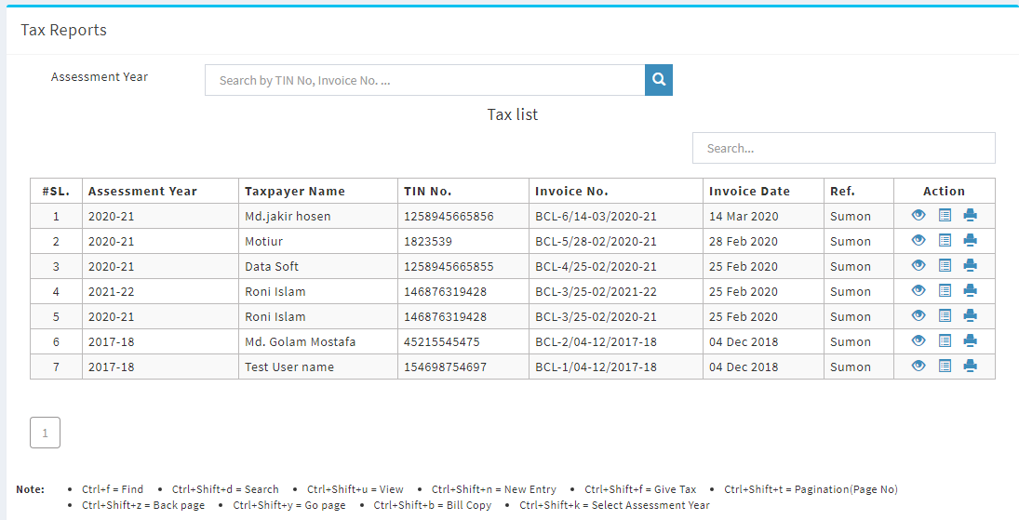
European University of Bangladesh Department of Computer science and Engineering Manage Tax Report

Slide 16
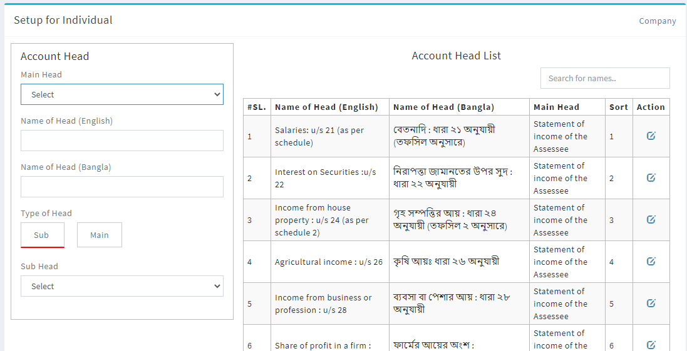
European University of Bangladesh Department of Computer science and Engineering Enrty / Update Head of form

Slide 17
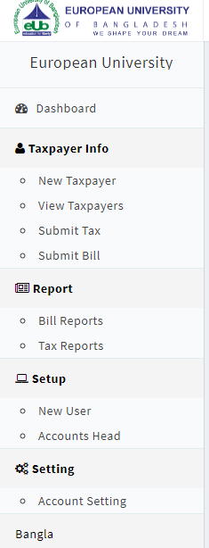
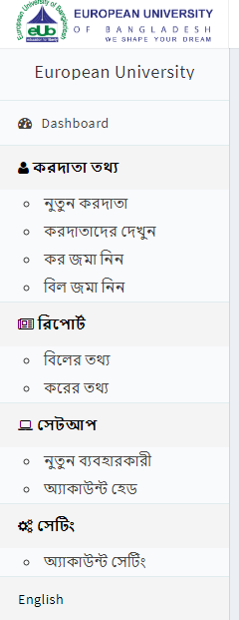
European University of Bangladesh Department of Computer science and Engineering Right Menu – Version (Bangla, English)

Slide 18
European University of Bangladesh Department of Computer science and Engineering Mission & Vision
Our Main Mission and Vision is help to Making Digital Bangladesh.
To help rural area’s people where tax agency are not available.
And for utilize intellectual property more efficiently.
Saving time and Cost.

Slide 19
European University of Bangladesh Department of Computer science and Engineering Terms and Conditions
Reply Time: Reply within 5 minutes.
Service: 24/7 .
Problem Solving: By team viewer , supreme , any desk. (Any time).
Via Payment : Bank.
Price : Price offered on delivery basis in BD taka excluding of all local VAT and TAX.

Slide 20
European University of Bangladesh Department of Computer science and Engineering Conclusion
Today tax is becoming more accurate, improving both in sensitivity and in specificity; creating tax report and has the capacity to provide virtual presentation. measurement, management and prevention.

Slide 21
instead, we must shift our value proposition to more human-oriented attributes and tasks that machines cannot supplant — empathy, communication, relationship building, and sound judgment — to ensure patients receive the best possible care. If we focus our efforts on fostering our best human qualities, then, in the future, the best radiologists will be defined not by their eyes but by their hearts

