Slide 1
Assess the value of data and information to individuals and organizations in relation to real-world business processes.
Data and information are crucial for supporting an organization's business processes and generating value. By utilizing data-driven insights, companies can make informed decisions, improve operational efficiency, and identify new opportunities for growth.

Slide 2
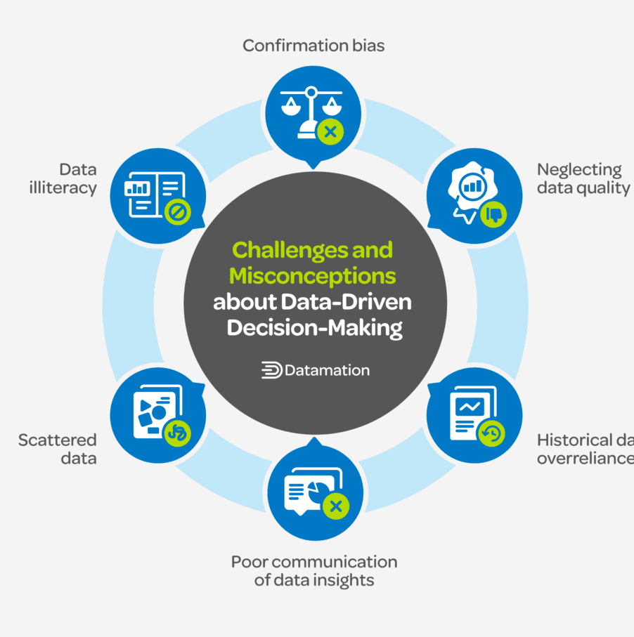
Data-Driven Decision Making
Fact-Based Insights
Informed Objectives
Innovative Solutions
Data analysis offers organizations factual insights that guide strategic and operational decisions, minimizing the need for intuition or guesswork.
By thoroughly analyzing data, businesses can establish clear, measurable goals and objectives that align with their overall strategy and vision.
Utilizing data empowers organizations to identify new opportunities, recognize emerging trends, and develop innovative solutions to complex business challenges.

Slide 3

Improved Efficiency and Productivity
Streamlined Processes
Automated Tasks
Informed Decision-Making
Data and information enable organizations to identify bottlenecks and streamline their operations, resulting in increased productivity and efficiency.
By utilizing data insights, companies can automate repetitive tasks, allowing employees to focus on more strategic work.
Access to accurate and timely data allows organizations to make better-informed decisions, optimize resource allocation, and enhance overall performance.

Slide 4
Enhanced Customer Experience
Personalized Interactions
Streamlined Processes
Proactive Support
Data and information enable organizations to better understand customer preferences, allowing them to tailor their offerings and communications for a more personalized experience.
Insights from data can help organizations optimize their processes, minimize friction, and enhance the overall customer journey.
By analyzing customer data, companies can anticipate needs and offer proactive support, leading to increased customer satisfaction and loyalty.

Slide 5
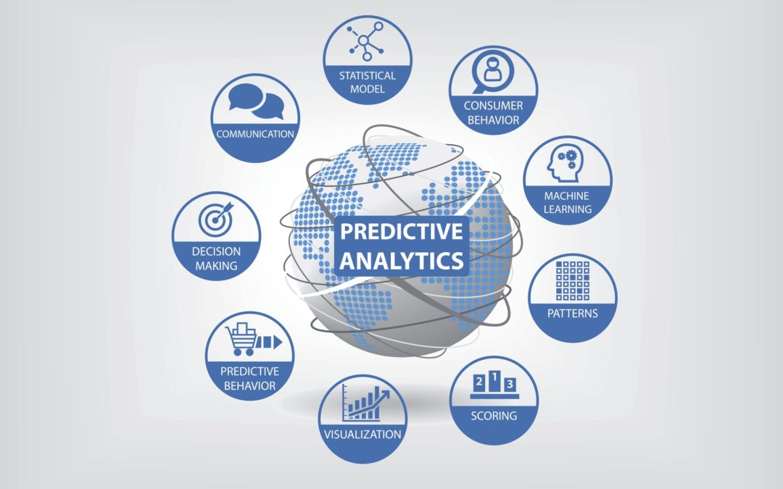
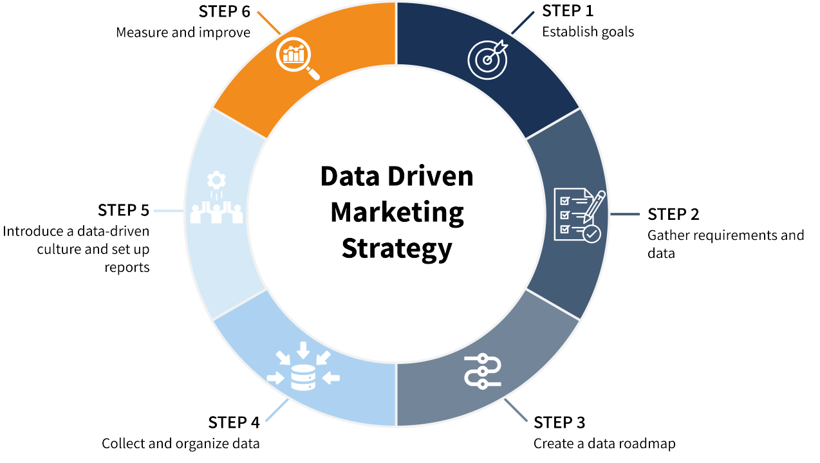

Competitive Advantage
Predictive Capabilities
Data-Driven Strategy
Differentiated Products and Services
Advanced data analytics and predictive modeling enable organizations to foresee market trends and customer behaviors, empowering them to adapt proactively and maintain a competitive edge.
By harnessing data and information, organizations can craft more informed, data-driven strategies to gain a competitive edge in their industry.
Insights gained from data analysis can assist businesses in developing distinctive, differentiated products and services that more effectively align with customer needs and preferences.

Slide 6
Innovation and New Product Development
Informed Decisions
Driving Growth
Data-driven analysis furnishes the insights necessary to make informed decisions regarding product features, pricing, and go-to-market strategies. By leveraging data, businesses can lower risk and enhance the likelihood of new product success through evidence-based strategies and targeted optimizations. This approach not only improves efficiency but also fosters innovation and responsiveness to market dynamics.
Leveraging data and information, organizations can identify emerging market trends and unmet customer needs. This insight fuels the development of innovative products and services that drive business growth. By analyzing data, businesses can proactively adapt to changing market conditions and customer preferences, ensuring they stay ahead of competitors. This strategic use of data not only enhances customer satisfaction but also strengthens brand loyalty, ultimately leading to sustainable business expansion and profitability.

Slide 7
Risk Management and Compliance
Security and Resiliency
Proactive Risk Identification
Regulatory Adherence
Implement strong cybersecurity measures and contingency plans to safeguard critical data and systems against potential threats.
Continuously monitor and analyze data to detect emerging risks, enabling the organization to take proactive measures.
Ensure that all business operations adhere to applicable industry regulations and standards to mitigate costly penalties and legal complications.

Slide 8
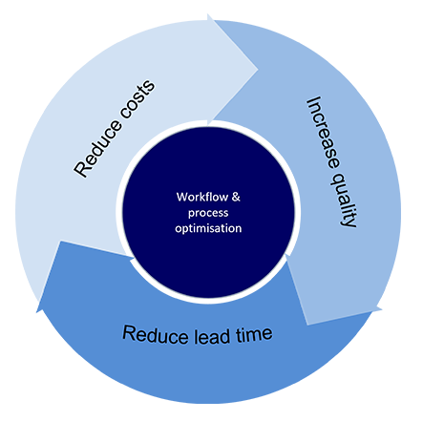
Process Optimization and Automation
Streamlined Processes
Continuous Improvement
Intelligent Automation
Through data analysis, organizations can pinpoint inefficiencies and bottlenecks in their business processes, facilitating streamlined operations and enhanced productivity.
Continuous data analysis and process monitoring enable organizations to consistently optimize their business processes, ensuring they maintain agility and responsiveness to evolving market conditions.
Automating repetitive, high-volume tasks through intelligent technologies such as AI and machine learning can greatly enhance process efficiency, minimize errors, and liberate employees to concentrate on more strategic endeavors.

Slide 9
Data-Driven Insights for Business Strategy
Competitive Intelligence
Predict and Respond to Change
Identify Growth Opportunities
Optimize Resource Allocation
Data-driven insights empower organizations to analyze market trends, competitor activities, and customer preferences. This intelligence supports strategic decision-making and helps organizations maintain a competitive edge.
Analyzing data patterns and trends enables organizations to anticipate market shifts, economic conditions, and changes in customer behavior, allowing them to adapt their strategies accordingly.
By closely analyzing data, organizations can identify unmet customer needs, discover emerging market segments, and develop new products or services to capitalize on these opportunities.
Data-driven insights help organizations make more informed decisions about resource allocation, whether in marketing, product development, or operational improvements.

Slide 10
The Value of Data and Information in Business Processes
Data and information are crucial assets that enable organizations to make informed decisions, optimize operations, and drive sustainable growth. By harnessing the power of data, businesses can gain a competitive edge, enhance customer experiences, and unlock new opportunities for innovation.

Slide 11
Data Generation
Organizations generate vast amounts of data through their daily operations and business activities. This data fuels essential business processes and decision-making.

Slide 12
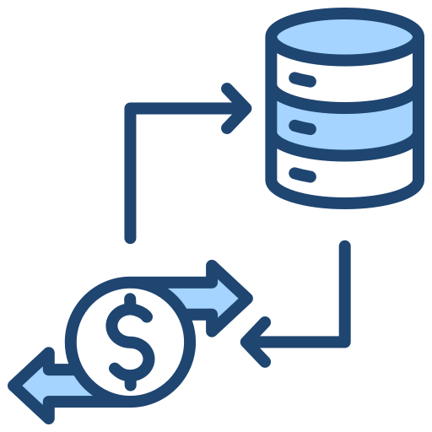
Transactional Data
Financial Transactions
Purchase History
Businesses also generate a vast amount of financial transaction data, including invoices, payments, deposits, and transfers. This data is crucial for accounting, budgeting, and financial reporting purposes.
Organizations generate detailed records of all customer purchases, including items bought, quantities, prices, and payment methods. This transactional data offers insights into customer buying behavior and trends.

Slide 13
Operational Data
Process Data
Reporting
Optimization
Operational data is generated through the daily activities and processes within an organization, including manufacturing, logistics, and inventory management.
Operational data is essential for generating detailed performance reports and making data-driven decisions within an organization.
Analyzing this data can reveal inefficiencies, optimize workflows, and enhance overall business operations and productivity.

Slide 14
Social Media Data
Real-time Insights
User-generated Content
Unstructured Data
Constantly generated social media data enables businesses to monitor trends, respond to customer needs, and make timely, data-driven decisions.
Customers generate a significant portion of the data on social media, providing direct insights into their thoughts, opinions, and experiences with a brand or product.
Social media platforms generate large volumes of unstructured data, comprising posts, comments, shares, and interactions. This data offers valuable insights into customer sentiment, preferences, and behaviors.

Slide 15



Customer Interaction Data
Online Reviews and Ratings
Customer Service Interactions
Customer Feedback Surveys
Analyzing customer reviews on websites and social media platforms aids businesses in identifying trends, addressing concerns, and improving their products or services.
Regular customer surveys offer valuable insights into satisfaction levels, product usage, and areas for improvement, guiding business decisions.
Organizations gather data from customer calls, emails, and chat sessions to grasp pain points, preferences, and enhance the overall customer experience.

Slide 16
Sensor Data
Widespread Deployment
Real-time Monitoring
Diverse Applications
Sensors are everywhere in our digital world, integrated into devices, infrastructure, and the environment, constantly collecting data about the physical world.
Sensor data offers real-time insights, allowing organizations to monitor and promptly respond to changes in their operations or customer experiences.
Sensor data can be utilized across various business applications, including supply chain optimization, predictive maintenance, and personalized marketing strategies.

Slide 17
Data Manipulation Tools
Organizations use a variety of tools to extract, transform, and refine data to derive meaningful business insights.

Slide 18
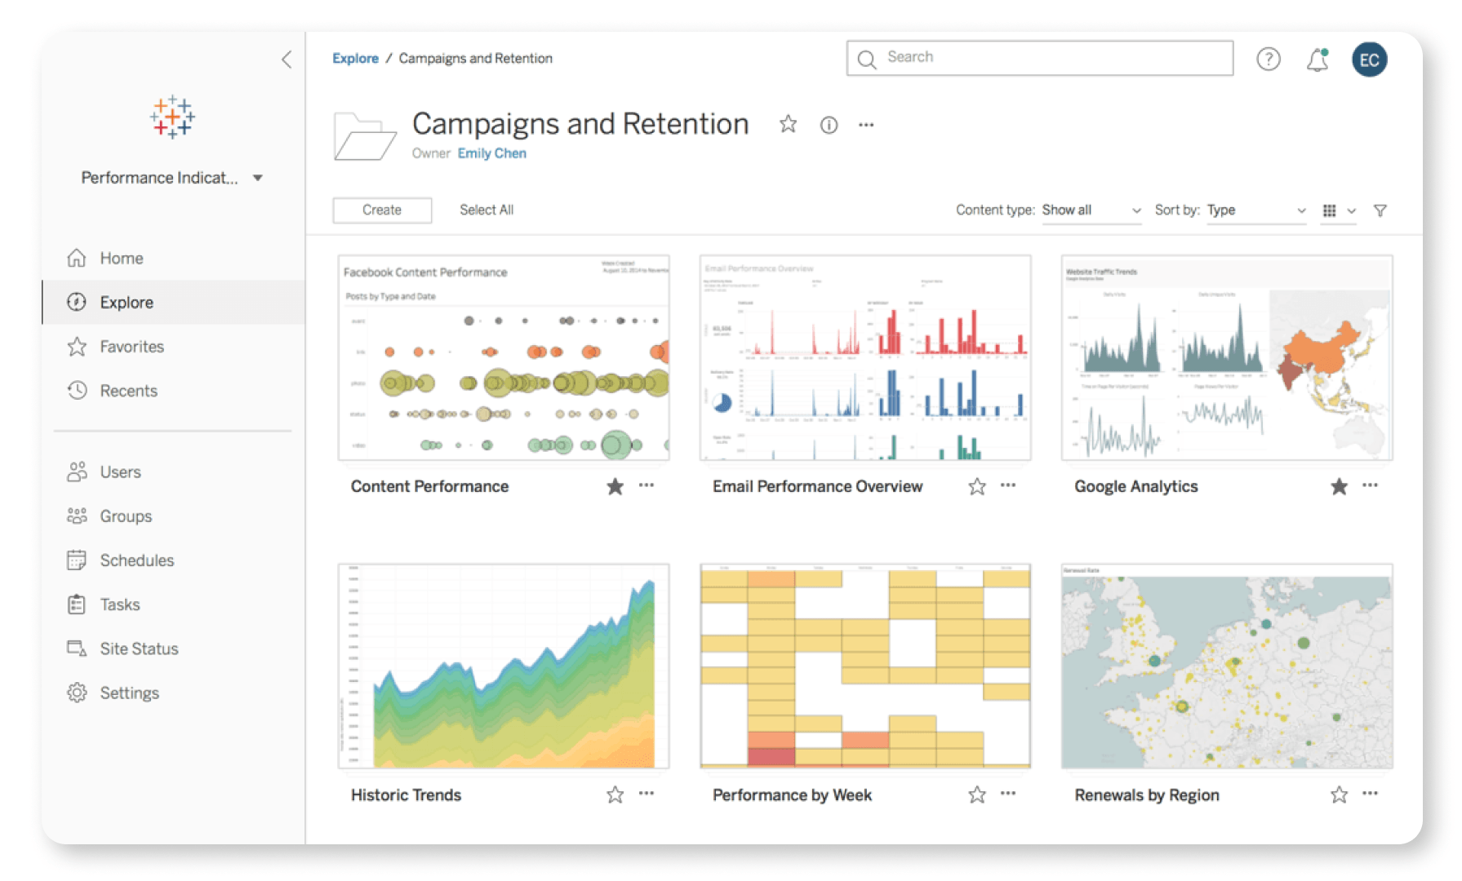
Tableau
Intuitive Visualization
Powerful Analytics
Collaborative Platform
Tableau provides an easy-to-use drag-and-drop interface for crafting impactful data visualizations and dashboards, requiring minimal coding expertise.
Tableau empowers users with advanced analytical capabilities to swiftly uncover insights and make data-driven decisions.
Tableau's sharing and collaboration features facilitate teamwork, enabling teams to share insights and create a significant impact throughout the organization.

Slide 19
datapine
Collaborative Analytics
All-in-One Functionality
Flexible Data Management
datapine enables smooth team collaboration by enabling users to share insights, create interactive dashboards, and collectively make data-driven decisions.
datapine is an intuitive, comprehensive business intelligence platform that integrates data visualization, reporting, and analytics into a unified, user-friendly solution.
datapine empowers users with its user-friendly interface and robust data management capabilities to effortlessly connect, transform, and analyze data from various sources.

Slide 20
Power BI
Seamless Connectivity
Comprehensive Dashboard
AI-Powered Insights
Collaborative Features
Power BI seamlessly integrates with a diverse array of data sources, such as Excel, SQL databases, and cloud-based services, facilitating effortless connection and analysis of data across the organization.
Power BI provides a robust dashboard that consolidates data from multiple sources into a single, interactive display, enabling users to visualize and analyze their business data effortlessly.
Power BI harnesses artificial intelligence to reveal hidden insights and trends, enabling users to make informed, data-driven decisions more effectively.
Power BI facilitates team collaboration by enabling users to share dashboards, reports, and insights with colleagues, enhancing decision-making capabilities.

Slide 21
Zoho Analytics
Robust Reporting
Seamless Integration
Easy Dashboards
Zoho Analytics provides advanced reporting capabilities, allowing you to create detailed, insightful reports that offer a comprehensive understanding of your business performance.
The tool seamlessly connects to diverse data sources, enabling you to integrate all your business data into a centralized platform for comprehensive analysis.
Zoho Analytics offers an intuitive interface for swiftly creating and customizing interactive dashboards, making it easy to visualize data clearly and accessibly.

Slide 22
SAS Viya
Advanced Analytics
Automated Visualization
SAS Viya is a robust analytics platform that provides extensive advanced analytical capabilities, such as machine learning, artificial intelligence, and predictive modeling.
SAS Viya offers automated data visualization tools that simplify complex data into clear charts and graphs, enabling users to swiftly identify trends and insights.

Slide 23
Power BI Project: Data Table and Value Analysis

Slide 24
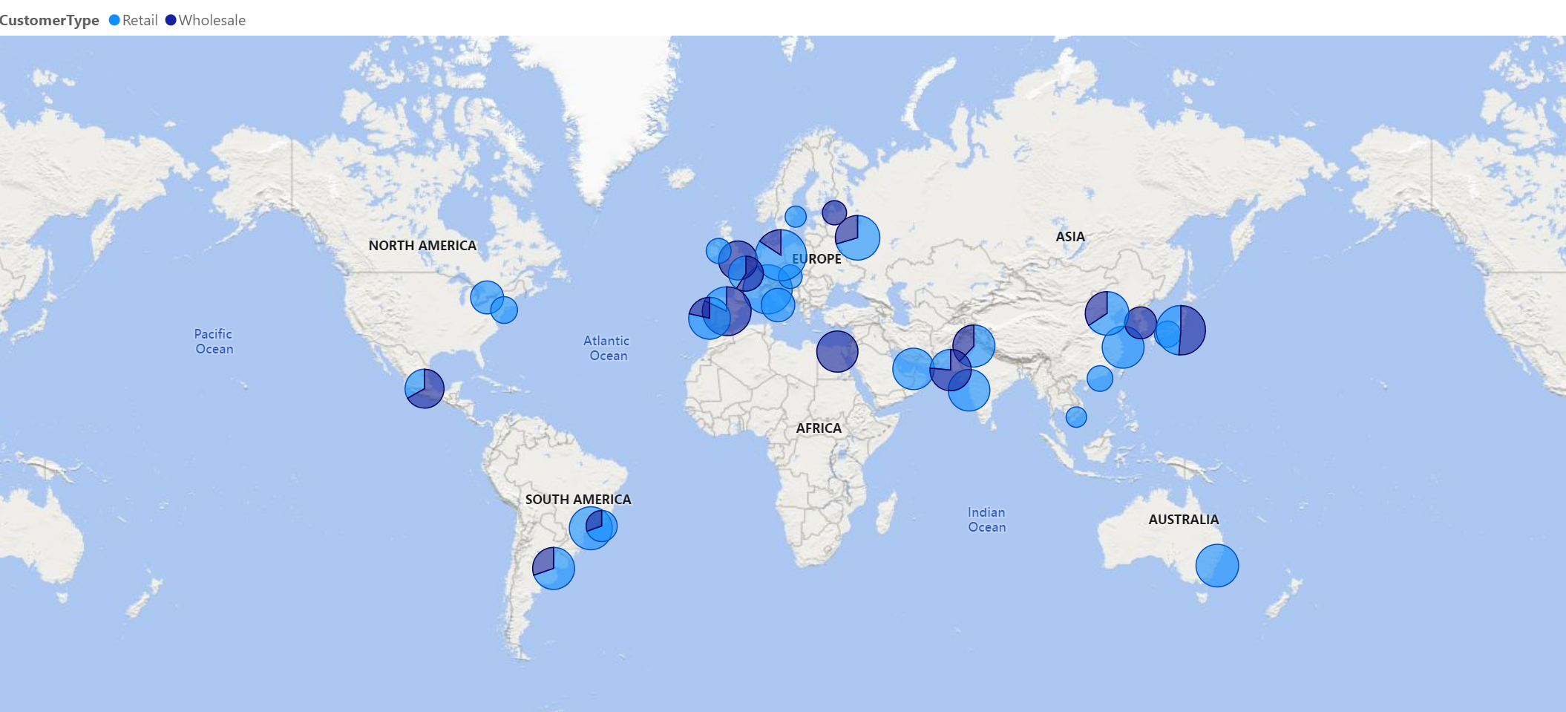
International Sales
On the map, all sales activities are displayed by country, with average sales distinguished by the size of the circles. These color variations allow viewers to easily differentiate between retail and wholesale sales.
Insights: This map enables the organization to identify potential markets with high sales potential. Additionally, it highlights regions where sales efforts may need to be increased.

Slide 25
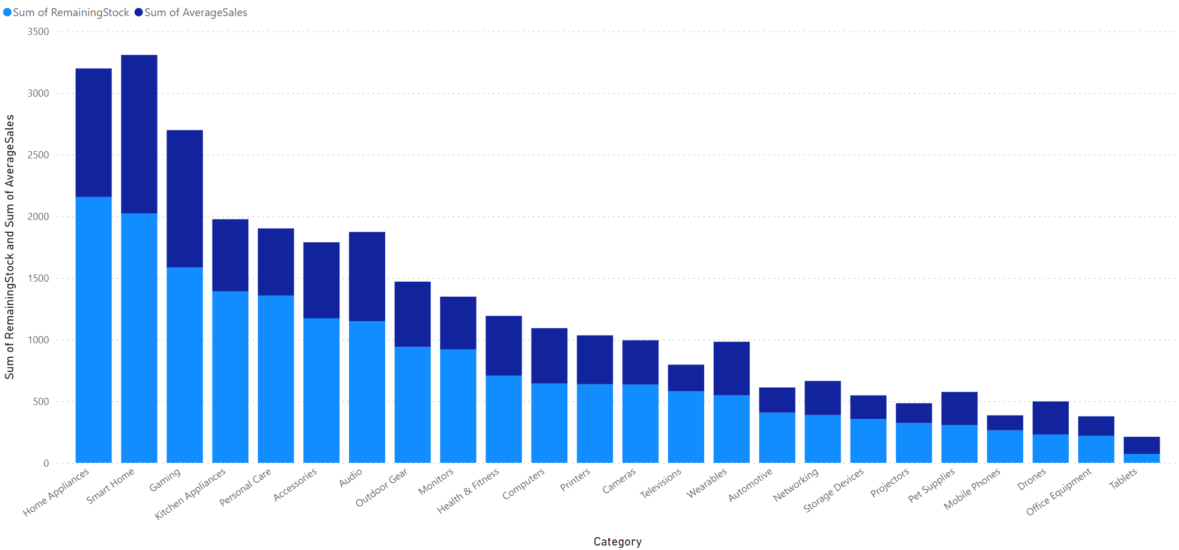
Average sales and stock chart
Column chart: The column bar chart shows the amount of products of each category sold and how many unsold products of each category are in stock.
Insight: This chart allows for the determination of the catagories that yield most of the sales, hence, the appropriate way to mix and market the products.

Slide 26
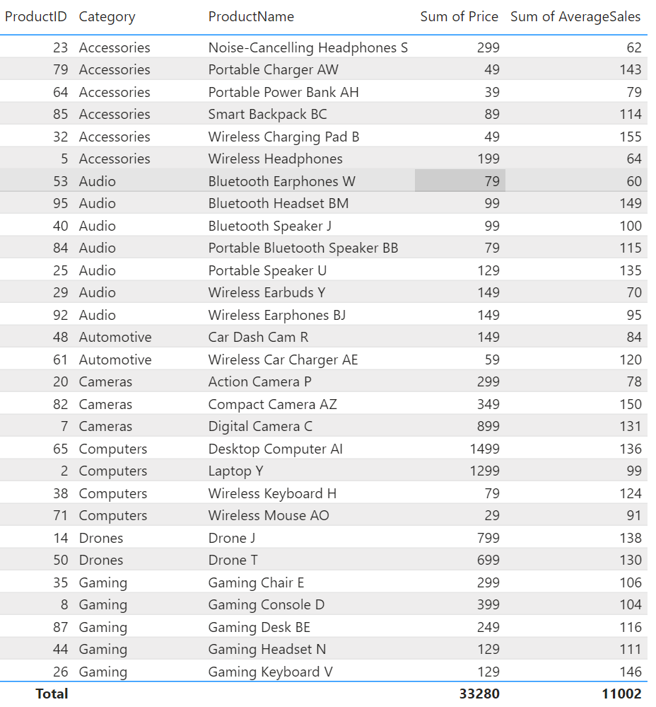
Product Data Sheet
This table offers comprehensive details on the sales performance of each product, including the product name, first sale date, total sales volume, and overall revenue.
Businesses can use this information to:
Identify "hot" products: Determine best-selling products to inform strategic focus.
Evaluate revenue: Assess the profitability of each product to guide development decisions.
Manage inventory: Prevent product shortages or surpluses through informed inventory management.

Slide 27
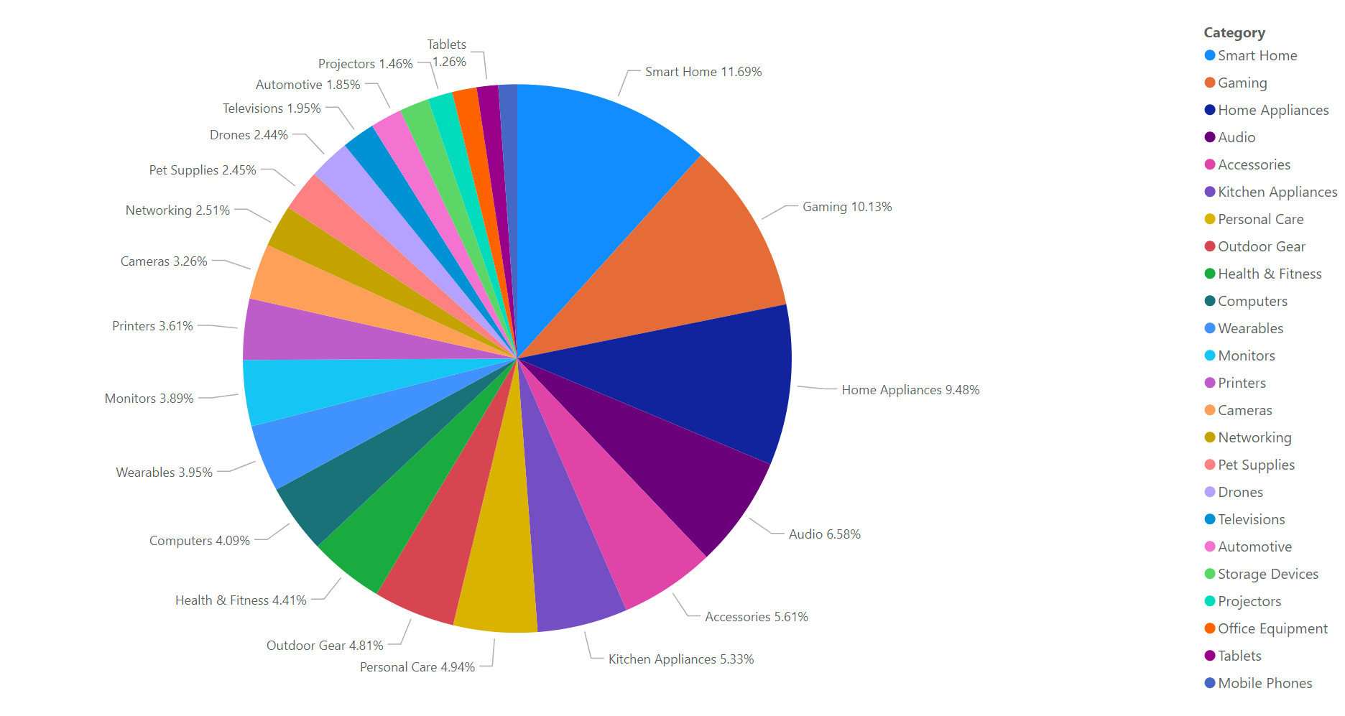
Sales and Category Products
Pie Chart: The pie chart breaks down annual product sales by categories such as Gaming, Automotives, Home Appliances, and Personal Care. Each segment highlights the percentage of the sales.
Insights: This chart helps identify the products that generate the most sales, allowing for more informed decisions on product mix and marketing strategies.

Slide 28
Data information is the key to business success
In addition to the examples illustrated using Power BI above, here are other valuable analyses that can aid businesses in making informed decisions: Organizations can leverage the robust analytics and visualization tools integrated into the software solution to uncover critical trends, enabling strategic growth and helping them outpace the competition.

Slide 29
Delivering insights based on Power BI data
Informed Insights: Power BI provides detailed reports on business performance, enabling businesses to truly understand the market, customers, and competitors.
Customer Analytics: Power BI assists companies in making decisions crucial for attracting and satisfying customers by analyzing detailed customer data.
Competitive Advantage: Power BI helps uncover competitors and develop strategies to counteract them effectively.
Real-Time Reporting: With its capability to build real-time reports and charts, Power BI ensures businesses can stay on top of current activities and respond promptly to changes.
Data Integration: Power BI excels at gathering data from multiple sources, offering a comprehensive view of business activities to support informed decision-making.

Slide 30
Effectiveness
Process Optimization: Sales tracking enhances strategy development and ensures timely product delivery.
Resource Allocation: Enterprise data helps concentrate scarce resources where they will yield the highest returns, focusing on high-margin products and regions.
Risk Mitigation: Business monitoring and digital platform targeting allow for pinpointing and preventing risks.
Performance Benchmarking: Benchmarking contributes significantly to business performance by comparing product and regional results.
Customer Segmentation: Segmenting customers allows for a better understanding and the creation of targeted advertising strategies.
Trend Analysis: Forecasting demand provides foresight, enabling appropriate production and marketing of products.
Financial Planning: Budgeting involves processing enterprise data to allocate financial resources effectively.

Slide 31
Customer Experience
Customer Satisfaction: Data analysis enhances service and product quality, ensuring customer expectations are met or exceeded, thus increasing satisfaction.
Targeted Marketing: Utilizing customer data enables more focused marketing campaigns, creating promotions that resonate with specific audiences.
Operational Efficiency: Data analysis improves operational efficiency by identifying areas for improvement in supply chain and inventory management, leading to a better overall customer experience.

Slide 32
Thank you
Analytics is becoming a popular tool for making business decisions because it provides valuable insights, enhances efficiency, and improves customer satisfaction. This crucial strategy helps businesses operate effectively in volatile environments by managing challenges and opportunities in pursuit of their objectives.

