Slide 1
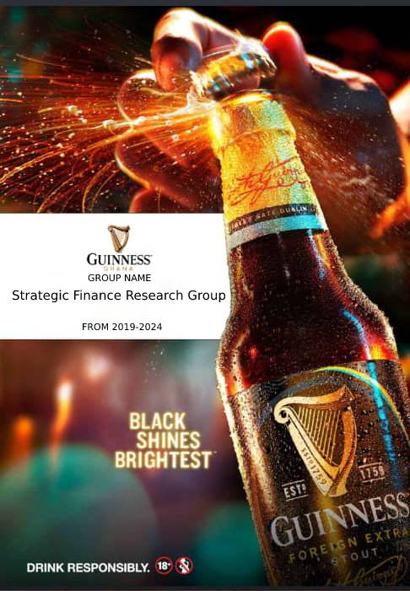

Slide 2

Overview
Founded: 1960 , Headquarters: Kumasi, Ghana
Industry: Beverage Manufacturing
Stock Listing: Ghana Stock Exchange (GSE)
History
Established to promote Guinness Foreign Extra Stout in Ghana.
Merged with Ghana Breweries Limited in 2004, expanding its product portfolio. Listed on the GSE in 1991
Product and Services
Operations, Distributions ,Workforce
Sustainability and Community Engagement :Local sourcing,Environmental initiative Community programs

Slide 3

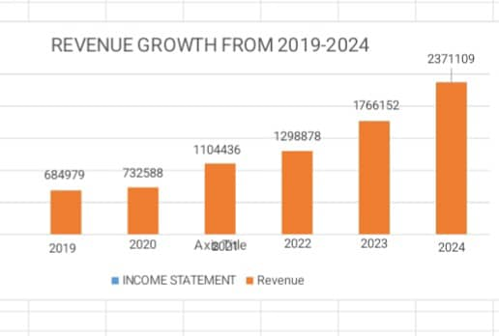
CORE OPERATION
MANUFACTURING
DISTRIBUTION
INNOVATION
MARKETLEADERSHIP
Recent Developments
OWNERSHIP
SUSTAINABILITY
EFFICIENCY
INTEGRATION LOCAL

Slide 4

EVARONMENTA
Renewable energy, water management, plastic waste reduction,
SOCIAL
Community Engagement, Health and Safety, Education
GOVERNMENT
Ethical Standards, Sustainability Goals, Recognition

Slide 5

Market Overview
Market Size and Growth
Key Competitors
Ghana Stock Exchange
Highlights
Stock Performance

Slide 6

MACROECONOMIC ANALYSIS
IMPLICATIONS

