Slide 1

NATURAL LANGUAGE PROCESSING /Spam Detector
Gizem BULUT – 19COMP1036
Obada KALO – 19SOFT1065

Slide 2

What is spam detector ?
A spam detector, also known as a spam filter or anti-spam software, is a program or system designed to identify and filter out unwanted electronic messages, such as email spam or social media spam. Spam detectors work by analyzing the content, sender, and other characteristics of incoming messages and comparing them to a set of rules or criteria that identify spam.
1/3

Slide 3
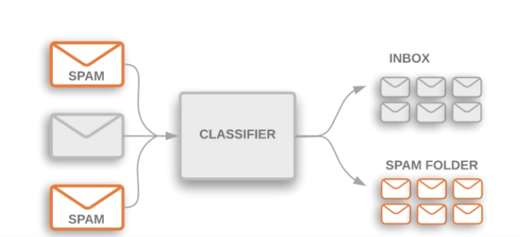
How The Spam Detector Work?
Spam detector works by analyzing incoming messages and identifying those that are likely to be spam , and comparing the characteristics of the message to a set of rules or criteria that are known to be associated with spam.
There are a lot of techniques that we can use for spam detector but the one we used is machine learning : By analyzing the features of known spam and ham messages, the algorithm can identify patterns and classify new messages as spam or ham.
2/3

Slide 4
What about the accuracy of spam detectors?
It's worth mentioning that Spam detector are not 100% accurate, and sometimes they may mistakenly categorize legitimate messages as spam, this is called false positive. So, most of the spam filters include a mechanism called false positive feedback, which allows the user to report a message as not spam, this way the filter can learn from it to improve its accuracy.
4/3

Slide 5
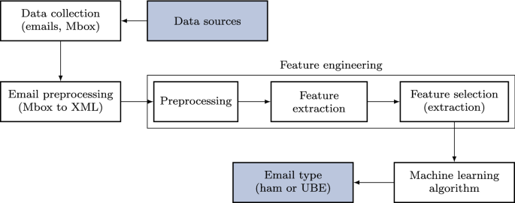
What We Need To Implement Spam Detector?
A dataset of known spam and non-spam messages
A machine learning algorithm
Feature extraction and selection
Training and validation
Evaluation and testing
4/4

