Slide 1
Leveraging Foursquare API and Hamilton Neighborhood Dataset for Auto-workshop location
IBM Data Science Capstone
By
Abiola Obembe

Slide 2
OUTLINE
Introduction
Problem Statement
Methodology
Results Discussion
Conclusion
Recommendation

Slide 3
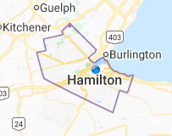
Introduction
Hamilton is a port city in the Canadian province of Ontario.
Hamilton has a population of 536,917, and its census metropolitan area, which includes Burlington and Grimsby, has a population of 747,545.
Residents of the city are known as Hamiltonians.
Since 1981, the metropolitan area has been listed as the ninth largest in Canada and the third largest in Ontario

Slide 4

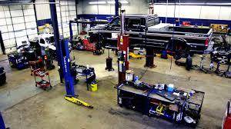
Problem Statement
A wealthy contractor has decided to establish an auto workshop industry in Hamilton; however, he is unsure of the best location for his workshop.
The aim of this project is to utilize available data from the city of Hamilton and Foursquare API to guide the contractor on choice location(s) to setup his workshop.

Slide 5
METHODOLOGY
Data Source
Data from city of Hamilton
Data Preparation
Data cleaning
Modeling
Four Square
K-Means Clustering
Exploratory analysis

