Slide 1
Trackener
Identifying horse movements with an accelerometer and a gyro meter,
with examples from 3 components geophone data from seismic arrivals

Slide 2
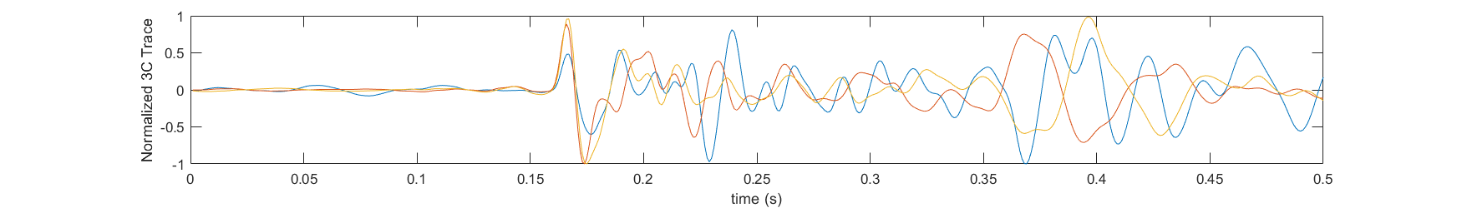
The seismic wave example
First seismic wave
Could be compared to the first horse movement to stand up
3C means Z,X & Y
Quiet, random noise
Could be compared to the horse is stationary
Rest of the seismic wave (converted waves, reflected waves…)
Could be compared to the rest of the horse movement to stand up or the horse is moving

Slide 3
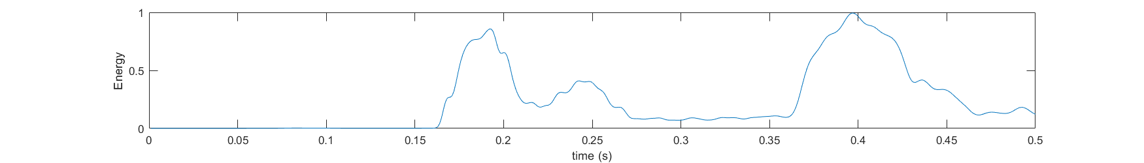
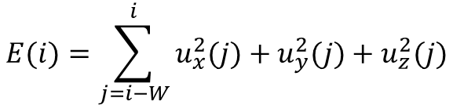
Feature #1: Energy
$$E(i)=\sum_{j=i−W}^{i}{u_{x}^{2}(j)+u_{y}^{2}(j)+u_{z}^{2}(j)}$$
W is the window size in samples

Slide 4
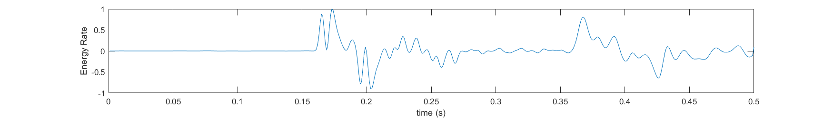
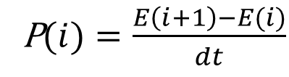
Feature #2: Energy Rate
P$(i)=\frac{E\left(i+1\right)−E(i)}{dt}$
dt = 1ms is the sampling rate

Slide 5
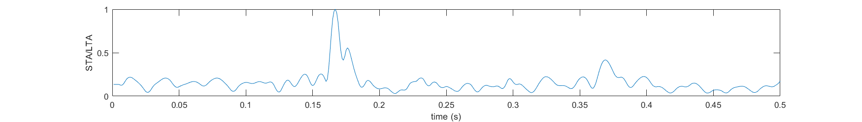

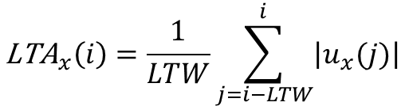
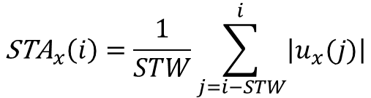
Feature #3: Short Term Average / Long Term Average: STA/LTA
$${\text{STA}}_{x}\left(i\right)=\frac{1}{STW}\sum_{j=i−STW}^{i}{\left|u_{x}(j)\right|}$$
$${\text{L}\text{TA}}_{x}\left(i\right)=\frac{1}{LTW}\sum_{j=i−LTW}^{i}{\left|u_{x}(j)\right|}$$
$${SLR}_{x}=\frac{{\text{STA}}_{x}}{{\text{L}\text{TA}}_{x}}$$
STW = 5 Short Term Window in sample
LTW = 50 Long Term Window in sample

Slide 6
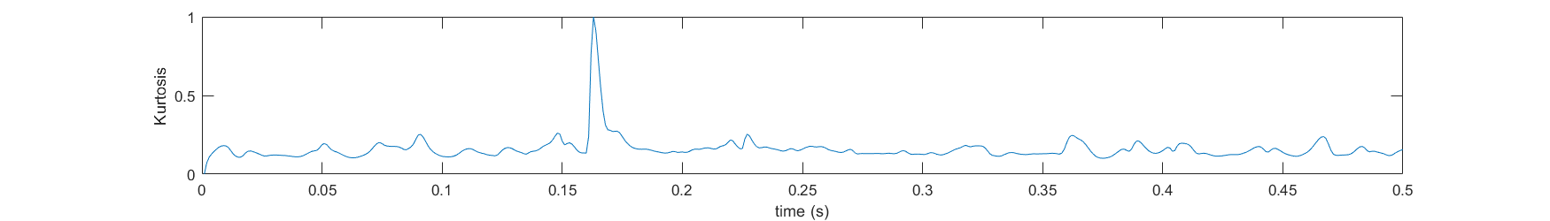
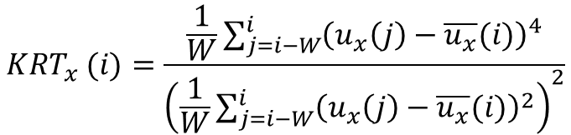
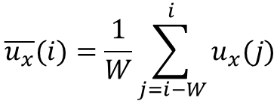
Feature #4: Kurtosis
$$\overline{u_{x}}(i)=\frac{1}{W}\sum_{j=i−W}^{i}{u_{x}(j)}$$
$${KRT}_{x} (i)=\frac{\frac{1}{W}\sum_{j=i−W}^{i}{{\left(u_{x}\left(j\right)−\overline{u_{x}}(i)\right)}^{4}}}{{\left(\frac{1}{W}\sum_{j=i−W}^{i}{{\left(u_{x}\left(j\right)−\overline{u_{x}}(i)\right)}^{2}}\right)}^{2}}$$
This equation can look scary but a lot of statistical library can calculate kurtosis and/or skewness for you.

Slide 7
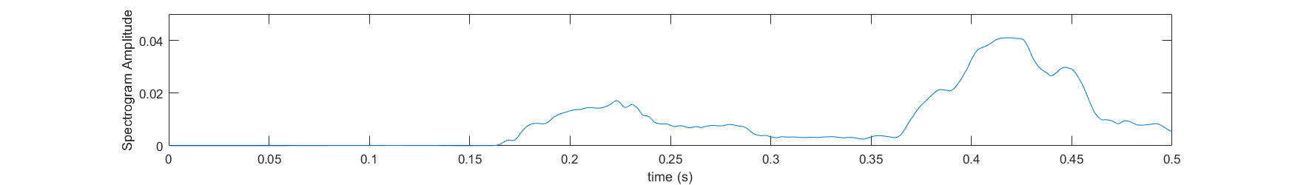


Feature #5: Spectrogram Amplitude
$${\text{FA}}_{x}\left(i\right)=max⁡(FFT\left(u_{x}\left(i−W:i\right)\right))$$
$FFT:$Fast Fourrier Transform

Slide 8
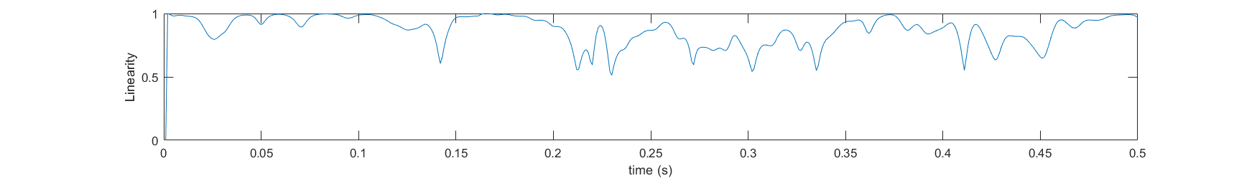




Feature #6: Linearity
$$λ=eig\left(u\left(i−W:i\right)\right)$$
$$λ\left(1\right)≥λ\left(2\right)≥λ\left(3\right)$$
$$L \left(i\right)=1−\frac{λ\left(3\right)+λ(2)}{2λ(1)}$$
$$u\left(i\right)=\left[u_{x}\left(i\right),u_{y}\left(i\right),u_{z}\left(i\right) \right]$$
Linearity and Planarity study the “shape” in 3D of the seismic wave on the 3C data.
ie: is the arrival more long and thin or more round like a sphere
I’m not entirely sure what it would bring to your classification, but I would definitely calculate the eigenvalues (lambda). These can be quite useful.

Slide 9
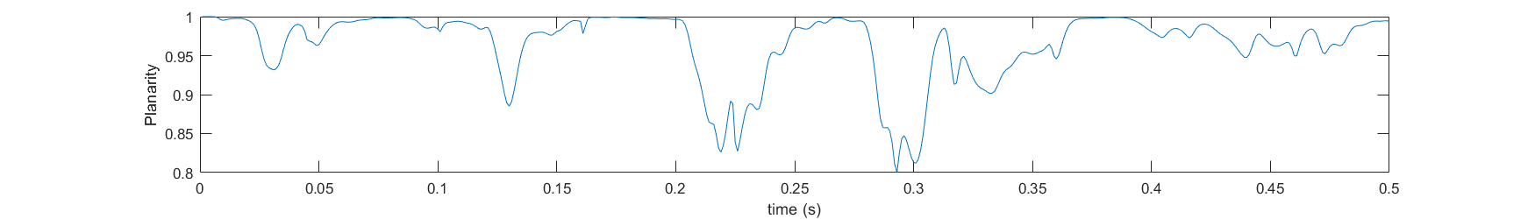

Feature #7: Planarity
$$λ=eig\left(u\left(i−W:i\right)\right)$$
$$λ\left(1\right)≥λ\left(2\right)≥λ\left(3\right)$$
$$P \left(i\right)=1−\frac{2λ\left(3\right)}{λ(1)+λ(2)}$$
$$u\left(i\right)=\left[u_{x}\left(i\right),u_{y}\left(i\right),u_{z}\left(i\right) \right]$$

