Slide 1



Vagrant: The A fast way for building Development Environments
Obed N Munoz Reynoso
@obednmr
http://obedmr.com

Slide 2


Slide 3

Before we start … the most important

Slide 4
Agenda
Developer’s Nightmares
Y ahora, quien podrá ayudarme?
What’s Vagrant?
Thinking about DevOps
Vagrant Concepts
Why should I use it?
Why not use it?
DEMO
Want more …
Q & A
Feel free to interrupt
If have questions ☺

Slide 5
Developers Nightmares
- Why should I wait the IT provisioning Service?
- I'm working in a mess
- Making Life easier with Automation?
“It was working on my machine”

Slide 6

Y ahora, quién podrá ayudarme?
Tech | Speed
Manual Install/Setup | Slow
Automation Scripts in VMs | Medium
Automation Scripts in Servers | Medium
Vagrant | ?
Docker | Medium

Slide 7

What’s Vagrant?

Slide 8
Vagrant will change the way you...
Set up
Configure
Work

Slide 9
Thinking about DevOps
Developers get more involved in Ops
Vagrant gives a sandbox to learn
Using Vagrant for Testing/Development
Closing the gap between Development and Ops

Slide 10
Vagrant Concepts
VagrantFile
Boxes
Vagrant cli
Providers
Provisioning (Shell, Chef, Puppet)
Plugins

Slide 11
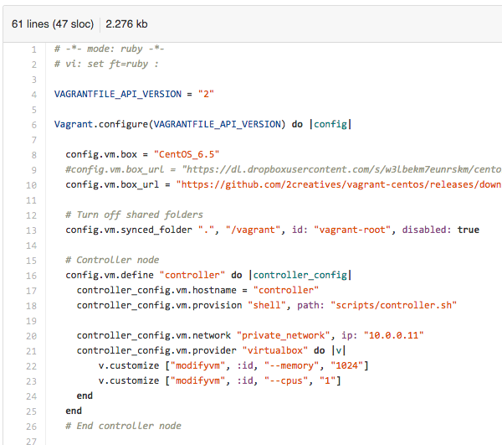
Vagrantfile

Slide 12
Vagrant Boxes
Vagrant Official Boxes
http://www.vagrantbox.es/
Vagrant Cloud
https://vagrantcloud.com/
Create your own Box (DEMO)

Slide 13
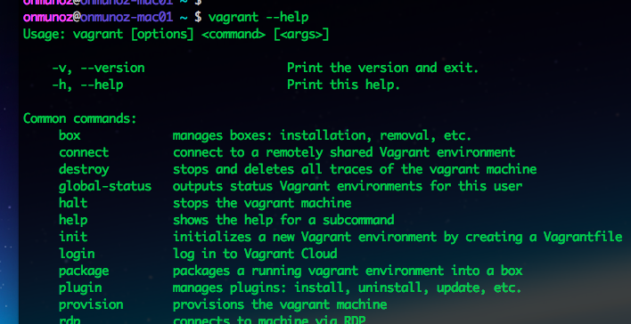
Vagrant CLI

Slide 14

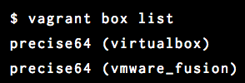






Providers
…

Slide 15
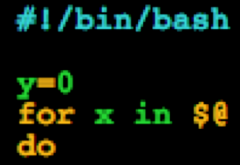


Provisioning
Shell Scripts
Puppet
Chef

Slide 16
Plugins
You can extend Vagrant
Commands
Configuration
Guest capabilities
Host Capabilities
Providers
Provisioners
https://docs.vagrantup.com/v2/plugins/index.html

Slide 17
Why should I use it?
As Developer
As Operations Engineer
As a designer
As a Student

Slide 18
Why not use it?
You don’t like it
You need to test in Production
Specific Hardware tests

Slide 19
DEMO

Slide 20
Want more …
Docker and LXCs
Vagrant included in Packer
Vagrant Code
https://github.com/mitchellh/vagrant
https://github.com/obedmr/vagrant_cisol

Slide 21
Q & A

Slide 22
Thank you

