Slide 1
IM Simulation
Mediated Binding Version

Slide 2
From Previous Versions:
Effect of Pbase and Delta on SPC
Lower Delta increases recency, and increases performance.
Lower Pbase appears to just increase performance overall

Slide 3
Pbase = 0.3, delta = 0.85

Slide 4
Pbase = 0.5, delta = 0.75

Slide 5
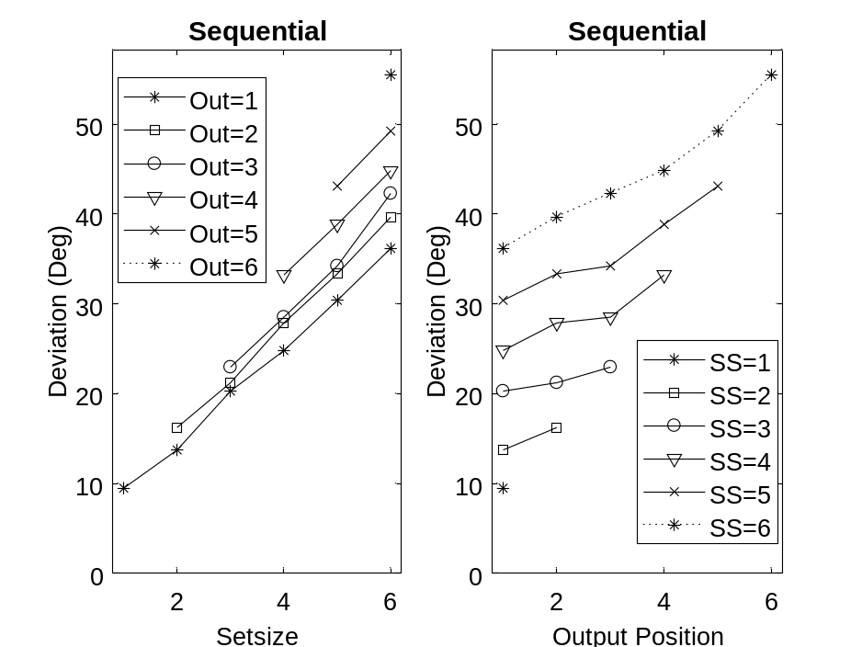
Pbase = 0.3, delta = 0.75

Slide 6
From Previous Versions:
Parametric variations of parameters

Slide 7
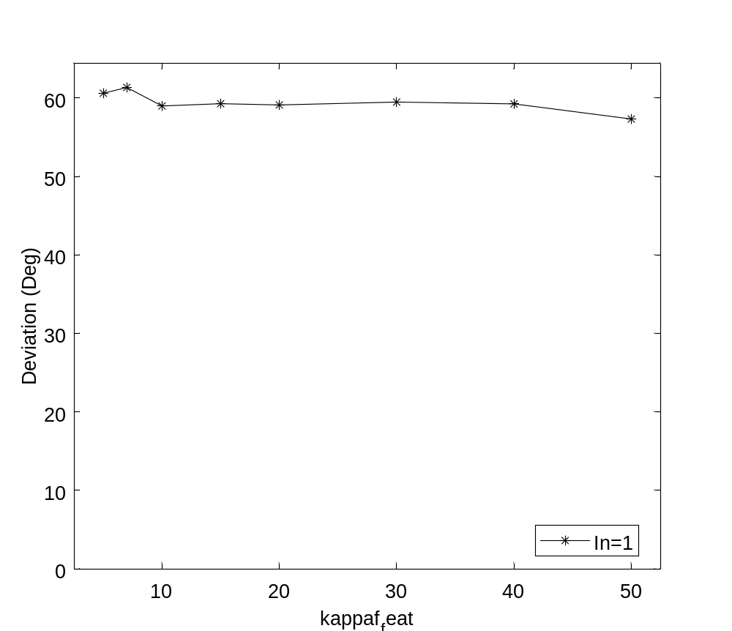
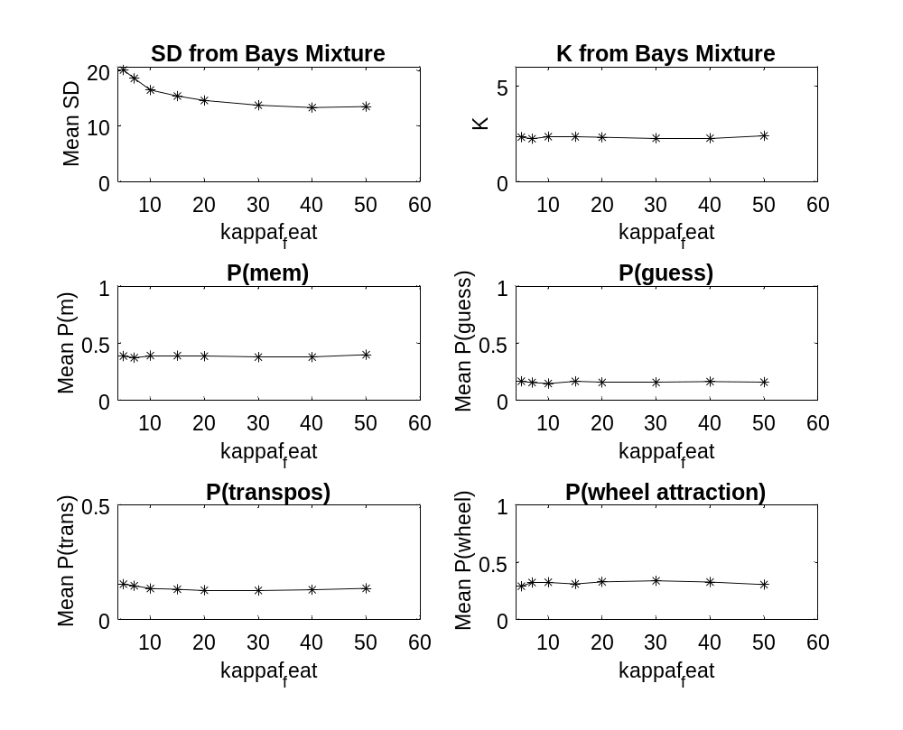

Slide 8
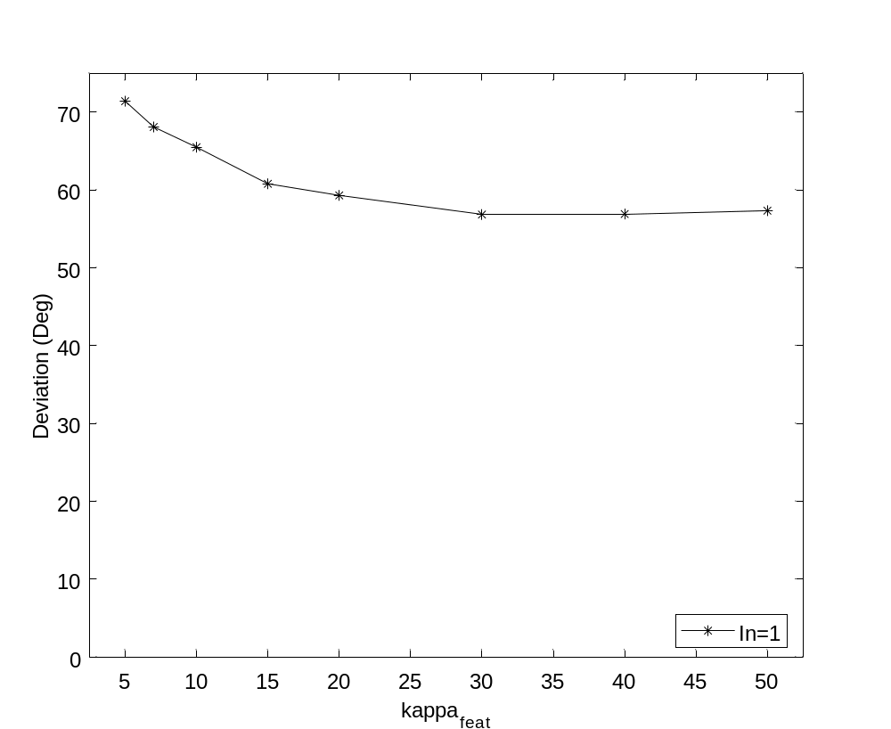
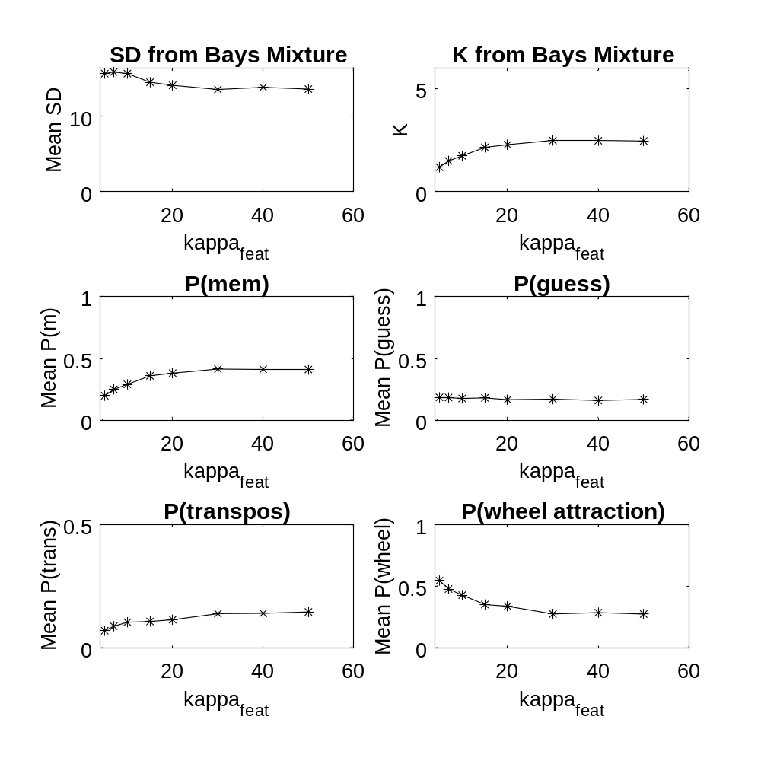

Slide 9
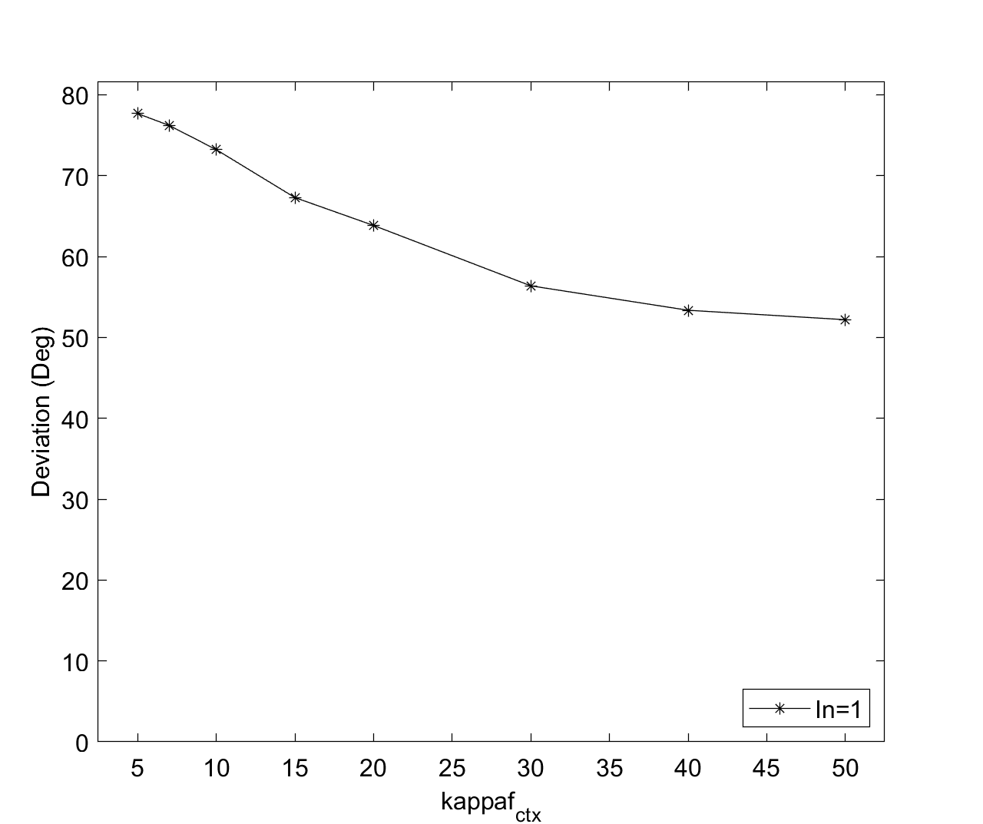
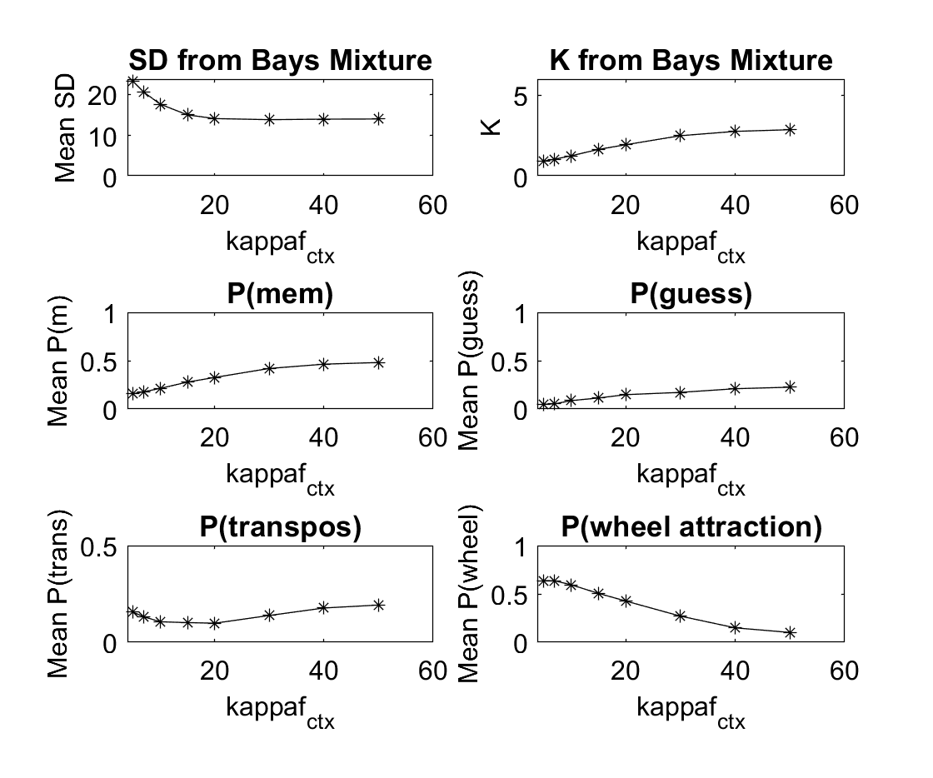

Slide 10
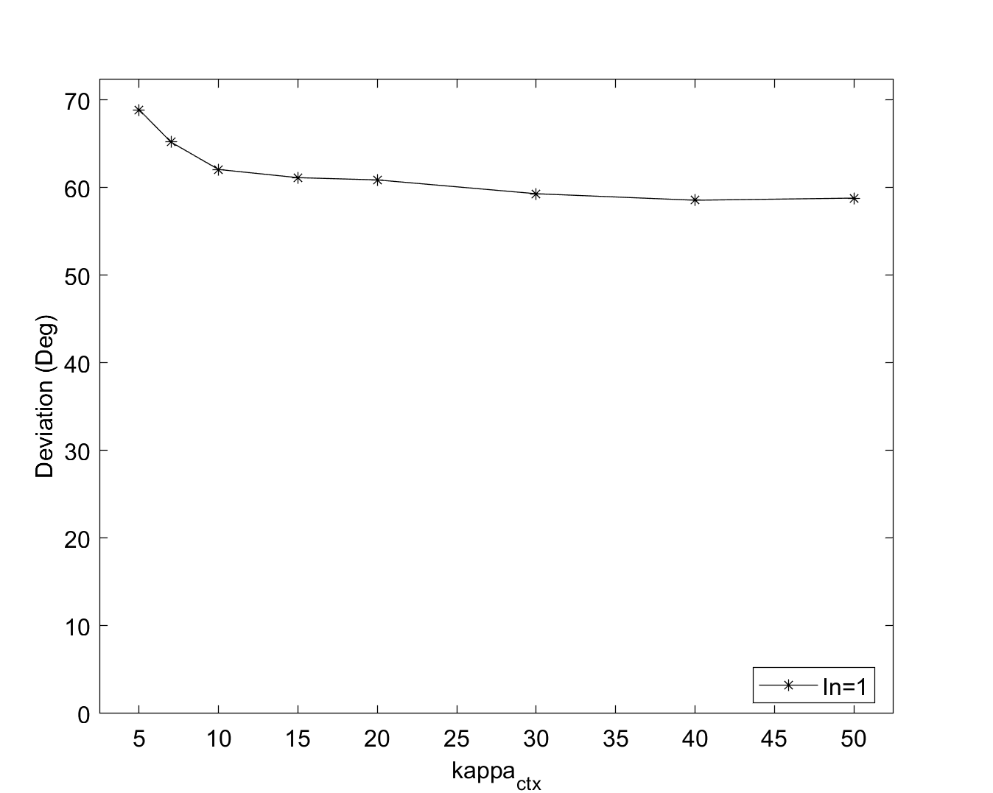
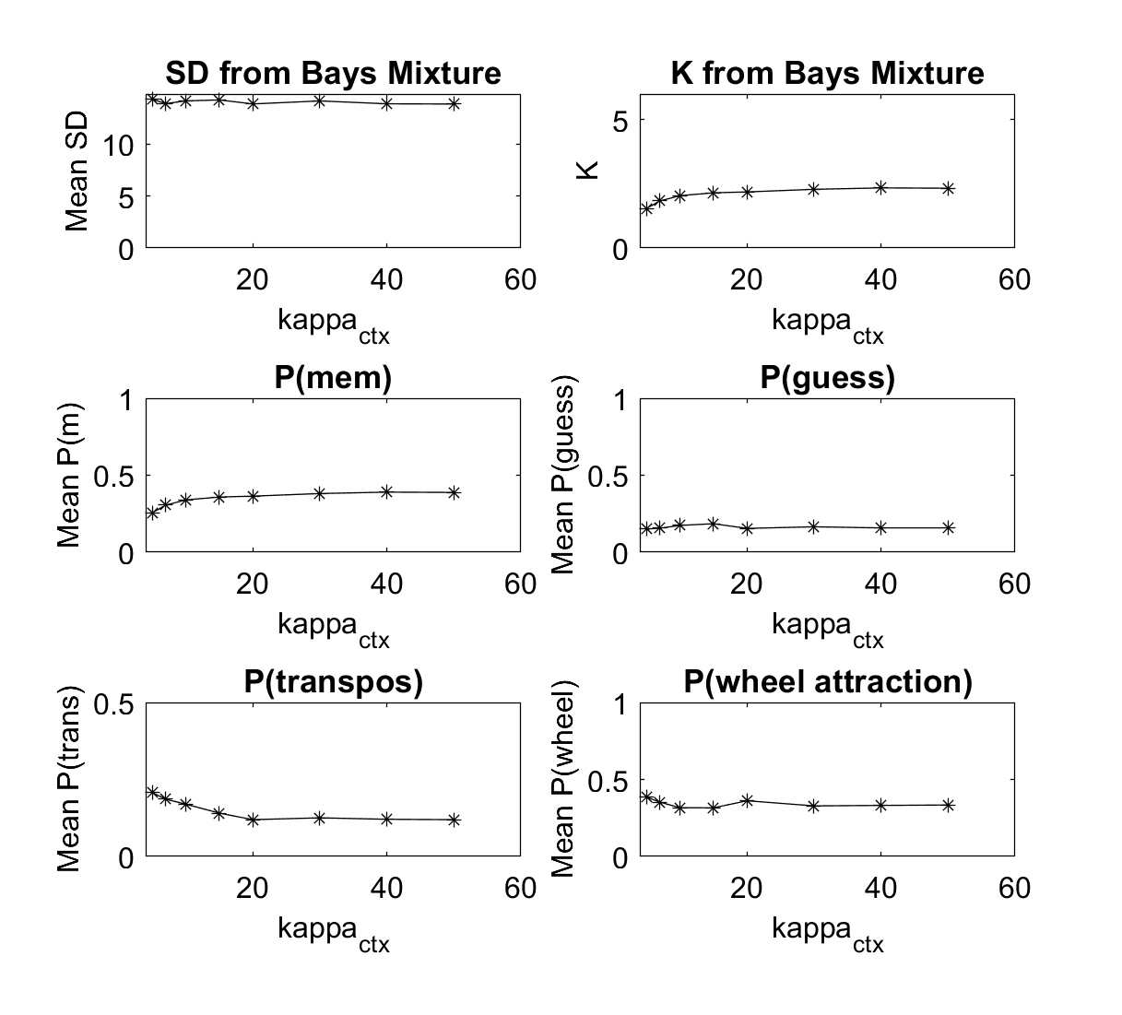

Slide 11
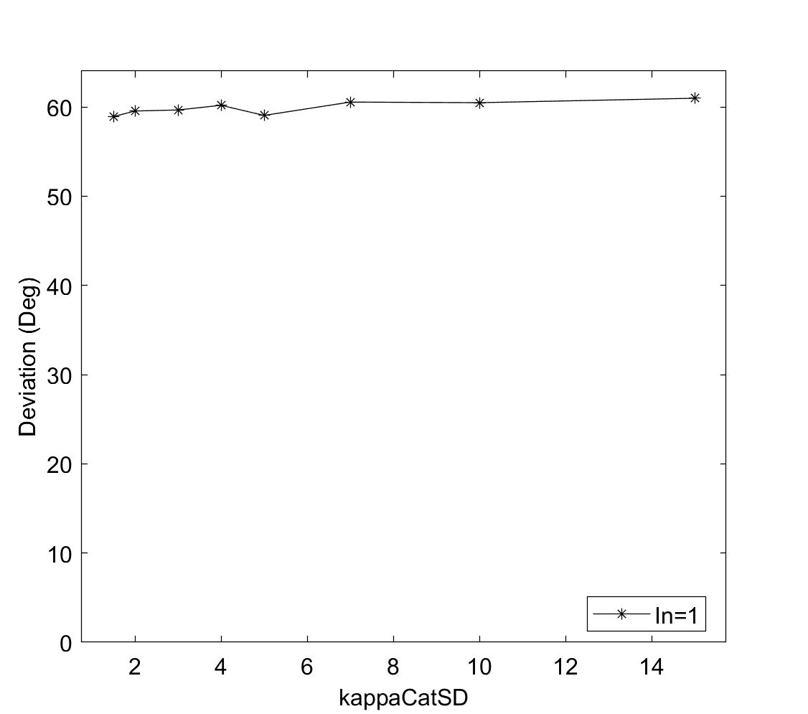
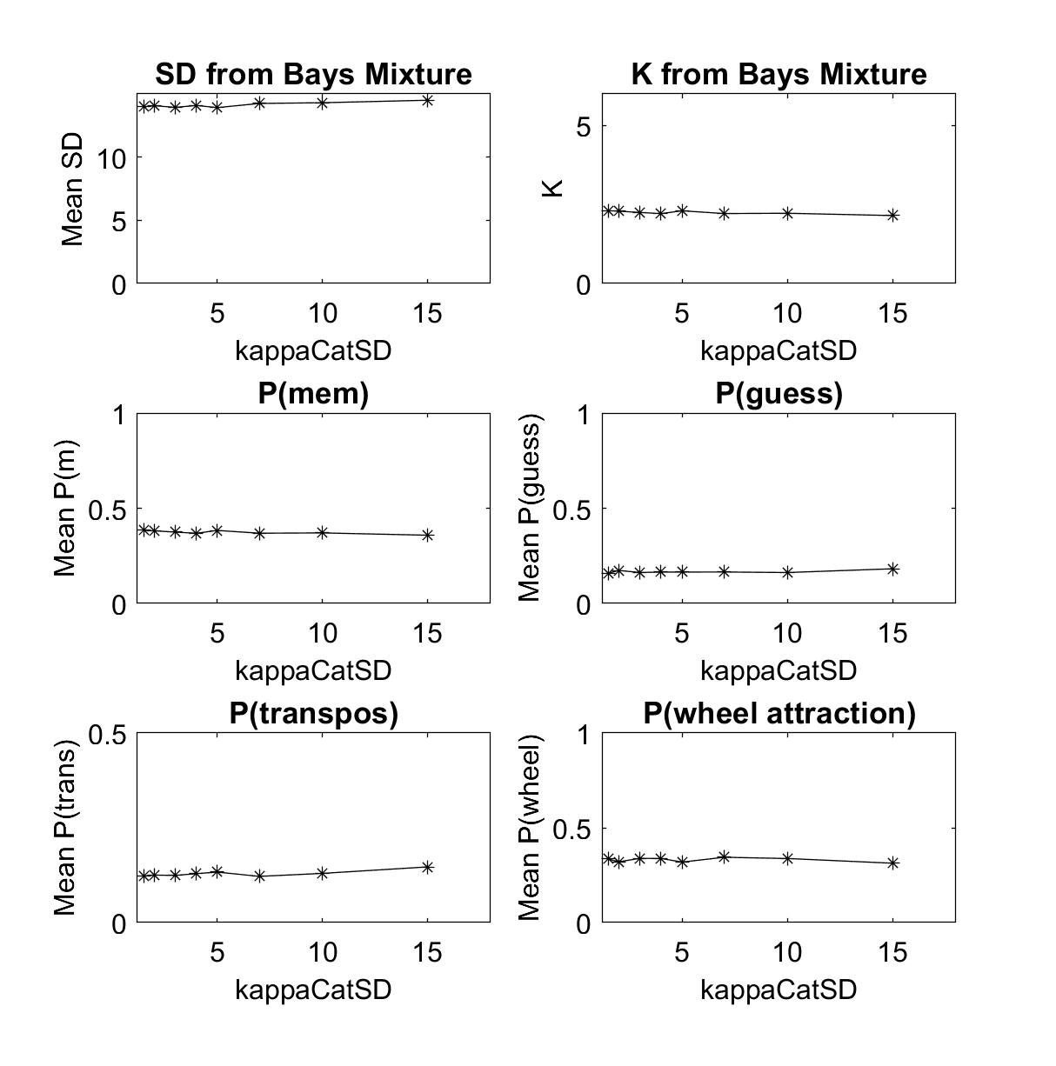

Slide 12

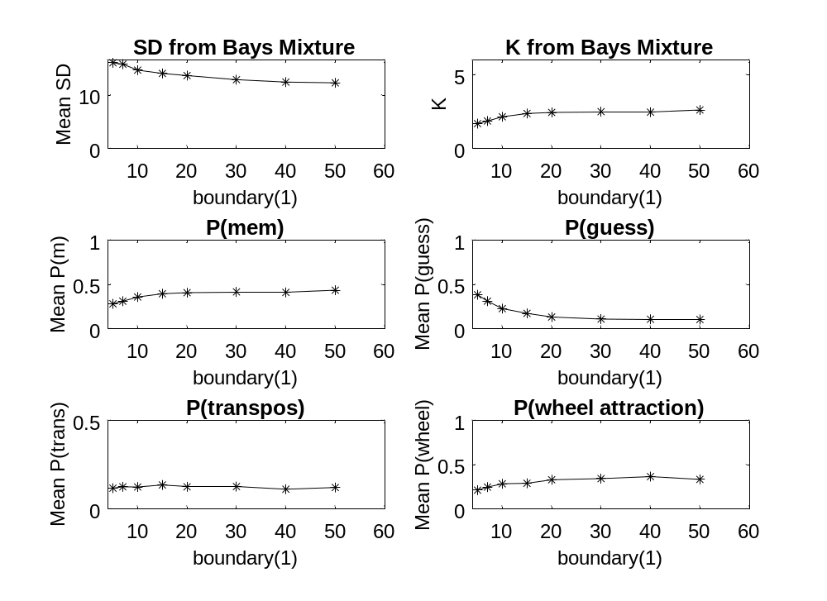
With noise = 0.8

Slide 13
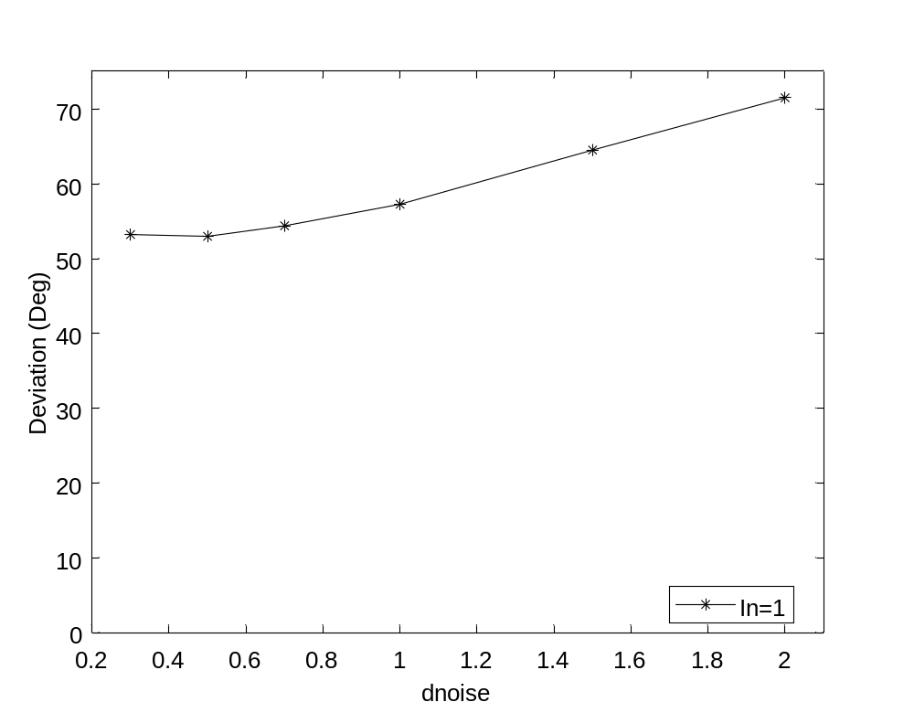
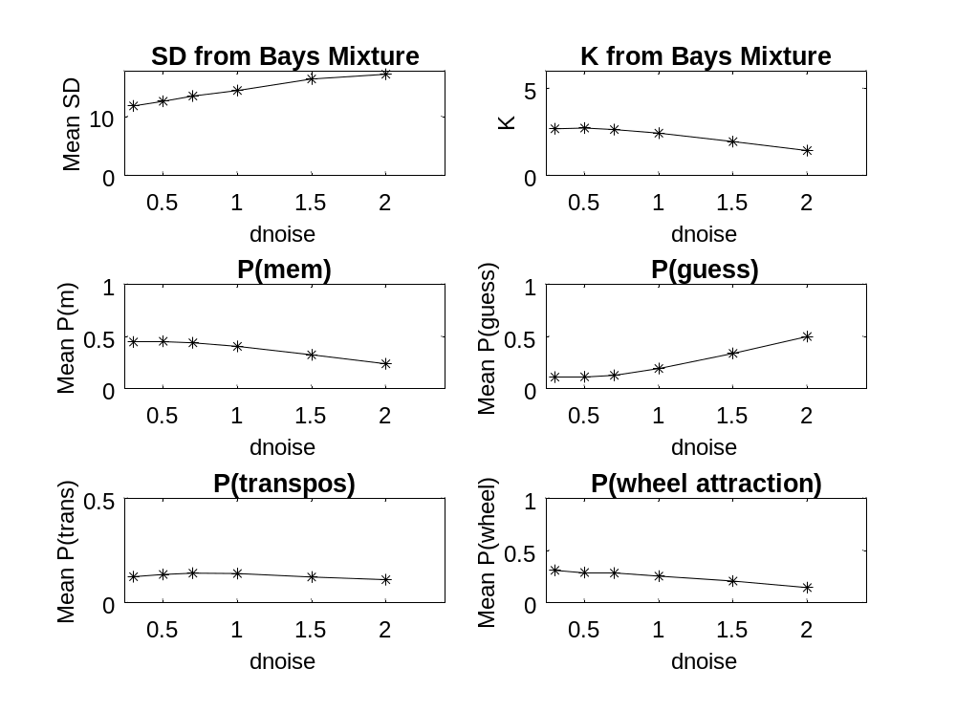
With boundary = 20 (or 15?)

Slide 14

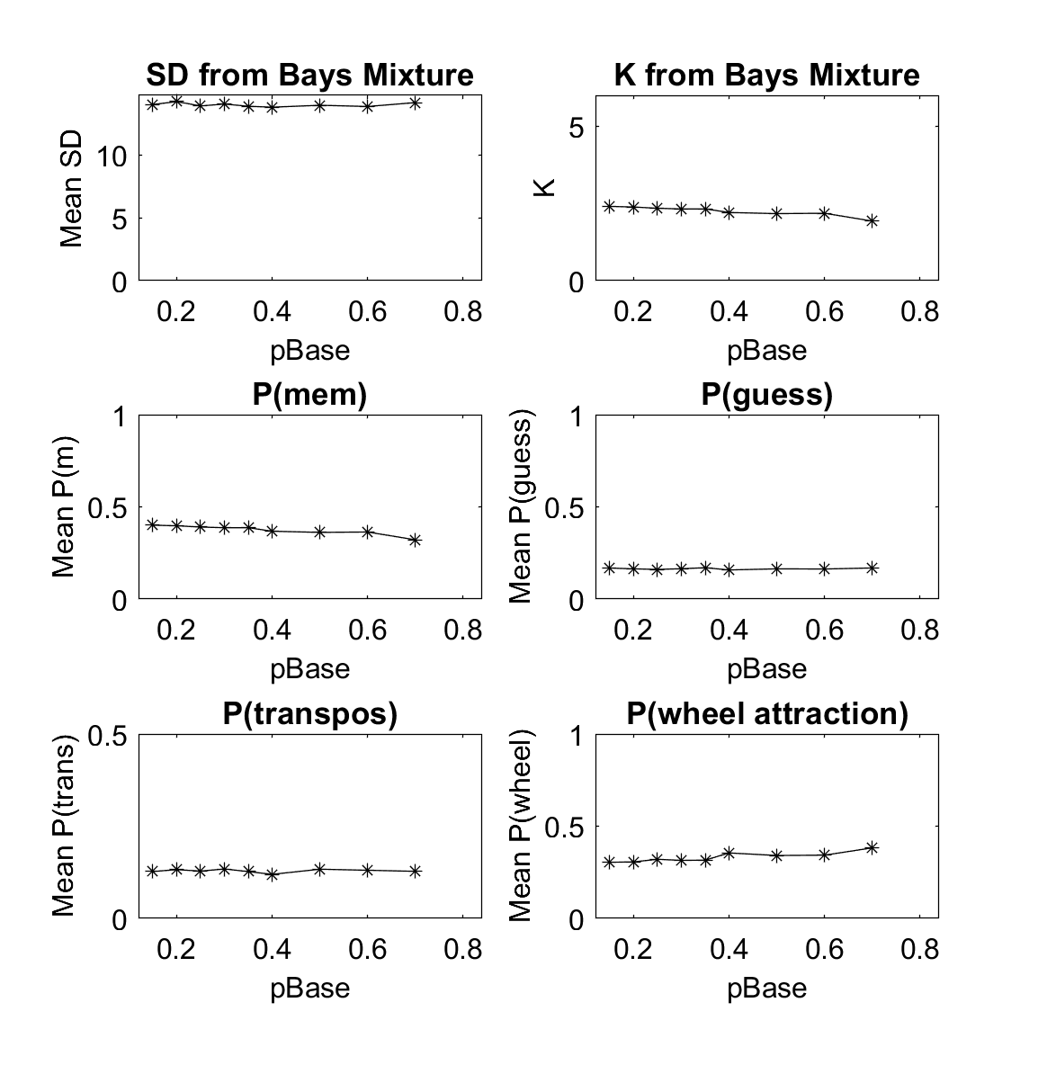

Slide 15
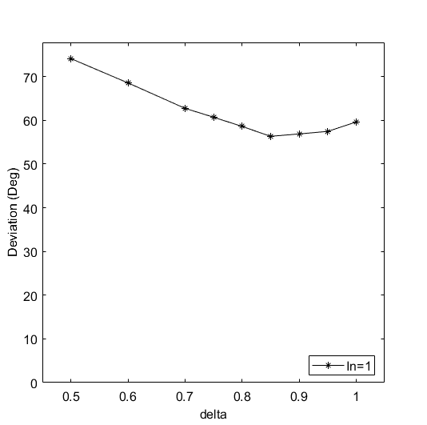
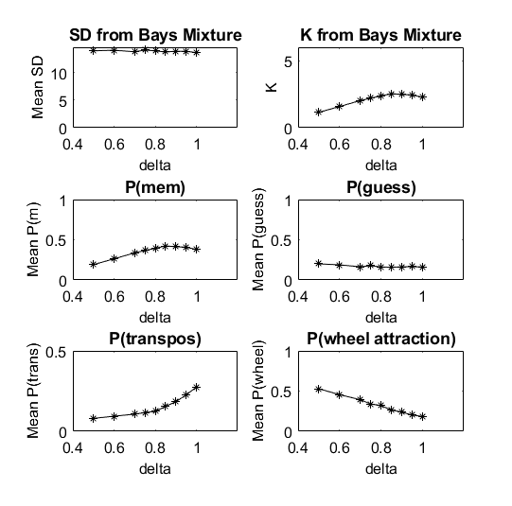

Slide 16
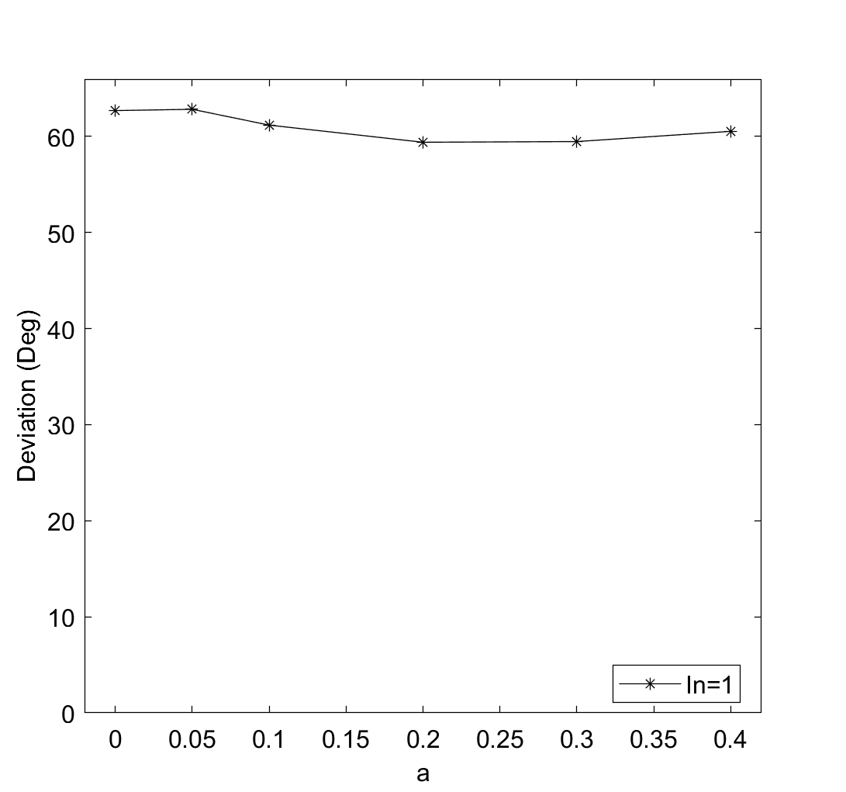
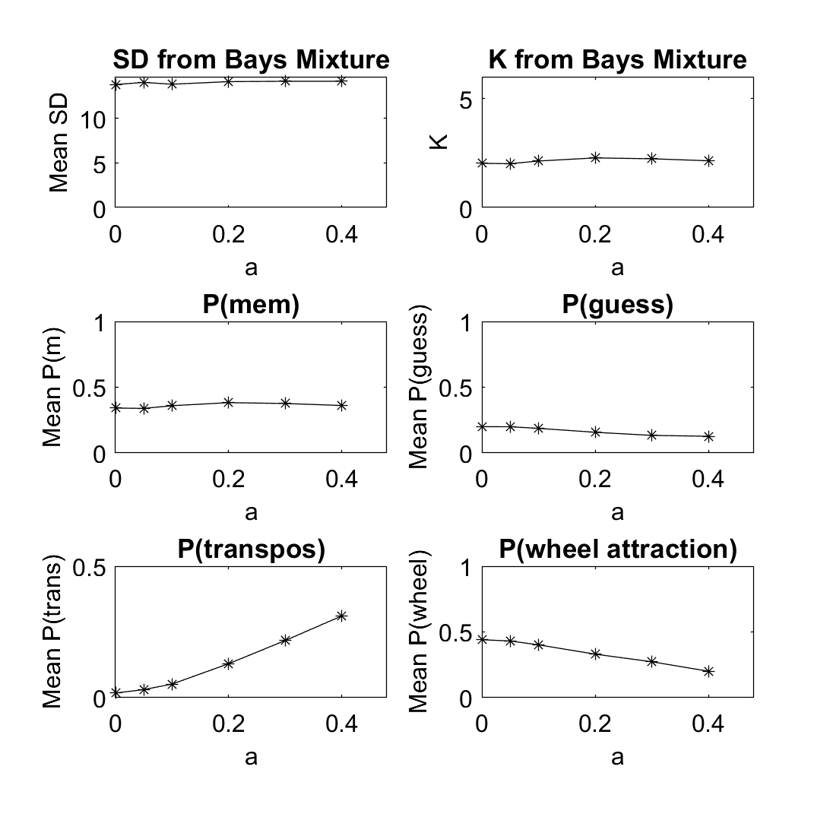

Slide 17
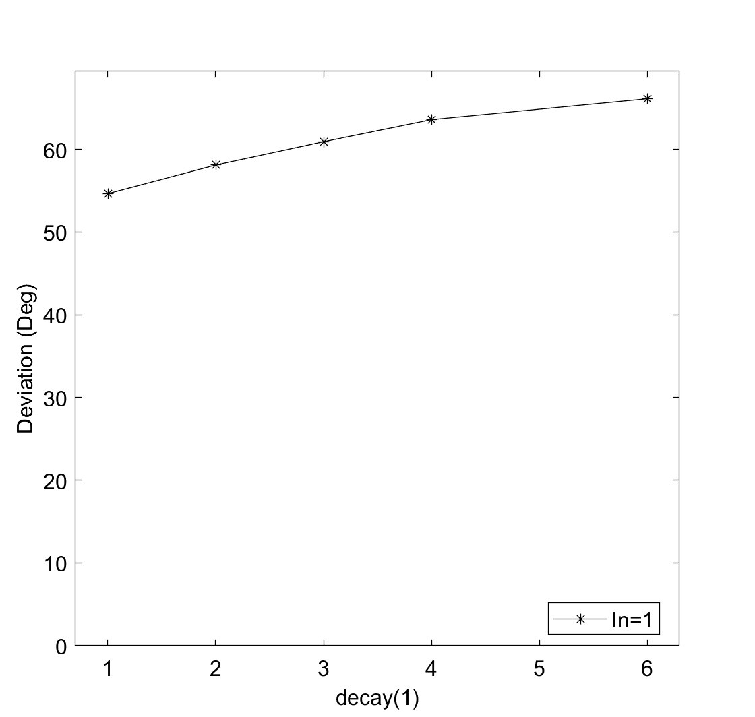
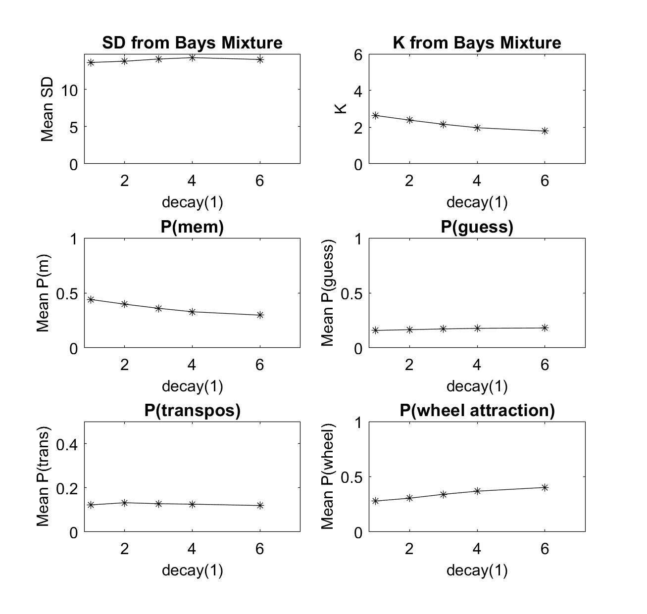

Slide 18

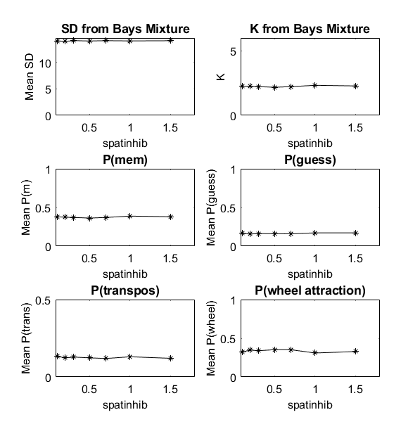

Slide 19
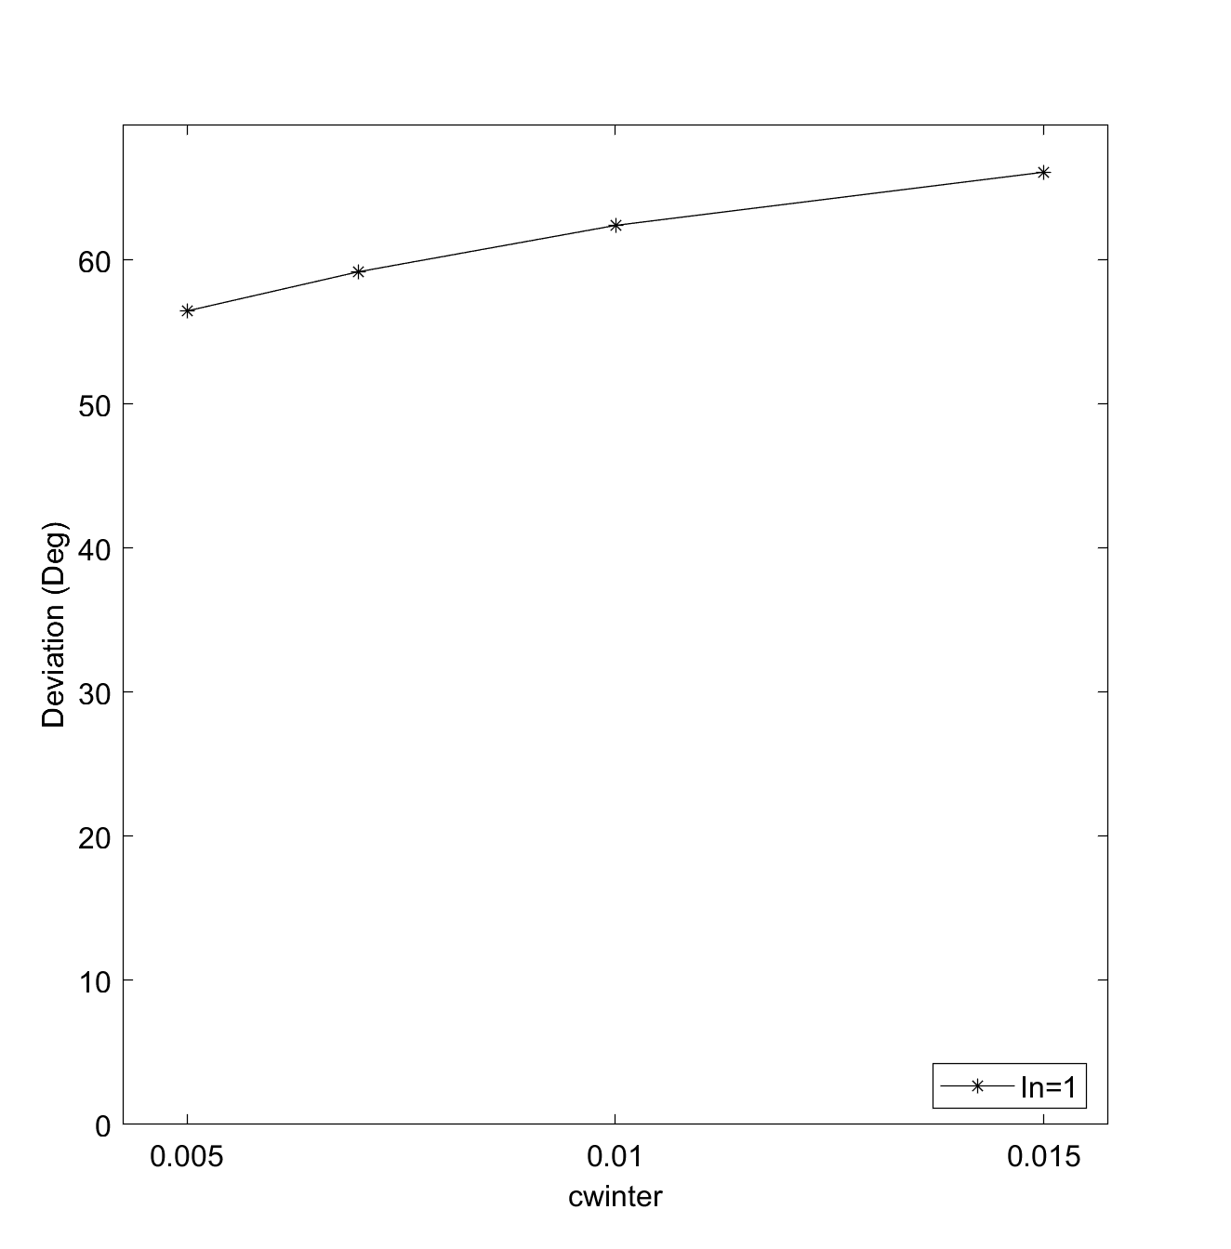
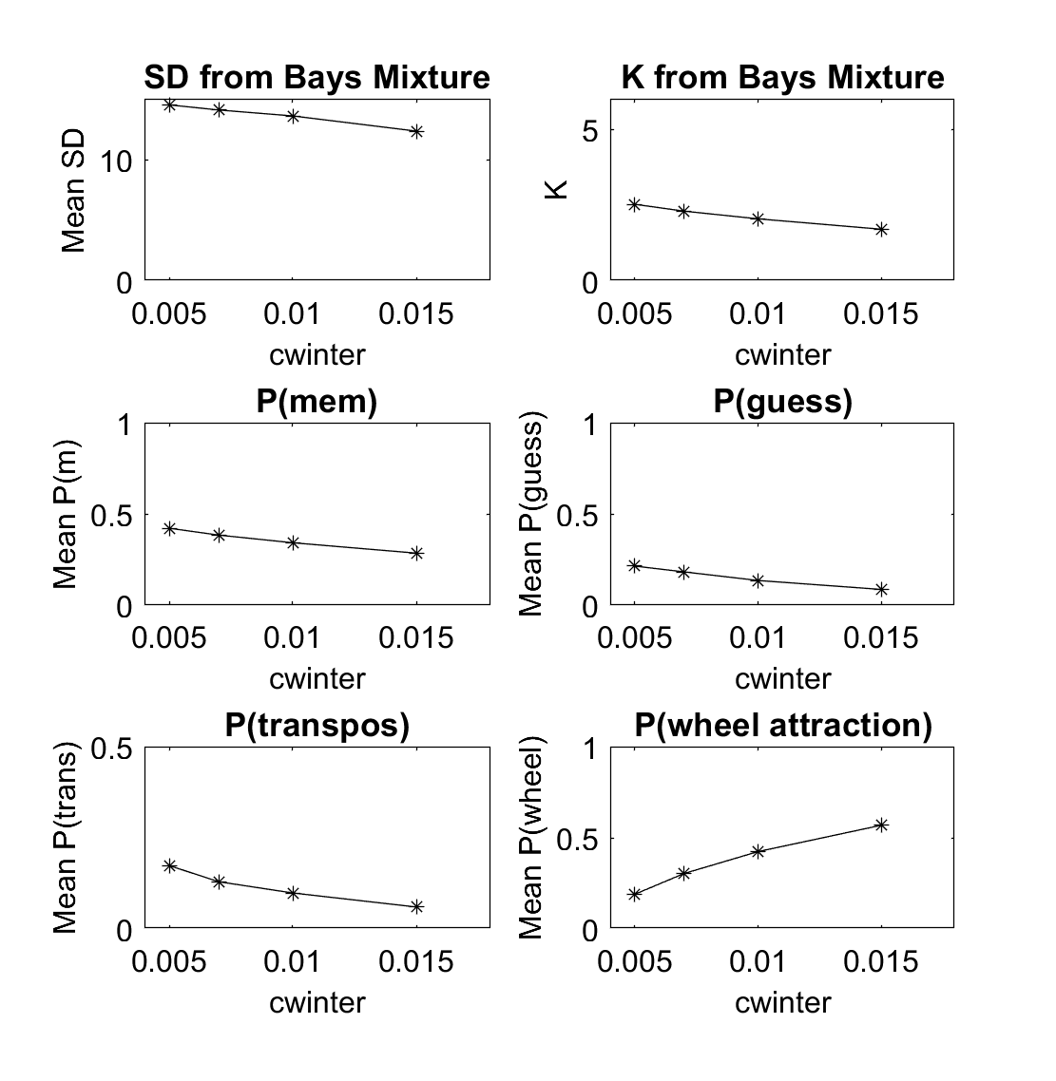

Slide 20
This Version: Parametric Variations
Change-Detection

Slide 21
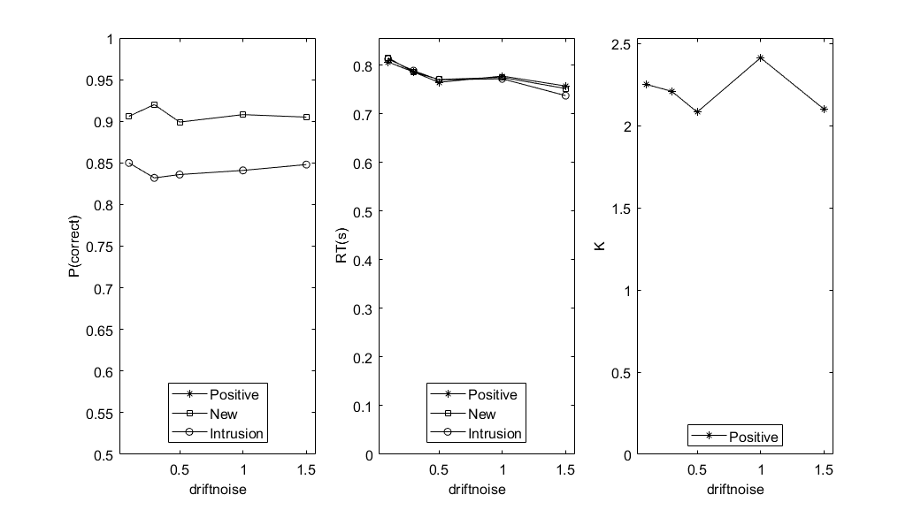

Slide 22
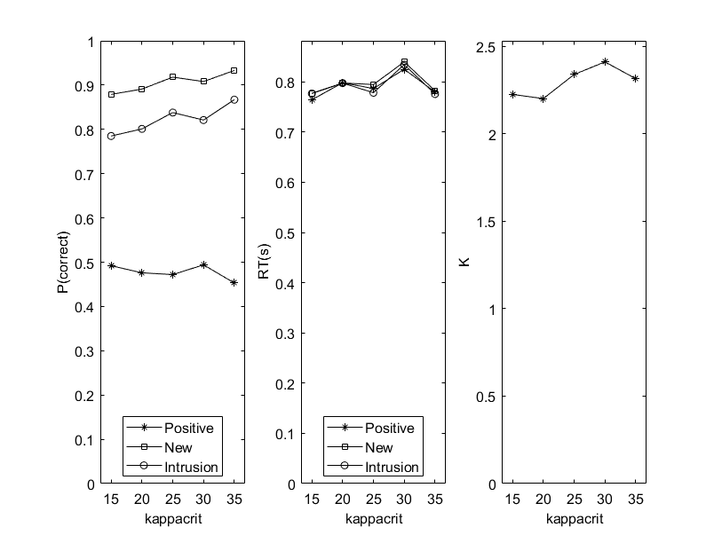
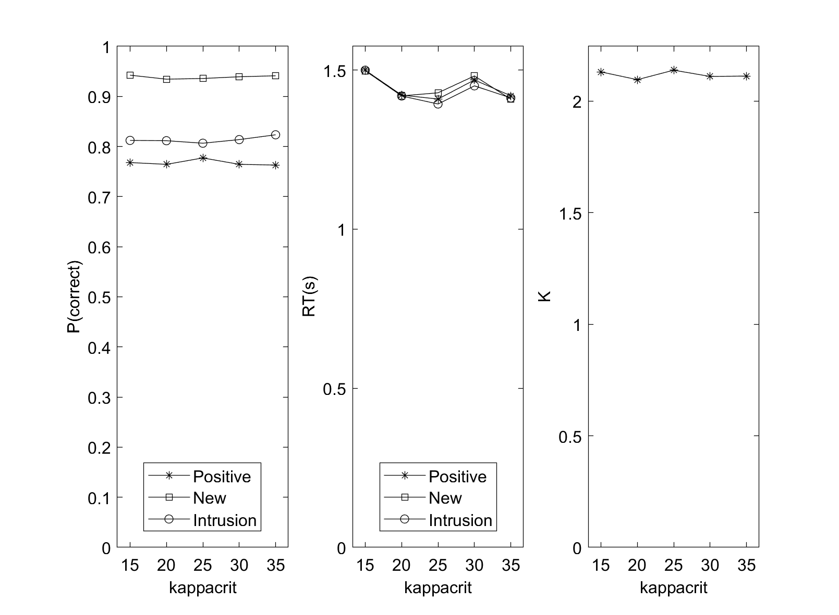
Setsize 6
Setsize 3 (and a bit later set of parameters)

Slide 23
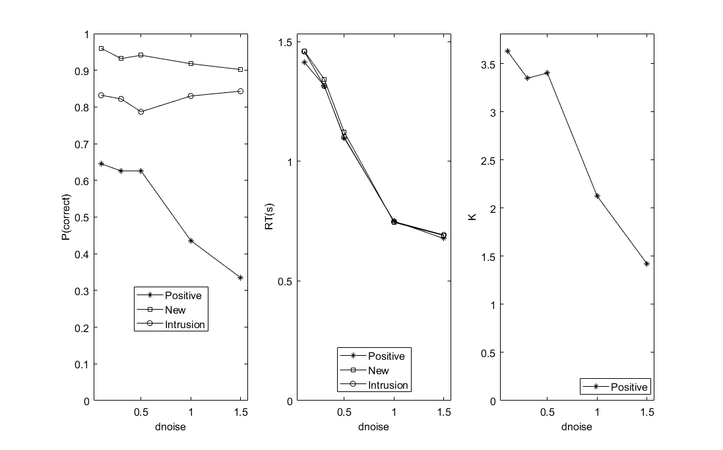

Slide 24
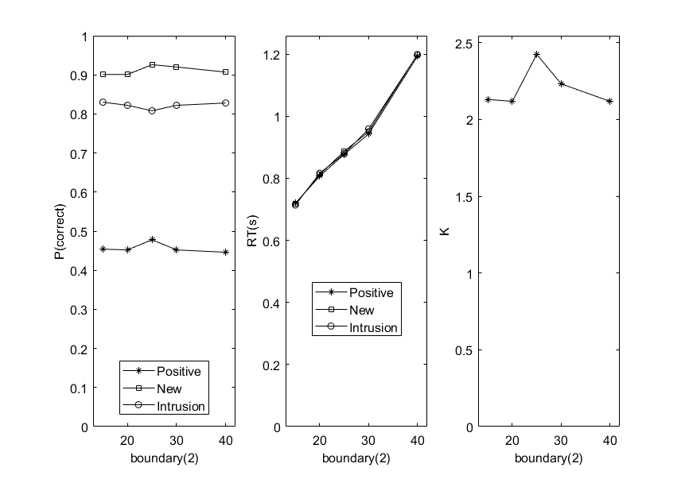

Slide 25
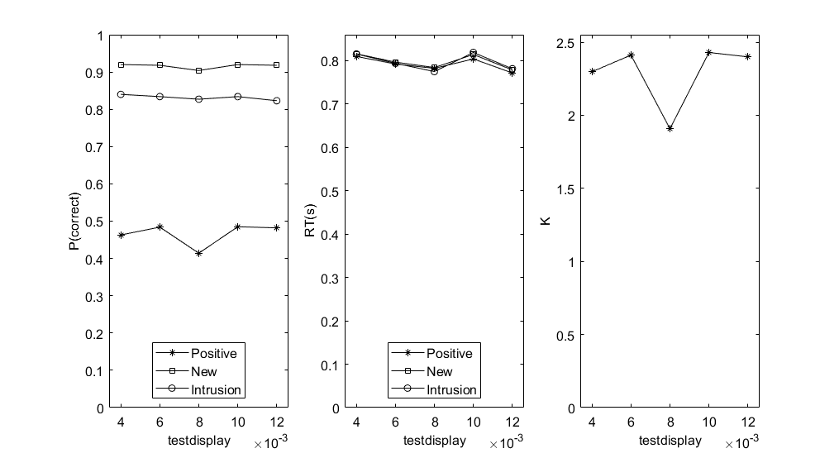

Slide 26
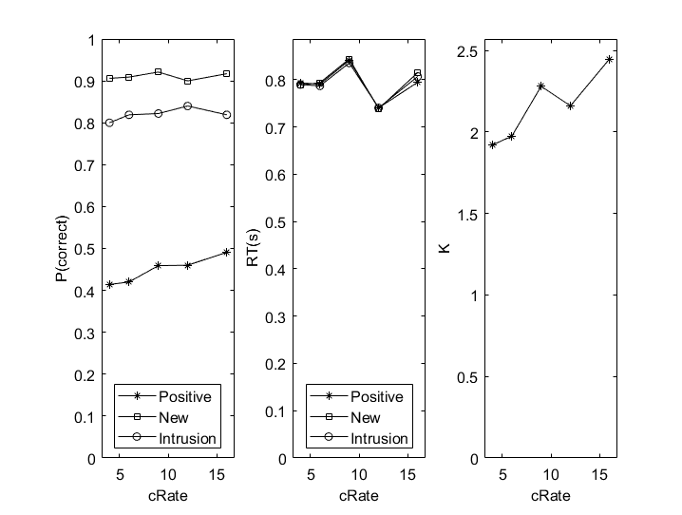

Slide 27
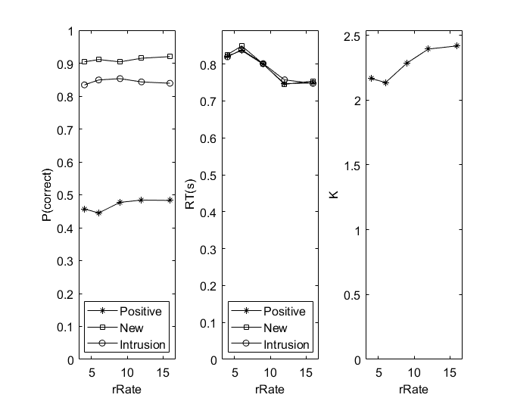

Slide 28
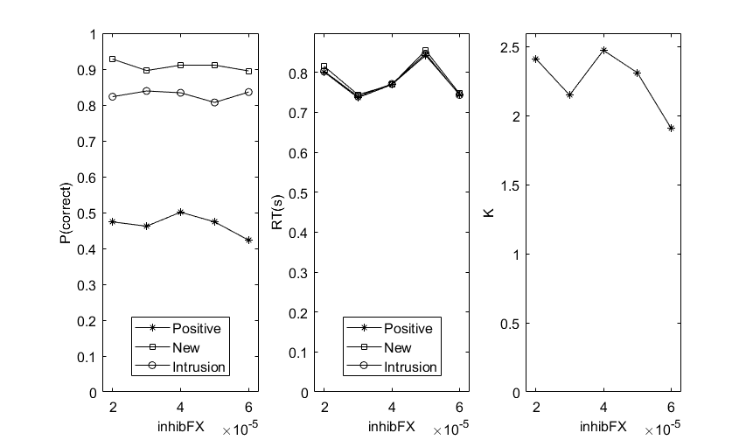

Slide 29
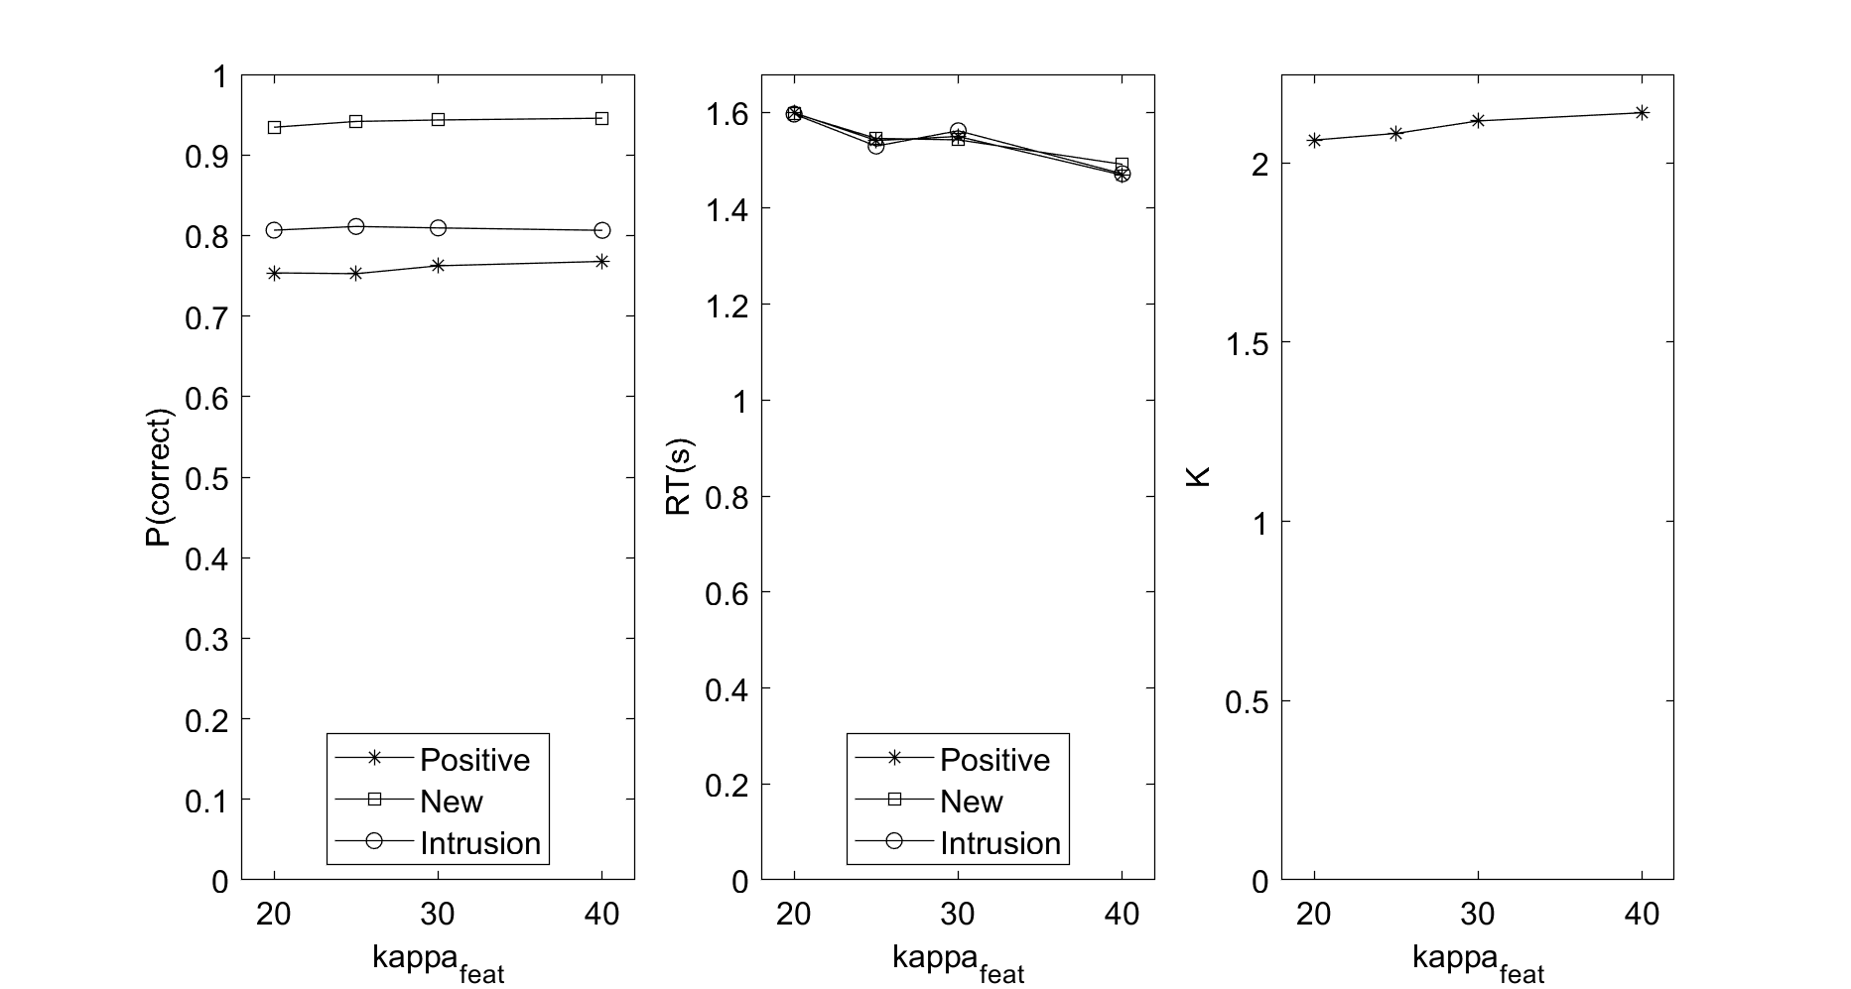

Slide 30
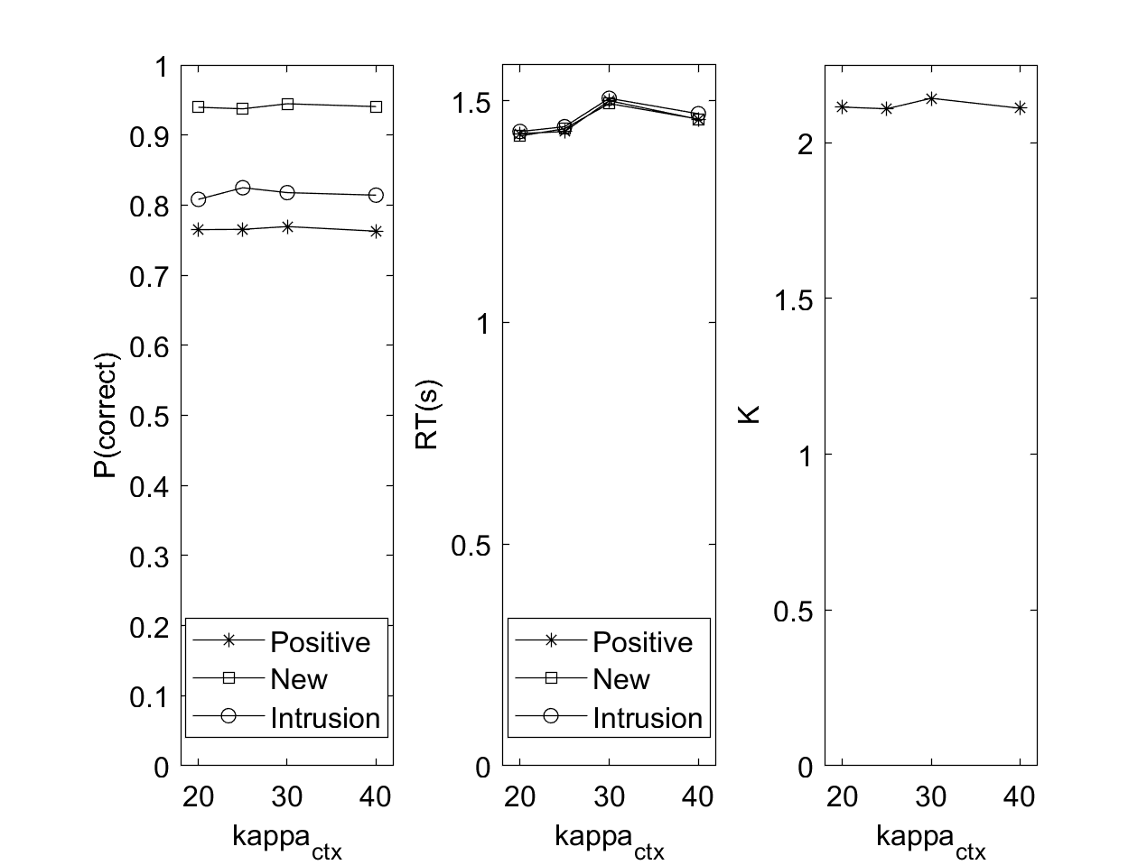

Slide 31
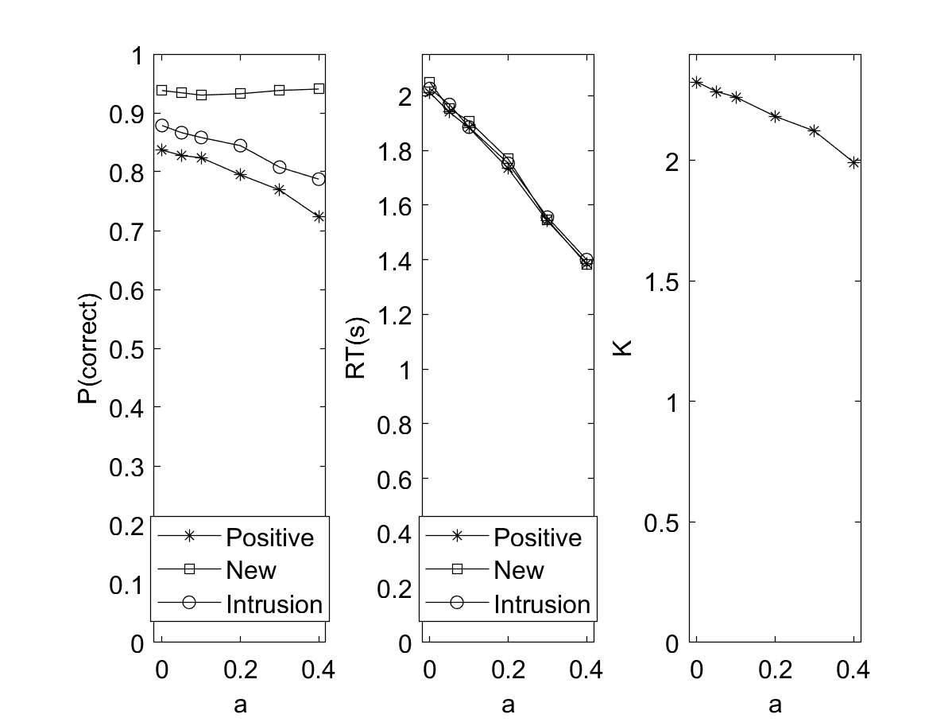

Slide 32
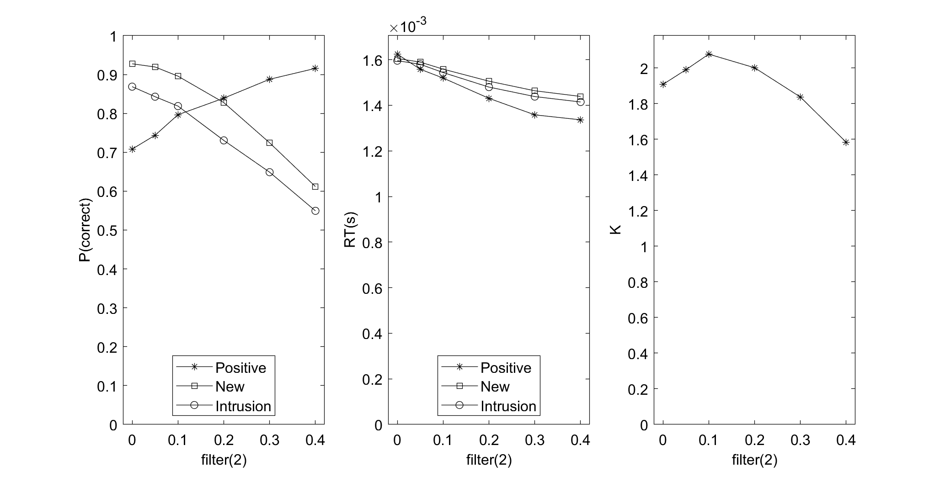

Slide 33
This Version: Experiments

Slide 34
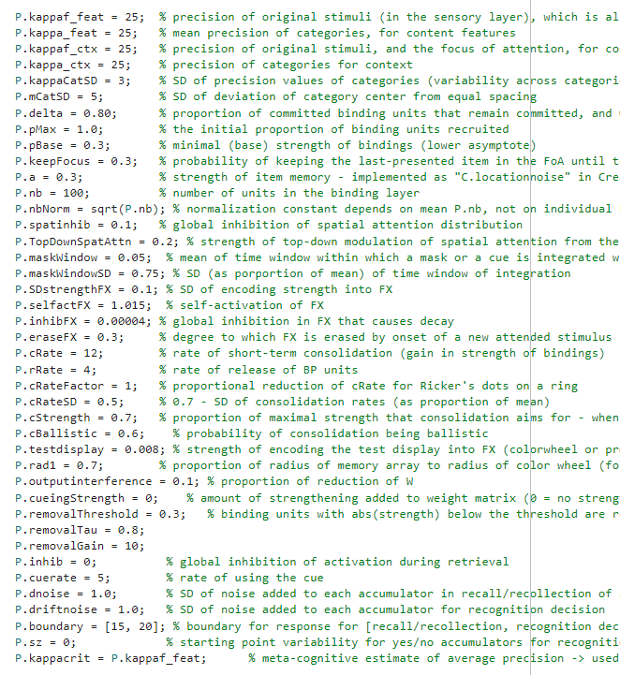
Parameters

Slide 35
1. Sequential Presentation

Slide 37
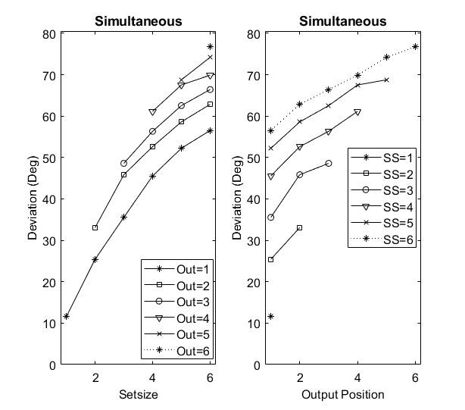
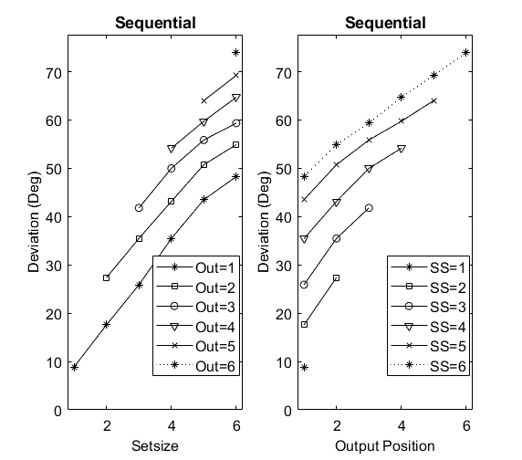

Slide 38
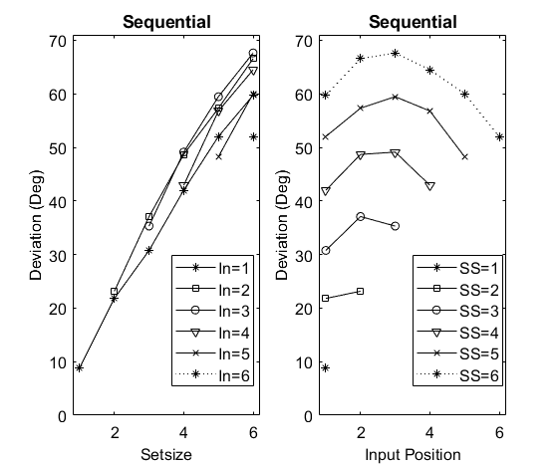

Slide 39
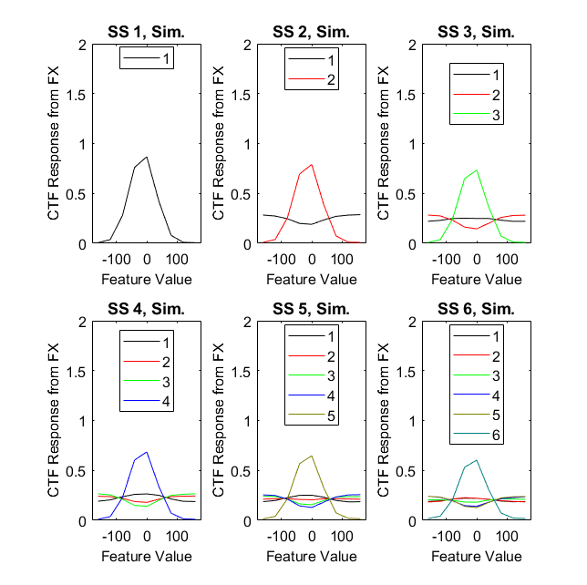
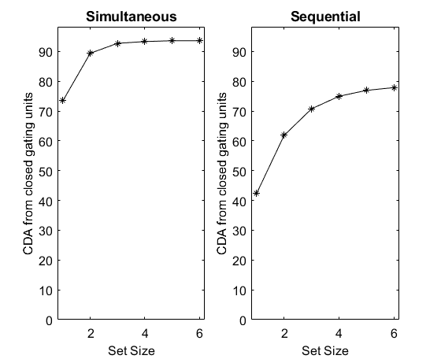

Slide 40
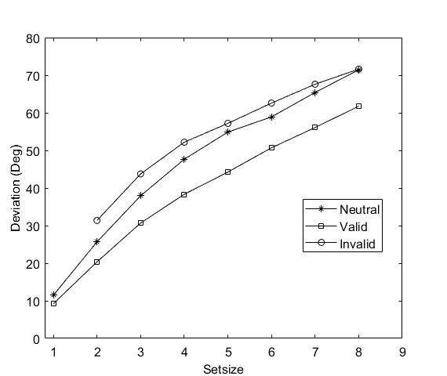
Simultaneous presentation, retro-cue

Slide 41
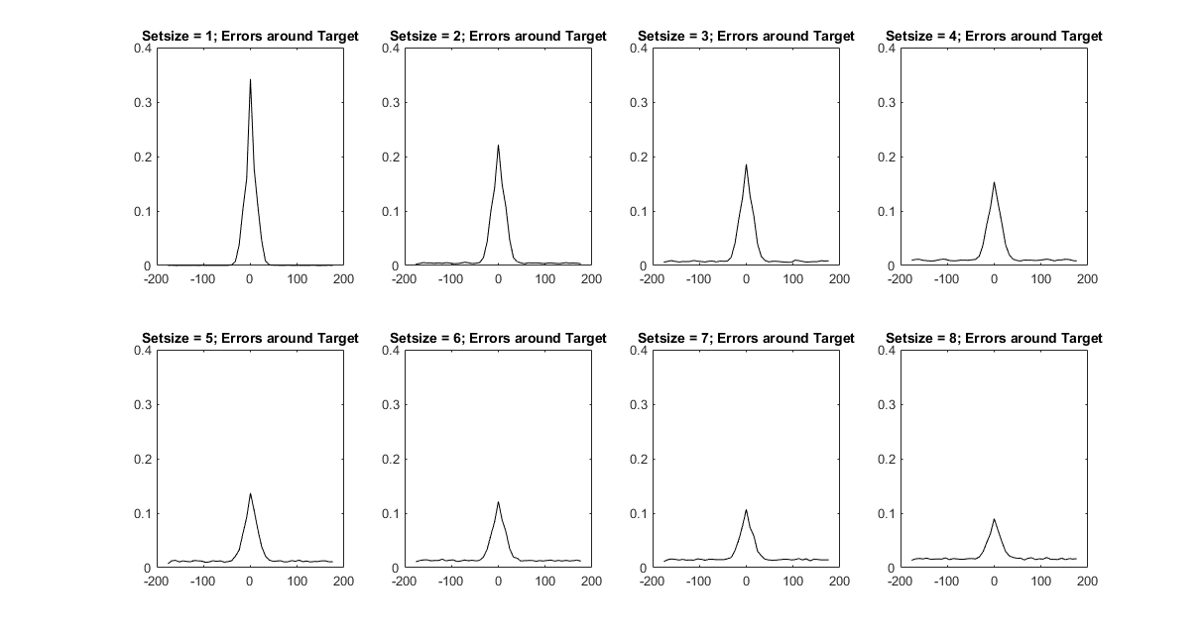

Slide 42
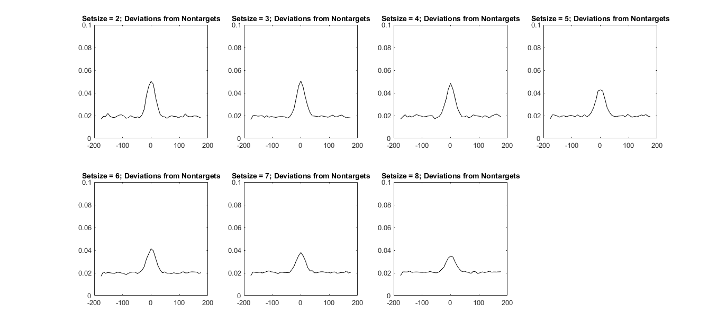

Slide 43
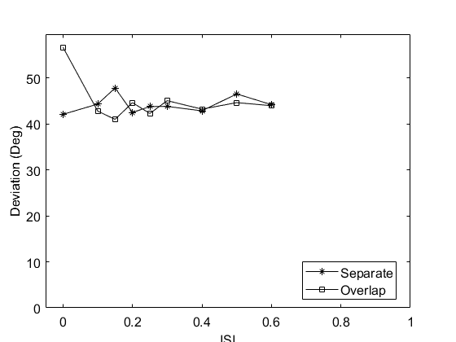
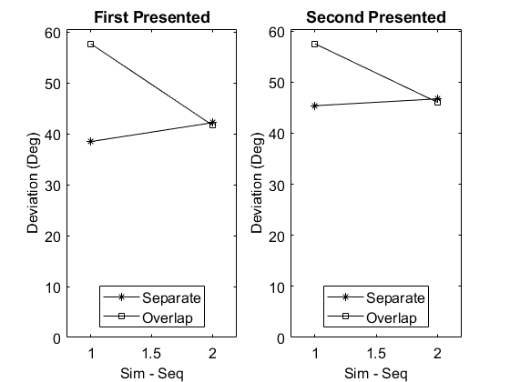
6. Sim./Seq presentation with spatially separated vs. overlapping stimuli

Slide 44
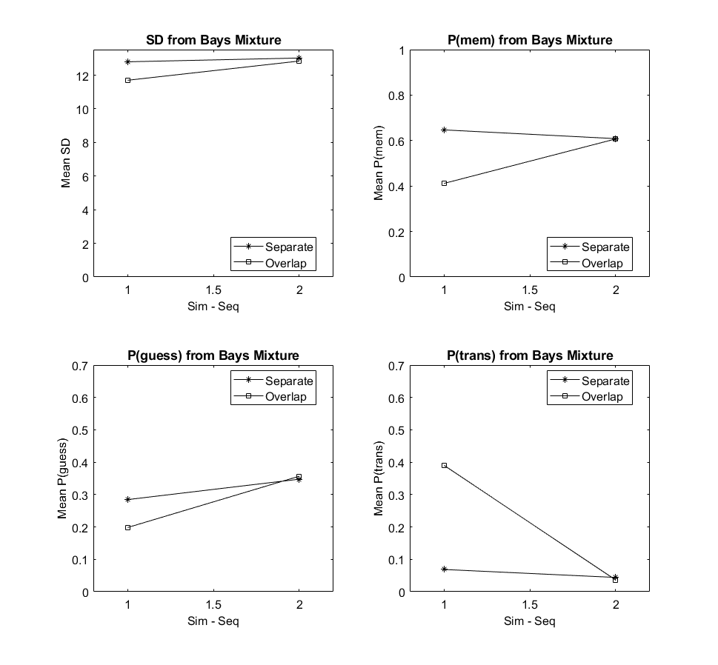

Slide 45
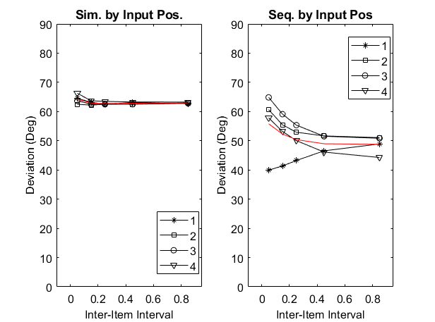

7. Sim. and Seq Consolidation (Jacob’s experiments)

Slide 46


Slide 47


With cRate decreased to 4:

Slide 48


With cRate = 10 and cStrength increased to 0.9

Slide 49


8. Ricker & Sandry Masking + Consolidation

Slide 50
9. Array-Mask SOA (Bays et al.)

Slide 51


2-array experiment

Slide 53


Individual Differences

Slide 54


Slide 55


Slide 56

Plain-vanilla Change Detection

Slide 57


Iconic memory (Pratte & Greene)

Slide 58



Slide 59


Slide 60


Slide 61



Slide 62


Slide 63


Slide 64

Cueing mechanisms,
individually

Slide 65

Setting wheel=0 (instead of only testdisplay = 0) in the conditions without visual interference reduces the retro-cue benefit without any mechanism
→ the condition “without any” still had the headstart before an update of FX (due to wheel=1), which is now removed.

Slide 66

decreasing cSim to 4 – what is going on?!
Apparently, with slower consolidation more items end up not consolidated during the RI, and hence, not removed from FX through “inhibition of return”. Hence, they can be read out of FX at retrieval. However, in the valid cueing condition, FX decays during the CTI, so that possibility is lost. (this happens also in the invalid-cue condition, though ...). In any case, including read-out from FX during the CTI reverses the picture

Slide 67

Eliminating consolidation as a mechanism, and instead including read-out from FX in the “head start” retrieval during the CTI. (“Without Any” is now CTI = 0.001)
This is now with cRate = 10 and cStrength = 0.9, therefore also slow consolidation (comparable to cRate = 4 and cStrength = 0.7)

Slide 68

As before, but increasing boundary(1) to 40 (and dnoise to 1.5) so that the head-start for retrieval does not result in much longer evidence accumulation
Bringing back consolidation (to little avail)

Slide 69


Slide 70

After re-introducing strengthening, and with dnoise = 2.5 and boundary = 70

Slide 71

Hautekiet & Oberauer (2026): Why no decay in the no-cue condition?

Slide 72

With p.wnoise = 0.015 there is no discernible decay, probably because of the increased dnoise

Slide 73


With p.wnoise = 0.03

Slide 74


Slide 75

Reloading: Why no retro-cue benefit?

Slide 76


Slide 77


Slide 78


Slide 79


Slide 80


Slide 81


After inserting a decay moment between display onset and retrieval from FX, the colorwheel intrusions are gone
(P.filter = 0.01) (they come back a little bit with P.filter = 0.2 but not 0.1; 0.3 vs. 0.2 makes no discernible difference)

Slide 82



With P.filter = 0.1, after correction of SD of reorienting attention after color-wheel onset

Slide 83

Reloading (P.filter = 0.1)

Slide 84


CD cueing (P.filter = 0.3)

Slide 85

Refreshing (P.filter = 0.3)

Slide 86

Prolific, cStrength reduced to 0.6

Slide 87


Slide 88



Slide 89



Slide 90


Slide 91


Slide 92

After making consolidation of an entire array ballistic (or not)

Slide 94
After correction of RI after the second array (matching ISI); with ballistic consolidation of only one item per array. Now test = n-AFC

Slide 95


Slide 100
Now with P.ballistic = 1

Slide 101
Explanation: At small set size, consolidation causes overtime only at short SOA (at long SOA, consolidation is always over before the end of the SOA). Longer set sizes cause overtime also at long SOAs, because often one consolidation process is still ongoing.

Slide 103
After applying ballistic to the entire array, and P.ballistic = 1

Slide 107
IMTrackSignals

Slide 110
Sequential presentation

Slide 112
Underlying figure: Before placing IndDiff after mechanism implementation; overlaid figure: after ...

Slide 114
After increasing boundary(1) to 70: There is still a headstart benefit – what causes it? Performance without mechanism became poorer by the raised boundary?!
Why is adding visual interference beneficial with valid cue rather than harmful with neutral cue?
The headstart benefit might come from the fact that with CSI>0, retrieval occurs before the test display. Even when filter = 0 (no colorwheel intrusion), the FX is erased at this point (completely because P.eraseFX = 0), so retrieval with CSI=0 does not benefit from FX

Slide 115
After fixing that issue by erasing FX in the conditions with other mechanisms (and using boundary = 30)

Slide 117
With filter(2) = 0.1

Slide 119
With filter(2) = 0.1 and dnoise increased (from 1.5) to 3

Slide 120

dnoise = 1.5

Slide 121


Why is ABA not better than CBA, but 2 refreshings > 1 refreshing? Probably because the 1-refreshing items suffer competition from the 2-refreshing item (they are hardly better than no-cue control when refreshed last, whereas CBA is much better than None)

Slide 122

increasing dnoise from 1.5 to 3

Slide 123


Slide 124



Slide 125


Slide 126

Pre-cue after revision: boost to strength of encoding into FX

Slide 127


Slide 128


After letting only 1 retrieval happen, either upon retro cue or upon test (i.e., removing the second retrieval at test)

Slide 129

The good pattern could be reproduced with “Mediated” in the Archive but not the branch June8. Differences with the current version:
IOR on FX has been parameterized
cRateSD has been corrected in the reorienting time during retrieval
rolling back that change did not help much

Slide 130

setting IOR = 1 fixes this

Slide 131

After fixing the decay of W to time-based rather timestep-based, and doubling wnoise:
Problem: The Hautekiet & Oberauer experiment uses no test-display interference, and hence, FX is not erased. It also hardly decays at set size 5, and is therefore well available at 1 second. Thereby, there is hardly any decay between 1 and 3 s. There is also little retro-cue effect because the retro-cue is not needed for protection against decay.
But increasing wnoise that much destroys guided refreshing

Slide 132



Slide 133



Slide 134


Sensory memory with inhibition = 0.004
Sensory memory with inhibition = 0.002

Slide 135



Alpha with inhibition = 0.002 and IOR = 0.1

Slide 136



Alpha with inhibition = 0.002 and IOR = 0.5
IOR destroys the early cross-over of alpha curves because it reduces the strength of FX at lower set sizes

Slide 137




Alpha with inhibition = 0.004 and IOR = 0.3

Slide 138
Correlations of alpha slope with parameters
IOR: 0.4: smaller IOR makes slope go more negative
kappaf_ctx: 0.3: smaller value makes slope go more negative
inhibFX: -.57: larger values make slope go more negative

Slide 139



IOR = 0.5, dnoise = 1, wnoise = 0.12, kappaf_feat and kappaf_ctx reduced to 10

Slide 140





Slide 141



CD and Retro-Cueing

Slide 142


Slide 143


Set Size, Sim and Seq

Slide 144


Set Size, Sim and Seq

Slide 145


Slide 146



Slide 147


Set Size, Change Detection (after reducing boundary(2) to 10)

Slide 148


For comparison: Archive, Mediated (May 2026), after some necessary repairs

Slide 149


For comparison: Archive, Mediated (May 2026), after some necessary repairs

Slide 150


For comparison: Archive, March 2026 (SetsizeCD: new probes integrated over all sizes of changes)
Transplanted into current environment (SetsizeCD):

Slide 151


For comparison: Archive, March 2026
Transplanted into current environment:

Slide 152


Setsize, ind diff

Slide 153


Slide 154


Setsize, tracking alpha, CDA, simultaneous

Slide 155
Setsize, tracking alpha, CDA, sequential

Slide 156
Sensory Memory (Pratte & Greene)

Slide 157
Set Size and RI

Slide 159
Sim. and Seq. Consolidation (Shepherdson et al.)

Slide 160
Sim. and Seq. Consolidation (Shepherdson et al.)

Slide 161
Consolidation (Ricker & Sandry)

Slide 162
Refreshing

Slide 163
Sim. Seq. Consolidation (Prolific)

Slide 164
Sim. Seq. Consolidation (Zurich Lab)

Slide 165
Stevanovski & Jolicoeur

Slide 166
Retro-Cue x RI

Slide 167
CD, Retro-Cue x Setsize

